Slide 1
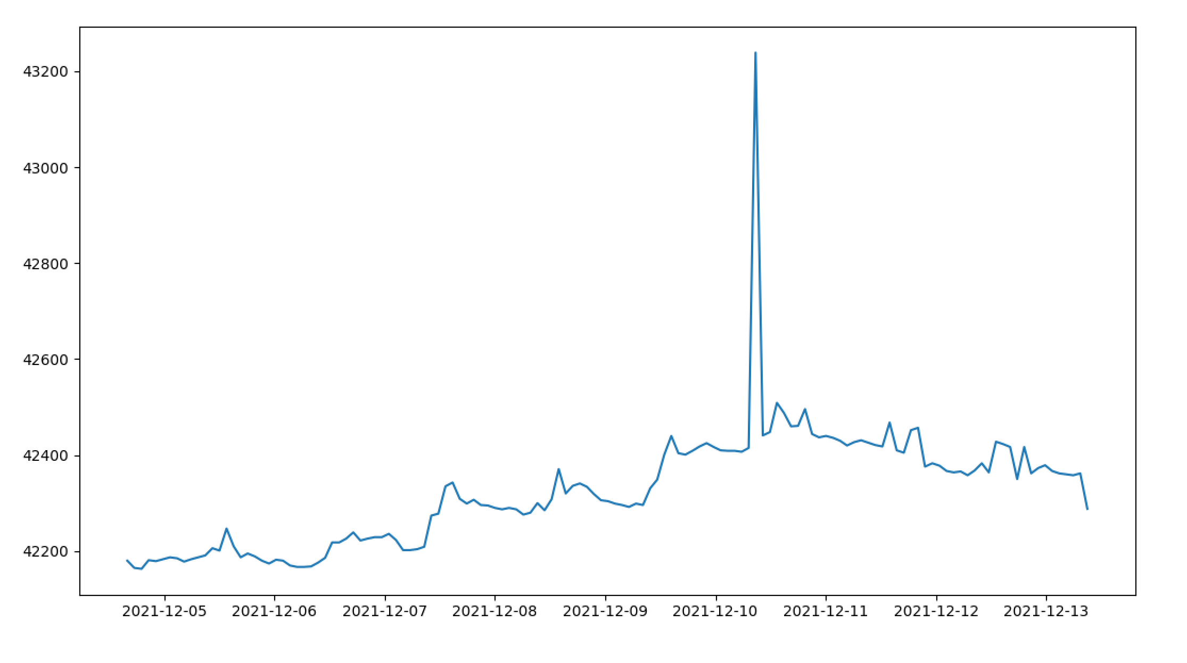
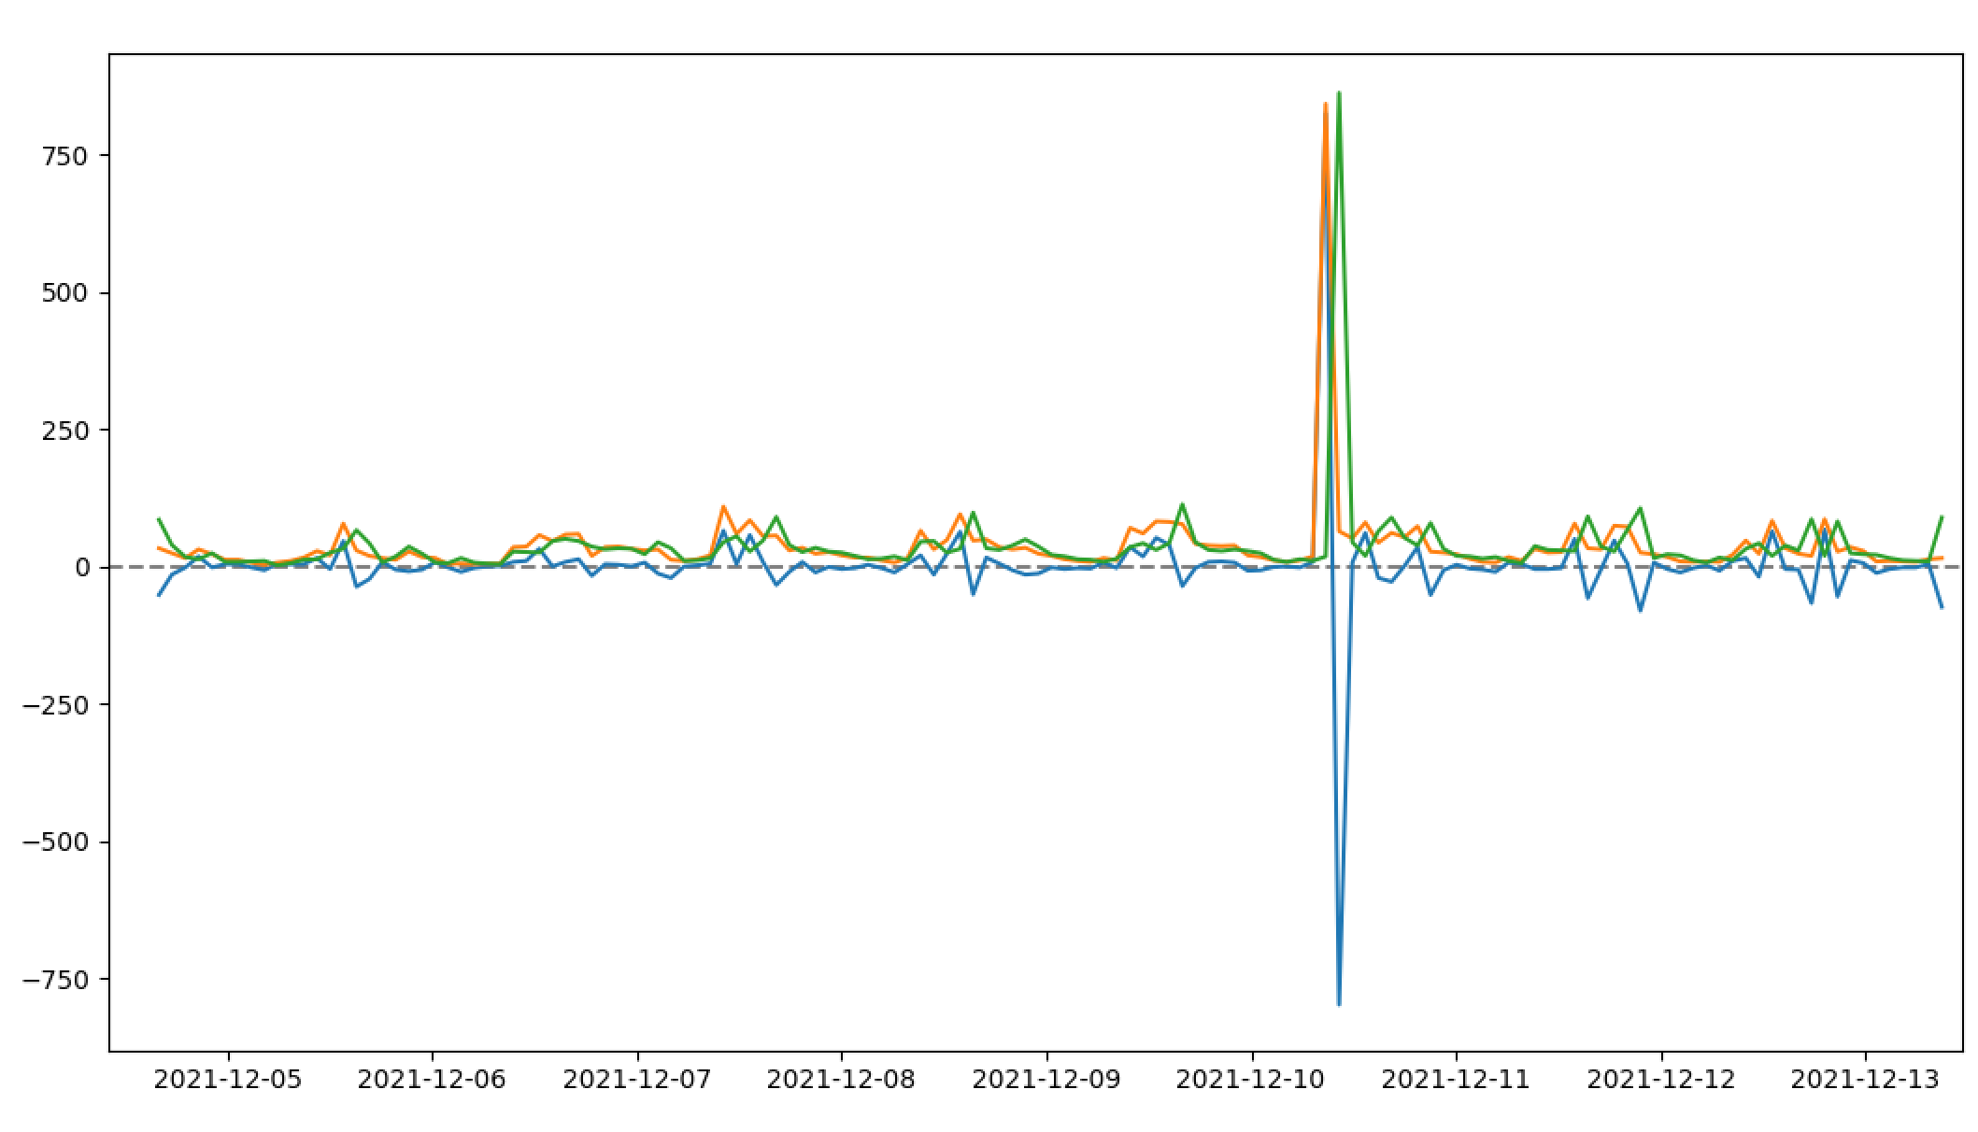
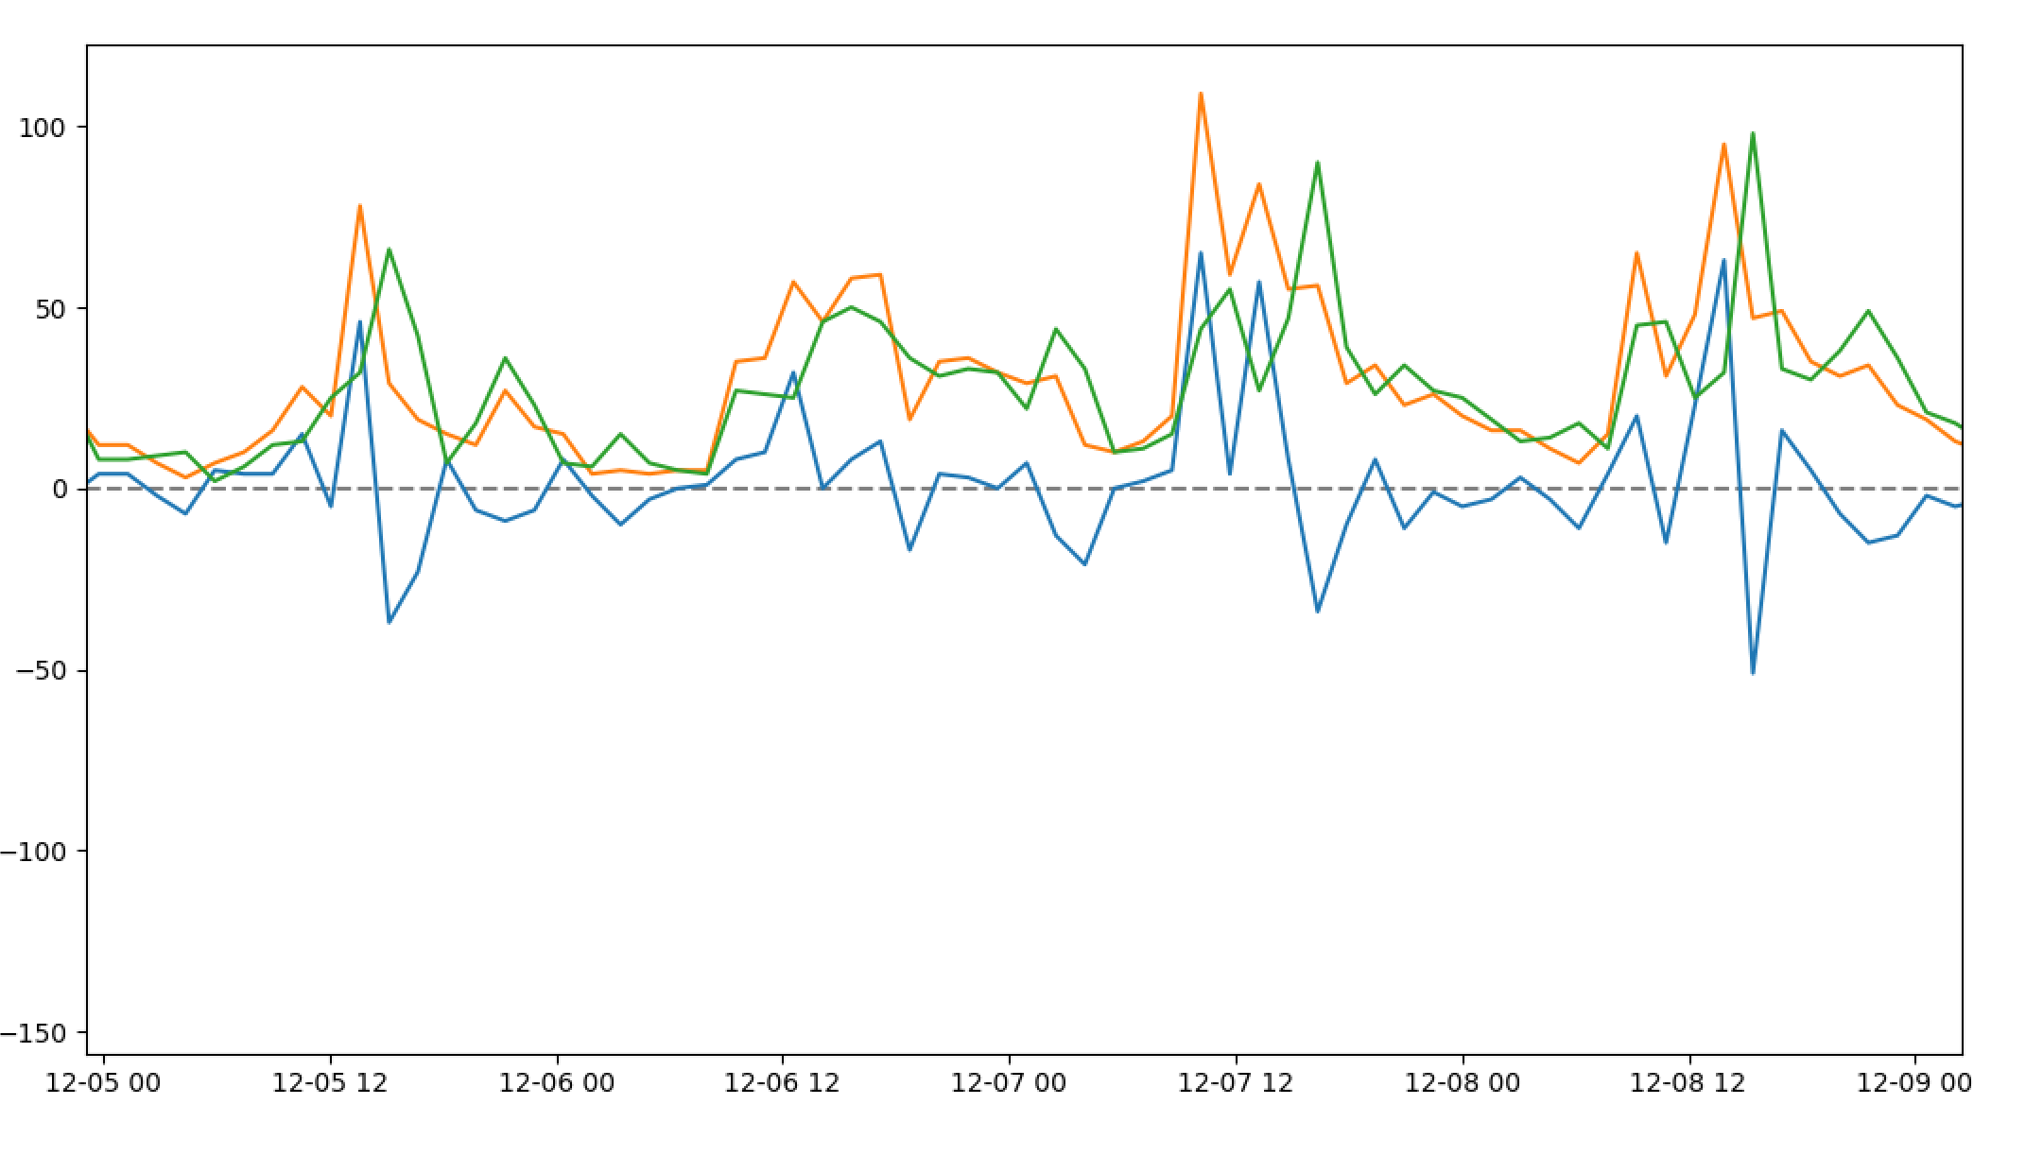
在线IP数统计
去掉峰值后的ip变化数
ip变化数

Slide 2
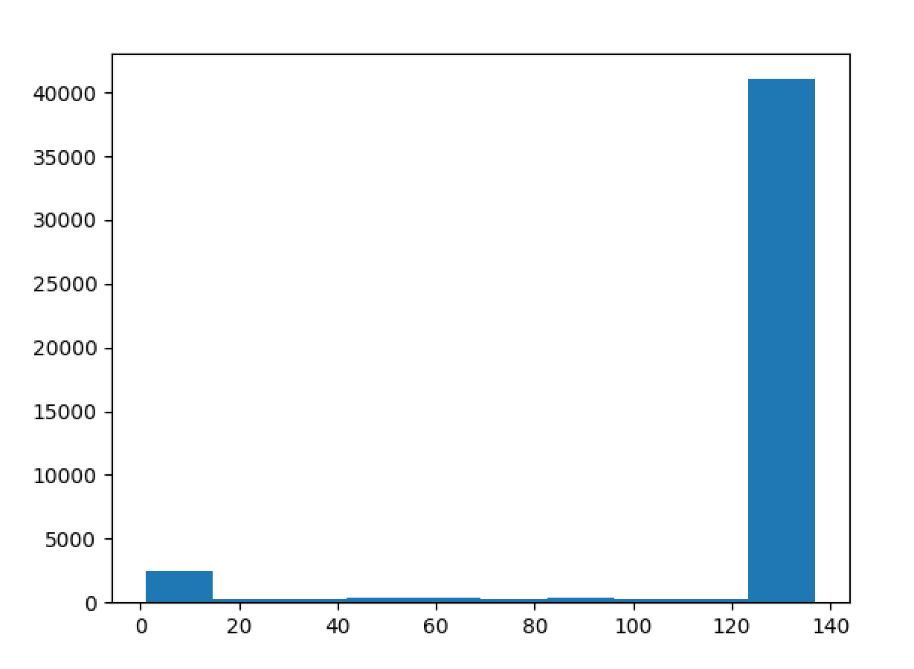
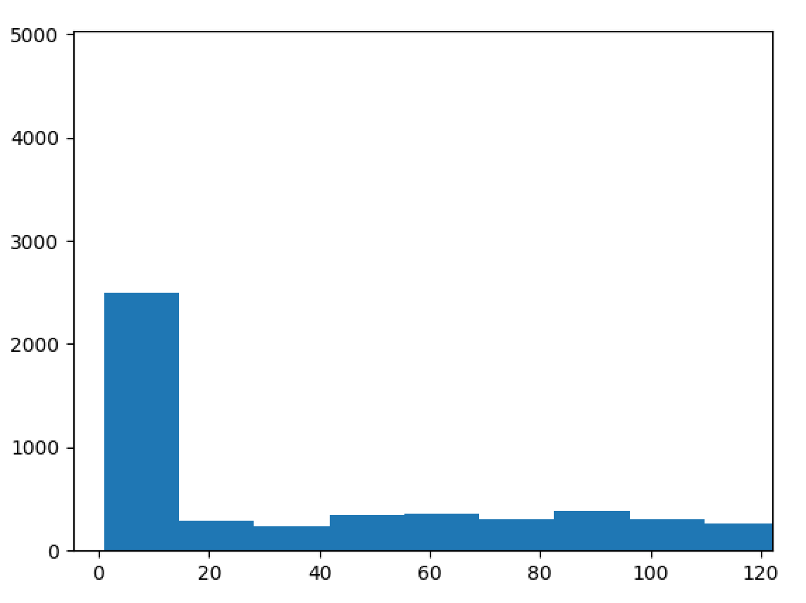
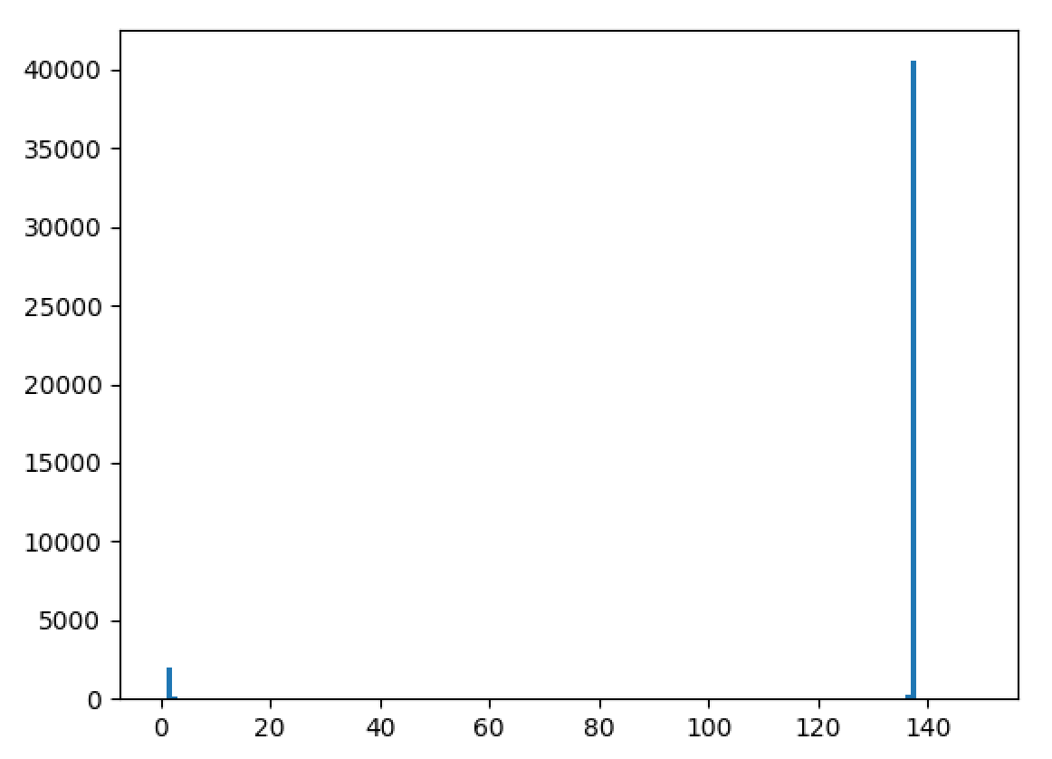
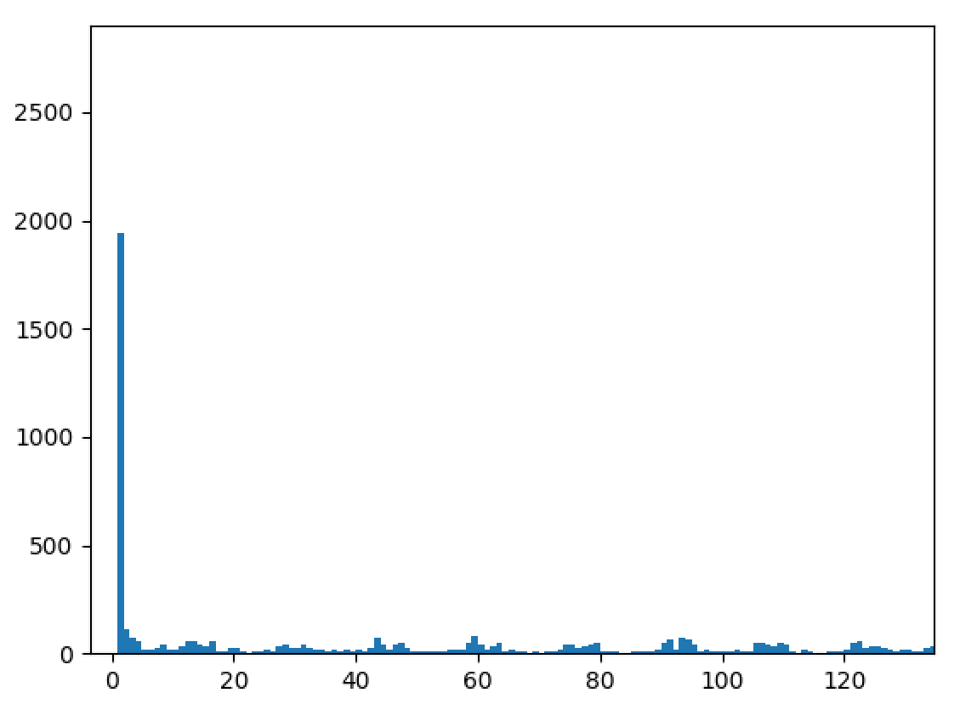
主机在线时长直方图
主机在线时长直方图

Slide 3
'2021-12-05 13:36:17', '2021-12-07 13:15:03', '2021-12-08 13:53:20', '2021-12-09 12:51:43', '2021-12-10 13:22:38', '2021-12-11 13:54:20', '2021-12-12 13:02:52'
'2021-12-04 16:00:12', '2021-12-05 15:08:45', '2021-12-07 16:21:09', '2021-12-08 15:25:00', '2021-12-09 15:55:57', '2021-12-10 16:27:09', '2021-12-11 15:26:57'
PORT STATE SERVICE VERSION
22/tcp open ssh OpenSSH for_Windows_8.0 (protocol 2.0)
135/tcp open msrpc Microsoft Windows RPC
139/tcp open netbios-ssn Microsoft Windows netbios-ssn
445/tcp open microsoft-ds Microsoft Windows Server 2008 R2 - 2012 microsoft-ds
3389/tcp open ms-wbt-server Microsoft Terminal Services
Service Info: OSs: Windows, Windows Server 2008 R2 - 2012; CPE: cpe:/o:microsoft:windows

Slide 4
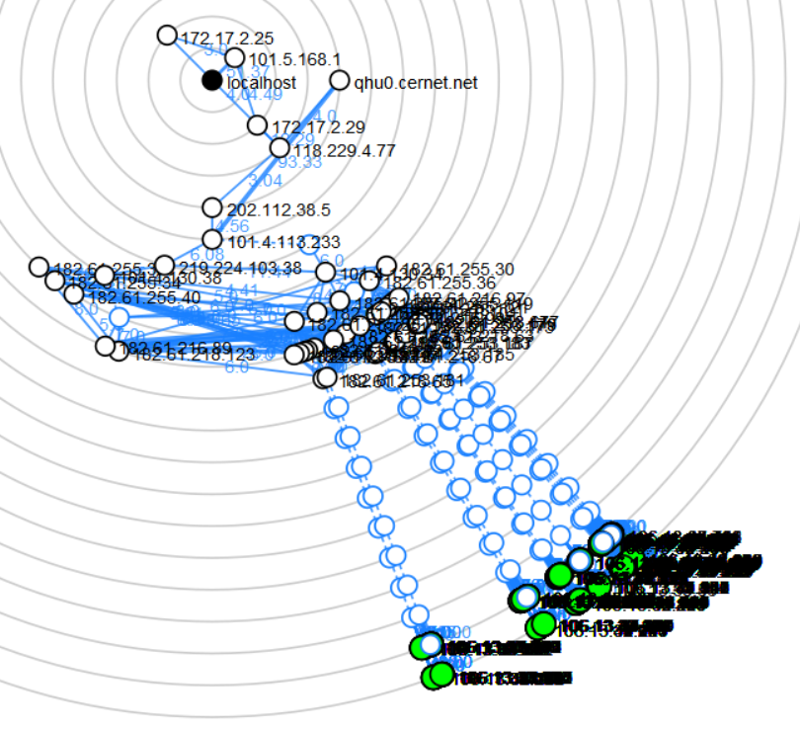
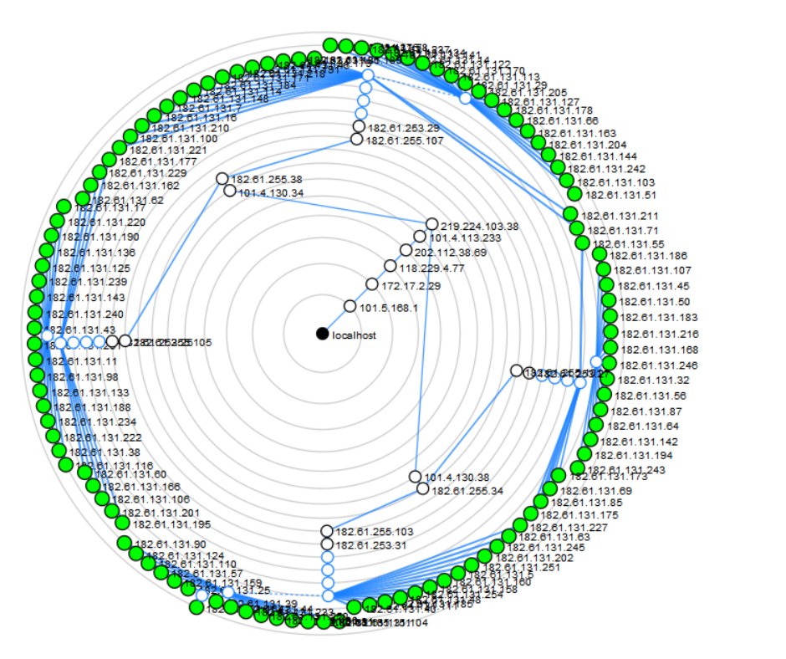
nmap -sn traceroute 106.13.32.0/20
nmap -sn --traceroute 182.61.131.0/24

Slide 5
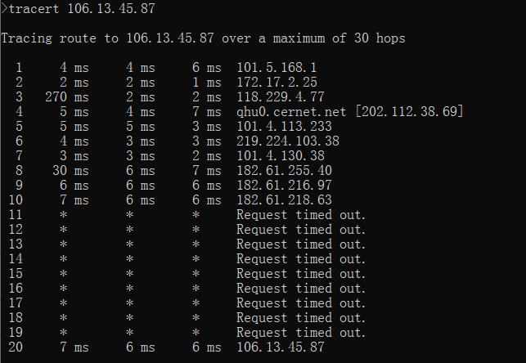
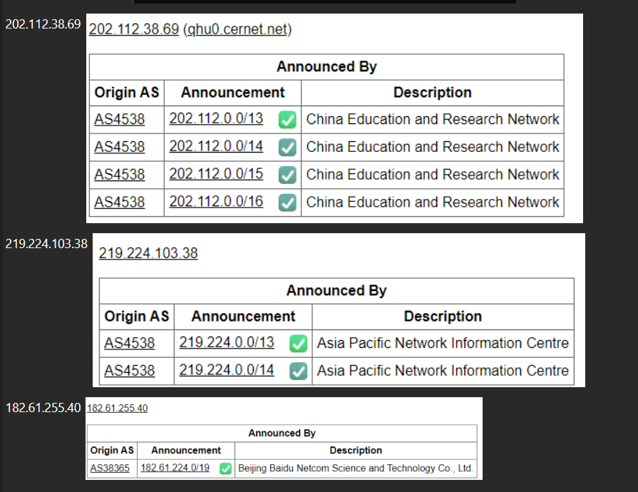
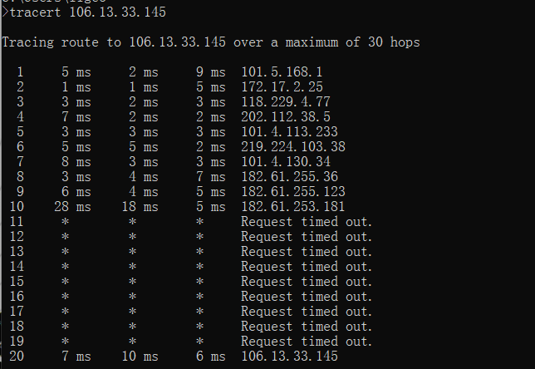

Slide 6
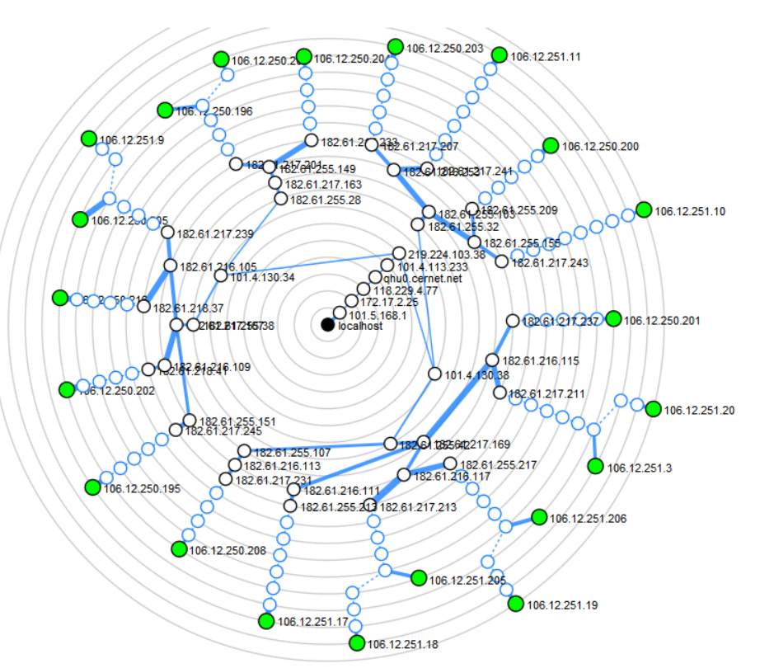

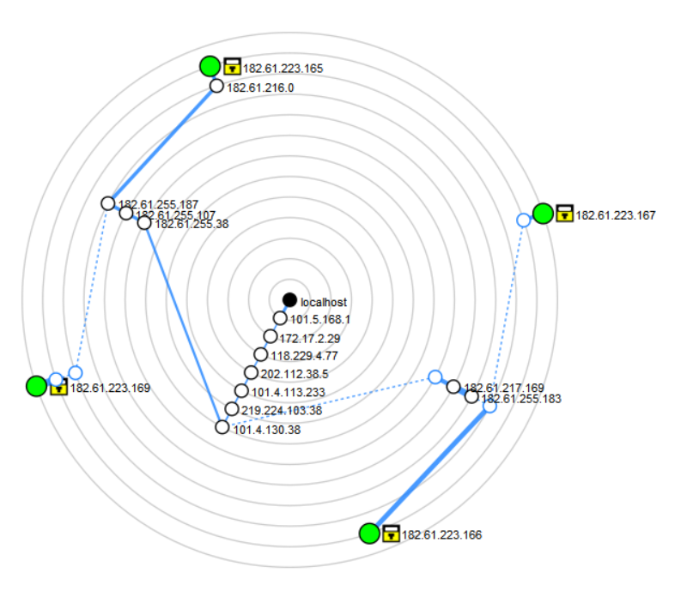
nmap -sn 180.76.40.0/24
nmap -sn --traceroute 180.76.76.0/24
nmap -T4 -A -v 182.61.223.0/24
-sn - 禁用端口扫描
-T4 -T<0-5>: 设置timing template(时序模板)（越高越快），提高质量和性能
-A - 启用操作系统检测、版本检测、脚本扫描和跟踪路由
-v - 增加详细程度 (print more information about the scan in progress )

