Slide 1
Data-Driven Restaurant Sales Insights
Sayantan Ghosh
ID – AF0436901
WBBTI – ANP-C8484

Slide 2
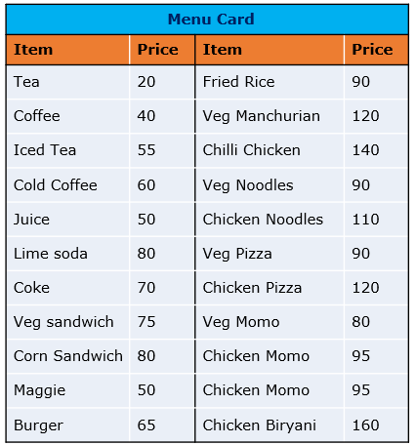
Problem Statement
We have the sales data of a restaurant of the last 15 days. It consists of details on the time of customer visit, type of orders, the amount spent against the orders by the customers, etc.
The restaurant provides a variety of menus.
However, the management wants to take action on cost-cutting and improving the profit.
Analyses the data and help them by providing actionable insights with the visual representation of data analysis to justify your suggestions.

Slide 3
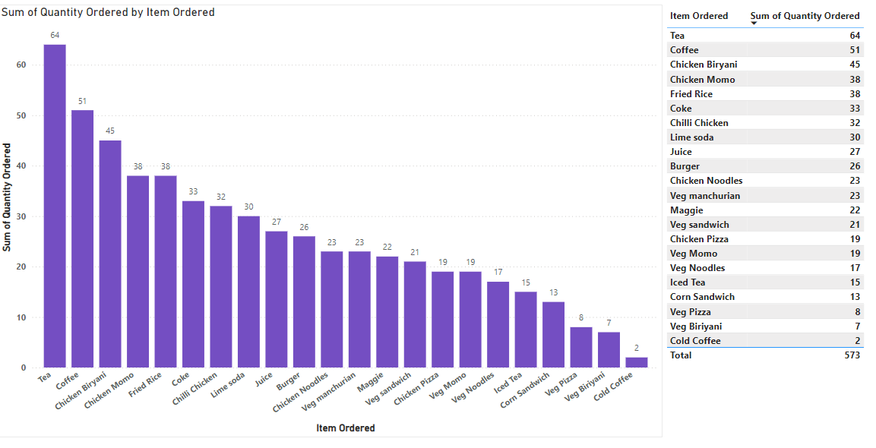
Item Ordered most and least
Tea is the most sold item with 64 units.
Cold Coffee is the least sold item with only 2 units.
This suggests that Tea is the most popular item among customers, while Cold Coffee has the lowest demand. This insight could help with inventory decisions, marketing focus and menu adjustments depending on the business's objectives.

Slide 4
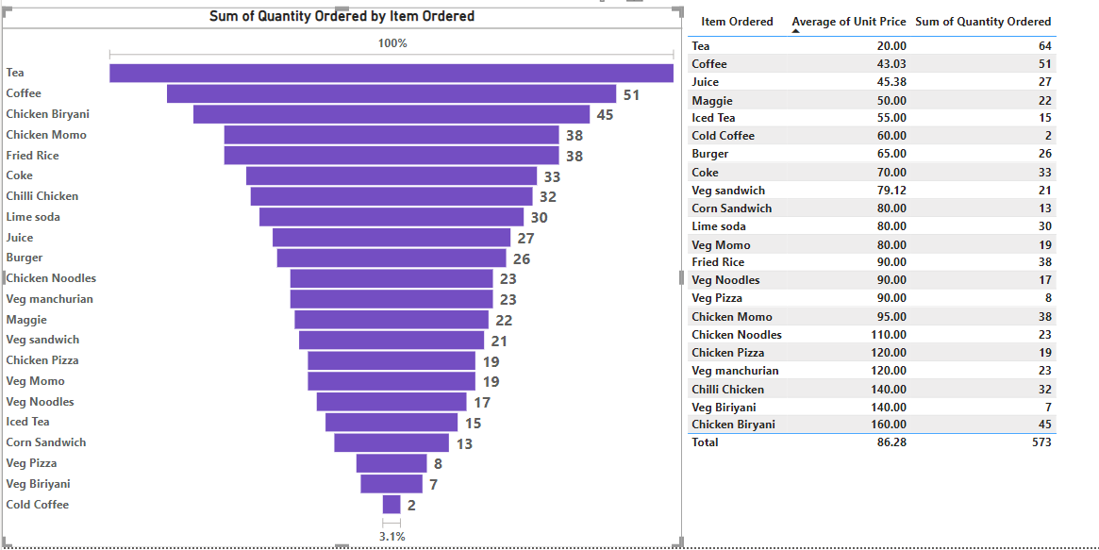
More units ordered against lower-priced items or higher-priced items in a single order
Funnel chart represents lower-priced items on higher quantities ordered (Ex- 64,51,45), while as the price increases (moving down the funnel), the quantity ordered decreases, with the lowest numbers at the bottom (Ex- 2,7,8)
Tea - 64 Units Order – Unit Price 20 ; Chicken Biriyani – 45 Units Order - Unit Price 160

Slide 5
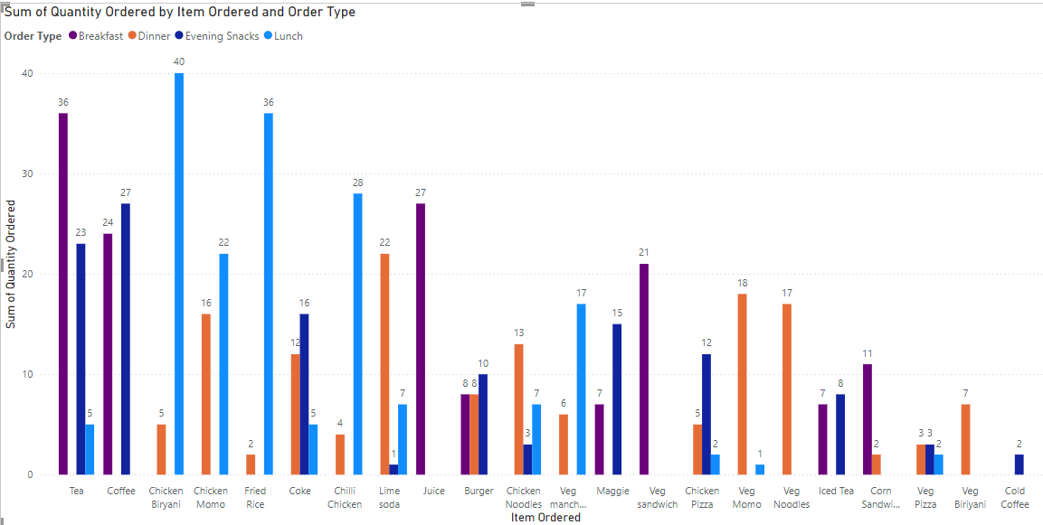
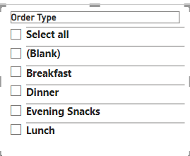
Items are sold more and less in diff. type of meal

Slide 6
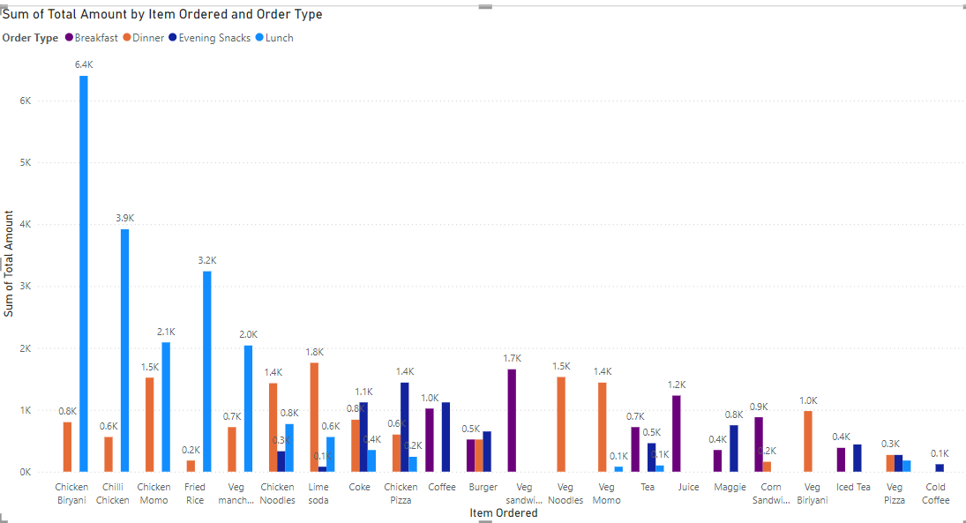
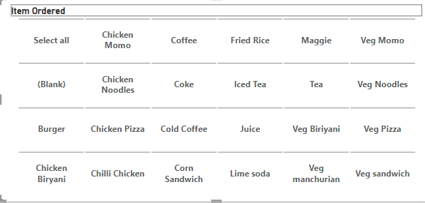
Items in diff. type of meal generate a greater amount of sales

Slide 7
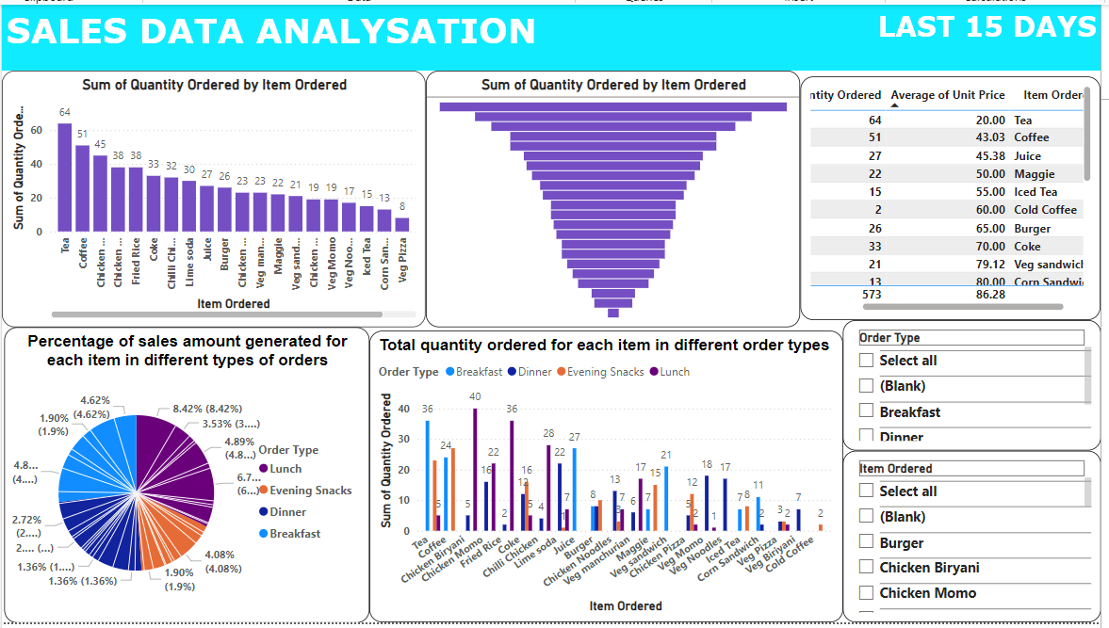
DASHBOARD

Slide 8
ANALYSATION
What items are sold more and what items are sold less in what type of meal
Most sold items
Tea (64 units) and Coffee (51 units) are the highest-selling items, especially during breakfast and evening snacks.
Chicken Biryani (45 units) and Fried Rice (38 units) perform well during lunch and dinner.
Least sold items
Cold Coffee (2 units) and Veg Biryani (7 units) have the lowest sales across all meal times.

Slide 9
ANALYSATION
Sale of which items in what type of meal generate a greater amount of sales?
Cold Coffee and Veg Biryani generate minimal sales, contributing less to overall revenue.
Tea, Coffee, and Chicken Biryani generate the most sales volume due to their high demand across breakfast and lunch and dinner

Slide 10
ANALYSATION
Should the company continue offering all items at different times of the day
Here are some key insights to consider the Company to continue offering all items at different times (Breakfast, Lunch, Dinner, and Evening Snacks) :
High-Performing Items at Specific Times :-
Tea and Coffee have consistently high sales during breakfast and evening snacks.
Fried Rice and Chicken Biryani perform well during lunch and dinner.
Veg Sandwiches and Chicken Pizzas show good sales during lunch and dinner.
Low-Performing Items :-
Some items, like Cold Coffee and Veg Biryani, have very low sales across all meal times.
Items like Lime Soda and Chicken Momos seem to perform poorly during specific meal times.
Items to Continue :-
Items like Tea, Coffee, Fried Rice, and Veg Sandwich should likely continue being offered during their high-performing meal times.
Items to Reconsider :-
Items with consistently low demand such as Cold Coffee or Lime Soda during most meal times, could be reconsidered for discontinuation or offered during specific time slots where they show even minimal performance.
Focus on profitability , it seems reasonable to limit the availability of some underperforming items during certain time period.

Slide 11
ANALYSATION
Focus on high-demand items: Prioritize stocking and promoting items like Tea, Coffee, Chicken Biryani, and Fried Rice etc.
Time-slot optimization: Tailor the menu to emphasize items that perform well during specific meals. Ex - push sales for sandwiches during lunch and lighter beverages during evening snacks.
Discontinue or limit low-demand items: Consider removing or offering items like Cold Coffee and Veg Biryani only at specific times to reduce waste and operational costs.
Actionable insights from the analysis for cost-cutting and improving the profit

Slide 12
ANALYSATION
Items being ordered by customers in at least 3 meal types:
Chicken Momo: Appears during lunch, dinner, and snacks.
Tea: Ordered during breakfast, evening snacks, and dinner.
Fried Rice: Ordered across lunch, dinner, and snacks.

Slide 13
ANALYSATION
Items being ordered in more than one meal type:
Lime Soda: Ordered during snacks and lunch.
Chilli Chicken: Appears during lunch and dinner.
Veg Sandwich: Ordered during breakfast and lunch.
Chicken Pizza: Ordered during lunch and dinner.

Slide 14
THANK YOU
Sayantan Ghosh
ID – AF0436901
WBBTI – ANP-C8484

