Slide 1
Budget Sales Analytics
Author : Akash.V
Twilearn Internship Project

Slide 2
PROJECT DETAIL
Project Title | Budget Sales Analytics
Technology | Data Science
Domain | Retail and Sales
Project Difficulty Level | Advanced
Programming Language Used | Python

Slide 3
PROBLEM STATEMENT
Budget and Sales are by far most important attributes that defines abusiness’s success and failure. Therefore, it is very important to keep a track on various features related to these attributes to keep onincreasing the Sales and to allocate the Budget so that it can be utilized wisely and efficiently. So, it is very important for businesses todig deep into the customer, sales, budget and product data to make better marketing strategy, to know the target customers, to make market friendly product upgrades and to keep a strong track on the budget efficiency. Good data driven systems can help achieve these goals and take the businesses forward towards success.

Slide 4
OBJECTIVE
The problem is to create a dashboard that provides information on domain sales, budgets, and variances. The dashboard should help with comparing sales and budgets with different attributes. It should also provide necessary information about products and customers. The aim is to use various visualizations and features to show key metrics and factors and their meaningful relationships between attributes.

Slide 5
USED TECHNIQUES
➢ Removing unwanted attributes.
➢ Visualizing relation of independent variables with each other.
➢ Cleaning data by removing column with missing values.
➢ Converting Numerical data into Categorical values.

Slide 6
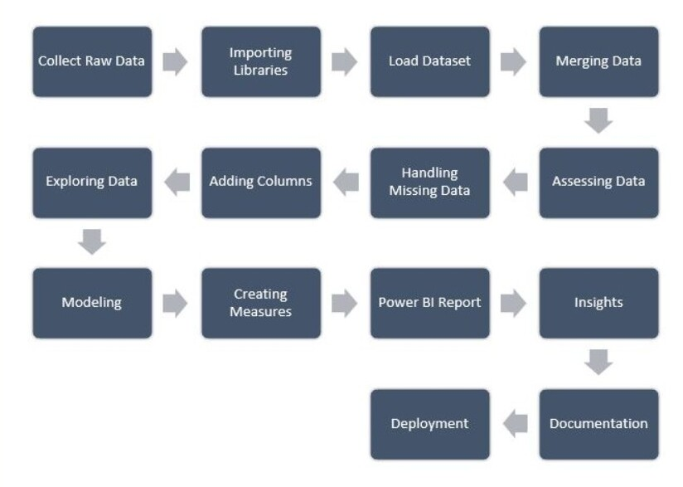
ARCHITECTURE

Slide 7
THANKYOU

