Slide 1

AKC
Organization
Organization 1
Organization 2
Organization 3
Application

Slide 2



Front End
Application Cluster
Databases
Blockchain Cluster
EKS Cluster
EKS Cluster
Front end components
(web portals, mobile apps)
Access Control- API
DataSync
Off-chain DBs
Application - API
Subscribe to
Block event
NodeJS Daemon
Run every x seconds
DAPP
Invoke Chaincode
Fabric Peer
Existing External Systems
Blockchain Network
External Systems

Slide 3





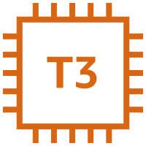




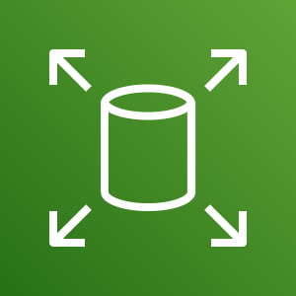
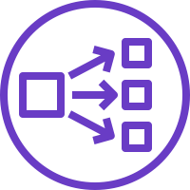



Organization Blockchain Cluster
EKS Cluster
AWS Services
VPC-1
Private Subnets
Public Subnet
Fabric Peers * n
AZ1
CouchDB
Aurora
NodeJS Daemon
Mapping
DAPP
Explorer
Request/
Response
AZ2
DataSync
KMS
EFS
CA
NAT Gateway
Worker Nodes
Microservices (Pods)
EBS
(PVC)
NLB
Internet
Control Plane
CA
HPA
Ingress Controller
ALB
Route 53
Notes:
PVC: Persistent Volume Claim
NLB for Grpc (for peer)

Slide 4

Organization Application Cluster
EKS Cluster
AWS Services
VPC-1
Private Subnets
Public Subnet
AZ1
Aurora
Mapping
Access Control
Application - API
Request/
Response
AZ2
KMS
EFS
NAT Gateway
Worker Nodes
Microservices (Pods)
Control Plane
EBS
(PVC)
Internet
CA
HPA
Ingress Controller
ALB
Route 53

Slide 5
AKC Blockchain Cluster
EKS Cluster
Organization 1
Blockchain Cluster
Organization 2
Blockchain Cluster
Organization 3
Blockchain Cluster
Root CA
Orderer
EKS Cluster
EKS Cluster
EKS Cluster
Kafka x 3
Intermediate CA
Intermediate CA
Intermediate CA
ZooKeeper x 3
Fabric Peers
Fabric Peers
Fabric Peers
Consortium Channel

