Slide 1
TensPilot+
Design of a Dual-Mode TENS Device
with a Companion Web Application

Slide 2
Presentation Outline
• The Problem & Our Solution
• Hardware Design & Specifications
• Testing & Clinical Results
• Two Therapy Modes
• Software Ecosystem (Patient & Doctor)
• AI Integration (Gemini)
• Innovation & Key Features
• Impact & SDGs

Slide 3
1. The Problem & Our Solution
The Problem
Our Solution
• Standard TENS machines are standalone systems.
• No tracking of pulse width, frequency, or intensity.
• Reliance on unreliable paper diaries.
• Doctors have limited visibility into home therapy.
A low-cost, locally developed TENS device integrated with an intelligent monitoring platform to bridge the gap between home and hospital.

Slide 4
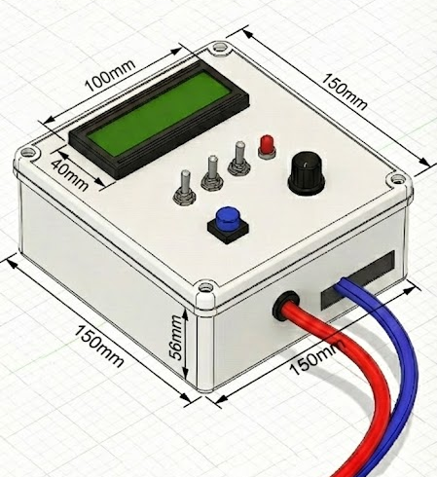
2. Hardware Design
HARDWARE PHOTO
(Device showing
LCD display, controls & layout)
Specifications
• Arduino Uno (ATmega328P)
• L298N H-Bridge driver
• XL6009 Boost converter
• 20x4 LCD display
• 5V Power Bank
• Size: 150×100×56 mm
• Weight: ~350g
• Battery: 4+ hours

Slide 5
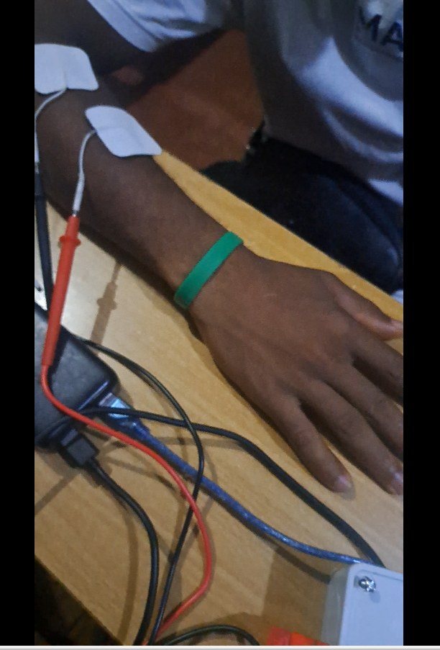
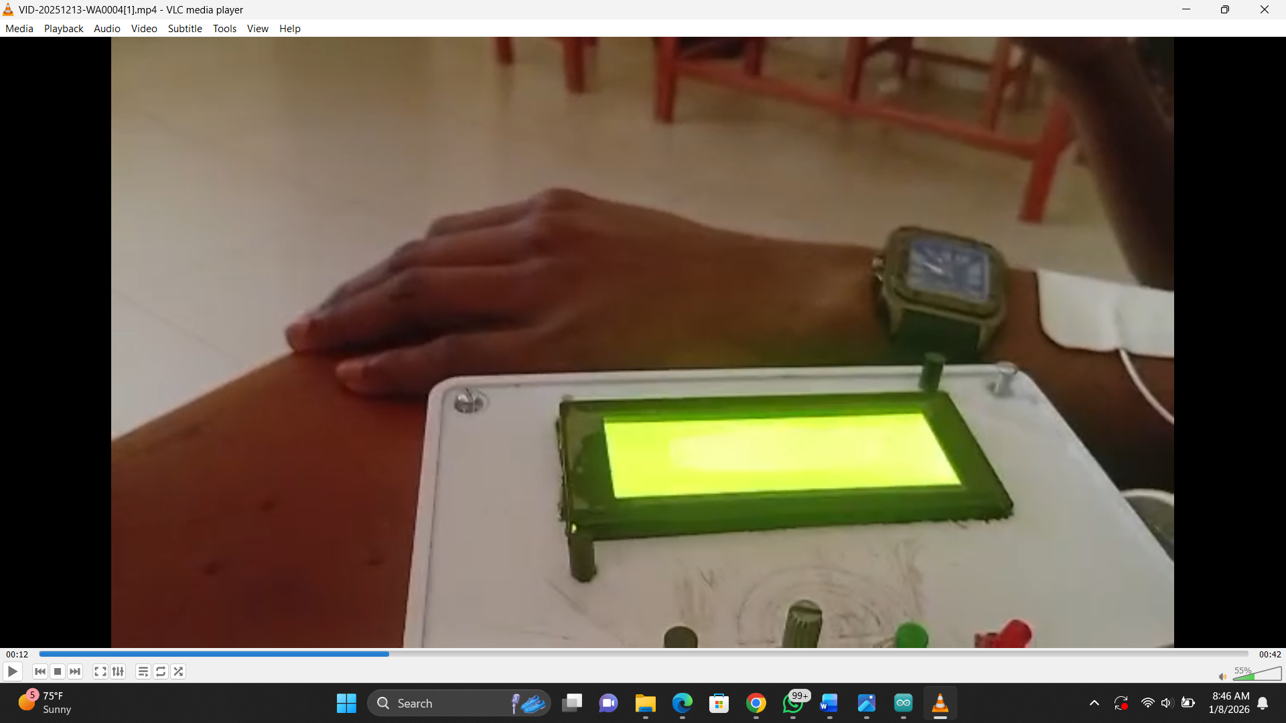
3. Testing & Results
Results from 12 Volunteers
• Signal accuracy: ±2%
• Charge balance: >98%
• Frequency range: 1–120 Hz stable
• Battery life: 4+ hours continuous
• Conventional mode: smooth tingling
• Acupuncture mode: rhythmic tapping
• No adverse effects reported
• Safe electrical parameters

Slide 6
4. Two Therapy Modes
CONVENTIONAL MODE
ACUPUNCTURE-LIKE MODE
20–120 Hz
1–10 Hz
Fast pain relief (10–20 minutes)
For acute pain & muscle soreness
Smooth tingling sensation
Longer relief (90–180 minutes)
For chronic & neuropathic pain
Rhythmic tapping with contractions

Slide 7
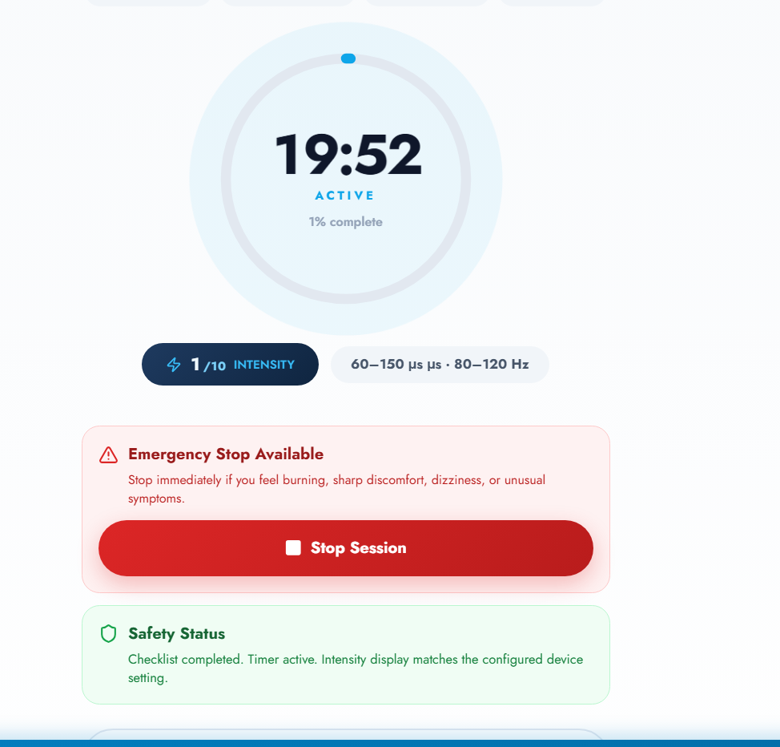
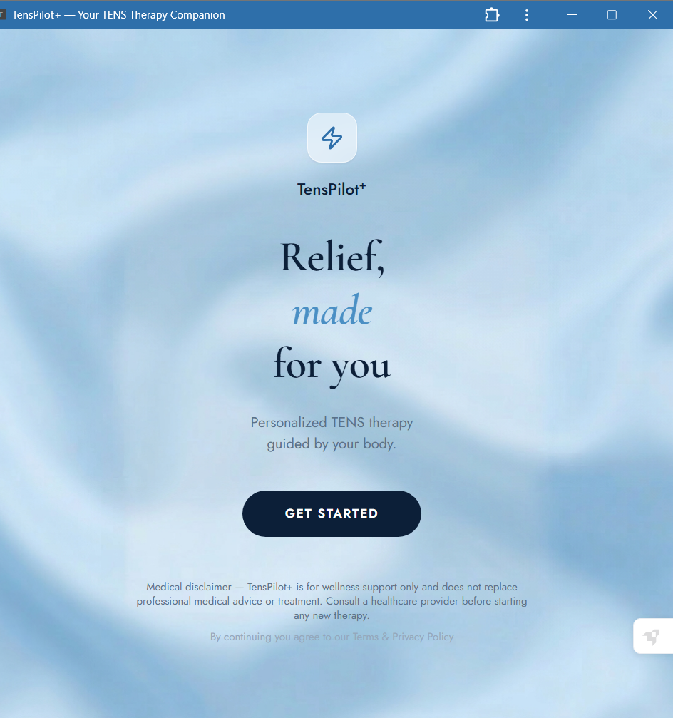
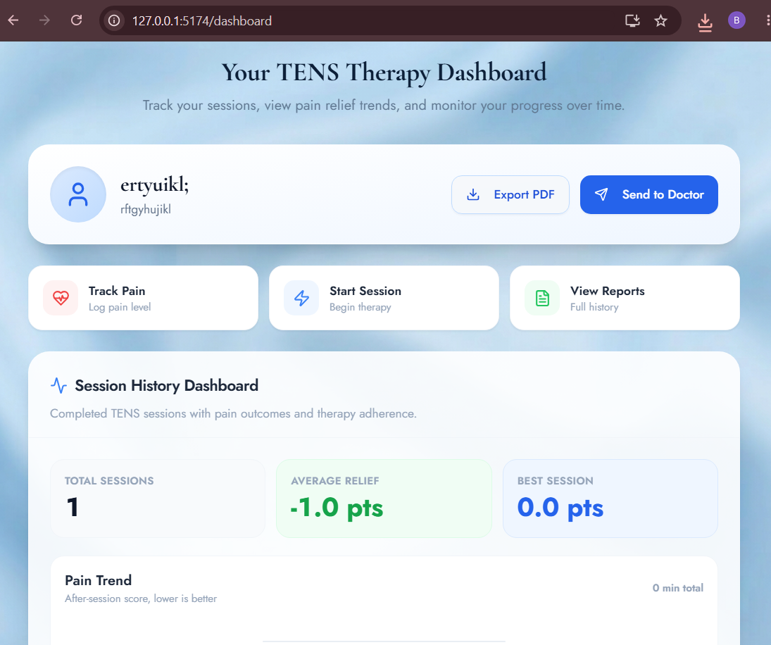
5. Patient Companion Application
Home & Setup
Screenshot
Active Session
Screenshot
Session History
Screenshot
App Features
• Intuitive Setup
• Live Logging
• Pain Tracking Algorithm
• Offline Access (PWA)

Slide 8
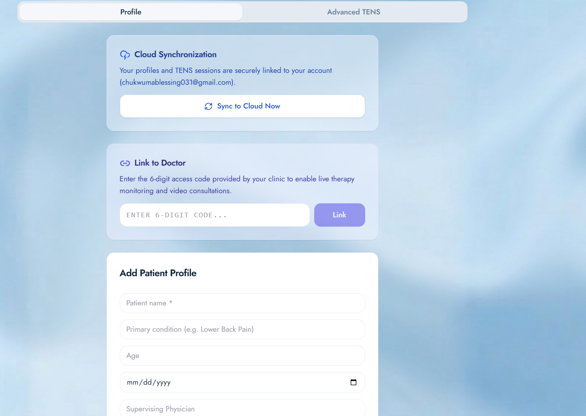
6. Ecosystem: Cloud Sync & Monitoring
Dashboard / Cloud Sync
Screenshot
Clinical Benefits
Secure storage of treatment records
Connects patients directly with healthcare providers
Monitors therapy usage and adherence
Tracks pain improvement over time
Supports informed treatment decisions

Slide 9
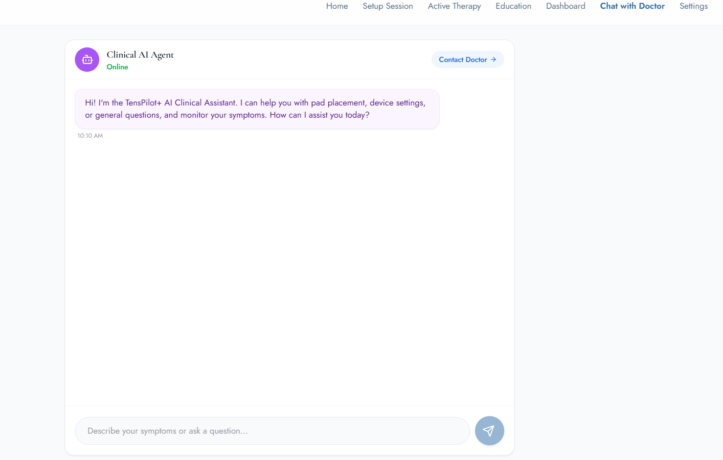
7. AI Integration: Gemini Virtual Assistant
AI Chat
Screenshot
Gemini Capabilities
• Recommends electrode placement based on pain type.
• Provides therapy guidance 24/7.
Key Benefits
• Reduces patient misinformation.
• Improves therapy adherence.

Slide 10
8. Innovation & Key Features
Hardware
Software
Integration
• Dual-mode capability
• Arduino-based
• Open-source design
• 20–30% cheaper
• Progressive Web App
• Offline-first (no internet)
• Local data storage
• Privacy-focused
• Manual data entry (current)
• Session tracking
• Progress analytics
• Future: Bluetooth

Slide 11
9. Impact, Accessibility & SDGs
Designed for Nigeria
Addressing SDGs
✅ Works with low internet
✅ Runs on low-end Android phones
✅ Reduces transportation costs
✅ Targets Vulnerable Demographics (Women, Elderly, etc)
• SDG 3: Good Health & Well-being
• SDG 9: Industry & Innovation
• SDG 10: Reduced Inequalities
• SDG 17: Partnerships for the Goals

Slide 12
Thank You For Listening!
TensPilot+
Any Questions?

