Slide 1
TensPilot+
Smart Telemetry-Enabled TENS System
Improving Access to Safe, Intelligent, and Remote Electrotherapy for Nigerians

Slide 2
1. Problem & Motivation
The Problem
Our Solution
• Standard TENS machines are "dumb" hardware.
• No tracking of pulse width, frequency, or intensity.
• Reliance on unreliable paper diaries.
• Doctors have zero visibility into home therapy.
A low-cost, locally developed TENS device integrated with intelligent monitoring software to bridge the gap between home and hospital. Transforming qualitative guessing into quantitative data.

Slide 3
2. Hardware Design: The Core Device
[ Insert Circuit / Prototype Image Here ]
Show physical components
Internal Components
• Microcontroller Unit (Arduino Uno)
• Battery Supply (5V Power Bank)
• L298N H-Bridge Driver
• Pulse Generation Circuit
• Hardware Safety Features
How it Works
Generates controlled electrical pulses that stimulate nerves and reduce pain without medication.

Slide 4
3. Hardware Demonstration
[ Insert Patient Testing Photo ]
Show device in action on a patient
Operational Capabilities
• Frequency (Hz) Control
• Pulse Width (µs) Control
• Intensity (mA) Control
• Portable Operation

Slide 5
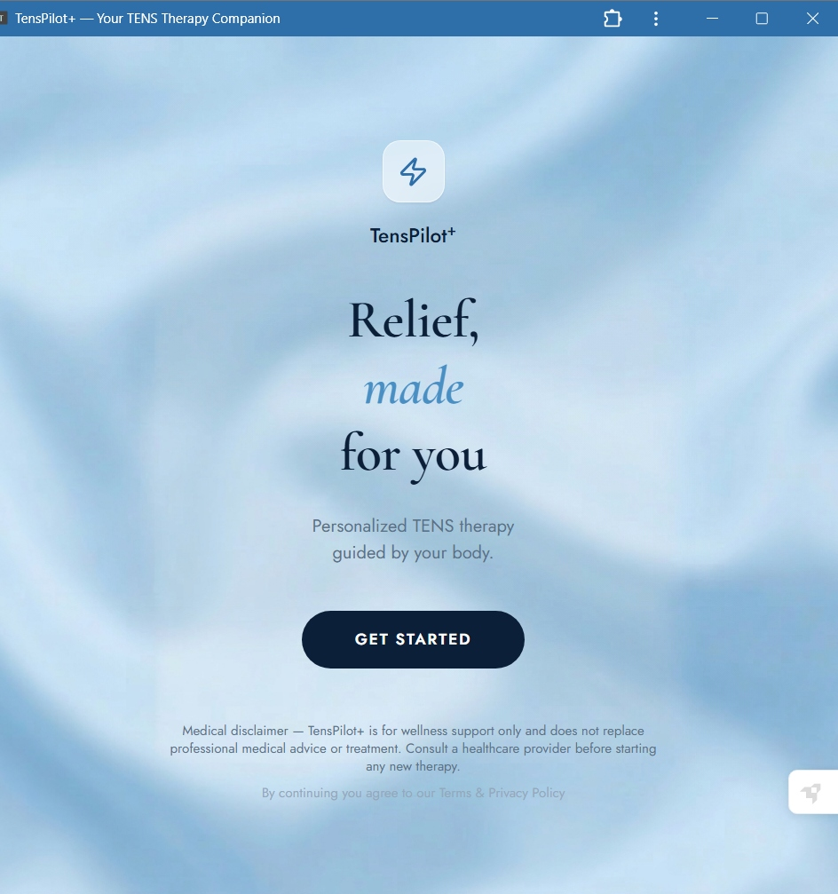
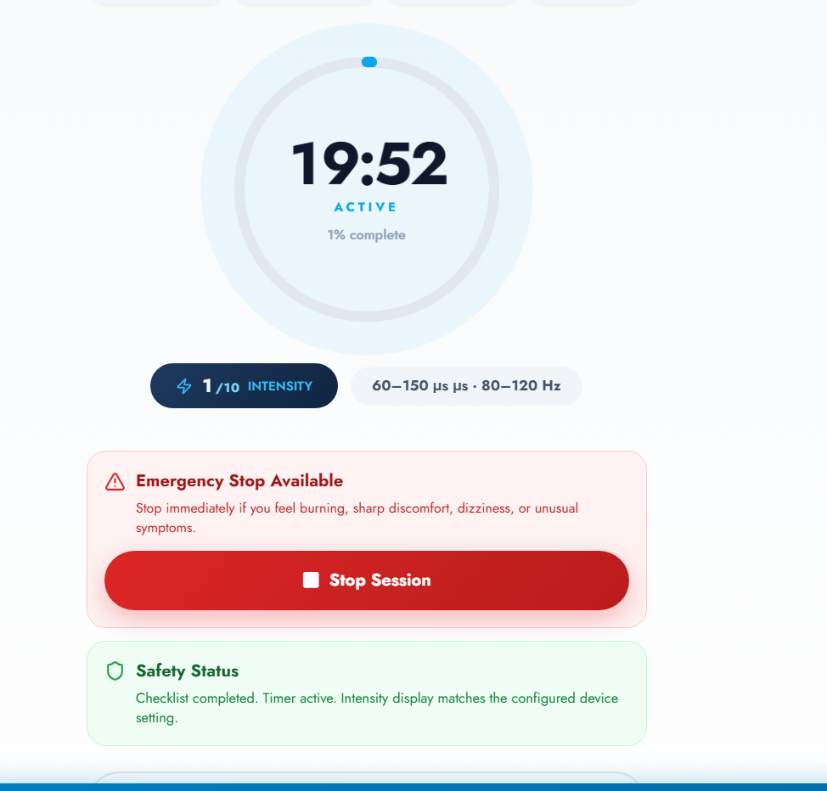
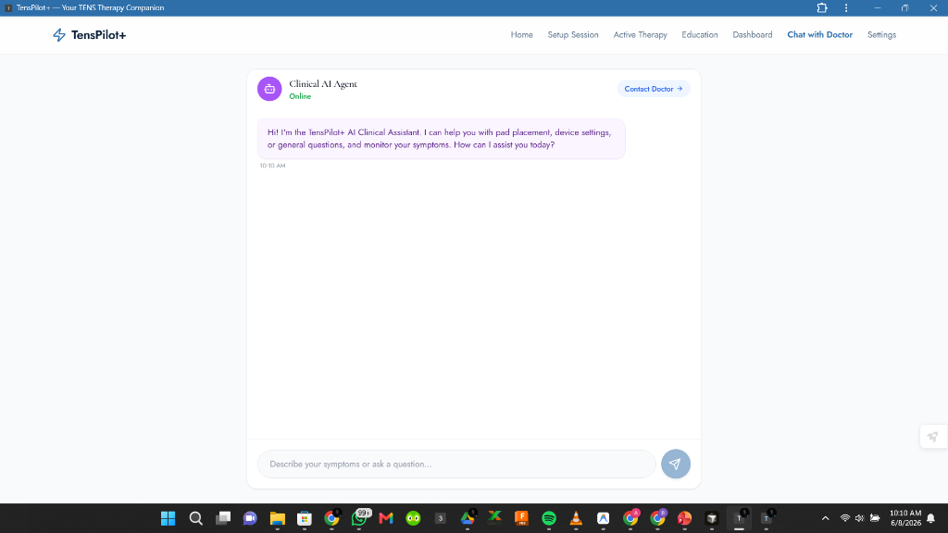
4. Ecosystem: Patient Application
App Features
• Intuitive Setup
• Live Logging
• Pain Tracking Algorithm
• Therapy Suggestions
• Offline Access (PWA)

Slide 6
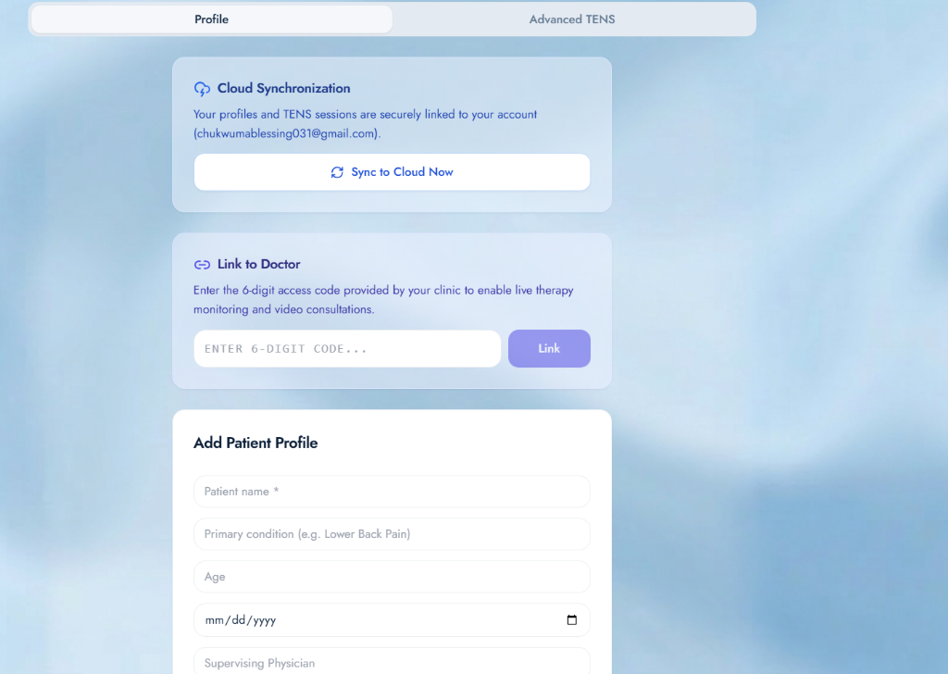
5. Ecosystem: Cloud Sync & Monitoring
Clinical Tools
• Secure Cloud Synchronization
• Direct Link to Doctor
• Track Global Compliance
• Monitor Effectiveness
• Adjust Therapy Plans

Slide 7
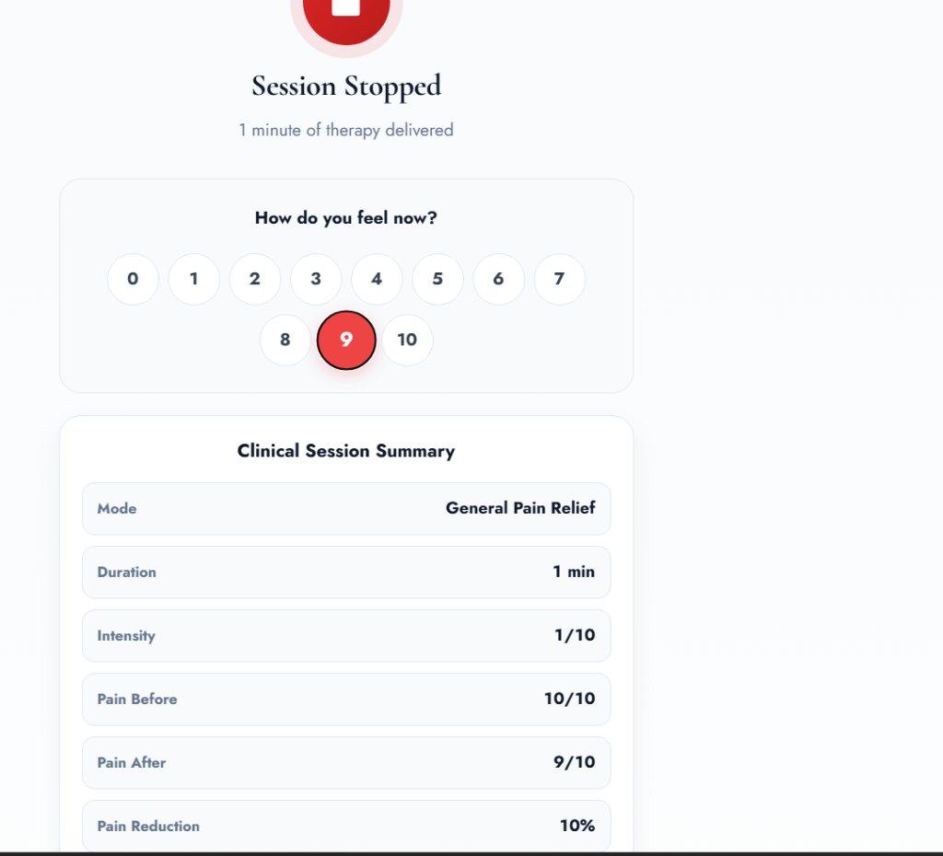
6. AI Integration: Gemini Virtual Assistant
Gemini-Powered Capabilities
• Recommends electrode placement based on pain type.
• Provides therapy guidance 24/7.
Key Benefits
• Reduces patient misinformation.
• Improves therapy adherence and confidence.

Slide 8
7. Innovative Edge & Market Comparison
Feature | Imported Smart TENS | TensPilot+
Cost | Highly Expensive | Low Cost & Accessible
Monitoring | Limited / Bluetooth Only | Global Cloud Telemetry
AI Guidance | None | Gemini Integrated
Nigeria-Focused | No | Yes (Offline/PWA)

Slide 9
8. Addressing Sustainable Development Goals
SDG 3: Good Health
SDG 9: Industry & Innovation
Improved pain management & better quality of life.
AI-enabled healthcare innovation through local hardware.
SDG 10: Reduced Inequalities
SDG 17: Partnerships
Affordable care for underserved populations & rural areas.
Connects patients and clinicians digitally across regions.

Slide 10
9. Impact & Accessibility
Designed for Nigeria
Vulnerable Demographics
✅ Works Offline via Service Workers
✅ Runs on low-end Android phones
✅ Reduces transportation costs
✅ Suitable for rural healthcare
• Women: Chronic pelvic & menstrual pain.
• Children: Non-drug, safe pain relief.
• Elderly: Arthritis care with reduced clinic visits.

Slide 11
10. Future Expansion Roadmap
Phase 1: Standalone TENS hardware
Phase 2: Telemetry software (Current Phase)
Phase 3: Bluetooth-enabled hardware integration
Phase 4: Official Hospital deployment
Phase 5: National pain-management platform

Slide 12
TensPilot+
A practical, affordable, and intelligent electrotherapy ecosystem that:
• Relieves pain • Supports clinicians • Empowers patients • Reduces healthcare burden
"From Pain Relief to Intelligent Pain Management."

