Slide 1
TensPilot+
Design of a Dual-Mode TENS Device
with a Companion Web Application

Slide 2
Presentation Outline
Hardware
Software
Impact
• The Problem
• Core Device Design
• Two Therapy Modes
• Testing & Validation
• Patient Application
• Cloud Synchronization
• Doctor Dashboard
• Gemini AI Assistant
• Market Comparison
• Addressing SDGs
• Accessibility
• Conclusion

Slide 3
1. The Problem & Our Solution
The Problem
Our Solution
Standard TENS devices provide effective pain relief but operate as standalone systems.
No structured tracking of treatment parameters such as pulse width, frequency, or intensity.
Patients often rely on memory or manual records to report therapy sessions.
Clinicians have limited visibility into home-based treatment progress and outcomes.
TensPilot+ combines a locally developed TENS device with a smart monitoring platform:
Tracks treatment sessions and pain outcomes.
Supports remote clinician oversight.
Provides data-driven insights for better care.
Makes home-based electrotherapy more effective and accountable.

Slide 4
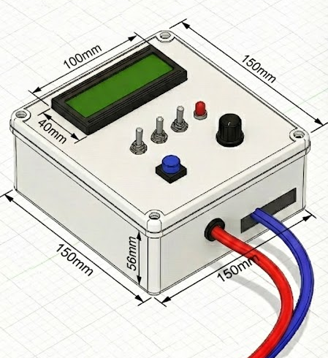
2. Hardware Design & Testing
Internal Components
• Microcontroller Unit (Arduino Uno)
• Battery Supply (5V Power Bank)
• L298N H-Bridge Driver
• Pulse Generation Circuit
• Hardware Safety Features
Operational Capabilities
• Tested on 12 Volunteers
• Frequency (1–120 Hz) & Pulse Width Control
• Intensity (mA) Control
• Portable Operation (4+ Hours)

Slide 5
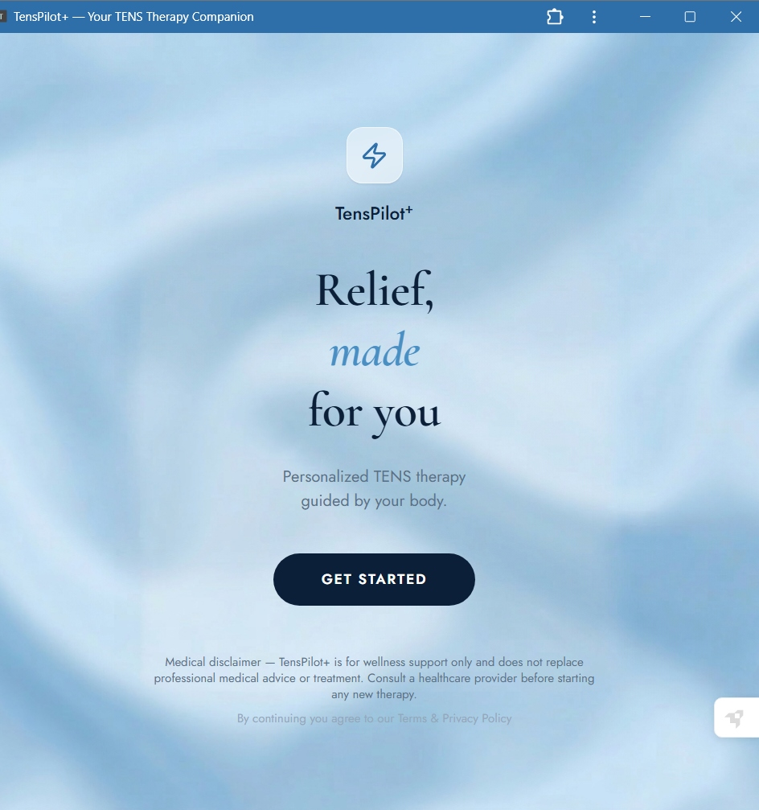
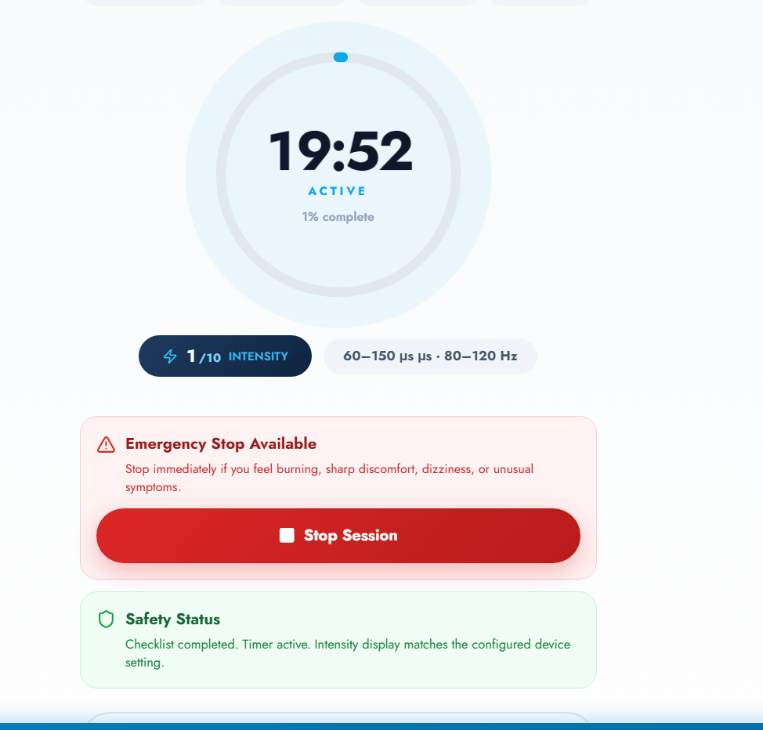
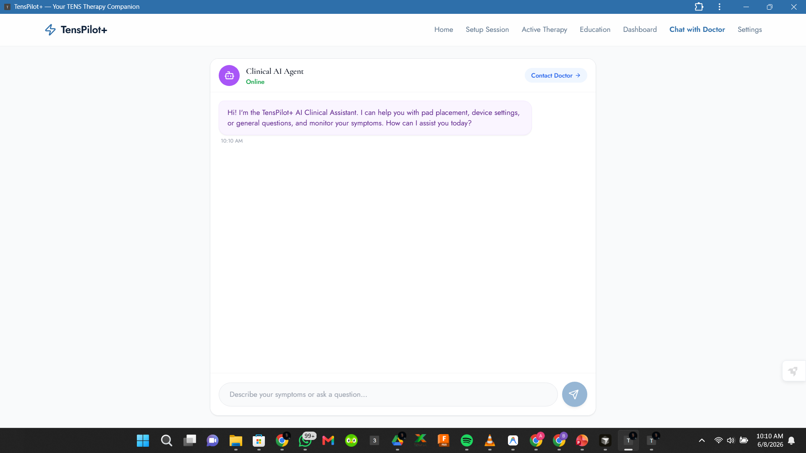

3. Ecosystem: Patient Application
How the App Supports the Device
Guides users through therapy sessions
Records treatment parameters and outcomes
Tracks pain improvement over time
Connects patients with healthcare providers
Enables access to AI-assisted support
The TensPilot+ Patient Application serves as the digital companion to the TENS device, helping users manage therapy sessions, monitor pain levels, receive guidance, and securely share treatment data with healthcare professionals.

Slide 6
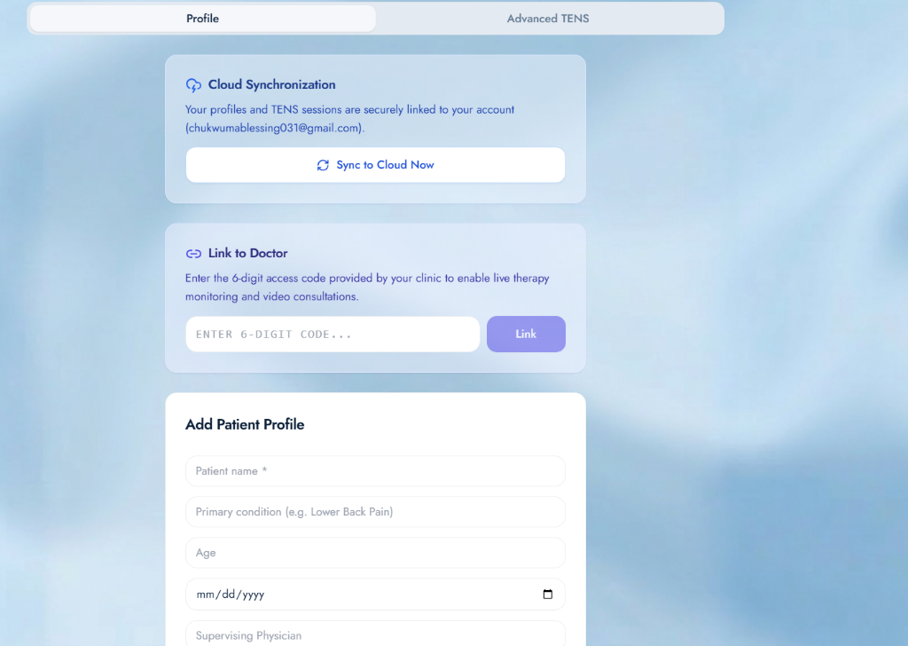
4. Remote Monitoring & Clinical Oversight
Clinical Benefits
• Secure storage of treatment records
Connects patients directly with healthcare providers
Monitors therapy usage and adherence
Tracks pain improvement over time
Supports informed treatment decisions

Slide 7
5. AI Integration: Gemini Virtual Assistant
Gemini-Powered Capabilities
• Recommends electrode placement based on pain type.
• Provides therapy guidance 24/7.
Key Benefits
• Reduces patient misinformation.
• Improves therapy adherence and confidence.

Slide 8
6. Two Therapy Modes
CONVENTIONAL MODE
ACUPUNCTURE-LIKE MODE
20–120 Hz
1–10 Hz
Fast pain relief (10–20 minutes)
For acute pain & muscle soreness
Smooth tingling sensation
Longer relief (90–180 minutes)
For chronic & neuropathic pain
Rhythmic tapping with contractions

Slide 9
7. Innovative Edge & Market Comparison
Feature | Imported Smart TENS | TensPilot+
Cost | Highly Expensive | Low Cost & Accessible
Monitoring | Limited / Bluetooth Only | Global Cloud Telemetry
AI Guidance | None | Gemini Integrated
Nigeria-Focused | No | Yes (Offline/PWA)

Slide 10
8. Addressing Sustainable Development Goals
SDG 3: Good Health
SDG 9: Industry & Innovation
Improved pain management & better quality of life.
AI-enabled healthcare innovation through local hardware.
SDG 10: Reduced Inequalities
SDG 17: Partnerships
Affordable care for underserved populations & rural areas.
Connects patients and clinicians digitally across regions.

Slide 11
9. Impact & Accessibility
Designed for Nigeria
Vulnerable Demographics
✅ Works Offline via Service Workers
✅ Runs on low-end Android phones
✅ Reduces transportation costs
✅ Suitable for rural healthcare
Women: Chronic pelvic & menstrual pain.
Adolescents and children under professional supervision
Elderly: Arthritis care with reduced clinic visits.

Slide 12
Thank You For Listening!
TensPilot+
Any Questions?

