Slide 1
Lorenz Attractor
Bryan Takemoto
takemb1@unlv.nevada.edu

Slide 2
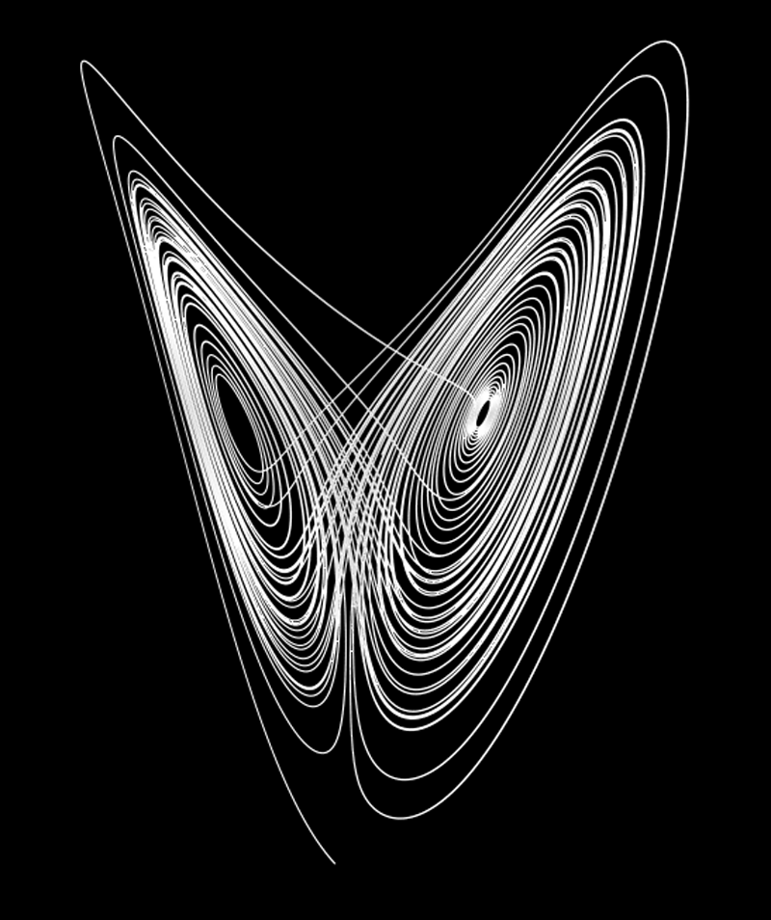
AIM & ACCOMPLISHMENT
AIM:
Program the Atmega328 to solve a nonlinear ordinary differential equation (Lorenz Attractor)
ACCOMPLISHMENT
Implement IEEE 32-bit floating-point functions onto the Atmega328
Implement the MCP4725 using I2C
Display the Lorenz Attractor onto the oscilloscope (XY)

Slide 3
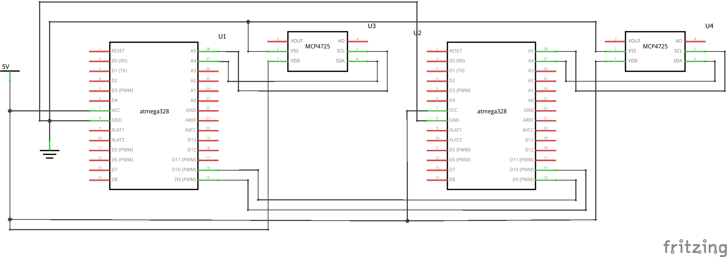
SCHEMATICS
Complete schematics

Slide 4
DESIGN STAGES
Components
ATMEGA328
MCP4725
Interfaces
Atmega328 – MCP4725 using I2C

Slide 5
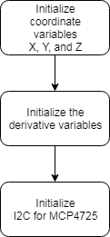
CODE DEVELOPMENT
Initialization
X, Y, and Z variables
DX, DY, and DZ variables
I2C for MCP4725

Slide 6
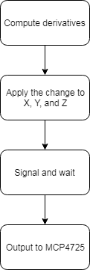
CODE DEVELOPMENT
Main loop
Solve for DX, DY, and DZ
Update change to X, Y, and Z
Convert floating-point to a binary number
Signal other Atmega328 that it’s ready
Wait for other Atmega328 to signal back
Output value to the MCP4725

Slide 7
DEMO SNAPSHOT/VIDEO
https://youtu.be/JO0ZHgcQKNw
https://youtu.be/H1mcc7StECk
https://youtu.be/s76RwIs8h-8
https://youtu.be/EKD-3kn4Iw8
https://youtu.be/ubKsdY5YW7M

