Slide 1
Lorenz Attractor
Bryan Takemoto
takemb1@unlv.nevada.edu

Slide 2
AIM & ACCOMPLISHMENT
AIM:
Program the Atmega328 to solve a nonlinear ordinary equation (Lorenz Attractor)
ACCOMPLISHMENT
Implement IEEE 32-bit floating-point functions onto the Atmega328
Implement the MCP4725 using I2C
Display the Lorenz Attractor onto the oscilloscope (XY)

Slide 3
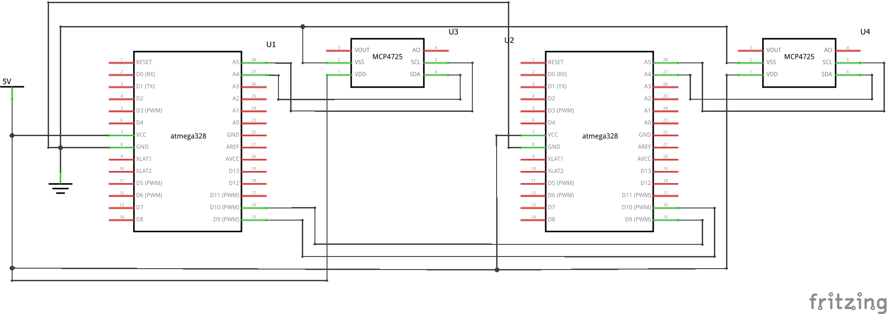
SCHEMATICS
Complete schematics

Slide 4
DESIGN STAGES
Components
ATMEGA328
MCP4725
Interfaces
Atmega328 – MCP4725 using I2C

Slide 5
CODE DEVELOPMENT
Initialization
Init ..
Data Collection
Networking/Visualization

Slide 6
DEMO SNAPSHOT/VIDEO
Just Provide Links

Slide 7
Group Projects
Student Name:
Task Completed:
Contribution % towards the project:
Coding (%):
Implementation (%):
Testing/Demo (%):
Documentation (%):
Presentation (%):

Slide 8
Group Projects
Student Name:
Task Completed:
Contribution % towards the project:
Coding (%):
Implementation (%):
Testing/Demo (%):
Documentation (%):
Presentation (%):

