Slide 1

PURCHASE PREDICTION
&
PRODUCT RECOMMENDATION ON BLACK FRIDAY SALES
DATASET
Akashdeep Balu(HC6943)​
Bharath Janapareddi(HC4765)​
Kavya Nagaraju(HC3344)​
Priyanka Patil(HC6653)​
Tejaswi Gundapaneni(GZ5527)​
​

Slide 2


Background
The day after Thanksgiving in the U.S. is called Black Friday and serves as the traditional start to the holiday shopping season.
It is known for deep discounts (e.g., doorbusters), Black Friday shopping manifests adventure, competition and urgency around getting great deals.
Although Cyber Monday is gaining popularity, Black Friday shopping continues to be popular because of an abundance of doorbuster deals, instant gratification, and the benefit of social shopping.

Slide 3
Motivation
Black Friday sales in US still accounts for a whopping $9.4 Billion in revenue.
In order to compete with Online Shopping Platforms, Brick and Mortar based Retailers need to figure out how to boost Sales during the most important Shopping Day of the Year.
By understanding the Purchase Patterns of the Customers Retailers can provide improved Service Quality.
Improve Staffing and Inventory of the Retail Store.
Provide suggestions to the retail store on which segment, demographic and city category the store can focus its marketing efforts on.
Increase Revenue and Sales.

Slide 4
Build Machine Learning models that can predict how much a Customer is likely to spend on the eve of Black Friday.
To increase the revenue of the store by recommending items to customers based on their previous purchases
Find out the Average Purchases of the Customers based on City Category.
Reveal and Understand the most important factors from predictors such as Age, Gender, City etc., that influence the spending of a Customer.
Objectives

Slide 5
Dataset
The Dataset comprises of 550068 observations about the Black Friday in a retail store.
It contains various kinds of variables either Numeric or Categorical in nature.
The dataset contains 2 columns with missing values and are excluded from this analysis:
173638 observations missing in column ‘Product_Category_2’.
383247 observations missing in column ‘Product_Category_3’.

Slide 6
The data set is cleaned from the original dataset.
Excluded Product_Category_2 and Product_Category_3 from the analysis.
Name​ | Data Type​
User_ID​ | Integer​
Product_ID​ | Factor​
Gender​ | Factor​
Age​ | Factor​
Occupation​ | Integer -> Factor​
City_Category​ | Factor​
Stay_In_Current_City_Years​ | Factor​
Marital Status​ | Integer -> Factor​
Product_Category​ | Integer -> Factor​
Purchase​ | Integer​
Pre-processing
&
Dataset Description
Renamed Product_Category_1 to Product_Category. ​
The clean Black Friday data set yields 550,068 entities observed for each of the 10 variables.

Slide 7

Exploratory Data Analysis
Given the cleaned Black Friday data set, the retail store has 5,891 shoppers making purchases.
Of the total shoppers at all the stores on Black Friday, about 72% of the shoppers are men and the remaining 28% of shoppers are women.
The skewness of the gender of shoppers might lead to a larger total revenue for male than that of female.

Slide 8
By City Category
Product Revenue = Sum(Purchase)
No. Distinct Shoppers = Distinct(User_ID)
Avg. Purchase per Shopper = Product Revenue / No. Distinct Shoppers
Number of product = n(Product_ID)
Avg. unit Price per product = Product Revenue / Number of product
Product per Shopper = Number of product / No. Distinct Shoppers
Calculations

Slide 9
Exploratory Data Analysis
The retail store has 5,891 shoppers making purchases, 3,631 products sold in store and total revenue of $5,095,812,742.
City C attracts the most unique shoppers, 3,139; which is larger than the number of shoppers in cities A and B combined.
The total revenue brought by city C residents, approximately 1.64 billion dollars, falls in between cities A ($1.3 billion) and B ($2.1 billion).
However, the average purchase per unique shopper in city C is $530043.80, which is much smaller than cities A and B.

Slide 10
Calculations
By Product Category
Product Revenue = Sum(Purchase)
Product Sold = n(Product_ID)
Unit Price = Product Revenue / Product Sold

Slide 11
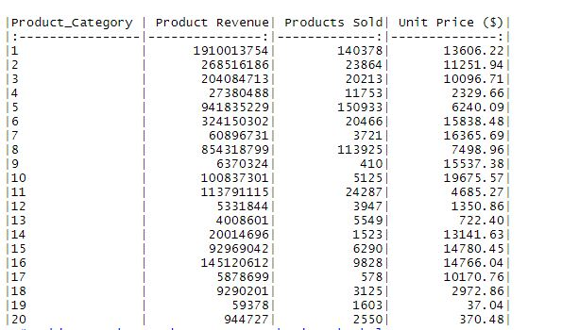
Exploratory Data Analysis
Analyzing the average unit price of each product category
The maximum average price is $19,675.57 for products in Category 10 while the minimum price is 722.40 dollars for category 13.
Category 5 sells the most products, 150,933 items, while category 9 sells the least number of products, 410 items.

Slide 12
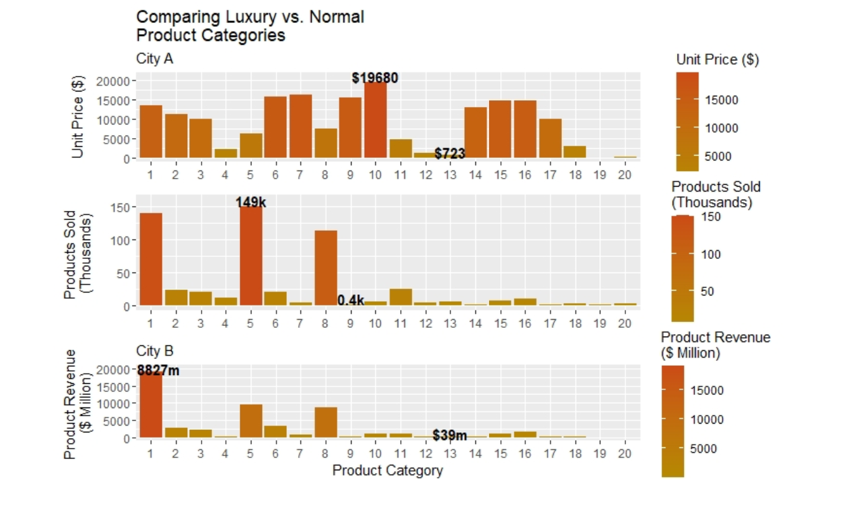
Exploratory Data Analysis
On average, product categories 1, 5 and 8 are the most popular product categories amongst shoppers. Category 12 and 13 yield the least revenue per shopper.
Normal products are those in categories with low unit prices and sell a high quantity of items whereas product categories with higher average unit price sell smaller quantities of products refer to luxury products. This initial analysis indicates managers should focus their attention on the product categories that sell normal goods - categories 5 and 8.
This allows us to understand the average shopper’s purchasing habits by product category.

Slide 13
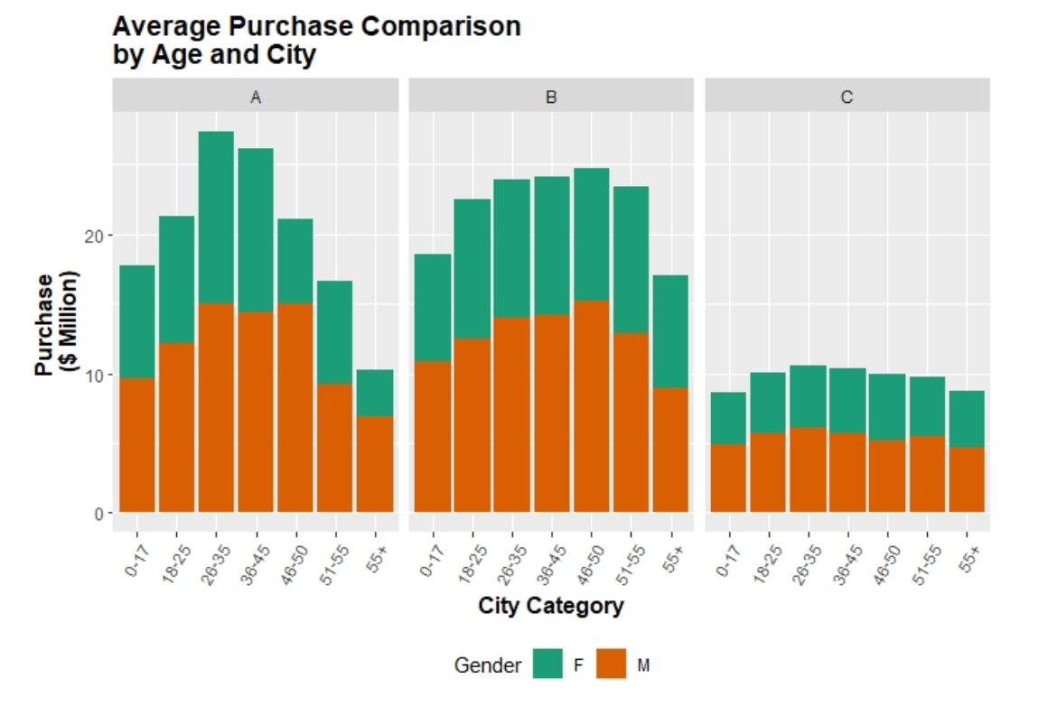
Exploratory Data Analysis
The graph depicts purchasing habits/revenue by age and gender in all the city categories.
Male shoppers buy more than their female counterparts in all age groups and all cities.
The data portrays a trend of purchasing habits - men purchase significantly more than women in age groups 18-25, 26-35 and 36-45.
Across age groups, shoppers in City C purchase the least regardless of age.

Slide 14
Average Purchase of the Customer Based on Cities
Hypothesis testing is used to assess the plausibility of a hypothesis by using sample data.
Alternate Hypothesis - People living in City A spend more than their peers in City B and C.
The variables Shopper Purchase, City_Category, Gender and Age are selected to conduct a two-sample t-test.
Based on the categorical nature of City_Category, Gender and Age, the two-sample t-test was chosen.

Slide 15
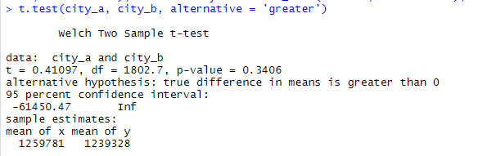
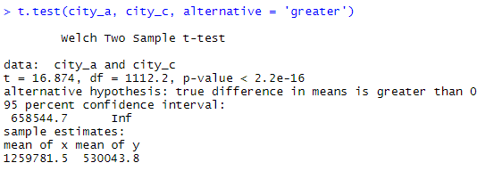
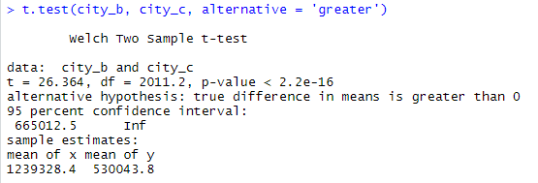
In this test, the results yield that shoppers in city A did not spend significantly more than their peers in city B but did spend more than peers in city C. Shoppers in city B spent significantly more than their peers in city C.​
The results also indicate shoppers in city C spend significantly less than cities A and B.
Two-Sample
T-Test
Therefore, the shopping habits of customers in city A are significantly different from the remaining cities. ​
The stores can focus more on learning the spending habits in city C to further understand factors that may lead to the low purchases in city C.​

Slide 16
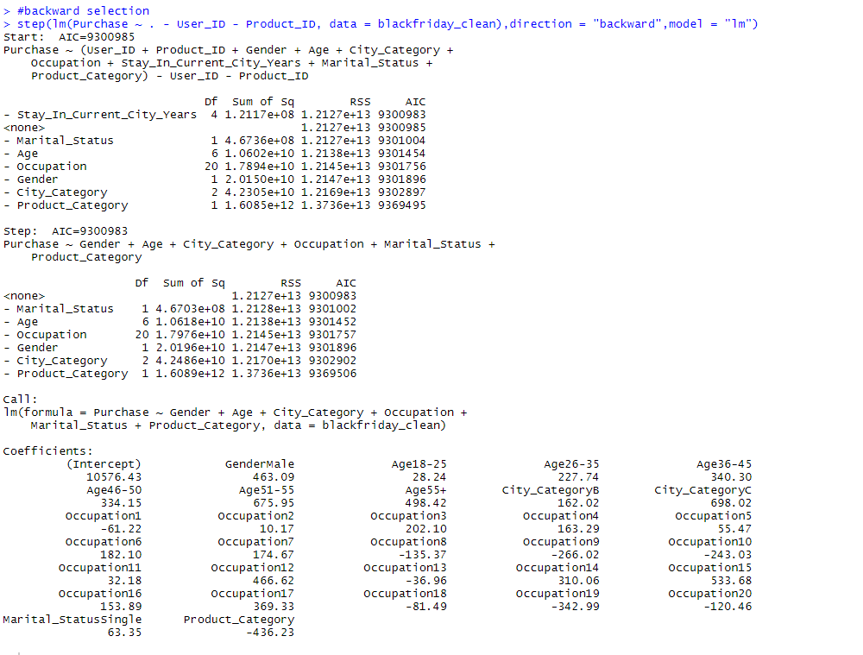
Multiple predictors might overfit the model.
Also, less predictors cause underfit of the model.
To overcome these issues Backward selection has been implemented.
Backward Selection

Slide 17
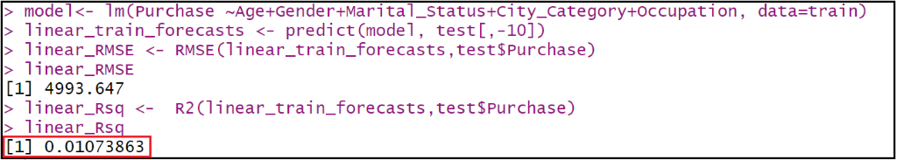
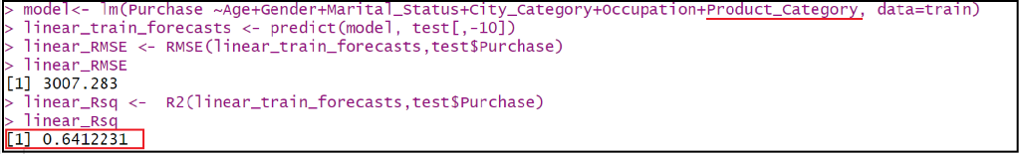
Linear model is implemented to determine the Purchase amount based on the variables Age, Gender, Marital status, Occupation, City category and Product category.
Linear Regression
Accuracy Improvisation
Initially we implemented the model with the predictors as Age, Gender, Marital status, Occupation, City category and got an accuracy of 1%
On adding the Product category to the model, performance was improved drastically from 1% to 64%.

Slide 18
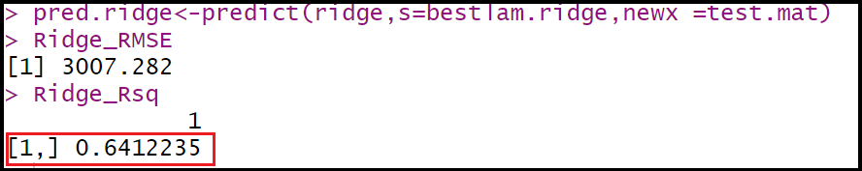
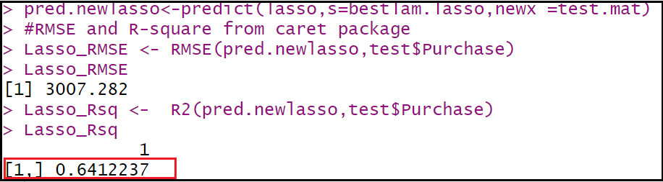
Ridge and Lasso Regression have been performed on the predictors Age, Gender, Marital status, Occupation, City category and Product category to determine the Purchase amount.
We have created training matrix and testing matrix.
If alpha=0 then a Ridge regression model is ﬁt, and if alpha=1 then a Lasso model is ﬁt.
Ridge
&
Lasso
Regression
Ridge Regression
Lasso Regression

Slide 19
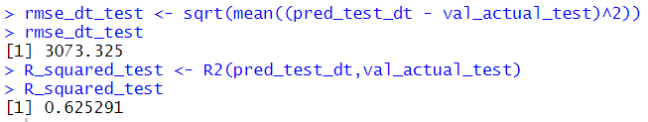
Decision tree model is implemented to determine the Purchase amount based on the variables Age, Gender, Marital status, Occupation, City category and Product category.
Decision Tree
Since our response variable is continuous value, we are using CARTs (Classification and Regression Trees).
From all our regression models, we could conclude Product Category is an important variable and it plays a huge role in predicting purchase amount.

Slide 20
 | TRAIN |  | TEST
Models​ | RMSE​ | R-square​ | RMSE​ | R-square​
Decision Tree Regression | 3081.557 | 0.6237949 | 3073.325 | 0.625291
Linear Regression​ | 3016.13​ | 0.6396003​ | 3007.286​ | 0.6412231​
Ridge Regression​ | 3016.13​ | 0.6396003​ | 3007.282​ | 0.641235​
Lasso Regression​ | 3016.131​ | 0.6396003​ | 3007.282​ | 0.6412237​
Regression
Results
Although, there was no major improvement on the performance of regression models from Linear to Lasso, there is a very slight increase in the Lasso Regression with the accuracy of 0.6412237.

Slide 21
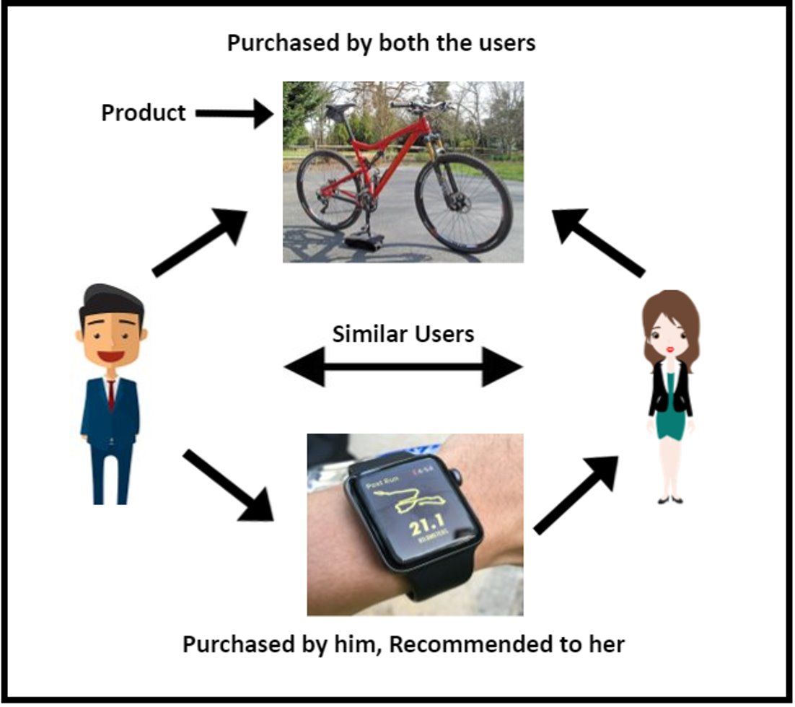
Product
Recommendation
Products are recommended to user based on the purchase habits of similar user(s).

Slide 22
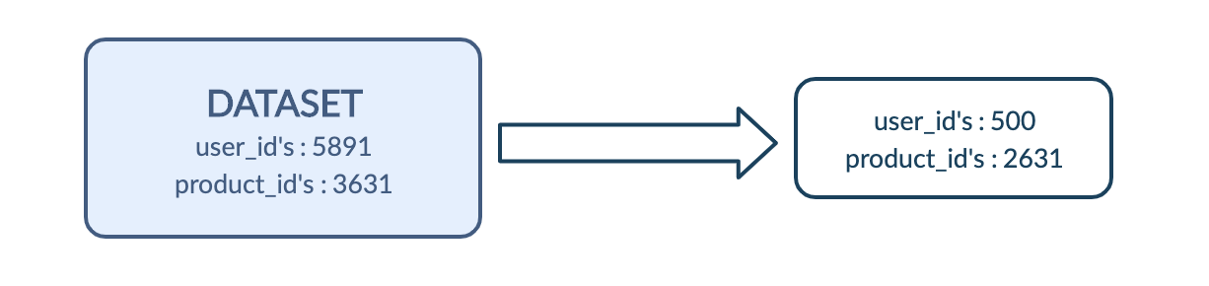
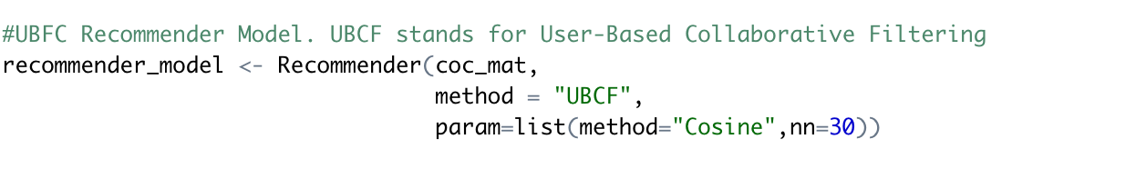
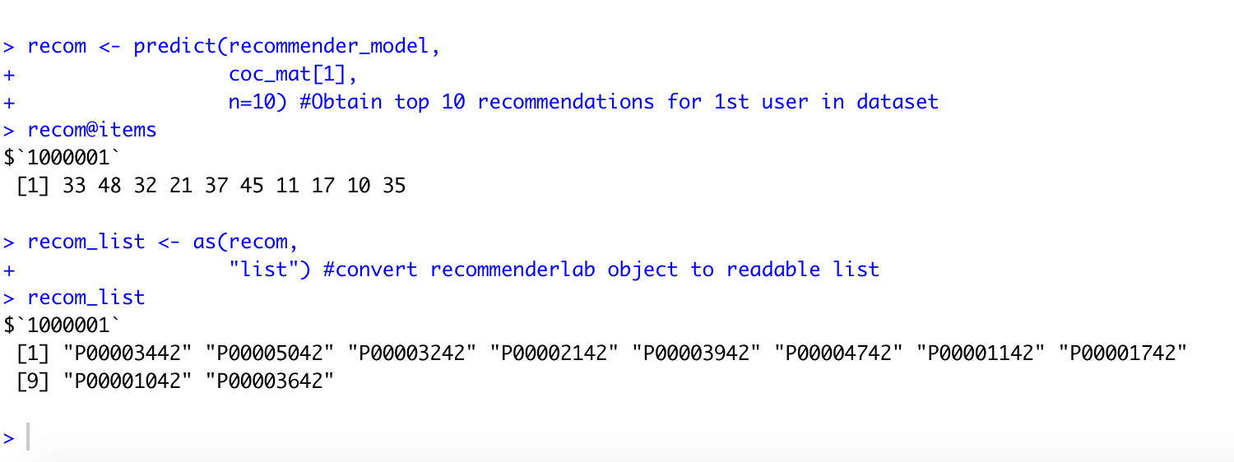
Product
Recommendation
A subset of 500 users is chosen from original dataset.
These users have purchased 2631 different products.
A recommender model is used with method UBFC to make recommendation.
Model computes the similarity matrix between users using cosine method.
Top 10 products are recommended to user.

Slide 23
Conclusion
All the above strategy suggestions should be factored into the marketing budget.
Such strategies can come in the forms of promotions, campaigns, increasing price and/or slashing the markup of some products in order to make products affordable.
Doing so, the managers can still focus on the above segment of shoppers and maintain, if not increase, purchasing habits.

Slide 24

Questions?

Slide 25

Thank You

