Slide 1

FACILITY/ WAREHOUSE LOCATION
OPERATION RESEARCH FINAL PROJECT
BY :- AKASHDEEP BALU
DATE :- 14/ OCT/ 2020

Slide 2
PROBLEM STATEMENT
An E-Commerce Company is planning to install its 8 facilities/warehouses based on 14 demand points in an area. The company has chosen a set of potential facility sites where a facility can be opened, and a set of demand points that must be serviced. The warehouses are given on annual lease and has limited capacity. The goal is to pick a subset of facilities to open, to minimize the sum of distances from each demand point to its nearest facility, plus the sum of opening costs of the facilities.

Slide 3
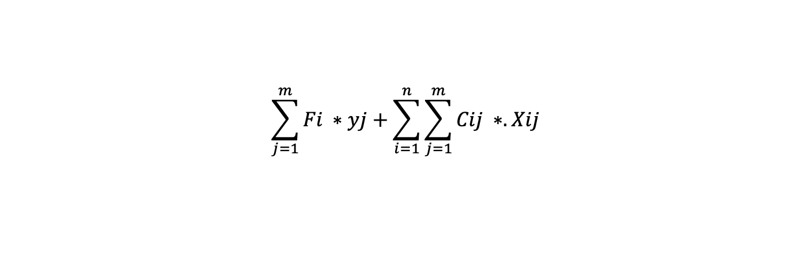
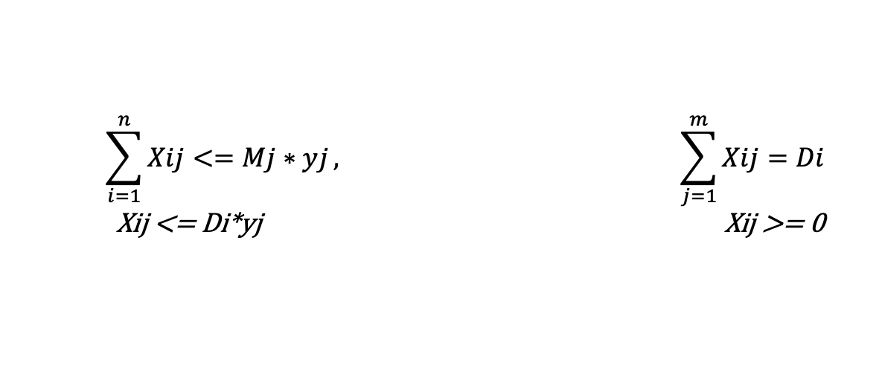
MODEL STRUCTURE
PARAMETERS
I= demand points F[j]= yearly activation cost C[i][j]= transportation cost
J= facilities. D[i]= annual demands M[j]= warehouse capacity
DECISION VARIABLES
𝑦[𝑗]∈{0,1} …. 1 if opening a facility/ warehouse otherwise 0.
CONSTARINTS
OBJECTIVE
Minimize
$$\sum_{i=1}^{n}{Xij<=Mj∗yj}, \sum_{j=1}^{m}{Xij=Di}$$
Xij <= Di*yj Xij >= 0
$$\sum_{j=1}^{m}{Fi ∗yj+\sum_{i=1}^{n}{\sum_{j=1}^{m}{Cij ∗. Xij}}}$$

Slide 4
Results
Customers i | 1 | 2 | 3 | 4 | 5
Annual demand Di | 80 | 270 | 250 | 160 | 180
Facility j | C ij |  |  |  |  | F j | M j
1 | 4 | 5 | 6 | 8 | 10 | 1000 | 500
2 | 6 | 4 | 3 | 5 | 8 | 1000 | 500
3 | 9 | 7 | 4 | 3 | 4 | 1000 | 500
Here I have created a small dataset to Implement integer programming model discussed before
* Implementation to original data and sensitivity, scenario analysis is pending.
Below Table has result for the problem. Yj=1 represents the establishment of the facilty / warehouse at the chosen location and 0 represents no warehouse needed. The volume transported matrix tell us how much material is transported from jth facility to ith demand point. Demand point 3. is served by both facility 2. and 3.
The optimal cost of the process is 5610.
Demand points/ facility | 1 | 2 | 3 | 4 | 5 | Yj
facility | Volume transported
1 | 0 | 0 | 0 | 0 | 0 | 0
2 | 80 | 370 | 150 | 0 | 0 | 1
3 | 0 | 0 | 100 | 160 | 180 | 1

Slide 5
THANK YOU

