Slide 1

Intern Projects

Slide 2

Project1: Assembly

Slide 3
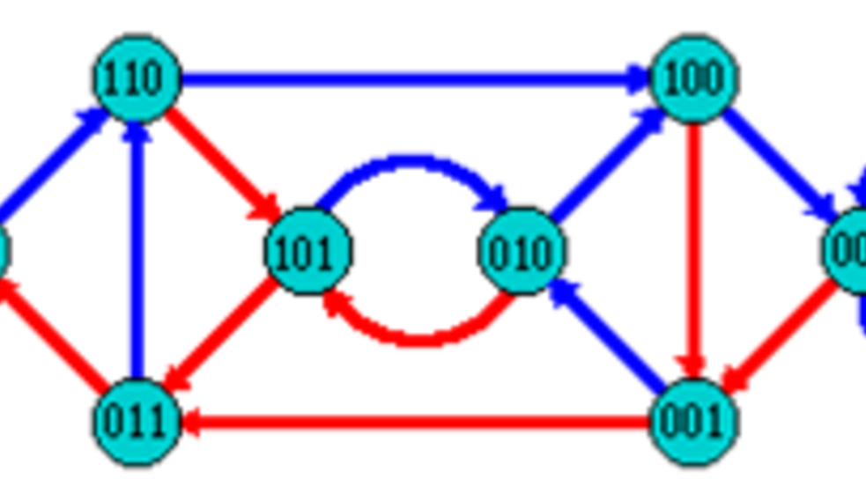
De Bruijn Graph
.

Slide 4
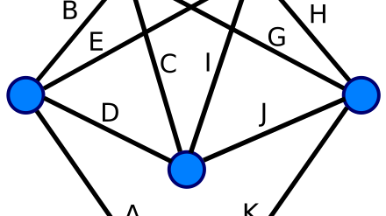
Eulerian Path

Slide 5




Slide 6

Project2: Columns Game

Slide 7

Arrow up -> right rotation
Arrow down -> left rotation
Arrow left -> left shift
Arrow right -> right shift
Space -> drop
P -> pause
Refresh -> refreshed the game
Quit -> quit the game

Slide 8
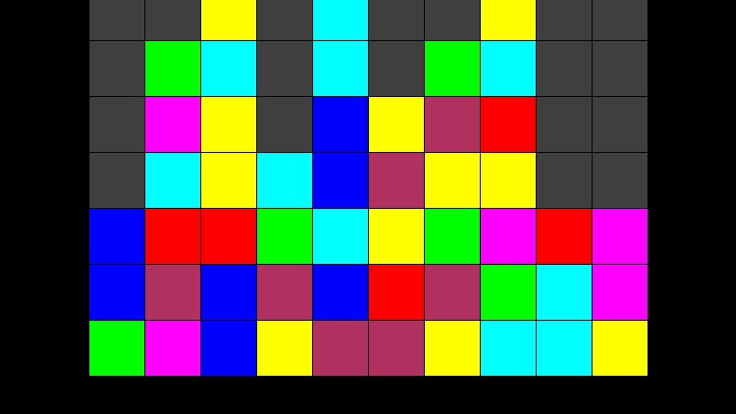
GamePlay

Slide 9
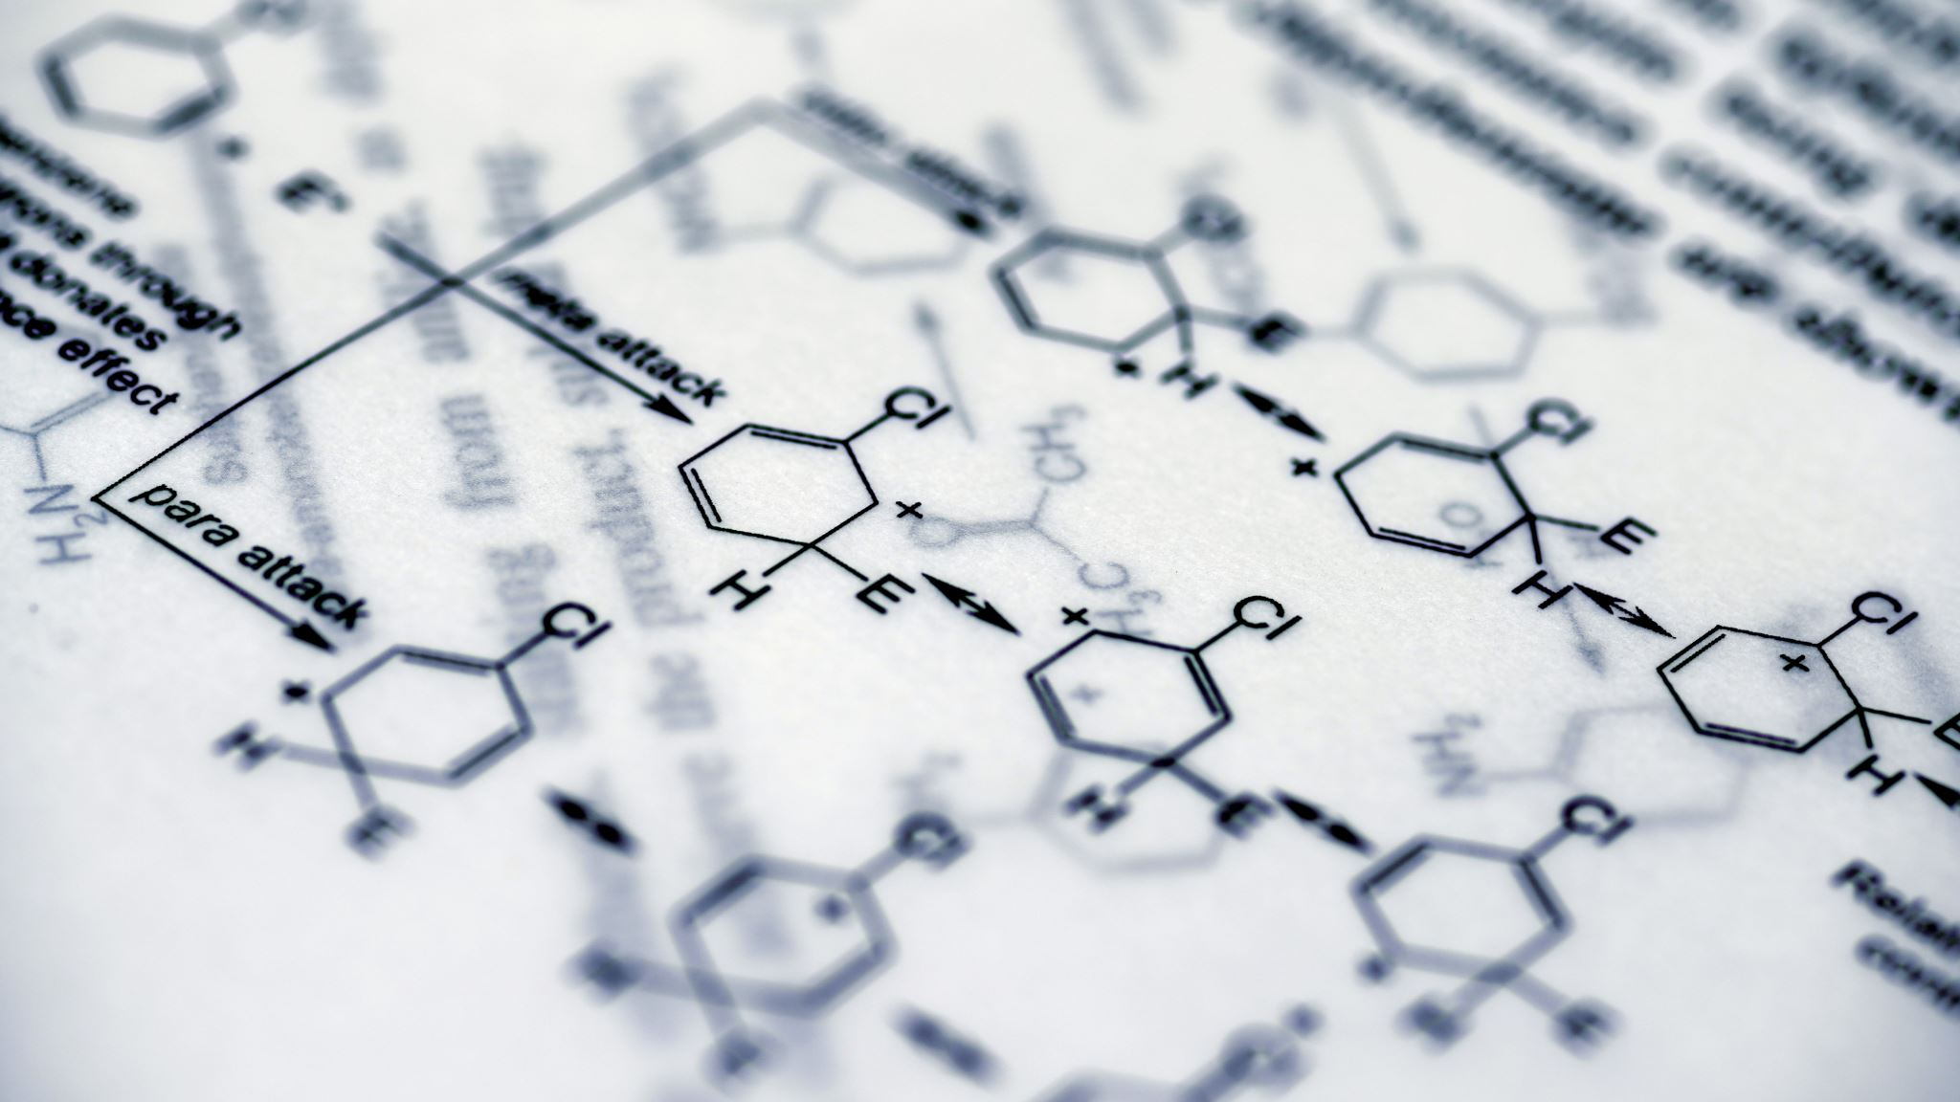
Project3: Peptides

Slide 10
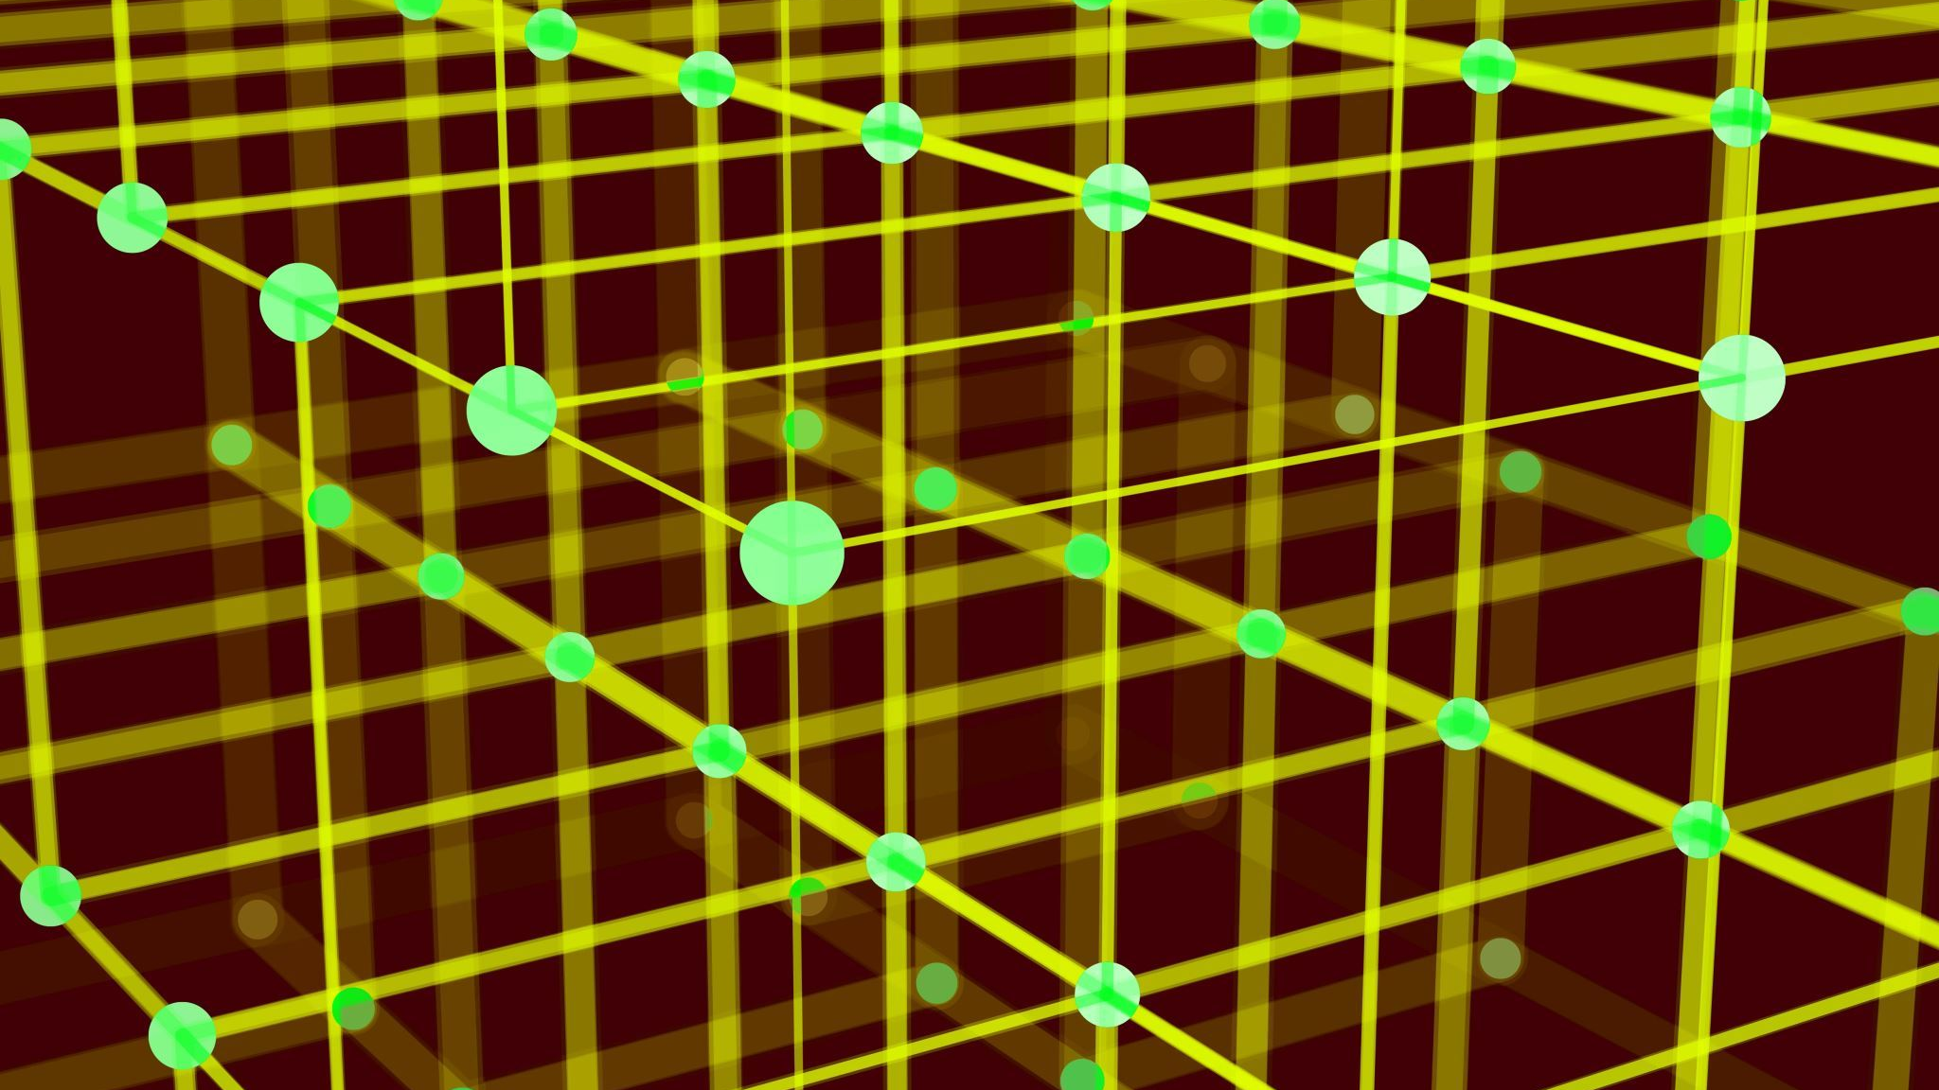
Algorithms
Approach 1:
use k-mers as we did before to find duplicates. Generate all k-mers (8-mers in our case) from long protein, put them into dictionary (Map<k-mer, position>) and then take peptides from library one by one and check whether it is in the map. If so, fetch matching k-mer’s position and put into a list for the peptide.
Approach 2:
Reverse compared to 1st one. Put peptides into a Map (Map<peptide, list of positions>) and then take k-mers from long protein one by one, sliding 1 position to the right every time. Then check whether the current k-mer is in the Map of peptides. If so, put k-mer’s position into a list of positions for the peptide.
Approach 3:
Generate map of peptides as long integers and re-apply approach 2: for each k-mer convert it into a long integer and search for it in a Map of peptides.
Approach 4: use Binary Search!
Instead of using Map of peptides just put their long integer representation into an array of longs and sort it.Then search for each k-mer in the array.

Slide 11

Project4: Picard tools

Slide 12

Multi Threading = Performace improvement

Slide 13
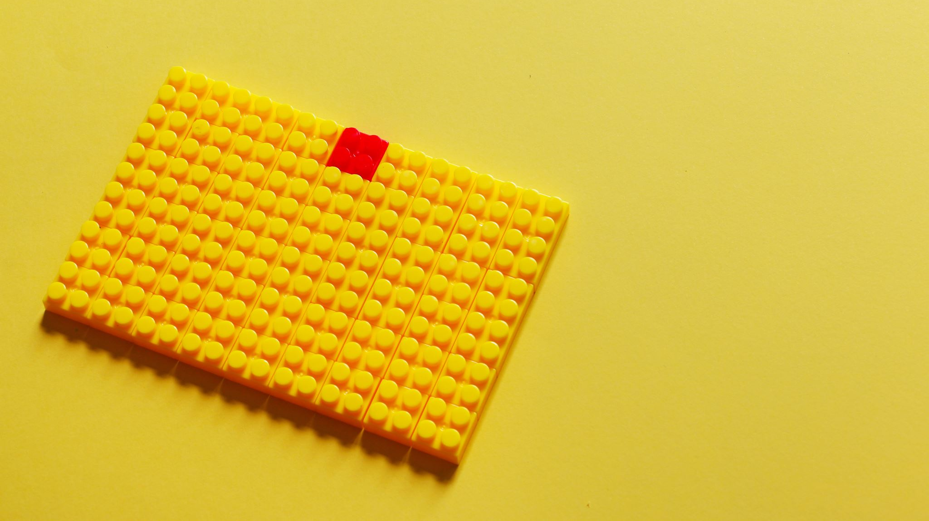
Project5: Tetris

Slide 14
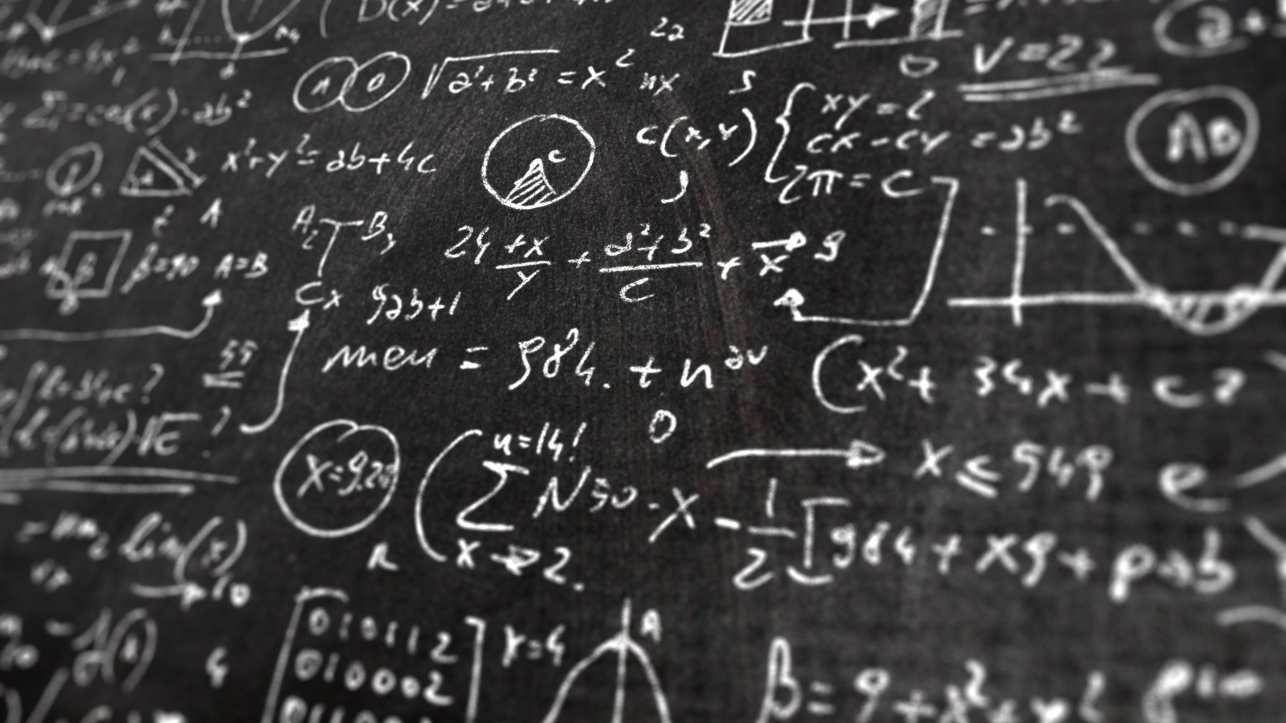
Description
0. add all figures from classic tetris
1. implement rotate (arrow up)
2. implement drop (arrow down)
3. implement full row removal from the field
4. implement game over
5. add score calculation and visualization
6. add difficulty level support (increase speed of the game when score reaches some limits)
7. use LibGDX

Slide 15
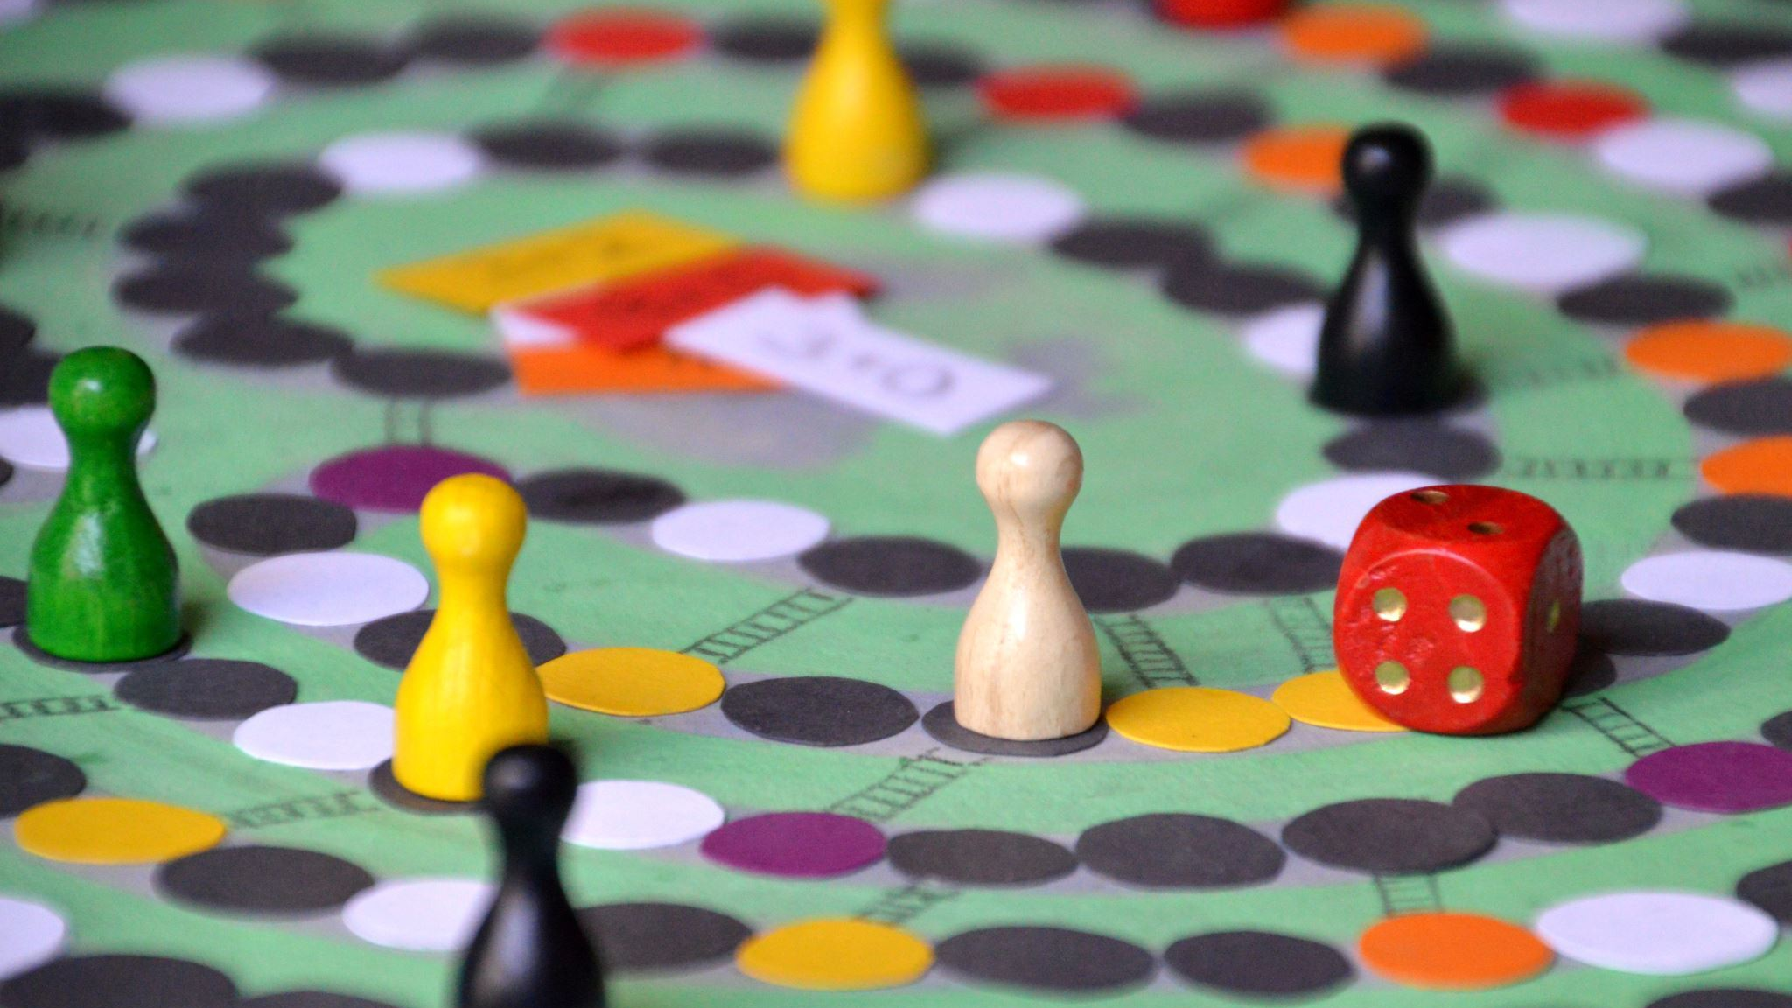
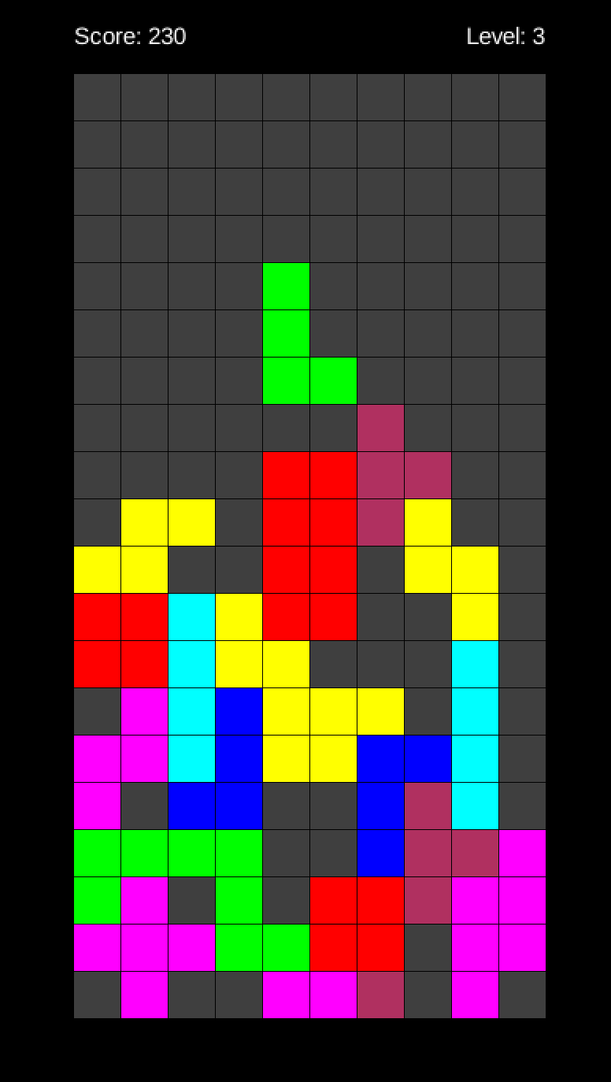
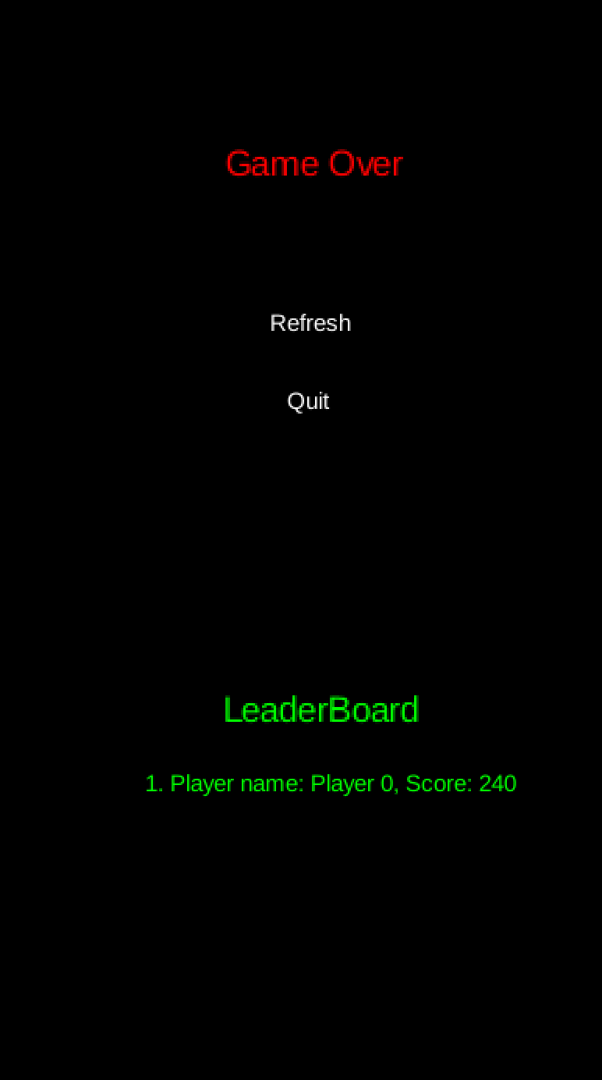
Game Play

Slide 16

Thanks for watching

