Slide 1




“Gemicates” a small intro………
A ENERGY Division……

Slide 2

MissioN: . Mission:Goalsandobjectives provide a road map that helps keep your organization on track; they keep your efforts focused on providing the greatest possible value to
Vision 1. Project five to ten years into the future. 2. Determine your purpose and position as an organization. 3. Describe what success looks like in your operations. 4. Consider your company type and structure. 5. Reference your competitors or create an analogy. 6. Describe a measurable goal

Slide 3

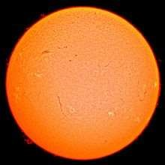
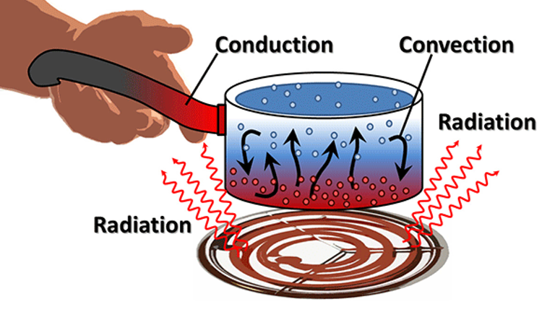
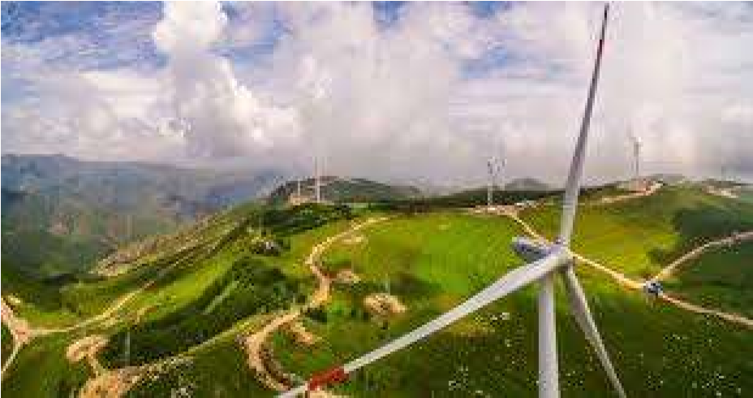

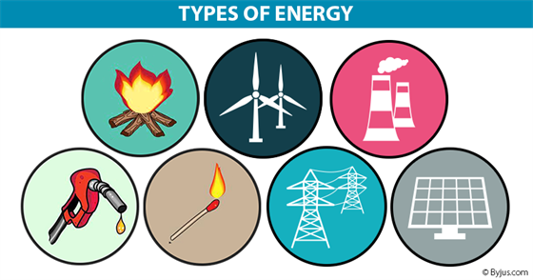
A energy small intro…
Basic forms of energy include:
Kinetic energy - energy of an object in motion, which acts as the capacity to undergo change in position over time. Potential energy - stored energy, which acts as the potential to do work. Heat - thermal energy which is used to vibrate atoms and molecules.

Slide 4
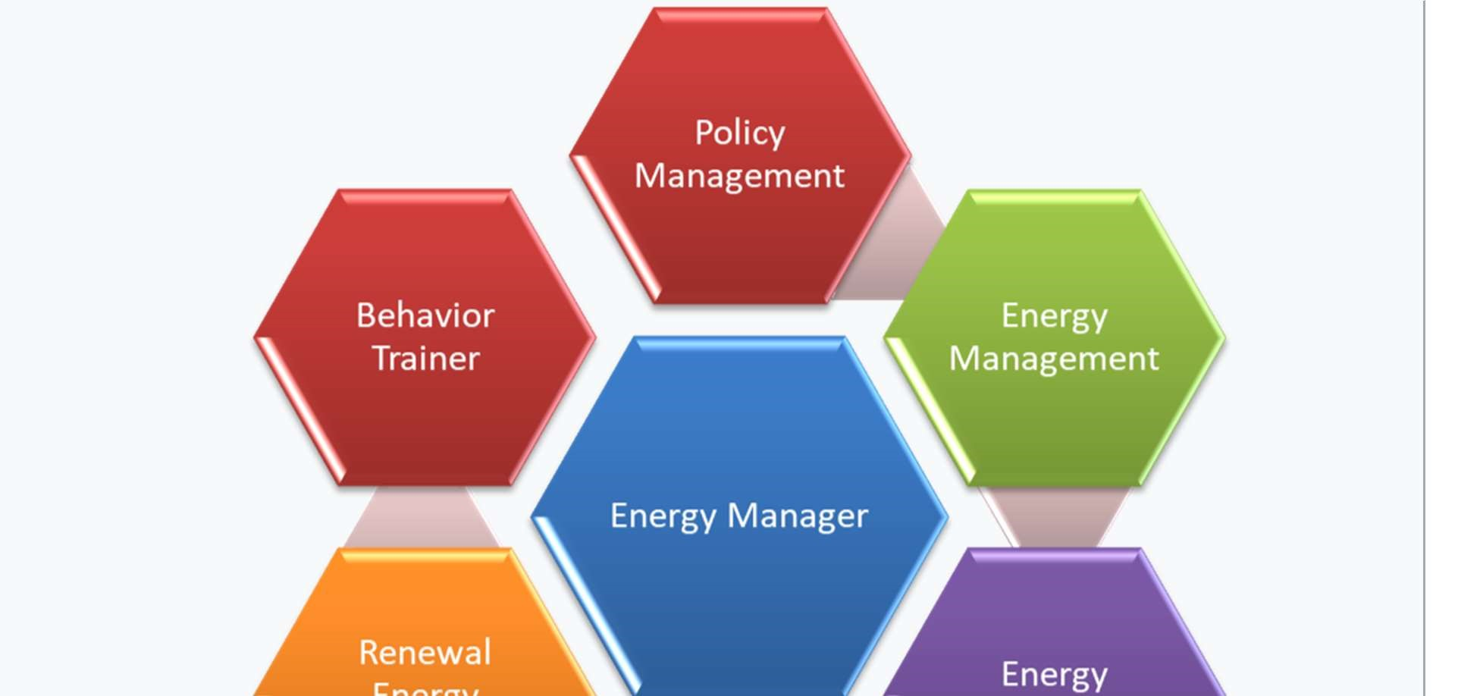

ENERGY Manager:
Energy

Slide 5
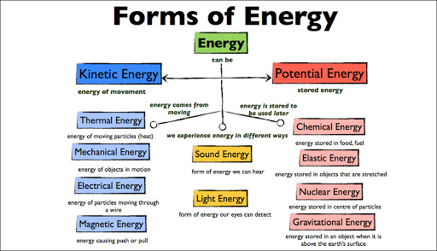
Forms of energy:

Slide 6
Type of energy with Description
Mechanical
the sum of macroscopic translational and rotational kinetic and potential energies
Electric
potential energy due to or stored in electric fields
Magnetic
potential energy due to or stored in magnetic fields
Gravitational
potential energy due to or stored in gravitational fields
Chemical
potential energy due to chemical bonds
Ionization
potential energy that binds an electron to its atom or molecule
Nuclear
potential energy that binds nucleons to form the atomic nucleus (and nuclear reactions)

Slide 7
Chromo dynamic
potential energy that binds quarks to form hadrons
Elastic
potential energy due to the deformation of a material (or its container) exhibiting a restorative force
Mechanical wave
kinetic and potential energy in an elastic material due to a propagated deformational wave
Sound wave
kinetic and potential energy in a fluid due to a sound propagated wave (a particular form of mechanical wave)
Radiant
potential energy stored in the fields of propagated by electromagnetic radiation, including light
Rest
potential energy due to an object's rest mass

Slide 8
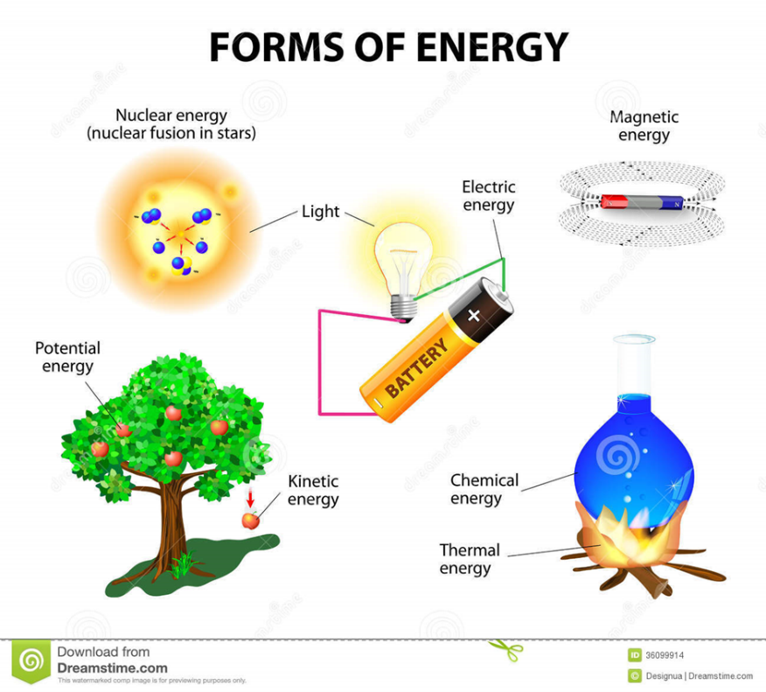
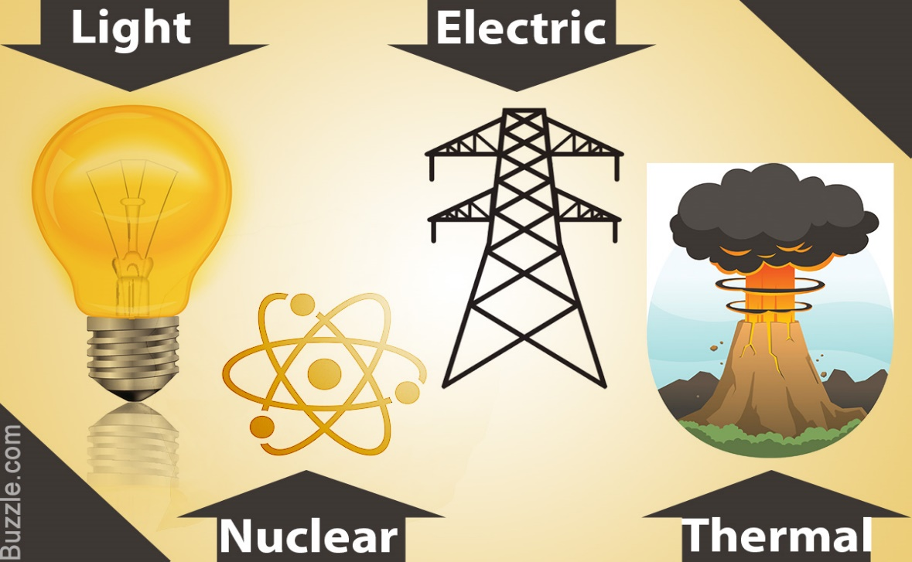
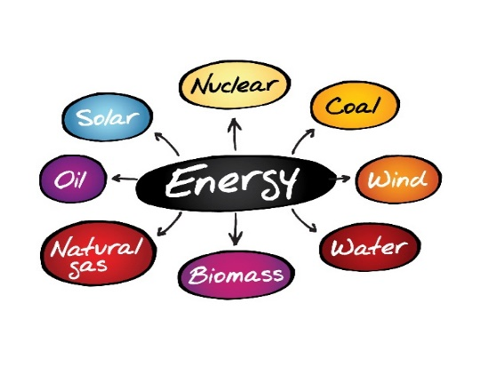
FORMS OF ENERGY & their conversion..

Slide 9

Providing Services For

Slide 10


Slide 11
Milestones
EHS POLICY
We are fully committed to operate safely and develop healthy and clean environment to shield key human resources, plant, machinery, and ensuring safe working practises towards achieving accident free work environment.
OUR SAFETY
SRES operates with the objective of “Safety of All” for employees, customers, and environment by working with great work-ethics.

Slide 12
Our Success Sites
Our Success Sites

Slide 13
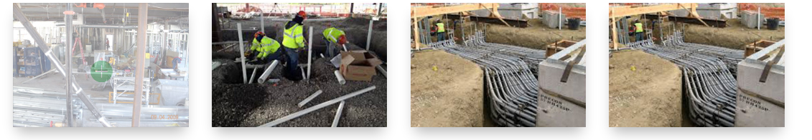
Work place:

Slide 14
Admin cum RnD office:
Manufacturing & Assembling :
Global Presence:
Mail Id:
Registered Office:
Gemicates Technologies Pvt Ltd having its office at 11/6, Sundareshwarer Koil Street, Saidapet, Chennai – 600015.

