Slide 1
CGB1201 – JAVA PROGRAMMING PROJECT REVIEW-2
Department of Computer Science and Engineering
Academic Year: 2024 – 2025 (Odd Semester)
Register Number : 8115U23AM005
Name : AKALYA K
Year : II
Semester : III
Date : 25/11/24

Slide 2
Title of the Project
REAL TIME ATTENDANCE TRACKING

Slide 3
Abstract
The Real-Time Attendance Tracking System is an automated solution designed to efficiently manage and monitor attendance for schools, workplaces, and events. Using technologies like biometrics, RFID, or facial recognition, the system records attendance instantly and securely. It features real-time updates, cloud-based data storage, and seamless integration with existing systems like HR and payroll. The system generates detailed reports, provides actionable insights, and reduces manual errors, ensuring transparency and efficiency. This project aims to streamline attendance management, enhance accuracy, and save administrative time for organizations.

Slide 4
Introduction
A Real-Time Attendance Register is an innovative solution designed to efficiently record and manage attendance in various settings such as schools, workplaces, events, or conferences. Leveraging modern technologies, this system ensures accurate and instant tracking of attendance, replacing traditional manual processes that are prone to errors and inefficiencies.

Slide 5
Java Programming - Concepts Used
Object-Oriented Programming (OOP):
Encapsulation: Restricts access to certain parts of an object, ensuring data security
using access modifiers
Inheritance: Enables a class to inherit properties and methods from another class.
Polymorphism: Allows objects to be treated as instances of their parent class, enabling
method overriding and overloading.
Class and Object: A class is a blueprint for objects, and an object is an instance of a class..
Abstraction: Focuses on exposing only essential details using abstract classes and
interfaces.

Slide 6
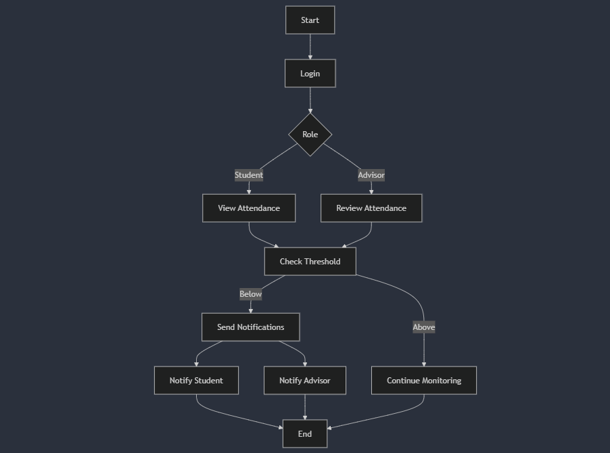
Proposed Architecture

Slide 7
Proposed Architecture - Description
1. User Interaction Layer (Front-End)
Technology: Angular, React, or Vue.js for admin dashboards and reporting tools
2. Data Collection Layer
Technology :IoT-enabled biometric devices integrated with AWS IoT Core.
3. Edge Processing Layer
Technology:AWS IoT Greengrass to enable local processing of data from biometric scanners and reduce latency.

Slide 8
Proposed Architecture - Description (Cont..)
AWS IoT Core for reliable and low-latency message transport.
4. Data Transport Layer
Technology : Amazon API Gateway for RESTful APIs.
5. Backend Processing Layer
Technology: AWS Lambda for serverless processing of incoming attendance data.
6. Data Storage Layer
Technology : Amazon S3 for archiving logs or historical data.

Slide 9
List of Modules
Student Module
Advisor Module
Attendance Tracker Module
Notification Service Module

Slide 10
Module Description
Student Module:
Represents a student and manages their attendance records.
Advisor Module
Represents an advisor responsible for monitoring student attendance.
Attendance Tracker Module
Manages attendance for all students and advisors..

Slide 11
Module Description (Cont..)
Notification Service Module
Handles sending notifications to students and advisors when attendance falls below the threshold.

Slide 12
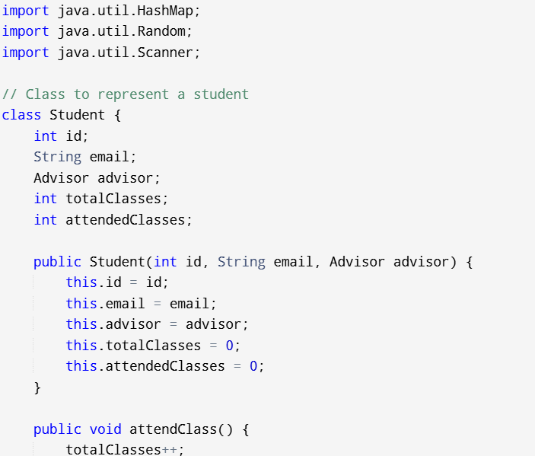
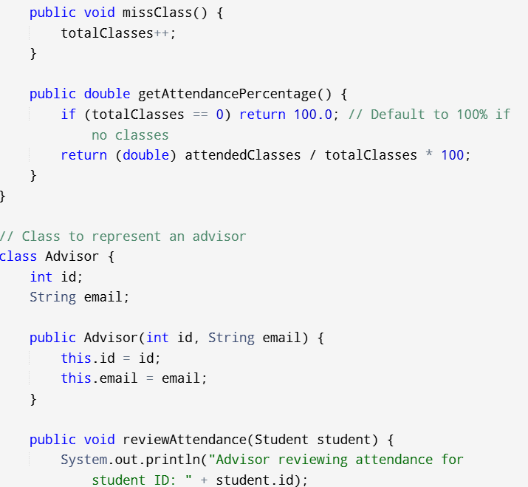
Results and Discussion

Slide 13
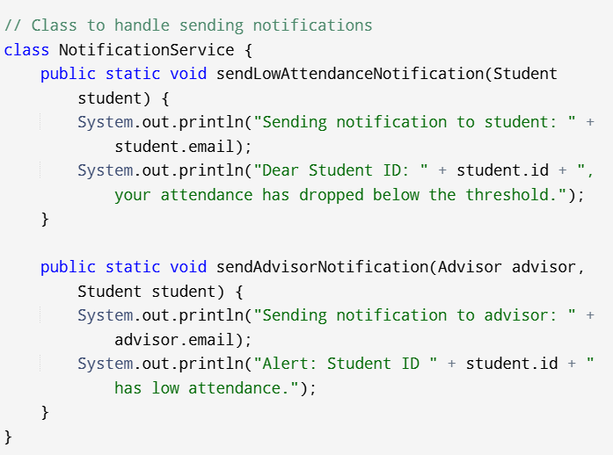
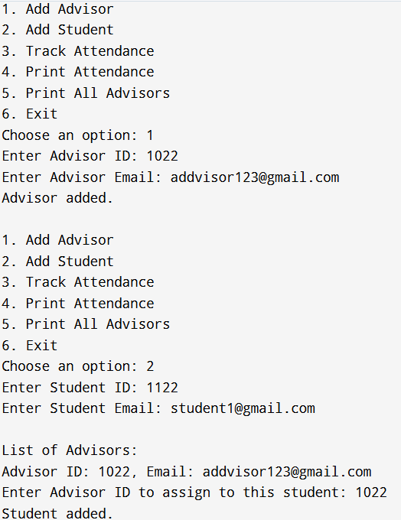
Results and Discussion (Cont..)

Slide 14
Conclusion
The Student Attendance Management System developed using Java provides a robust and scalable solution for efficiently tracking student attendance in real time. The system automates key processes, including attendance tracking, threshold notifications, and advisor reviews, ensuring a seamless experience for students and advisors alike. By automatically notifying students when their attendance falls below a predefined threshold, the system fosters accountability and encourages timely corrective action. Advisors can easily monitor attendance patterns, identify at-risk students, and intervene when necessary, thereby enhancing overall academic engagement.

Slide 15
Thank You
Any queries???

