Slide 1
Enterprise Programmering 1 Lesson 02: JPA
Dr. Andrea Arcuri
Westerdals Oslo ACT
University of Luxembourg

Slide 2
About these slides
These slides are just high level overviews of the topics covered in class
The details are directly in the code comments on the Git repository

Slide 3
Relationships
Database (DB) tables can have relationship among them
Category
SubCategory
Quiz
1
*
1
*
A category can have many subcategories
A subcategory has one parent category
Same kind of relations between SubCategory and Quiz
“Links” are foreignkey constraints

Slide 4
Relationship Annotations
5 kinds of annotations
@OneToOne
@OneToMany
@ManyToOne
@ManyToMany
@ElementCollection

Slide 5
EntityManager
Object used to sync the entities with the data in the DB
Different operations
persist()
clear()
find()
contains()
merge()
remove()
etc.

Slide 6
Java Persistence query language (JPQL)
You can use EntityManager#find() to query an @Entity with a given id
But what if you need to find all quizzes in a given category?
You can of course use SQL
JPQL: similar to SQL in syntax, but works by referring directly to @Entity, and not tables in DB
JPA will translate JPQL into SQL at runtime

Slide 7
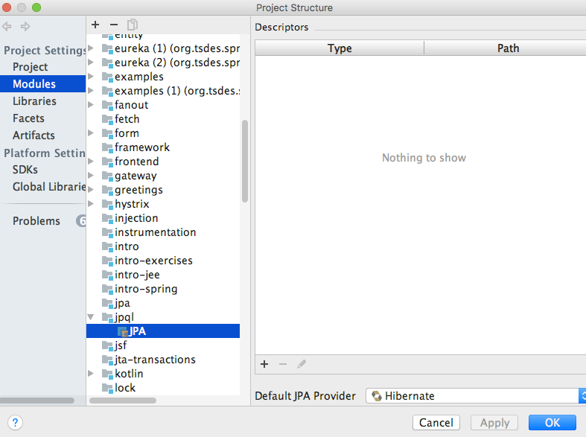
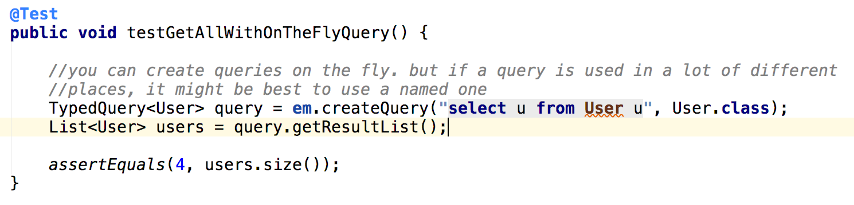
JPQL and IntelliJ
IntelliJ can automatically analyze syntax and do code completion for JPQL strings, but need configuration

Slide 8
Git Repository Modules
NOTE: most of the explanations will be directly in the code as comments, and not here in the slides
intro/jee/jpa/relationship
intro/jee/jpa/manager
intro/jee/jpa/jpql
intro/jee/jpa/fetch
Exercises for Lesson 02 (see documentation)

