Slide 1
Enterprise Programmering 1 Lesson 07: JSF
Dr. Andrea Arcuri
Westerdals Oslo ACT
University of Luxembourg

Slide 2
Web Applications

Slide 3
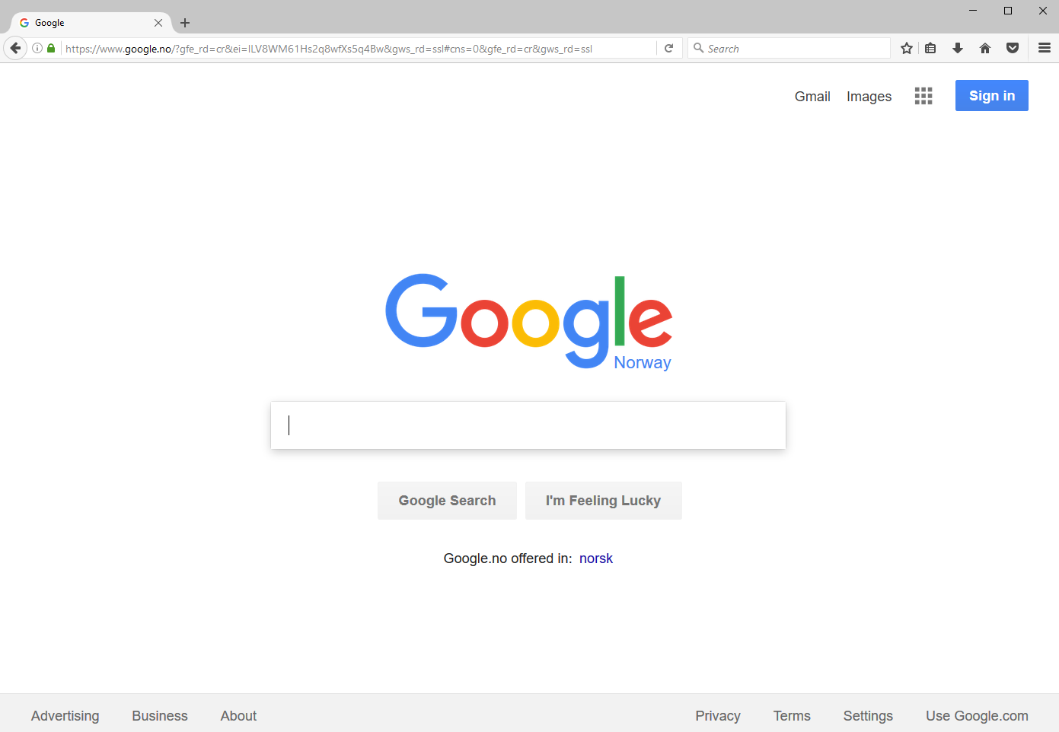

Slide 4
World Wide Web (WWW)
Invented by Tim Berners-Lee in 1989, at CERN, Switzerland
(Most of) You grew up with WWW… I was in high school when it was first available…
WWW is a set of documents/resources distributed among different machines
Resources/documents are identified with a Uniform Resource Locator (URL)
Resources are accessed/downloaded over the internet, typically HTTP over TCP
A web page is a resource written in HTML format
Browsers are tools used to download/visualize HTML pages, and enable the following of links

Slide 5
Send a HTTP request, and get back a HTML page which will be visualized in the browser

Slide 6
Many browsers…
Chrome (from Google)
Firefox (from Mozilla)
Edge (from Microsoft)
Mainly used to download Chrome/Firefox
Safari (from Apple)
Mainly used to download Chrome/Firefox, but OK on iPhone
Opera
… and others: PaleMoon, SeaMonkey, etc.

Slide 7
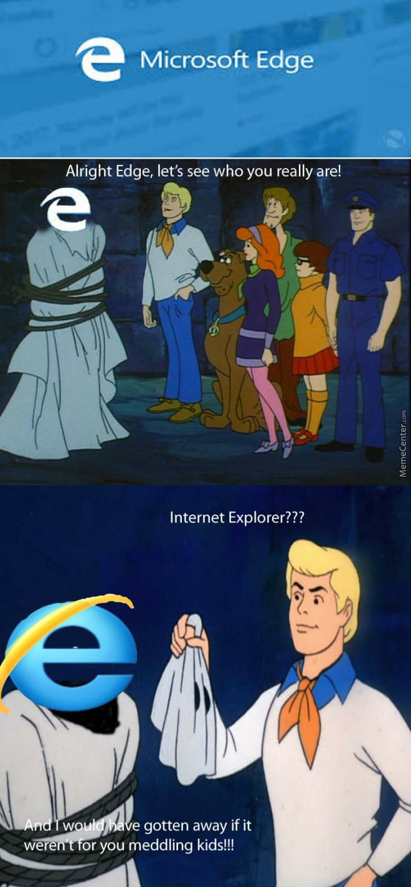

Slide 8
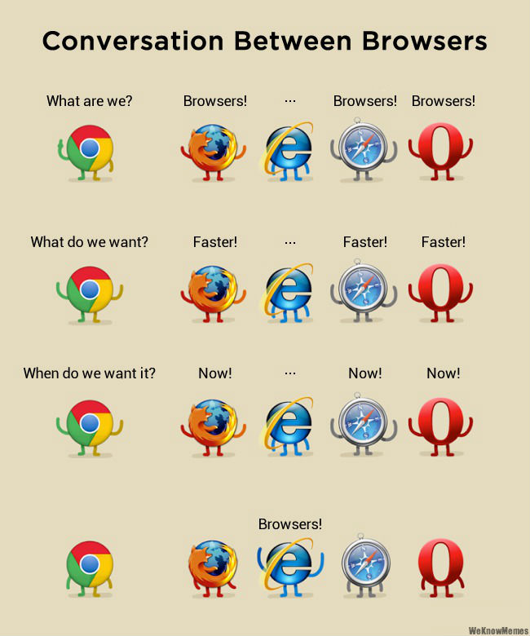

Slide 9
Domain Name System (DNS)
When you type “www.google.com” in your browser, how does it now which machine to “connect” to?
Internet connections are based on IP addresses
A 32 bit number, usually represented with 0-255 octets
74.125.131.103 for www.google.com
IPv4 is most currently used. IPv6 is sloooowly replacing it
To make the translation from “www.google.com” to 74.125.131.103, your machine needs to contact a DNS server
Discovery handled by the operating system (OS): either hardcoded known host (DNS roots) or broadcast on local network to get reply from your ISP (Internet Service Provider)

Slide 10
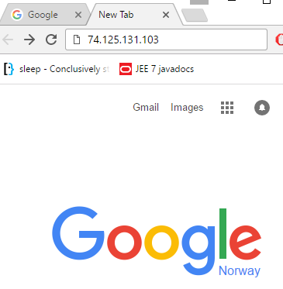
If you know the IP address, you can type it directly
Same “name” can be mapped to different IP addresses, ie different servers
The mapping can change

Slide 11
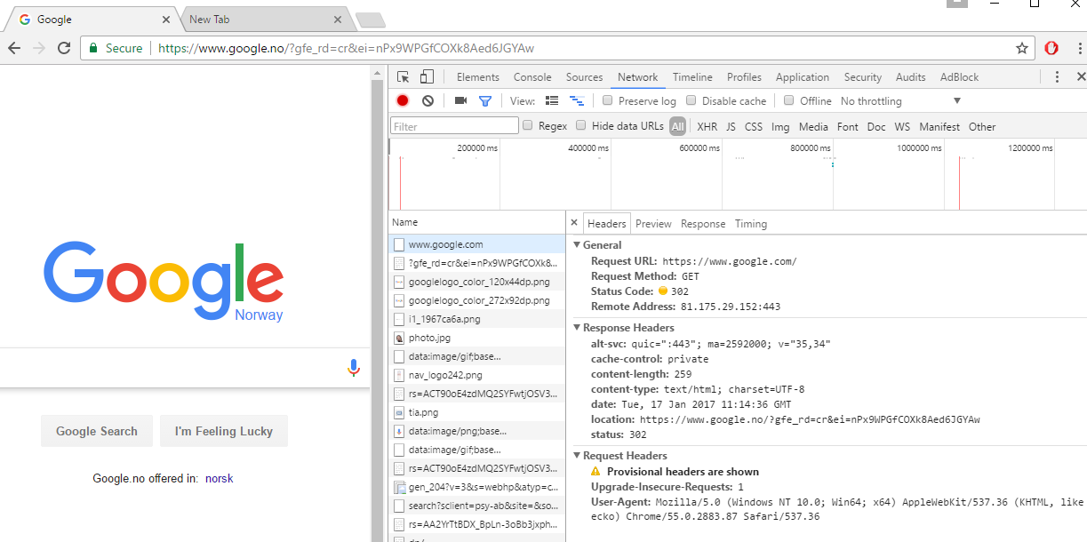
VERY IMPORTANT: Chrome -> More Tools -> Developer tools

Slide 12
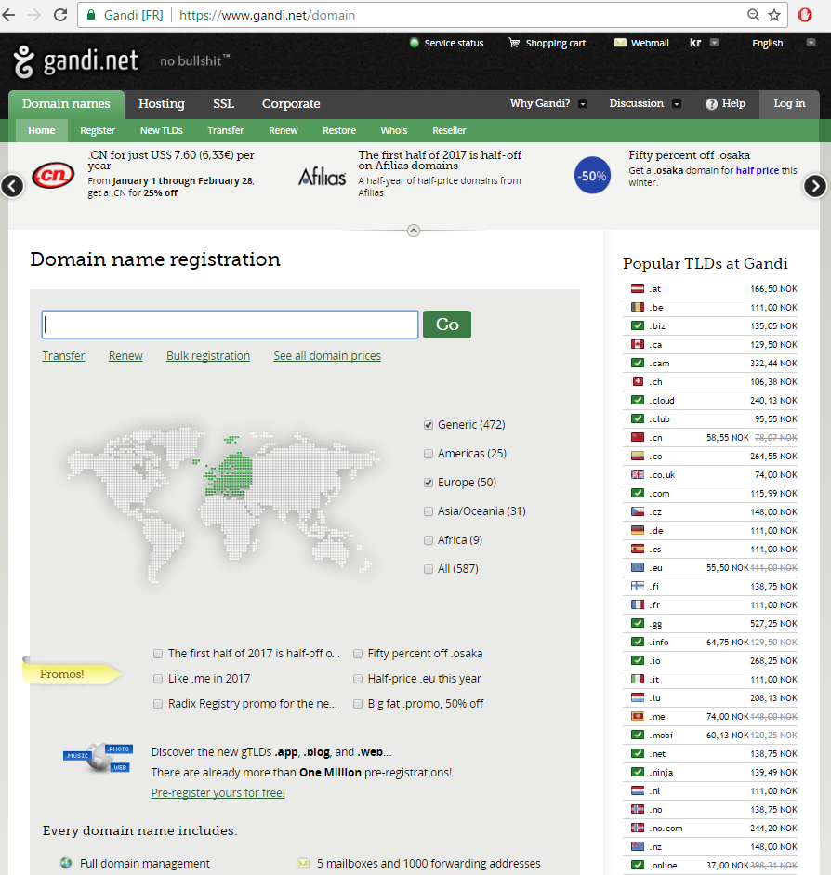
Registering a domain mapped to an IP address of your choice is not particularly expensive: eg 139 NOK per year for a “.no” address
For example, I used it to register “arcuriandrea.org”

Slide 13
Ports
An IP address is not enough to establish a TCP connection to a remote server
Need to also know the “port”, which is a number in 0-65535 (2^16 -1)
A server application running on a remote server machine will need to specify on which “port” it is listening to
On same machine, you can have several different applications binding to different ports
The range 0-1023 is for reserved ports, for very specific, well known types of applications

Slide 14
Ports to know
0: dynamically allocated (see next slide)
22: for SSH connections
Very common when you need to connect to a remote server using a terminal
80: for a HTTP connections
Typical case when browsing the web
443: for HTTPS, ie secure/encrypted HTTP over TLS/SSL
More and more common nowadays, even when no user authentication
8080: unreserved port.
“Typically” used by tools when running a HTTP server locally on your machine

Slide 15
Ephemeral/Dynamic ports
“Typically” in range 49152–65535
But will vary based on the OS
For short-lived communications
When you establish a connection to a remote server, a port will be open locally to read the responses
During development, when using port 0
Get a dynamic port which is free, not used
Eg, if you want to start a server locally for debugging/testing, you might want to avoid conflicts with other applications using the same port
Essential when you run tests in parallel, and need several server instances

Slide 16
Defaults
When nothing specified, browsers do default to known ports for the given protocol
Default protocol is HTTP, and default resource is the root “/”
So typing www.google.com is equivalent to http://www.google.com:80/
Typing https://www.google.com is equivalent to https://www.google.com:443/
Note: the page you request might not be the one you will get, as you could get a HTTP 3xx redirection

Slide 17
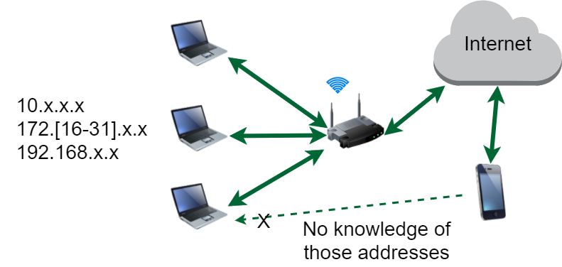
Local Networks
Router has IP accessible from internet
Machines connected to it have local IP not visible from outside
Cannot use mobile to connect to such machines, unless special settings on router, or WiFi directly to same router
Router might block machine-to-machine communications on same network for security reasons

Slide 18
HTTP message
When you ask your browser to display “http://www.google.com:80”, the browser will do a TCP connection to the remote server
The browser will send a command on this TCP connection, which is a stream of bytes
Think about it like a byte[] array
HTTP (Hypertext Transfer Protocol) is the protocol used to define the structure of the sent/received byte[] arrays

Slide 19
HTTP Protocol (Brief)
Will go into details in another lecture
3 main parts
First line specifying the action you want to do, eg GET a specific resource
Set of headers to provide extra meta-info
eg in which format you want the response: JSON? Plain Text? XML?
In which language? Norwegian? English?
(Optional) Body: can be anything.
Request: usually to provide user data, eg, login/password in a submitted form
Response: the actual resource that is retrieved, eg a HTML page
Most used version is 1.1, where data is sent like a readable string
HTTP 2.0 send data in binary format, but uses same commands/headers

Slide 20
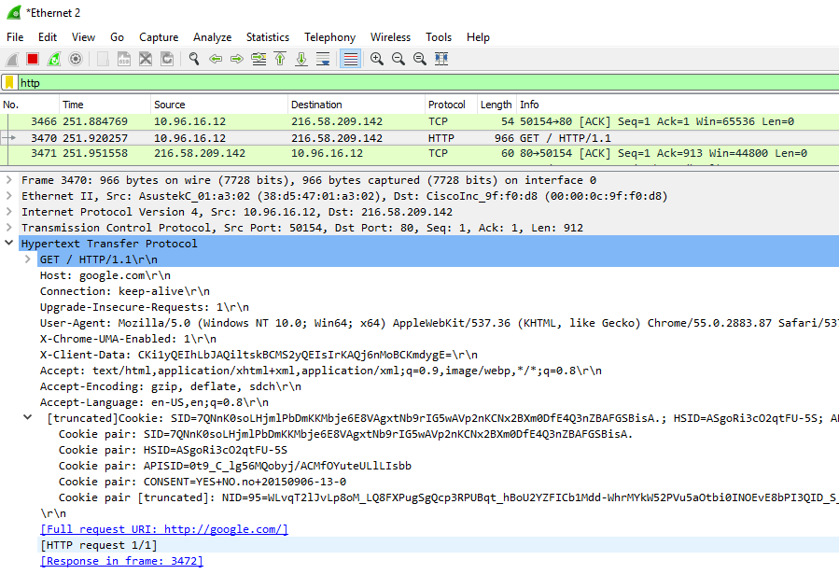
Use WireShark to see exactly what is sent over your network card

Slide 21
HTTP Server application
A program that opens a TCP port (eg, 80 or 443) and listens on incoming requests
For each request, will send a HTTP response with the given requested resource
The “resource” might be an existing file on disk (e.g., an html page or JPEG image), or created on the fly (eg based on content in database)
In the “old days”, a “web application” was just a set of static files accessible over HTTP

Slide 22
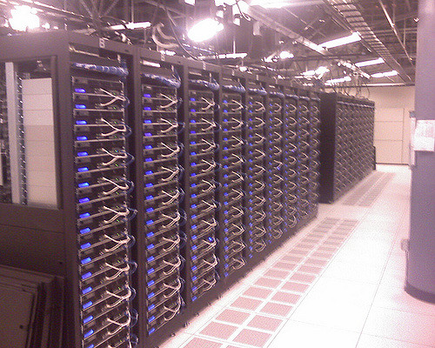
Old Days Server
/where/installed/
/index.html
/figs/cat.jpeg
/figs/dog.jpeg
Application server running on port 80, providing files from the folder “/where/installed”
If browser asks for “www.foo.org/index.html”, the server will check if a file called “index.html” is under the folder “/where/installed”, and return it as Body of the HTTP response

Slide 23
Cont.
When asked for “www.foo.org/index.html”, the browser will:
Resolve the IP address of www.foo.org
Establish a TCP connection toward <IP address>:80
Do a HTTP request with command: “GET /index.html HTTP/1.1”
Here the “index.html” is the requested resource
If asking for “www.foo.org/figs/cat.jpeg”, the request command will be “GET /figs/cat.jpeg HTTP/1.1”
What after the <IP address>:<port> is the so called “path” that identifies the resource on the server
Note: the client browser has no clue of where the files are actually stored on the server, ie the “/where/installed” folder

Slide 24
URL (Uniform Resource Locator)
Reference to a web resource and how to retrieve it
scheme:[//[user:password@]host[:port]][/]path[?query][#fragment]
https://en.wikipedia.org:443/wiki/Uniform_Resource_Locator#Syntax
scheme
port
fragmet
host
path

Slide 25
Cont.
Scheme: how to access the resource
http, https, file, ftp, etc.
Host: the name of the server, or directly its numeric IP address
Port: the listening port you will connect to on the remote server
Path: identifies the resource, usually in a hierarchical format
Eg, /a/b/c
Query: starting with “?”, list of <key>=<value> properties, separated by “&”
Eg https://github.com/search?q=java&type=Repositories&ref=searchresults
Fragment: identifier of further resource, usually inside the main you requested
Eg, a section inside an HTML page

Slide 26
URI (Uniform Resource Identifier)
String of characters used to identify a resource
A URL is a URI:
Exactly same format
In URL, the resource is typically located on a network
Given a URL, you should be able to access the resource, which is not necessarily true for URI
The distinction between URL and URI is conceptually very thin
Most people use the two terms interchangeably

Slide 27
Dynamic Pages
Static, pre-defined HTML pages are not enough for modern applications
You might want to base the HTML pages on data from database or dynamic content
Web forum
Shopping chart
Live chats
Etc.
HTML pages will need to be created on the fly at each HTTP request
Browser will still just see a HTML file: no clue if automatically generated

Slide 29
Server-Side HTML Rendering
The whole HTML page is created on the server in one go
HTML templates
Files that mix together HTML data and instructions/code on how to create the dynamic parts
Many different template technologies, even within the same language
eg, JSF (JavaServer Faces) for Java (.xhtml)

Slide 30

MVC (Model–view–controller)
A design pattern for developing GUI/Web applications
Clear separation of concerns: easier to develop and maintain
Model: internal state of the application
Controller: running code with the business logic. Receive inputs from User, and modify the state, ie the Model
View: what the user will receive, eg displayed HTML pages

Slide 31
HTML (HyperText Markup Language)
A markup language, not a programming one
Composed by tags, eg <body>, <p>, <a>, etc
When a browser receives a HTML file, it will parse its content, and create a GUI based on those tags
Most HTML pages do have references to other files, like for example images
Before a page is fully displayed in browser, those other files need to be downloaded (eg, by further HTTP requests)

Slide 32
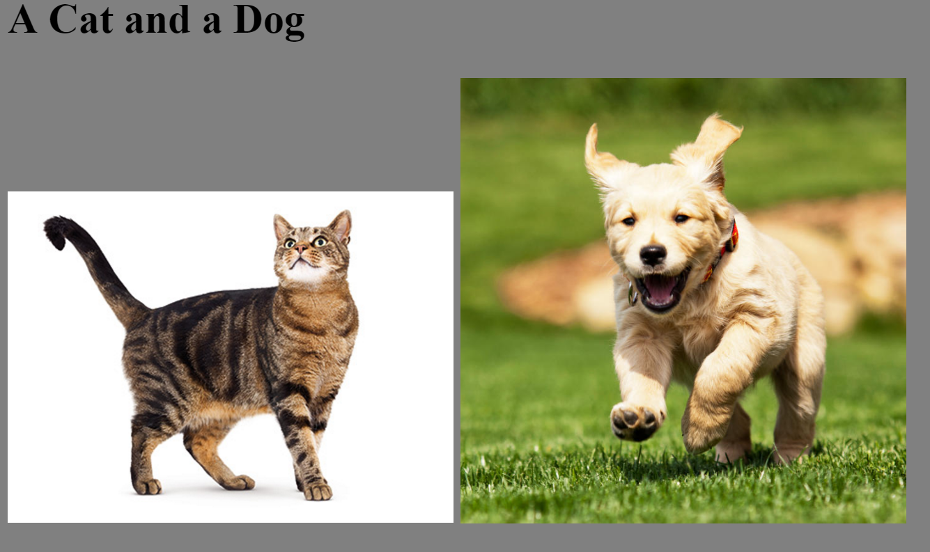

Slide 33
<HTML>
<HEAD>
<TITLE>Example</TITLE>
</HEAD>
<BODY BGCOLOR="gray">
<h2> A Cat and a Dog </h2>
<DIV>
<IMG SRC="figs/cat.jpg" style="width:256px">
<IMG SRC="figs/dog.jpg" style="width:256px">
</DIV>
</BODY>
</HTML>

Slide 34
Links to other files
To display the page in the previous slide, after a GET of the index.html page, the browser will do two further HTTP GET requests
Those further 2 requests could be done in parallel on two different TCP connections

Slide 35
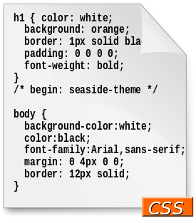
CSS (Cascading Style Sheets)
Language used to specify how the different HTML components should be displayed
Needed to specify for example: layout, colors and fonts
Can be embedded directly in HTML pages (eg, in the header)
However, often in separated files
for separation of document content from document presentation

Slide 36
JavaScript
JavaScript (JS) has nothing to do with Java
Programming language executed in the browser
JS code referenced by webpages like any other resource (eg images and CSS files), or can be embedded directly in HTML
JS can manipulate the DOM (Document Object Model) to alter the webpages structure/content based on user’s interactions (eg mouse clicks)

Slide 37
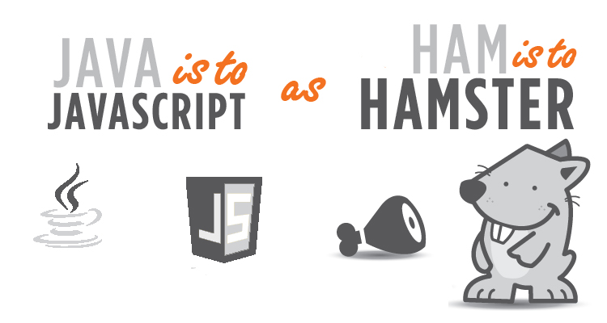

Slide 38
JavaScript is King on Browser
If web page needs to execute code on browser, you use JS
But historically there were other options in the (not so long ago) past:
Java with Java Applets (practically dead)
Flash (still found in some old web pages)
Silverligth
Etc.
Those were not natively supported by browser, and you had to install plugins to run them

Slide 39
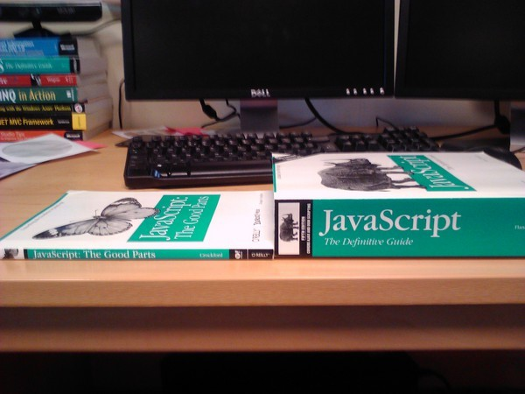
But JavaScript is a badly designed language…
When the most famous book is called “The Good Parts”, that tells you something…
However, there are other languages that do transpile to JS, like TypeScript and Kotlin
WebAssembly will hopefully one day replace JS

Slide 40
AJAX (Asynchronous JavaScript and XML)
Executing JS on the client browser opens the door to many possibilities
JS can retrieve new data from the server in the background, and update the current webpage without the need for the user to reload it completely
Chats
News (eg, refreshed every hour)
Etc.
JS can run in background, and do AJAX calls every X seconds to server to retrieve data in XML/JSON format, and update DOM accordingly

Slide 42
WebSocket
Limitation of AJAX is that client has to make the request for data
Asking at time intervals (eg every 10s) is inefficient:
Many requests, often even if new data is not available
If new data is available, cannot get it immediately, and have to wait till next scheduled AJAX call
WebSocket is a protocol working on TCP to allow full-duplex communication between client and server
Server can “push” new data even if client did not ask for it
A relatively recent protocol… first version in Chrome in 2009

Slide 43
Front-End Development
Front-end development is becoming more complex
Can be 10s or 100s of thousands of lines of JS
Making good GUIs requires special skills, eg in interaction design
In large organizations, not strange to have separated teams for front-end and back-end development
In such cases, using “template” technologies (eg JSF) might not be the best option
Front-end developers might be HTML/CSS/JS specialists that might not know about the specific language(s) chosen for the backend
When your pages depend on running the backend, it is more difficult to prototype the GUI

Slide 44
Possible Solution
Have a complete separation between front-end and backend
Front-end: only “static” files like HTML/CSS/JavaScript
No template language
Backend: provide just data in JSON format, and the client JS will update the DOM from the HTML static files
Ie, client-side rendering
Data can be read via AJAX when HTML page is loaded in browser
How to provide JSON data? RESTful Web Services

Slide 45
REST (Representational State Transfer)
Not a protocol, but rather an architectural style
Used to define how web resources should be structured and accessed
Based on the HTTP protocol
Server will answer to different URL requests, where the path represents the data to return in an hierarchical format, eg
/menus , return all menus
/menus/today , return the menu of today
/menus/today/dishes, return all the dishes in today’s menu
Data can be returned in different formats, but in most cases it is in JSON (JavaScript Object Notation), as client browser JS can directly use it without the need to unmarshal it

Slide 46
JavaScript + REST
More and more companies are moving to this approach to develop web applications instead of server-side templates
Different RESTful services can be written in different languages, serving the same page
RESTful can also serve other GUIs, eg mobile apps
Front-end can be tested/prototyped without a running backend server (can just stub out the JSON responses with static files)
No silver bullet: client-side rendering puts more strain on the client, which can become an issue on mobile web browsers

Slide 47
Enterprise 1 vs Enterprise 2 Course
In E1, we are going to only see server-side HTML rendering with a template technology like JSF (which is tight to Java-backends)
In E2, we will see REST and client-side rendering with AJAX and WebSockets, with frameworks like Reach and Angular (which are not tied to any specific backend technology)
Note 1: in current market, learning a framework like React is better than JSF… but still important to get some experience with such kind of frameworks
Note 2: we only going to scratch the surface of JSF, using the minimum necessary to make some non-trivial pages…

Slide 48
JSF

Slide 49
TODO JSF

Slide 51
Docker

Slide 52
TODO Docker

Slide 53
Git Repository Modules
NOTE: most of the explanations will be directly in the code as comments, and not here in the slides
intro/jee/jsf/base
intro/jee/jsf/examples
Exercises for Lesson 07 (see documentation)

