Slide 1
Enterprise Programmering 1 Lesson 05: EJB
Dr. Andrea Arcuri
Westerdals Oslo ACT
University of Luxembourg

Slide 2
About these slides
These slides are just high level overviews of the topics covered in class
The details are directly in the code comments on the Git repository

Slide 3
EJB Types
3 types, using @ annotations on the class
@Stateless
@Stateful
@Singleton

Slide 4
@Stateless
A EJB which is not supposed to have own state, ie fields
eg, “private int x = 0;”
can still inject objects, like EntityManager
Technically, you can declare field variables, but there is no guarantee call on proxyed EJB is always on same instance
For a given EJB, Container can have a pool of instances, and each time you use an injected proxy it can call method on different instance

Slide 5
@Stateful
Can have state, ie local variables
@Stateful EJB are linked to users (to sessions, to be more precise)
If you have many requests (eg web page visits) from different users, need to have a EJB instance for each of them
eg, 50,000 different users asking for a page using a @Stateful EJB? Then you need to keep 50,000 instances in memory
JEE Container can automatically store EJB instances to disk when running out of space (and resume when those are needed)

Slide 6
@Singleton
A EJB that can have state
Only one instance exists in the whole Container
Every time you inject a @Singleton, is always the same instance
As the same singleton can be used by different threads (eg handling concurrent web page requests), each method invocation is automatically synchronized in the proxy class to avoid concurrency issues

Slide 7
Injection
You can inject a EJB inside another EJB by declaring a variable annotated with @EJB
eg, “@EJB private A a;”
recall that you cannot instantiate a EJB directly with “new”
Note: you can also use @Inject, but that is part of the CDI (Contexts and Dependency Injection) specs, which is a more general framework for injection, not just EJB
Note: we will not see the details of CDI specs in this course

Slide 8
@PostConstruct
The Container, before doing dependency injection, needs to create an instance of the EJB with “new”
This means that the code of the constructor is called BEFORE dependency injection (DI) is done
If you need to access an injected variable in the constructor, you will hence get a null pointer exception
A method marked with @PostConstruct will be executed AFTER the constructor and DI
so, useful when you need initializing code relying on injected variables

Slide 9
Container Deployment
To use EJBs, we need to run them in a JEE Container
Wildfly, GlassFish, Payara, etc.
We would need to package the JAR/WAR with our code, install it on a running container
But before that, we would need to download, install and start a container
But how to test the methods of EJBs directly from a JUnit test?

Slide 10
Arquillian
A library extending JUnit that allows you to package JAR/WAR files directly from tests and deploy them on a container
The tests themselves are run in the container, so can use dependency injection @EJB
Configuration in special resource file called arquillian.xml
Limitations: cannot just right-click in IDE to run tests, need some manual settings first…
… plus, you still need to download and install a JEE Container

Slide 11
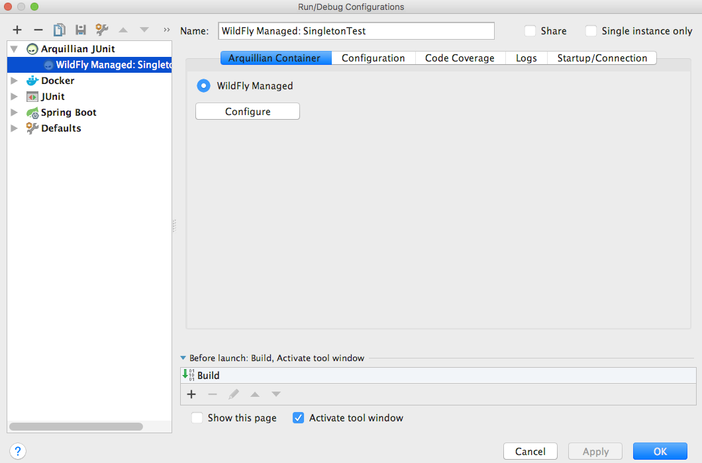
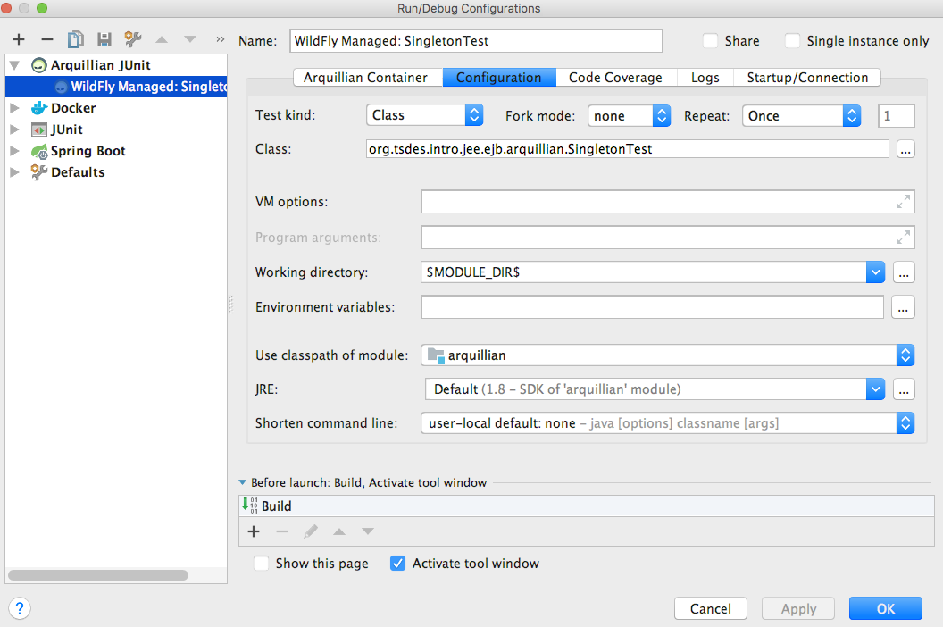
Test Configuration
Arquillian “WildFly Managed”
“Working directory” -> “$MODULE_DIR$”

Slide 12
Download/Install WildFly
We do it with Maven plugin, as part of the build
WildFly installed under the “target” folder
So it would be deleted when running “mvn clean”
Need to run “mvn test” at least once to download/install WildFly BEFORE you can run tests in IntelliJ

Slide 13
Git Repository Modules
NOTE: most of the explanations will be directly in the code as comments, and not here in the slides
intro/jee/ejb/singleton
intro/jee/ejb/arquillian
intro/jee/ejb/multithreading
intro/jee/ejb/stateful
intro/jee/ejb/callback
Exercises for Lesson 05 (see documentation)

