Slide 1
Enterprise Programmering 1 Lesson 05: EJB
Prof. Andrea Arcuri

Slide 2
About these slides
These slides are just high level overviews of the topics covered in class
The details are directly in the code comments on the Git repository

Slide 3
EJB Types
3 types, using @ annotations on the class
@Stateless
@Stateful
@Singleton

Slide 4
@Stateless
An EJB which is not supposed to have own state, ie fields
eg, “private int x = 0;”
can still inject objects, like EntityManager
Technically, you can declare field variables, but there is no guarantee call on proxyed EJB is always on same instance
For a given EJB, Container can have a pool of instances, and each time you use an injected proxy it can call method on a different instance

Slide 5
@Stateful
Can have state, ie local variables
@Stateful EJB are linked to users (to sessions, to be more precise)
If you have many requests (eg web page visits) from different users, need to have an EJB instance for each of them
eg, 50,000 different users asking for a page using a @Stateful EJB? Then you need to keep 50,000 instances in memory
JEE Container can automatically store EJB instances to disk when running out of space (and resume when those are needed)

Slide 6
@Singleton
A EJB that can have state
Only one instance exists in the whole Container
Every time you inject a @Singleton, is always the same instance
As the same singleton can be used by different threads (eg handling concurrent web page requests), each method invocation is automatically synchronized in the proxy class to avoid concurrency issues

Slide 7
Injection
You can inject a EJB inside another EJB by declaring a variable annotated with @EJB
eg, “@EJB private A a;”
recall that you cannot instantiate a EJB directly with “new”
Note: you can also use @Inject, but that is part of the CDI (Contexts and Dependency Injection) specs, which is a more general framework for injection, not just EJB
Note: we will not see the details of CDI specs in this course

Slide 8
@PostConstruct
The Container, before doing dependency injection, needs to create an instance of the EJB with “new”
This means that the code of the constructor is called BEFORE dependency injection (DI) is done
If you need to access an injected variable in the constructor, you will hence get a null pointer exception
A method marked with @PostConstruct will be executed AFTER the constructor and DI
so, useful when you need initializing code relying on injected variables

Slide 9
Container Deployment
To use EJBs, we need to run them in a JEE Container
WildFly, GlassFish, Payara, etc.
We would need to package the JAR/WAR with our code, install it on a running container
But before that, we would need to download, install and start a container
But how to test the methods of EJBs directly from a JUnit test?

Slide 10
Arquillian
A library extending JUnit that allows you to package JAR/WAR files directly from tests and deploy them on a container
The tests themselves are run in the container, so can use dependency injection @EJB
Configuration in special resource file called arquillian.xml
Limitations: cannot just right-click in IDE to run tests, need some manual settings first…
… plus, you still need to download and install a JEE Container

Slide 11
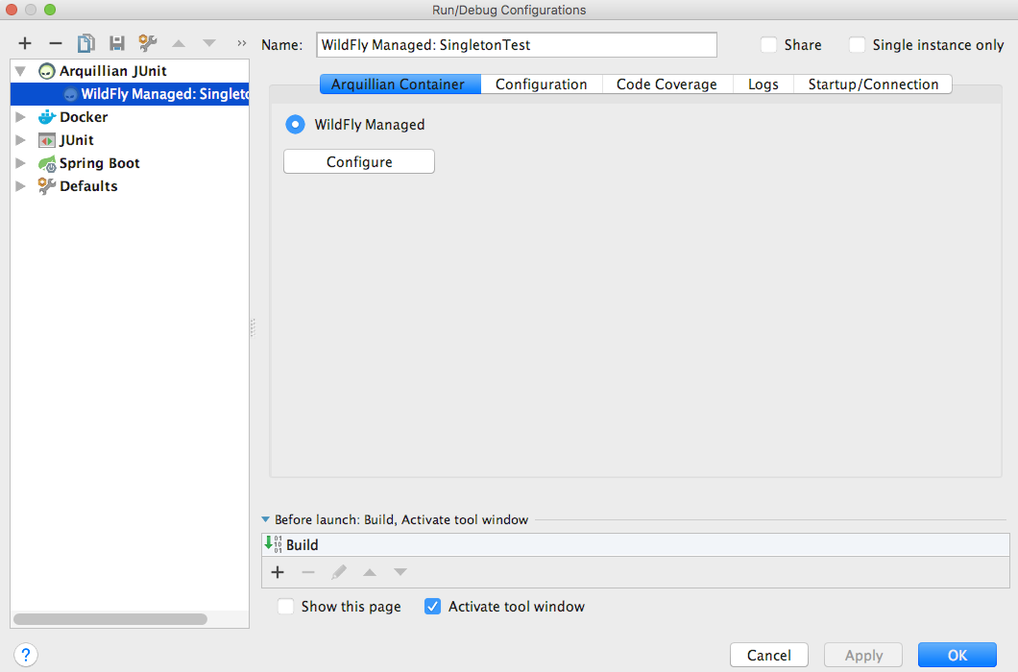
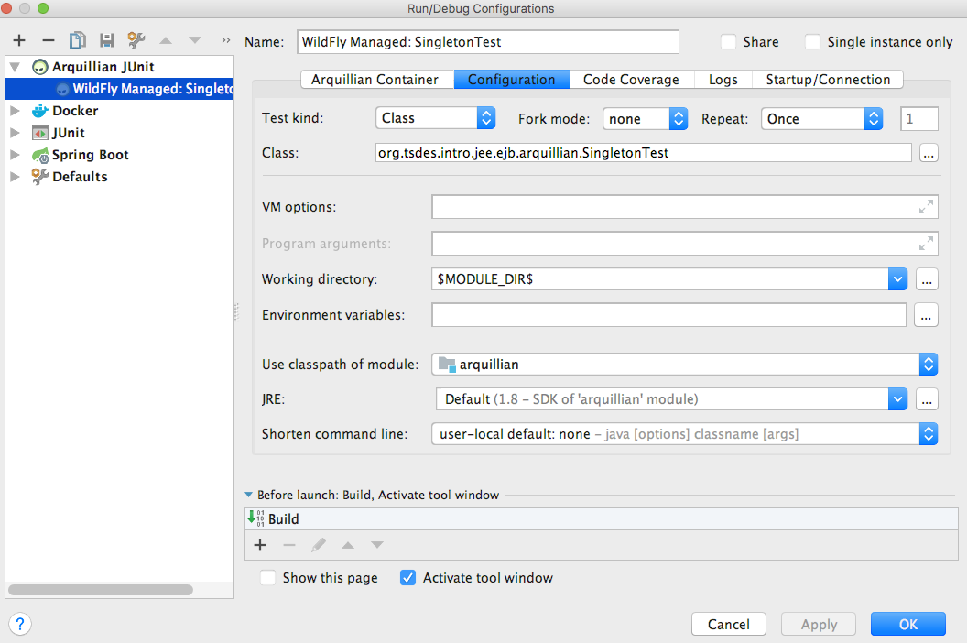
Test Configuration
Arquillian “WildFly Managed”
“Working directory” -> “$MODULE_DIR$”
note: recent versions of IntelliJ might use a different name for such variable, eg “$MODULE_WORKING_DIR$”. Just choose the right one from the drop-down list

Slide 12
Download/Install WildFly
We do it with a Maven plugin, as part of the build
Note: we could use Docker… but here we just want to see how Maven plugins can be used to do several different things during the build
WildFly installed under the “target” folder
So it would be deleted when running “mvn clean”
Need to run “mvn test” at least once to download/install WildFly BEFORE you can run tests in IntelliJ

Slide 13
Multi-Module Projects
Usually, you would run Maven commands like “mvn test” directly from the root of your project
TSDES is a large project: if you build from root, might take a long while…
well, “large” for students, but not compared to actual enterprise systems…
If you build a module directly (eg “mvn test” in the module folder), it will fail if using other modules as dependency
You need to run “mvn install -DskipTests” at least once from the root of the project
so, all JARs of the modules get installed in your ~/.m2 folder, and can be referenced when modules are built in isolation and not from the root of the project

Slide 14
Multi-Threading
A server like WildFly will have a pool of threads
Each incoming HTTP request could be handled by a different thread, possibly in parallel on 2 or more CPUs
Issue when different threads are working on same data
example, state in a @Singleton
recall that threads in the same process share the same heap, ie the objects and their state declared with new keyword, but each thread has its own method-call-stack

Slide 15
CPU and Caches
Assume a thread is manipulating a variable x, eg, by doing x++
x needs to be loaded from the RAM, all the way down to the CPU registers
It might take a while before changes in registers are propagated back to the RAM
x=0
RAM
RAM
L2 Cache
L2 Cache
L1 Cache
L1 Cache
Registers
Registers
x=1
CPU
x++
CPU

Slide 16
Performance
RAM are large but expensive and slow
Caches are faster but (much) smaller
A computation will use data, and we want to have such data as close as possible to the CPU
But registers/caches cannot hold all the data needed for the computation (ie the code executed by the thread)
So, page swaps between caches to retrieve needed data
If data already in cache, do not load it again from RAM

Slide 17
Issue: 2 Threads on 2 CPUs
x=0
RAM
x=0
Assume both threads are reading the same x from the heap
Registers in both CPUs will see the same value, eg x=0
But what if CPU-0 does a x++?
CPU-1 will not see it, as still using the cached x=0
What if both CPUs do a x++?
only one of them might effect the RAM
L2 Cache
L2 Cache
L1 Cache
L1 Cache
Registers
Registers
CPU-0
CPU-1

Slide 18
Cont.
x=1
RAM
x=1
If threads are executed at same time, both will change x from 0 to 1
x=1 will be in the cache, and later on propagated up to the RAM
But if 2 threads do not run at exactly same time, the result could be x=2, as second thread could use the updated x=1 from the RAM
L2 Cache
L2 Cache
L1 Cache
L1 Cache
Registers
Registers
CPU-0
CPU-1

Slide 19
Volatile
In Java, variables can be declared with volatile keyword
eg, volatile int x = 0;
A volatile variable is always read from RAM, and not used from cache
Useful to get most recent update in RAM, when local values in cache could become stale if other threads do modify such values
Good when you just need to read such values, but not to write them, as read/write is not atomic

Slide 20
Volatile Issue
Assume x being volatile
3 threads on 3 CPUs read x=0 at the same time from RAM
CPU-0 does a x++
CPU-1 reads value back once CPU-0 modification saved in RAM: it will use x=1 instead of relaying on cached x=0
CPU-2 stills uses x=0, even if volatile and CPU-0 did x++, as update not in RAM yet
CPU-0
CPU-1
CPU-2
Read x=0
Read x=0
Read x=0
x++
Using x=0
x=1 saved back from cache to RAM
Read x=1

Slide 21
Atomicity
When we need to READ and then WRITE a shared variable between different threads, we want it atomic
eg, if thread does x++, no other thread should be able to read and use x until the +1 is saved back in RAM
Java provides ways to execute code blocks atomically, with synchronized keyword, putting a lock on an object, released once block’s execution is completed
Any other thread trying to execute the same code has to wait (ie put on hold) until the lock is released
Issue: thread waiting and context-switch are computationally expensive

Slide 22
Git Repository Modules
NOTE: most of the explanations will be directly in the code as comments, and not here in the slides
intro/jee/ejb/singleton
intro/jee/ejb/arquillian
intro/jee/ejb/multithreading
intro/jee/ejb/stateful
intro/jee/ejb/callback
Exercises for Lesson 05 (see documentation)

