Slide 1
Enterprise Programmering 1 Lesson 07: JSF and Docker
Prof. Andrea Arcuri

Slide 2
Web Applications

Slide 3
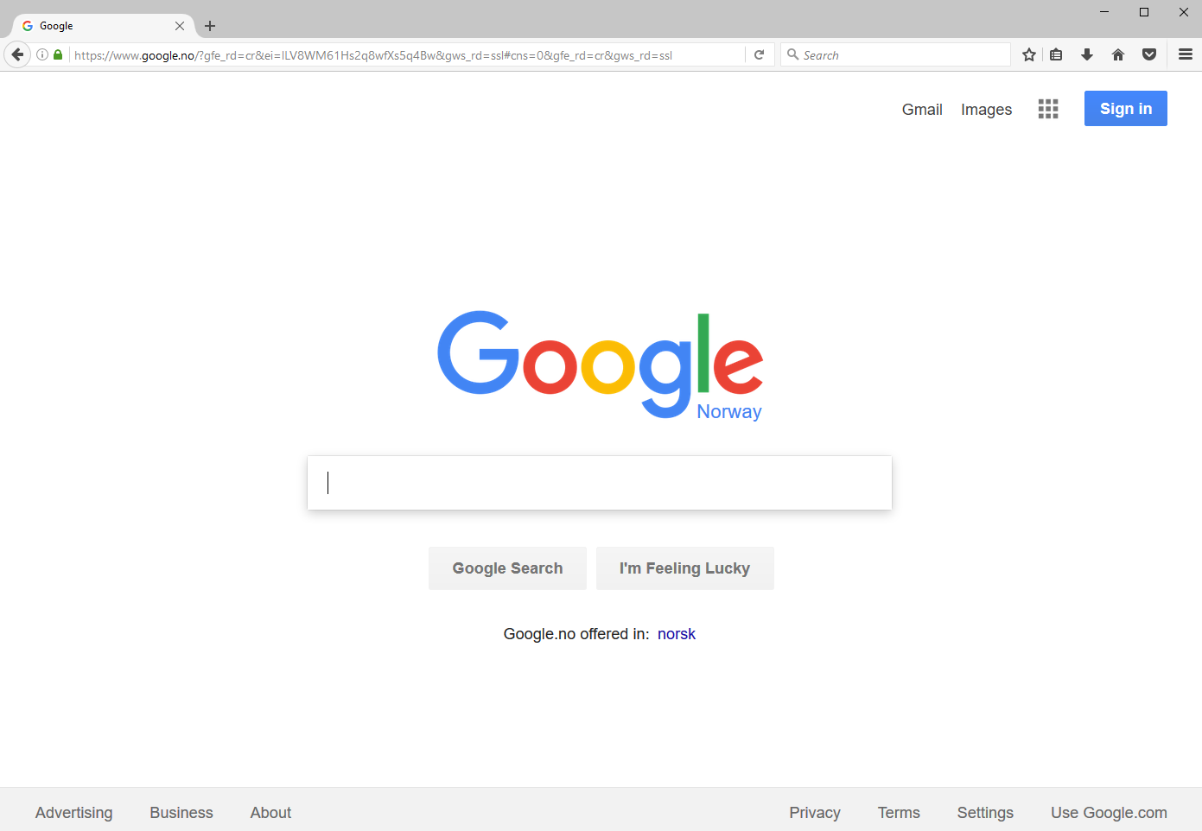

Slide 4
World Wide Web (WWW)
Invented by Tim Berners-Lee in 1989, at CERN, Switzerland
I was in high school when it was first available…
WWW is a set of documents/resources distributed among different machines
Resources/documents are identified with a Uniform Resource Locator (URL)
Resources are accessed/downloaded over the internet, typically HTTP over TCP
A web page is a resource written in HTML format
Browsers are tools used to download/visualize HTML pages, and enable the following of links

Slide 5
Send a HTTP request, and get back a HTML page which will be visualized in the browser

Slide 6
Domain Name System (DNS)
When you type “www.google.com” in your browser, how does it now which machine to “connect” to?
Internet connections are based on IP addresses
A 32 bit number, usually represented with 0-255 octets
74.125.131.103 for www.google.com
IPv4 is most currently used. IPv6 is sloooowly replacing it
To make the translation from “www.google.com” to 74.125.131.103, your machine needs to contact a DNS server
Discovery handled by the operating system (OS): either hardcoded known host (DNS roots) or broadcast on local network to get reply from your ISP (Internet Service Provider)

Slide 7
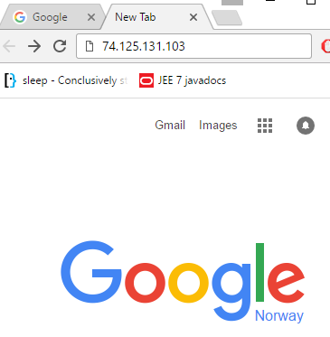
If you know the IP address, you can type it directly
Same “name” can be mapped to different IP addresses, ie different servers
The mapping can change

Slide 8
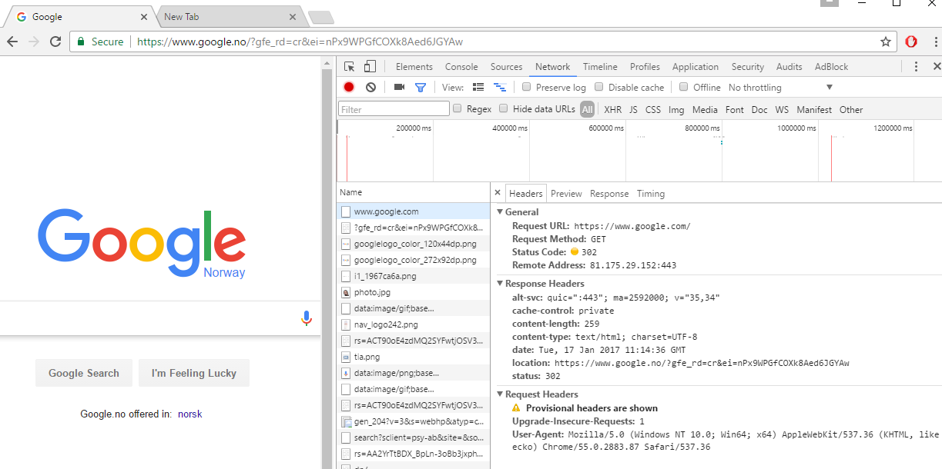
VERY IMPORTANT: Chrome -> More Tools -> Developer tools

Slide 9
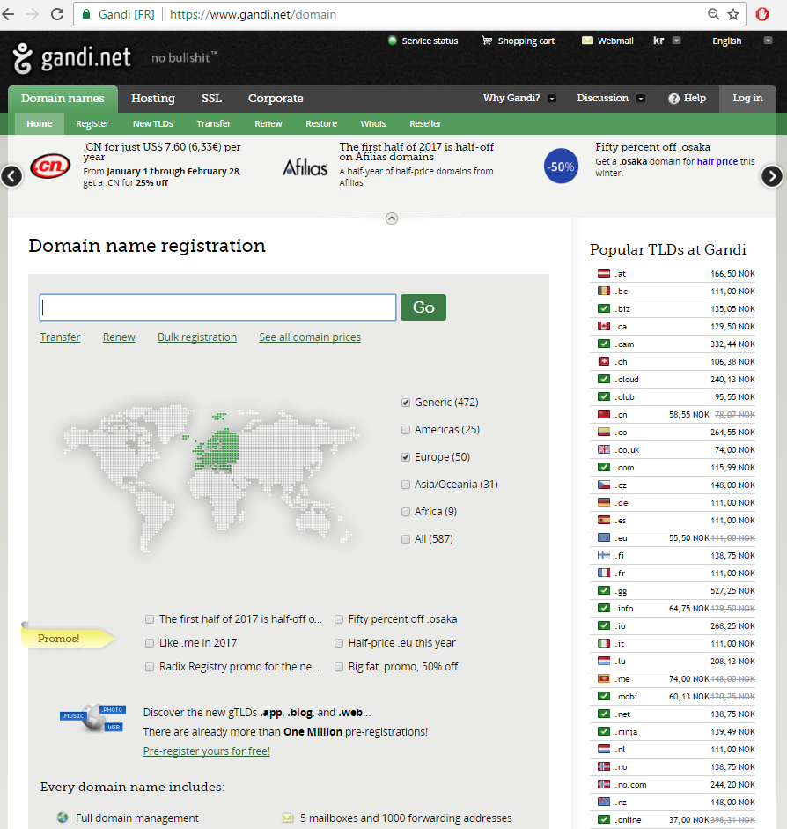
Registering a domain mapped to an IP address of your choice is not particularly expensive: eg 139 NOK per year for a “.no” address
For example, I used it to register “arcuriandrea.org”

Slide 10
Ports
An IP address is not enough to establish a TCP connection to a remote server
Need to also know the “port”, which is a number in 0-65535 (2^16 -1)
A server application running on a remote server machine will need to specify on which “port” it is listening to
On same machine, you can have several different applications binding to different ports
The range 0-1023 is for reserved ports, for very specific, well known types of applications

Slide 11
Ports to know
0: dynamically allocated (see next slide)
22: for SSH connections
Very common when you need to connect to a remote server using a terminal
80: for a HTTP connection
When browsing the web without encryption
443: for HTTPS, ie secure/encrypted HTTP over TLS/SSL
More and more common nowadays, even when no user authentication
8080: unreserved port.
“Typically” used by tools when running a HTTP server locally on your machine

Slide 12
Ephemeral/Dynamic ports
“Typically” in range 49152–65535
But will vary based on the OS
For short-lived communications
When you establish a connection to a remote server, a port will be open locally to read the responses
During development, when using port 0
Get a dynamic port which is free, not used
Eg, if you want to start a server locally for debugging/testing, you might want to avoid conflicts with other applications using the same port
Essential when you run tests in parallel, and need several server instances

Slide 13
Defaults
When nothing specified, browsers do default to known ports for the given protocol
Default protocol is HTTP, and default resource is the root “/”
So typing www.google.com is equivalent to http://www.google.com:80/
Typing https://www.google.com is equivalent to https://www.google.com:443/
Note: the page you request might not be the one you will get, as you could get a HTTP 3xx redirection

Slide 14
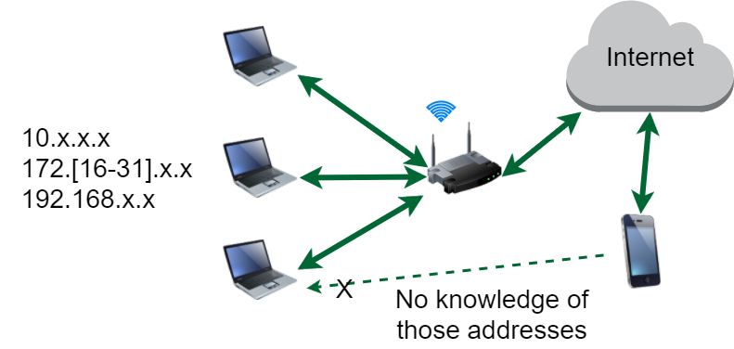
Local Networks
Router has IP accessible from internet
Machines connected to it have local IP not visible from outside
Cannot use mobile to connect to such machines, unless special settings on router, or WiFi directly to same router
Router might block machine-to-machine communications on same network for security reasons

Slide 15
HTTP Message
When you ask your browser to display “http://www.google.com:80”, the browser will do a TCP connection to the remote server
The browser will send a command on this TCP connection, which is a stream of bytes
Think about it like a byte[] array
HTTP (Hypertext Transfer Protocol) is the protocol used to define the structure of the sent/received byte[] arrays

Slide 16
HTTP Protocol (Brief)
Will go into low level details next course, Enterprise 2
3 main parts
First line specifying the action you want to do, eg GET a specific resource
Set of headers to provide extra meta-info
eg in which format you want the response: JSON? Plain Text? XML?
In which language? Norwegian? English?
(Optional) Body: can be anything.
Request: usually to provide user data, eg, login/password in a submitted form
Response: the actual resource that is retrieved, eg a HTML page
Most used version is 1.1, where data is sent like a readable string
HTTP 2.0 send data in binary format, but uses same commands/headers

Slide 17
HTTP Server Application
A program that opens a TCP port (eg, 80 or 443) and listens on incoming requests
For each request, will send a HTTP response with the given requested resource
The “resource” might be an existing file on disk (e.g., an html page or JPEG image), or created on the fly (eg based on content in database)
In the “old days”, a “web application” was just a set of static files accessible over HTTP

Slide 18
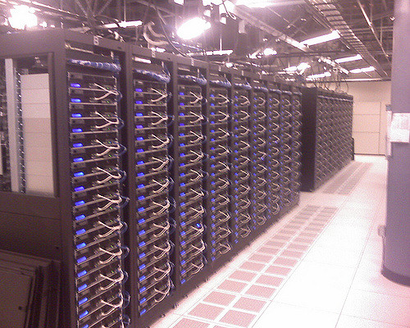
Old Days Server
/where/installed/
/index.html
/figs/cat.jpeg
/figs/dog.jpeg
Application server running on port 80, providing files from the folder “/where/installed”
If browser asks for “www.foo.org/index.html”, the server will check if a file called “index.html” is under the folder “/where/installed”, and return it as Body of the HTTP response

Slide 19
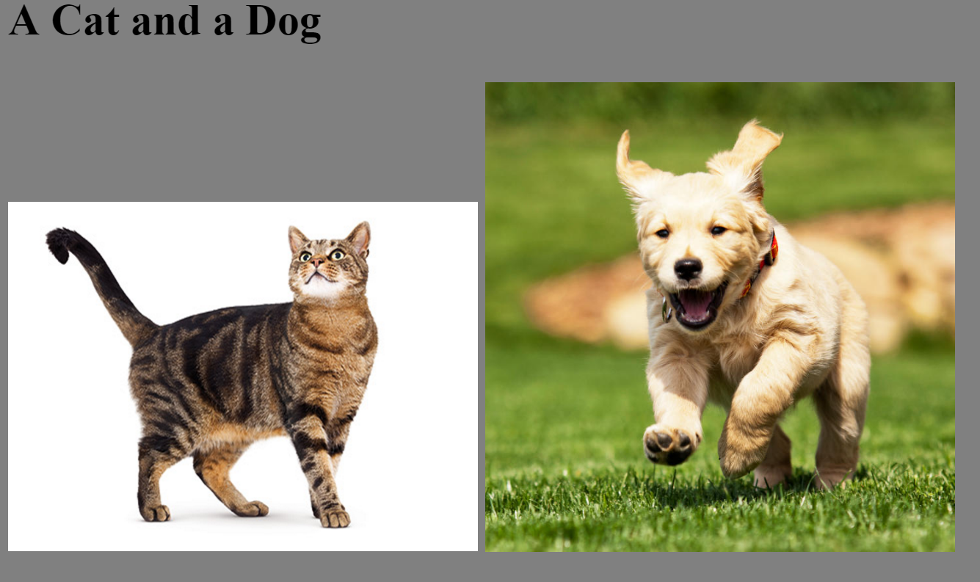

Slide 20
<HTML>
<HEAD>
<TITLE>Example</TITLE>
</HEAD>
<BODY BGCOLOR="gray">
<h2> A Cat and a Dog </h2>
<DIV>
<IMG SRC="figs/cat.jpg" style="width:256px">
<IMG SRC="figs/dog.jpg" style="width:256px">
</DIV>
</BODY>
</HTML>

Slide 21
Links to other files
To display the page in the previous slide, after a GET of the index.html page, the browser will do two further HTTP GET requests
Those further 2 requests could be done in parallel on two different TCP connections

Slide 22
Cont.
When asked for “www.foo.org/index.html”, the browser will:
Resolve the IP address of www.foo.org
Establish a TCP connection toward <IP address>:80
Do a HTTP request with command: “GET /index.html HTTP/1.1”
Here the “index.html” is the requested resource
If asking for “www.foo.org/figs/cat.jpeg”, the request command will be “GET /figs/cat.jpeg HTTP/1.1”
What after the <IP address>:<port> is the so called “path” that identifies the resource on the server
Note: the client browser has no clue of where the files are actually stored on the server, ie the “/where/installed” folder

Slide 23
Dynamic Pages
Static, pre-defined HTML pages are not enough for modern applications
You might want to base the HTML pages on data from database or dynamic content
Web forum
Shopping chart
Live chats
Etc.
HTML pages will need to be created on the fly at each HTTP request
Browser will still just see a HTML file: no clue if automatically generated

Slide 25
Server-Side HTML Rendering
The whole HTML page is created on the server in one go
HTML templates
Files that mix together HTML data and instructions/code on how to create the dynamic parts
Many different template technologies, even within the same language
eg, JSF (JavaServer Faces) for Java (.xhtml)

Slide 26

MVC (Model–view–controller)
A design pattern for developing GUI/Web applications
Clear separation of concerns: easier to develop and maintain
Model: internal state of the application
Controller: running code with the business logic. Receive inputs from User, and modify the state, ie the Model
View: what the user will receive, eg displayed HTML pages

Slide 27
Client-Side Rendering with JavaScript
JavaScript (JS) has nothing to do with Java
Programming language executed in the browser
JS code referenced by webpages like any other resource (eg images and CSS files), or can be embedded directly in HTML
JS can manipulate the DOM (Document Object Model) to alter the webpages structure/content based on user’s interactions (eg mouse clicks)

Slide 28
JS: AJAX and WebSockets
Executing JS on the client browser for DOM manipulation opens the door to many possibilities with AJAX and WebSockets
AJAX can be used to retrieve only the needed data (eg JSON), instead of whole HTML page
WebSockets enables “pushes” from the server
essential for chats and other live-applications like real-time games

Slide 29
Frontend Development
Front-end development is becoming more complex
Can be 10s or 100s of thousands of lines of JS
Making good GUIs requires special skills, eg in interaction design
In large organizations, not strange to have separated teams for front-end and back-end development
In such cases, using “template” technologies (eg JSF) might not be the best option
Front-end developers might be HTML/CSS/JS specialists that might not know about the specific language(s) chosen for the backend
When your pages depend on running the backend, it is more difficult to prototype the GUI

Slide 30
Possible Solution
Have a complete separation between front-end and backend
Frontend: only “static” files like HTML/CSS/JavaScript
No template language
Backend: provide just data in JSON format, and the client JS will update the DOM from the HTML static files
Ie, client-side rendering
Data can be read via AJAX when HTML page is loaded in browser
How to provide JSON data? RESTful Web Services

Slide 31
REST (Representational State Transfer)
Not a protocol, but rather an architectural style
Used to define how web resources should be structured and accessed
Based on the HTTP protocol
Server will answer to different URL requests, where the path represents the data to return in an hierarchical format, eg
/menus , return all menus
/menus/today , return the menu of today
/menus/today/dishes, return all the dishes in today’s menu
Data can be returned in different formats, but in most cases it is in JSON (JavaScript Object Notation), as client browser JS can directly use it without the need to unmarshal it

Slide 32
JavaScript + REST
More and more companies are moving to this approach to develop web applications instead of server-side templates
Different RESTful services can be written in different languages, serving the same page
RESTful can also serve other GUIs, eg mobile apps
Frontend can be tested/prototyped without a running backend server (can just stub out the JSON responses with static files)
No silver bullet: client-side rendering puts more strain on the client, which can become an issue on mobile web browsers

Slide 33
Enterprise 1 vs Other Courses
In E1, we are going to only see server-side HTML rendering with a template technology like JSF (which is tight to Java-backends)
In WDAD, we see REST and client-side rendering with AJAX and WebSockets, with libraries like React (which are not tied to any specific backend technology), in so-called Single-Page-Applications
In E2, we will have JVM backends with JS frontends
Note 1: in current job market, learning a library like React is better than JSF…
Note 2: we only going to scratch the surface of JSF, using the minimum necessary to make some non-trivial pages…

Slide 34
So... Why Learning JSF???
Important to learn the foundations of web development
need to learn how full web applications can be developed with no JS
just studying the latest trends does not give you the depth and insight to understand the new technologies of tomorrow
Need some experience with server-side HTML rendering
Could have used any other template technology… chose JSF just because can run on both JEE and Spring

Slide 35
JSF

Slide 36
JEE Containers
Besides handling specs like JPA and EJB, a Container also provides a web server handling HTTP requests
A servlet is the part that handles the HTTP requests, and creates dynamic HTML pages based on templates
Different template technologies, using servlets underneath
JSF main one in JEE, replacing older JSP
As container can have different WARs installed, first step when receiving HTTP request is to check which WAR should handle it (based on URL path)

Slide 37
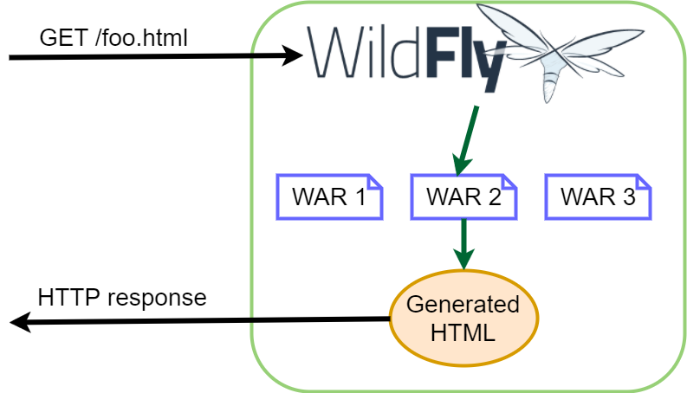

Slide 39
JSF: JavaServer Faces
Template technology
Templates written in XHTML: Extensible Hypertext Markup Language
Valid XML files, resembling HTML
Mixing together HTML-tags (eg <p>, <a>) with special tags that are going to be handled and transformed by JSF Servlet

Slide 40
JSF Template .XHTML example
<!DOCTYPE html PUBLIC "-//W3C//DTD XHTML 1.0 Transitional//EN" "http://www.w3.org/TR/xhtml1/DTD/xhtml1-transitional.dtd"> <html xmlns="http://www.w3.org/1999/xhtml" xmlns:h="http://xmlns.jcp.org/jsf/html" xmlns:f="http://xmlns.jcp.org/jsf/core" > <body> <h2>Example of Dynamic Page</h2> <p> Back to <a href="../index.html">Home</a> </p> <p> Current date: <h:outputText value="#{session.lastAccessedTime}"> <f:convertDateTime pattern="MM/dd/yyyy" type="date"/> </h:outputText> </p> </body> </html>

Slide 41
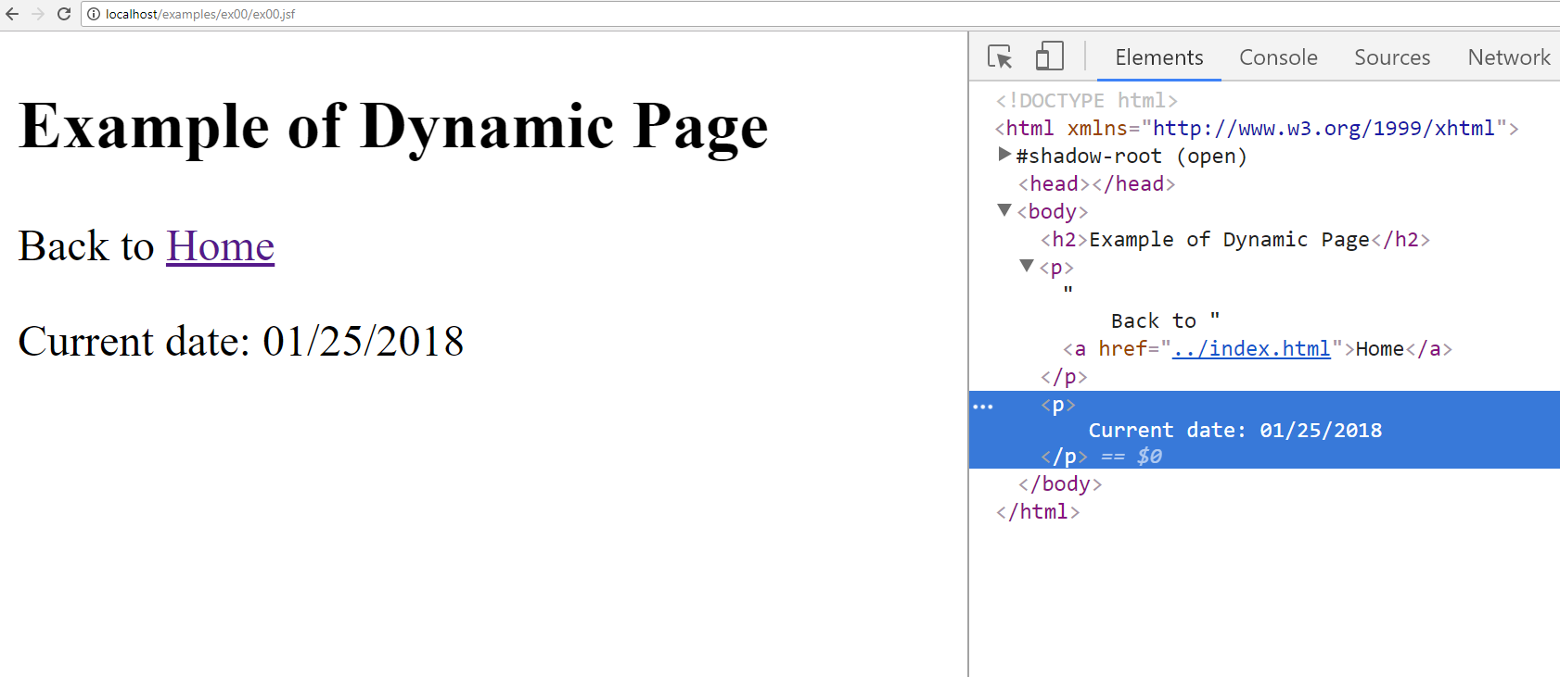

Slide 42
Tags
Based on tags, JSF decides how to translate <tags> into HTML
JSF has a predefined sets of tags that it can handle
In some cases, direct mapping to HTML
Other cases, will execute code to generate HTML
<h:outputText value="#{session.lastAccessedTime}">
Create text based on Java code executed inside “#{}”
<f:convertDateTime pattern="MM/dd/yyyy" type="date"/>
Specify how a Java Date object should be printed

Slide 43
Namespaces (ns)
<html xmlns="http://www.w3.org/1999/xhtml" xmlns:h="http://xmlns.jcp.org/jsf/html" xmlns:f="http://xmlns.jcp.org/jsf/core">
Namespaces are like “import packages” in Java, used to avoid name conflicts
Used namespaces need to be declared at beginning, with a custom variable name (usually just a letter, like h and f, to avoid too much typing)
<a> belongs to default namespace
"http://www.w3.org/1999/xhtml" in this example
<h:outputText> belongs to namespace called h
“http://xmlns.jcp.org/jsf/html” in this example

Slide 44
JSF Tags
JSF provides several tags with different namespaces
JSF can also be extended with more tags, with libraries like PrimeFaces and OmniFaces
But we are not going to see them…
Available tags/namespaces (see online for full list of available tags):
http://xmlns.jcp.org/jsf/html
http://xmlns.jcp.org/jsf/core
http://xmlns.jcp.org/jsf/facelets
http://xmlns.jcp.org/jsf/composite
http://xmlns.jcp.org/jsf/passthrough
http://xmlns.jcp.org/jsp/jstl/core
http://xmlns.jcp.org/jsp/jstl/functions

Slide 45
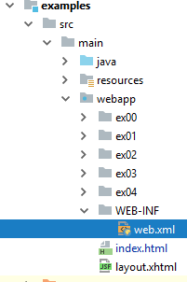
Maven Folder Structure
Template .XHTML and other assets (HTML/CSS/JS/images/etc.) are not source files to compile
Need to be put under “src/main/webapp”
Anything under such folder will be available with HTTP request to server, but “WEB-INF”
“WEB-INF/web.xml” is where configurations are set, like JSF handling

Slide 46
JSF Managed Beans
From XHTML, we can call Java code, inside #{} blocks in the tag attributes
“value” can be read when generating HTML server-side
“action” can be executed once server receives HTTP POSTs
JSF uses special beans as a bridge between the HTML GUI and the business logic (eg EJBs)
Different kinds of JSF-Beans, but we will just need 2:
@RequestScoped, created for each HTTP request
@SessionScoped, created for each user session (based on cookies)

Slide 47
Cont.
To be able to be referenced from XHTML, the beans need to be marked with @Named
can then use name of the class with first letter in lower case to reference an instance of the bean, eg a class FooBar can be referenced with a variable called fooBar
JSF-Beans can have injected EJBs
JSF-Beans should not really have business logic (which should be in the EJBs)
JSF-Beans should mainly deal with handling of form data and page navigation

Slide 48
Page Navigation
Can simply use <a> tags for simple navigation between pages
Complexity arises when <form> POSTs execute JSF-Bean code on the backend
this is will be defined inside the “action” attribute
eg, <h:commandButton value=“X” action="#{fooBar.someMethod}" />
If the JSF-Bean method returns void, then the POST returns the rendered HTML of the current page
If otherwise returns a String, that can be a URL path toward another page to redirect to
eg, once submitted data in a form, want to go to page showing this new data
eg, after login (userId/password sent by a form), automatically go to home-page

Slide 49
Forward and Redirect
In JSF, there are 2 main ways for navigation
Forward: return the rendered HTML of the linked-page as part of the body payload of the POST request
this is the default behavior
issue: the URL on address bar in browser does NOT change
Redirect: return a 302 redirection, where path returned by “action” will be in the Location HTTP header
issue: browser will need to make 2 calls (first the POST, and then a GET), but the address bar will be updated correctly
needs to be activated with URL attribute: “?faces-redirect=true”
this is the one you should use most of the time

Slide 50
Docker

Slide 51
Deploy OS Images
When developing applications, not limit to just package your code
Java, NodeJS, PHP, etc.
Create a whole image of an OS, including all needed software
Eg the version of JRE/.Net/Ruby/etc. that you need
Eg having a JEE Container like WildFly
Particularly useful when developing web applications to install on a server
Do not install the OS image on the server, but rather run it in a virtual machine
Also, instead of installing a database, could just load a OS image with it
How to automate all this?

Slide 52
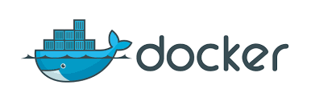
Docker to the Rescue
Automate the deployment of application inside software containers
Create whole OS images, based on predefined ones
Eg, a Linux distribution with the latest version of the frameworks you need
NodeJS, PHP, JDK, etc.
Large online catalog of existing base images at Docker Hub
Your application, and any needed third-party library, will be part of the OS image
Use Docker (and tools built on / using it) to deploy your OS images and start them locally or on remote servers

Slide 53
How to Use Docker?
First you need to install it
https://store.docker.com/
Note: if you are using Windows, Home Edition might not be enough. You would need a better version, like the Educational one, which you should be able to freely get from school
To run existing images, you just need to type commands from a shell terminal (eg, GitBash)
When you are writing your own projects, you need to create configuration files
Dockerfile: specify how to build an OS image
docker-compose.yml: for handling multi-images
Then, use docker and docker-compose commands from the command line

Slide 54
Docker Examples
https://docs.docker.com/get-started/
https://hub.docker.com/r/docker/whalesay/
docker run docker/whalesay cowsay boo
This will install the image “docker/whalesay”, and run it with input “cowsay boo”
First time you run it, the “docker/whalesay” image will be downloaded

Slide 55
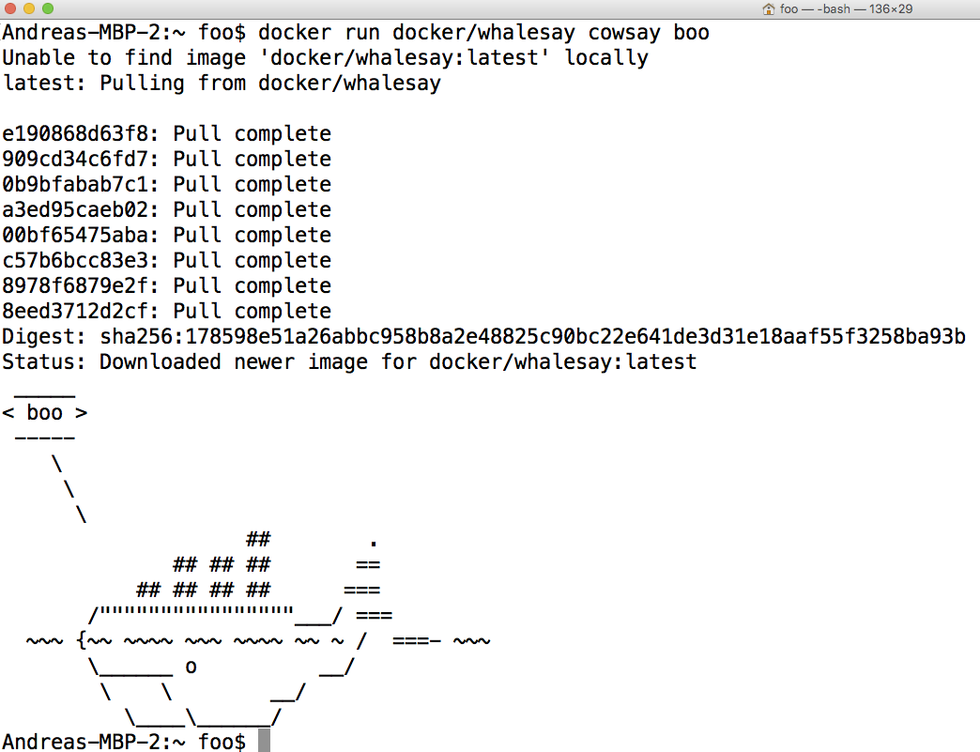

Slide 56
Custom Images
Extend existing images to run the applications you develop
Just need to create a text file called “Dockerfile”
FROM: specify the base OS image
RUN: execute commands in the virtual OS to set it up, like installing programs or create files/directories
CMD: the actual command for your application
ENV: define an environment variable
COPY: take a file X from your hard-disk, and copy it over to the Docker image at the given path Y
When Docker image runs, it can access X at path Y, even when you deploy the image on a remote server
Note, there is also an ADD option. Do NOT use it (ie, not recommended, as having side-effects besides adding files)
WORKDIR: specify the working directory for the executed commands
Think about it like doing “cd” to that folder, so all commands/files are relative to that folder, and you do not need to specify full path
# are comments

Slide 57
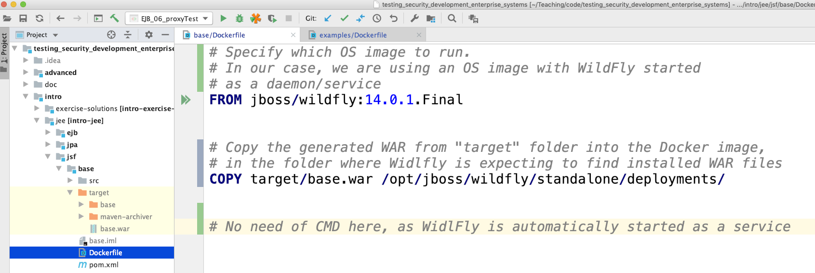

Slide 58
Docker Commands
docker build -t <name> .
Create an image with name <name>, from the Dockerfile in the current “.” folder
docker run <name>
Run the given image
docker ps
Show running images
docker stop <id>
Stop the given running image. Note: an image can be run in several instances, with different ids
In IntelliJ, you can also install “Docker integration” plugin

Slide 59
Networking
When you run a server on your local host, it will open a TCP port, typically 80 or 8080
A server running inside Docker will open the same kind of ports, but those will not be visible from the host OS
You need to explicitly make a mapping from host to guest ports
Ex.: docker run –p 80:8080 foo
When we do a connection on localhost on port 80, it will be redirected to 8080 inside Docker

Slide 60
CTRL-C
When running Docker (eg “docker run”) in a terminal, you can use CTRL-C to stop it
On Windows/GitBash it might happen that the image still run in background
Use “docker ps” to check if indeed the case
Use “docker stop <id>” to stop an image manually
If you have Docker images running in the background, that can be a problem if they use TCP ports

Slide 61
Docker in This Course
Java is quite portable… for monolithic Java servers (ie single applications), using Docker is not critical (compared to other languages/frameworks…)
But it simplify starting JEE Containers
We will also use it for databases (eg Postgres) and browsers (eg Chrome) for testing (ie Selenium)
Docker will be critical in Enterprise 2, when dealing with microservices
where we will need to orchestrate many applications…

Slide 62
Git Repository Modules
NOTE: most of the explanations will be directly in the code as comments, and not here in the slides
intro/jee/jsf/base
intro/jee/jsf/examples
Exercises for Lesson 07 (see documentation)

