Slide 1
Enterprise Programmering 2 Lesson 06: Mocking, Circuit Breakers and Test Generation
Prof. Andrea Arcuri

Slide 2
Goals
Learn how to test services relying on other external services, by mocking those external services
Understand how and why Circuit Breakers are used when dealing with external services
A look at advanced research topics like Automated Test Generation

Slide 3
Service Mocking

Slide 4
External Dependencies
Client
HTTP
REST
HTTP
External
A client calls our REST, and we need to call an external service to compute our response
What if the external service is currently down?
What if the external service has a temporary bug?
Test cases have to be deterministic
External service poses a major challenge for testing

Slide 5
Mocking
Client
HTTP
REST
HTTP
External
Mock
When running tests, run a Mock process listening to TCP connections
Change in REST the IP address of External to point to Mock
From the tests, specify what Mock should return when receiving HTTP messages
REST does not know that it is speaking with Mock instead of the real External

Slide 6
Benefits
Tests become deterministic
do not need to worry of network and External’s state (eg its database)
Can easily test scenarios which would be hard to configure for External
eg, special rare responses
Can implement and test our REST even if External is not working/implemented yet
Example: 2 students writing 2 REST APIs. First student can implement and test X which depends on Y, even if other student is not done with Y yet

Slide 7
Downsides
We are not testing how REST would behave in a real context, but in what is our expectation of how External interacts with it
If lots of interactions, might need to write a lot of mocked responses
If External does change often, then maintaining the mocks becomes expensive
Still need some live tests with real External anyways
but those will be handled specially

Slide 8
Circuit Breaker

Slide 9

Circuit Breaker
If too many connections to a server fail, stop ALL future attempts at connecting
Can use a library to wrap each call to external services
Once the circuit breaker is on after several failures, it will periodically check if the server comes up again. If so, all communications are restored

Slide 10
Why?
TCP/HTTP communications are expensive
If an external service is down, want to avoid wasting resources in trying to connect to it
Performance gain: can return response immediately instead of trying to connect to external services which are down
When external service will come up again, don’t want to bombard it immediately with all clients resending all the messages that failed before, all at the same time (which might congest the external service again)

Slide 11
Automated Test Generation

Slide 12
Goals
See how test case generation can be modelled as an optimization problem, eg using Evolutionary Algorithms
Introduction to EvoMaster research tool, aimed at system testing of REST APIs
Disclaimer: this is based on my research work, and not something widespread in industry

Slide 13
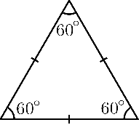

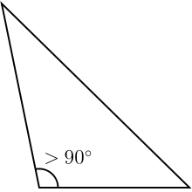
Example: Triangle Classification (TC)
Equilateral
Input
Output
A
Isosceles
SUT
B
Scalene
C
Not a triangle
3 integer numbers (A, B and C) as input representing the length of the edges
4 possible outcomes
Does the system under test (SUT) give the right answer?

Slide 14
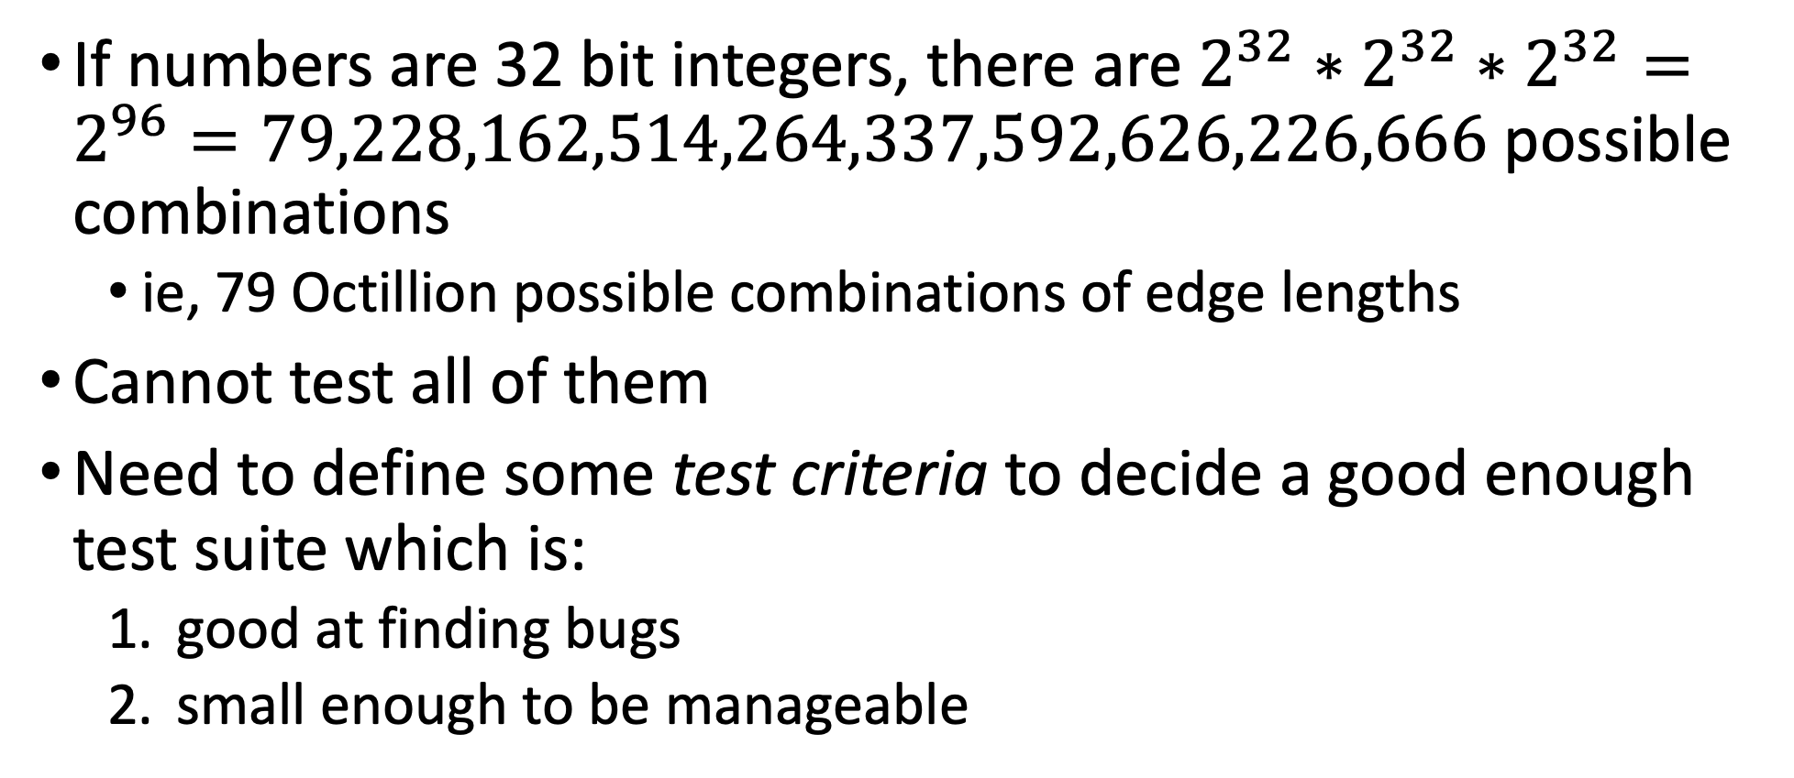
How to test TC?
If numbers are 32 bit integers, there are $2^{32}∗2^{32}∗2^{32}=2^{96}=79,228,162,514,264,337,592,626,226,666$ possible combinations
ie, 79 Octillion possible combinations of edge lengths
Cannot test all of them
Need to define some test criteria to decide a good enough test suite which is:
good at finding bugs
small enough to be manageable

Slide 15
1 Test per Output
t0:(A=42, B=42, C=42) => EQUILATERAL
t1:(A=42, B=42, C=5) => ISOSCELES
t2:(A=42, B=43, C=44) => SCALENE
t3:(A=42, B=42, C=12345) = NOT A TRIANGLE
Would such 4 test cases be enough?
What if the EQUILATERAL case is implemented with just something as naïve as “if A==B and B==C then EQUILATERAL”?
(A=-3, B=-3, C=-3) would wrongly return EQUILATERAL instead of NOT A TRIANGLE
Just checking basic scenarios is not enough

Slide 16
White-Box Testing
public Classification classify(
int a, int b, int c){ if(a <=0 || b<= 0 || c<= 0){ return Classification.NOT_A_TRIANGLE; } if(a==b && b==c){ return Classification.EQUILATERAL; } int max = Math.max(a, Math.max(b,c)); if( (max == a && max -b -c >= 0 ) || (max == b && max -a -c >= 0 ) || (max == c && max -a -b >= 0 ) ){ return Classification.NOT_A_TRIANGLE; } if(a==b || b==c || a==c){ return Classification.ISOSCELES; } else { return Classification.SCALENE; } }
Code can have bugs
To trigger a bug, the code must be executed
But code can have very complex control flow
Some rare “paths” in the code might be executed only in very complex scenarios
Goal: in a test suite, have each single line and branch be executed at least once

Slide 17
Example
if( (max == a && max -b -c >= 0 ) || (max == b && max -a -c >= 0 ) || (max == c && max -a -b >= 0 ) )
In this disjunction of 3 different clauses, if in your test suite the first clause is always true, the other 2 would never be executed
so if wrong, you would not know
This is a TRIVIAL example… real industrial software can be way more complex…
Writing tests for each path is not only tedious, but can be quite hard as well

Slide 18
Automated Test Case Generation
Automatically generate test cases
Model software testing as an optimization problem
Maximize code coverage
Find bugs
Etc.
Use optimization algorithms
Benefits: cheaper and more effective than manual testing
Hard problem to automate
given a non-linear constraint, there is no guaranteed algorithm that can solve it in polynomial time

Slide 19
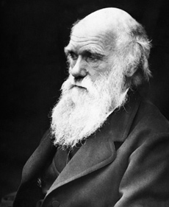
Search-Based Software Testing (SBST)
Biology meets Software Engineering (SE)
Casting SE problems into Optimization Problems
Genetic Algorithms: one of most famous optimization algorithm, based on theory of evolution
Evolve test cases

Slide 20
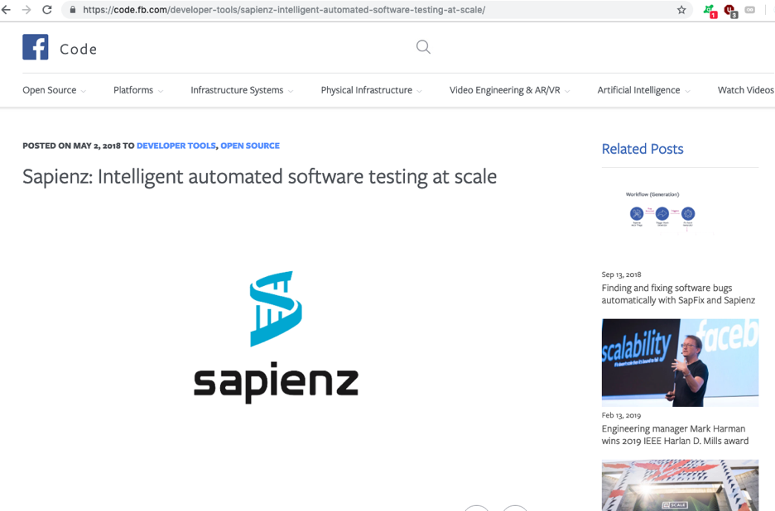
Success Stories: Facebook
Facebook uses SBST for automatically testing their software, especially their mobile apps
eg, tools like Sapienz and SapFix

Slide 21
Search Space
Depends on testing problem
Unit testing of TC? space of all possible combination of 3 integer inputs
OO software? sequence of function calls, with their heterogenous inputs
REST APIs? sequence of HTTP calls, setting strings like query parameters, and JSON/XML body payloads, etc.

Slide 22
Search Operators
Depend on the representation of the genes
Usually, small changes on the genes
Integer inputs? add +-1 on them
Strings? add/remove/change single chars in them
Object? modify 1 of their fields
etc.

Slide 23
Fitness Guidance
Just using code coverage as fitness function is not enough
binary: either we cover or we do not cover a target
Need guidance to be able to solve constraints in code predicates
“if(x == 123456 && complexPredicate(y) )”
Would be extremely difficult to get the right x and y to solve that predicate at random

Slide 24
SBST Heuristics: Branch Distance
Standard technique in the SBST literature to solve constraints
Example: if(x==100)
both 5 and 90 do not solve the constraint, but 90 is heuristically closer
Distance to minimize: if 0, then predicate is solved
Not just for integers, but also all other types, eg strings
Need to instrument the code to calculate those branch distances
Bytecode manipulation: need it fully automatically, eg with class loaders and Java Agents
Lot of technical details on how to achieve it efficiently

Slide 25
Branch Distance Examples
d(x == y) = |x-y|
d(x >= 0) = 0 if x>=0, -x otherwise
d(A && B) = d(A) + d(B)
d(A || B) = min(d(A), d(B))
etc.

Slide 26
EvoMaster

Slide 27
What about Automated Test Generation for RESTful APIs?
Would be very useful for enterprises
No tool available (AFAIK)
In the past, quite a lot of work on SOAP web services
(which are not so common any more)
Very few research papers on testing REST
Most techniques are black box

Slide 28
EvoMaster: Evolutionary Multi-Context Automated System Testing
Tool to automatically generate tests for REST APIs
White box
can exploit structural and runtime information of the SUT
Search-based testing technique (SBST)
Fully automated
Open-source prototype: www.evomaster.org
Currently targeting JVM languages (eg Java and Kotlin)

Slide 30
OpenAPI/Swagger
REST is not a protocol
Need to know what endpoints are available, and their parameters
Schema defining the APIs
Swagger is the most popular one
Defined as JSON file, or YAML
Many REST frameworks can automatically generate Swagger schemas from code

Slide 31
EvoMaster Core
From Swagger schema, defines set of endpoints that can be called
Test case structure:
setup initializing data in DB with SQL INSERTs
sequence of HTTP calls toward such endpoints
HTTP call has many components:
Verb (GET, POST, DELETE, etc.)
Headers
Query parameters
Body payload (JSON, XML, etc.)
Evolutionary algorithm to evolve such sequences and their inputs
Output: self-contained JUnit tests

Slide 32
Fitness Function
Needed to drive the evolution
Reward code coverage and fault detection
HTTP return statuses as automated oracles:
Eg 2xx if OK, 4xx are user errors, but 5xx are server errors (often due to bugs)

Slide 33
EM Driver: SBST Heuristics as a Service
Core and Driver are running on different processes
Code coverage and branch distances sent over the net, in JSON format
Cannot send all data: too inefficient if per test execution
different techniques to determine only what is necessary
EM Driver is itself a RESTful API
Why? Because so we can use Driver for other languages (eg C# and JS) without the need to touch EM Core

Slide 35
Using EvoMaster
Need to add dependency library
Need to write a driver class extending EmbeddedSutController
Once driver is up and running, should run “evomaster.jar” from command-line
once downloaded from GitHub
More info at www.evomaster.org

Slide 36
Git Repository Modules
NOTE: most of the explanations will be directly in the code as comments, and not here in the slides
advanced/rest/wiremock
advanced/rest/circuit-breaker
advanced/rest/evomaster

