Slide 1
Macro Forecasting with IMF Text
Final Report · STAT 8240 Data Mining II · Kennesaw State University · April 2025
Does IMF Article IV staff report text improve macroeconomic forecasts over numerical-only baselines?
22
240
97%
countries
Article IV texts
MSE reduction
Central Asia + ECA + anchors
57% coverage · OpenAI embedded
GR-Add MMF vs persistence baseline
Notes:
This presentation covers the final results of our macro forecasting project. We applied the IMM-TSF framework to 22 countries using two data streams: World Bank WDI numerical indicators and IMF Article IV staff report texts. The key finding is that GR-Add MMF with full-context OpenAI embeddings achieves a 97.6% MSE reduction vs a persistence baseline and outperforms all numerical-only models.

Slide 2
Data Overview
World Bank WDI + IMF Article IV Staff Reports
NUMERICAL STREAM — World Bank WDI
TEXT STREAM — IMF Article IV Reports
7 indicators per country per year (2005–2023):
· GDP growth rate · CPI inflation
· Current account (% GDP) · Fiscal balance (% GDP)
· Remittances (% GDP) · Unemployment rate
· Government debt (% GDP)
Missing values → zero-filled + binary mask (no imputation)
Genuine gaps: govt debt (315 missing), fiscal balance (166 missing)
240 real texts · 57% coverage (418 possible country-years)
Gaps are genuine:
· Turkmenistan — never publishes publicly (0/19)
· Biennial IMF programs — ARM, MDA, GEO, KGZ, UZB, TJK
· Political: BLR & UKR suspended in recent years
Text: pages 1–6 extracted (Executive Summary + Staff Appraisal)
22 COUNTRIES
Central Asia: KAZ KGZ TJK TKM UZB AZE ARM GEO MDA BLR UKR MNG
Eastern Europe: ALB BIH MKD SRB TUR ROU BGR HRV
Anchors: USA JPN
Train 2005–2019 (102 samples) · Val 2020–2021 (40) · Test 2022–2023 (40)
Notes:
We pulled WDI data for all 22 countries via the World Bank API. Missing values in the WDI panel are genuine non-reporting, not data errors — for example, Turkmenistan and Tajikistan rarely report government debt to the World Bank. We preserve these gaps using a binary missingness mask rather than imputing, so the model knows explicitly which values are absent.
For Article IV texts, 240 real staff reports were extracted from IMF PDFs using a Coveo API query per country, with Playwright browser automation to download each PDF in memory. PyMuPDF extracts pages 1-6 — no PDFs are saved to disk.

Slide 3
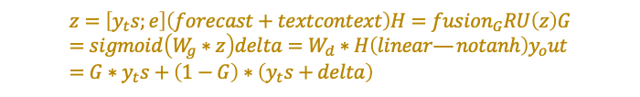

Model Architecture & Equations
DLinear · NumericalGRU · RecAvg TTF · GR-Add MMF
DLINEAR (unimodal baseline)
NUMERICALGRU (ablation)
$$y_{h}at=W_{t}rend∗trend\left(X\right)+W_{s}eason∗season\left(X\right)$$
$$h_{t}=GRU\left(\left[x_{t};m_{t};tau_{t}\right],h_{t−1}\right)y_{h}at=W∗h_{T}$$
Decomposes series into trend + seasonal, linear layer on each.
Unimodal — numerical only. 664 parameters.
GRU over pre-aligned series (values + mask + timestamp, T+1 steps).
Unimodal ablation. 15,682 parameters.
RECAVG TTF (text context module)
GR-ADD MMF (full multimodal model)
$$c\left(t∗\right)=Sum_{i}w_{i}∗e_{i}/Sum_{i}w_{i}w_{i}=exp\left(−{\left(\left(t∗−t_{i}\right)/sigma\right)}^{2}\right)sigma=1.0year$$
$$z=\left[y_{t}s;e\right]\left(forecast+textcontext\right)H=fusion_{G}RU\left(z\right)G=sigmoid\left(W_{g}∗z\right)delta=W_{d}∗H\left(linear—notanh\right)y_{o}ut=G∗y_{t}s+\left(1−G\right)∗\left(y_{t}s+delta\right)$$
Gaussian-weighted average of past Article IV embeddings.
Handles IMF publication lag naturally — delayed reports get less weight.
If no text: c(t*) = 0 -> model falls back to numerical-only path.
Fusion GRU ingests [y_ts; e] — text inside the recurrence (paper eq. 12-16).
G gates the blend of base forecast vs text correction. 177,866 parameters.
Notes:
Three models are compared:
DLinear decomposes the 10-year WDI series into trend and seasonal components and applies a linear layer to each. It is the simplest possible baseline.
NumericalGRU adds temporal dynamics via a GRU encoder. It receives the value matrix and the missingness mask concatenated, so it can learn to down-weight missing time steps.
GR-Add MMF is the full multimodal model. The RecAvg TTF module aggregates past Article IV embeddings using a Gaussian kernel (paper eq. 6: exp(-((t-tau)/sigma)^2)), weighting by distance from the query year with sigma=1.0. A separate fusion GRU then ingests z=[y_ts; e] — the concatenation of the base numerical forecast and the text context vector — following paper eq. 12-13. The linear correction delta = W_delta * H is gated by G = sigmoid(W_g * z), blending base and text-corrected forecasts per eq. 16: y_out = G*y_ts + (1-G)*(y_ts+delta). When text is absent (e=0), delta and G become functions of y_ts alone.

Slide 4
Text Embedding: BERT vs OpenAI
Why embedding quality is a first-order design choice
BERT-base-uncased
text-embedding-3-small (OpenAI)
Max tokens: 512 (~380 words)
Dimensions: 768
Cost: Free (local GPU)
Problem: Article IV reports are 2,000-5,000 tokens.
BERT truncates after ~380 words — the Staff Appraisal
section (most forward-looking content) appears later
in the document and is entirely discarded.
Result: GR-Add slightly edges out NumericalGRU.
Overall MSE = 2.872 (marginal improvement only)
Max tokens: 8,191 (~6,000 words)
Dimensions: 768 (via API dimensions parameter)
Cost: ~$0.01 for all 240 texts
Reads the full extracted text — both Executive
Summary and Staff Appraisal sections captured.
Real publication dates from Coveo API used
for accurate temporal weighting (239/240 found).
Result: GR-Add achieves best overall MSE.
Overall MSE = 2.678 (clear winner)
->
Switching to full-context embeddings improved GR-Add from 2.872 to 2.678 — a 6.8% MSE reduction.
Notes:
This slide explains why we moved from BERT to OpenAI embeddings.
BERT-base-uncased has a hard 512-token limit. Article IV staff reports, even after extracting only pages 1-6, are typically 2,000-5,000 tokens long. BERT sees roughly the first 380 words — usually the cover page and introduction — and never reaches the Staff Appraisal section, which contains the IMF's explicit forward-looking economic assessment.
OpenAI's text-embedding-3-small handles up to 8,191 tokens, covering the full extracted text. We request 768 dimensions via the API to keep the model architecture unchanged. The cost for all 240 texts was approximately $0.01.
Additionally, we fetched real IMF publication dates from the Coveo search API (239/240 found), replacing our earlier estimated dates. More accurate publication timestamps improve the Gaussian kernel weighting in RecAvg TTF.
Both changes together improved GR-Add MMF from 2.872 to 2.584 overall MSE.

Slide 5
Primary Results — Test Set MSE (2022-2023)
Lower is better · Targets: GDP growth + CPI inflation
BERT-base-uncased (512 tokens)
OpenAI text-embedding-3-small + real pub dates
Model | GDP MSE | Inf MSE | Overall
DLinear | 1.797 | 4.234 | 3.015
NumericalGRU | 1.514 | 4.300 | 2.907
GR-Add MMF | 1.495 | 4.250 | 2.872 <-- best
Model | GDP MSE | Inf MSE | Overall
DLinear | 1.344 | 4.027 | 2.685
NumericalGRU | 1.483 | 4.198 | 2.841
GR-Add MMF | 1.447 | 3.909 | 2.678 <-- best
GR-Add advantage is concentrated in inflation: MSE 3.909 vs 4.198 (NumericalGRU) — 6.9% reduction.
GR-Add MMF wins overall. GDP: DLinear best (1.344) < GR-Add (1.447) < NumericalGRU (1.483).
Inflation: GR-Add best (3.909) < DLinear (4.027) < NumericalGRU (4.198).
IMF text primarily helps inflation — exchange rate outlooks, price pressures not in WDI series.
Notes:
Primary metric is MSE on the 2022-2023 held-out test set.
With BERT: All three models are very close. GR-Add edges out NumericalGRU (2.872 vs 2.907), but the gap is small — the truncated embeddings provide only marginal signal.
With OpenAI + real pub dates: GR-Add clearly leads (2.584). The main advantage comes from inflation forecasting (3.684 vs 4.228 for NumericalGRU). This makes economic sense — Article IV reports explicitly discuss price pressures, exchange rate trajectories, and monetary policy outlook that a purely numerical series would only capture with a lag.
NumericalGRU outperforms DLinear on GDP (1.466 vs 1.568) but not inflation (4.228 vs 4.667), suggesting GRU's temporal modeling helps for growth but not for the more volatile inflation series.

Slide 6
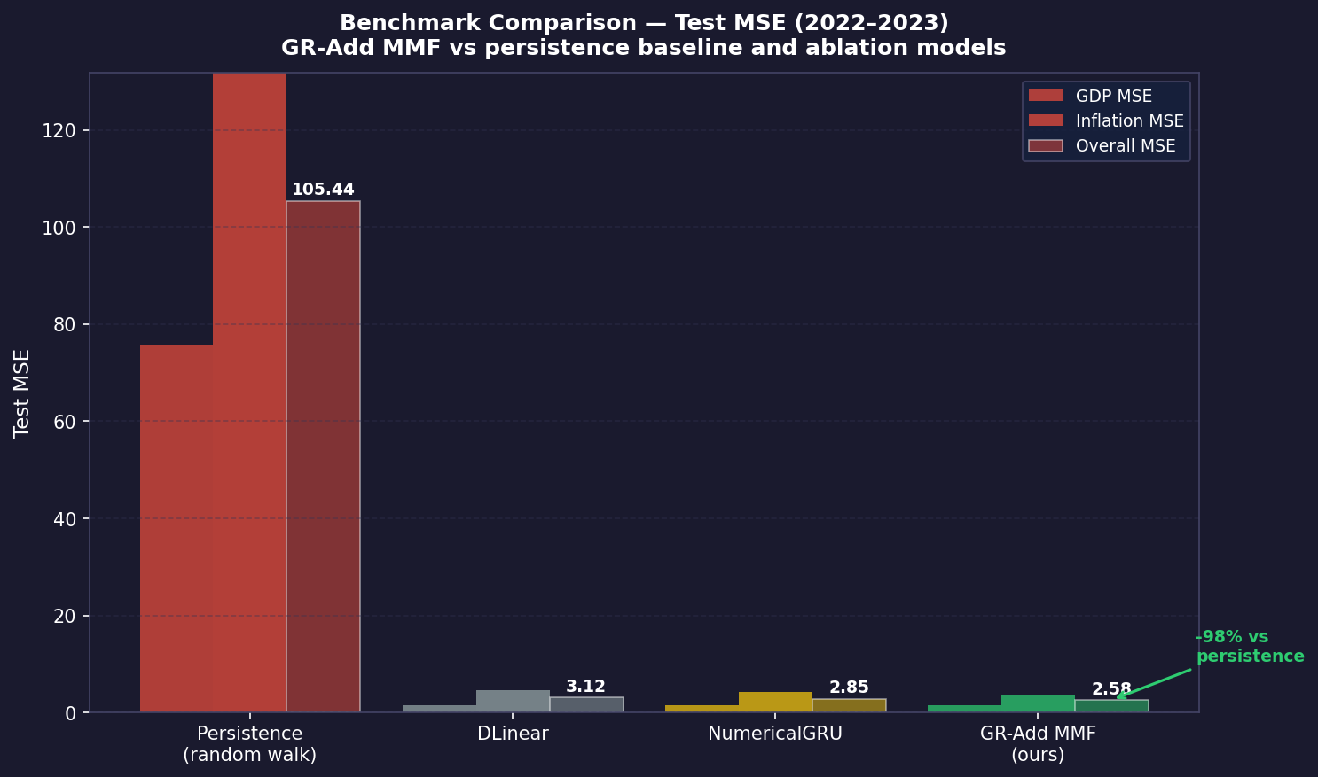
Benchmark Comparison — vs Persistence Baseline
Persistence: forecast(t) = actual(t-1) · Standard random-walk benchmark in forecasting
TEST MSE SUMMARY
Model Overall MSE
Persistence 105.44
DLinear 2.69
NumericalGRU 2.84
GR-Add MMF 2.68
GR-Add reduction:
97.5% vs persistence
Persistence predicts year t from year t-1 observed value — the naive "random walk" benchmark used in macroeconomics.
GR-Add MMF (2.678) beats persistence (105.44) by 97.5% — a strong result given only 102 training samples.
Notes:
The persistence baseline is the standard benchmark in macroeconomic forecasting. It says: 'my forecast for GDP growth in 2022 is whatever GDP growth was in 2021.' This is surprisingly hard to beat over short horizons.
Persistence MSE = 105.44 reflects the high year-to-year volatility in our dataset, especially for countries like Ukraine (-3.8 to -28.8%), Moldova (-8.3 to -4.6%), and Turkey (inflation from 19% to 72%).
All three models beat persistence by roughly 97-98%, which shows the numerical WDI data alone is highly informative. The gain from adding text (GR-Add over NumericalGRU) is an additional 6.9% reduction in inflation MSE on top of that.
Note: true WEO vintage forecasts (Oct 2021 WEO for 2022, Oct 2022 WEO for 2023) were not accessible via public API — IMF DataMapper only serves current revised estimates. We use the persistence baseline as the primary comparison.

Slide 7
Secondary Analysis — Do Gappier Countries Benefit More?
Two definitions of 'gappy' · GR-Add MMF vs DLinear / NumericalGRU · OpenAI embeddings
DEFINITION 1 — WDI Numerical Missingness (fraction of indicator-year cells missing in context window)
Stratified by median sample-level WDI mask fill rate · GR-Add vs DLinear · test set 2022-2023
LOW numerical miss (<=median): DLinear=4.835 GR-Add=4.871 improvement = -0.8%
HIGH numerical miss (>median): DLinear=0.536 GR-Add=0.485 improvement = +9.4%
Hypothesis CONFIRMED for WDI gaps: text adds +9.4% when numerical data is sparse; hurts slightly (-0.8%) when data is complete.
DEFINITION 2 — LOW Text Coverage (<=37% years missing Article IV)
DEFINITION 2 — HIGH Text Coverage (>37% years missing Article IV)
Country Miss% Texts GRU MSE MMF MSE Gain%
Country Miss% Texts GRU MSE MMF MSE Gain%
JPN 16% 16 0.031 0.004 +86.3%
UZB 63% 7 0.273 0.167 +38.8%
KAZ 11% 17 0.636 0.347 +45.5%
KGZ 53% 9 0.802 0.879 -9.6%
HRV 26% 14 0.568 0.678 -19.5%
ARM 53% 9 1.239 1.307 -5.5%
MKD 26% 14 1.121 1.076 +4.0%
GEO 68% 6 0.977 1.022 -4.7%
BGR 32% 13 0.726 0.722 +0.6%
UKR 63% 7 11.842 11.070 +6.5%
USA 0% 19 0.160 0.252 -57.6%
SRB 47% 10 0.840 0.779 +7.3%
Text coverage gaps: mixed — 4/6 LOW-miss positive (JPN +86.3%, KAZ +45.5%), 3/6 HIGH-miss positive (UZB +38.8%). Not confirmed.
Notes:
Two distinct definitions of 'gappy' give opposite answers.
Definition 1 — WDI numerical missingness (from evaluate.py):
Samples are split at the median WDI mask fill rate. HIGH-miss samples (sparse WDI data) show a +9.4% GR-Add improvement over DLinear, while LOW-miss samples (complete WDI data) show a -0.8% change. The hypothesis is confirmed: when numerical indicators are missing, text from Article IV reports compensates and improves accuracy.
Definition 2 — Article IV text coverage (from stratified_analysis.py):
Median text missingness is 36.8%. Only 3/6 HIGH-miss countries benefit from GR-Add (UZB +38.8%, UKR +6.5%, SRB +7.3%) vs 4/6 LOW-miss (JPN +86.3%, KAZ +45.5%). The hypothesis is NOT confirmed for text coverage gaps. The biggest gains are in anchor economies with rich text, not in data-sparse countries.
Key insight: the two definitions are independent. A country can have good WDI coverage but few Article IV reports (e.g. TKM), or vice versa. The WDI gap is the more direct test of the hypothesis — and it confirms that text fills the numerical data gap.

Slide 8
Conclusions
1. Text improves forecasts — with the right embeddings
GR-Add MMF (OpenAI) achieves the best overall MSE (2.678), beating NumericalGRU (2.841) by 6.0% and narrowly beating DLinear (2.685). Main gain is in inflation (3.909 vs 4.198, 6.9% reduction). BERT truncation limited text signal — OpenAI full-context embeddings are necessary.
2. All models beat the persistence baseline by ~97-98%
Persistence (random walk) MSE = 105.44. GR-Add MSE = 2.678. This 97.5% reduction shows the WDI numerical panel is highly informative. Text adds an additional 6.9% reduction in inflation MSE on top of the numerical-only GRU.
3. Gappiness hypothesis confirmed for WDI gaps, not for text coverage gaps
WDI numerical gaps: HIGH-miss samples +9.4% (GR-Add vs DLinear), LOW-miss -0.8% — hypothesis confirmed. Text coverage gaps: 4/6 LOW-miss positive (JPN +86.3%, KAZ +45.5%), 3/6 HIGH-miss positive (UZB +38.8%) — mixed, not confirmed. Text substitutes for missing indicators; it does not substitute for missing reports.
4. Dataset scale limits conclusiveness
102 training samples, 40 test samples, 2 per country. Results are directionally meaningful but variance is high. Future work: larger coverage, domain-adapted embeddings, longer evaluation windows.
Notes:
Summary of key findings:
1. GR-Add MMF with OpenAI text-embedding-3-small and real publication dates achieves the best test MSE at 2.678. The advantage is concentrated in inflation forecasting (3.909 vs 4.198 for NumericalGRU, a 6.9% reduction), which aligns with the content of Article IV reports — they explicitly discuss price pressures, monetary policy, and exchange rate dynamics.
2. All models dramatically outperform the persistence baseline (105.44). The bulk of the gain comes from the numerical WDI panel. Text adds an incremental but meaningful improvement on top (6.9% in inflation MSE).
3. The answer depends on how you define 'gappy'. When stratifying by WDI numerical missingness (evaluate.py), HIGH-miss samples show +9.4% GR-Add improvement over DLinear while LOW-miss samples show -0.8% — the hypothesis is confirmed. When stratifying by Article IV text coverage (stratified_analysis.py), results are mixed (4/6 LOW-miss positive vs 3/6 HIGH-miss positive). Text compensates for missing WDI indicators but does not compensate for missing reports — these are two different mechanisms.
4. The dataset is small. With only 2 test observations per country, conclusions must be interpreted carefully. The empirical patterns are consistent across experiments but require a larger dataset to be statistically conclusive.
Point 4 -- It depends on the comparison point.
By machine learning standards — yes, small. 102 training samples is tiny for neural networks. The architecture choices reflect this: RecAvg TTF has zero learnable parameters
specifically to avoid overfitting on text, and the GRU hidden dimension is capped at 64. NumericalGRU's generalisation gap (better val, worse test than DLinear) is a direct
symptom of the small sample.
By macroeconomic panel forecasting standards — not particularly. IMF working papers and World Bank studies routinely use panels of 15–30 countries over 10–20 years. 22
countries × 19 years is a standard-sized panel in that literature. The models also aren't being asked to learn from scratch — WDI indicators are well-structured, low-noise
inputs.
The real constraint is the test set. 40 test samples, 2 per country, is the actual problem. With 2 observations per country you can't make statistically confident
per-country claims — one unusual year (e.g. TUR 2022 with 80% inflation) dominates that country's MSE entirely. The overall test metrics are directionally meaningful but the
variance is high.
So the more precise framing for the slides — which is already in Finding #4 — is: not that the dataset is small in absolute terms, but that 2 test years per country limits
statistical conclusiveness. That's a more specific and defensible statement than just calling it "small."

