Slide 1
FINGER SLEEVE TECHNOLOGY: A WEARABLE NAVIGATION DEVICE MOHAMMED ADAMU ST/CS/HND/21/050 A SEMINAR PRESENTED TO THE DEPARTMENT OF COMPUTER SCIENCE, SCHOOL OF SCIENCE AND TECHNOLOGY, FEDERAL POLYTECHNIC MUBI, ADAMAWA STATE, NIGERIA AUGUST, 2023

Slide 2
INTRODUCTION
Finger Sleeve, is a wearable navigation device, works along with the Android Smartphone. Android Operating Systems (OS) based Smartphone covers largest consumer market share, which helps us choose Android Smartphone as a GPS navigator. Here android OS based Smartphone is running a Google Map like application and providing the navigational signals to the Finger Sleeve. The user has to wear Finger Sleeve and pair it with the Smartphone running a navigational application.

Slide 3
Components of finger sleeve
A complete operational system using Finger Sleeve has two major parts:
a) Android OS based Smartphone (Application).
b) A Finger sleeve device.

Slide 4
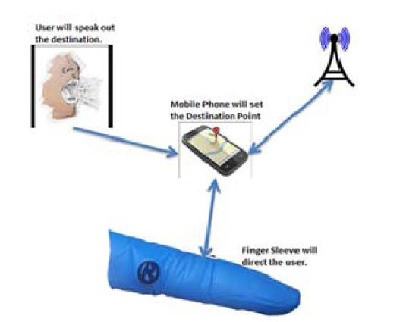
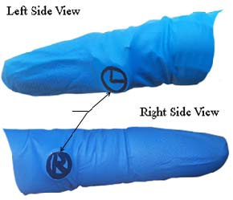
Architectural design of Finger Sleeve

Slide 5
Each vibrator corresponds to particular haptic navigational signal viz. Right or Left. Li-ion Rechargeable Battery Pack: Battery pack is responsible to power the Arduino nano. It is a rechargeable battery capable to maintain 80% capacity after 800 cycles. The smallest size of a battery pack, micro vibrator, Microcontroller Unit (MCU) and Bluetooth module helps Finger Sleeve to be worn easily.
There are few pre-requisites to be done on the Smartphone prior to start the application:
Start the Bluetooth and pair the Finger sleeve with Smartphone. However, this is done only once and henceforth Bluetooth connection will be automatically established.
Enable the GPS of Smartphone.
Wear Finger sleeve into the index finger.

Slide 6
Advantages of Finger sleeve technology
The system makes the authentication process quick and easy; however, it has other advantages, that are:
Quicker Authentication
Improves the Security System
Maximizes Convenience
Complete Control Over Access
Scalability
Flexible

Slide 7
Disadvantages of finger sleeve
The system may offer various advantages to enterprises; however, if you’re opting for it have a look at the disadvantages below:
Physical Disabilities
Expensive on the Pocket
Software Malfunction
Security Breaches
Fake Positives

Slide 8
CONCLUSION
In this seminar, we have presented the experimental results and in depth analysis of the Finger Sleeve prototype for navigation during walking and driving a car tasks. Finger Sleeve, a wearable navigational assistant, shows the potential of being effective navigational beacon. Preliminary studies of user reactions and feasibility of using such wearable navigational device suggest that it is an easy to use and apropos for the navigational needs of the user in present era.

Slide 9
RECOMMENDATIONS
Such navigational system stands a base for multiple applications, which can be extended from the basic version, such as:
Media controller for a Smartphone.
A wearable pointing device.
Customizable keys to be used along with the mouse.
Finger sleeve can help visually impaired, but it has to be integrated with obstacle detection systems.

Slide 10
THANK YOU

