Slide 1
Stevenson
Tour
Guide
By Akan Eyoh, Daniel Yan, and Ulysses Yu

Slide 2
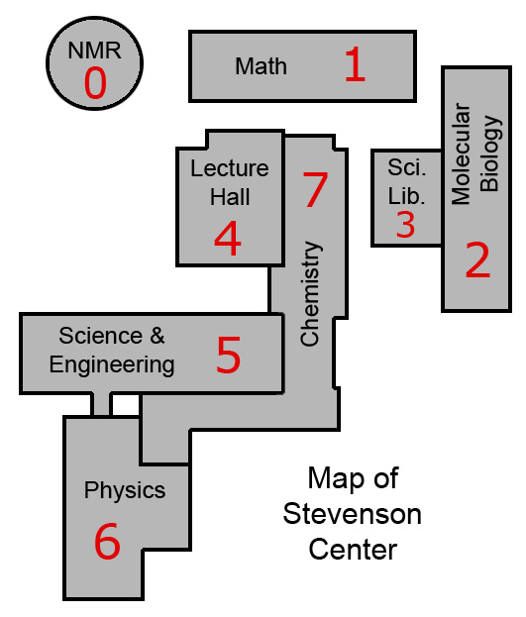
Problem
Stevenson Center is notorious for being difficult to navigate especially among first years during the first few days of class.

Slide 3
Solution
Stevenson Tour Guide:
build a phone app that presents the shortest path between two rooms in Stevenson Center

Slide 4
Demo

Slide 5




Tech Stack
Python backend runs Dijsktra’s shortest path on a graph representation of Stevenson (right now just the math building)
Django server obtains string input for rooms and produces a json object for the path
Android frontend takes user input, makes a get request to the Django server, and obtains the shortest path
Django server hosted in AWS EC2 instance

Slide 6
Testing
Unit tests written with the Pytest framework
Tests on Travis CI for automatic testing with commits:
https://travis-ci.org/AkanEyoh/StevensonTourGuide

Slide 7
Next Steps & Future Improvements
adding a picture for each instruction listed
Extending app to be usable in all 7 buildings
running the app on a 24/7 server
more specific directional instructions like “turn left” and “turn right”
Implementing the “Tour Guide Mode” which would take the user through all 7 buildings

