Slide 1
SMART BIN INDICATOR USING RASPBERRY PI

Slide 2
INTRODUCTION
Managing waste from trash bin has always been a major issue to the urban areas.
Trash management is one of the major concern in the modern era
It’s a a huge challenge to get rid of the trash management.
Can reduce unnecessary fuel costing of trucks by detecting the real time information of the trash bin.

Slide 3
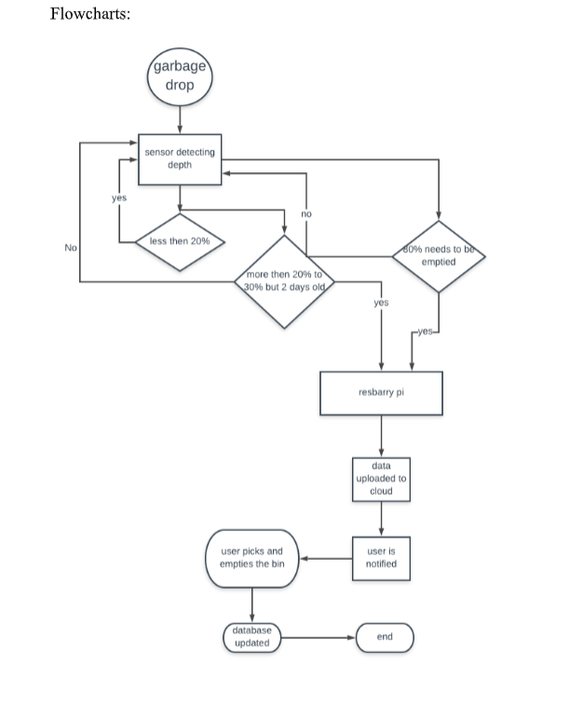
FLOWCHART

Slide 4
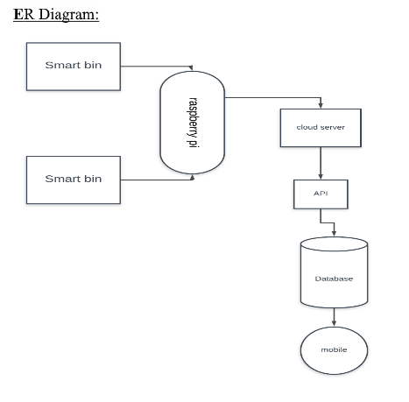
ER DIAGRAM

Slide 5
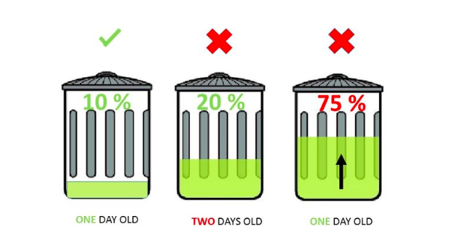
Planning

Slide 6
SWOT ANALYSIS
In the SWOT analysis we’ll discuss about
Strengths
Weaknesses
Opportunities
Threats

Slide 7
Strengths
Iot based
More efficient
Less resource needed
Less manpower needed

Slide 8
WEAKNESSES
Due to server down device might get damaged
Invalid objects might misread the desired value of the device.
Powered by battery
Threat
Significant unemployment may rise because of less man power and batter management system

Slide 9
THREATS
Significant unemployment may rise because of less man power and batter management system.

Slide 10
OPPORTUNITIES
If our project become a success and people are getting more used to our project that will increase our opportunities in the future.
More offices , residential areas school might be interested to our project that will be huge

Slide 11
APPLICATION
We can use our device in the main point of the streets
It can also be utilized in front of the school, shopping malls, hospitals where it needs the most.
We also can set this device in front of the houses or the offices.

Slide 12
CONCLUSION
All we want is a clean and healthy environment.
Better management system
Reduce human effort using the technology
Saving resources like fuels, gas etc.

