Slide 1

Frenbox
Social Platform Around Files Sharing
www.frenbox.com

Slide 2

Problem
Linda Needs This Semester’s Course Materials, She Goes to ask From Bob, Bob Says he doesn’t have it, He would ask Some One who should have.
Well Bob Asks A fellow Student who asks a fellow student, the question kept flying around.
AND
Finally Someone has it.

Slide 3

Problem
Peter creates courses, digital contents and He would like to monetize them.
He would love a platform where users would have to pay to access his contents, he should be able to add contents and his students would get them instantly.
He would also want his students to be able to reach out to him easily for one on one Support.

Slide 4
What Could have made Things easier for Linda and Bob?
A Globally accessible Repo where Files can be stored. That way everyone can just search for and get what they need.
For Peter, the Digital Content Creator?
A Platform that can allow only paid users to access your contents, delivers contents to paid users in almost realtime and allow users interact with you right there on the platform.

Slide 5
Frenbox
Stores your files in the Cloud
Gives the Choice to make files and folders globally accessible: files and folders is just a search away.
Sync files across Devices.
Helps set up paywalls so that only paid users can access your files.
Just like any social media platform, it has forums where users can interact and discuss around the shared files.

Slide 6
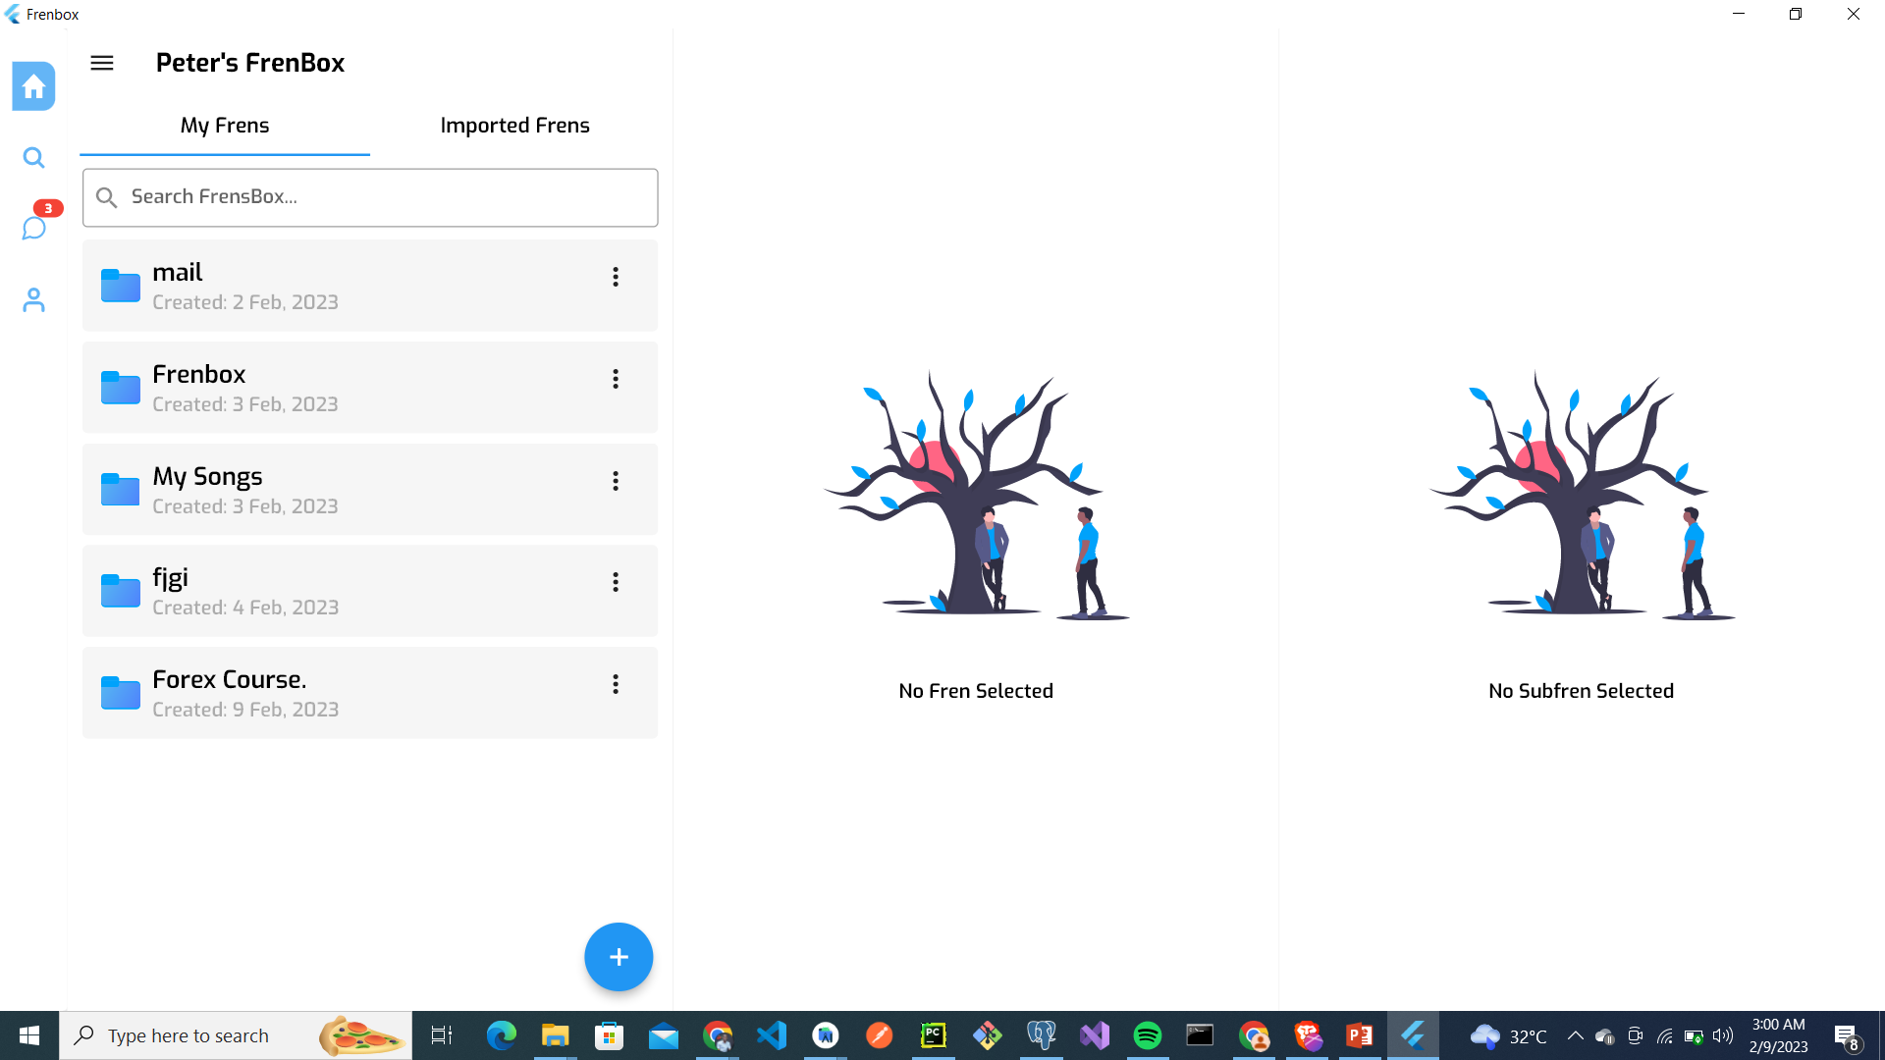
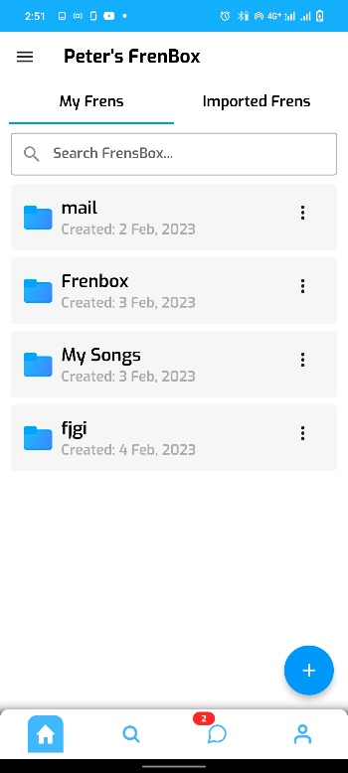
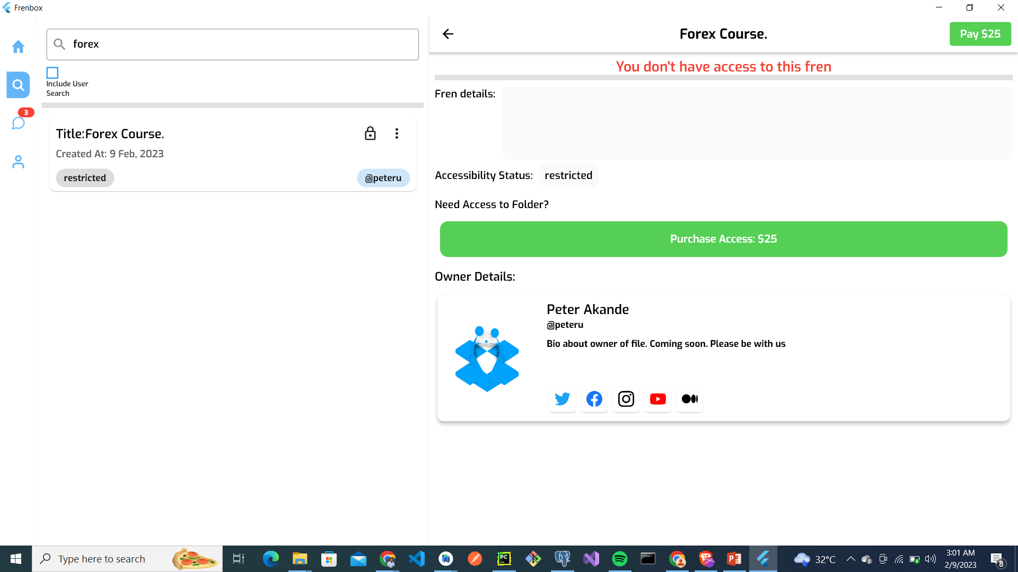
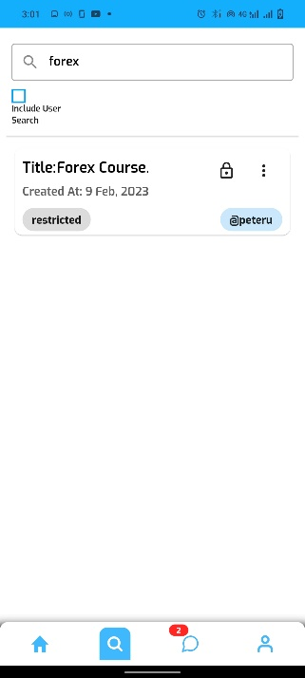
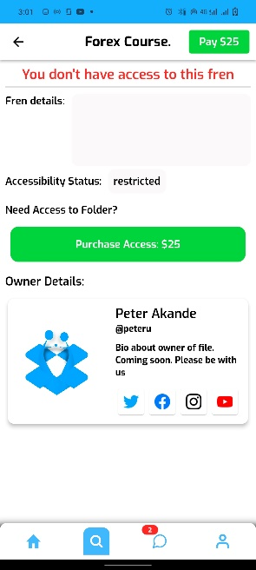
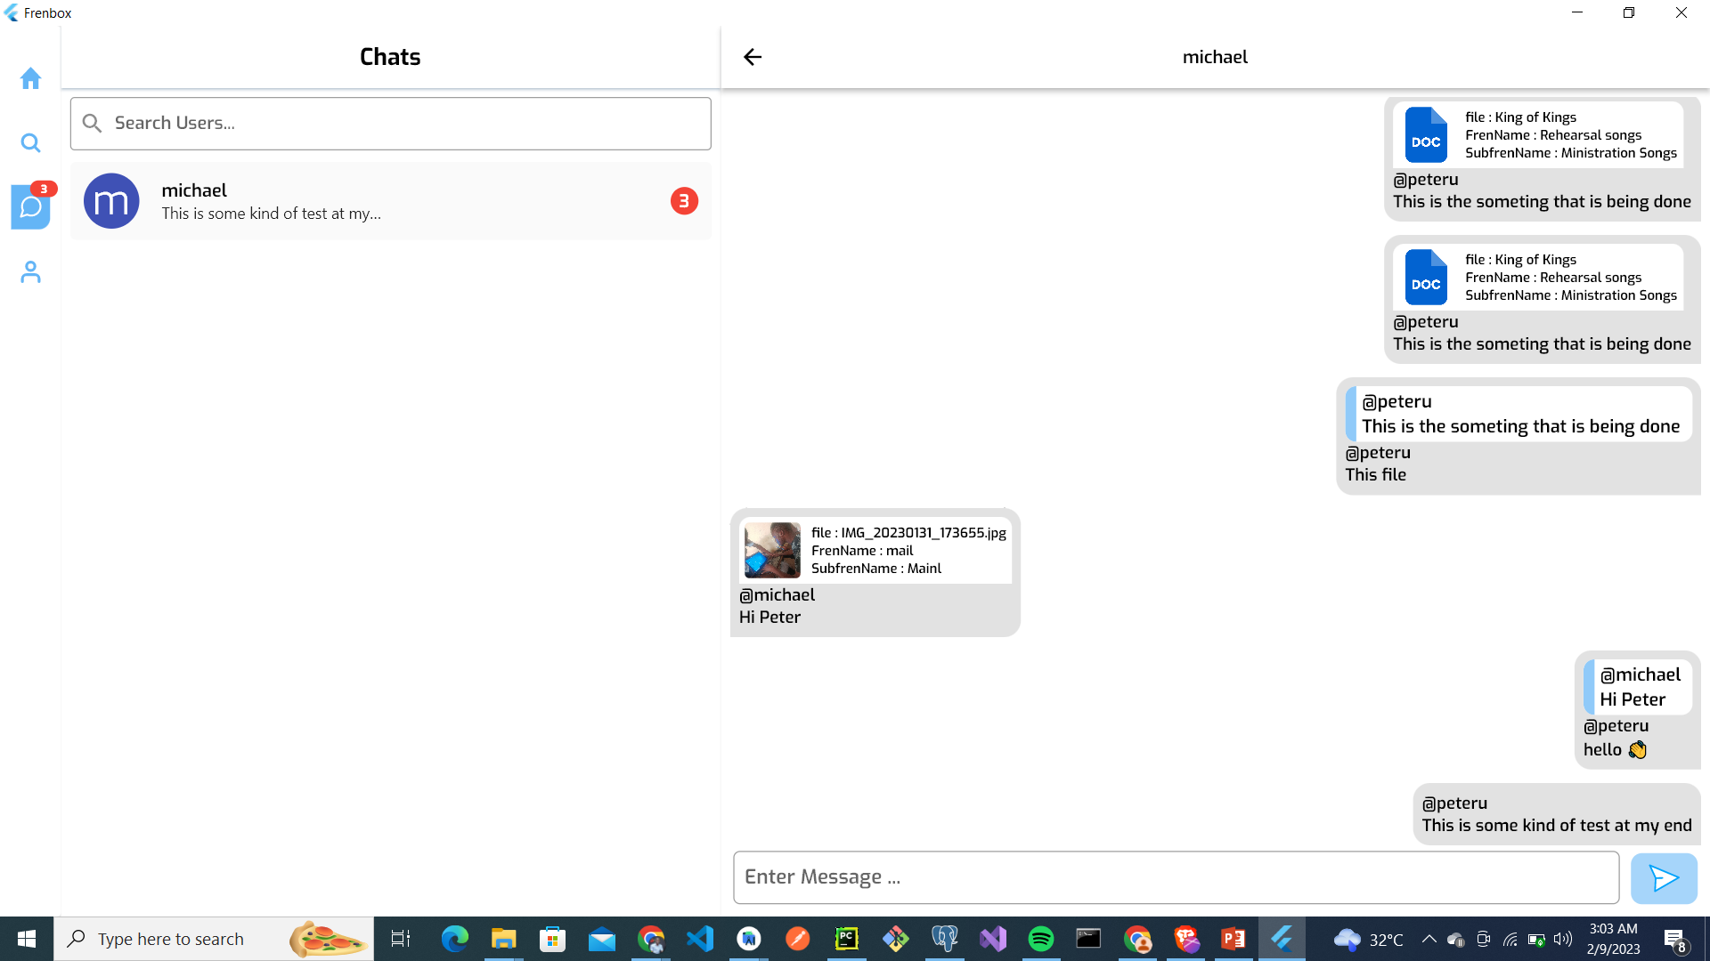
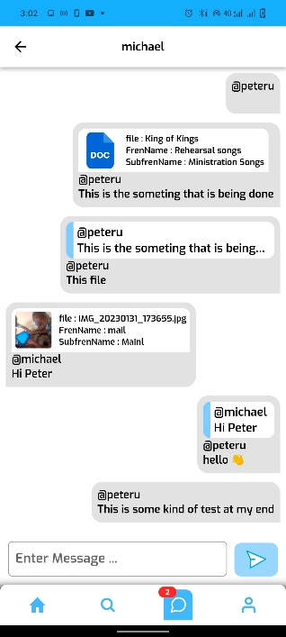
Demo

Slide 7
Who Can use Frenbox?
Anyone who would like to have their files backed up in the cloud.
Digital Content Creators who monetize their contents?
Lecturers of a school who would like to have a central folder to share his materials, one folder that anyone can search and access.
Schools can use Frenbox for their mini libraries.

Slide 8
Competitors
Dropbox
Google Drive
Gumroad
Etsy
Icedrive
Mega
Other Cloud Storage Services.

Slide 9
Business Model
Individuals: Freemium, A subscription would be needed if larger cloud storage space is desired.
Users with monetization in place: There would be a 5% charge for every subscriber who pays to access a Folder.

Slide 10
Customer Acquisition
Students are the initial targets
Have The whole Semester’s Materials and make use of School’s announcement channels to bring awareness.

Slide 11

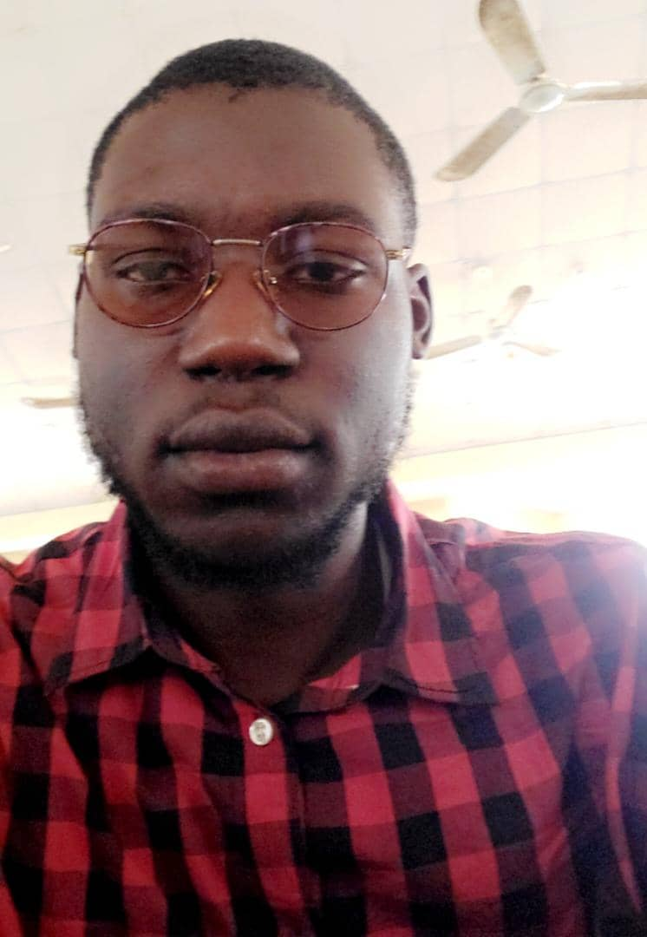
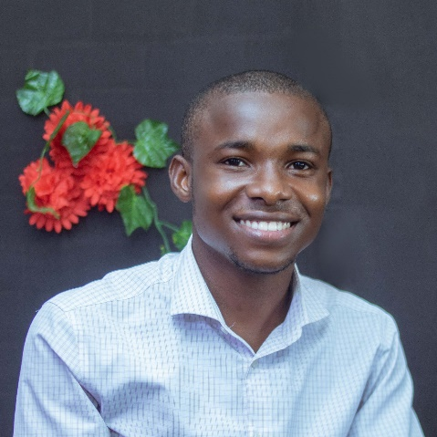

Team
Akande Peter.
Software Developer.
Team Lead
Aduwo Ayooluwa.
Software Developer
Agu Jonas
Software Developer
Akinpelu Micheal
Product Manager

