Slide 1

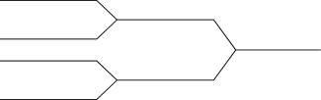
BUSINESS CASE 2
PREDICTING CANCELLATIONS
HOTEL CHAIN C - H2
Group V:
Anis Tmar (m20211157)
André Forte (m20210590)
Opeyemi Mary Akande (m20211320)
Rafael Nunes (m20210832)

Slide 2

Overview
Predicting Cancellations
Data Understanding
Deployment Suggestions
Modeling
Business
Understanding
Data Preparation
Business
Implications

Slide 3
Business
Understanding
Business Goal
Data Mining Goal
Reduce the number of cancellations in the total of bookings.
Rate down the cancellations to 20%
Build and optimize a algorithm that can predict if a booking is cancelled or not.

Slide 4




Data Understanding
First Notes
Classification Problem
Target is binary: cancellation and non-cancellation.
Imbalanced Dataset
The proportion of cancellations in the total of bookings is 41.7%.
Data Quality
25902 duplicated entries, 28 missing values and possible outliers.

Slide 5
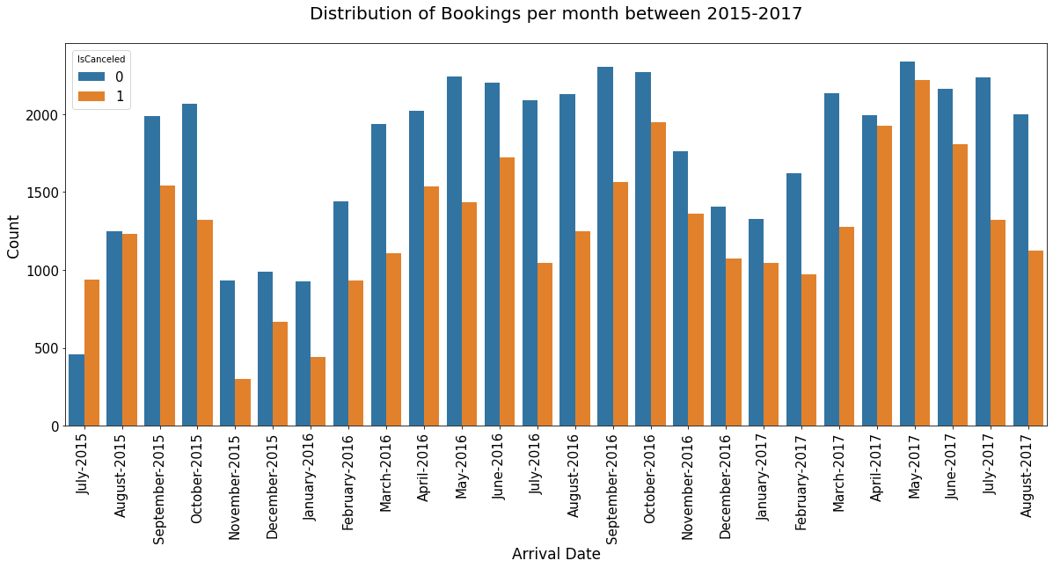
Distribution of Bookings
(2015-2017)
It is possible to see a
pattern across time
Seasonality

Slide 6
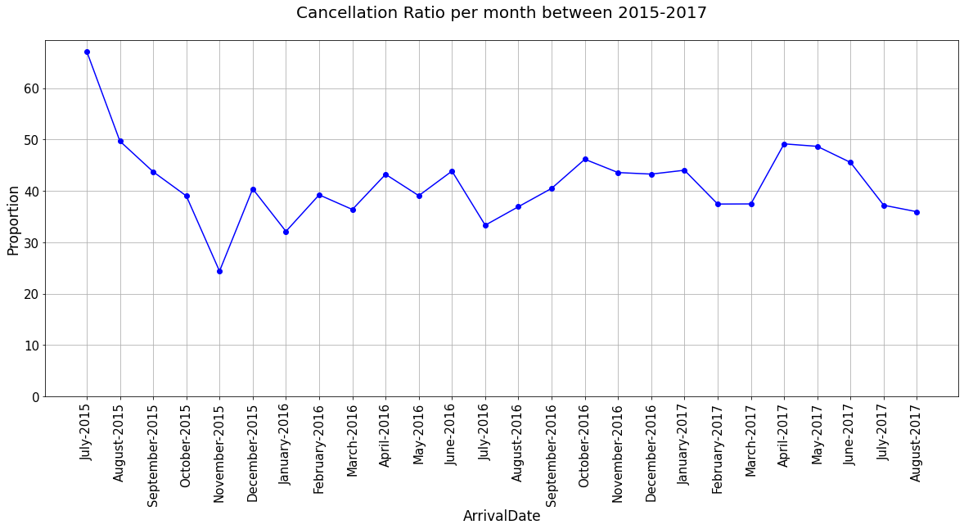
Cancellation Ratio (2015-2017)
Cancellation Ratio:
Proportion of cancellations in the total of bookings per month
Usually, cancellation ratios are higher during Spring and Summer months, but it doesn't mean we have more/less cancellations

Slide 7
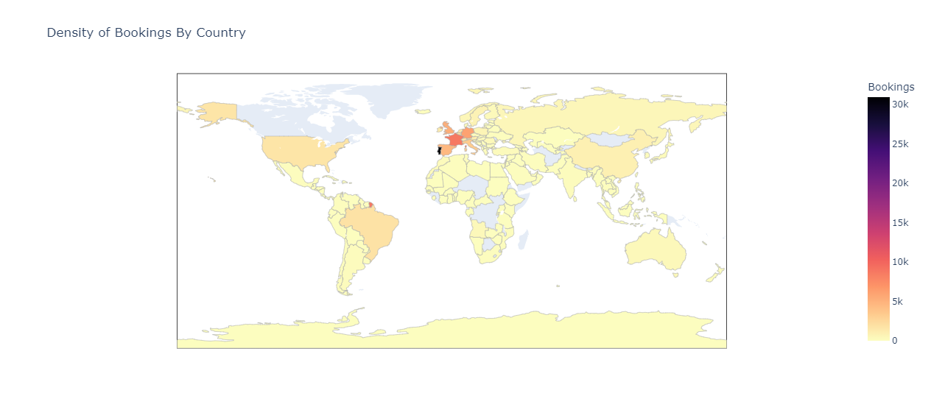
Guests' Countries (2015-2017)
The majority of the guests are coming from:
America
Europe

Slide 8
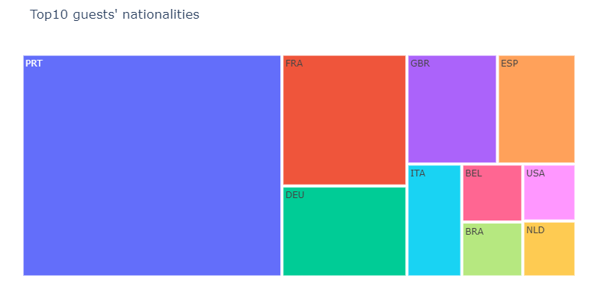
Top10 guests' nationalities
The majority of the guests are coming from:
Portugal
France
Germany

Slide 9
Data Understanding
Additional important information:
This is the first time of the most guests in the hotel, so they don’t register any previous cancellations
The majority of the customers tend to demand between 0 and 2 special requests
There are some rows without any guest which means that they don’t represent reservations
Most of the customers don’t require car parking spaces

Slide 10
Data Preparation
01
02
Cleaning Data
Feature Engineering
Missing values' Imputation using mode for the categorical and median for numeric variables.
Removed the rows which were not bookings.
Outliers' removal.
To reduce cardinality we transformed:
- Country
- Agent
- MarketSegment
New Variables: RoomChange and Kids
03
Data Normalization
To improve the efficiency of our modeling algorithm:
- OneHotEncoder for non-metric variables
- MinMaxScaler for metric variables

Slide 11
Modeling
Algorithms
Decision Tree
Random Forest
CatBoost
Evaluation Metrics
Precision
Recall
F1 score
High proportion of correct cancellations' predictions
High proportion of correct predicted cancellations in the actual cancellations
Weighted average of Precision and Recall
(important when we have imbalanced datasets)
AUC

Slide 12
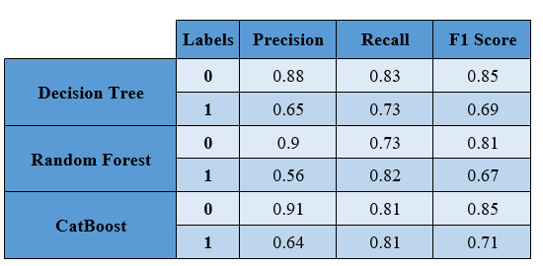
Modeling - Results
Considering the results, the CatBoost Classifier is the best model:
64% of our predicted cancellations were predicted correctly.
We can predict 81% of the actual cancellations.
It has the highest F1 score.
0- "No Cancellation"
1 - "Cancellation"

Slide 13
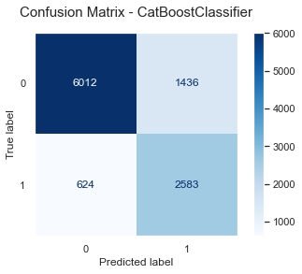
Modeling - Results

Slide 14
Business Implications
Variables' contribution to predictions:
TotalofSpecial Requests
RequiredCarParkingSpaces
Bookings with a high number of special requests have a low probability to cancel.
Bookings with a high number of required car parking spaces have a low probability to cancel.
Lead Time
Agent 9
Bookings with a high number days between reservation and arrival date have a high probability to cancel.
Bookings that are coming from Travel Agency 9 have a high probability to cancel.

Slide 15
Business Implications
The high number of False Negatives in our algorithm....
OVERBOOKING
SOLUTION:
offering them special services based on bookings’ value
However,
This approach could be a way to create important loyalty relationships with them, which might give them profit in a long term.

Slide 16
Suggested Deployment
Create a specific framework that could link different departments in the business process
Changes may occur - the model must be revised over time

Slide 17
Thank you!
Group V

