Slide 1
Review for the Final Exam
Lei Wu
Zhejiang University

Slide 2
Disclaimer
Many images and resources used in this lecture are collected from the Internet, and they are used only for the educational purpose. The copyright belong to the original owners, respectively.

Slide 3
Overview
The FINAL exam is scheduled
  Jun 27, 2023 @ 10:30 AM - 12:30 PM
  紫金港东1B-204
May check the grades later on “学在浙大”
  Feel free to let us know if there exists any problem

Slide 4
About the Final Exam
Will be open notes
  You can bring an A4 page of handwritten notes
Will be out of 100 points
  30 points for 15 single-choice questions
  70 points for 5 “big” questions

Slide 5
Topics for the Final Exam
Computer System & Von-Neumann Model
Number representation
Binary logic gates, boolean algebra & logic function
Basic Verilog
Combinational logic
Sequential logic
Computational operations & units
ISA & assembly programming language
CPU design

Slide 6
Topics for the Final Exam
Computer System & Von-Neumann Model
Number representation
Binary logic gates, boolean algebra & logic function
Basic Verilog
Combinational logic
Sequential logic
Computational operations & units
ISA & assembly programming language
CPU design

Slide 7
Abstract Layers of A COMPUTER SYSTEM
Application
Compiler / Libraries of Macros and Procedures
Software
Operating System
Operating System (OS)
Computer Architecture
Instruction Set Architecture (ISA)
Computer Organization
Computer Organization (Micro Architecture)
Digital Logic
Register Transfer Level (RTL)
Hardware
Digital Logic Circuit (DLC)
Device Technology

Slide 8
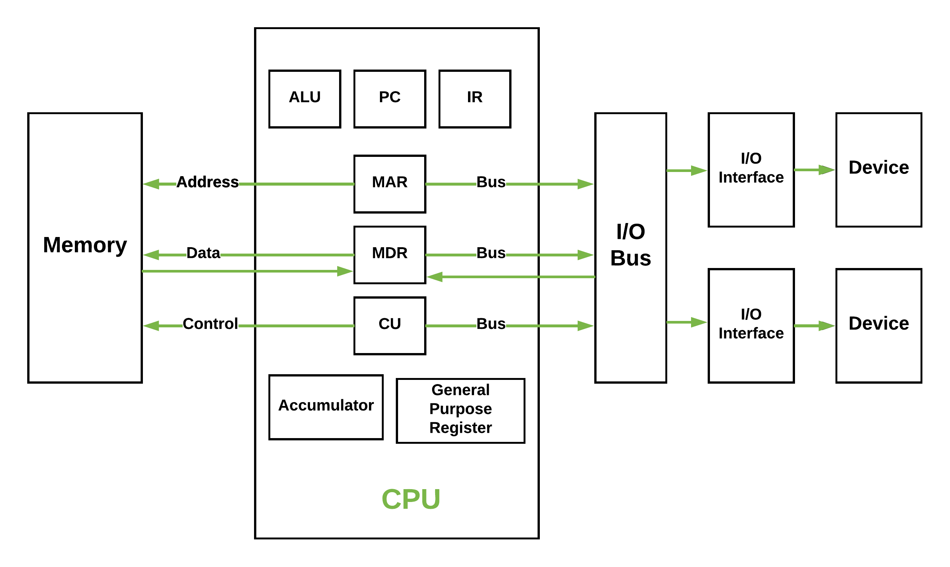
Details in Von-Neumann Model
https://media.geeksforgeeks.org/wp-content/uploads/vn_cpu.png

Slide 9
Topics for the Final Exam
Computer System & Von-Neumann Model
Number representation
Binary logic gates, boolean algebra & logic function
Basic Verilog
Combinational logic
Sequential logic
Computational operations & units
ISA & assembly programming language
CPU design

Slide 10
Number representation
Binary number representation
Representation of numeric data
Representation of non-numeric data
Data width and storage

Slide 11
Converting R-base to Decimal
To convert to decimal, use decimal arithmetic to form Σ (digit × respective power of R).
Convert (100101.01)₂to N₁₀:
  1*2⁵+0*2⁴+0*2³+1*2²+0*2¹+1*2⁰+0*2⁻¹+1*2⁻²=(37.25)₁₀
Convert 3A.CH to N₁₀:
  3*16¹+10*16⁰+12*16⁻¹=(58.75)₁₀
Notes:
Powers of 2: 43210
11010₂ =>
1 X 2⁴ = 16
+ 1 X 2³ = 8
+ 0 X 2² = 0
+ 1 X 2¹ = 2
+ 0 X 2⁰ = 0
26₁₀

Slide 12
Converting Decimal to R-base
To convert from one base to another:
  Convert the integer part
  Convert the fraction part
  Join the two results together

Slide 13
Number representation
Binary number representation
Representation of numeric data
Representation of non-numeric data
Data width and storage

Slide 14
Representation of Numeric Data
Fixed-point number representation
Representation of integers
Floating-point number representation
Binary codes for decimal digits

Slide 15
Fixed-point number representation
The number represented by the computer‘s internal code is called machine number, and the corresponding value is called true value.
After encoding X_{T} with n-bit binary numbers, the machine number X can be expressed as:
Unsigned integer
  0≤X ≤ 2^{n}-1
Signed integer
  Depend on the encoding method
Notes:
计算机内部编码表示后的数叫做机器数，机器数真正的值称为真值。
数值型数据在计算机内部的编码问题，本质上是机器数X的各位X_{i}的取值和真值X_{T}的关系问题。
True value: -10
Machine number: -1010B -> 11110110B

Slide 16
Representation of integers
Original code
Complement code
Inverse code
Frameshift code
Notes:
整数小数点固定，实数不固定。

Slide 17
IEEE Floating Point
Carnegie Mellon
IEEE Standard 754
  Established in 1985 as uniform standard for floating point arithmetic
    Before that, many idiosyncratic formats
  Supported by all major CPUs
Driven by numerical concerns
  Nice standards for rounding, overflow, underflow
  Hard to make fast in hardware
    Numerical analysts predominated over hardware designers in defining standard
Notes:
IEEE 标准 754
William Kahan 从1976年开始为Intel 设计(1989获图灵奖)
1985年成为浮点运算的统一标准，快速, 易于实现、精度损失小
优雅、易理解
所有主流的CPU都支持
之前有很多不同格式、不太关注精确性

Slide 18
Floating-point number representation
Carnegie Mellon
IEEE Standard 754
Numerical Form:
(–1)^{s} M 2E
  Sign bit s determines whether number is negative or positive
  Significand M normally a fractional value in range [1.0,2.0).
  Exponent E weights value by power of two
Encoding
  MSB s is sign bit s
  exp field encodes E (but is not equal to E)
  frac field encodes M (but is not equal to M)
s | exp | frac
Notes:
符号(sign)s， 决定数的符号，是正数(s=0)或负数(s=1)
尾数(Significand) M，二进制小数，数值范围: [1.0,2.0)
阶码(Exponent) E ，用2E将数值加权
浮点数编码
最高有效位(MSB)s，作为符号位s
exp 字段 编码E (和E不一定相等)
frac 字段编码尾数 M (和M不一定相等)

Slide 19
Number representation
Binary number representation
Representation of numeric data
Representation of non-numeric data
Data width and storage

Slide 20
7 BIT ASCII CODE TABLE
b6b5b4 b3b2b1b0 | 000 | 001 | 010 | 011 | 100 | 101 | 110 | 111
0000 | NUL | DLE | SP | 0 | @ | P | ， | p
0001 | SOM | DC | ! | 1 | A | Q | a | q
0010 | STX | DC | “ | 2 | B | R | b | r
0011 | ETX | DC | # | 3 | C | S | c | s
0100 | EOT | DC | $ | 4 | D | T | d | t
0101 | ENQ | NAA | % | 5 | E | U | e | u
0110 | ACA | SYN | & | 6 | F | V | f | v
0111 | BEL | ETB | ， | 7 | G | W | g | w
1000 | BS | CAN | ( | 8 | H | X | h | x
1001 | HT | EM | ) | 9 | I | Y | i | y
1010 | LF | SUB | * | : | J | Z | j | z
1011 | VT | ESC | + | ; | A | [ | k
1100 | FF | FS | ， | < | L | \ | l | |
1101 | CR | GS | － | = | M | ] | m
1110 | SO | RS | ． | > | N |  | n | ~
1111 | SI | US | / | ? | O | ← | o | DEL

Slide 21
Number representation
Binary number representation
Representation of numeric data
Representation of non-numeric data
Data width and storage

Slide 22
Topics for the Final Exam
Computer System & Von-Neumann Model
Number representation
Binary logic gates, boolean algebra & logic function
Basic Verilog
Combinational logic
Sequential logic
Computational operations & units
ISA & assembly programming language
CPU design

Slide 23
Binary Logic and Gates
Binary variables take on one of two values.
Logical operators operate on binary values and binary variables.
Basic logical operators are the logic functions AND, OR and NOT.
Logic gates implement logic functions.
Boolean Algebra: a useful mathematical system for specifying and transforming logic functions.
We study Boolean algebra as a foundation for designing and analyzing digital systems!

Slide 24
Binary Variables
Recall that the two binary values have different names:
  True/False
  On/Off
  Yes/No
  1/0
We use 1 and 0 to denote the two values.
Variable identifier examples:
  A, B, y, z, or X

Slide 25
Logical Operations
The three basic logical operations are:
  AND
  OR
  NOT
AND is denoted by a dot (·).
OR is denoted by a plus (+).
NOT is denoted by an overbar ( ¯ ), a single quote mark (') after, or (~) before the variable.

Slide 26

Truth Table
A tabular listing of the values of a function for all possible combinations of values on its arguments
Example: Truth tables for the basic logic operations:
AND
OR
X | Y | Z = X+Y
0 | 0 | 0
0 | 1 | 1
1 | 0 | 1
1 | 1 | 1
NOT
X
Y
Z = X·Y
X
Z
=
$$\overline{X}$$
0
0
0
0
1
0
1
0
1
0
1
0
0
1
1
1

Slide 27
Logic Gates
Perform logic functions:
  inversion (NOT), AND, OR, NAND, NOR, etc.
Single-input:
  NOT gate, buffer
Two-input:
  AND, OR, XOR, NAND, NOR, XNOR
Multiple-input
Please refer to the lectures for more details!
Notes:
Buffer：缓冲器，将一个“弱”逻辑信号转换为具有相同逻辑值的“强”逻辑信号的电路，时序不同。

Slide 28
Boolean algebra & logic function
Boolean algebra
Logic functions
Simplification of logic functions

Slide 29
Boolean algebra
Axioms
Theorems
  Single variable
  2-3 variables
  n variables
Identities & duality

Slide 30
Boolean algebra & logic function
Boolean algebra
Logic functions
Simplification of logic functions

Slide 31
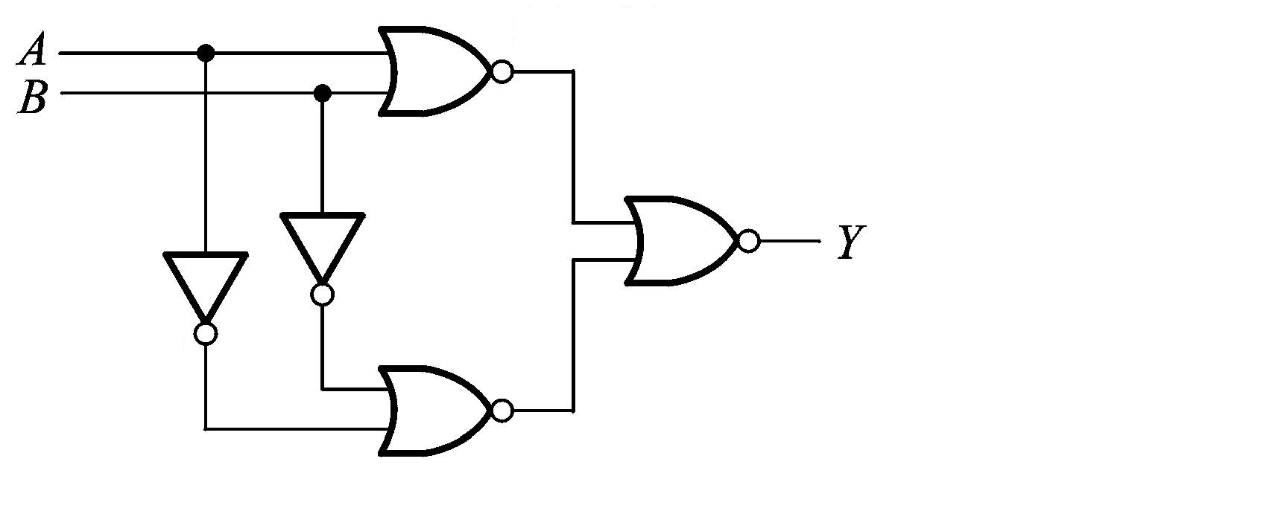
Representation of Logic Functions
Logic Functions
  F(X₁, X₂, …, X_{n})
Representations of Logic Functions
  Truth Table
  Waveforms
X₁ | … | X_{n} | F
0 | … | 1 | 0
0 | … | 0 | 1
1 | … | 1 | 1
… | … | … | …
0 | … | 0 | 1
X₁
X₂
…
X_{n}
F
…
…
…
…
…
Notes:
逻辑函数是反映输入变量和输出变量之间关系的逻辑关系表达式。
每一组输入组合都有一个确定的输入值，F(x,y)有4个输入，则输出有16种组合，那么就对应着16个不同的逻辑函数F_{i}(x,y)
F(A, B) = Y = ((A + B)’ + (A’ + B’))’

Slide 32
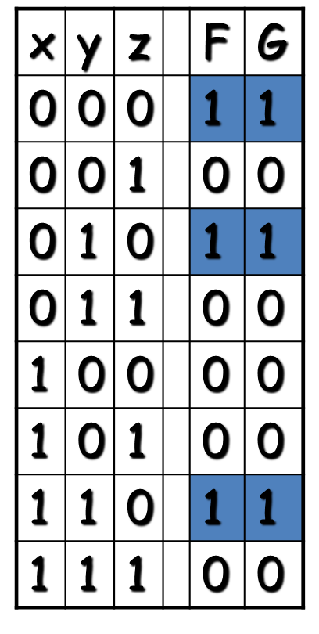
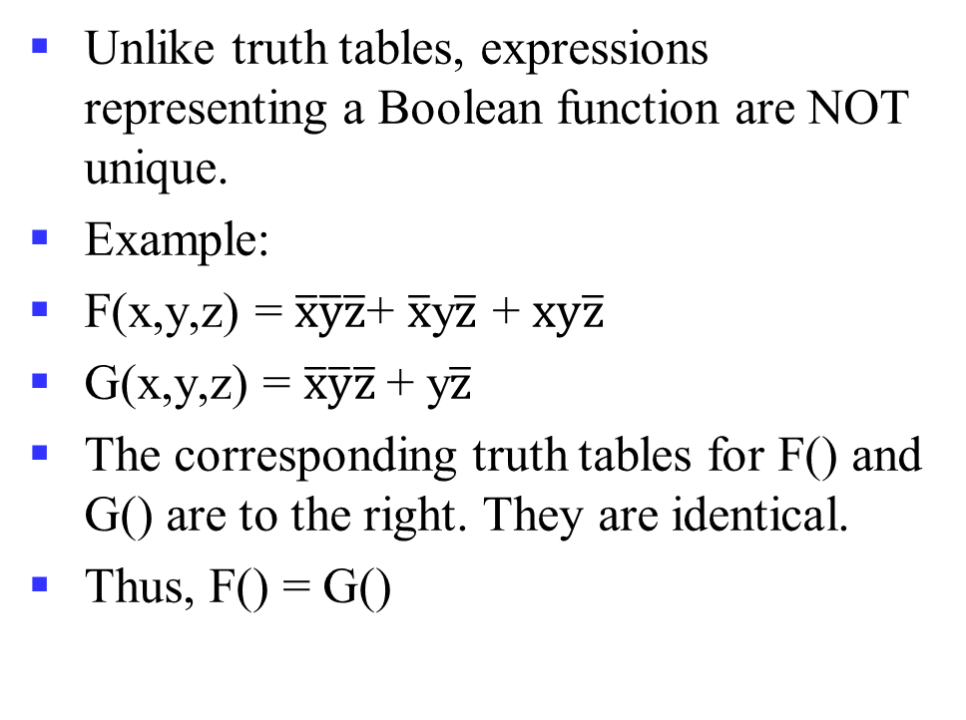
Boolean expressions-NOT unique
Unlike truth tables, expressions representing a Boolean function are NOT unique.
Example:
F(x,y,z) = $\overline{x}\overline{y}\overline{z}$+ $\overline{x}$y$\overline{z}$ + $xy\overline{z}$
G(x,y,z) = $\overline{x}\overline{y}\overline{z}$+ y$\overline{z}$
The corresponding truth tables for F() and G() are to the right. They are identical.
Thus, F() = G()

Slide 33
Complement of a Function
The complement of a function is derived by interchanging (• and +), and (1 and 0), and complementing each variable.
Otherwise, interchange 1s to 0s in the truth table column showing F.
The complement of a function IS NOT THE SAME as the dual of a function.

Slide 34
Canonical and Standard Forms
We need to consider formal techniques for the simplification of Boolean functions.
  Identical functions will have exactly the same canonical form.
  Minterms and Maxterms
  Sum-of-Minterms and Product-of-Maxterms
  Product and Sum terms
  Sum-of-Products (SOP) and Product-of-Sums (POS)
Notes:
Canonical and Standard
规范型和标准型

Slide 35
Boolean algebra & logic function
Boolean algebra
Logic functions
Simplification of logic functions

Slide 36
Simplification of Logic Functions
Algebra Method
  Use the theorems
Karnaugh Map
  Graphical representations

Slide 37
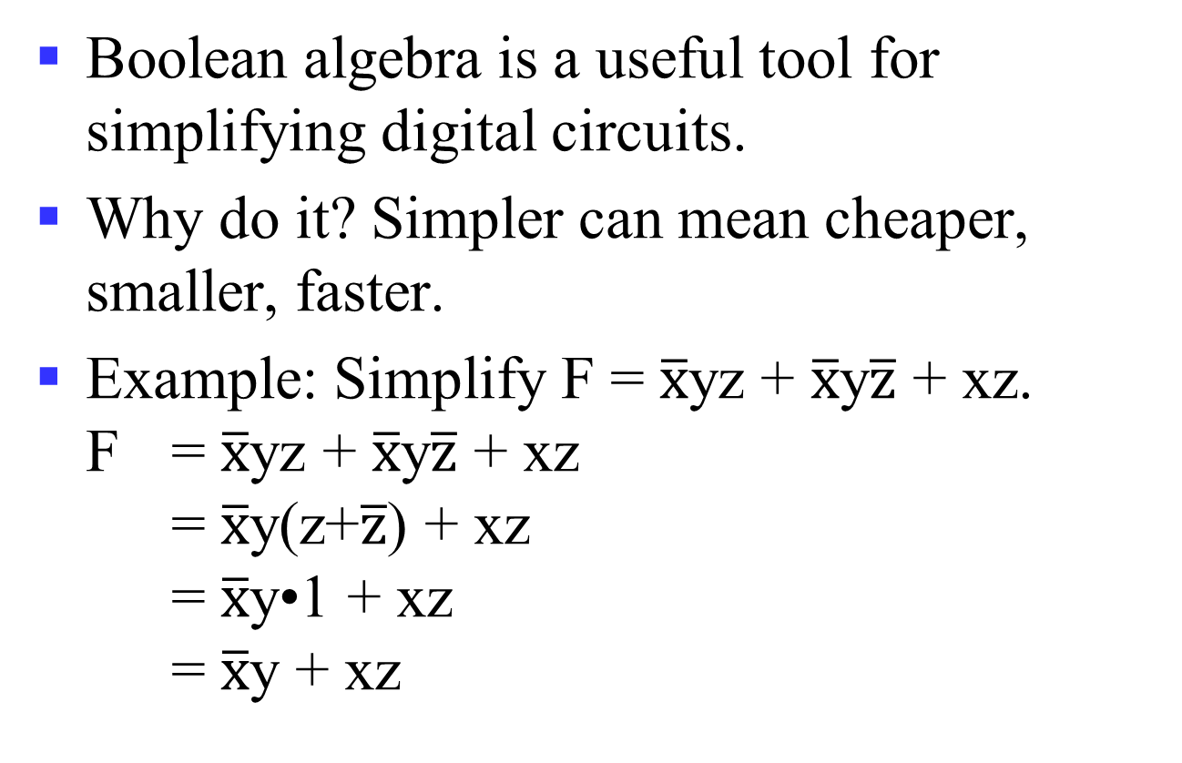
Algebraic Manipulation
Boolean algebra is a useful tool for simplifying digital circuits.
Why do it? Simpler can mean cheaper, smaller, faster.
Example: Simplify F = $\overline{x}$yz + $\overline{x}$y$\overline{z}$ + xz.
F = $\overline{x}$yz + $\overline{x}$y$\overline{z}$ + xz
= $\overline{x}$y(z+$\overline{z}$) + xz
= $\overline{x}$y•1 + xz
= $\overline{x}$y + xz

Slide 38
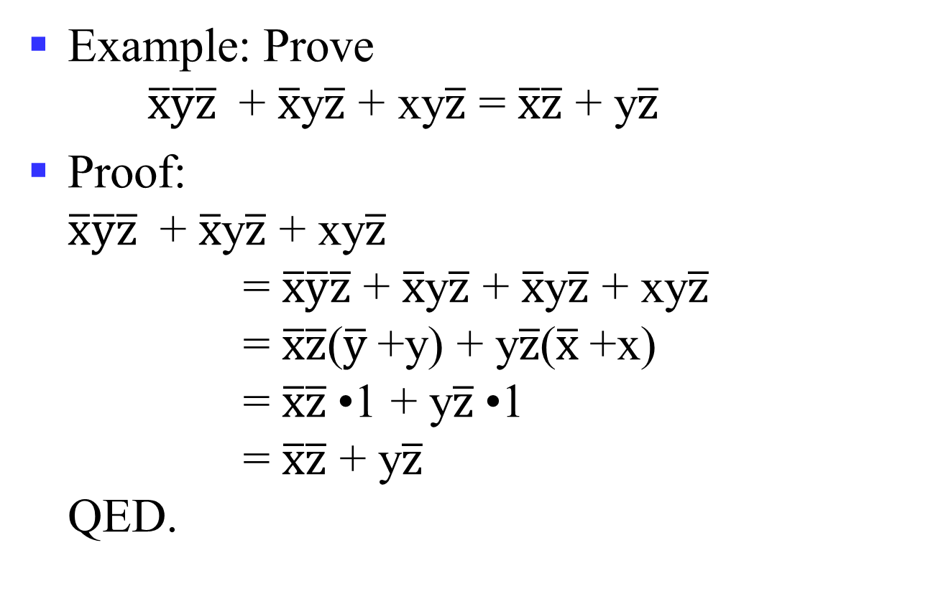
Algebraic Manipulation (cont.)
Example: Prove
$\overline{x}\overline{y}\overline{z}$ + $\overline{x}$y$\overline{z}$ + xy$\overline{z}$ = $\overline{x}\overline{z}$ + y$\overline{z}$
Proof:
$\overline{x}\overline{y}\overline{z}$ + $\overline{x}$y$\overline{z}$ + xy$\overline{z}$
= $\overline{x}\overline{y}\overline{z}$ + $\overline{x}$y$\overline{z}$ + $\overline{x}$y$\overline{z}$ + xy$\overline{z}$
= $\overline{x}\overline{z}$($\overline{y}$+y) + y$\overline{z}$($\overline{x}$+x)
= $\overline{x}\overline{z}$•1 + y$\overline{z}$•1
= $\overline{x}\overline{z}$ + y$\overline{z}$
QED.

Slide 39
Karnaugh Maps (K-map)
Karnaugh maps (K-maps) are graphical representations of boolean functions.
One map cell corresponds to a row in the truth table.
Also, one map cell corresponds to a minterm or a maxterm in the boolean expression
Multiple-cell areas of the map correspond to standard terms.

Slide 40
n-variable Karnaugh Map
matrix with 2^{n} cells
  E.g., 2-variables, 3-variables and 4-variables
W
X
X
WX
 | 00 | 01 | 11 | 10
00 | m₀ | m₄ | m₁₂ | m₈
01 | m₁ | m₅ | m₁₃ | m₉
11 | m₃ | m₇ | m₁₅ | m₁₁
10 | m₂ | m₆ | m₁₄ | m₁₀
X
XY
YZ
 | 0 | 1
0 | m₀ | m₂
1 | m₁ | m₃
 | 00 | 01 | 11 | 10
0 | m₀ | m₂ | m₆ | m₄
1 | m₁ | m₃ | m₇ | m₅
Y
Z
Y
Z
Z
Y
Y
X

Slide 41
Some Uses of K-Maps
Finding optimum or near optimum
  SOP and POS standard forms, and
  two-level AND/OR and OR/AND circuit implementations
for functions with small numbers of variables
Visualizing concepts related to manipulating Boolean expressions, and
Demonstrating concepts used by computer-aided design programs to simplify large circuits

Slide 42
Simplification of Logic Functions
Example: F(X, Y, Z) = ∑ m(3, 5, 6, 7)
X
Index | X Y Z | F(X, Y, Z)
0 | 0 0 0 | 0
1 | 0 0 1 | 0
2 | 0 1 0 | 0
3 | 0 1 1 | 1
4 | 1 0 0 | 0
5 | 1 0 1 | 1
6 | 1 1 0 | 1
7 | 1 1 1 | 1
XY
 | 00 | 01 | 11 | 10
0 |  |  | 1
1 |  | 1 | 1 | 1
Z
Z
Y
XY
X · Y
 | 00 | 01 | 11 | 10
0 |  |  | 1
1 |  | 1 | 1 | 1
Z
X · Z
Y · Z

Slide 43
K-Map Definitions
Implicant
  Product of literals ABC, AC, BC
Prime implicant
  implicant corresponding to the largest circle in a K-map, i.e., is a product term obtained by combining the maximum possible number of adjacent squares in the map into a rectangle with the number of squares a power of 2.
Essential prime implicant
  A prime implicant is called an Essential Prime Implicant if it is the only prime implicant that covers (includes) one or more minterms.
Notes:
Implicant：蕴涵项，如果一个乘积项包含了一个或多个最小项，那么称之为蕴涵项
Prime implicant：质蕴涵项，如果某个蕴涵项不能被该函数的其它蕴涵项所覆盖，则称为质蕴涵项
如xy=x’yz+xyz，因此yz覆盖了最小项x’yz和xyz
如果逻辑函数的所有最小项都能被一组质蕴涵项覆盖，则该组质蕴涵项称为函数的一个覆盖，一定包含了所有的实质蕴涵项
Prime Implicants and Essential Prime Implicants can be determined by inspection of a K-Map.
A prime implicant is called an Essential Prime Implicant if it is the only prime implicant that covers (includes) one or more minterms.

Slide 44
K-Map Rules
Every 1 must be circled at least once
Each circle must span a power of 2 (i.e. 1, 2, 4) squares in each direction
Each circle must be as large as possible
A circle may wrap around the edges
A “don't care” (X) is circled only if it helps minimize the equation
Notes:
A Prime Implicant is a product term obtained by combining the maximum possible number of adjacent squares in the map into a rectangle with the number of squares a power of 2.
A set of prime implicants "covers all minterms" if, for each minterm of the function, at least one prime implicant in the set of prime implicants includes the minterm.

Slide 45
Example of Prime Implicants
Find ALL Prime Implicants
CD
ESSENTIAL Prime Implicants
C
C
B
D
B
D
1
1
1
1
1
1
BD
1
1
BD
1
1
B
B
1
1
1
1
A
A
A
B
1
1
1
1
1
1
1
1
D
D
AD
B
C
Minterms covered by single prime implicant

Slide 46
Prime Implicant Selection Rule
Minimize the overlap among prime implicants as much as possible. In particular, in the final solution, make sure that each prime implicant selected includes at least one minterm not included in any other prime implicant selected.

Slide 47
Selection Rule Example
Simplify F(A, B, C, D) given on the K-map
Selected
Essential
C
C
1
1
1
1
1
1
1
1
1
1
1
1
B
B
1
1
A
A
1
1
1
1
D
D
Minterms covered by essential prime implicants

Slide 48
Selection Rule Example with Don't Cares
Simplify F(A, B, C, D) given on the K-map
Selected
Essential
C
C
1
x
1
x
1
x
x
1
1
x
x
1
B
B
x
x
A
A
1
1
x
1
1
x
D
D
Minterms covered by essential prime implicants

Slide 49
Systematic Simplification
Example: ∑ _{m}(1, 2, 5, 7, 8, 10, 12, 13, 15)
AB
AB
AB
 | 00 | 01 | 11 | 10
00 |  |  | 1 | 1
01 | 1 | 1 | 1
11 |  | 1 | 1
10 | 1 |  |  | 1
 | 00 | 01 | 11 | 10
00 |  |  | 1 | 1
01 | 1 | 1 | 1
11 |  | 1 | 1
10 | 1 |  |  | 1
 | 00 | 01 | 11 | 10
00 |  |  | 1 | 1
01 | 1 | 1 | 1
11 |  | 1 | 1
10 | 1 |  |  | 1
CD
CD
CD
Notes:
F(A,B,C,D) = BD + A’CD+ B’CD’+AC’D’

Slide 50
Topics for the Final Exam
Computer System & Von-Neumann Model
Number representation
Binary logic gates, boolean algebra & logic function
Basic Verilog
Combinational logic
Sequential logic
Computational operations & units
ISA & assembly programming language
CPU design

Slide 51
Verilog HDL
Basic syntax
Modeling methods

Slide 52
Basic Syntax: Module, Port and Instantiate
Module and port
module model-name (port list);
<Port definition> - optional
Data type definition
Logic function description
endmodule
Instantiate
model-name instance-identifier (port related list);
  module top(
  input a,
  input b,
  output c
  );
  assign c = a & b;
  endmodule
  module sim_top();
  reg a_in,b_in;
  wire c_out;
  top dut(
  .a(a_in),
  .b(b_in),
  .c(c_out)
  );
  initial begin
  a_in = 1’b0;
  b_in = 1’b0;
  #2
  b_in = 1’b1;
  #2
  a_in = 1’b1;
  #2
  $finish;
  end
  always @(*) begin
  $display(“a=%d,b=%d,c=%d, a_in,b_in,c_out);
  end
  endmodule
Notes:
sim_top是父模块，top是子模块，模块实例化建立了父模块的信号和子模块的端口之间的关联。
数字逻辑电路内部可视为若干元件和若干结点互连而成，每个结点时若干连线的汇集点，会给于同一结点的所有连线上传输的时同一个信号。
元件和结点（或连线）时两类基本要素。元件可抽象为模块，而汇集于同一结点的物理连线则代表同一个信号，描述了多个元件或模块之间应该如何连接。因此，数字电路设计可归纳为：实例化元件或模块并用线将它们连接起来。

Slide 53
Basic Syntax: Data Type
Net
  Physical connection (wire type)
Register
  Storage element (reg type)
Vectors and Arrays
  Vector: multi-bit signal
    E.g., wire[7:0] a; reg[31:0] rdata, wdata;
  Array:
    E.g., wire b[2:0] or reg[15:0] mem [1023:0]
Parameter
  Local scope (the current module)
  Usually defined as constant
Notes:
网线类型：用于表示原件或模块之间的物理连接，可综合电路中，最常用的是wire，也是端口表达式声明的默认数据类型，其它类型大部分不可综合或很少使用；
寄存器类型：表示抽象的存储元件，可综合电路中最常用的是reg，其它很少使用；
向量和数组：允许多个一位信号组成整体操作，即向量；可构成数组，使用时只能单个元素引用，早期（2001之前？）不能引用内部比特位，之后可以。
参数类型：用于给常量赋予有意义的标识符，提高可读性，类似C语言的typdef

Slide 54
Basic Syntax: Data Type (cont’d)
Module’s port type
  Input
    Definition: wire
    Instantiate: wire or reg
  Output
    Definition: wire or reg
    Instantiate: wire
  module Right (
  input in1,
  input wire in2,
  input [3:0] in3,
  output out1,
  output [3:0] out2,
  output reg [1:0] out3
  );
  …
  endmodule
  module Wrong (
  input reg in1, output out1 [2:0]
  );
  …
  endmodule
Notes:
模块端口可定义为向量，不能为数组
允许关联信号的位宽于端口尾款不同，会有警告，需仔细检查并排除
允许端口保持未关联状态，可认为未关联的输出端口不被使用；但未关联的输入端口缺省值是高阻态，并非可综合电路的特性，一般综合器会用0作为缺省值，对于低电平有效的输入端口而言可能会导致非预期结果。

Slide 55
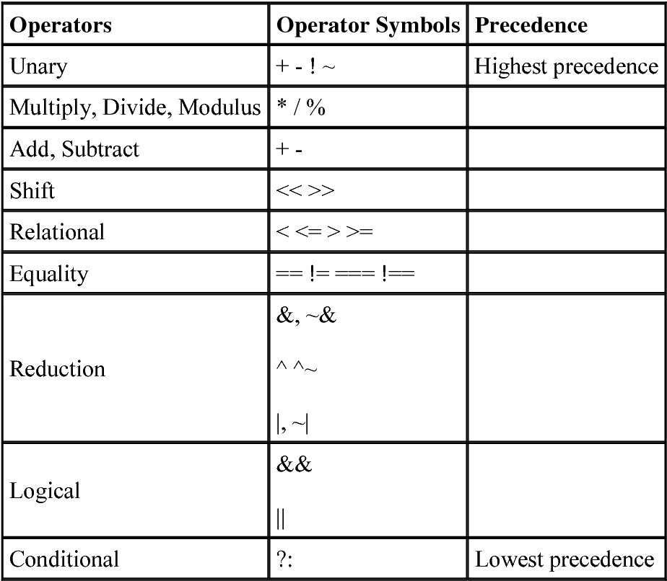
Basic Syntax: Operator and Precedence
Unary operators:
  + -
Bitwise operators
  ~ & | ^ ^~
Arithmetic operators
  + - * / %
Reduction operators
  & ~& | |~ ^ ^~
Logic operators
  && || !
Logic equality operators
  == !=
Relational operators
  < <= > >=
Bit Concatenation operators
  { }
Shift operators
  >> <<
Conditional operator
  ?:

Slide 56
Modeling methods
Structured modeling
  Module-level
  Gate-level
  Switch-level
Dataflow modeling
  Suitable for modeling combinational logic circuits
  Use continuous assignment statements: assign
Behavioral modeling
  Key elements: always
  always @(event signal list) procedure statement
Notes:
结构化建模：将电路描述程一个分级的子模块系统，并通过逐层调用子模块来构建复杂的系统，根据子模块不同的抽象级别，可分为三类
模块级结构化建模：通过调用用户设计的子模块对电路建模；
门级结构化建模：通过调用Verilog内建的基本门级元件（如或、与、非门）来对电路建模；
开关级结构化建模：通过调用Verilog内建的基本开关元件（如晶体管等）来对电路建模；
数据流建模：从数据的视角出发，通过描述数据在电路中的流动方向来描述电路的功能，可用于组合逻辑电路（大部分组合逻辑电路都是采用数据流建模方式描述），不适用于时序逻辑电路（因涉及数据的存储和更新）；主要通过连续赋值语句进行建模，需注意：
多个连续赋值语句之间是并行关系；
Verilog中未定义的信号缺省为位宽为1的wire类型，如果对一个未定义的变量赋值，则相当于对该wire类型变量进行驱动，若此时赋值号右边表达式结果为向量，则会发生位宽的截断，可能会造成行为与预期不符。
不能对相同的网线进行重复驱动。
所描述的电路不能出现组合回路。
3)和4)符合组合逻辑电路的要求。
行为建模：通过一系列以高级编程语言编写的过程块来描述数字系统的功能，主要从整个系统的功能考，无需关注电路的具体结构，由综合器根据过程块所描述的行为综合处实现该行为的电路结构。
always是关键要素，表示当事件信号列表中任意一个信号发生变化时，过程语句中的信号将按照所描述的行为进行更新；
过程语句中被赋值的只能是reg类型变量；
一个模块中可以有多个always语句，之间是并行关系；
事件信号列表可以是单个或多个信号（用逗号或关键字or连接），还可以是星号（*），表示隐式事件信号列表，是过程语句中赋值号右侧所有信号集合的简写方式，即赋值号右侧任意一个信号发生变化都会导致左侧的信号进行更新，与数据流建模的连续赋值语句行为类似，可通过隐式事件信号列表的always语句对组合逻辑电路进行建模。
行为建模方式跟接近人的思考方式，大大提升了效率，代码可读性也更好，大部分时序逻辑电路采用行为建模方式开发。但由于特性较多、方式灵活，且可以不考虑电路的具体结构，所以初学者很容易编写出有问题的代码，包括仿真行为正确但无法综合，仿真行为正确且可综合但综合后电路行为不正确等。

Slide 57
Topics for the Final Exam
Computer System & Von-Neumann Model
Number representation
Binary logic gates, boolean algebra & logic function
Basic Verilog
Combinational logic
Sequential logic
Computational operations & units
ISA & assembly programming language
CPU design

Slide 58
Combinational logic
About combinational logic circuits
Some classic/basic designs
Timing analysis

Slide 59
Combinational Logic Circuit
A combinational logic circuit has:
  A set of m Boolean inputs,
  A set of n Boolean outputs, and
  n switching functions, each mapping the 2^{m} input combinations to an output such that the current output depends only on the current input values
A block diagram:
Combinational
Circuit
n-inputs
•
m-outputs
•
•
•
•
•
Notes:
A combinational circuit consists of logic gates whose outputs, at any time, are determined by combining the values of the inputs.
For n input variables, there are 2^{n} possible binary input combinations.
For each binary combination of the input variables, there is one possible output.

Slide 60
Combinational vs. Sequential Circuits
Combinational circuits are memory-less
  The output value depends ONLY on the current input values.
Sequential circuits consist of combinational logic as well as memory elements (used to store certain circuit states)
  Outputs depend on BOTH current input values and previous input values (kept in the storage elements).
Notes:
A combinational circuit consists of logic gates whose outputs, at any time, are determined by combining the values of the inputs.
For n input variables, there are 2^{n} possible binary input combinations.
For each binary combination of the input variables, there is one possible output.

Slide 61
Combinational vs. Sequential Circuits
n-inputs
Combinational
Circuit
m-outputs
(Depend only on inputs)
Combinational Circuit
n-inputs
m-outputs
Combinational
Circuit
Storage
Elements
Next
state
Sequential Circuit
Notes:
门电路实现的是1位运算，如果是n位的逻辑值运算，只需重复使用n个相同的门电路即可。
无需画出所有的，只需在输入端和输出端标注位数即可。
n位表示方法，textbook page #59

Slide 62
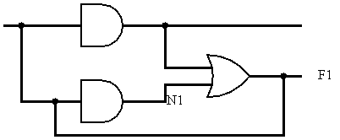
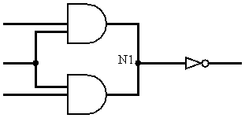
Characteristics of Combinational Logic Circuits
Each element is a combinational logic circuit.
A node can only be the output of one element.
Loop is not allowed.
Notes:
任何一个逻辑表达式都可以写成与、或、非三种基本的逻辑组合，因此任何一个组合逻辑电路都可以用与门、或门和非门的组合来描述。
最简单的组合逻辑电路是逻辑门电路。组合逻辑电路的构成规则规定了如何由门电路和简单组合电路构成更复杂的组合逻辑电路：
每个元件本身是组合逻辑电路；
不存在同一个结点同时是两个元件的输出结点；
不存在回路。

Slide 63
Design Choice Of Combinational Circuits
2-level vs. multi-level
  Gate delay
  Fan-in/fan-out
  Trade-off between cost and speed
Notes:
每个逻辑表达式都可转换为规范/标准型，因此任何逻辑电路都可以是一个两级电路。
从逻辑门的输入信号改变开始，到输出信号发生改变所用的时间。两级电路延迟短，运算速度快。
两级电路所需硬件数量成倍增长，有时不可实现。
如F = A xor B xor C = A’B’C + ‘ABC’ + AB’C’ + ABC，两级电路需要4个3输入端与门和4个输入端或门，而多级电路只需串联两个异或门。
如果是8输入端异或门，两及电路要求128个8输入端与门和一个128输入端或门，无法实现；多级电路只需串联7个2输入端异或门。

Slide 64
How to Design Combinational Logic Circuits
Design procedure
  Determine inputs, outputs and their logic relationship
    Truth table
  Determine logic functions and perform optimization
    Algebra or K-map
  Draw logic circuit diagram and timing diagram
    Timing analysis

Slide 65
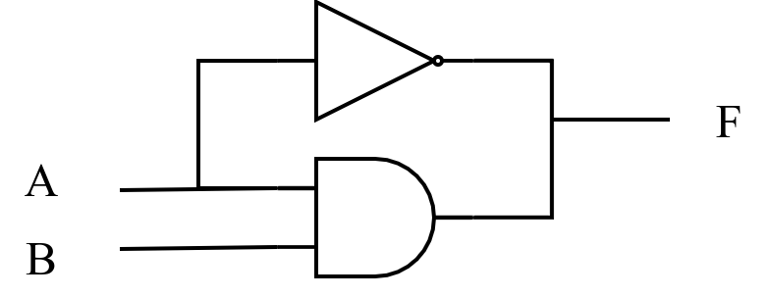
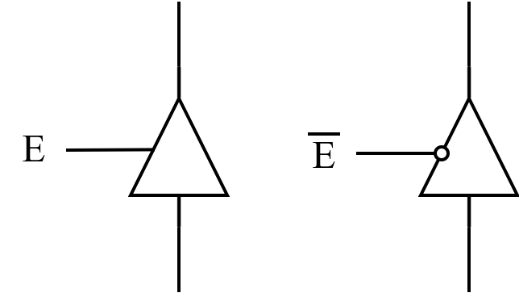
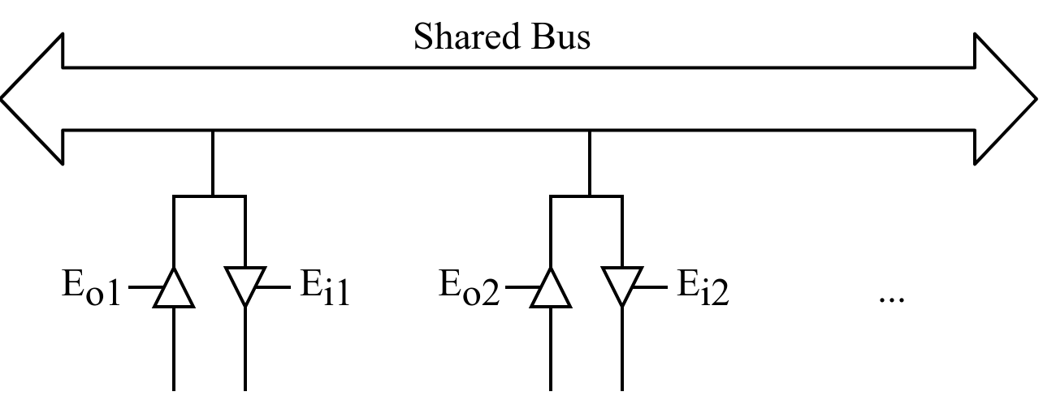
Specifical Values in Circuits
Invalid value
High impedance
  Three-state gate
Notes:
非法值：如果B为1，A为任意值都会导致F同时被高低电平驱动，有可能导致F结点处两个逻辑门之间有较大电流流动，使电路发热损坏，电路中应避免这种错误。
高阻态：三态门是一种重要的总线接口电路，也称三态缓冲器，即输出可以是正常的0/1，也可以是高阻态；使能端E有效，则输出是0/1，E无效，则输出为高阻态。
左图中E是高电平有效，E’为低电平时有效，所以加了一个小圈；右图实际电路中只有一个三态门使能信号有效，因此不会构成回路。

Slide 66
Combinational logic
About combinational logic circuits
Some classic/basic designs
Timing analysis

Slide 67
Some Classic/Basic Designs
Encoder and decoder
Multiplexer and demultiplexer
Half adder and full adder
Please refer to the lectures for more details!

Slide 68
Combinational logic
About combinational logic circuits
Some classic/basic designs
Timing analysis

Slide 69
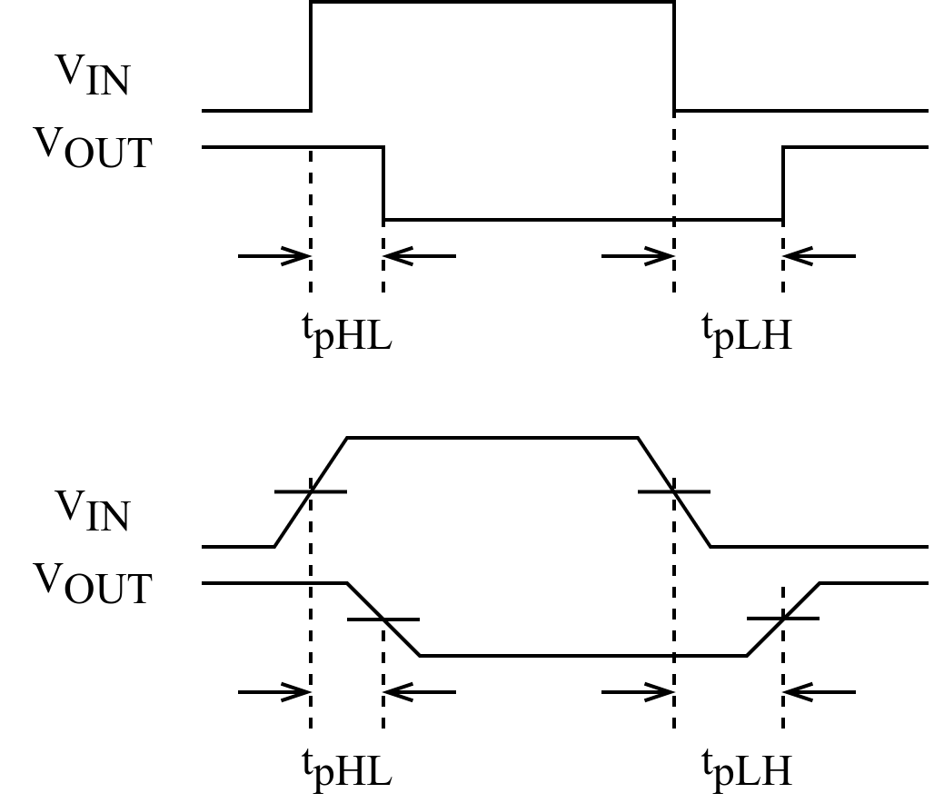
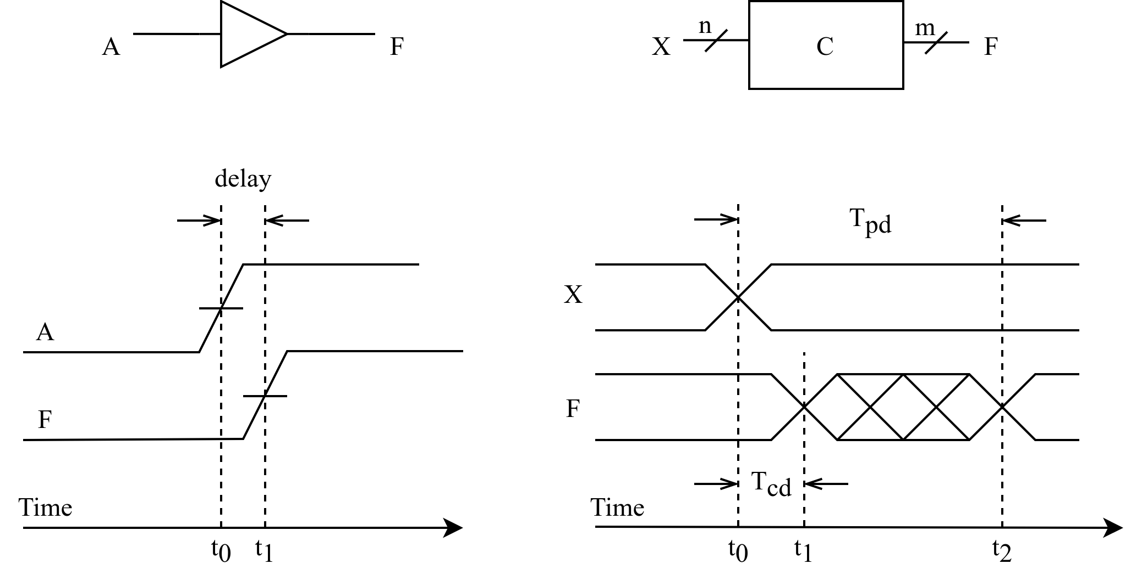
Timing Analysis
Circuit delay
Ideal case
In practice
Delay of the invertor
Rise-time delay of the transmission gate
Notes:
信号通过连线以及电路元件时，会有一定的延迟：连线的长短、元件的数量、电路制造工艺、工作电压、温度等；此外信号的高低电平转换也需要一定的过渡时间。
任何组合逻辑电路从输入信号的改变到随之引起的输出信号的改变中间都有一定的时间延迟。
理想情况：忽略上升时间和下降时间
为避免信号上升过程和下降过程时间不一致带来的影响，通常取信号转换的中点来测量电路的延迟时间。
缓冲器电路的时序图（上升沿电路延迟）：时间位t0和t1之间的间隔，分别是输入A和输出F两个信号的上升沿的中间点。

Slide 70
Timing Analysis (cont’d)
Propagation delay
  T_{pd} = max delay from input to output
Contamination delay
  T_{cd} = min delay from input to output
Reasons why T_{pd} and T_{cd} may be different:
  Different rising and falling delays
  Multiple inputs and outputs, some of which are faster than others
  Circuits slow down when hot and speed up when cold
Notes:
组合逻辑电路的时序特征包括：
1. Propagation delay: 传输延迟，从输入端的变化开始到所有输出端得到最终稳定的信号所需的最长时间
2. Contamination delay：最小延迟，从输入端变化开始到任何一个输出开始发生改变所需的最短时间
电路延迟可以通过计算信号从输入到输出所经过的路径上每个元件的延迟之和得到。

Slide 71
Timing Analysis (cont’d)
The critical (longest) path
  T_{pd} of the circuit = ∑ all T_{pd} of circuit elements along the critical path
The shortest path
  T_{cd} of the circuit = ∑ all T_{cd} of circuit elements along the shortest path
Tpd = 2Tpd_AND + Tpd_OR
Tcd = Tcd_AND
Notes:
1) 一个组合电路在输入和输出之间经过的最长路径称为关键路径，因此组合电路的传输延迟就是关键路径上所有元件的传输延迟之和；
2) 最小延迟就是最短路径上所有元件的最小延迟之和。

Slide 72
Topics for the Final Exam
Computer System & Von-Neumann Model
Number representation
Binary logic gates, boolean algebra & logic function
Basic Verilog
Combinational logic
Sequential logic
Computational operations & units
ISA & assembly programming language
CPU design

Slide 73
Sequential logic
Introduction to sequential circuits
Basic sequential logic elements
Synchronous sequential logic design
Classic sequential logic elements

Slide 74
Sequential logic
Introduction to sequential circuits
Basic sequential logic elements
Sequential logic design
Classic sequential logic elements

Slide 75
Introduction to Sequential Circuits
Sequential circuits
Sequential circuit analysis

Slide 76
Sequential Circuits
Sequential circuits consist of combinational logic as well as storage elements (used to store certain circuit states).
Outputs depend on BOTH current input values and previous input values (kept in the storage elements).
State: all the information about a circuit necessary to explain its future behavior
n-inputs
m-outputs
Combinational
Circuit
Storage
Elements
State
Next
state
Sequential Circuit
Notes:
A sequential circuit will:
1. Give sequence to events
2. Have memory (short-term)
3. Use feedback from output to input to store information
A sequential circuit contains:
Storage/state elements
Combinational logic
数字系统中存储信息有多种方式，使用逻辑电路是其中一种，如带回路的缓冲器。

Slide 77
Sequential Circuits: Storage Elements
Bistable circuits
  Latches
  Flip-flops
n-inputs
m-outputs
Combinational
Circuit
Storage
Elements
State
Next
state
Sequential Circuit
Notes:
双稳态电路
Latches and flip-flops: State elements that store one bit of state
Latch：锁存器
Flip-flop：触发器

Slide 78
Level-Triggered vs. Edge-Triggered
Level-triggered/sensitive
  Output controlled by the level of the clock input.
Edge-triggered/sensitive
  Output changes only at the point in time when the clock changes from value to the other.
  Can be positive-edge triggered (0 to 1), or negative-edge triggered (1 to 0).
Flip-flops are edge-triggered while clocked (gated) latches are level-sensitive.
  The advantage of flip-flops over latches is that the signal on the input pin(s) is captured the moment the flip-flop is clocked, and subsequent changes on the input(s) will be ignored until the next clock event. This provides better timing control in complex circuits.

Slide 79
Sequential Circuits: Combinational Circuit
Inputs are signals from the outside, and outputs are signals to the outside
  Implements a multiple-output switching function
    Mealy: outputs = g(inputs, state)
    Moore: outputs = h(state)
  Output function type depends on specification and affects the design significantly
Other inputs, state or present state, are signals from storage elements
The remaining outputs, next state are inputs to storage elements
  Next state function: next state = f(inputs, state)
n-inputs
m-outputs
Combinational
Circuit
Storage
Elements
State
Next
state
Sequential Circuit
Notes:
根据输出逻辑对于输入信号的依赖情况，可以分为两类：
1. Mealy型时序逻辑电路：输出逻辑不仅依赖当前状态，同时还依赖当前输入
2. Moore型时序逻辑电路：输出逻辑仅依赖当前状态，和当前输入无关
输出函数和激励函数

Slide 80
Types of Sequential Circuits
Depends on the times at which:
  Storage elements observe their inputs, and
  Storage elements change their state
Synchronous
  Circuit output changes only at some discrete instants of time.
  Achieves synchronization by using a timing signal called the clock.
Asynchronous
  Circuit output can change at any time (clockless).
Notes:
时序电路分为两类，取决于观察输入信号的时间和内部状态改变的时间：
1. 同步时序电路：行为可以根据在离散的时间点其信号线上的相关信息来进行定义；只在离散的时刻采集影响存储元件的信号，同步过程是通过时钟发生器（clock generator）这种时序器件产生的周期性的时钟脉冲（clock pulse）序列来实现的。脉冲分布在整个系统中，同步存储元件只在每一个脉冲特定的时刻上受到影响。实际上，时钟脉冲被用来与其它信号一起改变存储元件的数据。存储元件的输出仅在出现时钟脉冲时发生变化。把时钟脉冲作为存储元件输入信号的同步时序电路称为钟控时序电路（clocked sequential circuit），该类型电路在实际中广泛应用，同步设计比较容易。
2. 异步时序电路：行为依赖于某一时刻的输入信号以及输入信号在连续时间内变化的顺序；异步电路设计较为困难，因为行为与门的传播延迟以及输入信号变化的时间序列密切相关，大部分设计者选用同步电路；但异步有时候也是必要的，比如同步电路中用来存储信息的元件触发器，就是以异步锁存器为模块来构造的。
同步优点是控制机制简单，每个电路的运算都必须在时钟的两个脉冲之间固定的间隔内完成，称为一个时钟周期，只有满足这个条件才能保证电路时可靠的，但也有如下缺点：
1. 时钟信号必须要分配到电路的每一个元件（触发器），而时钟通常频率较高，会产生功耗（热量），即便元件没做任何事也会有功耗存在。
2. 最大可能的时钟频率由电路中最慢的逻辑路径（关键路径）决定，从最简单到最复杂的逻辑运算都必须在一个时钟周期内完成；可用流水线分解复杂运算，提高时钟频率。

Slide 81
Sequential Circuit Analysis
Terminology
  Finite state machine (FSM)
  State diagram
  State table
Basic analysis procedure
  Purpose
  Logic diagram

Slide 82
Finite State Machine and State Diagram
Finite state machine (FSM) is a generic model for sequential circuits used in sequential circuit design
The sequential circuit function can be represented in graphical form as a state diagram with the following components:
  A circle with the state name in it for each state
  A directed arc from the Present State to the Next State for each state transition
  A label on each directed arc with the Input values which causes the state transition, and
  A label:
    On each circle with the output value produced, or
    On each directed arc with the output value produced.
1/0
0/0
A
B
0/0
0/0
0/0
1/0
1/0
D
C
1/1
Notes:
e.g., 系统是否出现了连续4个1（1111），必须记忆输入情况，涉及记忆状态的切换。
有限状态机是一种刻画状态以及状态转换的理论工具。
通常用状态图描述有限状态机，圆圈代表状态，状态之间有向边代表特定输入信息的激励下状态的转换方向。
边上需表明输入的条件和系统的输出响应，一般为”输入信号/输出响应”。如果输出响应与输入信号之间没有直接的逻辑关系，且只与当前状态有关，则可以把输出响应标注在状态圆圈中状态名旁边。
e.g., A初始节点，输入1111序列，输出响应是1，系统处于状态D。

Slide 83
State Table
State table – a multiple variable table with the following four sections:
  Present State – the values of the state variables for each allowed state.
  Input – the input combinations allowed.
  Next-state – the value of the state at time (t+1) based on the present state and the input.
  Output – the value of the output as a function of the present state and (sometimes) the input.
From the viewpoint of a truth table:
  the inputs are Input, Present State
  and the outputs are Output, Next State

Slide 84
Basic Analysis Procedure
The analysis consists of obtaining a suitable description that demonstrates the time sequence of inputs, outputs, and states.
Logic diagram
  Boolean gates, flip-flops (of any kind), and appropriate interconnections.
The logic diagram is derived from any of the following:
  Boolean equations (inputs and outputs)
  State table
  State diagram
Notes:
状态图刻画了时序逻辑的功能特性，如果能正确设计出状态图，则可方便实现数字电路：
1. 首先要把状态机的输入、输出以及内部状态转换为二进制表示，编码是关键，会影响形成的电路实现和总体性能。
2. 其次要解决状态记忆问题：或者设计专门的记忆器件-双稳态器件（锁存器、触发器），或者采用反馈电路，利用电路的稳态来表征状态机中的状态。
3. 最后是如何设计出符合状态转换逻辑要求的状态记忆器件的激励函数和输出函数，并完成时序分析。

Slide 85


Example
Input: x(t)
Output: y(t)
State: (A(t), B(t))
What is the output function?
What is the next state function?
x
D
Q
A
C
$$\overline{Q}$$
$$\overline{A}$$
D
Q
B
CP
C
$$\overline{Q}$$
y

Slide 86

Example: Boolean Equation
Boolean equations for the functions:
  A(t+1) = A(t)x(t) + B(t)x(t)
  B(t+1) = $\overline{A}$(t)x(t)
  y(t) = $\overline{x}$(t)(B(t) + A(t))
x
D
Q
A
C
$$\overline{Q}$$
$$\overline{A}$$
Next State
D
Q
B
CP
C
$$\overline{Q}$$
y
Output

Slide 87

Example: State Table
Boolean equations for the functions:
  A(t+1) = A(t)x(t) + B(t)x(t)
  B(t+1) = $\overline{A}$(t)x(t)
  y(t) = $\overline{x}$(t)(B(t) + A(t))
Present State
Input
Next State
Output
A(t) B(t)
x(t)
A(t+1) B(t+1)
y(t)
0 0
0
0 0
0
0 0
1
0 1
0
0 1
0
0 0
1
0 1
1
1 1
0
1 0
0
0 0
1
1 0
1
1 0
0
1 1
0
0 0
1
1
1
1
1 0
0

Slide 88
Example: State Diagram
Diagram gets confusing for large circuits
For small circuits, usually easier to understand than the state table
x=0/y=0
x=0/y=1
x=1/y=0
A B
0 0
x=0/y=1
1 0
x=1/y=0
x=1/y=0
x=0/y=1
0 1
1 1
x=1/y=0

Slide 89
Sequential logic
Introduction to sequential circuits
Basic sequential logic elements
Sequential logic design
Classic sequential logic elements

Slide 90

Basic sequential logic elements
Bistable circuit
Latches
  SR, $\overline{S}\overline{R}$, clocked SR, D
Flip-flops
  SR, D, JK, T
Please refer to the lectures for more details!

Slide 91
Sequential logic
Introduction to sequential circuits
Basic sequential logic elements
Sequential logic design
Classic sequential logic elements

Slide 92
Sequential logic design
Some definitions
The design procedure
State machine design

Slide 93
Equivalent State
Two states are equivalent if their response for each possible input sequence is an identical output sequence.
Alternatively, two states are equivalent if their outputs produced for each input symbol is identical and their next states for each input symbol are the same or equivalent.
Notes:
两个状态等价是指在状态图/状态表所描述的状态转换逻辑前提下，两个状态在所有输入组合情况下，其输出都相同，且下一个状态也相同或者为等价状态。

Slide 94
Moore and Mealy Models
There are two formal models of FSMs:
Moore model
  Named after E.F. Moore
  Outputs are a function ONLY of states
  Usually specified on the states.
Mealy model
  Named after G. Mealy
  Outputs are a function of inputs AND states
  Usually specified on the state transition arcs.

Slide 95
The Design Procedure
Specification
Formulation
  Obtain a state diagram or state table
State assignment
  Assign binary codes to the states
Flip-flop input equation determination
  Select flip-flop types and derive flip-flop equations from next state entries in the table
Output equation determination
  Derive output equations from output entries in the table
Optimization
  Optimize the equations
Technology mapping
  Find circuit from equations and map to flip-flops and gate technology
Verification
  Verify correctness of final design
Notes:
1. Specification
Write a specification for the circuit if one is not already available
2. Formulation
Derive a truth table or initial Boolean equations that define the required relationships between the inputs and outputs, if not in the specification
Apply hierarchical design if appropriate
3. Optimization
Apply 2-level and multiple-level optimization
Draw a logic diagram or provide a netlist for the resulting circuit using ANDs, ORs, and inverters
4. Technology Mapping
Map the logic diagram or netlist to the implementation technology selected
5. Verification
Verify the correctness of the final design manually or using simulation
How to design combinational logic circuits
Design procedure
1. Determine inputs, outputs and their logic relationship
Truth table
2. Determine logic functions and perform optimization
Algebra or K-map
3. Draw logic circuit diagram and timing diagram
Timing analysis

Slide 96
Sequence Recognizer Procedure (cont’d)
Example: Recognize the sequence 1101
  Note that the sequence 1111101 contains 1101 and "11" is a proper sub-sequence of 1101.
Thus, the sequential machine must remember that the first two one's have occurred as it receives another symbol.
Also, the sequence 1101101 contains 1101 as both an initial subsequence and a final subsequence with some overlap, i. e., 1101101 or 1101101.
And, the 1 in the middle, 1101101, is in both subsequences.
The sequence 1101 must be recognized each time it occurs in the input sequence.

Slide 97
Example: Recognize 1101
Define states for the sequence to be recognized:
  assuming it starts with first symbol,
  continues through each symbol in the sequence to be recognized, and
  uses output 1 to mean the full sequence has occurred,
  with output 0 otherwise.
Starting in the initial state (Arbitrarily named "A"):
  Add a state that recognizes the first "1."
  State "A" is the initial state, and state "B" is the state which represents the fact that the "first" one in the input subsequence has occurred. The output symbol "0" means that the full recognized sequence has not yet occurred.
1/0
A
B

Slide 98
Formulation: Find State Table
From the state diagram, we can fill in the state table.
There are 4 states, one input, and one output. We will choose the form with four rows, one for each current state.
From State A, the 0 and 1 input transitions have been filled in along with the outputs.
0/0
1/0
0/0
1/0
1/0
0/0
1/0
A
B
C
D
0/0
1/1
0/0
Present
Next State
Output
State
x=0 x=1
x=0 x=1
A
A
B
0
0
B
A
C
0
0
C
D
C
0
0
D
A
B
0
1
Note that state table can also be used to merge equivalent states.
What would the state diagram and state table look like for the Moore model?

Slide 99
Example: Moore Model for Sequence 1101
For the Moore model, outputs are associated with states.
We need to add a state "E" with output value 1 for the final 1 in the recognized input sequence.
  This new state E, though similar to B, would generate an output of 1 and thus be different from B.
The Moore model for a sequence recognizer usually has more states than the Mealy model.

Slide 100
Example: Moore Model (cont’d)
We mark outputs on states for Moore model
Arcs now show only state transitions
Add a new state E to produce the output 1
Note that the new state, E produces the same behavior in the future as state B. But it gives a different output at the present time. Thus, these states do represent a different abstraction of the input history.
0
1
1
1
0
A/0
B/0
C/0
D/0
0
1
1
0
E/1
0

Slide 101
Example: Moore Model (cont’d)
Fill in the state table according to the stable diagram
Memory aid re more state in the Moore model: “Moore is More.”
0
1
Present
Next State
Output
1
1
0
State
x=0 x=1
y
A/0
B/0
C/0
D/0
A
A
B
0
0
1
1
B
A
C
0
0
C
D
C
0
E/1
D
A
E
0
0
E
A
C
1

Slide 102
State Assignment
Each of the m states must be assigned a unique code
Minimum number of bits required is n such that
n ≥ log₂m
where x is the smallest integer ≥ x
There are useful state assignments that use more than the minimum number of bits
There are 2^{n} - m unused states

Slide 103
State Assignment: Example 2
Present
Next State
Output
State
x=0 x=1
x=0 x=1
A
A B
0 0
B
A C
0 0
C
D C
0 0
D
A B
0 1
How many assignments of codes with a minimum number of bits?
Does code assignment make a difference in cost?
Notes:
2 bits to represent 4 states, and there are 24 (4 x 3 x 2 x 1) possible assignments.
不同的赋值确实对cost有影响：接下来用counting order和cray code为例说明。

Slide 104
State Assignment: Example 2 (cont’d)
Counting Order Assignment: A = 00, B = 01, C = 10, D = 11
The resulting coded state table:
Present State Y₁ Y₂ | Next State x = 0 x = 1 D₁ D₂ D₁ D₂ |  | Output x = 0 x = 1
0 0 | 0 0 | 0 1 | 0 | 0
0 1 | 0 0 | 1 0 | 0 | 0
1 0 | 1 1 | 1 0 | 0 | 0
1 1 | 0 0 | 0 1 | 0 | 1

Slide 105
State Assignment: Example 2 (cont’d)
Gray Code Assignment: A = 00, B = 01, C = 11, D = 10
The resulting coded state table:
Present State Y₁ Y₂ | Next State x = 0 x = 1 D₁ D₂ D₁ D₂ |  | Output x = 0 x = 1
0 0 | 0 0 | 0 1 | 0 | 0
0 1 | 0 0 | 1 1 | 0 | 0
1 1 | 1 0 | 1 1 | 0 | 0
1 0 | 0 0 | 0 1 | 0 | 1

Slide 106
Find Flip-Flop Input and Output Equations: Counting Order Assignment
Assume D flip-flops
Interchange the bottom two rows of the state table, to obtain K-maps for D1, D2, and Z:
D1
D2
Z
X
X
X
0
0
0
1
0
0
0
1
0
0
0
0
Y2
Y2
Y2
0
0
0
1
0
0
Y1
Y1
Y1
1
1
1
0
0
1

Slide 107
Optimization: Counting Order Assignment
Performing two-level optimization:
D₁ = Y₁Y₂ + XY₁Y₂
D₂ = XY₁Y₂ + XY₁Y₂ + XY₁Y₂
Z = XY₁Y₂
D1
D2
Z
X
X
X
0
0
0
1
0
0
0
1
0
0
0
0
Y2
Y2
Y2
0
0
0
1
0
0
Y1
Y1
Y1
1
1
1
0
0
1
Gate Input Cost =
Notes:
组合逻辑22: 5 + 9 + 3 + 5 = 22
D触发器约14，总代价： 22 + 14 * 2 = 50

Slide 108
Find Flip-Flop Input and Output Equations: Gray Code Assignment
Assume D flip-flops
Obtain K-maps for D1, D2, and Z:
D1
D2
Z
X
X
X
0
0
0
1
0
0
0
1
0
1
0
0
Y2
Y2
Y2
1
1
0
1
0
0
Y1
Y1
Y1
0
0
0
1
0
1

Slide 109
Optimization: Gray Code Assignment
Performing two-level optimization:
D₁ = Y₁Y₂ + XY₂
D₂ = X
Z = XY₁Y₂
D1
D2
Z
X
X
X
0
0
0
1
0
0
0
1
0
1
0
0
Y2
Y2
Y2
1
1
0
1
0
0
Y1
Y1
Y1
0
0
0
1
0
1
Gate Input Cost =
Notes:
D₂ = X不是组合逻辑，不统计在cost=9那里
总代价：9 + 14 * 2 = 37

Slide 110
Rules for State Assignment
States which have the same next state for a given input should be given adjacent assignment.
States which are the next states of the same state should be given adjacent assignment.
States which have the same output for a given input should be given adjacent assignment (for output simplification.)
Present
Next State
Output
State
x=0 x=1
x=0 x=1
A
A B
0 0
B
A C
0 0
C
D C
0 0
D
A B
0 1
Notes:
(1) 在相同输入条件下具有相同次态的现态，应尽可能分配相邻的二进制编码，该准则可以使次态逻辑较少依赖于当前状态变量：A和D应相邻
(2) 在相邻输入条件，同一现态的次态应尽可能分配相邻的二进制编码，该准则能使此次态逻辑较少依赖于输入变量：A和B，A和C，C和D应相邻；
(3) 输出完全相同的现态应尽可能分配相邻的二进制编码，该准则能使输出逻辑较少依赖于当前变量： A，B，C 三者应相邻；
此外，最小化状态表中出现次数最多的状态或初始状态应分配逻辑0：A分配为逻辑0
具体设计过程中，常常存在准则运用的取舍问题，不一定要追求最少的编码达到最少的状态变量数。有时候适当增加编码位数虽然会增加状态记忆单元数目，但次态逻辑可能会变得简单。往往最终编码方案是多种因素综合权衡的结果。
One-Hot State Assignment: use one FF for each state.

Slide 111
Map Technology: Gray Code Assignment
D Flip-flops with Reset (not inverted)
NAND gates with up to 4 inputs and inverters
D
Y1
C
R
Z
Y2
X
D
Clock
C
R
Reset
Initial circuit
Notes:
AND-OR gates

Slide 112
Mapped Circuit: Final Result
Y1
D
C
R
Z
Y2
X
D
Clock
C
R
Reset
Notes:
NAND-NOT gates

Slide 113
Sequential Circuit Analysis: An Example
Logic diagram:
A
D
Q
Z
C
R
Q
B
D
Q
C
R
Q
C
D
Q
Clock
C
R
Q
Reset

Slide 114
Flip-Flop Input Equations
Variables
  Inputs: None
  Outputs: Z
  State Variables: A, B, C
Initialization: Reset to (0,0,0)
Equations
  A(t+1) = Z =
  B(t+1) =
  C(t+1) =
Notes:
A(t+1) = BC
B(t+1) = B’C + BC’
C(t+1) = A’C’
Z = A

Slide 115

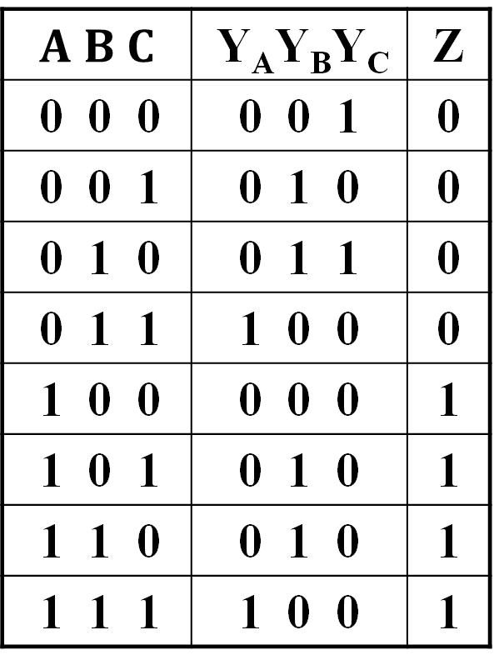
State Table
A(t+1) = $BC$
B(t+1) = $\overline{B}C+B\overline{C}$
C(t+1) = $\overline{A}\overline{C}$
Z = A
Let Y=X(t+1)
$A B C$ | Y_{A}Y_{B}Y_{C} | Z
0 0 0 | 0 0 1 | 0
0 0 1 | 0 1 0 | 0
0 1 0 | 0 1 1 | 0
0 1 1 | 1 0 0 | 0
1 0 0 | 0 0 0 | 1
1 0 1 | 0 1 0 | 1
1 1 0 | 0 1 0 | 1
1 1 1 | 1 0 0 | 1

Slide 116
State Diagram
Which states are used?
What is the function of
the circuit?
ABC
Reset
000
111
100
001
011
010
101
110
Notes:
Only states reachable from the reset state 000 are used: 000, 001, 010, 011, and 100.
The circuit produces a 1 on Z after four clock periods and every five clock periods thereafter:
000 -> 001 -> 010 -> 011 -> 100 -> 000 -> 001 -> 010 -> 011 -> 100 …
1 1
A mod 5 counter…

Slide 117
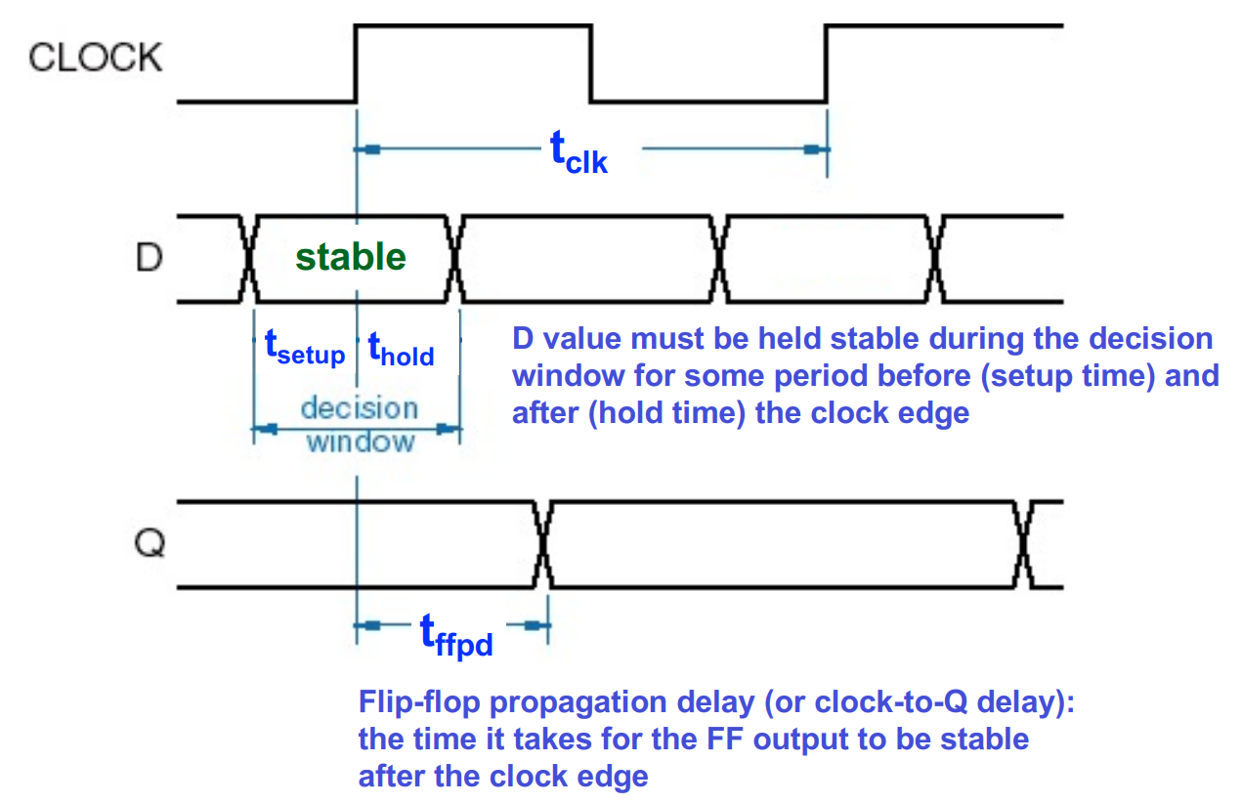
Flip-Flop Timing
E.g., D flip-flop
  tsetup - required time of stable input before CLK, input before CLK
  thold - required time of stable input after CLK, input after CLK
  tffpd - flip-flop propagation delay after CLK, aka Clk-to-Q time

Slide 118
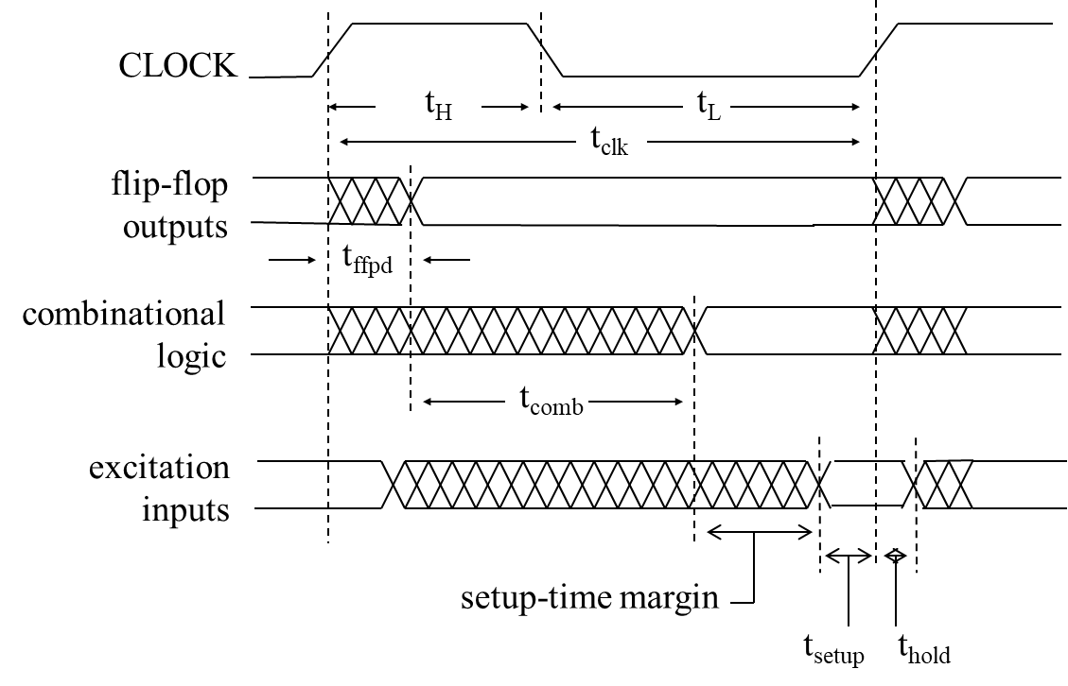
Timing Diagram of Sequential Circuits
tclk ≥ tffpd + tcomb + tsetup
thold ≤ tffpd + tcomb
Notes:
Excitation inputs == flip-flop inputs
e.g., t_{ffpd} = 0.3 ns, t_{comb} = 1.2 ns, t_{steup} = 0.2 ns
t_{clk} >= 1.7 ns -> feq <= 1 / 1.7 ns ~ 588 MHz

Slide 119
Sequential logic
Introduction to sequential circuits
Basic sequential logic elements
Sequential logic design
Classic sequential logic elements

Slide 120
Classic Sequential Logic Elements
Registers
  Basic introduction
  Registers in the digital system
  Shift Registers
Counters
  Basic introduction
  Ripple Counters
  Synchronous Counters
Please refer to the lectures for more details!
Notes:
寄存器和计数器作为时序功能模块广泛应用于数字计算机系统的设计中。寄存器用于存储和处理数据信息，计数器主要用于对操作进行排序和控制。
计数器是指在时钟脉冲地激励下，能遍历预先规定好地状态序列地一种寄存器。计数器中按某种方式连接起来地逻辑门使得计数器能够生成规定顺序地二进制状态序列。尽管计数器也是一种特殊类型的寄存器，但一般而言，人们总是将它与寄存器区别对待。

Slide 121
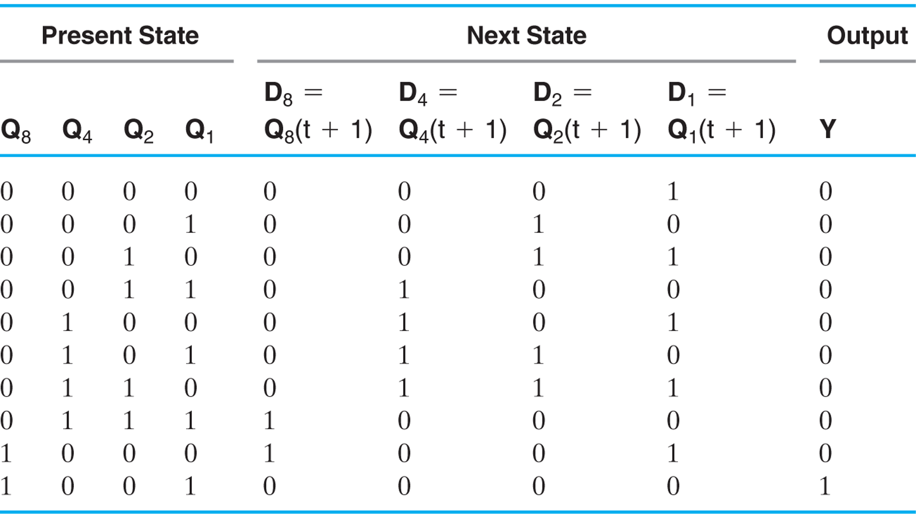
Synchronous BCD with D Flip-Flops
Use the sequential logic model to design a synchronous BCD counter with D flip-flops
Input combinations 1010 through 1111 are don’t cares
Notes:
Y = 0 0 0 0 0 0 0 0 0 1
i.e., 1001 -> 0000, Y = 1

Slide 122
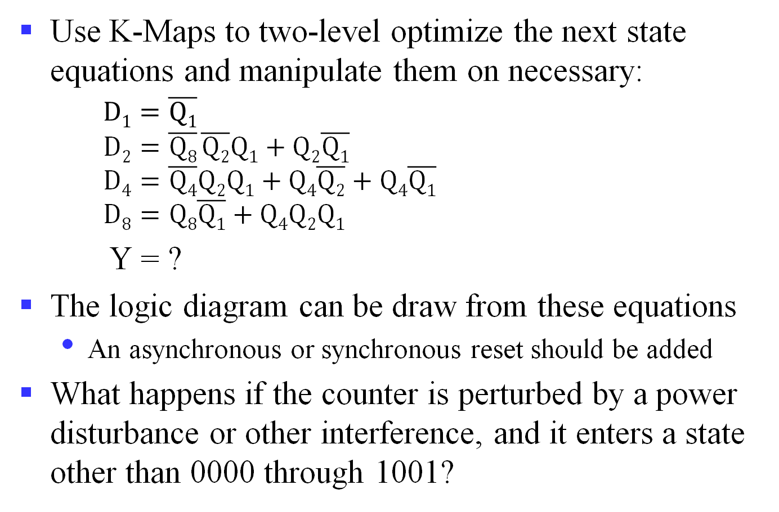
Synchronous BCD with D Flip-Flops (cont’d)
Use K-Maps to two-level optimize the next state equations and manipulate them on necessary:
$D1=\overline{Q1}$
$D2=\overline{Q8} \overline{Q2}Q1+Q2\overline{Q1}$
$D4=\overline{Q4}Q2Q1+Q4\overline{Q2}+Q4\overline{Q1}$
$D8=Q8\overline{Q1}+Q4Q2Q1$
Y = ?
The logic diagram can be draw from these equations
  An asynchronous or synchronous reset should be added
What happens if the counter is perturbed by a power disturbance or other interference, and it enters a state other than 0000 through 1001?
Notes:
$$y=Q8Q1$$

Slide 123
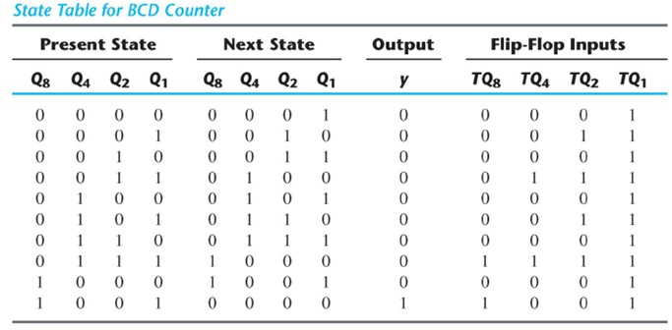
Synchronous BCD with T Flip-Flops
Use the sequential logic model to design a synchronous BCD counter with T flip-flops
Input combinations 1010 through 1111 are don’t cares
What about the equations?
Notes:
T_{Q1} = 1
T_{Q2} = $\overline{Q8} Q1$
T_{Q4} = Q₂Q₁
T_{Q8} = Q₈Q₁ + Q₄Q₂Q₁
y = Q₈Q₁
4 T flip-flops, 4 AND gates and 1 OR gate

Slide 124
Topics for the Final Exam
Computer System & Von-Neumann Model
Number representation
Binary logic gates, boolean algebra & logic function
Basic Verilog
Combinational logic
Sequential logic
Computational operations & units
ISA & assembly programming language
CPU design

Slide 125
Computational operations & units
Basic computational units
Fixed number operations
Arithmetic logic unit (ALU)

Slide 126
Computational operations & units
Basic computational units
Fixed number operations
Arithmetic logic unit (ALU)

Slide 127
Basic computational units
Half adder, full adder
Ripple carry propagate adders
  Ripple-carry
  Carry-lookahead
Please refer to the lectures for more details!

Slide 128
Computational operations & units
Basic computational units
Fixed number operations
Arithmetic logic unit (ALU)

Slide 129
Fixed number operations
Addition & subtraction
  Adders with flags
    Carry
    Overflow
Multiplication & division
Please refer to the lectures for more details!

Slide 130
Computational operations & units
Basic computational units
Fixed number operations
Arithmetic logic unit (ALU)

Slide 131
Arithmetic logic unit (ALU)
ALU & datapath
How to design an ALU
Please refer to the lectures for more details!

Slide 132

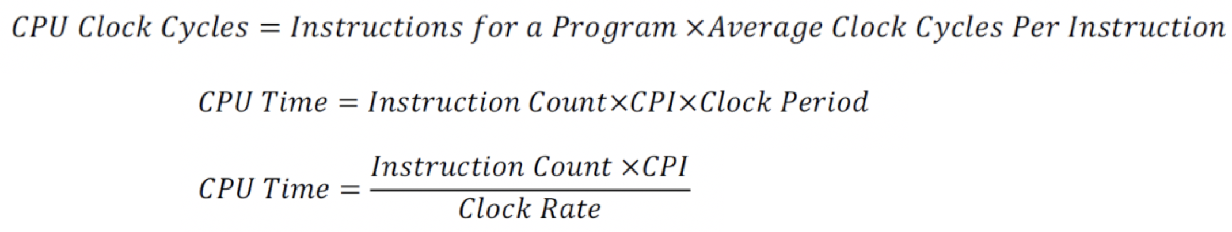
Instruction Count and CPI
Instruction Count for a program
  Determined by program, ISA and compiler
Average cycles per instruction (CPI)
  Determined by CPU hardware
  If different instructions have different CPI
    Average CPI affected by instruction mix
Notes:
CPI 执行一条指令所需的时钟周期数。
对于一条特定的指令，CPI指执行该指令所需的时钟周期数，CPI是个特定值；
对于一段程序或机器，CPI指执行该程序或机器指令集中的所有指令所需的平均时钟周期数，是一个平均值。
CPU time=CPI*指令条数*时钟周期

Slide 133
CPI Example
Computer A: Cycle Time = 250ps, CPI = 2.0
Computer B: Cycle Time = 500ps, CPI = 1.2
Same ISA
  Which is faster, and by how much?

Slide 134
CPI in More Detail
If different instruction classes take different numbers of cycles
Weighted average CPI
Relative frequency

Slide 135
Weighted CPI Example
Alternative compiled code sequences using instructions in classes A, B, C
Sequence 1: IC = 5 Clock Cycles = 2×1 + 1×2 + 2×3 = 10
  Avg. CPI = 10/5 = 2.0
Sequence 2: IC = 6 Clock Cycles = 4×1 + 1×2 + 1×3 = 9
  Avg. CPI = 9/6 = 1.5
Class | A | B | C
CPI for class | 1 | 2 | 3
IC in sequence 1 | 2 | 1 | 2
IC in sequence 2 | 4 | 1 | 1

