Slide 1
Unsigned & Signed Numeric Values
X
B2U(X)
B2T(X)
Equivalence
Same encodings for nonnegative values
Uniqueness
Every bit pattern represents unique integer value
Each representable integer has unique bit encoding
⇒ Can Invert Mappings
U2B(x) = B2U⁻¹(x)
Bit pattern for unsigned integer
T2B(x) = B2T⁻¹(x)
Bit pattern for two’s comp integer
0000
0
0
0001
1
1
0010
2
2
0011
3
3
0100
4
4
0101
5
5
0110
6
6
0111
7
7
1000
8
–8
1001
9
–7
1010
10
–6
1011
11
–5
1100
12
–4
1101
13
–3
1110
14
–2
1111
15
–1
Notes:
相同
非负数值的编码相同
单值性
每个位模式对应一个唯一的整数值
每个可描述整数有一个唯一编码
⇒ 有逆映射
U2B(x) = B2U⁻¹(x)
无符号整数的位模式
T2B(x) = B2T⁻¹(x)
补码的位模式

Slide 2
Sign Extension
Task:
Given w-bit signed integer x
Convert it to w+k-bit integer with same value
Rule:
Make k copies of sign bit:
X ′ = x_{w–1} ,…, x_{w–1} , x_{w–1} , x_{w–2} ,…, x₀
k copies of MSB
w
X
• • •
• • •
X ′
• • •
• • •
k
w

Slide 3
Multiplication
1 0001
4 x 0100
0000
0000
0001
0000 0
xxxxxxxx
4 00000100
1 0001
-4 x 1100
0000
0000
0001
11111 0
xxxxxxxx
-4 11111100
符号位1，我们取反+1：0001->1110->1111，
高位补齐，低位添0
->（1）1111(000)
-7 1001
4 x 0100
0000
0000
111001
0000 0
xxxxxxxx
-28 11100100
-7 1001
-4 x 1100
00000000
0000000
111001
00111 0 (符号位1，同上)
xxxxxxxx
28 100011100

Slide 4
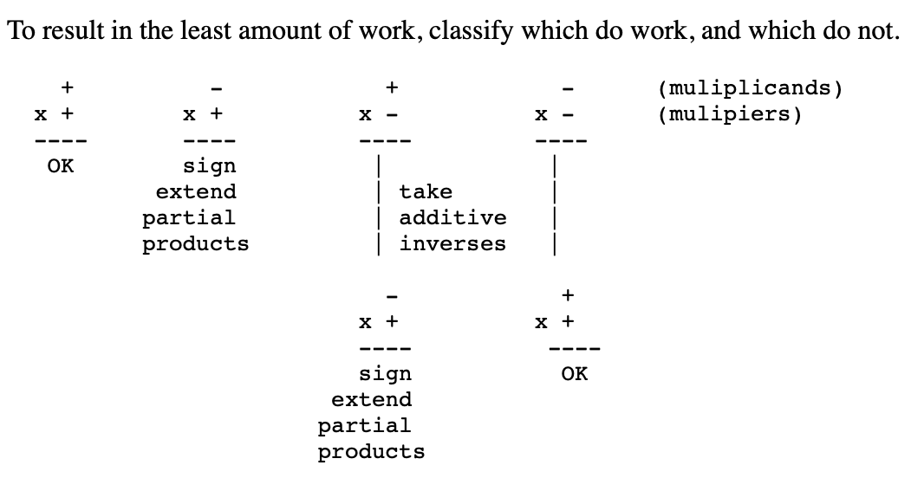
https://pages.cs.wisc.edu/~markhill/cs354/Fall2008/beyond354/int.mult.html

Slide 5
Floating Point Representation
Carnegie Mellon
Numerical Form: (–1)^{s} M 2E
Sign bit s determines whether number is negative or positive
Significand M normally a fractional value in range [1.0,2.0).
Exponent E weights value by power of two
Encoding
MSB s is sign bit s
exp field encodes E (but is not equal to E)
frac field encodes M (but is not equal to M)
s | exp | frac
Notes:
符号(sign)s， 决定数的符号，是正数(s=0)或负数(s=1)
尾数(Significand) M，二进制小数，数值范围: [1.0,2.0)
阶码(Exponent) E ，用2E将数值加权
浮点数编码
最高有效位(MSB)s，作为符号位s
exp 字段 编码E (和E不一定相等)
frac 字段编码尾数 M (和M不一定相等)

Slide 6
Normalized Values
Carnegie Mellon
Condition: exp ≠ 000…0 and exp ≠ 111…1
指数000…0和111…1是保留给特殊情况
Exponent coded as biased value: E = Exp – Bias
Exp: unsigned value exp
Bias = 2^{k-1} - 1, where k is number of exponent bits
Single precision: 127 (Exp: 1…254, E: -126…127)
Double precision: 1023 (Exp: 1…2046, E: -1022…1023)
Significand coded with implied leading 1:
M = 1.xxx…x₂
注意，内存中M仅存储分数部分。1在每次计算中自动会加。
Notes:
规格化数
条件: exp ≠ 000…0 且 exp ≠ 111…1
阶码(Exponent) 采用偏置值编码: E = Exp – Bias
Exp: exp 字段的无符号数值
偏置Bias = 2k-1 - 1, k 为阶码的位数
单精度: 127 (Exp: 1…254, E: -126…127)
双精度: 1023 (Exp: 1…2046, E: -1022…1023)
尾数(Significand) 编码隐含先导数值1: M = 1.xxx…x2
xxx…x: 是 frac字段的数码
frac=000…0 (M = 1.0)时，为最小值
frac=111…1 (M = 2.0 – ε)时，为最大值
额外增加了一位的精度（隐含值1）

Slide 7
Normalized Encoding Example
Value: Float F = 15213.0;
15213₁₀ = 11101101101101₂
= 1.1101101101101₂ x 2¹³
Significand
M = 1.1101101101101₂
frac = 11011011011010000000000₂
Exponent
E = 13
Bias = 127
Exp = 140 = 10001100₂
Result: 0 10001100 11011011011010000000000
s
exp
frac

Slide 8
Denormalized Values
Carnegie Mellon
Condition: exp = 000…0
Exponent value: E = –Bias + 1 (instead of E = 0 – Bias)
Significand coded with implied leading 0: M = 0.xxx…x2
xxx…x: bits of frac
Cases
exp = 000…0, frac = 000…0
Represents zero value
Note distinct values: +0 and –0 (why?)
exp = 000…0, frac ≠ 000…0
Numbers very close to 0.0
Lose precision as get smaller
Equispaced: abrupt underflow vs. gradual underflow
Notes:
条件: exp = 000…0
阶码(Exponent) 值: E = 1 – Bias =-126/-1022(instead of E = 0 – Bias)
尾数(Significand)编码隐含先导数值0: M = 0.xxx…x2
xxx…x:是 frac字段的数码
情况1： exp = 000…0, frac = 000…0
表示值0
注意有不同的数值 +0 和 –0 (why?)
情况2：exp = 000…0, frac ≠ 000…0
最接近0.0的那些数
间隔均匀：突然式下溢出(abrupt underflow) 和 渐进式下溢出(gradual underflow)
IEEE754-1985标准采用非规约浮点数，用来解决填补绝对值意义下最小规约数与零的距离。
非规约浮点数源于70年代末IEEE浮点数标准化专业技术委员会酝酿浮点数二进制标准时，Intel公司对渐进式下溢出（gradual underflow）的力荐。而当时十分流行的DECVAX机的浮点数表示采用了突然式下溢出（abrupt underflow）。
如果没有渐进式下溢出，那么0与绝对值最小的浮点数之间的距离（gap）将大于相邻的浮点数之间的距离。例如单精度浮点数的绝对值最小的规约浮点数是2⁻¹²⁶,绝对值次小的规约浮点数为（1 + 2⁻²³） * 2⁻¹²⁶,这两个数之间的距离为（1 + 2⁻²³） * 2⁻¹²⁶ - 2⁻¹²⁶ = 2⁻¹⁴⁹。而2⁻¹²⁶与0之间的距离为2⁻¹²⁶，如果不采用渐进式下溢出，那么绝对值最小的规约浮点数与0的距离是相邻的小浮点数之间距离的223倍！可以说是非常突然的下溢出到0。
采用了渐进式下溢出后将不会出现这种情况。例如对于单精度浮点数，指数部分实际最小值是（-126），对应的尾数部分从000……000,000……001，000……010，000……011 一直到111……101，111……110，111……111，每两个相邻两小浮点数之间的距离（gap）都是2⁻¹²⁶ * 2⁻²³ = 2⁻¹⁴⁹；而0与最近的浮点数（即最小的非规约数）之间的距离也是2⁻¹⁴⁹。

Slide 9
Special Values
Carnegie Mellon
Condition: exp = 111…1
Case: exp = 111…1, frac = 000…0
Represents value ∞ (infinity)
Operation that overflows
Both positive and negative
E.g., 1.0/0.0 = −1.0/−0.0 = +∞, 1.0/−0.0 = −∞
Case: exp = 111…1, frac ≠ 000…0
Not-a-Number (NaN)
Represents case when no numeric value can be determined
E.g., sqrt(–1), ∞ − ∞, ∞ × 0
Notes:
条件: exp = 111…1
情况1: exp = 111…1, frac = 000…0
表示 无穷(infinity) 
溢出的运算
正无穷、负无穷
情况2: exp = 111…1, frac ≠ 000…0
表示：不是一个数Not-a-Number (NaN)
表示没有数值结果（实数或无穷）

Slide 10
Visualization: Floating Point Encodings
Carnegie Mellon
−∞
+∞
−Normalized
−Denorm
+Denorm
+Normalized
NaN
NaN
−0
+0

Slide 11
Dynamic Range (Positive Only)
Carnegie Mellon
s exp frac E Value
0 0000 000 -6 0
0 0000 001 -6 1/8*1/64 = 1/512
0 0000 010 -6 2/8*1/64 = 2/512
…
0 0000 110 -6 6/8*1/64 = 6/512
0 0000 111 -6 7/8*1/64 = 7/512
0 0001 000 -6 8/8*1/64 = 8/512
0 0001 001 -6 9/8*1/64 = 9/512
…
0 0110 110 -1 14/8*1/2 = 14/16
0 0110 111 -1 15/8*1/2 = 15/16
0 0111 000 0 8/8*1 = 1
0 0111 001 0 9/8*1 = 9/8
0 0111 010 0 10/8*1 = 10/8
…
0 1110 110 7 14/8*128 = 224
0 1110 111 7 15/8*128 = 240
0 1111 000 n/a inf
closest to zero
Denormalized
numbers
largest denorm
smallest norm
closest to 1 below
Normalized
numbers
closest to 1 above
largest norm

Slide 12
Foundations of Digital Logic
Lei Wu
Zhejiang University

Slide 13
Disclaimer
Many images and resources used in this lecture are collected from the Internet, and they are used only for the educational purpose. The copyright belong to the original owners, respectively.
Part of slides credit to
David Money Harris and Sarah L. Harris. Digital Design and Computer Architecture, 2nd Edition.
Prof. Yabo Dong @ ZJU
CSE 140: Components and Design Techniques for Digital Systems (Prof. C.K. Cheng @ UCSD)

Slide 14
Overview
Introduction
Binary logic and gates
Transistors
Some IC parameters
Boolean algebra
Logic functions
Simplification of logic functions

Slide 15
Overview
Introduction
Binary logic and gates
Transistors
Some IC parameters
Boolean algebra
Logic functions
Simplification of logic functions

Slide 16
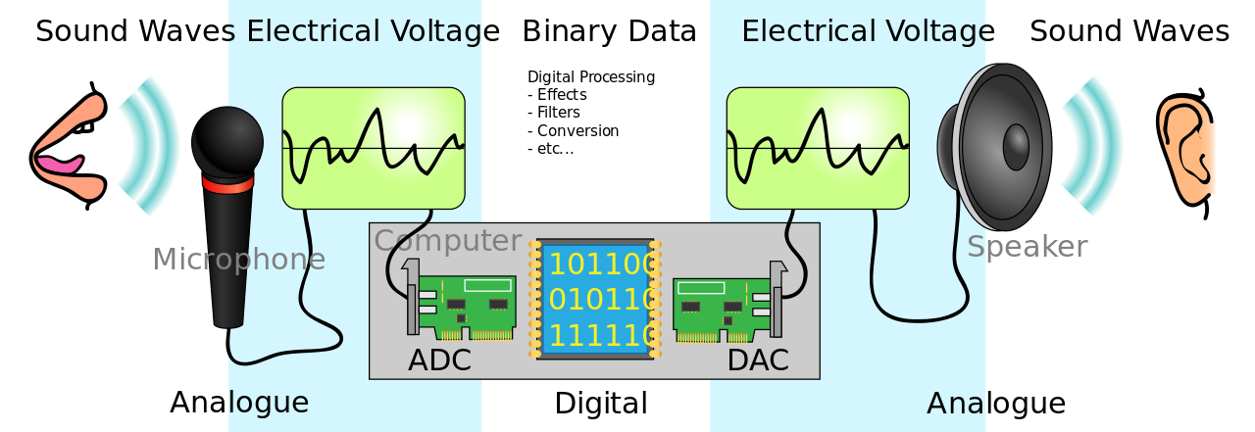
Electronic Systems
Analog signals vs. Digital signals
Notes:
Most physical variables are continuous
Voltage on a wire
Frequency of an oscillation
Position of a mass
Digital abstraction considers discrete subset of values
Abstraction: 物理（电子）-> 器件（晶体管）->模拟电路（放大器）->数字电路（或门）->逻辑（加法器、存储器）->微体系结构（数据通路、控制器）->体系结构（指令、寄存器）

Slide 17
Why Digital?
Intentionally restrict design choices
Example: Digital discipline
Discrete voltages instead of continuous
Simpler to design than analog circuits – can build more sophisticated systems
Digital systems replacing analog predecessors:
i.e., digital cameras, digital television, cell phones, CDs
Notes:
Discipline：设计的内在限制，可以更有效地在更高的抽象层次工作。如数字电路和模拟电路，前者使用离散电压，后者使用连续电压，因此数字电路是模拟电路的子集；能力弱但设计简单，更容易将组件组合成复杂的系统。

Slide 18
Overview
Introduction
Binary logic and gates
Transistors
Some IC parameters
Boolean algebra
Logic functions
Simplification of logic functions

Slide 19
Binary Logic and Gates
Binary variables take on one of two values.
Logical operators operate on binary values and binary variables.
Basic logical operators are the logic functions AND, OR and NOT.
Logic gates implement logic functions.
Boolean Algebra: a useful mathematical system for specifying and transforming logic functions.
We study Boolean algebra as a foundation for designing and analyzing digital systems!

Slide 20
Binary Variables
Recall that the two binary values have different names:
True/False
On/Off
Yes/No
1/0
We use 1 and 0 to denote the two values.
Variable identifier examples:
A, B, y, z, or X

Slide 21
Logical Operations
The three basic logical operations are:
AND
OR
NOT
AND is denoted by a dot (·).
OR is denoted by a plus (+).
NOT is denoted by an overbar ( ¯ ), a single quote mark (') after, or (~) before the variable.

Slide 22

Truth Table
A tabular listing of the values of a function for all possible combinations of values on its arguments
Example: Truth tables for the basic logic operations:
AND
OR
X | Y | Z = X+Y
0 | 0 | 0
0 | 1 | 1
1 | 0 | 1
1 | 1 | 1
NOT
X
Y
Z = X·Y
X
Z
=
$$\overline{X}$$
0
0
0
0
1
0
1
0
1
0
1
0
0
1
1
1

Slide 23
How to Model Logic Functions?
Using Switches
For inputs:
logic 1 is switch closed
logic 0 is switch open
For outputs:
logic 1 is light on
logic 0 is light off.
NOT uses a switch such
that:
logic 1 is switch open
logic 0 is switch closed
Switches in parallel => OR
Switches in series => AND
Normally-closed switch => NOT
C

Slide 24

An Example: Logic Using Switches
Light is on (L = 1) for
L(A, B, C, D) =
and off (L = 0), otherwise.
Useful model for relay circuits and for CMOS gate circuits, the foundation of current digital logic technology
B
$$C$$
A
D
Notes:
L (A, B, C, D) = A ((B C') + D) = A B C' + A D

Slide 25
Logic Gates
Perform logic functions:
inversion (NOT), AND, OR, NAND, NOR, etc.
Single-input:
NOT gate, buffer
Two-input:
AND, OR, XOR, NAND, NOR, XNOR
Multiple-input
Notes:
Buffer：缓冲器，将一个“弱”逻辑信号转换为具有相同逻辑值的“强”逻辑信号的电路，时序不同。

Slide 26
Single-Input Logic Gates

Slide 27
Single-Input Logic Gates

Slide 28
Two-Input Logic Gates

Slide 29
Two-Input Logic Gates

Slide 30
More Two-Input Logic Gates

Slide 31
More Two-Input Logic Gates
Notes:
XOR: 异或
XNOR：同或

Slide 32
Multiple-Input Logic Gates

Slide 33
Multiple-Input Logic Gates
Notes:
多输入异或：RC4

Slide 34
Overview
Introduction
Binary logic and gates
Transistors
Some IC parameters
Boolean algebra
Logic functions
Simplification of logic functions

Slide 35
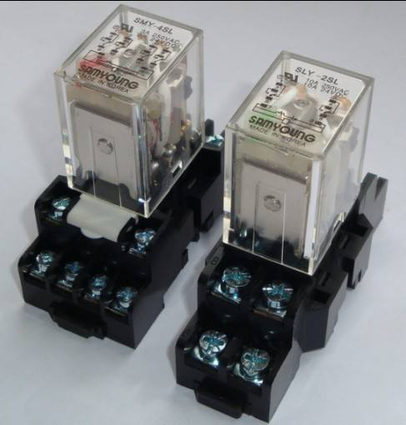
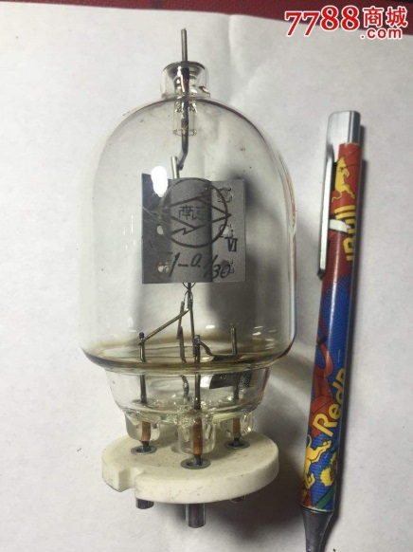
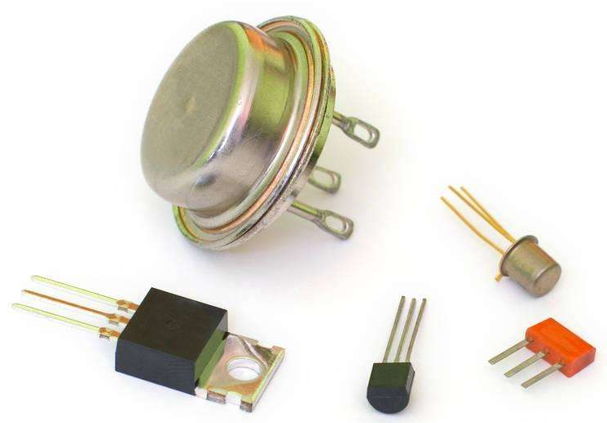
Relays vs. Vacuum Cube vs. Transistor
In the earliest computers, switches were opened and closed by magnetic fields produced by energizing coils in relays. The switches in turn opened and closed the current paths.
Later, vacuum tubes that open and close current paths electronically replaced relays.
Today, transistors are used as electronic switches that open and close current paths.

Slide 36
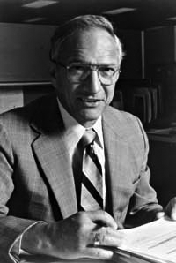
Robert Noyce, 1927-1990
Nicknamed “Mayor of Silicon Valley”
Cofounded Fairchild Semiconductor in 1957
Cofounded Intel in 1968
Co-invented the integrated circuit
Notes:
1947年12月16日：威廉·肖克利(William Shockley)、约翰·巴顿(John Bardeen)和沃特·布拉顿(Walter Brattain)成功地在贝尔实验室制造出第一个晶体管。
1950年：威廉·肖克利开发出双极晶体管(Bipolar Junction Transistor)，这是现在通行的标准的晶体管。
1953年：第一个采用晶体管的商业化设备投入市场，即助听器。
1954年10月18日：第一台晶体管收音机Regency TR1投入市场，仅包含4只锗晶体管。
1958年：集成电路 杰克·基尔比（Jack Kilby）and 罗伯特·诺伊斯(Robert Noyce)
1961年4月25日：第一个集成电路专利被授予罗伯特·诺伊斯(Robert Noyce)。最初的晶体管对收音机和电话而言已经足够，但是新的电子设备要求规格更小的晶体管，即集成电路。
1965年：摩尔定律诞生。当时，戈登·摩尔(Gordon Moore)预测，未来一个芯片上的晶体管数量大约每年翻一倍(10年后修正为每两年)，摩尔定律在Electronics Magazine杂志一篇文章中公布。
1968年7月：罗伯特·诺伊斯和戈登·摩尔从仙童(Fairchild)半导体公司辞职，创立了一个新的企业，即英特尔公司，英文名Intel为“集成电子设备(integrated electronics)”的缩写。
1969年：英特尔成功开发出第一个PMOS硅栅晶体管技术。这些晶体管继续使用传统的二氧化硅栅介质，但是引入了新的多晶硅栅电极。
1971年：英特尔发布了其第一个微处理器4004。4004规格为1/8英寸 x 1/16英寸，包含仅2000多个晶体管，采用英特尔10微米PMOS技术生产。
1978年：英特尔标志性地把英特尔8088微处理器销售给IBM新的个人电脑事业部，武装了IBM新产品IBM PC的中枢大脑。16位8088处理器含有2.9万个晶体管，运行频率为5MHz、8MHz和10MHz。8088的成功推动英特尔进入了财富(Forture) 500强企业排名，《财富(Forture)》杂志将英特尔公司评为“七十大商业奇迹之一(Business Triumphs of the Seventies)”。
1982年：286微处理器(又称80286)推出，成为英特尔的第一个16位处理器，可运行为英特尔前一代产品所编写的所有软件。286处理器使用了13400个晶体管，运行频率为6MHz、8MHz、10MHz和12.5MHz。
1985年：英特尔386™微处理器问世，含有27.5万个晶体管，是最初4004晶体管数量的100多倍。386是32位芯片，具备多任务处理能力，即它可在同一时间运行多个程序。

Slide 37
Silicon
Transistors built from silicon, a semiconductor
Pure silicon is a poor conductor (no free charges)
Doped silicon is a good conductor (free charges)
n-type (free negative charges, electrons)
p-type (free positive charges, holes)
Notes:
本征半导体：指不含任何掺杂元素的半导体，如纯硅晶片或纯锗晶片。
P型半导体：掺杂了产生空穴的含较低电价杂质的半导体，如在本征半导体中Si（4+）中掺入硼B（3+）的半导体。
N型半导体：掺杂了产生自由电子的含较低电价杂质的半导体，如在本征半导体中硅Si（4+）中掺入磷P（5+）的半导体。
由P型半导体和N型半导体相接触时，就产生一个独特的P-N结界面，在界面的两侧形成空间电荷层，构成自建电场。
当外加电压等于零时，由于P-N 结两边载流子的浓度差引起扩散电流和由自建电场引起的漂移电流相等而处于电平衡状态，这也是常态下的PN结。
以PN结为核心结构，加上引线或引脚形成单向导电的二极管。

Slide 38
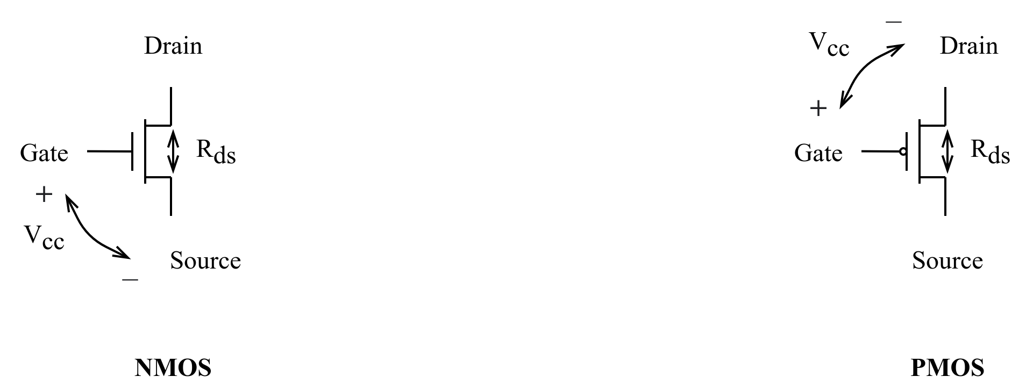
Integrated Circuit and Transistors
Integrated Circuit (IC)
Transistor-Transistor Logic (TTL)
Bipolar Junction Transistor (BJT)
Complementary Metal-Oxide Semiconductor (CMOS)
Field Effect Transistor (FET)
CMOS Transistors
Gate, source, drain
NMOS transistor / PMOS transistor
Notes:
双极结型晶体管（Bipolar Junction Transistor—BJT）又称为半导体三极管
Gate： 栅极
Source：源极
Drain：漏极
通过改变栅极和源极之间的电压差，可以控制两者间电阻R_{ds}的大小

Slide 39
MOS Transistors
Metal oxide silicon (MOS) transistors:
Polysilicon (used to be metal) gate
Oxide (silicon dioxide) insulator
Doped silicon
Notes:
Polysilicon：多晶硅
Insulator：绝缘体
Gate： 栅极
Source：源极
Drain：漏极

Slide 40
Transistors: nMOS
Gate = 0
OFF (no connection between source and drain)
Gate = 1
ON (channel between source and drain)
Notes:
NPN

Slide 41
Transistors: pMOS
pMOS transistor is opposite
ON when Gate = 0
OFF when Gate = 1
Notes:
PNP

Slide 42
Transistor Function

Slide 43
Transistor Function
nMOS: pass good 0’s, so connect source to GND
pMOS: pass good 1’s, so connect source to V_{DD}
Notes:
nMOS适用于导通低电平，下拉网络，因此接GND
pMOS适用于导通高电平，上拉网络，因而接V_{DD}
上拉下拉同时导通，短路（short circuit）
上拉下拉同时截止，处于浮空（float）状态，电压不确定
正常逻辑门，上拉或下拉必然一个导通一个截止
传导互补规则：nMOS串联则pMOS并联；nMOS并联则pMOS串联

Slide 44
Implementation of Logic Gates with Transistors
+V
+V
•
•
•
•
+V
•
X
.
Y
•
F
•
•
•
X
X
•
G = X +
Y
•
X
•
X
•
Y
•
Y
•
•
(a) NOR
(b) NAND
(c) NO
T
Transistor or tube implementations of logic functions are called logic gates or just gates
Transistor gate circuits can be modeled by switch circuits

Slide 45
CMOS Gates: NOT Gate
A | P1 | N1 | Y
0
1

Slide 46
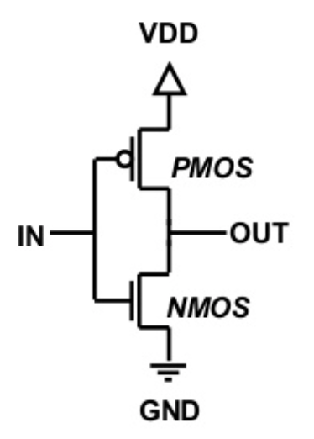
CMOS Gates: NOT Gate
A | P1 | N1 | Y
0 | ON | OFF | 1
1 | OFF | ON | 0

Slide 47
CMOS Gates: NAND Gate
A | B | P1 | P2 | N1 | N2 | Y
0 | 0
0 | 1
1 | 0
1 | 1

Slide 48
CMOS Gates: NAND Gate
A | B | P1 | P2 | N1 | N2 | Y
0 | 0 | ON | ON | OFF | OFF | 1
0 | 1 | ON | OFF | OFF | ON | 1
1 | 0 | OFF | ON | ON | OFF | 1
1 | 1 | OFF | OFF | ON | ON | 0

Slide 49
NOR Gate
How do you build a three-input NOR gate?
NOR3 gate
Notes:
所有输入都为0时，或非门输出才是1
所以，上拉网络必须是3个pMOS串联，nMOS并联

Slide 50
Other CMOS Gates
How do you build a two-input AND gate?
AND2 gate

Slide 51
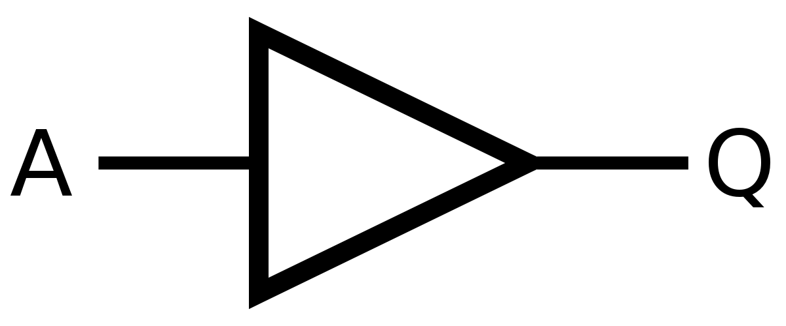
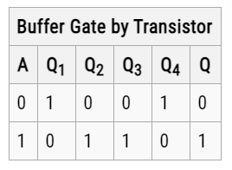
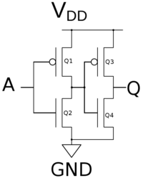
Buffer Gate
Notes:
等价于两个非门

Slide 52
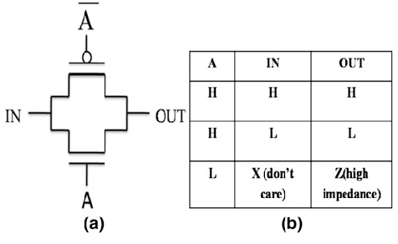
Transmission Gate
nMOS pass 1’s poorly
pMOS pass 0’s poorly
Transmission gate is a better switch
passes both 0 and 1 well
When A = 1, the switch is ON:
IN is connected to OUT
When A = 0, the switch is OFF:
IN is not connected to OUT
Notes:
逻辑控制开关，传输或阻断数字逻辑信号传输。A为高态，两个晶体管都导通，可在IN-OUT间双向传输；IN-OUT间传输一个高态逻辑信号则pMOS导通，低态逻辑信号则nMOS导通。当A为低态，两个晶体管断开，IN-OUT间阻断。
1) 在直流电路中，把对电流的阻碍作用叫做电阻；2) 在交流电路中出现了电容、电感元件，它们对电流的阻碍作用分别称为：容抗、感抗。
但交流电路中存在电阻、电感、电容时，电路的元件参数是一个复数，记做Z（复数记号），表达式为：Z=R+jX，实部为“阻”，虚部为“抗”，Z的模就是阻抗大小。阻抗impedance，一般是电容，电感加电阻产生的，主要是交流下产生。high impedance 高阻抗。电阻resistance就是单纯的电阻，通常指纯直流。

Slide 53
Overview
Introduction
Binary logic and gates
Transistors
Some IC parameters
Boolean algebra
Logic functions
Simplification of logic functions

Slide 54
Some IC Parameters
V_{CC} (Power Supply Voltage)
Logic levels
V_{IH}, V_{IL}, V_{OH}, V_{OL}
Noise margin
Propagation delay
Transition time
Power dissipation
Fan-in and Fan-out
Notes:
Logic level：逻辑电平，可以将连续变量映射到离散的二进制变量

Slide 55
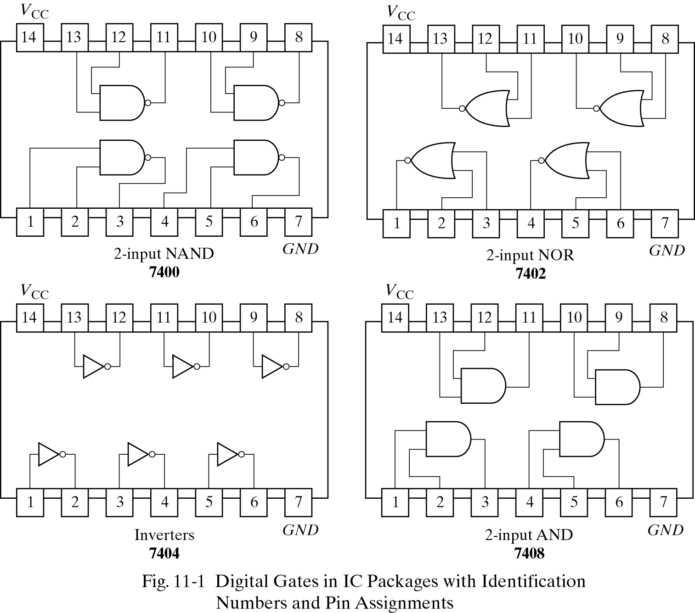
V_{CC} – Power Supply Voltage
Common across a logic family (e.g., 5V for all HC parts)
V_{CC} and GND commonly called “power supply rails”
Sometimes V_{DD} and V_{SS} for CMOS devices
+5V

Slide 56
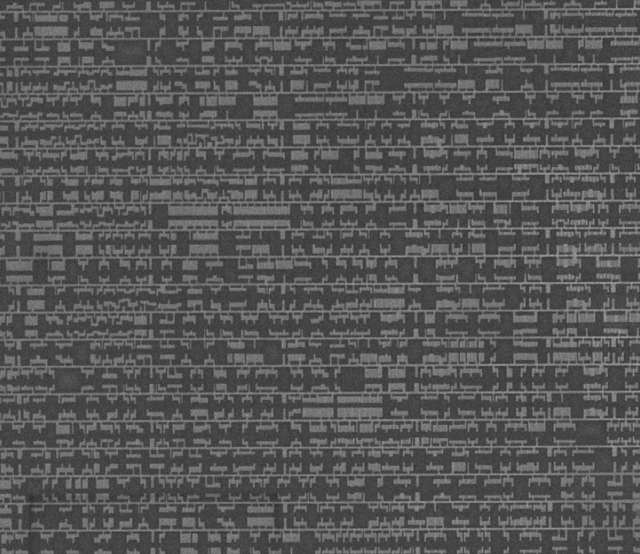

Slide 57
Logic Levels
Discrete voltages represent 1 and 0
For example:
0 = ground (GND) or 0 volts
1 = V_{CC} or 5 volts
What about 4.99 volts? Is that a 0 or a 1?
What about 3.2 volts?
Range of voltages for 1 and 0
Different ranges for inputs and outputs to allow for noise
Notes:
Logic level：逻辑电平，可以将连续变量映射到离散的二进制变量

Slide 58
What is Noise?
Anything that degrades the signal
E.g., resistance, power supply noise, coupling to neighboring wires, etc.
Example: a gate (driver) outputs 5 V but, because of resistance in a long wire, receiver gets 4.5 V

Slide 59
Use Voltage Thresholds to Extract Discrete Values from Continuous Signals
0
1
0
Voltage
Time
Simplest version: 1-bit signal
Either high range (1) or low range (0)
With guard range between them
Not strongly affected by noise or low-quality circuit elements
Can make circuits simple, small, and fast
Notes:
用电压阈值从连续信号中提取离散值
最简单版本：1位信号
或者是高位，或者是低位
在高位和低位之间有保护范围
不会收到噪音或者低质量的电路因素影响
可以使得电路简单、规模小、速度快

Slide 60
Noise Margins
NM_{H} = V_{OH} - V_{IH}
NM_{L} = V_{IL} - V_{OL}
Notes:
Noise margin: 噪声容限
Common across a logic family
V_{IH}, V_{IL}, V_{OH}, V_{OL}
V_{IH} Minimum input voltage guaranteed to be recognized as H
V_{IL} Maximum input voltage guaranteed to be recognized as L
V_{OH} Minimum output voltage guaranteed produced for H
V_{OL} Maximum output voltage guaranteed produced for L
V_{OH} > V_{IH}
V_{OL} < V_{IL}

Slide 61
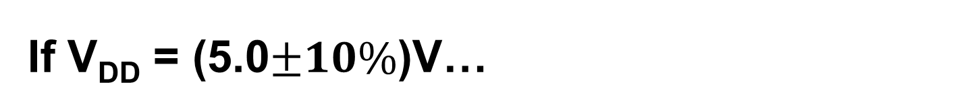
If VDD = (5.0$±10\%$)V…
VDD = 5.0V
V_{OH} = 4.4V
Typical CMOS Values
V_{OH} V_{DD} – 0.1V
V_{IH} 70% of V_{DD}
V_{IL} 30% of V_{DD}
V_{OL} GND + 0.1V
High
V_{IH} = 3.15V
Forbidden
Zone
V_{IL} = 1.35V
Low
V_{OL} = 0.1V
0.0V
NM_{H} = V_{OH} – V_{IH} = 1.25V
NM_{L} = VI_{L} – V_{OL} = 1.25V

Slide 62
DC Transfer Characteristics
Ideal Buffer: Real Buffer:
NM_{H} = NM_{L} = VDD / 2
NM_{H}, NM_{L} < VDD / 2
Notes:
直流电压传输特性，考察门的模拟行为以理解数字抽象的局限性。
门的直流电压传输特性描述了当输入垫哑变化足够慢且保证输出能跟上输入的变化时，输出电压随输入电压变化的函数关系。
理想的在V_{DD}/2时产生跳变，如左图所示。
真实的在两个极端之间变化更缓慢，如右图所示。变化平滑，如何定义逻辑电平？
一种合理方法是，在传输特征曲线斜率dV(Y)/dV(A)为1的位置，这两个位置称为单位增益点（unity gain point），可最大化噪声容限。

Slide 63
The Static Discipline
With logically valid inputs, every circuit element must produce logically valid outputs
Use limited ranges of voltages to represent discrete values
Notes:
为了避免输入落入禁止区域，数字逻辑门的设计需要遵循静态约束，要求对于给定的有效逻辑输入，每个电路元件应该能产生有效的逻辑输出。
V_{DD}和逻辑电平可任意选择，但所有互相通信的逻辑门必须保持兼容的逻辑电平。

Slide 64
V_{DD} Scaling
In 1970’s and 1980’s, V_{DD} = 5 V
V_{DD} has dropped
Avoid frying tiny transistors
Save power
3.3 V, 2.5 V, 1.8 V, 1.5 V, 1.2 V, 1.0 V, …
Be careful connecting chips with different supply voltages
Chips operate because they contain magic smoke
Proof:
if the magic smoke is let out, the chip stops working

Slide 65
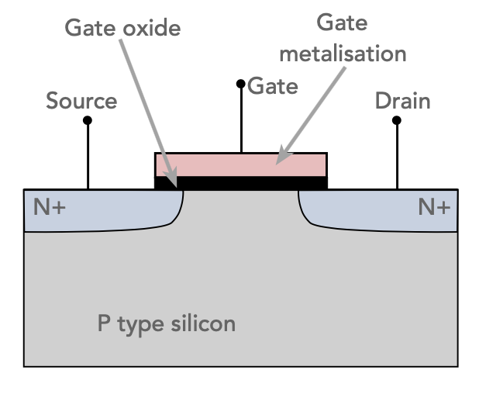
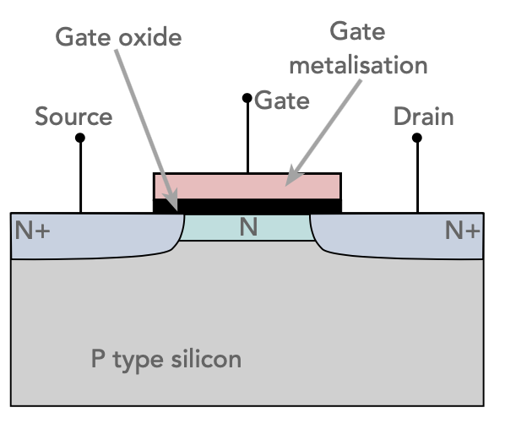
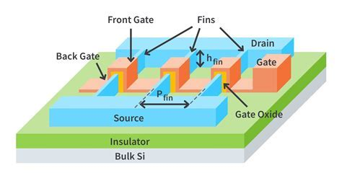
Planar
FinFet

Slide 66
Logic Family Examples
Logic Family | V_{DD} | V_{IL} | V_{IH} | V_{OL} | V_{OH}
TTL | 5 (4.75 - 5.25) | 0.8 | 2.0 | 0.4 | 2.4
CMOS | 5 (4.5 - 6) | 1.35 | 3.15 | 0.33 | 3.84
LVTTL | 3.3 (3 - 3.6) | 0.8 | 2.0 | 0.4 | 2.4
LVCMOS | 3.3 (3 - 3.6) | 0.9 | 1.8 | 0.36 | 2.7
Notes:
所以逻辑门可按照逻辑系列（logic family）区分，同一个系列的所有门都遵循同样的静态约束，彼此像积木一样组合在一起，使用相同的电源电压和逻辑电平。
TTL: Transistor-Transistor Logic
CMOS: Complementary Metal-Oxide-Semiconductor Logic
LVTTL: Low Voltage TTL
LvCMOS: Low Voltage CMOS
V_{OH} > V_{IH}
V_{OL} < V_{IL}
TTL驱动CMOS不兼容：TTL_VOH（2.4） < CMOS_VIH （3.15）

Slide 67
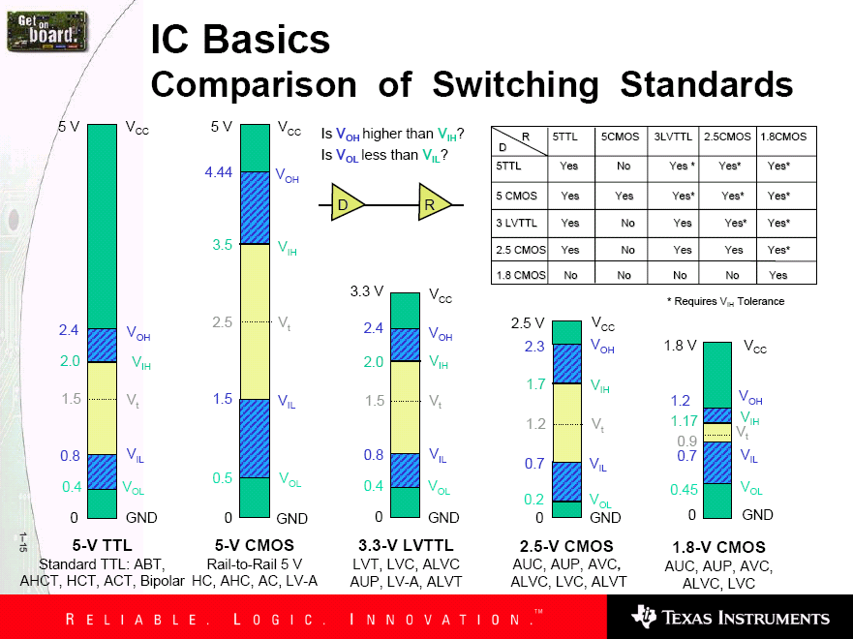
Family Logic Level Comparison
Noise Margins for Various Families
Notes:
Aside from ensuring correct operation within a logic family, why else might we care about Vih, Vil, Voh, Vol?
Interfacing between logic families!
V_{OH} > V_{IH}
V_{OL} < V_{IL}

Slide 68
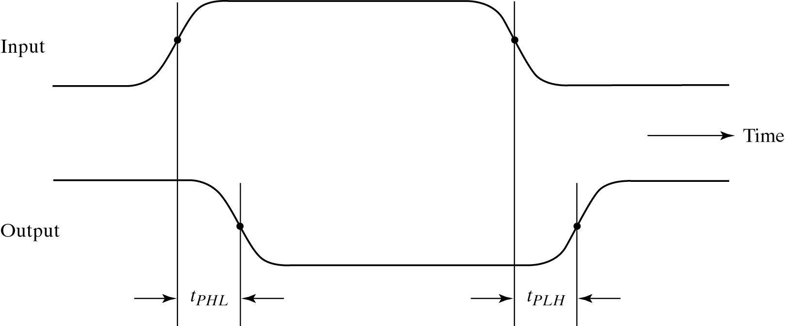
Propagation Delay (T_{pd}, T_{plh}, T_{phl})
Outputs don’t instantaneously reflect input changes
Propagation delay is a measure of this time
Delay from H to L can be different than from L to H
Notes:
输入信号发生变化到输出信号发生变化所需时间。
不同的信号通路（signal path，从一个输入信号到输出信号所经历的电气通路）传输延迟不同。
同一个信号通路，由于输出信号变化的方向不同，传输延迟也有可能不同。

Slide 69
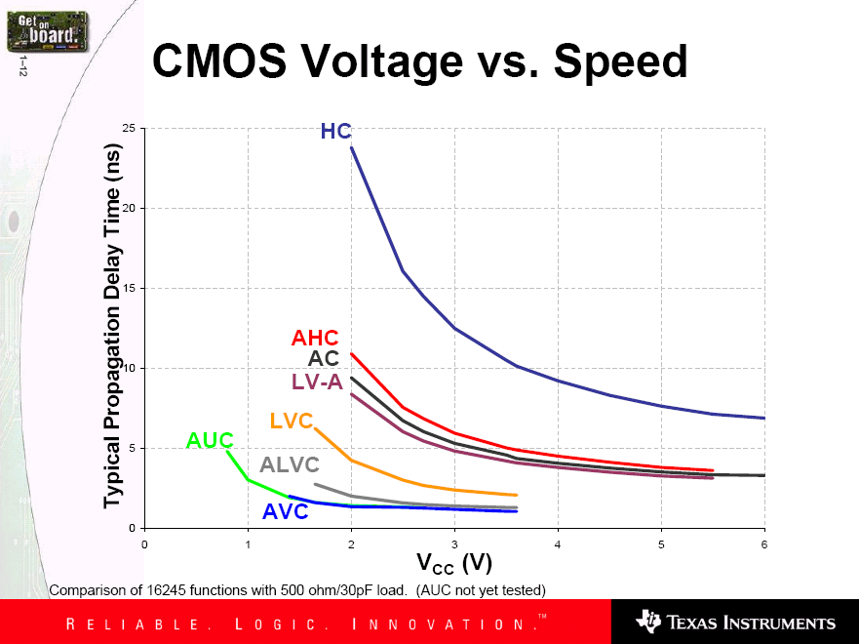
How voltage affects speed?
Voltage grows and speed grows
Notes:
HC/HCT - High-Speed CMOS Logic
AC/ACT - Advanced CMOS Logic
LVC - Low Voltage CMOS Technology
AUC − Advanced Ultra-Low-Voltage CMOS Logic
AVC - Advanced Very-Low-Voltage CMOS Logic

Slide 70
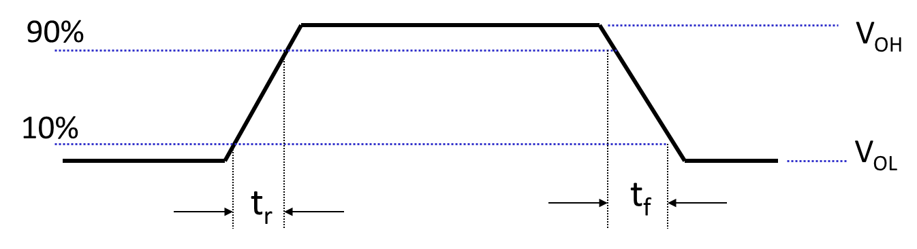
Transition Time (Rise & Fall)
Takes time for signal to reach its output voltage
Will be affected by capacitance, fan-out
Also known as slew rate
Typically measured from 10%/90% of V_{OL}/V_{OH} swing
Notes:
Transition time：转换时间，输出信号从一种状态转换到另一种状态所需要时间。
Rise time: 输出从低态到高态的转换时间
Fall time: 输出从高态到低态的转换时间
Capacitance: 电容
Fan-out: 扇出,可以从输出设备馈送输入信号的电路数量
Slew rate: 电压转换速率
V_{OL}/V_{OH} swing: 输出电压范围

Slide 71
Power Dissipation
Power “dissipation” and “consumption”
Static (“quiescent”) power dissipation
When device outputs not changing
Caused by the quiescent supply current, I_{DD} (also called the leakage current)：P_{S} = I_{DD} · V_{CC}
Very low for CMOS
Dynamic power dissipation
Notes:
功率损耗
C_{PD}: 功耗电容值，输出状态转换引发的电路内部功耗
C_{L}: 负载电容值，输出从低态到高态，PMOS给负载电容充电，输出从高态到低态，NMOS让负载电容放电。
电容（Capacitance）亦称作“电容量”，是指在给定电位差下自由电荷的储藏量，指容纳电荷的能力。
一般来说，电荷在电场中会受力而移动，当导体之间有了介质，则阻碍了电荷移动而使得电荷累积在导体上，造成电荷的累积储存，储存的电荷量则称为电容。
F为输入信号高低状态的转换频率，即每秒高低状态转化次数除以2

Slide 72
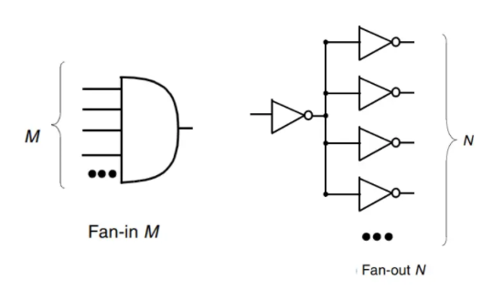
Fan-in and Fan-out
Fan-in refers to the maximum number of input signals that feed the input equations of a logic cell.
Fan-out refers to the maximum number of output signals that are fed by the output equations of a logic cell.
Notes:
The fan-out is defined as the maximum number of inputs (load) that can be connected to the output of a gate without degrading the normal operation.

Slide 73
Fan-in and Fan-out
Fan-out refers to the maximum number of output signals that are fed by the output equations of a logic cell.
Fan Out is calculated from the amount of current available in the output of a gate and the amount of current needed in each input of the connecting gate. It is specified by manufacturer and is provided in the data sheet. Exceeding the specified maximum load may cause a malfunction because the circuit will not be able supply the demanded power.
Notes:
The fan-out is defined as the maximum number of inputs (load) that can be connected to the output of a gate without degrading the normal operation.

Slide 74
Fan-in and Fan-out
Fan-in refers to the maximum number of input signals that feed the input equations of a logic cell.
Fan-in is a term that defines the maximum number of digital inputs that a single logic gate can accept. Most transistor-transistor logic ( TTL) gates have one or two inputs, although some have more than two. A typical logic gate has a fan-in of 1 or 2.
Notes:
The fan-out is defined as the maximum number of inputs (load) that can be connected to the output of a gate without degrading the normal operation.

Slide 75
小结
PMOS和NMOS工作原理
CMOS互补结构优势
NAND和NOR的物理结构
真值表
（前级）输出范围和（本级）输入范围
响应时间（弛豫）
Fan-in和Fan-out（扇入、扇出）

Slide 76
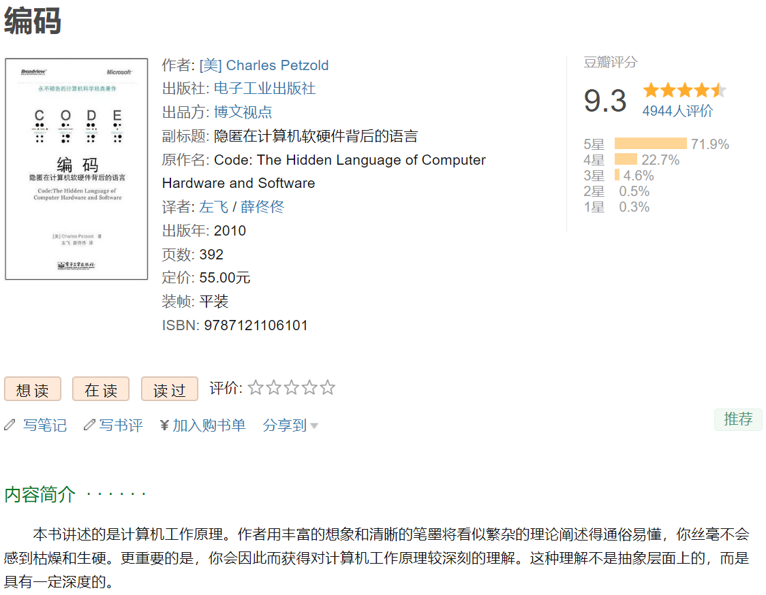
Further Reading (Optional)

Slide 77

Further Reading (Optional)

