Slide 1
Foundations of Digital Logic
Lei Wu
Zhejiang University

Slide 2
Disclaimer
Many images and resources used in this lecture are collected from the Internet, and they are used only for the educational purpose. The copyright belong to the original owners, respectively.
Part of slides credit to
David Money Harris and Sarah L. Harris. Digital Design and Computer Architecture, 2nd Edition.
Prof. Yabo Dong @ ZJU
CSE 140: Components and Design Techniques for Digital Systems (Prof. C.K. Cheng @ UCSD)

Slide 3
Overview
Introduction
Binary logic and gates
Transistors
Some IC parameters
Boolean algebra
Logic functions
Simplification of logic functions

Slide 4
Overview
Introduction
Binary logic and gates
Transistors
Some IC parameters
Boolean algebra
Logic functions
Simplification of logic functions

Slide 5
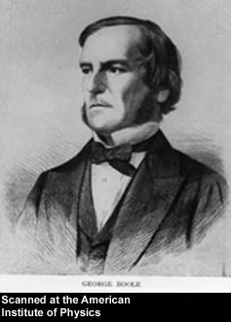
George Boole, 1815 - 1864
Born to working class parents
Taught himself mathematics and joined the faculty of Queen’s College in Ireland.
Wrote An Investigation of the Laws of Thought (1854)
Introduced binary variables
Introduced the three fundamental logic operations: AND, OR, and NOT.
Notes:
An Investigation of the Laws of Thought: 思维规律的研究

Slide 6
Switching Algebra
Boolean Algebra: multiple-valued logic, i.e., each variable have multiple values.
Switching Algebra: binary logic, i.e., each variable can be either 1 or 0.
Boolean Algebra ≠ Switching Algebra
BB
Boolean Algebra
Switching Algebra
Two Level Logic

Slide 7
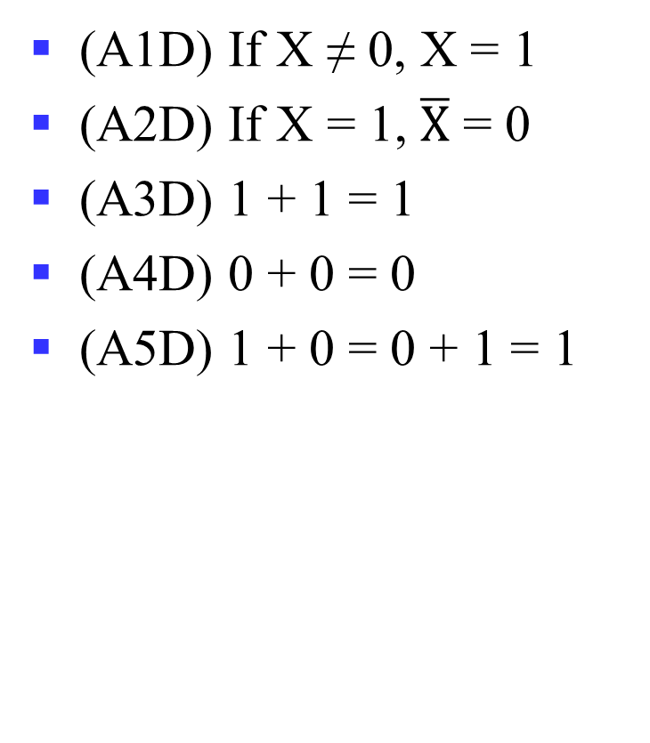
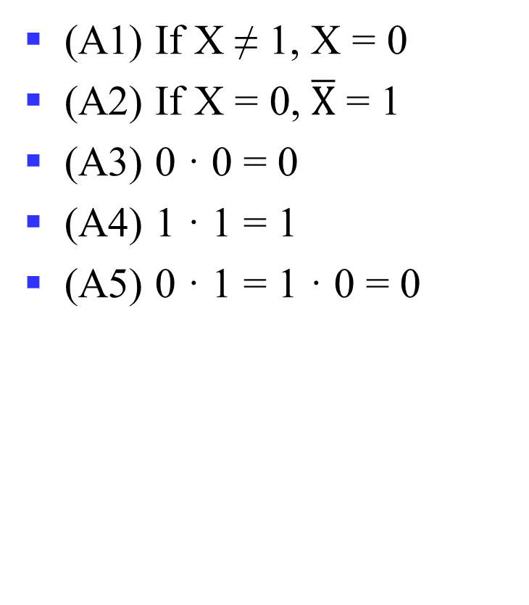
Axioms
(A1) If X ≠ 1, X = 0
(A2) If X = 0, $\overline{X}$ = 1
(A3) 0 · 0 = 0
(A4) 1 · 1 = 1
(A5) 0 · 1 = 1 · 0 = 0
(A1D) If X ≠ 0, X = 1
(A2D) If X = 1, $\overline{X}$ = 0
(A3D) 1 + 1 = 1
(A4D) 0 + 0 = 0
(A5D) 1 + 0 = 0 + 1 = 1

Slide 8
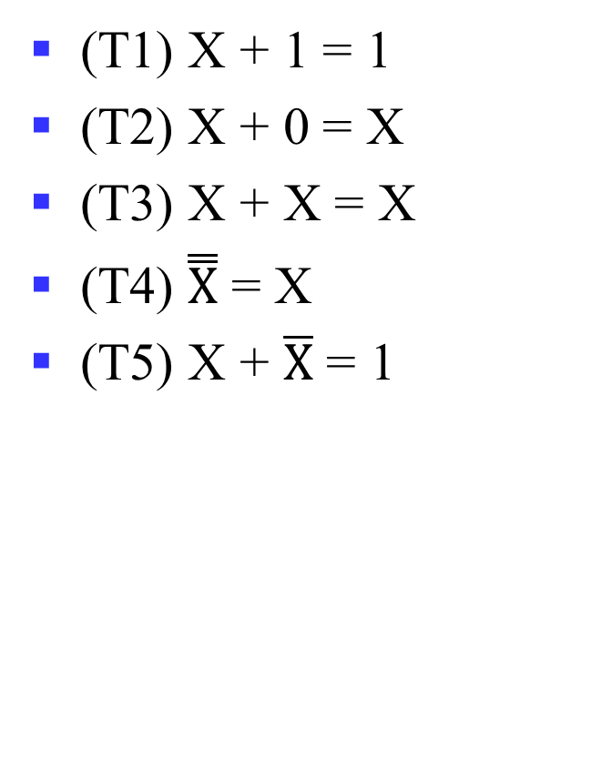

Theorems: Single Variable
(T1) X + 1 = 1
(T2) X + 0 = X
(T3) X + X = X
(T4) $\overset{̿}{X}$ = X
(T5) X + $\overline{X}$ = 1
(T1D) X · 0 = 0
(T2D) X · 1 = X
(T3D) X · X = X
(T5D) X · $\overline{X}$ = 0
Notes:
T1: Dominance 零律
T2: Identity 同一律
T3: Idempotent 幂等律
T4: Double negation 双重否定律
T5: Complement 互补律 （or T5: Excluded middle 排中律；T5D: Contradiction 矛盾律)

Slide 9


Theorems: 2-3 Variables
(T6) X + Y = Y + X
(T7) (X + Y) + Z = X + (Y + Z)
(T8) X · (Y + Z) = X · Y + X · Z
(T9) X + X · Y = X
(T10) X · Y + X · $\overline{Y}$ = X
(T11) X · Y + $\overline{X}$ · Z + Y · Z = X · Y + $\overline{X}$ · Z
(T6D) X · Y = Y · X
(T7D) (X · Y) · Z = X · (Y · Z)
(T8D) X + Y · Z = (X + Y) · (X + Z)
(T9D) X · (X + Y) = X
(T10D) (X + Y) · (X + $\overline{Y}$) = X
(T11D) (X + Y) · ($\overline{X}$ + Z) · (Y + Z) = (X + Y) · ($\overline{X}$ + Z)
Notes:
T6: 交换律 Commutative
T7: 结合律 Associative
T8: 分配律 Distributive
T9: 吸收律 Absorption
T10: 组合律 Adjacency
T11: 一致律 Consensus

Slide 10
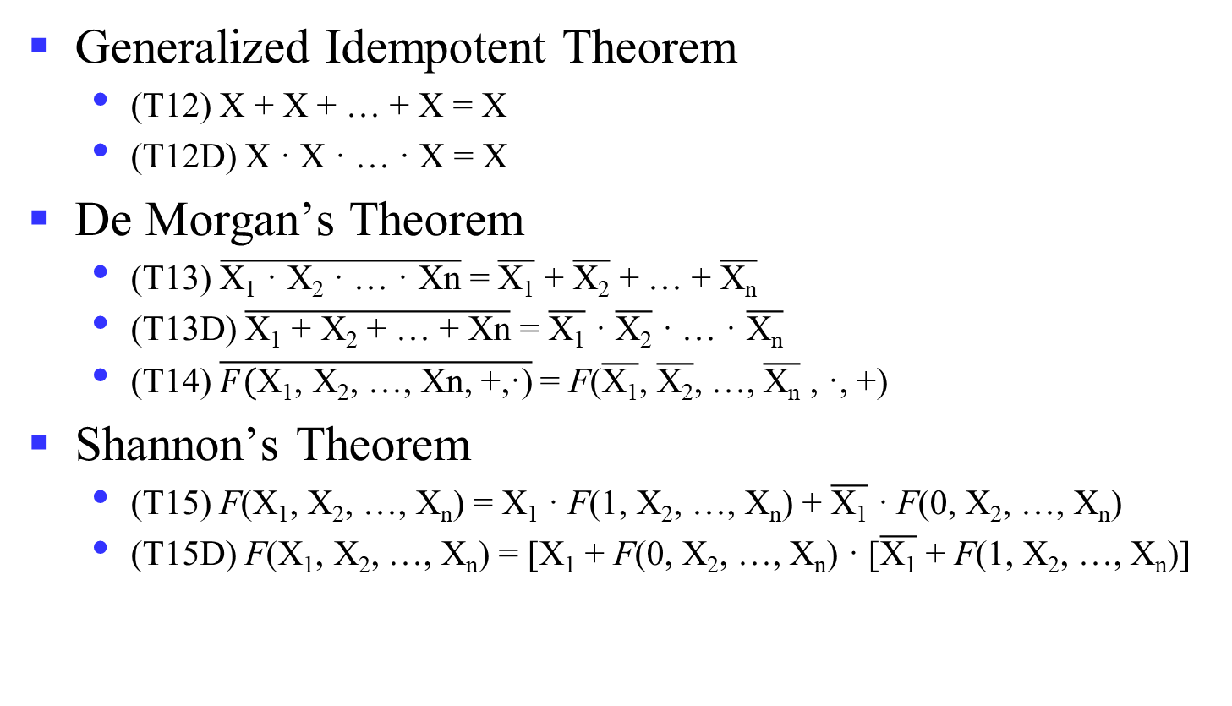
Theorems: n Variables
Generalized Idempotent Theorem
(T12) X + X + … + X = X
(T12D) X · X · … · X = X
De Morgan’s Theorem
(T13) $\overline{\text{X}\text{1}\text{ · }\text{X}\text{2}\text{ · … · }\text{Xn}}$ = $\overline{\text{X}\text{1}}$ + $\overline{\text{X}\text{2}}$ + … + $\overline{\text{X}\text{n}}$
(T13D) $\overline{\text{X}\text{1} \text{+} \text{X}\text{2} \text{+}\text{ … }\text{+} \text{Xn}}$ = $\overline{\text{X}\text{1}}$ $\text{·}$ $\overline{\text{X}\text{2}}$ $\text{·}$ … $\text{·}$ $\overline{\text{X}\text{n}}$
(T14) $\overline{F(\text{X}\text{1}\text{,} \text{X}\text{2}\text{,}\text{ …}\text{,} \text{Xn}\text{, +,}\text{·}\text{)}}$= F($\overline{\text{X}\text{1}}\text{,}$ $\overline{\text{X}\text{2}}\text{,}$ …$\text{,}$ $\overline{\text{X}\text{n}}$ , $\text{·}$, +)
Shannon’s Theorem
(T15) F(X₁, X₂, …, X_{n}) = X₁ · F(1, X₂, …, X_{n}) + $\overline{\text{X}\text{1}}$ · F(0, X₂, …, X_{n})
(T15D) F(X₁, X₂, …, X_{n}) = [X₁ + F(0, X₂, …, X_{n}) · [$\overline{\text{X}\text{1}}$ + F(1, X₂, …, X_{n})]
Notes:
~(X+Y·Z) = ?
Wrong: (~X)·(~Y)+(~Z)?
XYZ=110
广义德摩根定理：对于一个逻辑表达式取反的结果，可以通过对每一项变量取反，并交换AND运算和OR运算而得到。
香农定理在组合逻辑函数的实现中有十分重要的应用，尤其是FPGA，利用LUT实现组合逻辑，但输入有限，通常为6变量函数。
如要实现7输入变量，则可利用香农定理，将两个6输入变量函数LUT的输出组合起来，可以实现任何7输入变量的逻辑函数。

Slide 11
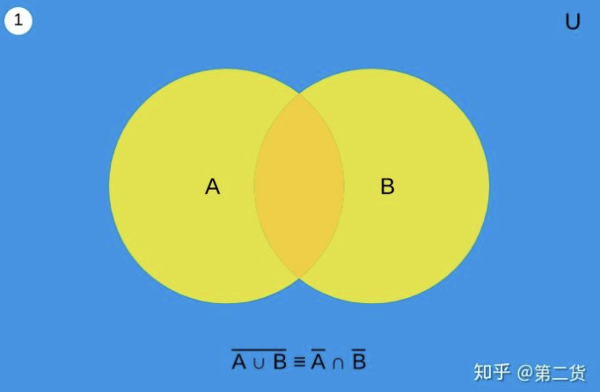
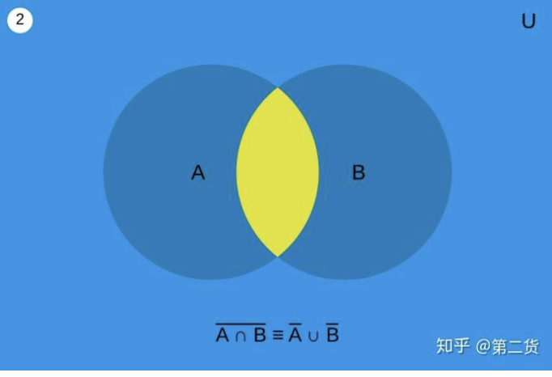
De Morgan’s Theorem
(T13) $\overline{\text{X}\text{1}\text{ · }\text{X}\text{2} }$ = $\overline{\text{X}\text{1}}$ + $\overline{\text{X}\text{2}}$ (T13D) $\overline{\text{X}\text{1} \text{+} \text{X}\text{2}}$ = $\overline{\text{X}\text{1}}$ $\text{·}$ $\overline{\text{X}\text{2}}$

Slide 12
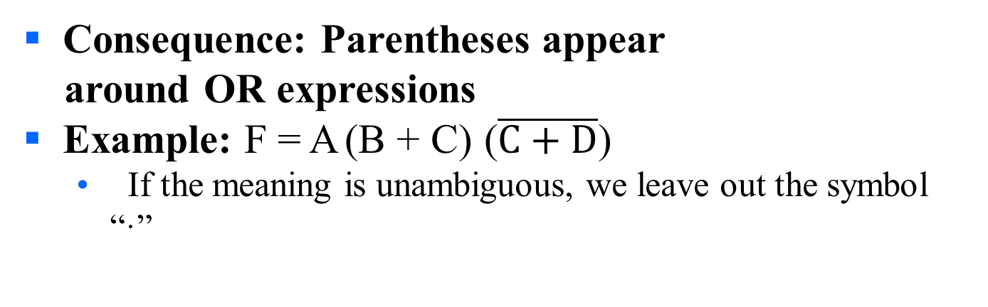
Boolean Operator Precedence
The order of evaluation in a Boolean expression is:
1.
Parentheses
2.
NOT
3.
AND
4.
OR
Consequence: Parentheses appear around OR expressions
Example: F = A (B + C) ($\overline{C+D}$)
If the meaning is unambiguous, we leave out the symbol “·”

Slide 13
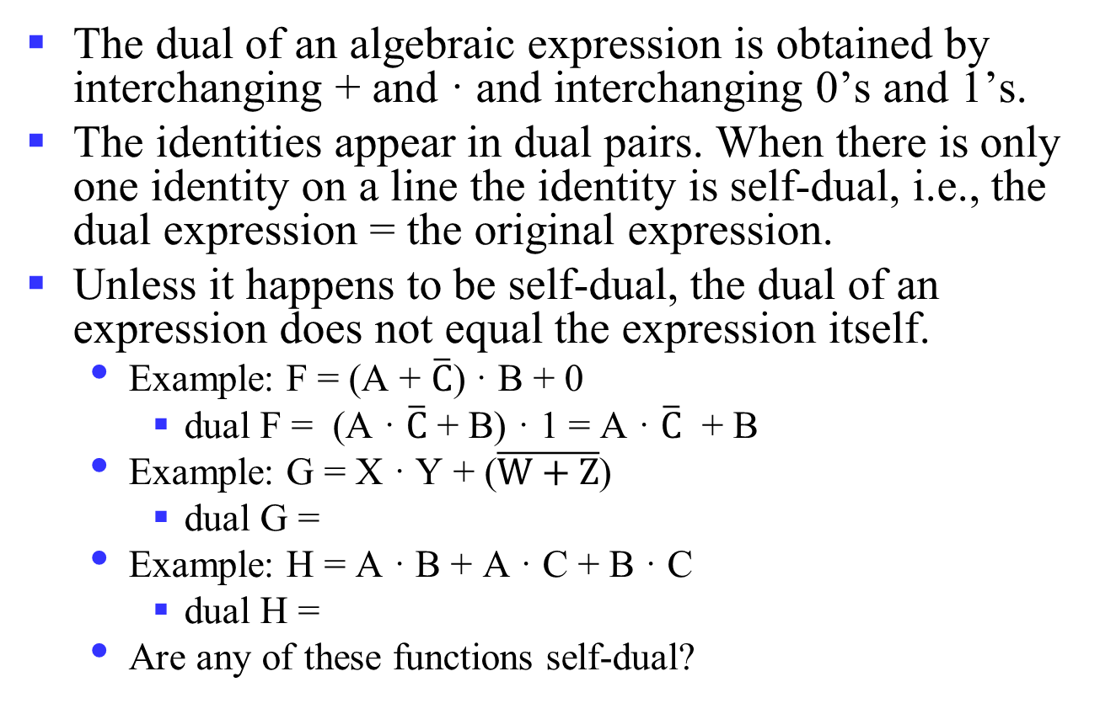
Some Properties of Identities & the Algebra
The dual of an algebraic expression is obtained by interchanging + and · and interchanging 0’s and 1’s.
The identities appear in dual pairs. When there is only one identity on a line the identity is self-dual, i.e., the dual expression = the original expression.
Unless it happens to be self-dual, the dual of an expression does not equal the expression itself.
Example: F = (A + $\overline{C}$) · B + 0
dual F = (A · $\overline{C}$ + B) · 1 = A · $\overline{C}$ + B
Example: G = X · Y + ($\overline{W+Z}$)
dual G =
Example: H = A · B + A · C + B · C
dual H =
Are any of these functions self-dual?
Notes:
Dual G = ((X+Y) · (W · Z)') = ((X+Y) ·(W' + Z')
Dual H = (A + B)(A + C)(B + C). Using the Boolean identities,
= (A +BC) (B+C) = AB + AC + BC.
So H is self-dual.

Slide 14
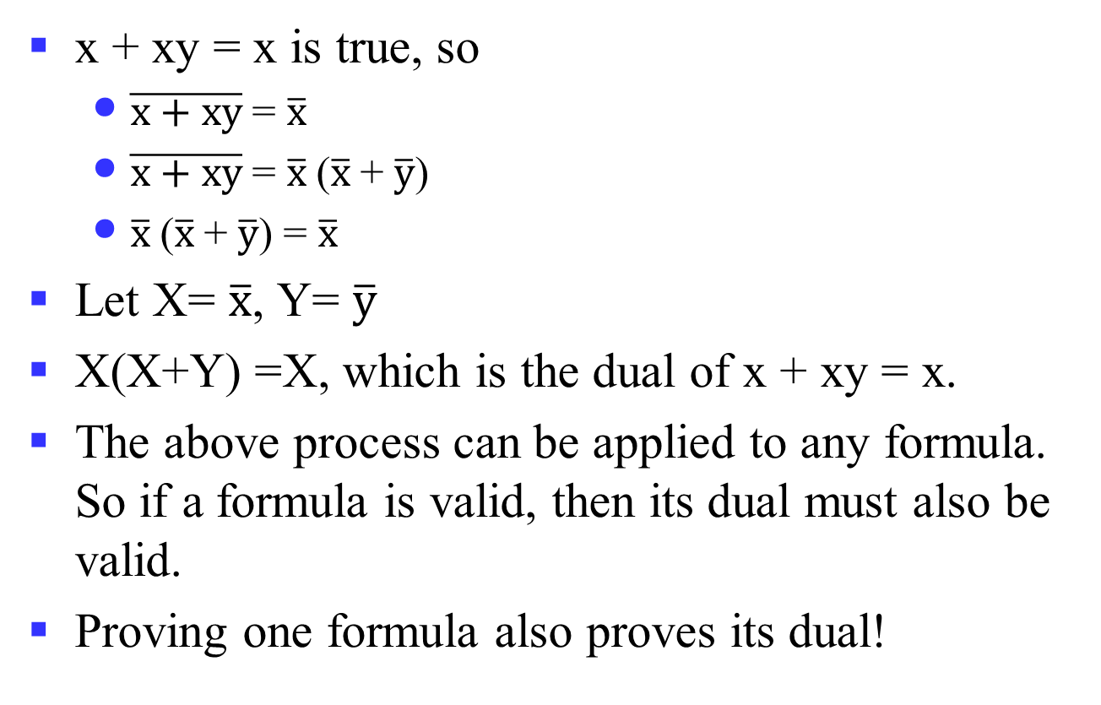
Power of Duality
x + xy = x is true, so
$\overline{x+xy}$= $\overline{x}$
$\overline{x+xy}$= $\overline{x}$($\overline{x}$+ $\overline{y}$)
$\overline{x}$($\overline{x}$+ $\overline{y}$) = $\overline{x}$
Let X= $\overline{x}$, Y= $\overline{y}$
X(X+Y) =X, which is the dual of x + xy = x.
The above process can be applied to any formula. So if a formula is valid, then its dual must also be valid.
Proving one formula also proves its dual!
Notes:
Recall T9 and T9D
(T9) X + X · Y = X
(T9D) X · (X + Y) = X
对偶性原理：若两个逻辑表达式相等，那么它们的对偶式也相等。

Slide 15
Example 1: Boolean Algebraic Proof
A + A·B = A (Absorption Theorem)
Proof Steps Justification (identity or theorem)
A + A·B
= A · 1 + A · B X = X · 1
= A · ( 1 + B) X · Y + X · Z = X ·(Y + Z)(Distributive Law)
= A · 1 1 + X = 1
= A X · 1 = X
Our primary reason for doing proofs is to learn:
Careful and efficient use of the identities and theorems of Boolean algebra, and
How to choose the appropriate identity or theorem to apply to make forward progress, irrespective of the application.

Slide 16
Example 2: Boolean Algebraic Proofs
AB + AC + BC = AB + AC (Consensus Theorem)
Proof Steps
AB + AC + BC
= ?
Notes:
Justification 1: 1 . X = X
Justification 2: X + X’ = 1
= AB + A’C + ABC + A’BC X(Y + Z) = XY + XZ (Distributive Law)
= AB + ABC + A’C + A’BC X + Y = Y + X (Commutative Law)
= AB . 1 + ABC + A’C . 1 + A’C . B X . 1 = X, X . Y = Y . X (Commutative Law)
= AB (1 + C) + A’C (1 + B) X(Y + Z) = XY +XZ (Distributive Law)
= AB . 1 + A’C . 1 = AB + A’C X . 1 = X

Slide 17

Example 3: Boolean Algebraic Proofs
$\left(\overline{X+Y}\right)Z$ + $X\overline{Y}$= $\overline{Y}(X+Z)$
Proof Steps
$\left(\overline{X+Y}\right)Z$ + $X\overline{Y}$
= ?
Notes:
= X’ Y’ Z + X Y’ (A + B)’ = A’ . B’ (DeMorgan’s Law)
= Y’ X’ Z + Y’ X A . B = B . A (Commutative Law)
= Y’ (X’ Z + X) A(B + C) = AB + AC (Distributive Law)
= Y’ (X’ + X)(Z + X) A + BC = (A + B)(A + C) (Distributive Law)
= Y’ . 1 . (Z + X) A + A’ = 1
= Y’ (X + Z) 1 . A = A, A + B = B + A (Commutative Law)

Slide 18

Proof of DeMorgan’s Laws
$\overline{X+Y}$= $\overline{X}\text{·}\overline{Y}$
$\overline{X\text{·}Y}$ = $\overline{X}$ + $\overline{Y}$
Notes:
It is important that we do not USE DeMorgan’s Laws in doing this proof. This requires a different proof method. We will show that, x’ . y’, satisfies the definition of the complement of (x + y), defined as (x + y)’ by DeMorgan’s Law.
To show this we need to show that A + A’ = 1 and A.A’ = 0 with A = x + y and A’ = x’. y’. This proves that x’. y’ = (x + y)’.
Part 1: Show x + y + x’. y’ = 1.
x + y + x’. y’
= (x + y + x’) (x + y + y’) X + YZ = (X + Y)(X + Z) (Distributive Law)
= (x + x’ + y) (x + y + y’) X + Y = Y + X (Commutative Law)
= (1 + y)(x + 1) X + X’ = 1
= 1 . 1 1 + X = 1
= 1 1 . X = 1
Part 2: Show (x + y) . x’. y’ = 0.
(x + y) . x’. y’
= (x . x’. y’ + y . x’. y’) X (Y + Z) = XY + XZ (Distributive Law)
= (x . x’. y’ + y . y’ . x’) XY = YX (Commutative Law)
= (0 . y’ + 0 . x’) X . X’ = 0
= (0 + 0) 0 . X = 0
= 0 X + 0 = X (With X = 0)
Based on the above two parts, x’y’ = (x + y)’
The second DeMorgans’ law is proved by duality. Note that DeMorgan’s Law, given as an identity is not an axiom in the sense that it can be proved using the other identities.

Slide 19
Overview
Introduction
Binary logic and gates
Digital abstraction
Transistors
Boolean algebra
Logic functions
Simplification of logic functions

Slide 20
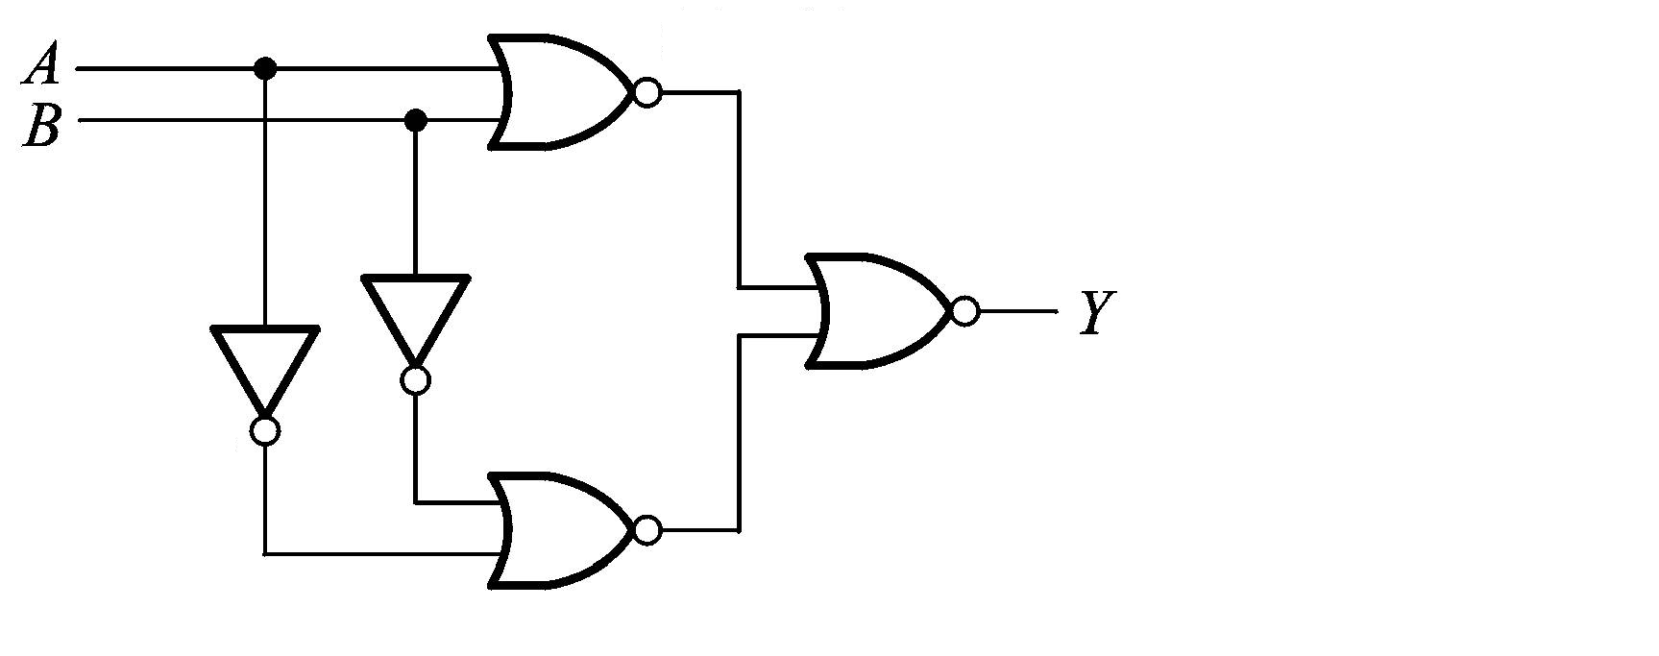
Representation of Logic Functions
Logic Functions
F(X₁, X₂, …, X_{n})
What is the logic function?
Notes:
逻辑函数是反映输入变量和输出变量之间关系的逻辑关系表达式。
每一组输入组合都有一个确定的输入值，F(x,y)有4个输入，则输出有16种组合，那么就对应着16个不同的逻辑函数F_{i}(x,y)
F(A, B) = Y = ((A + B)’ + (A’ + B’) ’)’

Slide 21
Truth Table vs. Waveforms
Representations of Logic Functions
Truth Table
Waveforms
X₁ | … | X_{n} | F
0 | … | 1 | 0
0 | … | 0 | 1
1 | … | 1 | 1
… | … | … | …
0 | … | 0 | 1
X₁
X₂
…
X_{n}
F
…
…
…
…
…
Notes:
逻辑函数输入变量的变化和输出的变化之间存在时间上的关联，因此可以用波形图来显示函数输出变量对于输入变量的变化所产生的响应。
理想状态下，波形图可以忽视数字电路的时间延迟。
一个完整的波形图需要列出所有的输入组合和对应的输出值。

Slide 22
Truth Tables
Truth table: a unique representation of a Boolean function
If two functions have identical truth tables, the functions are equivalent (and vice-versa).
Truth tables can be used to prove equality theorems.
However, the size of a truth table grows exponentially with the number of variables involved, hence unwieldy. This motivates the use of Boolean Algebra.

Slide 23
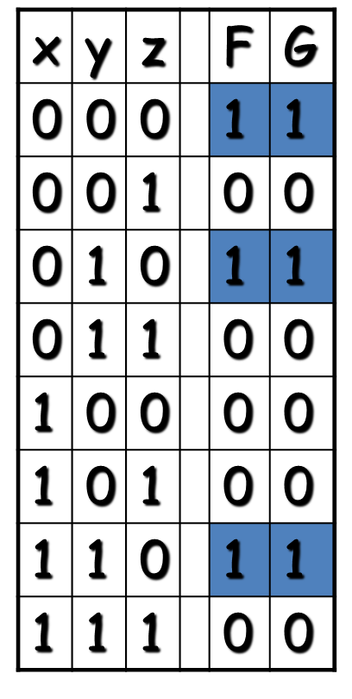
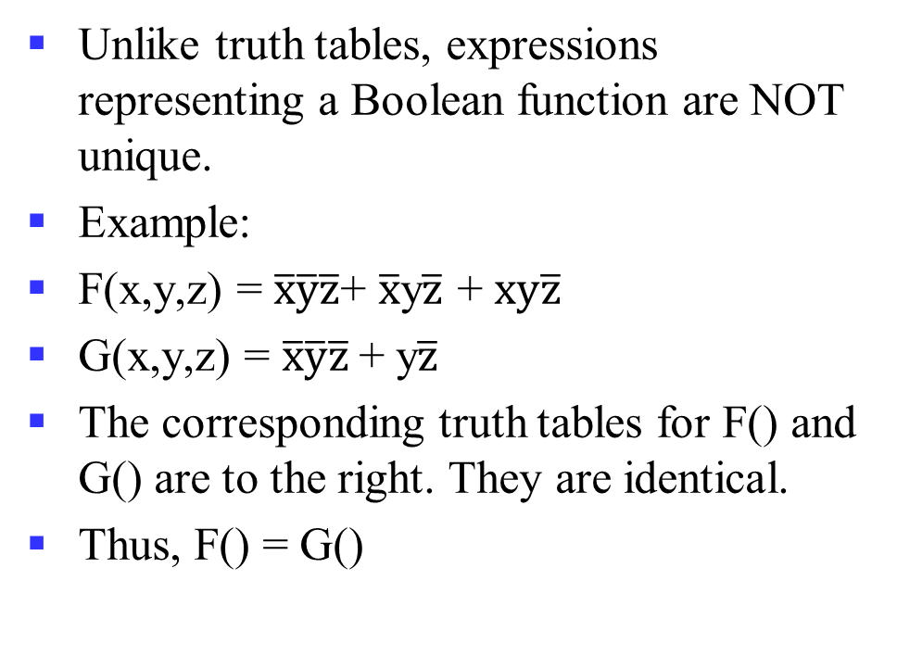
Boolean expressions-NOT unique
Unlike truth tables, expressions representing a Boolean function are NOT unique.
Example:
F(x,y,z) = $\overline{x}\overline{y}\overline{z}$+ $\overline{x}$y$\overline{z}$ + $xy\overline{z}$
G(x,y,z) = $\overline{x}\overline{y}\overline{z}$+ y$\overline{z}$
The corresponding truth tables for F() and G() are to the right. They are identical.
Thus, F() = G()

Slide 24
Complement of a Function
The complement of a function is derived by interchanging (• and +), and (1 and 0), and complementing each variable.
Otherwise, interchange 1s to 0s in the truth table column showing F.
The complement of a function IS NOT THE SAME as the dual of a function.

Slide 25
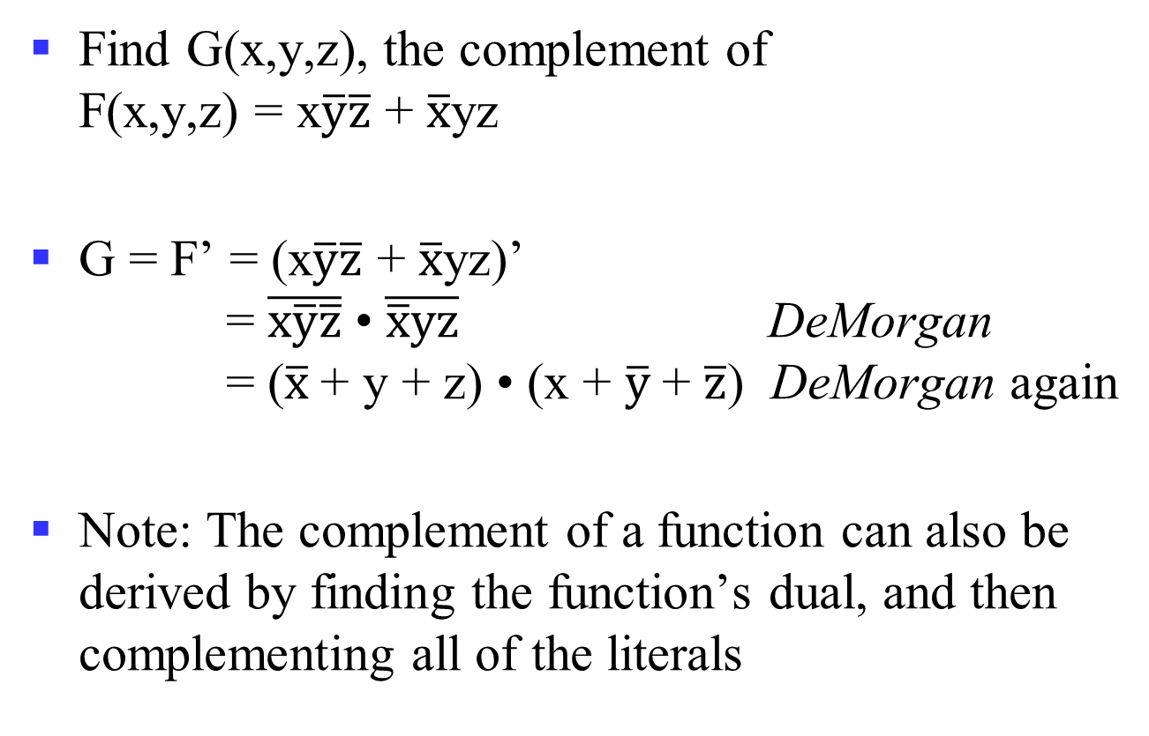
Complementation: An Example
Find G(x,y,z), the complement of F(x,y,z) = x$\overline{y}\overline{z}$ + $\overline{x}$yz
G = F’ = (x$\overline{y}\overline{z}$ + $\overline{x}$yz)’ = $\overline{x\overline{y}\overline{z}}$ • $\overline{\overline{x}yz}$ DeMorgan = ($\overline{x}$+ y + z) • (x + $\overline{y}$+ $\overline{z}$) DeMorgan again
Note: The complement of a function can also be derived by finding the function’s dual, and then complementing all of the literals
Notes:
Complement G = (a + bc)d + e
G' = ((a (b' + c'))+ d ) e' = (a (b' + c') + d) e'

Slide 26
Canonical and Standard Forms
We need to consider formal techniques for the simplification of Boolean functions.
Identical functions will have exactly the same canonical form.
Minterms and Maxterms
Sum-of-Minterms and Product-of- Maxterms
Product and Sum terms
Sum-of-Products (SOP) and Product-of-Sums (POS)
Notes:
Canonical and Standard
规范型和标准型

Slide 27
Definitions
Literal: A variable or its complement
Product term: literals connected by •
Sum term: literals connected by +
Minterm: a product term in which all the variables appear exactly once, either complemented or uncomplemented
Maxterm: a sum term in which all the variables appear exactly once, either complemented or uncomplemented
Notes:
Literal: 字面量/文字，一个变量或者反变量
Product term: 乘积项
Sum term: 求和项
Minterm: 最小项，每个逻辑变量出现且仅出现一次的乘积项
Maxterm: 最大项，每个逻辑变量出现且仅出现一次的求和项

Slide 28
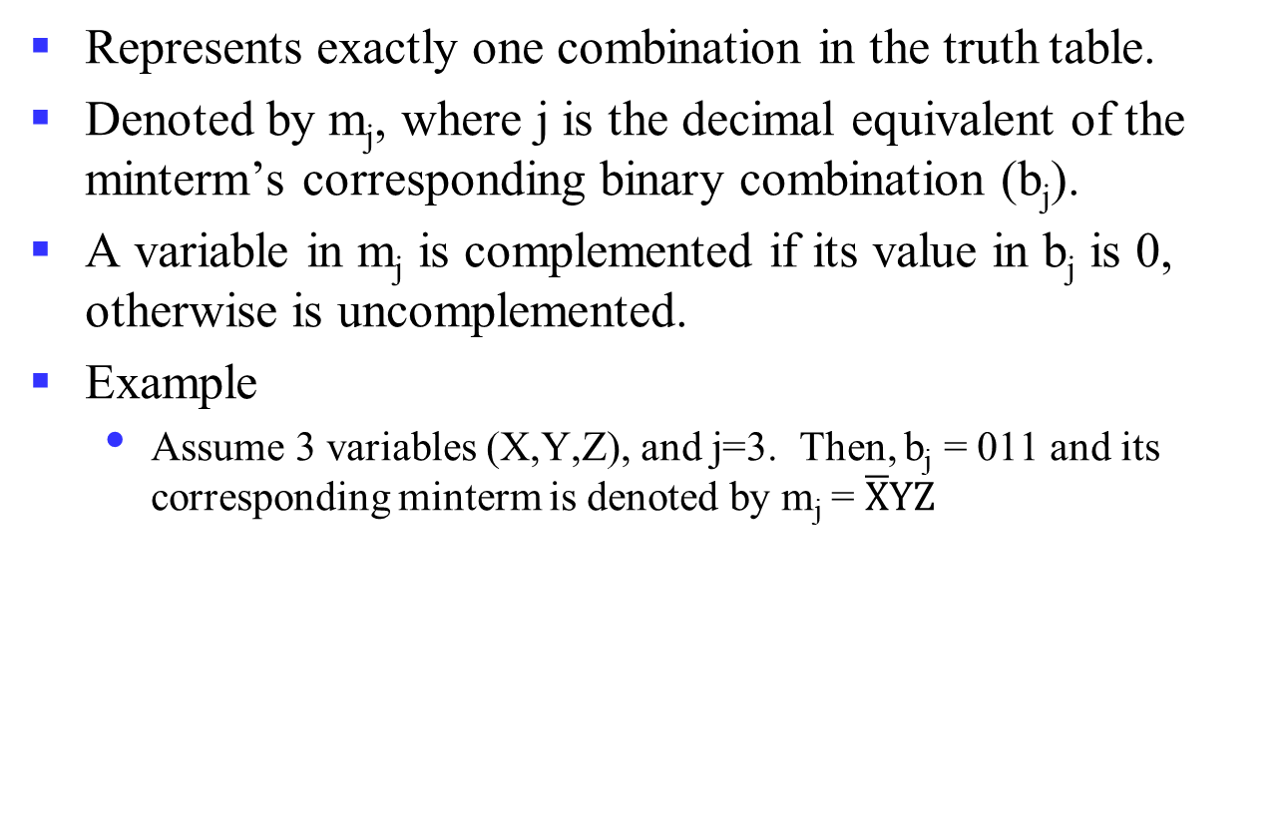
Minterm
Represents exactly one combination in the truth table.
Denoted by m_{j}, where j is the decimal equivalent of the minterm’s corresponding binary combination (b_{j}).
A variable in m_{j} is complemented if its value in b_{j} is 0, otherwise is uncomplemented.
Example
Assume 3 variables (X,Y,Z), and j=3. Then, b_{j} = 011 and its corresponding minterm is denoted by m_{j} = $\overline{X}YZ$

Slide 29

Maxterm
Represents exactly one combination in the truth table.
Denoted by M_{j}, where j is the decimal equivalent of the maxterm’s corresponding binary combination (b_{j}).
A variable in M_{j} is complemented if its value in b_{j} is 1, otherwise is uncomplemented.
Example
Assume 3 variables (X,Y,Z), and j=3. Then, b_{j} = 011 and its corresponding maxterm is denoted by M_{j} = X+ $\overline{Y}$+ $\overline{Z}$

Slide 30
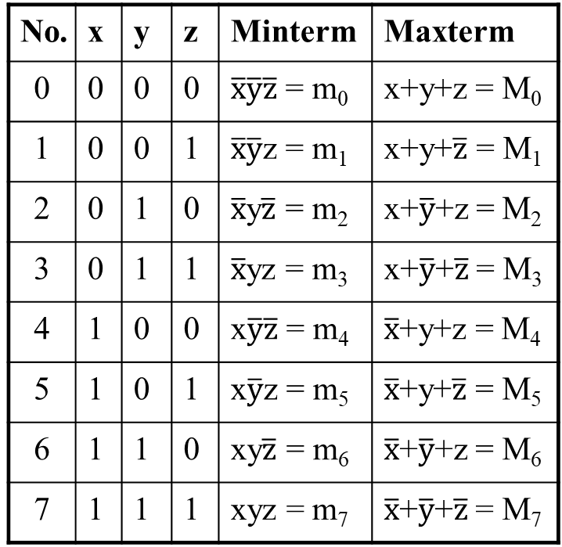
Truth Table notation for Minterms and Maxterms
Minterms and Maxterms are easy to denote using a truth table.
Example: Assume 3 variables x,y,z (order is fixed)
No. | x | y | z | Minterm | Maxterm
0 | 0 | 0 | 0 | $\overline{x}\overline{y}\overline{z}$ = m₀ | x+y+z = M₀
1 | 0 | 0 | 1 | $\overline{x}\overline{y}$z = m₁ | x+y+$\overline{z}$ = M₁
2 | 0 | 1 | 0 | $\overline{x}$y$\overline{z}$ = m₂ | x+$\overline{y}$+z = M₂
3 | 0 | 1 | 1 | $\overline{x}$yz = m₃ | x+$\overline{y}$+$\overline{z}$ = M₃
4 | 1 | 0 | 0 | x$\overline{y}\overline{z}$ = m₄ | $\overline{x}$+y+z = M₄
5 | 1 | 0 | 1 | x$\overline{y}$z = m₅ | $\overline{x}$+y+$\overline{z}$ = M₅
6 | 1 | 1 | 0 | xy$\overline{z}$ = m₆ | $\overline{x}$+$\overline{y}$+z = M₆
7 | 1 | 1 | 1 | xyz = m₇ | $\overline{x}$+$\overline{y}$+$\overline{z}$ = M₇

Slide 31
Canonical Forms (Unique)
Any Boolean function F() can be expressed as a unique sum of minterms and a unique product of maxterms (under a fixed variable ordering).
In other words, every function F() has two canonical forms:
Canonical Sum-Of-Products (sum of minterms)
Canonical Product-Of-Sums (product of maxterms)
Notes:
规范形式（唯一的）

Slide 32
Canonical Forms (cont.)
Canonical Sum-Of-Products: The minterms included are those m_{j} such that F() = 1 in row j of the truth table for F().
Canonical Product-Of-Sums: The maxterms included are those M_{j} such that F() = 0 in row j of the truth table for F().
F(X1, X2,…, Xn) = Σ (minterms for 1s of the function)
F(X1, X2,…, Xn) = Π (maxterms for 0s of the function)

Slide 33
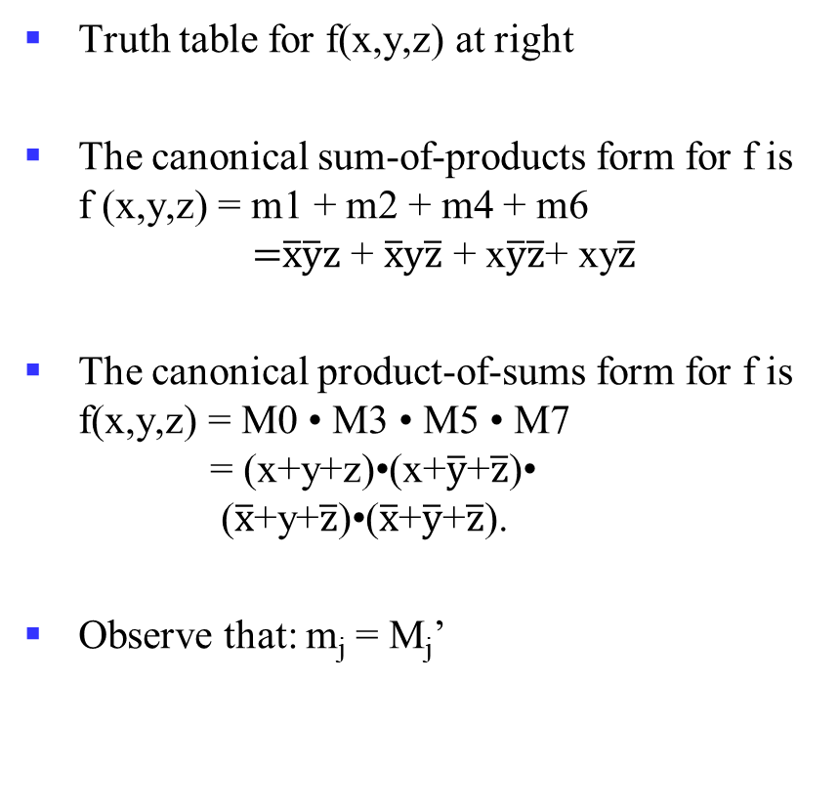
An Example
Truth table for f(x,y,z) at right
The canonical sum-of-products form for f is f (x,y,z) = m1 + m2 + m4 + m6 =$\overline{x}\overline{y}z$ + $\overline{x}y\overline{z}$ + x$\overline{y}\overline{z}$+ xy$\overline{z}$
The canonical product-of-sums form for f is f(x,y,z) = M0 • M3 • M5 • M7 = (x+y+z)•(x+$\overline{y}$+$\overline{z}$)• ($\overline{x}$+y+$\overline{z}$)•($\overline{x}$+$\overline{y}$+$\overline{z}$).
Observe that: m_{j} = M_{j}’
x | y | z |  | f
0 | 0 | 0 |  | 0
0 | 0 | 1 |  | 1
0 | 1 | 0 |  | 1
0 | 1 | 1 |  | 0
1 | 0 | 0 |  | 1
1 | 0 | 1 |  | 0
1 | 1 | 0 |  | 1
1 | 1 | 1 |  | 0

Slide 34
Shorthand: ∑ and ∏
f(x,y,z) = ∑ m(1,2,4,6), where ∑ indicates that this is a sum-of-products form, and m(1,2,4,6) indicates that the minterms to be included are m1, m2, m4, and m6.
f(x,y,z) = ∏ M(0,3,5,7), where ∏ indicates that this is a product-of-sums form, and M(0,3,5,7) indicates that the maxterms to be included are M0, M3, M5, and M7.
Since m_{j} = M_{j}’ for any j, ∑ m(1,2,4,6) = ∏ M(0,3,5,7) = f(x,y,z)
Notes:
∑ m(1,2,4,6) 最小项列表
∏ M(0,3,5,7) 最大项列表
一个n变量逻辑函数的最小项列表编号集合约最大项列表编号集合的并集为n位编号全集{0, 1, …, 2^{n}-1}，两者交集为空，是互补关系。
所以可以互相转换，只需对编码集合求补即可：Replace ∑ with ∏ (or vice versa) and replace those j’s that appeared in the original form with those that do not.

Slide 35
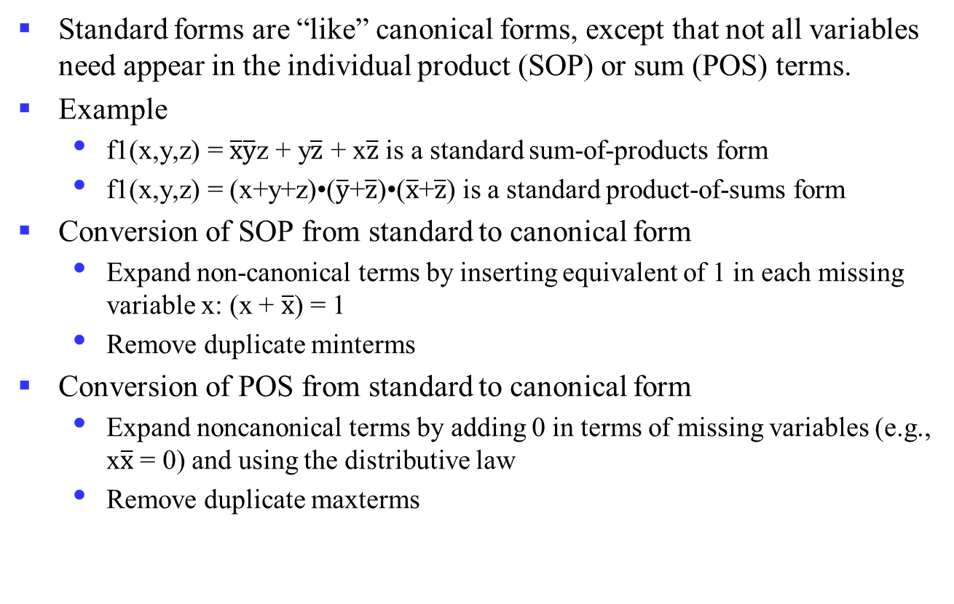
Standard Forms (NOT Unique)
Standard forms are “like” canonical forms, except that not all variables need appear in the individual product (SOP) or sum (POS) terms.
Example
f1(x,y,z) = $\overline{x}\overline{y}$z + y$\overline{z}$ + x$\overline{z}$ is a standard sum-of-products form
f1(x,y,z) = (x+y+z)•($\overline{y}$+$\overline{z}$)•($\overline{x}$+$\overline{z}$) is a standard product-of-sums form
Conversion of SOP from standard to canonical form
Expand non-canonical terms by inserting equivalent of 1 in each missing variable x: (x + $\overline{x}$) = 1
Remove duplicate minterms
Conversion of POS from standard to canonical form
Expand noncanonical terms by adding 0 in terms of missing variables (e.g., x$\overline{x}$ = 0) and using the distributive law
Remove duplicate maxterms
Notes:
SOP （standard->canonical）
f₁(x,y,z) = x’y’z + yz’ + xz’ = x’y’z + (x+x’)yz’ + x(y+y’)z’ = x’y’z + xyz’ + x’yz’ + xyz’ + xy’z’ = x’y’z + xyz’ + x’yz + xy’z’
POS （standard->canonical）
f₁(x,y,z) = (x+y+z)•(y’+z’)•(x’+z’) = (x+y+z)•(xx’+y’+z’)•(x’+yy’+z’) = (x+y+z)•(x+y’+z’)•(x’+y’+z’)•(x’+y+z’)•(x’+y’+z’) = (x+y+z)•(x+y’+z’)•(x’+y’+z’)•(x’+y+z’)

Slide 36
Overview
Introduction
Binary logic and gates
Transistors
Some IC parameters
Boolean algebra
Logic functions
Simplification of logic functions

Slide 37
Simplification of Logic Functions
About Cost Criterion
See the optional material for more details
Algebra Method
Use the theorems
Karnaugh Map
Graphical representations

Slide 38
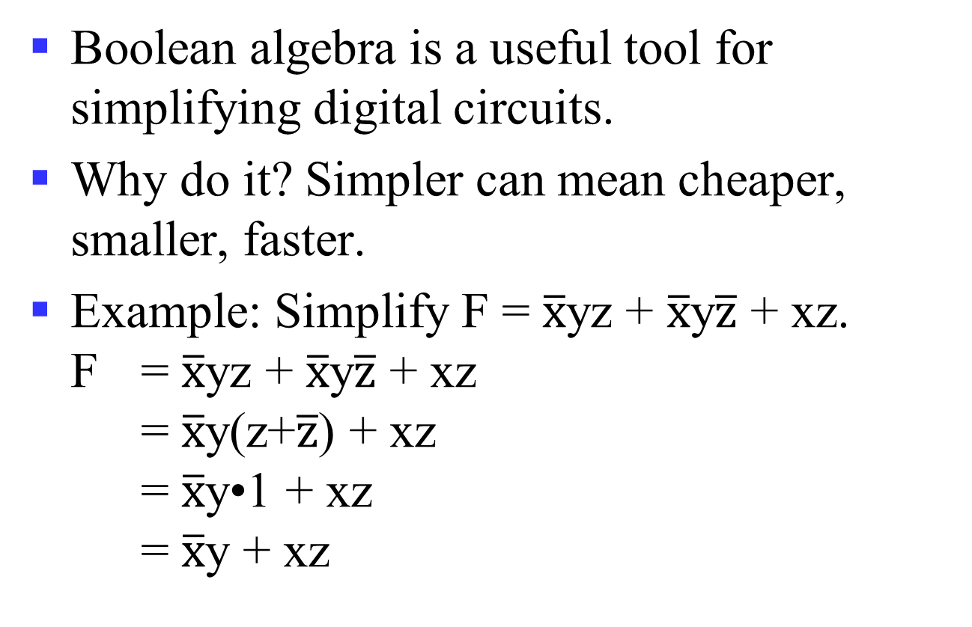
Algebraic Manipulation
Boolean algebra is a useful tool for simplifying digital circuits.
Why do it? Simpler can mean cheaper, smaller, faster.
Example: Simplify F = $\overline{x}$yz + $\overline{x}$y$\overline{z}$ + xz. F = $\overline{x}$yz + $\overline{x}$y$\overline{z}$ + xz = $\overline{x}$y(z+$\overline{z}$) + xz = $\overline{x}$y•1 + xz = $\overline{x}$y + xz

Slide 39
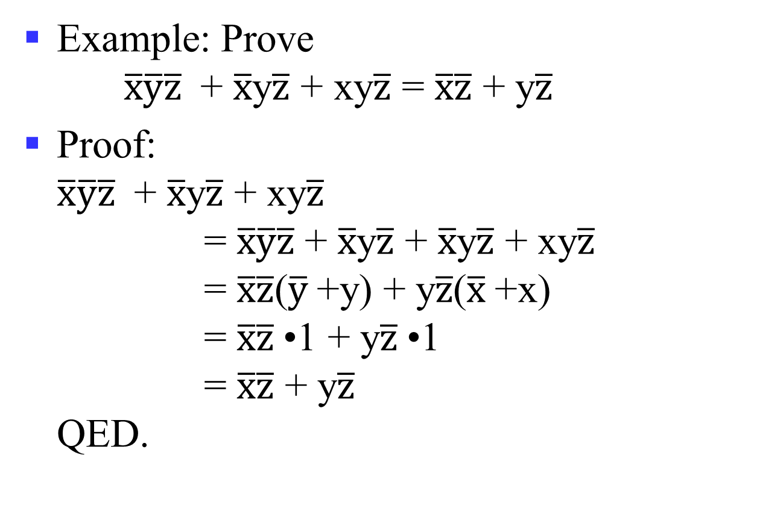
Algebraic Manipulation (cont.)
Example: Prove $\overline{x}\overline{y}\overline{z}$ + $\overline{x}$y$\overline{z}$ + xy$\overline{z}$ = $\overline{x}\overline{z}$ + y$\overline{z}$
Proof: $\overline{x}\overline{y}\overline{z}$ + $\overline{x}$y$\overline{z}$ + xy$\overline{z}$ = $\overline{x}\overline{y}\overline{z}$ + $\overline{x}$y$\overline{z}$ + $\overline{x}$y$\overline{z}$ + xy$\overline{z}$ = $\overline{x}\overline{z}$($\overline{y}$+y) + y$\overline{z}$($\overline{x}$+x) = $\overline{x}\overline{z}$•1 + y$\overline{z}$•1 = $\overline{x}\overline{z}$ + y$\overline{z}$ QED.

Slide 40
A Quiz
F(X, Y, Z) = ∑ m(1, 2, 4, 6) ?
Notes:
F(X, Y, Z) = ∑ m(1, 2, 4, 6)
= X’ · Y’ · Z + X’ · Y · Z’ + X · Y’ · Z’ + X · Y · Z’
= X’ · Y’ · Z + X’ · Y · Z’ + (X · Y’ · Z’ + X · Y · Z’)
= X’ · Y’ · Z + X’ · Y · Z’ + X · Z’
= X’ · Y’ · Z + (X’ · Y + X) · Z’
= X’ · Y’ · Z + (X + Y) · Z’
= X’ · Y’ · Z + X · Z’ + Y · Z’

Slide 41
Yet Another One
A Simplification Example:
Writing the minterm expression:
F = A B C + A B C + A B C + ABC + ABC
Simplifying:
F =
Notes:
F = A’ B’ C + A (B’ C’ + B C’ + B’ C + B C)
= A’ B’ C + A (B’ + B) (C’ + C)
= A’ B’ C + A.1.1
= A’ B’ C + A
= B’C + A --- Distributive Law: X + YZ = (X+Y)(X+Z)
Simplified F contains 3 literals compared to 15 in minterm F

Slide 42
The Benefit
The two implementations for F are shown below – it is quite apparent which is simpler!

Slide 43
Karnaugh Maps (K-map)
Karnaugh maps (K-maps) are graphical representations of boolean functions.
One map cell corresponds to a row in the truth table.
Also, one map cell corresponds to a minterm or a maxterm in the boolean expression
Multiple-cell areas of the map correspond to standard terms.
Notes:
布尔表达式化简过程不是那么容易，函数可以有多种形式，没有规则指导下一步。

Slide 44
N-Variable Karnaugh Map
Matrix with 2^{n} cells
E.g., 2-variables, 3-variables and 4-variables
W
X
X
WX
 | 00 | 01 | 11 | 10
00 | m₀ | m₄ | m₁₂ | m₈
01 | m₁ | m₅ | m₁₃ | m₉
11 | m₃ | m₇ | m₁₅ | m₁₁
10 | m₂ | m₆ | m₁₄ | m₁₀
X
XY
YZ
 | 0 | 1
0 | m₀ | m₂
1 | m₁ | m₃
 | 00 | 01 | 11 | 10
0 | m₀ | m₂ | m₆ | m₄
1 | m₁ | m₃ | m₇ | m₅
Y
Z
Y
Z
Z
Y
Y
X
Notes:
不多于4变量的化简用卡诺图是较好的方法，函数在途中可被看成所有使函数取值为1的方格，其对应的最小项包含在函数中。
进一步地，卡诺图本质上是对一个函数所有可能地标准表示方式的图形化，通过相邻项合并求最优的表达。卡诺图可用于2级电路的优化，不能直接用于更多级的电路。

Slide 45
Some Uses of K-Maps
Finding optimum or near optimum
SOP and POS standard forms, and
two-level AND/OR and OR/AND circuit implementations
for functions with small numbers of variables
Visualizing concepts related to manipulating Boolean expressions, and
Demonstrating concepts used by computer-aided design programs to simplify large circuits

Slide 46
Simplification of Logic Functions
Example: F(X, Y, Z) = ∑ m(3, 5, 6, 7)
X
Index | X Y Z | F(X, Y, Z)
0 | 0 0 0 | 0
1 | 0 0 1 | 0
2 | 0 1 0 | 0
3 | 0 1 1 | 1
4 | 1 0 0 | 0
5 | 1 0 1 | 1
6 | 1 1 0 | 1
7 | 1 1 1 | 1
XY
 | 00 | 01 | 11 | 10
0 |  |  | 1
1 |  | 1 | 1 | 1
Z
Z
Y
XY
X · Y
 | 00 | 01 | 11 | 10
0 |  |  | 1
1 |  | 1 | 1 | 1
Z
X · Z
Y · Z

Slide 47
K-Map Definitions
Implicant
Product of literals ABC, AC, BC
Prime implicant
Implicant corresponding to the largest circle in a K-map, i.e., is a product term obtained by combining the maximum possible number of adjacent squares in the map into a rectangle with the number of squares a power of 2.
Essential prime implicant
A prime implicant is called an Essential Prime Implicant if it is the only prime implicant that covers (includes) one or more minterms.
Notes:
Implicant：蕴涵项，如果一个乘积项包含了一个或多个最小项，那么称之为蕴涵项
Prime implicant：质蕴涵项，如果某个蕴涵项不能被该函数的其它蕴涵项所覆盖，则称为质蕴涵项
Essential prime implicant：实质蕴涵项，质蕴涵项覆盖的最小项中至少有一个最小项没有被其它质蕴涵项覆盖
如果逻辑函数的所有最小项都能被一组质蕴涵项覆盖，则该组质蕴涵项称为函数的一个覆盖，一定包含了所有的实质蕴涵项
F(A, B, C) = sigma m(1, 3, 4, 5, 7)

Slide 48
K-Map Rules
Every 1 must be circled at least once
Each circle must span a power of 2 (i.e., 1, 2, 4) squares in each direction
Each circle must be as large as possible
A circle may wrap around the edges
A “don't care” (X) is circled only if it helps minimize the equation
Notes:
A Prime Implicant is a product term obtained by combining the maximum possible number of adjacent squares in the map into a rectangle with the number of squares a power of 2.
A set of prime implicants "covers all minterms" if, for each minterm of the function, at least one prime implicant in the set of prime implicants includes the minterm.

Slide 49
Example of Prime Implicants
Find ALL Prime Implicants
CD
ESSENTIAL Prime Implicants
C
C
B
D
B
D
1
1
1
1
1
1
BD
1
1
BD
1
1
B
B
1
1
1
1
A
A
A
B
1
1
1
1
1
1
1
1
D
D
AD
B
C
Minterms covered by single prime implicant

Slide 50
Prime Implicant Practice
Find all prime implicants for:
Notes:
Prime implicants are: A, B'C, and B'D'

Slide 51
Prime Implicant Selection Rule
Minimize the overlap among prime implicants as much as possible.
In particular, in the final solution, make sure that each prime implicant selected includes at least one minterm not included in any other prime implicant selected.

Slide 52
Selection Rule Example
Simplify F(A, B, C, D) given on the K-map
Selected
Essential
C
C
1
1
1
1
1
1
1
1
1
1
1
1
B
B
1
1
A
A
1
1
1
1
D
D
Minterms covered by essential prime implicants

Slide 53
An Example of 4-Variable K-Map

Slide 54
An Example of 4-Variable K-Map

Slide 55
Selection Rule Example with Don't Cares
Simplify F(A, B, C, D) given on the K-map
Selected
Essential
C
C
1
x
1
x
1
x
x
1
1
x
x
1
B
B
x
x
A
A
1
1
x
1
1
x
D
D
Minterms covered by essential prime implicants
Notes:
某些场景某些输入组合不关心，函数输出结果不确定，不完全确定函数(incompletely specified function)。
不确定的最小项称为无关最小项(don’t care condition)，可使得卡诺图进一步化简。

Slide 56
An Example with Don’t Cares

Slide 57
An Example with Don’t Cares

Slide 58
Systematic Simplification
Example: ∑ _{m}(1, 2, 5, 7, 8, 10, 12, 13, 15)
AB
AB
AB
 | 00 | 01 | 11 | 10
00 |  |  | 1 | 1
01 | 1 | 1 | 1
11 |  | 1 | 1
10 | 1 |  |  | 1
 | 00 | 01 | 11 | 10
00 |  |  | 1 | 1
01 | 1 | 1 | 1
11 |  | 1 | 1
10 | 1 |  |  | 1
 | 00 | 01 | 11 | 10
00 |  |  | 1 | 1
01 | 1 | 1 | 1
11 |  | 1 | 1
10 | 1 |  |  | 1
CD
CD
CD
Notes:
F(A,B,C,D) = BD + A’CD+ B’CD’+AC’D’

Slide 59
Systematic Simplification
F(W,X,Y,Z) = ∑ _{m}(3, 4, 5, 7, 9, 13, 14, 15) ?
Notes:
Q = XZ
P = W' X Y’ + WY’Z + W' Y Z + WXY
F = Q + P
Q == XZ(W+W’)(Z+Z’)
F = XZ(W+W’)(Z+Z’) + P = P

Slide 60
Results May NOT Be Unique
F(X, Y, Z) = XZ’ + X’Z + YZ’ + Y’Z
F(X, Y, Z) = ∑ _{m}?
?
Notes:
F(X,Y,Z) = X’Y’Z + X’YZ’+ X’YZ + XY’Z’ + XY’Z + XYZ’
= ∑ _{m}(1, 2, 3, 4, 5, 6)
F(X,Y,Z) = X’Z + XY’ + YZ’
F(X,Y,Z) = X’Y + XZ’+ Y’Z

Slide 61
DeMorgan’s Theorem Can Be Useful
Y = AB = A + B
Y = A + B = A B

Slide 62
Bubble Pushing
Backward:
Body changes
Adds bubbles to inputs
Forward:
Body changes
Adds bubble to output

Slide 63
Bubble Pushing
What is the Boolean expression for this circuit?
Y = AB + CD

Slide 64
Bubble Pushing Rules
Begin at output, then work toward inputs
Push bubbles on final output back
Draw gates in a form so bubbles cancel

Slide 65
Bubble Pushing Example

Slide 66
Bubble Pushing Example

Slide 67
Bubble Pushing Example

Slide 68
Bubble Pushing Example

Slide 69
Summary
Introduction
Binary logic and gates
Transistors
Some IC parameters
Boolean algebra
Logic functions
Simplification of logic functions

Slide 70
More Materials (Optional)
Circuit optimization and cost criterion
More about k-maps

Slide 71
More Materials (Optional)
Circuit optimization and cost criterion
More about k-maps

Slide 72
Circuit Optimization
Goal: To obtain the simplest implementation for a given function
Optimization is a more formal approach to simplification that is performed using a specific procedure or algorithm
Optimization requires a cost criterion to measure the simplicity of a circuit
Distinct cost criteria we will use:
Literal cost (L)
Gate input cost (G)
Gate input cost with NOTs (GN)

Slide 73
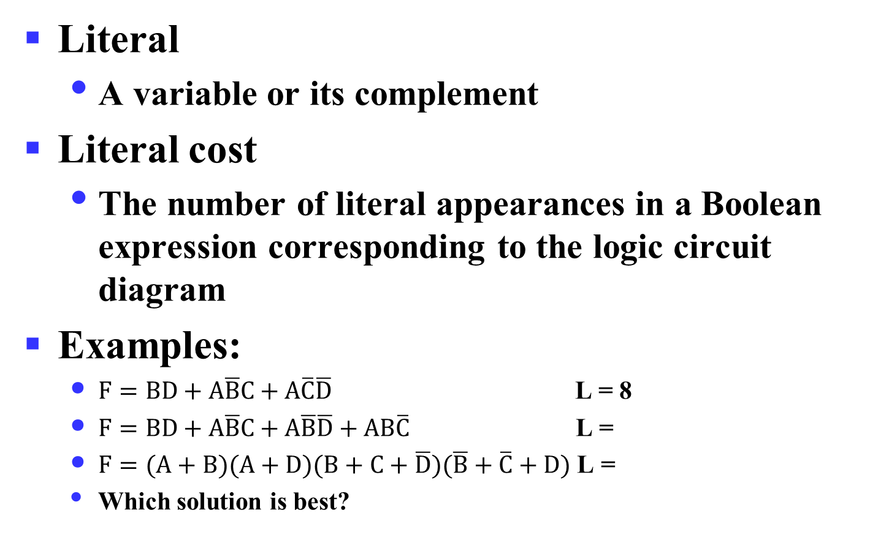
Literal Cost
Literal
A variable or its complement
Literal cost
The number of literal appearances in a Boolean expression corresponding to the logic circuit diagram
Examples:
$F=BD+A\overline{B}C+A\overline{C}\overline{D}$ L = 8
$F=BD+A\overline{B}C+A\overline{B}\overline{D}+AB\overline{C}$ L =
$F=(A+B)(A+D)(B+C+\overline{D})(\overline{B}+\overline{C}+D)$ L =
Which solution is best?
Notes:
2nd Literal Cost = 11
3rd Literal Cost = 10
The first solution is best

Slide 74

Literal Cost
Another Example:
$F=ABCD+\overline{A}\overline{B}\overline{C}\overline{D}$
$F=(A+B)(B+\overline{C})(C+\overline{D})(D+\overline{A})$
Which solution is best?
Notes:
2个函数项 vs. 4个函数项

Slide 75
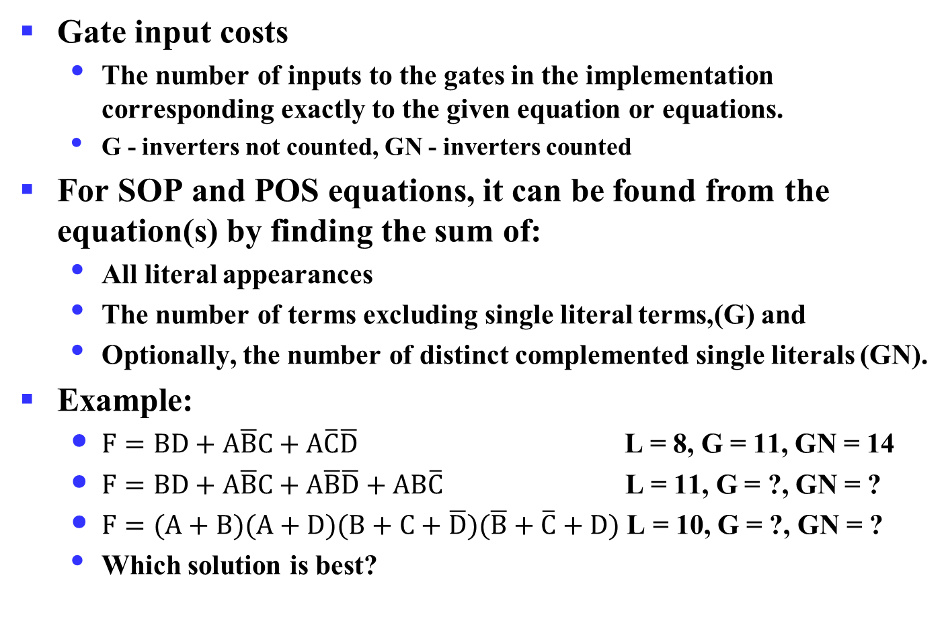
Gate Input Cost
Gate input costs
The number of inputs to the gates in the implementation corresponding exactly to the given equation or equations.
G - inverters not counted, GN - inverters counted
For SOP and POS equations, it can be found from the equation(s) by finding the sum of:
All literal appearances
The number of terms excluding single literal terms,(G) and
Optionally, the number of distinct complemented single literals (GN).
Example:
$F=BD+A\overline{B}C+A\overline{C}\overline{D}$ L = 8, G = 11, GN = 14
$F=BD+A\overline{B}C+A\overline{B}\overline{D}+AB\overline{C}$ L = 11, G = ?, GN = ?
$F=(A+B)(A+D)(B+C+\overline{D})(\overline{B}+\overline{C}+D)$ L = 10, G = ?, GN = ?
Which solution is best?
Notes:
门输入成本，所用门的输入端的个数。
G = 15, GN = 18
G = 14, GN = 17
1st solution is best

Slide 76

Cost Criteria (continued)
Example 1:
$F=A+BC+\overline{B}\overline{C}$
GN = G + 2 = 9
L = 5
G = L + 2 = 7
B
C
A
F
L (literal count) counts the AND inputs and the single literal OR input
G (gate input count) adds the remaining OR gate inputs
GN(gate input count with NOTs) adds the inverter inputs

Slide 77
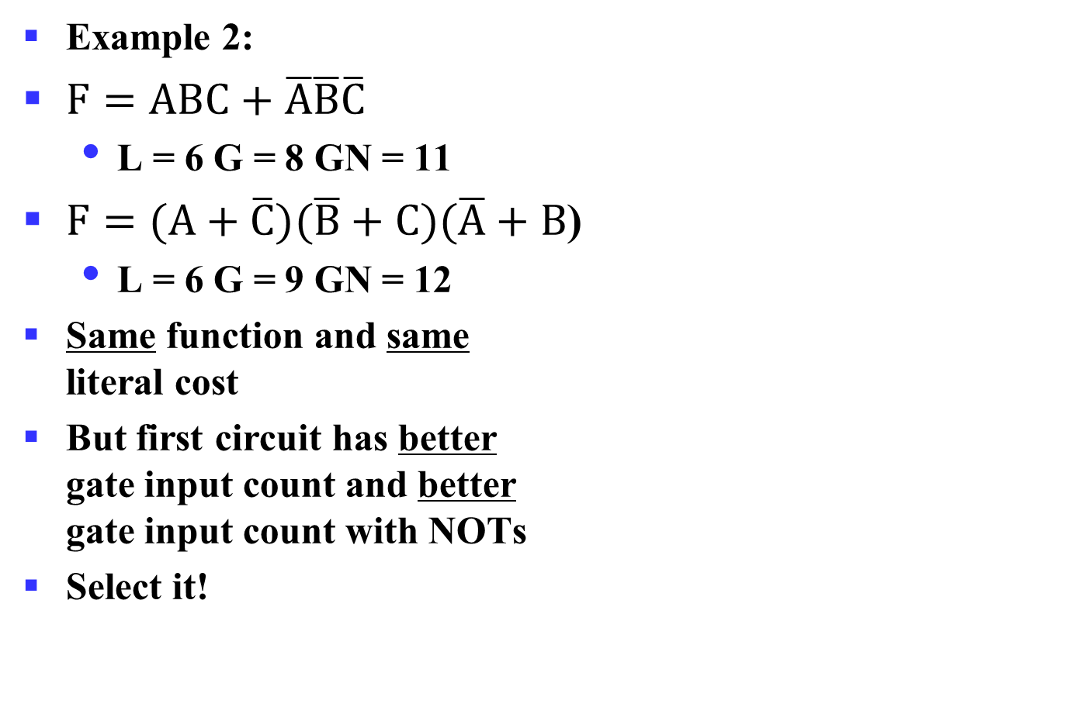
Cost Criteria (continued)
A
Example 2:
$F=ABC+\overline{A}\overline{B}\overline{C}$
L = 6 G = 8 GN = 11
$F=(A+\overline{C})(\overline{B}+C)(\overline{A}+B$)
L = 6 G = 9 GN = 12
Same function and same literal cost
But first circuit has better gate input count and better gate input count with NOTs
Select it!
B
C
F
A
B
C
F

Slide 78
Boolean Function Optimization
Minimizing the gate input (or literal) cost of a (a set of) Boolean equation(s) reduces circuit cost.
We choose gate input cost.
Boolean Algebra and graphical techniques are tools to minimize cost criteria values.
Some important questions:
When do we stop trying to reduce the cost?
Do we know when we have a minimum cost?
Treat optimum or near-optimum cost functions for two-level (SOP and POS) circuits first.
Introduce a graphical technique using Karnaugh maps (K-maps, for short)

Slide 79
Multiple-Level Optimization
Multiple-level circuits - circuits that are not two-level (with or without input and/or output inverters)
Multiple-level circuits can have reduced gate input cost compared to two-level (SOP and POS) circuits
Multiple-level optimization is performed by applying transformations to circuits represented by equations while evaluating cost

Slide 80
More Materials (Optional)
Circuit optimization and cost criterion
More about k-maps
2-variable maps
3-variable maps
4-variable maps
5-variable maps

Slide 81




Two Variable Maps
A 2-variable Karnaugh Map:
Note that minterm m₀ and
minterm m₁ are “adjacent”
and differ in the value of the
variable y
Similarly, minterm m₀ and
minterm m₂ differ in the x variable.
Also, m₁ and m₃ differ in the x variable as well.
Finally, m₂ and m₃ differ in the value of the variable y
y = 0
y = 1
x = 0
m₀ = $\overline{x}\overline{y}$
m1 = $\overline{x}y$
x = 1
m2 = $x\overline{y}$
m3 = $xy$

Slide 82
K-Map and Truth Tables
The K-Map is just a different form of the truth table.
Example – Two variable function:
We choose a,b,c and d from the set {0,1} to implement a particular function, F(x,y).
Function Table
K-Map
Input
Function
y = 0
y = 1
Values
Value
(x,y)
F(x,y)
x = 0
a
b
0 0
a
x = 1
c
d
0 1
b
1 0
c
1 1
d

Slide 83

K-Map Function Representation
Example: F(x,y) = x
For function F(x,y), the two adjacent cells containing 1’s can be combined using the Minimization Theorem:
F = x
y = 0
y = 1
x = 0
0
0
x = 1
1
1
$F\left(x,y\right)=x\overline{y}+xy=x$

Slide 84
K-Map Function Representation
Example: G(x,y) = x + y
For G(x,y), two pairs of adjacent cells containing 1’s can be combined using the Minimization Theorem:
G = x+y
y = 0
y = 1
x = 0
0
1
x = 1
1
1
$G\left(x,y\right)=\left(x\overline{y}+xy\right)+\left(\overline{x}y+xy\right)=x+y$
Duplicate x y

Slide 85








Three Variable Maps
A three-variable K-map:
Where each minterm corresponds to the product terms:
Note that if the binary value for an index differs in one bit position, the minterms are adjacent on the K-Map
yz=00
yz=01
yz=11
yz=10
x=0
m₀
m₁
m₃
m₂
x=1
m₄
m₅
m₇
m₆
yz=00
yz=01
yz=11
yz=10
x=0
$$\overline{x}\overline{y}\overline{z}$$
$$\overline{x}\overline{y}z$$
$$\overline{x}yz$$
$$\overline{x}y\overline{z}$$
x=1
$$x\overline{y}\overline{z}$$
$$x\overline{y}z$$
$$xyz$$
$$xy\overline{z}$$

Slide 86
Alternative Map Labeling
Map use largely involves:
Entering values into the map, and
Reading off product terms from the map.
Alternative labelings are useful:
y
y z
y
y
x
00
01
11
10
x
0
1
3
2
0
0
1
3
2
x
x
4
5
7
6
1
4
5
7
6
z
z
z
z

Slide 87
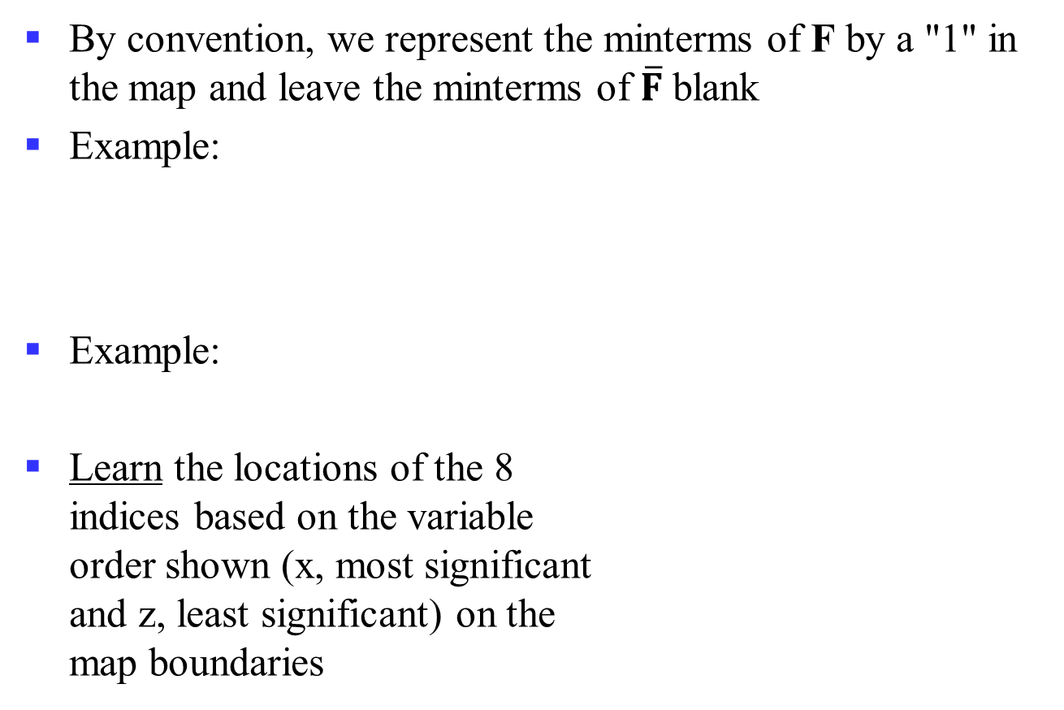
Example Functions
By convention, we represent the minterms of F by a "1" in the map and leave the minterms of $\overline{F}$ blank
Example:
Example:
Learn the locations of the 8 indices based on the variable order shown (x, most significant and z, least significant) on the map boundaries
y
0
3
1
1
1
2
x
4
7
6
1
5
1
z
y
0
1
3
2
1
x
4
7
1
5
1
6
1
z

Slide 88
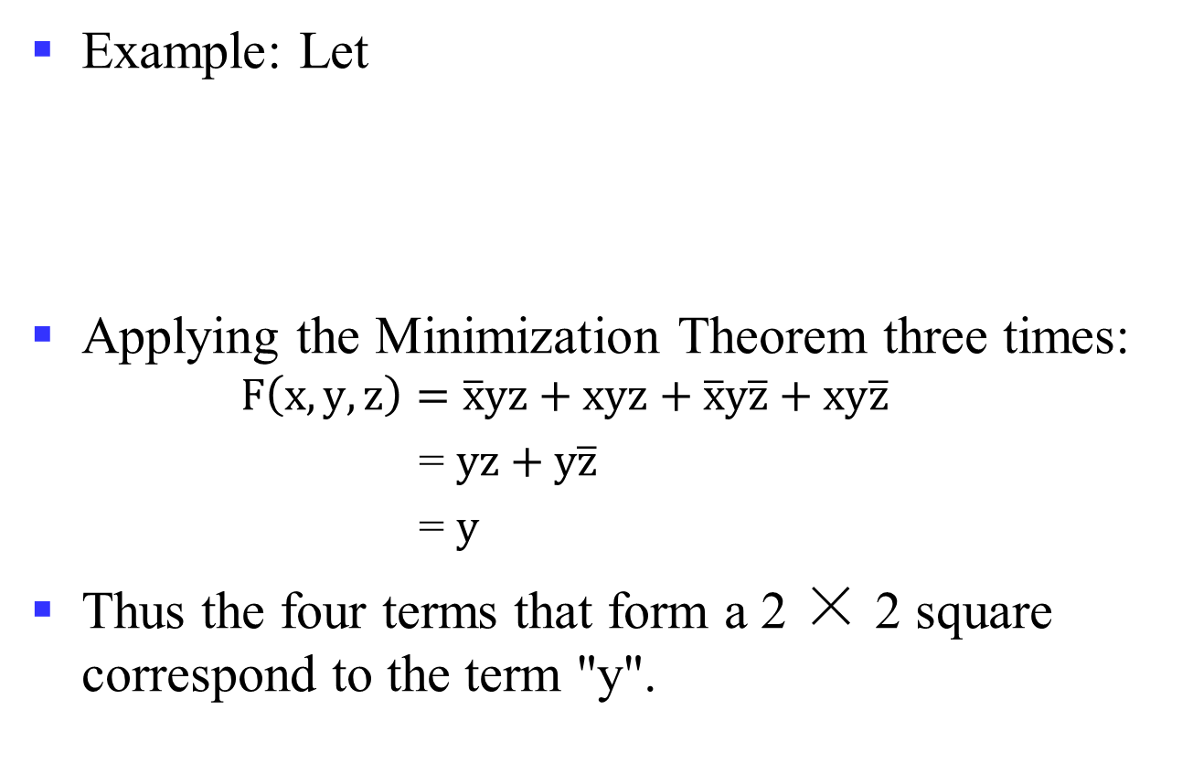
Example: Combining Squares
y
Example: Let
Applying the Minimization Theorem three times:
$$F\left(x,y,z\right)=\overline{x}yz+xyz+\overline{x}y\overline{z}+xy\overline{z}$$
= $yz+y\overline{z}$
= $y$
Thus the four terms that form a 2 × 2 square correspond to the term "y".
0
3
2
1
1
1
x
4
5
7
6
1
1
z

Slide 89
Three-Variable Maps
Reduced literal product terms for SOP canonical forms correspond to rectangles on K-maps containing cell counts that are powers of 2.
Rectangles of 2 cells represent 2 adjacent minterms; of 4 cells represent 4 minterms that form a “pairwise adjacent” ring.
Rectangles can contain non-adjacent cells as illustrated by the “pairwise adjacent” ring above.

Slide 90
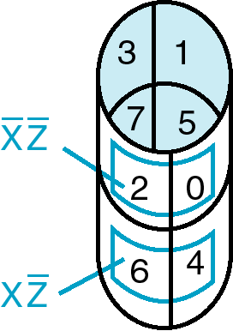
Three-Variable Maps
Topological warps of 3-variable K-maps that show all adjacencies:
Cylinder

Slide 91
Three-Variable Maps
Example Shapes of 2-cell Rectangles:
Read off the product terms for the rectangles shown
y
0
1
3
2
x
4
5
7
6
z

Slide 92
Three-Variable Maps
Example Shapes of 4-cell Rectangles:
Read off the product terms for the rectangles shown
y
0
1
3
2
x
4
5
7
6
z

Slide 93



Three Variable Maps
K-Maps can be used to simplify Boolean functions by systematic methods. Terms are selected to cover the “1s”in the map.
Example: Simplify
$$z$$
$$\overline{x}y$$
y
1
1
1
$$F\left(x,y,z\right)=z+\overline{x}y$$
x
1
1
z

Slide 94
Three-Variable Map Simplification
Use a K-map to find an optimum SOP equation for
Notes:
F = Z’ + X’ Y’ + X Y

Slide 95
Four Variable Maps
Map and location of minterms:
WXYZ
Y
00
01
11
10
0
1
3
2
00
4
5
7
6
01
12
15
14
X
Variable Order
13
11
W
8
9
11
10
10
Z

Slide 96
Four Variable Terms
Four variable maps can have rectangles corresponding to:
A single 1 = 4 variables, (i.e. Minterm)
Two 1s = 3 variables,
Four 1s = 2 variables
Eight 1s = 1 variable,
Sixteen 1s = zero variables (i.e. Constant "1")

Slide 97
Four-Variable Maps
Example Shapes of Rectangles:
Y
0
1
3
2
4
5
7
6
12
13
15
14
X
W
8
9
11
10
Z

Slide 98
Four-Variable Maps
Example Shapes of Rectangles:
Y
0
1
3
2
4
5
7
6
X
12
13
15
14
W
8
9
11
10
Z

Slide 99

Four-Variable Map Simplification
$F\left(W,X,Y,Z\right)=\sum_{m}{(0,2,4,5,6,7,8,10,13,15)}$
Notes:
F = XZ + X'Z'

Slide 100
Five Variable or More K-Maps
For five variable problems, we use two adjacent K-maps. It becomes harder to visualize adjacent minterms for selecting PIs. You can extend the problem to six variables by using four K-Maps.
V = 0
V = 1
Y
Y
X
X
W
W
Z
Z

