Slide 1
Combinational Logic Design
Lei Wu
Zhejiang University

Slide 2
Disclaimer
Many images and resources used in this lecture are collected from the Internet, and they are used only for the educational purpose. The copyright belong to the original owners, respectively.
Part of slides credit to
David Money Harris and Sarah L. Harris. Digital Design and Computer Architecture, 2nd Edition.
Prof. Yabo Dong @ ZJU
CSE 140: Components and Design Techniques for Digital Systems (Prof. C.K. Cheng @ UCSD)

Slide 3
Overview
Introduction to Verilog HDL
About combinational logic circuits
Some classic/basic designs
Timing analysis

Slide 4
Digital Logic Circuit
A “blackbox” with input(s) and output(s)
Input: 0/1
Output: 0/1
A collection of interconnected digital components
Circuit elements
Nodes
Input, internal and output
Two types
Combinational logic circuit
Sequential logic circuit
Notes:
数字逻辑电路可被视为带有若干输入端和输出端的黑盒。
若干元件和结点互连而成，元件本身又可以是一个数字逻辑电路，结点可以是输入结点、内部结点和输出结点三种。
结点实际上是若干连线的汇集点，汇集于同一结点的所有连线上传输的是同一个信号。

Slide 5
Combinational Logic Circuit
A combinational logic circuit has:
A set of m Boolean inputs,
A set of n Boolean outputs, and
n switching functions, each mapping the 2^{m} input combinations to an output such that the current output depends only on the current input values
A block diagram:
Combinational
Circuit
m-inputs
•
n-outputs
•
•
•
•
•
Notes:
A combinational circuit consists of logic gates whose outputs, at any time, are determined by combining the values of the inputs.
For n input variables, there are 2^{n} possible binary input combinations.
For each binary combination of the input variables, there is one possible output.

Slide 6
Combinational vs. Sequential Circuits
Combinational circuits are memory-less
The output value depends ONLY on the current input values.
Sequential circuits consist of combinational logic as well as memory elements (used to store certain circuit states)
Outputs depend on BOTH current input values and previous input values (kept in the storage elements).

Slide 7
Combinational vs. Sequential Circuits
n-inputs
Combinational
Circuit
m-outputs
(Depend only on inputs)
Combinational Circuit
n-inputs
m-outputs
Combinational
Circuit
Storage
Elements
Next
state
Sequential Circuit
Notes:
门电路实现的是1位运算，如果是n位的逻辑值运算，只需重复使用n个相同的门电路即可。
无需画出所有的，只需在输入端和输出端标注位数即可。
n位表示方法，textbook page #59

Slide 8
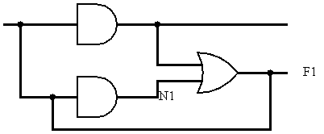
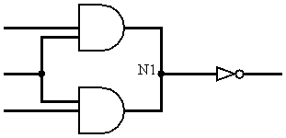
Characteristics of Combinational Logic Circuits
Each element is a combinational logic circuit.
A node can only be the output of one element.
Loop is not allowed.
Notes:
任何一个逻辑表达式都可以写成与、或、非三种基本的逻辑组合，因此任何一个组合逻辑电路都可以用与门、或门和非门的组合来描述。
最简单的组合逻辑电路是逻辑门电路。组合逻辑电路的构成规则规定了如何由门电路和简单组合电路构成更复杂的组合逻辑电路：
每个元件本身是组合逻辑电路；
不存在同一个结点同时是两个元件的输出结点；
不存在回路。

Slide 9
Design Choice Of Combinational Circuits
2-level vs. multi-level
Gate delay
Fan-in/fan-out
Trade-off between cost and speed
Notes:
每个逻辑表达式都可转换为规范/标准型，因此任何逻辑电路都可以是一个两级电路。
从逻辑门的输入信号改变开始，到输出信号发生改变所用的时间。两级电路延迟短，运算速度快。
两级电路所需硬件数量成倍增长，有时不可实现。
如F = A xor B xor C = A’B’C + ‘ABC’ + AB’C’ + ABC，两级电路需要4个3输入端与门和4个输入端或门，而多级电路只需串联两个异或门。
如果是8输入端异或门，两及电路要求128个8输入端与门和一个128输入端或门，无法实现；多级电路只需串联7个2输入端异或门。

Slide 10
How to Design Combinational Logic Circuits
Design procedure
Determine inputs, outputs and their logic relationship
Truth table
Determine logic functions and perform optimization
Algebra or K-map
Draw logic circuit diagram and timing diagram
Timing analysis

Slide 11
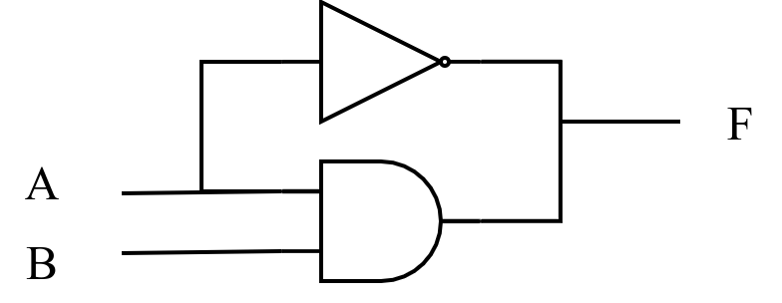
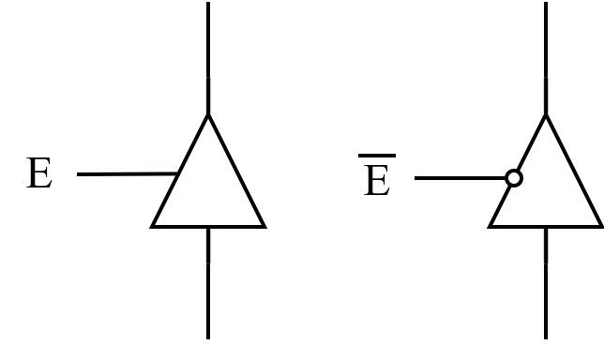
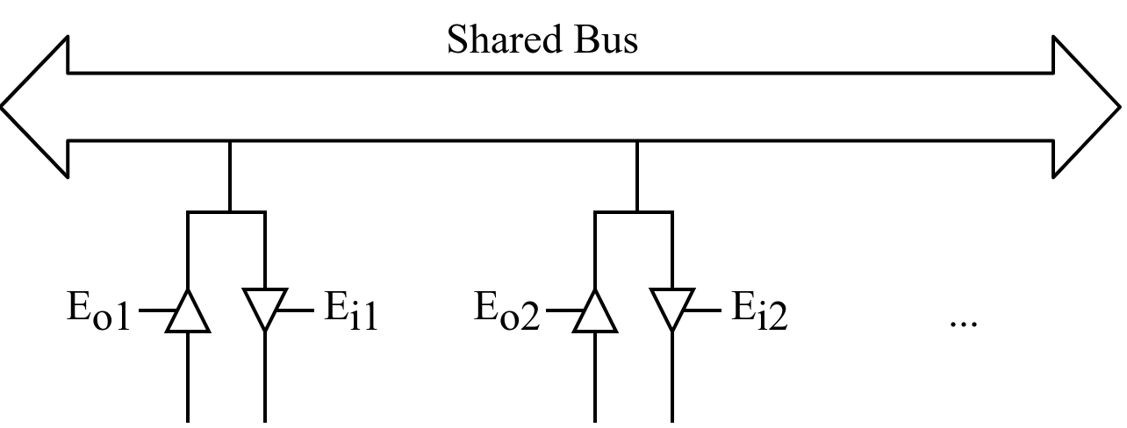
Specifical Values in Circuits
Invalid value
High impedance
Three-state gate
Notes:
非法值：如果B为1，A为任意值都会导致F同时被高低电平驱动，有可能导致F结点处两个逻辑门之间有较大电流流动，使电路发热损坏，电路中应避免这种错误。
高阻态：三态门是一种重要的总线接口电路，也称三态缓冲器，即输出可以是正常的0/1，也可以是高阻态；使能端E有效，则输出是0/1，E无效，则输出为高阻态。
左图中E是高电平有效，E’为低电平时有效，所以加了一个小圈；右图实际电路中只有一个三态门使能信号有效，因此不会构成回路。

Slide 12
Overview
Introduction to Verilog HDL
About combinational logic circuits
Some classic/basic designs
Timing analysis

Slide 13
Some Classic/Basic Designs
Encoder and decoder
Multiplexer and demultiplexer
Half adder and full adder

Slide 14
Classic Designs: Decoder
Multiple inputs: address, binary code, ...
Multiple outputs: one-hot, ...
Example:
3-bit binary input, 8-bit output.
When the input 3 bits are 000, then the first bit in output is 1, and others are 0.
When the input 3 bits are 001, then only the second bit in output is 1.
...
Notes:
保证每一个有效的输入码都产生唯一的输出码。
多输入端、多输出端电路，输入端少于输出端
输入端一般是一种二进制编码（地址码、指令码等），输出端通常为单热点编码。
Decoding - the conversion of an n-bit input code to an m-bit output code with n <= m <= 2^{n} such that each valid code word produces a unique output code
Circuits that perform decoding are called decoders
Here, functional blocks for decoding are
called n-to-m line decoders, where m <= 2^{n}, and
generate 2^{n} (or fewer) minterms for the n input variables

Slide 15
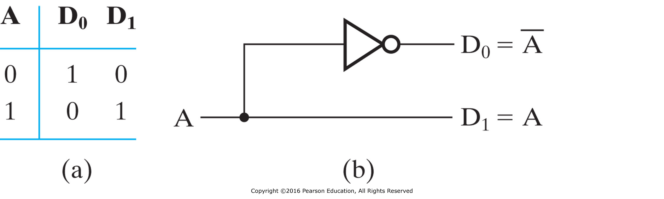
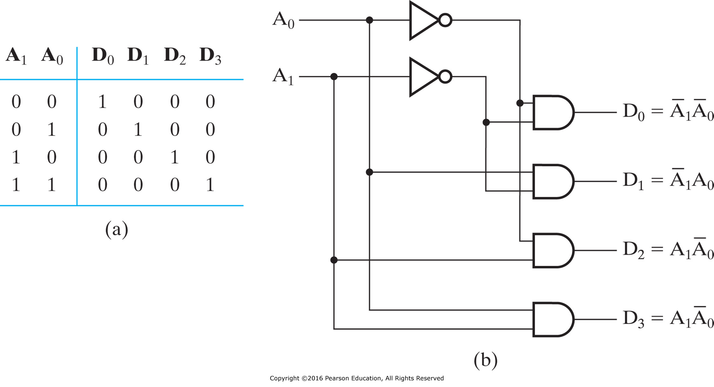
Decoder Examples
1-to-2-Line Decoder
2-to-4-Line Decoder
The 2-4-line made up of 2 1-to-2-line decoders and 4 (2-inputs) AND gates.

Slide 16
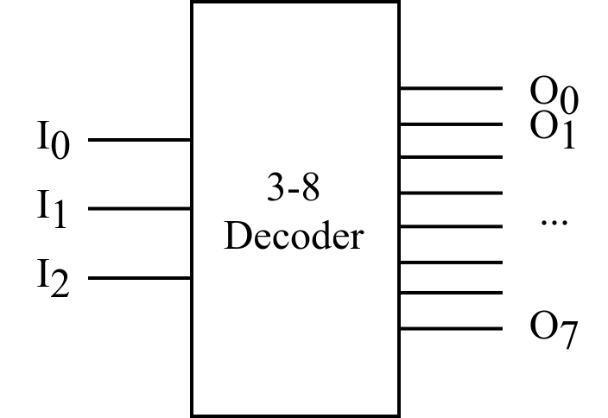
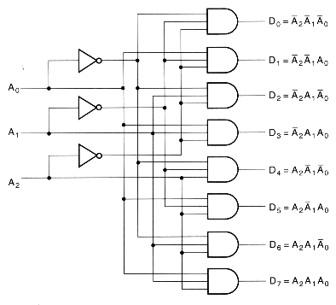
Decoder Examples (cont’d)
Input |  |  | Output
A₂ | A₁ | A₀ | D₀ | D₁ | D₂ | D₃ | D₄ | D₅ | D₆ | D₇
0 | 0 | 0 | 1 | 0 | 0 | 0 | 0 | 0 | 0 | 0
0 | 0 | 1 | 0 | 1 | 0 | 0 | 0 | 0 | 0 | 0
0 | 1 | 0 | 0 | 0 | 1 | 0 | 0 | 0 | 0 | 0
0 | 1 | 1 | 0 | 0 | 0 | 1 | 0 | 0 | 0 | 0
1 | 0 | 0 | 0 | 0 | 0 | 0 | 1 | 0 | 0 | 0
1 | 0 | 1 | 0 | 0 | 0 | 0 | 0 | 1 | 0 | 0
1 | 1 | 0 | 0 | 0 | 0 | 0 | 0 | 0 | 1 | 0
1 | 1 | 1 | 0 | 0 | 0 | 0 | 0 | 0 | 0 | 1
The 3-8-line is made up of 3 1-to-2-line decoders and 8 (3-inputs) AND gates.
Notes:
Gate input cost: 3 + 3 * 8 = 27

Slide 17
Decoder Expansion
General procedure for any decoder with n inputs and 2^{n} outputs
Step 1: let k = n
Step 2: there are 2^{k} AND gates which will be driven by 2 decoders
If k is even, both decoders have 2^{k}/2 outputs.
If k is odd, one decoder has 2^{(k+1)/2} outputs, while another one has 2^{(k-1)/2} outputs.
Step 3: for each decoder obtained from step 2, let the number of outputs becomes k, and repeat step 2 until k=1 (i.e., 1-to-2-line decoder).
The output AND gates are driven by two decoders with their numbers of inputs either equal or differing by 1.
These decoders are then designed using the same procedure until 1-to-2-line decoders are reached.
The procedure can be modified to apply to decoders with the number of outputs ≠ 2^{n}.
Notes:
分层设计降低门输入成本。
This procedure builds a decoder backward from the outputs.

Slide 18
Decoder Expansion: 3-8 Decoder
Number of output ANDs = 8
Number of inputs to decoders driving output ANDs = 3
Closest possible split to equal
2-to-4-line decoder
1-to-2-line decoder
2-to-4-line decoder
Number of output ANDs = 4
Number of inputs to decoders driving output ANDs = 2
Closest possible split to equal
Two 1-to-2-line decoders

Slide 19
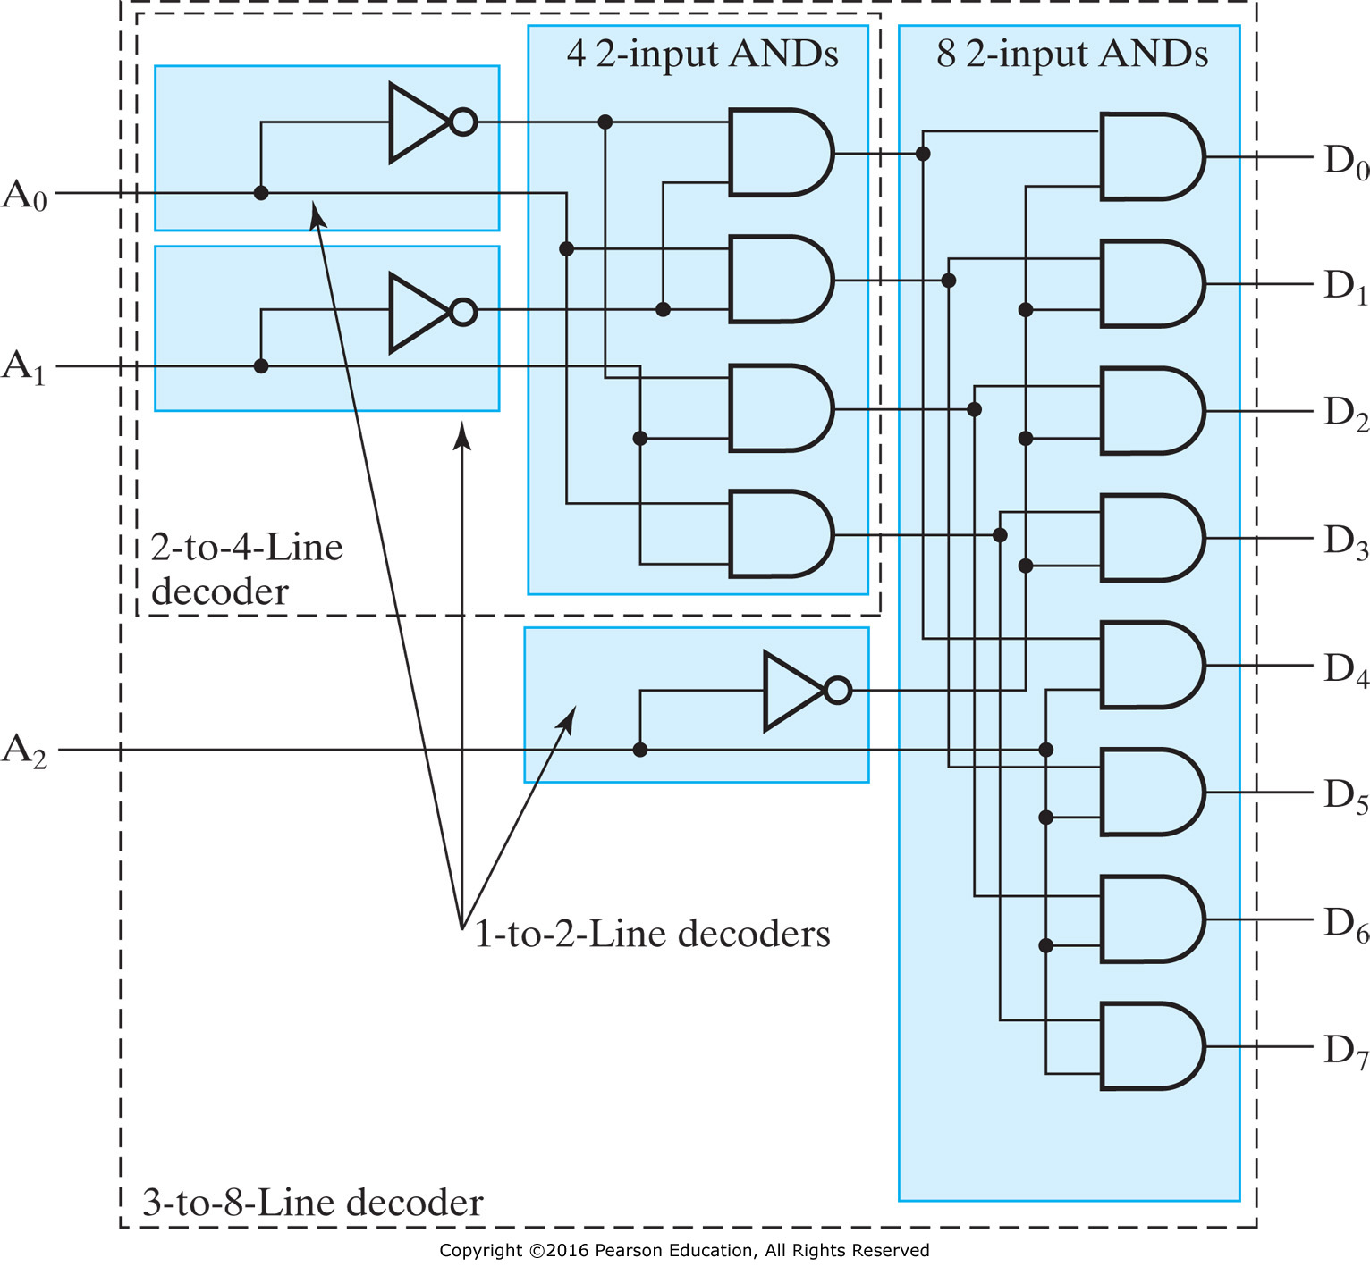
Decoder Expansion: 3-8 Decoder (cont’d)
Notes:
Gate input cost：3 + 2 * 4 + 2 * 8 = 27
How about 6-64 decoder?
6 + 6 * 64 = 390 vs. 6 + 2 * (2 * 4) + 2 * (2 * 8) + 2 * 64 = 182

Slide 20
Decoder with Enable
In general, attach m-enabling circuits to the outputs
See truth table below for function
Note use of X’s to denote both 0 and 1
Combination containing two X’s represent four binary combinations
Alternatively, can be viewed as distributing value of signal EN to 1 of 4 outputs
In this case, called a demultiplexer
Notes:
可视为多路分配器，把EN的值分配到output

Slide 21
Combinational Logic Implementation - Decoder and OR Gates
Implement m functions of n variables with:
Sum-of-minterms expressions
One n-to-2^{n}-line decoder
m OR gates, one for each output
Approach 1:
Find the truth table for the functions
Make a connection to the corresponding OR from the corresponding decoder output wherever a 1 appears in the truth table
Approach 2
Find the minterms for each output function
OR the minterms together
Notes:
基于译码器的组合电路
n个输入变量的译码器可以产生2^n个最小项，由于任何Boolean function都可以由SoP表示，任何n输入m输出的组合电路都可以用1个n-2^n译码器和m个或门实现。

Slide 22
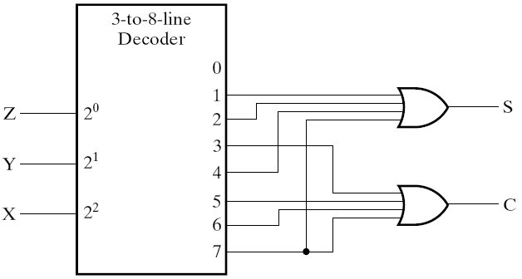
Decoder and OR Gates Example
Implement a binary Adder
Finding sum of minterms expressions
S(X, Y, Z) = Σ_{m}(1, 2, 4, 7) C(X, Y, Z) = Σ_{m}(3, 5, 6, 7)
Find circuit
X | Y | Z | M | C | S
0 | 0 | 0 | 0 | 0 | 0
0 | 0 | 1 | 1 | 0 | 1
0 | 1 | 0 | 2 | 0 | 1
0 | 1 | 1 | 3 | 1 | 0
1 | 0 | 0 | 4 | 0 | 1
1 | 0 | 1 | 5 | 1 | 0
1 | 1 | 0 | 6 | 1 | 0
1 | 1 | 1 | 7 | 1 | 1
Truth Table
Notes:
1位的二进制加法：X + Y，Z是来自低位的进位输入
输出S，进位输出位C

Slide 23
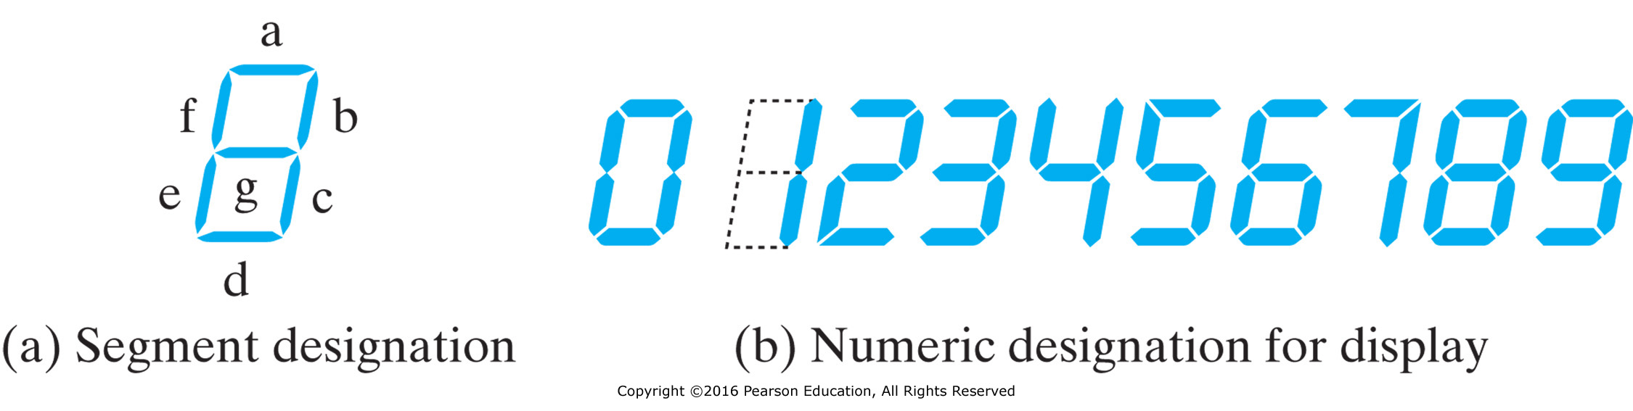
Seven-Segment Display Decoder
Input |  |  |  | Output
I₀ | I₁ | I₂ | I₃ | O_{a} | O_{b} | O_{c} | O_{d} | O_{e} | O_{f} | O_{g}
0 | 0 | 0 | 0 | 1 | 1 | 1 | 1 | 1 | 1 | 0
0 | 0 | 0 | 1 | 0 | 1 | 1 | 0 | 0 | 0 | 0
0 | 0 | 1 | 0 | 1 | 1 | 0 | 1 | 1 | 0 | 1
0 | 0 | 1 | 1 | 1 | 1 | 1 | 1 | 0 | 0 | 1
0 | 1 | 0 | 0 | 0 | 1 | 1 | 0 | 0 | 1 | 1
0 | 1 | 0 | 1 | 1 | 0 | 1 | 1 | 0 | 1 | 1
0 | 1 | 1 | 0 | 1 | 0 | 1 | 1 | 1 | 1 | 1
0 | 1 | 1 | 1 | 1 | 1 | 1 | 0 | 0 | 0 | 0
1 | 0 | 0 | 0 | 1 | 1 | 1 | 1 | 1 | 1 | 1
1 | 0 | 0 | 1 | 1 | 1 | 1 | 1 | 0 | 1 | 1
Seven-segment display decoder
Oa
I0
Ob
I1
Oc
Od
I2
Oe
I3
Of
Og
Notes:
4-16译码器+7个或门

Slide 24
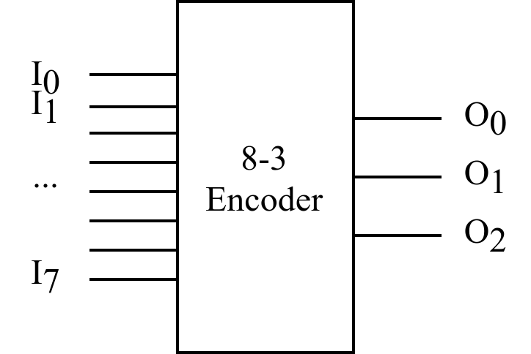

Classic Designs: Encoder
8-to-3-line encoder
Input |  |  |  |  |  |  |  | Output
I₀ | I₁ | I₂ | I₃ | I₄ | I₅ | I₆ | I₇ | O₀ | O₁ | O₂
1 | 0 | 0 | 0 | 0 | 0 | 0 | 0 | 0 | 0 | 0
0 | 1 | 0 | 0 | 0 | 0 | 0 | 0 | 0 | 0 | 1
0 | 0 | 1 | 0 | 0 | 0 | 0 | 0 | 0 | 1 | 0
0 | 0 | 0 | 1 | 0 | 0 | 0 | 0 | 0 | 1 | 1
0 | 0 | 0 | 0 | 1 | 0 | 0 | 0 | 1 | 0 | 0
0 | 0 | 0 | 0 | 0 | 1 | 0 | 0 | 1 | 0 | 1
0 | 0 | 0 | 0 | 0 | 0 | 1 | 0 | 1 | 1 | 0
0 | 0 | 0 | 0 | 0 | 0 | 0 | 1 | 1 | 1 | 1
$$O0=I4+I5+I6+I7$$
$$O1=I2+I3+I6+I7$$
$$O2=I1+I3+I5+I7$$
OR gates!
However, there exists two issues that may make the encoder just designed does not work:
1. If more than one input value is 1 (e.g., I3 & I6 are both 1)
2. All inputs are 0 vs. I0 = 1

Slide 25
Priority Encoder Example
Priority encoder with 4 inputs (D₃, D₂, D₁, D₀) - highest priority to most significant 1 present - Code outputs A1, A0 and V where V indicates at least one 1 present.
Xs in input part of table represent 0 or 1; thus table entries correspond to product terms instead of minterms. The column on the left shows that all 16 minterms are present in the product terms in the table
No. of Min-terms/Row | Inputs |  |  |  | Outputs
 | D3 | D2 | D1 | D0 | A1 | A0 | V
1 | 0 | 0 | 0 | 0 | X | X | 0
1 | 0 | 0 | 0 | 1 | 0 | 0 | 1
2 | 0 | 0 | 1 | X | 0 | 1 | 1
4 | 0 | 1 | X | X | 1 | 0 | 1
8 | 1 | X | X | X | 1 | 1 | 1
Notes:
优先权编码器，紧凑真值表

Slide 26
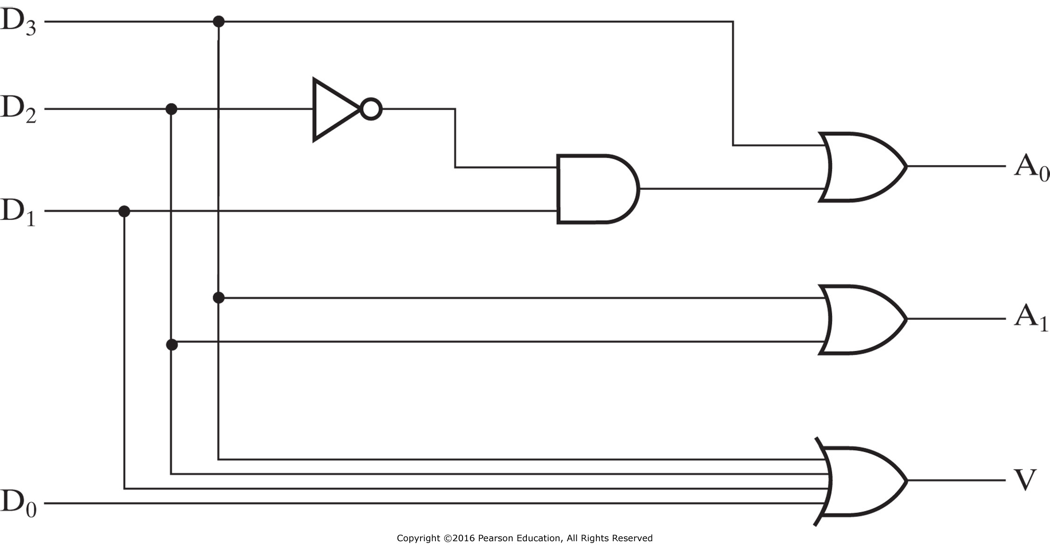

Priority Encoder Example (cont’d)
Could use a K-map to get equations, but can be read directly from table and manually optimized if careful:
$A1= ?$
$A0= ?$
$V= ?$
Notes:
A1=D3 + D2
A0=D3+(D2)’D1
V = D3 + D2 + D1 + D0

Slide 27
Classic Designs: Multiplexer
Selecting of data or information is a critical function in digital systems and computers
Circuits that perform selecting have:
A set of information inputs from which the selection is made
A single output
A set of control lines for making the selection
Logic circuits that perform selecting are called multiplexers
Selecting can also be done by three-state logic or transmission gates
Notes:
Multiplexer (MUX, mux)
Decoder with enable

Slide 28
Multiplexers
A multiplexer selects information from an input line and directs the information to an output line
A typical multiplexer has n control inputs (S_{n − 1}, … S₀) called selection inputs, 2^{n} information inputs (I₂^{n} ₋ ₁, … I₀), and one output Y
A multiplexer can be designed to have m information inputs with m < 2^{n} as well as n selection inputs
MUX
DBUS
m
Y
n
CBUS
Notes:
多路选择器，也称复用器或数据选择器，功能是从多个可能的输入中选择一个直接输出，包括输入端和控制端S。
K路选择器，S位数应该是log₂k向上取整。
比如对于3路或者4路选择器，S有2位；对于5~8路选择器，S有3位。

Slide 29
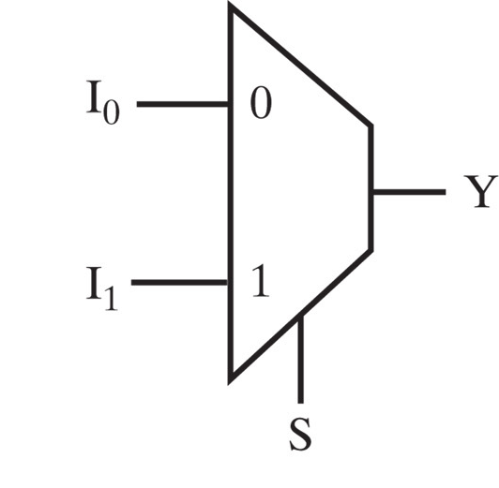
2-to-1-Line Multiplexer
Since 2 = 2¹, n = 1
The single selection variable S has two values:
S = 0 selects input I₀
S = 1 selects input I₁
The equation:
Y = I₀ + SI₁
The circuit:
S

Slide 30
2-to-1-Line Multiplexer (cont’d)
Note the regions of the multiplexer circuit shown:
1-to-2-line Decoder
2 Enabling circuits
2-input OR gate
To obtain a basis for multiplexer expansion, we combine the Enabling circuits and OR gate into a 2 × 2 AND-OR circuit:
1-to-2-line Decoder
2 ⋅ 2 AND-OR
In general, for an 2^{n}-to-1-line multiplexer:
n-to-2^{n}-line Decoder
2^{n} ⋅ 2 AND-OR

Slide 31
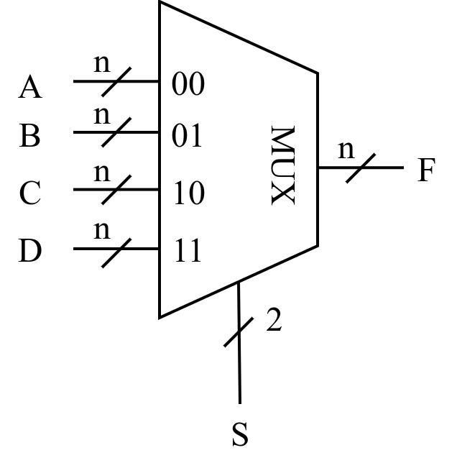
4-to-1-line Multiplexer
Input |  | Output
S₀ | S₁ | F
0 | 0 | A
0 | 1 | B
1 | 0 | C
1 | 1 | D
Notes:
F = S₁’S₀’A + S₁’S₀B + S₁S₀’C + S₁S₀D
Cost: 12 + 4 + 2 = 18

Slide 32
4-to-1-line Multiplexer (cont’d)
2-to-2²-line decoder
2² × 2 AND-OR
S
Decoder
1
S
4
×
2 AND-OR
0
Decoder
S
Decoder
S
1
1
S
S
0
I
0
0
Y
I
1
Y
Y
I
2
I
3
Notes:
F = (S₁’S₀’)A + (S₁’S₀)B + (S₁S₀’)C + (S₁S₀)D
Cost: 4 + 2 * 8 + 2 = 22

Slide 33
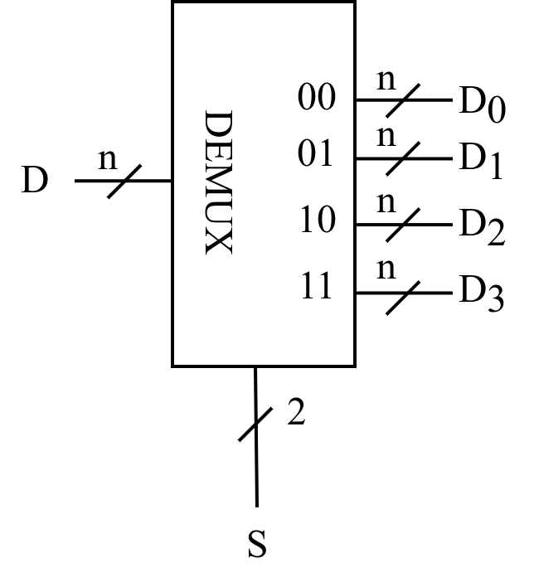
Classic Designs: Demultiplexer
Demultiplexer (DEMUX, DMUX)
Input |  | Output
S₀ | S₁ | D₀ | D₁ | D₂ | D₃
0 | 0 | D | 0 | 0 | 0
0 | 1 | 0 | D | 0 | 0
1 | 0 | 0 | 0 | D | 0
1 | 1 | 0 | 0 | 0 | D
Notes:
多路分配器与多路选择器相反，把唯一的输入发送到多个输出端中的一个，选择哪一个输出端取决于控制端。
多路分配器常与多路选择器联用实现多通道数据的分时传送：
发送端由MUX将各路数据分时送到总线；
接收端再由DEMUX将总线上的数据适时分配到相应的输出端，传送到目的部件。

Slide 34
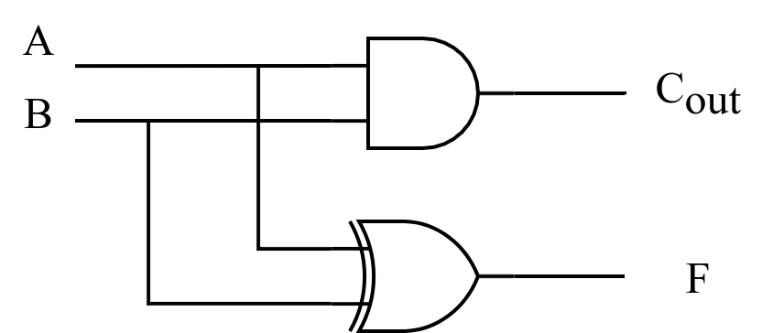
Classic Designs: Half-Adder
A 2-input, 1-bit width binary adder that performs the following computations:
A half adder adds two bits to produce a two-bit sum
The sum is expressed as a sum bit , F and a carry bit, C
The half adder can be specified as a truth table for F and C ⇒
A
0
0
1
1
+ B
+ 0
+ 1
+ 0
+ 1
C F
0 0
0 1
0 1
1 0
A
B
F
C
0
0
0
0
0
1
1
0
1
0
1
0
1
1
0
1
Notes:
F= A XOR B
Cout = AB

Slide 35
Classic Designs: Full Adder
A full adder is similar to a half adder, but includes a carry-in bit from lower stages.
Like the half-adder, it computes a sum bit F and a carry bit C_{in}
For a carry-in (C_{in}) of 0, it is the same as the half-adder:
For a carry-in (C_{in}) of 1:
Cin
0
0
0
0
A
0
0
1
1
+ B
+ 0
+ 1
+ 0
+ 1
Cout F
0
0
0 1
0 1
1 0
Cin
1
1
1
1
A
0
0
1
1
+ B
+ 0
+ 1
+ 0
+ 1
Cout F
0 1
1 0
1 0
1
1
Notes:
F = A XOR B XOR C_{in}
C_{out} = AB + AC_{in} + Bc_{in}

Slide 36
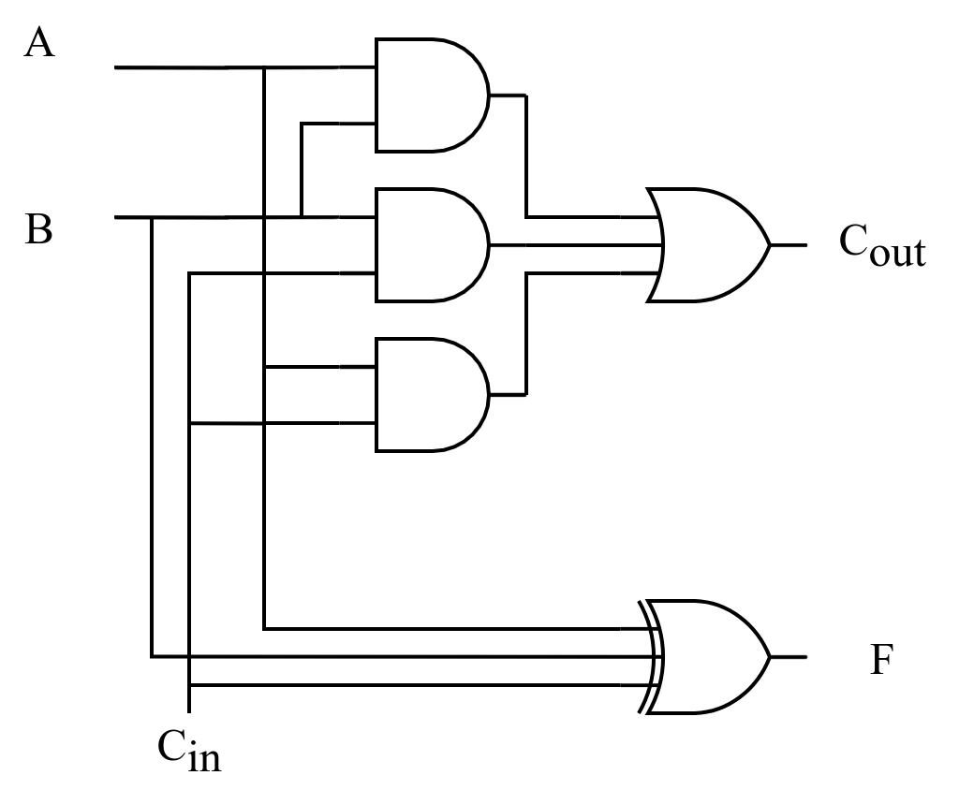
Classic Designs: Full Adder (cont’d)
Input |  |  | Output
A | B | C_{in} | F | C_{out}
0 | 0 | 0 | 0 | 0
0 | 0 | 1 | 1 | 0
0 | 1 | 0 | 1 | 0
0 | 1 | 1 | 0 | 1
1 | 0 | 0 | 1 | 0
1 | 0 | 1 | 0 | 1
1 | 1 | 0 | 0 | 1
1 | 1 | 1 | 1 | 1
Notes:
F = A XOR B XOR C_{in} = (A XOR B) XOR C
C_{out} = AB + AC_{in} + Bc_{in} = AB + C_{in}(A + B)
2 HA + OR -> FA

Slide 37
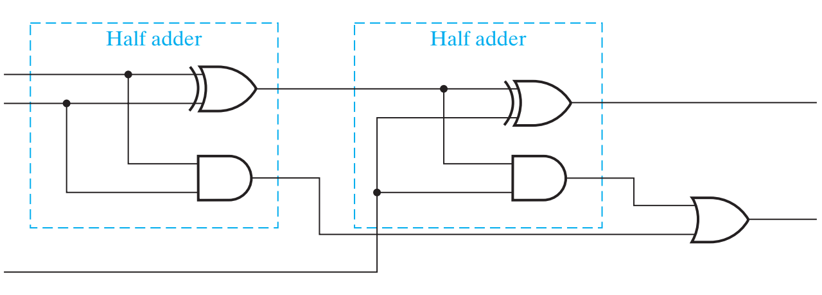
Classic Designs: Full Adder (cont’d)
A
B
F
Cout
Cin
Notes:
F = A XOR B XOR C_{in} = (A XOR B) XOR C
C_{out} = AB + AC_{in} + Bc_{in} = AB + C_{in}(A + B)
2 HA + OR -> FA

Slide 38
Overview
Introduction to Verilog HDL
About combinational logic circuits
Some classic/basic designs
Timing analysis

Slide 39
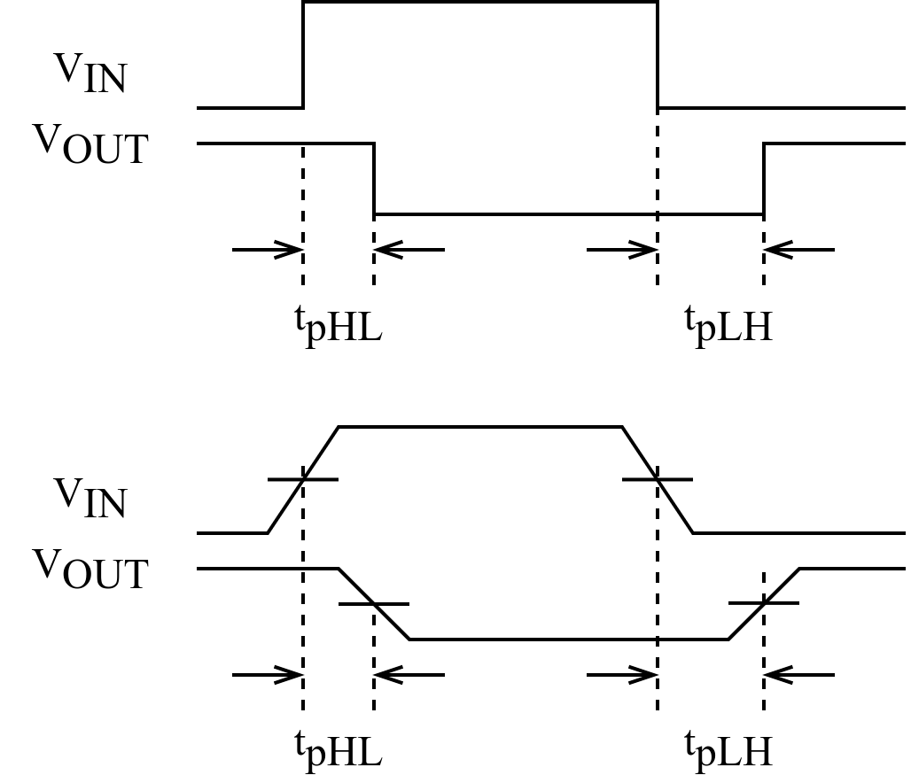
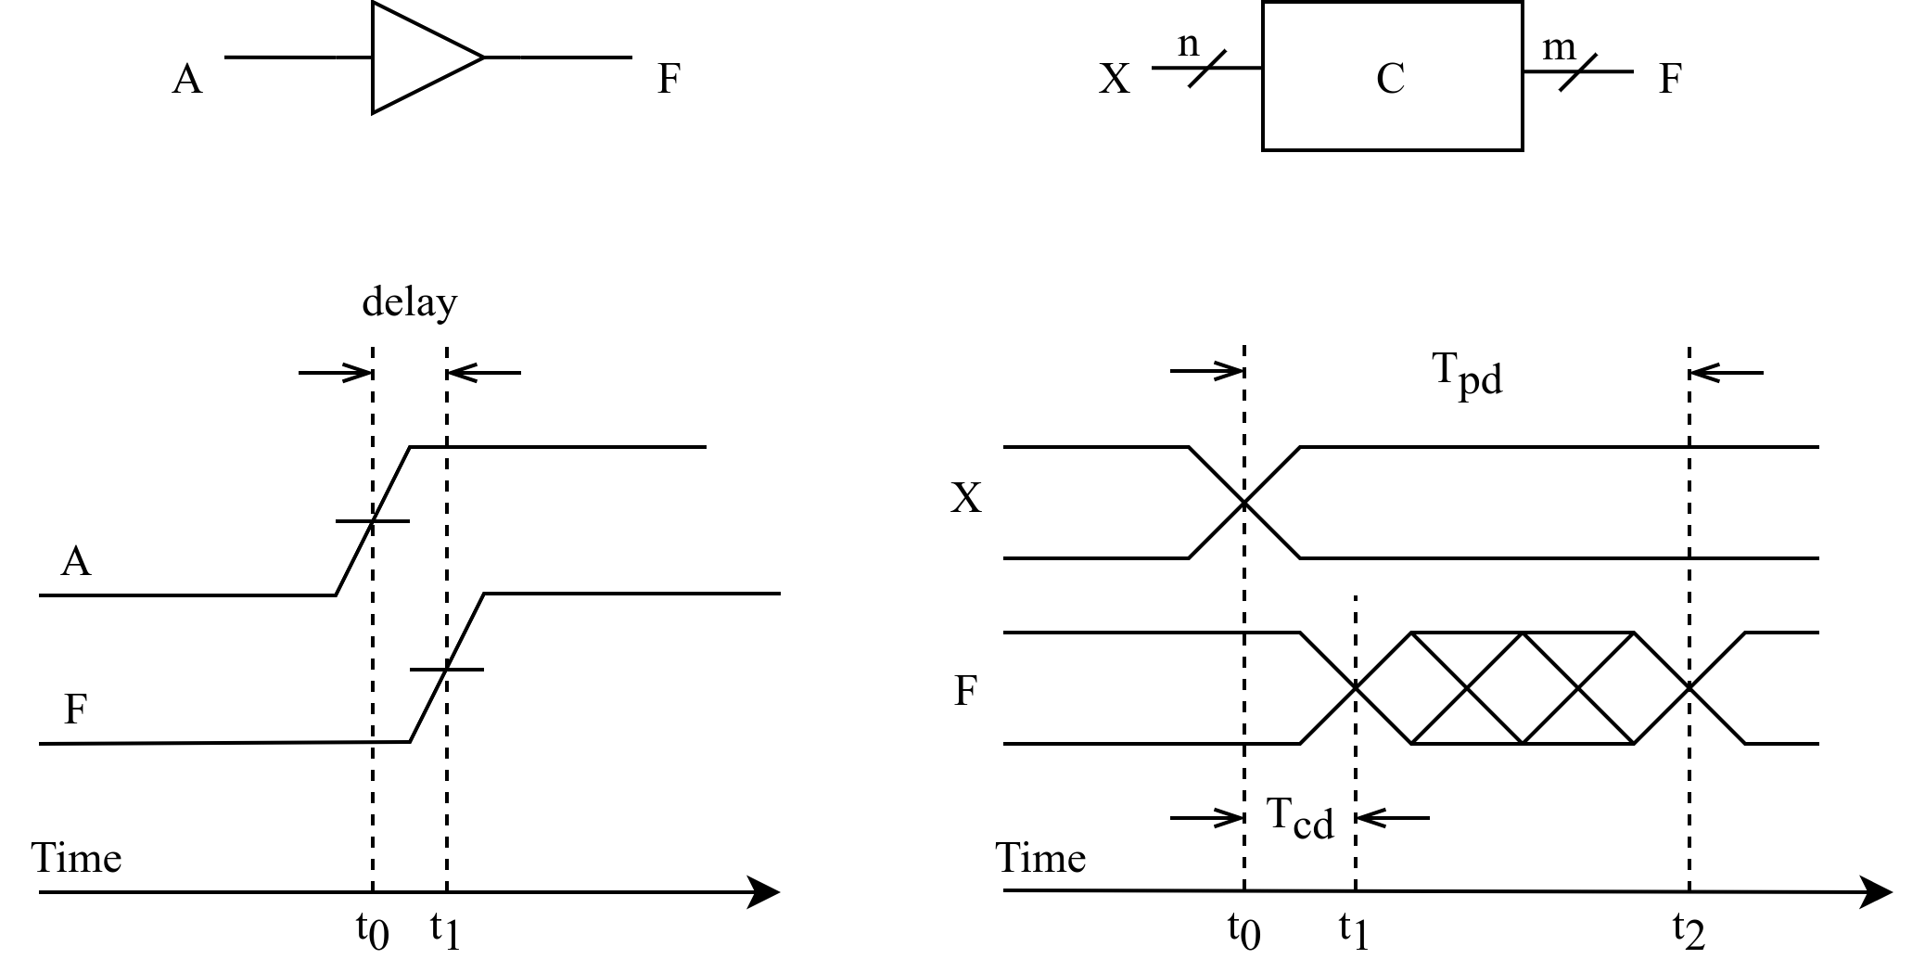
Timing Analysis
Circuit delay
Ideal case
In practice
Delay of the invertor
Rise-time delay of the transmission gate
Notes:
信号通过连线以及电路元件时，会有一定的延迟：连线的长短、元件的数量、电路制造工艺、工作电压、温度等；此外信号的高低电平转换也需要一定的过渡时间。
任何组合逻辑电路从输入信号的改变到随之引起的输出信号的改变中间都有一定的时间延迟。
理想情况：忽略上升时间和下降时间
为避免信号上升过程和下降过程时间不一致带来的影响，通常取信号转换的中点来测量电路的延迟时间。
缓冲器电路的时序图（上升沿电路延迟）：时间位t0和t1之间的间隔，分别是输入A和输出F两个信号的上升沿的中间点。

Slide 40
Timing Analysis (cont’d)
Propagation delay
T_{pd} = max delay from input to output
Contamination delay
T_{cd} = min delay from input to output
Reasons why T_{pd} and T_{cd} may be different:
Different rising and falling delays
Multiple inputs and outputs, some of which are faster than others
Circuits slow down when hot and speed up when cold
Notes:
组合逻辑电路的时序特征包括：
1. Propagation delay: 传输延迟，从输入端的变化开始到所有输出端得到最终稳定的信号所需的最长时间
2. Contamination delay：最小延迟，从输入端变化开始到任何一个输出开始发生改变所需的最短时间
电路延迟可以通过计算信号从输入到输出所经过的路径上每个元件的延迟之和得到。

Slide 41
Timing Analysis (cont’d)
The critical (longest) path
T_{pd} of the circuit = ∑ all T_{pd} of circuit elements along the critical path
The shortest path
T_{cd} of the circuit = ∑ all T_{cd} of circuit elements along the shortest path
Tpd = 2Tpd_AND + Tpd_OR
Tcd = Tcd_AND
Notes:
1) 一个组合电路在输入和输出之间经过的最长路径称为关键路径，因此组合电路的传输延迟就是关键路径上所有元件的传输延迟之和；
2) 最小延迟就是最短路径上所有元件的最小延迟之和。

Slide 42
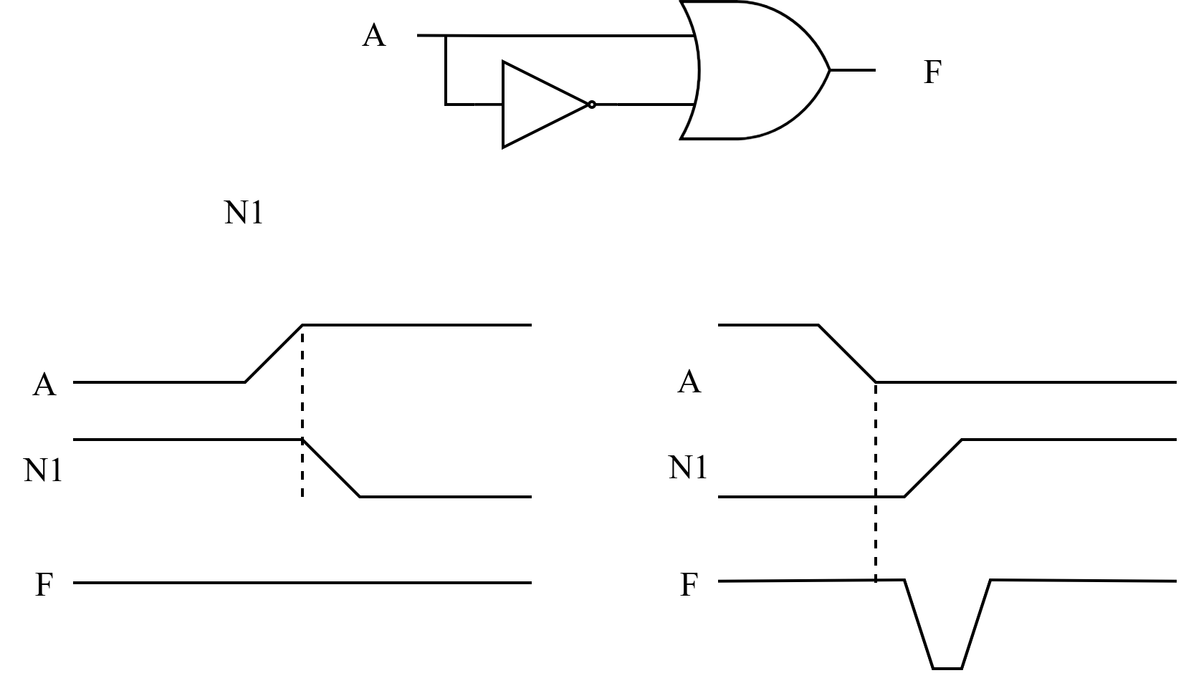
Timing Analysis (cont’d)
Race hazard
Glitch: when a single input change causes multiple output changes
N1
Race hazard in a circuit
No glitch
Glitch
Notes:
如果存在某个输入信号经过两条或者两条以上的路径作用到输出端F，由于路径延迟不同，输入信号会对输出信号发生先后不同的影响，即竞争（race）。
由于竞争的存在，当多路输入信号的电平值发生变化时，在信号变化的瞬间，电路的输出信号可能会出现一些不正确的尖峰信号，即毛刺（glitch）。
如果要给组合逻辑电路中有毛刺出现，说明改电路存在冒险（hazard），或竞争冒险。
A从低电平变为高电平，N1随之从高变低，N1变为低电平之前，A已经变为高电平，所以F一直是高电平，无毛刺；反之则有毛刺。
如果输出信号最终将稳定在正确的电平上，毛刺通常不会导致问题，只要在获取电路输出值之前至少等待传输延迟的时间即可。

Slide 43
Summary
Introduction to Verilog HDL
About combinational logic circuits
Some classic/basic designs
Timing analysis

