Slide 1
Sequential Logic Design
Lei Wu
Zhejiang University

Slide 2
Disclaimer
Many images and resources used in this lecture are collected from the Internet, and they are used only for the educational purpose. The copyright belong to the original owners, respectively.
Part of slides credit to
David Money Harris and Sarah L. Harris. Digital Design and Computer Architecture, 2nd Edition.
Morris R. Mano , Charles R. Kime and Tom Martin. Logic & Computer Design Fundamentals, Fifth Edition.
Prof. Yabo Dong @ ZJU
CSE 140: Components and Design Techniques for Digital Systems (Prof. C.K. Cheng @ UCSD)

Slide 3
Overview
Introduction to sequential circuits
Basic sequential logic elements
Synchronous sequential logic design
Classic sequential logic elements

Slide 4
Overview
Introduction to sequential circuits
Basic sequential logic elements
Sequential logic design
Classic sequential logic elements

Slide 5
Introduction to Sequential Circuits
Sequential circuits
Sequential circuit analysis

Slide 6
Sequential Circuits
Sequential circuits consist of combinational logic as well as storage elements (used to store certain circuit states).
Outputs depend on BOTH current input values and previous input values (kept in the storage elements).
State: all the information about a circuit necessary to explain its future behavior
n-inputs
m-outputs
Combinational
Circuit
Storage
Elements
State
Next
state
Sequential Circuit
Notes:
A sequential circuit will:
1. Give sequence to events
2. Have memory (short-term)
3. Use feedback from output to input to store information
A sequential circuit contains:
Storage/state elements
Combinational logic
数字系统中存储信息有多种方式，使用逻辑电路是其中一种，如带回路的缓冲器。

Slide 7
Sequential Circuits: Storage Elements
Bistable circuits
Latches
Flip-flops
n-inputs
m-outputs
Combinational
Circuit
Storage
Elements
State
Next
state
Sequential Circuit
Notes:
双稳态电路
Latches and flip-flops: State elements that store one bit of state
Latch：锁存器
Flip-flop：触发器

Slide 8
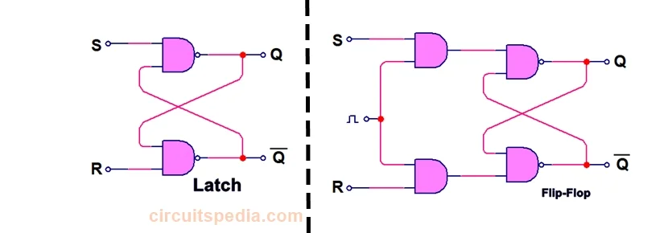
Latch and Flip-flop

Slide 9
Level-Triggered vs. Edge-Triggered
Level-triggered/sensitive
Output controlled by the level of the clock input.
Edge-triggered/sensitive
Output changes only at the point in time when the clock changes from value to the other.
Can be positive-edge triggered (0 to 1), or negative-edge triggered (1 to 0).
Flip-flops are edge-triggered while clocked (gated) latches are level-sensitive.
The advantage of flip-flops over latches is that the signal on the input pin(s) is captured the moment the flip-flop is clocked, and subsequent changes on the input(s) will be ignored until the next clock event. This provides better timing control in complex circuits.

Slide 10
Sequential Circuits: Combinational Circuit
Inputs are signals from the outside, and outputs are signals to the outside
Implements a multiple-output switching function
Mealy: outputs = g(inputs, state)
Moore: outputs = h(state)
Output function type depends on specification and affects the design significantly
Other inputs, state or present state, are signals from storage elements
The remaining outputs, next state are inputs to storage elements
Next state function: next state = f(inputs, state)
n-inputs
m-outputs
Combinational
Circuit
Storage
Elements
State
Next
state
Sequential Circuit
Notes:
根据输出逻辑对于输入信号的依赖情况，可以分为两类：
1. Mealy型时序逻辑电路：输出逻辑不仅依赖当前状态，同时还依赖当前输入
2. Moore型时序逻辑电路：输出逻辑仅依赖当前状态，和当前输入无关
输出函数和激励函数

Slide 11
Types of Sequential Circuits
Depends on the times at which:
Storage elements observe their inputs, and
Storage elements change their state
Synchronous
Circuit output changes only at some discrete instants of time.
Achieves synchronization by using a timing signal called the clock.
Asynchronous
Circuit output can change at any time (clockless).
Notes:
时序电路分为两类，取决于观察输入信号的时间和内部状态改变的时间：
1. 同步时序电路：行为可以根据在离散的时间点其信号线上的相关信息来进行定义；只在离散的时刻采集影响存储元件的信号，同步过程是通过时钟发生器（clock generator）这种时序器件产生的周期性的时钟脉冲（clock pulse）序列来实现的。脉冲分布在整个系统中，同步存储元件只在每一个脉冲特定的时刻上受到影响。实际上，时钟脉冲被用来与其它信号一起改变存储元件的数据。存储元件的输出仅在出现时钟脉冲时发生变化。把时钟脉冲作为存储元件输入信号的同步时序电路称为钟控时序电路（clocked sequential circuit），该类型电路在实际中广泛应用，同步设计比较容易。
2. 异步时序电路：行为依赖于某一时刻的输入信号以及输入信号在连续时间内变化的顺序；异步电路设计较为困难，因为行为与门的传播延迟以及输入信号变化的时间序列密切相关，大部分设计者选用同步电路；但异步有时候也是必要的，比如同步电路中用来存储信息的元件触发器，就是以异步锁存器为模块来构造的。
同步优点是控制机制简单，每个电路的运算都必须在时钟的两个脉冲之间固定的间隔内完成，称为一个时钟周期，只有满足这个条件才能保证电路时可靠的，但也有如下缺点：
1. 时钟信号必须要分配到电路的每一个元件（触发器），而时钟通常频率较高，会产生功耗（热量），即便元件没做任何事也会有功耗存在。
2. 最大可能的时钟频率由电路中最慢的逻辑路径（关键路径）决定，从最简单到最复杂的逻辑运算都必须在一个时钟周期内完成；可用流水线分解复杂运算，提高时钟频率。

Slide 12
Sequential Circuit Analysis
Terminology
Finite state machine (FSM)
State diagram
State table
Basic analysis procedure
Purpose
Logic diagram

Slide 13
Finite State Machine and State Diagram
Finite state machine (FSM) is a generic model for sequential circuits used in sequential circuit design
The sequential circuit function can be represented in graphical form as a state diagram with the following components:
A circle with the state name in it for each state
A directed arc from the Present State to the Next State for each state transition
A label on each directed arc with the Input values which causes the state transition, and
A label:
On each circle with the output value produced, or
On each directed arc with the output value produced.
1/0
0/0
A
B
0/0
0/0
0/0
1/0
1/0
D
C
1/1
Notes:
e.g., 系统是否出现了连续4个1（1111），必须记忆输入情况，涉及记忆状态的切换。
有限状态机是一种刻画状态以及状态转换的理论工具。
通常用状态图描述有限状态机，圆圈代表状态，状态之间有向边代表特定输入信息的激励下状态的转换方向。
边上需表明输入的条件和系统的输出响应，一般为”输入信号/输出响应”。如果输出响应与输入信号之间没有直接的逻辑关系，且只与当前状态有关，则可以把输出响应标注在状态圆圈中状态名旁边。
e.g., A初始节点，输入1111序列，输出响应是1，系统处于状态D。

Slide 14
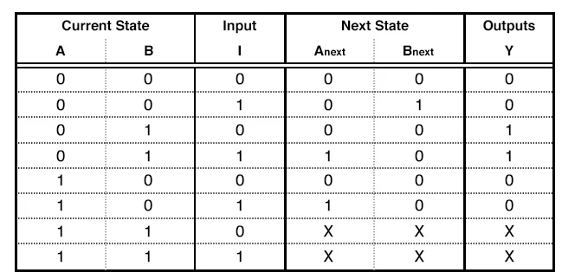
State Table
State table – a multiple variable table with the following four sections:
Present State – the values of the state variables for each allowed state.
Input – the input combinations allowed.
Next-state – the value of the state at time (t+1) based on the present state and the input.
Output – the value of the output as a function of the present state and (sometimes) the input.
From the viewpoint of a truth table:
the inputs are Input, Present State
and the outputs are Output, Next State

Slide 15
Basic Analysis Procedure
The analysis consists of obtaining a suitable description that demonstrates the time sequence of inputs, outputs, and states.
Logic diagram
Boolean gates, flip-flops (of any kind), and appropriate interconnections.
The logic diagram is derived from any of the following:
Boolean equations (inputs and outputs)
State table
State diagram
Notes:
状态图刻画了时序逻辑的功能特性，如果能正确设计出状态图，则可方便实现数字电路：
1. 首先要把状态机的输入、输出以及内部状态转换为二进制表示，编码是关键，会影响形成的电路实现和总体性能。
2. 其次要解决状态记忆问题：或者设计专门的记忆器件-双稳态器件（锁存器、触发器），或者采用反馈电路，利用电路的稳态来表征状态机中的状态。
3. 最后是如何设计出符合状态转换逻辑要求的状态记忆器件的激励函数和输出函数，并完成时序分析。

Slide 16


Example
Input: x(t)
Output: y(t)
State: (A(t), B(t))
What is the output function?
What is the next state function?
x
D
Q
A
C
$$\overline{Q}$$
$$\overline{A}$$
D
Q
B
CP
C
$$\overline{Q}$$
y

Slide 17

Example: Boolean Equation
Boolean equations for the functions:
A(t+1) = A(t)x(t) + B(t)x(t)
B(t+1) = $\overline{A}$(t)x(t)
y(t) = $\overline{x}$(t)(B(t) + A(t))
x
D
Q
A
C
$$\overline{Q}$$
$$\overline{A}$$
Next State
D
Q
B
CP
C
$$\overline{Q}$$
y
Output

Slide 18

Example: State Table
Boolean equations for the functions:
A(t+1) = A(t)x(t) + B(t)x(t)
B(t+1) = $\overline{A}$(t)x(t)
y(t) = $\overline{x}$(t)(B(t) + A(t))
Present State
Input
Next State
Output
A(t) B(t)
x(t)
A(t+1) B(t+1)
y(t)
0 0
0
0 0
0
0 0
1
0 1
0
0 1
0
0 0
1
0 1
1
1 1
0
1 0
0
0 0
1
1 0
1
1 0
0
1 1
0
0 0
1
1
1
1
1 0
0

Slide 19
Example: State Diagram
Diagram gets confusing for large circuits
For small circuits, usually easier to understand than the state table
x=0/y=0
x=0/y=1
x=1/y=0
A B
0 0
x=0/y=1
1 0
x=1/y=0
x=1/y=0
x=0/y=1
0 1
1 1
x=1/y=0

Slide 20
Overview
Introduction to sequential circuits
Basic sequential logic elements
Sequential logic design
Classic sequential logic elements

Slide 21

Basic sequential logic elements
Bistable circuit
Latches
SR, $\overline{S}\overline{R}$, clocked SR, D
Flip-flops
SR, D, JK, T

Slide 22

Bistable Circuit
Fundamental building block of other state elements
Two outputs: $Q$, $\overline{Q}$
No inputs
Notes:
在这两种信号组合的条件下，该电路信号的逻辑电平都是稳定且相互支撑的，是有两种不同的稳定状态输出的电路，即双稳态电路。
双稳态元件可作为基本的存储单元，在 时序电路中实现状态记忆功能。
Q：置位/高电平稳态；~Q：复位/低电平稳态

Slide 23
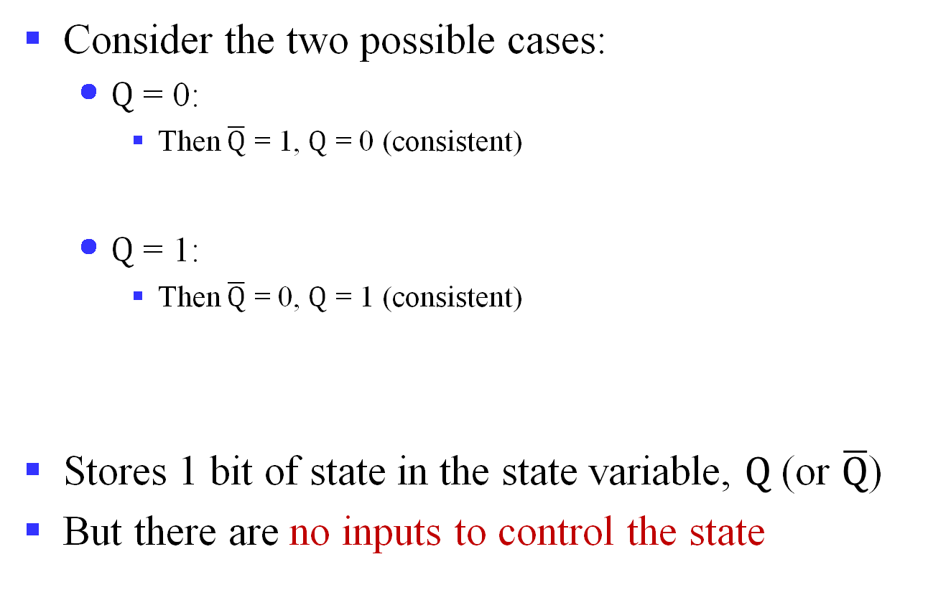
Bistable Circuit Analysis
Consider the two possible cases:
$Q$ = 0:
Then $\overline{Q}$ = 1, $Q$ = 0 (consistent)
$Q$ = 1:
Then $\overline{Q}$ = 0, $Q$ = 1 (consistent)
Stores 1 bit of state in the state variable, $Q$ (or $\overline{Q}$)
But there are no inputs to control the state
Notes:
从模拟电路角度看，双稳态原件除了高低电平两个稳态之外，理论上还存在一个亚稳态。非门在对输入电平做转换时，存在输入输出电位相等的情况，处于逻辑高电位和低电位区间的中间，如果双稳态元件的输入和输出恰好处于这个电位，则也处于稳态，但极不稳定，稍有波动即变为高/低电平稳态。
数字逻辑电路分析时常忽略亚稳态，实际中可能会进入亚稳态，应尽量避免。

Slide 24


SR Latch
SR (Set/Reset) latch
Consider the four possible cases:
S = 1, R = 0
S = 0, R = 1
S = 0, R = 0
S = 1, R = 1
S
$$Q$$
R
$$\overline{Q}$$

Slide 25


SR Latch Analysis
S = 1, R = 0:
Then $Q$ = 1 and $\overline{Q}$ = 0
S = 0, R = 1:
Then $\overline{Q}$ = 1 and $Q$ = 0

Slide 26
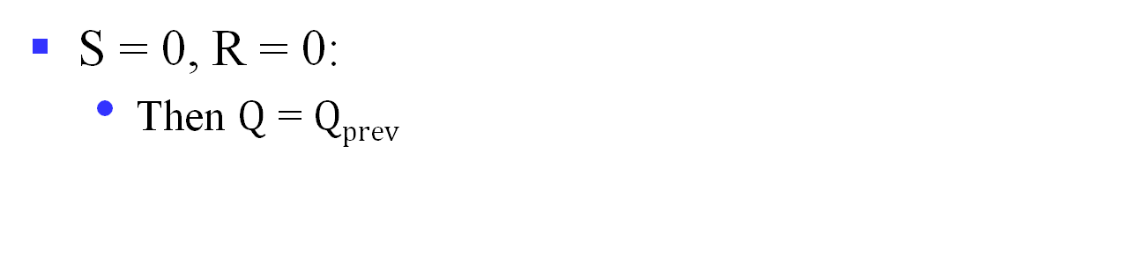
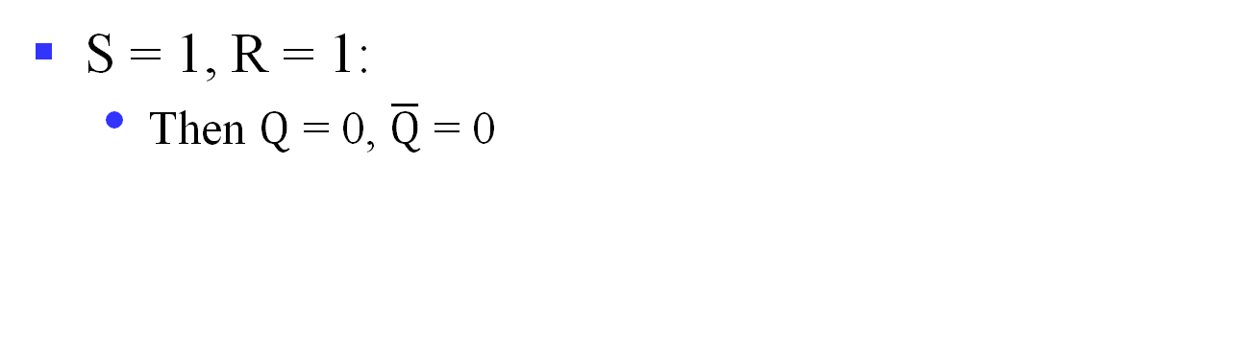
SR Latch Analysis (cont’d)
S = 0, R = 0:
Then $Q$ = $Qprev$
Memory!
S = 1, R = 1:
Then $Q$ = 0, $\overline{Q}$ = 0
Invalid state!

Slide 27
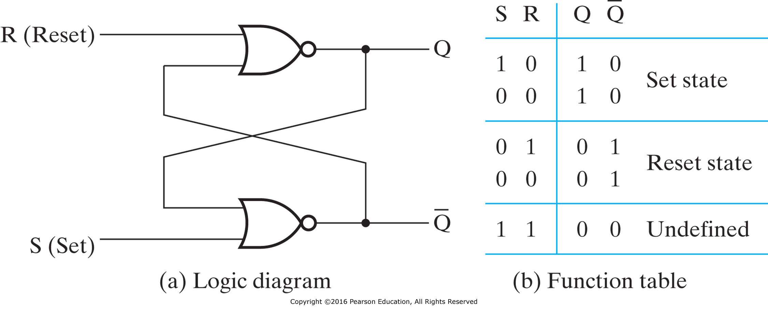
SR Latch with NOR Gates

Slide 28
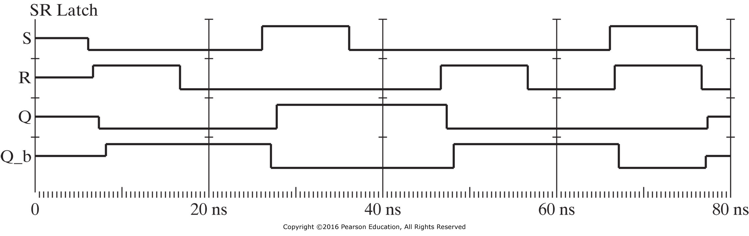
Logic Simulation of SR Latch Behavior

Slide 29
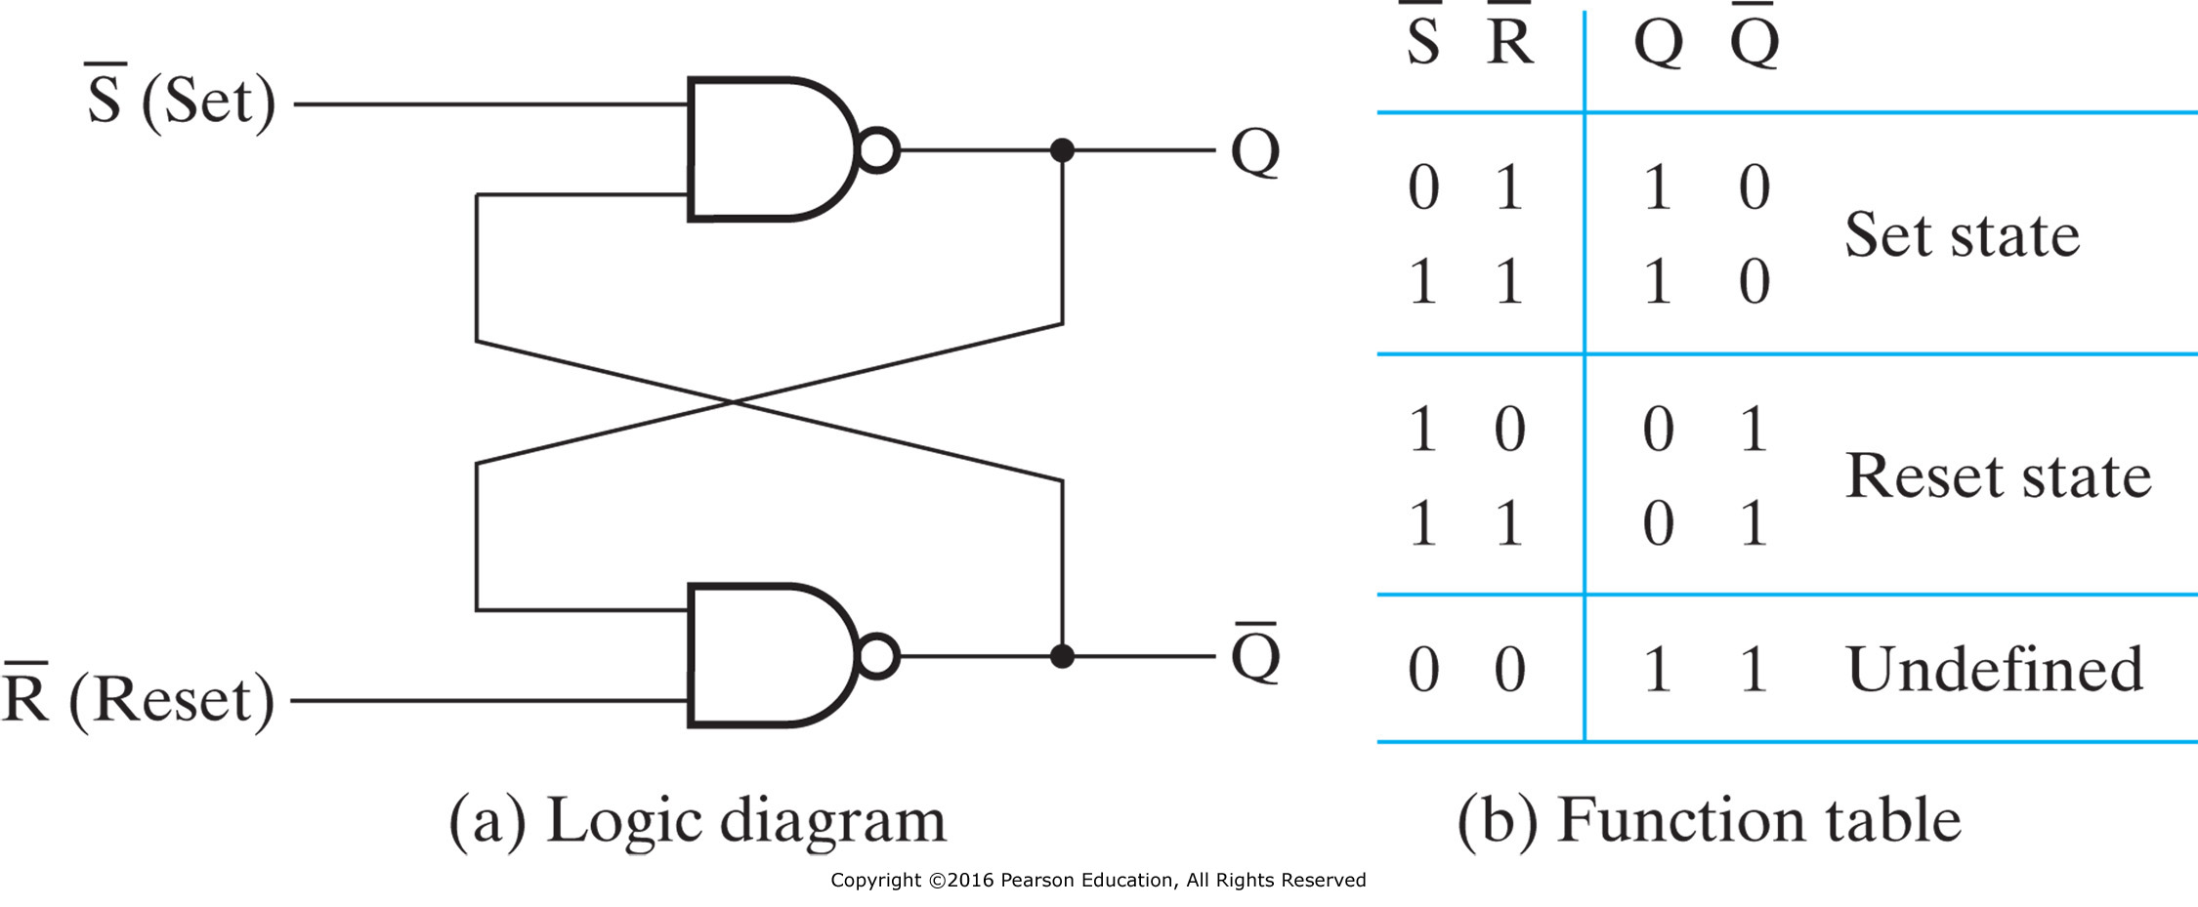

$\overline{S}\overline{R}$ Latch with NAND Gates

Slide 30
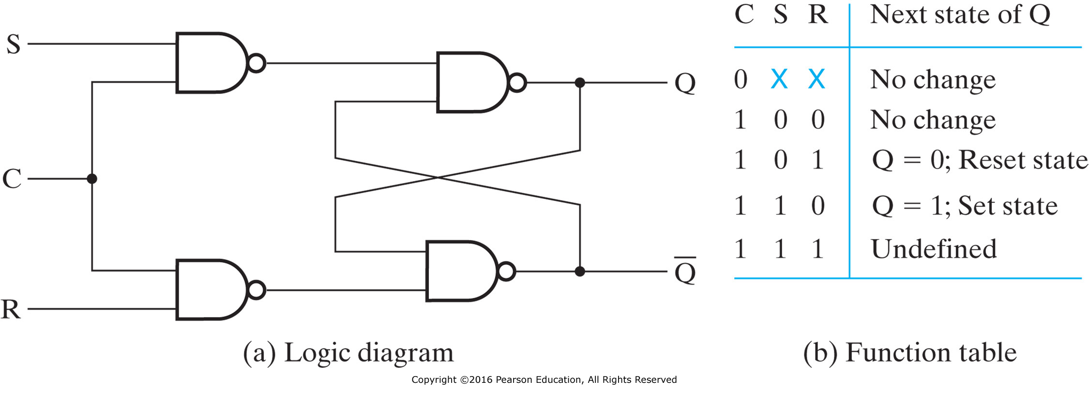



SR Latch with Control Input
Aka clocked SR latch
Adding two NAND gates to the basic $\overline{S}\overline{R}$ NAND latch gives the clocked SR latch
Has a time sequence behavior like the basic SR latch except that the S and R inputs are only observed when the line C is high
Q(t+1)
S
$$Q$$
C
R
$$\overline{Q}$$
(c) The graphic symbol
Notes:
C means “control” or “clock”，控制何时对输入敏感。
The table describes what happens after the clock [at time (t+1)] based on:
1. current inputs (S,R,C) and
2. current state Q(t).

Slide 31
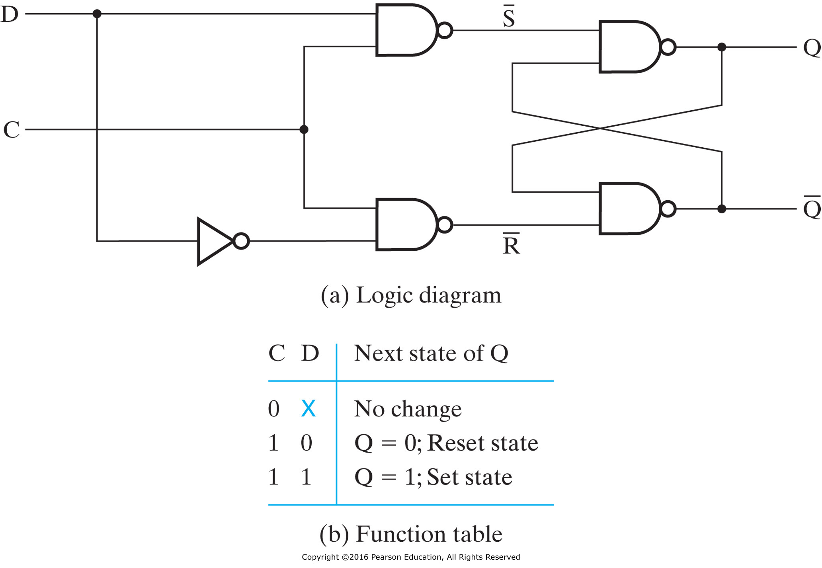
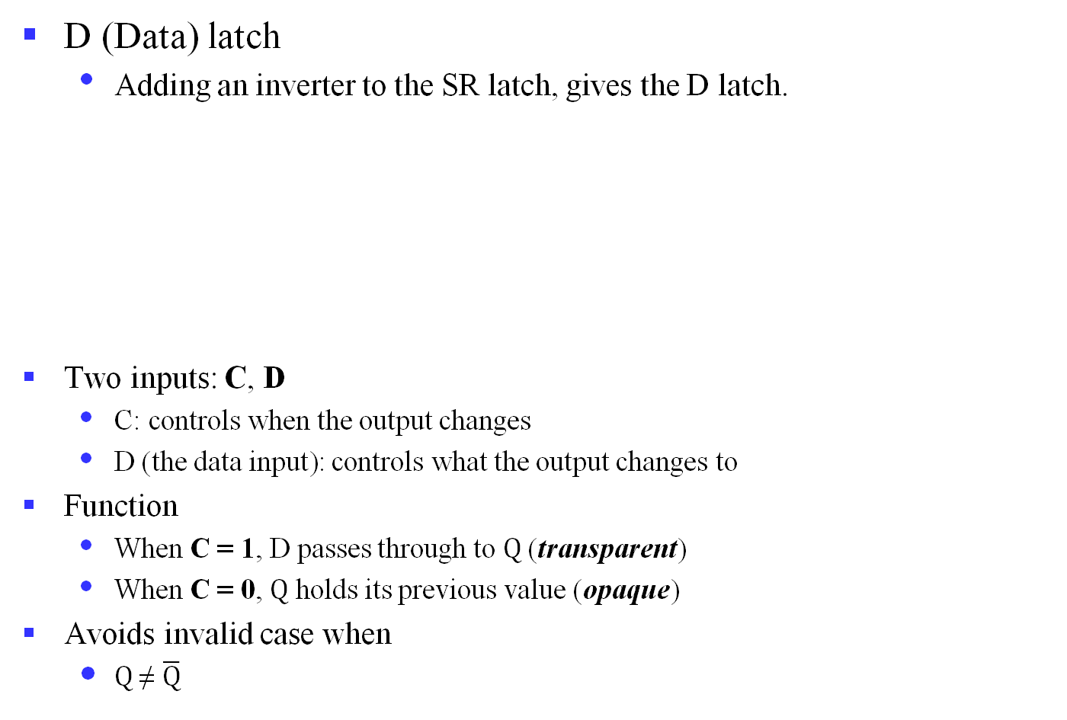
D Latch
D (Data) latch
Adding an inverter to the SR latch, gives the D latch.
Two inputs: C, D
C: controls when the output changes
D (the data input): controls what the output changes to
Function
When C = 1, D passes through to $Q$ (transparent)
When C = 0, $Q$ holds its previous value (opaque)
Avoids invalid case when
$Q$ ≠ $\overline{Q}$
D
$$Q$$
C
$$\overline{Q}$$
The graphic symbol
Notes:
Note that there are no “undefined” states!

Slide 32
The Latch Timing Problem
Consider the following circuit:
Suppose that initially Y = 0.
As long as C = 1, the value of Y continues to change!
The changes are based on the delay present on the loop through the connection from Y back to Y.
If the stored value can change state more than once during a single clock pulse, the result is a hazard that might introduce a glitch later in the circuit.
Desired behavior: Y changes only once per clock pulse!
D
$$Q$$
Y
CLK
C
$$\overline{Q}$$
CLK
Y
Notes:
D锁存器在C有效期间，存在由于输入端信号的改变而直接改变锁存器状态的情况，存在输出波动风险。因此，所有由单一时钟信号触发的锁存器，其输出端均不能直接或经由组合逻辑连接到自身或其它锁存器的输入端！
In a sequential circuit, paths may exist through combinational logic:
From one storage element to another
From a storage element back to the same storage element
The combinational logic between a latch output and a latch input may be as simple as an interconnect
For a clocked D latch, the output Q depends on the input D whenever the clock input C has value 1, the latch is transparent.

Slide 33
The Latch Timing Problem (cont’d)
A solution to the latch timing problem is to break the closed path from Y to Y within the storage element
The commonly-used, path-breaking solution is the master-slave flip-flop
Edge-triggered flip-flop
Pulse-triggered flip-flop
Notes:
触发器能够保证才做正确性的关键在于消除了锁存器的透明性：
在输出信号改变之前，输入信号与输出信号之间的通路被断开，因此在一个时钟周期内，一个触发器不能“看到”自身输出信号的改变和连接到其输入端的其它触发器输出信号的改变；
这样，触发器的新状态只取决于前面一个瞬间的状态，不会发生多次状态改变的情况。
主从式触发有两种：
脉冲触发式：pulse-triggered，1）当出现时钟脉冲时，输入信号控制触发器状态；2）当时钟脉冲消失时，触发器状态才会发生改变。
边沿触发式：edge-triggered，只有在时钟在由0变1或者由1变0时（即时钟信号跳变），触发器才被触发；其它所有时间（包括时钟脉冲维持为1）触发器都处于无效状态。
边沿触发器工作速度更快，设计限制少，因此使用比较普遍。

Slide 34


Pulse-Triggered Flip-Flop
SR flip-flop
Consists of two clocked SR latches in series with the clock on the second latch inverted
The input is observed by the first latch with C = 1
The output is changed by the second latch with C = 0
The path from input to output is broken by the difference in clocking values (C = 1 and C = 0).
The behavior demonstrated by the example with D driven by Y given previously is prevented since the clock must change from 1 to 0 before a change in Y based on D can occur.
S
S
$$Q$$
S
$$Q$$
$$Q$$
C
C
C
R
R
$$\overline{Q}$$
R
$$\overline{Q}$$
$$\overline{Q}$$
Notes:
SR锁存器构成的主从式触发器是脉冲触发式（pulse-triggered）触发器

Slide 35
Pulse-Triggered Flip-Flop Problem
The change in the flip-flop output is delayed by the pulse width which makes the circuit slower or
S and/or R are permitted to change while C = 1
Suppose Q = 0 and S goes to 1 and then back to 0 with R remaining at 0
The master latch sets to 1
A 1 is transferred to the slave
Suppose Q = 0 and S goes to 1 and back to 0 and R goes to 1 and back to 0
The master latch sets and then resets
A 0 is transferred to the slave
These behaviors are called 1’s and 0’s catching
Notes:
时钟周期导致脉冲式触发器电路延迟。
1’s catching: 0-1-0 glitch on R or S while clock is high is "caught" by master stage

Slide 36
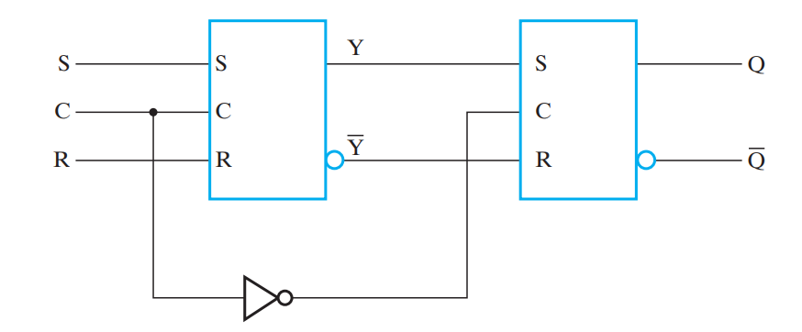
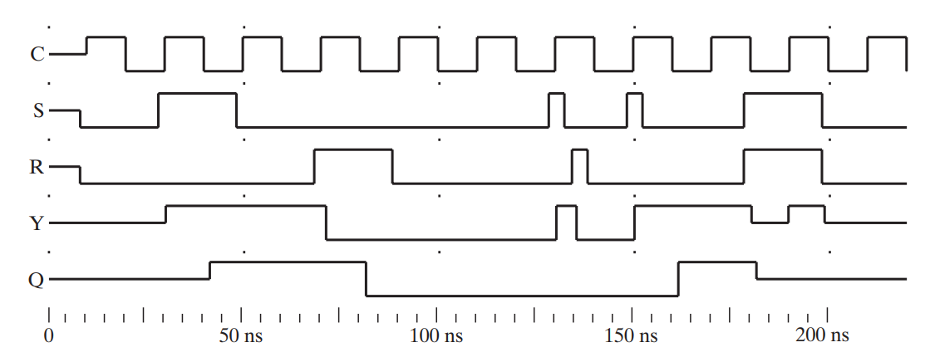
1’s Catching
Notes:
1’s catching: 0-1-0 glitch on R or S while clock is high is "caught" by master stage

Slide 37
Flip-Flop Solution
Use edge-triggering flip-flop
An edge-triggered flip-flop ignores the pulse while it is at a constant level and triggers only during a transition of the clock signal
Edge-triggered flip-flops can be built directly at the electronic circuit level
Notes:
边沿触发器忽略了处于保持阶段的时钟脉冲，只在时钟信号跳变时触发。

Slide 38











Edge-Triggered D Flip-Flop
The edge-triggered D flip-flop can be formed by:
Replacing the first clocked SR latch with a clocked D latch or
Adding a D input and inverter to a master-slave SR flip-flop
The delay of the SR master-slave flip-flop can be avoided since the 1’s-catching behavior is not present with D replacing S and R inputs
The change of the D flip-flop output is associated with the negative edge at the end of the pulse, i.e., negative-edge triggered flip-flop
D
D
$$Q$$
S
$$Q$$
$$Q$$
D
D
$$Q$$
D
$$Q$$
$$Q$$
C
C
C
$$\overline{Q}$$
R
$$\overline{Q}$$
$$\overline{Q}$$
C
C
$$\overline{Q}$$
C
$$\overline{Q}$$
$$\overline{Q}$$
Notes:
下降沿触发的D触发器

Slide 39
Positive-Edge Triggered D Flip-Flop
Formed by adding inverter to clock input
Q changes to the value on D applied at the positive clock edge within timing constraints to be specified
Our choice as the standard flip-flop for most sequential circuits
D
D
$$Q$$
D
$$Q$$
$$Q$$
C
C
$$\overline{Q}$$
$$\overline{Q}$$
$$\overline{Q}$$
C
Notes:
上升沿触发的D触发器

Slide 40


Positive-Edge vs. Negative-Edge
Positive-edge trigger
D | CLK
0 | ↑ | 0 | 1
1 | ↑ | 1 | 0
↑ : Rising Edge of Clock
D
$$Q$$
CLK
$$\overline{Q}$$
Negative-edge trigger
D | CLK
0 | ↓ | 0 | 1
1 | ↓ | 1 | 0
↓ : Falling Edge of Clock
D
$$Q$$
CLK
$$\overline{Q}$$

Slide 41
D Flip-Flop: Example Timing
Q=D=1
Q=D=0
Q=D=0
No Change
Q=D=1
Q=D=1
No Change
Q=D=0
Q=D=0
No Change
Q
D
CLK
Notes:
Timing diagram example for a D flip-flop.

Slide 42
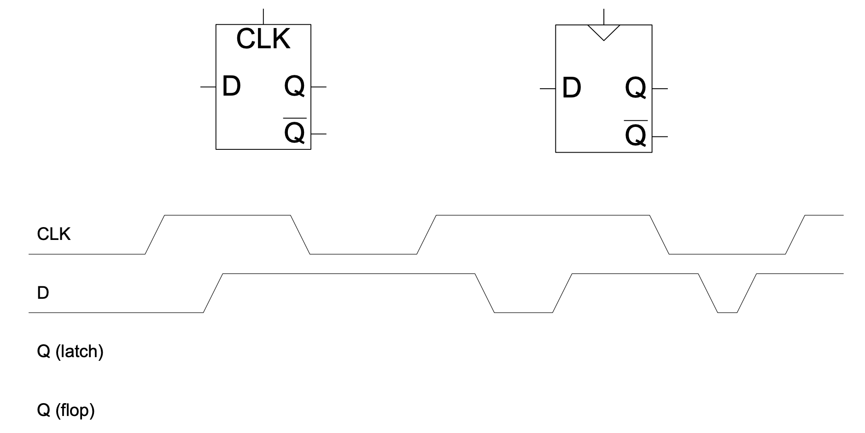
D Latch vs. D Flip-Flop

Slide 43
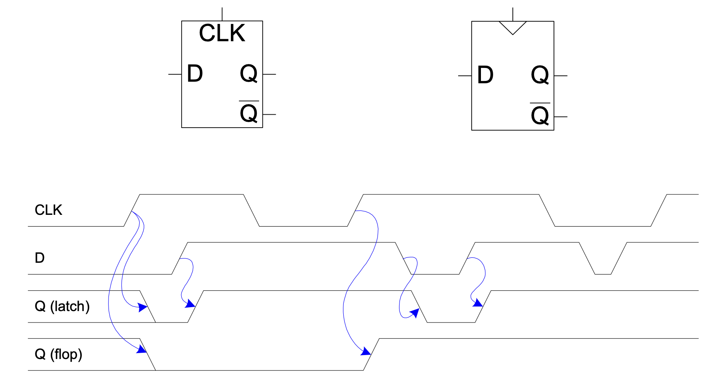
D Latch vs. D Flip-Flop

Slide 44
Latches vs. Flip-Flops
A latch can be considered as a door
CLK = 0, door is shut
CLK = 1, door is unlocked
A flip-flop is a two-door entrance
CLK = 1
CLK = 0
CLK = 1

Slide 45
Enabled D Flip-Flop
Inputs: CLK, D, EN
The enable input (EN) controls when new data (D) is stored
Function
EN = 1: D passes through to Q on the clock edge
EN = 0: the flip-flop retains its previous state

Slide 46
Resettable D Flip-Flop
Inputs: CLK, D, Reset
Function:
Reset = 0: Q is forced to 0
Reset = 1: flip-flop behaves as ordinary D flip-flop
Two types:
Synchronous: resets at the clock edge only
Asynchronous: resets immediately when Reset = 1

Slide 47
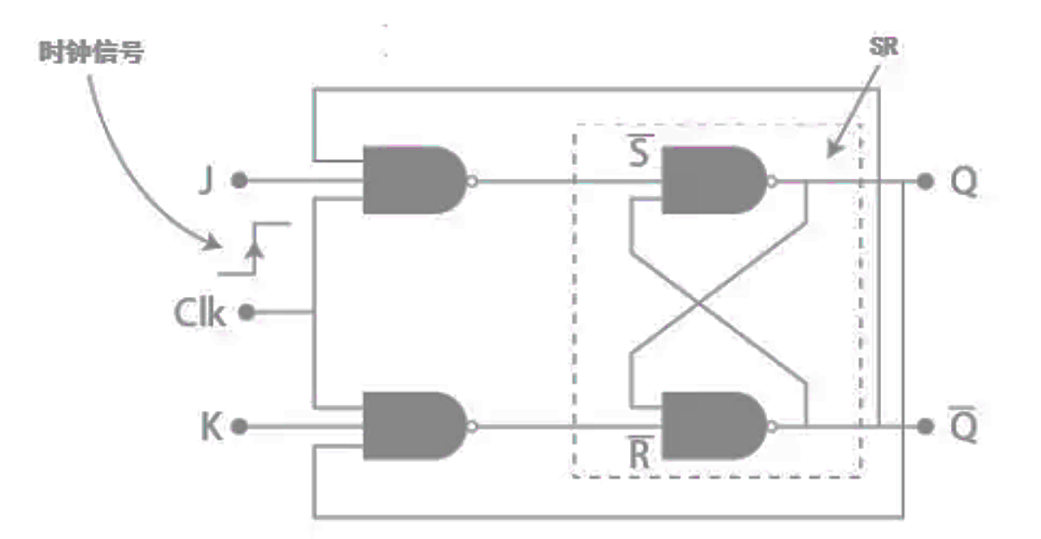
JK Flip-Flop
Behavior
Same as SR flip-flop with J analogous to S and K analogous to R
Except that J = K = 1 is allowed, and
For J = K = 1, the flip-flop changes to the opposite state
Has the same “1s catching” behavior as SR flip-flop
If the master changes to the wrong state, that state will be passed to the slave
E.g., if master falsely set by J = 1, K = 1 cannot reset it during the current clock cycle
Notes:
The JK flip flop was named after Jack Kilby

Slide 48
JK Flip-Flop (cont’d)
Implementation
To avoid 1’s catching behavior, one solution used is to use an edge-triggered D as the core of the flip-flop
J
J
D
C
K
C
K

Slide 49
T Flip-Flop
Behavior
Has a single input T
For T = 0, no change to state
For T = 1, changes to opposite state
Same as a JK flip-flop with J = K = T
Has the same “1’s catching” behavior as JK flip-flop
Cannot be initialized to a known state using the T input
Reset (asynchronous or synchronous) essential

Slide 50
T Flip-Flop (cont’d)
Implementation
To avoid 1’s catching behavior, one solution used is to use an edge-triggered D as the core of the flip-flop
D
T
T
C
C

