Slide 1
Sequential Logic Design
Lei Wu
Zhejiang University

Slide 2
Disclaimer
Many images and resources used in this lecture are collected from the Internet, and they are used only for the educational purpose. The copyright belong to the original owners, respectively.
Part of slides credit to
  David Money Harris and Sarah L. Harris. Digital Design and Computer Architecture, 2nd Edition.
  Morris R. Mano , Charles R. Kime and Tom Martin. Logic & Computer Design Fundamentals, Fifth Edition.
  Prof. Yabo Dong @ ZJU
  CSE 140: Components and Design Techniques for Digital Systems (Prof. C.K. Cheng @ UCSD)
  CEG 360/560; EE 451/651: Digital System Design (Prof. Travis Doom @ Wright State University)

Slide 3
Overview
Introduction to sequential circuits
Basic sequential logic elements
Sequential logic design
Classic sequential logic elements

Slide 4
Sequential logic design
Some definitions
The design procedure
State machine design

Slide 5
Equivalent State
Two states are equivalent if their response for each possible input sequence is an identical output sequence.
Alternatively, two states are equivalent if their outputs produced for each input symbol is identical and their next states for each input symbol are the same or equivalent.
Notes:
两个状态等价是指在状态图/状态表所描述的状态转换逻辑前提下，两个状态在所有输入组合情况下，其输出都相同，且下一个状态也相同或者为等价状态。

Slide 6
Equivalent State Example
For states S3 and S2
  the output for input
  0 is 1 and input 1 is 0, and
  the next state for input
  0 is S0 and for input
  1 is S2
By the alternative definition, states S3 and S2 are equivalent.
0/0
1/0
S0
S1
0/1
0/1
0/1
1/0
1/0
S2
S3
1/0

Slide 7
Equivalent State Example
Replacing S3 and S2
by a single state gives
state diagram:
Examining the new diagram,
states S1 and S2 are equivalent since
  their outputs for input
  0 is 1 and input 1 is 0
  their next state for input
  0 is S0 and for input
  1 is S2
Replacing S1 and S2 by a
single state gives state
diagram:
0/0
1/0
S0
S1
0/1
0/1
1/0
S2
1/0
0/0
1/0
S0
S1
0/1
1/0
Notes:
Note that state table can also be used to merge equivalent states. Will give an example after introducing sequence recognizer on page 21.

Slide 8
Equivalent State Example
Replacing S3 and S2
by a single state gives
state diagram:
Examining the new diagram,
states S1 and S2 are equivalent since
  their outputs for input
  0 is 1 and input 1 is 0
  their next state for input
  0 is S0 and for input
  1 is S2
Replacing S1 and S2 by a
single state gives state
diagram:
0/0
1/0
S0
S1
0/1
0/1
1/0
S2
1/0
0/0
1/0
S0
S1
0/1
1/0
Notes:
Some more cases.
Note that state table can also be used to merge equivalent states.
Will give an example after introducing sequence recognizer on page 21.

Slide 9
Moore and Mealy Models
There are two formal models of FSMs:
Moore model
  Named after E.F. Moore
  Outputs are a function ONLY of states
  Usually specified on the states.
Mealy model
  Named after G. Mealy
  Outputs are a function of inputs AND states
  Usually specified on the state transition arcs.

Slide 10
Moore and Mealy Example
Moore model state table/diagram maps states to outputs
Mealy model state table/diagram maps inputs and state to outputs
x=0
Present
Next State
Output
A/0
x=0
State
x=0 x=1
A
A B
0
x=1
B
A C
0
x=1
x=0
C
A C
1
B/0
C/1
x=1
Present
Next State
Output
x=1/y=0
State
x=0 x=1
x=0 x=1
x=0/y=0
0
0 1
0 0
0
1
1
0 1
0 1
x=0/y=0
x=1/y=1

Slide 11
The Design Procedure
Specification
Formulation
  Obtain a state diagram or state table
State assignment
  Assign binary codes to the states
Flip-flop input equation determination
  Select flip-flop types and derive flip-flop equations from next state entries in the table
Output equation determination
  Derive output equations from output entries in the table
Optimization
  Optimize the equations
Technology mapping
  Find circuit from equations and map to flip-flops and gate technology
Verification
  Verify correctness of final design
Notes:
1. Specification
Write a specification for the circuit if one is not already available
2. Formulation
Derive a truth table or initial Boolean equations that define the required relationships between the inputs and outputs, if not in the specification
Apply hierarchical design if appropriate
3. Optimization
Apply 2-level and multiple-level optimization
Draw a logic diagram or provide a netlist for the resulting circuit using ANDs, ORs, and inverters
4. Technology Mapping
Map the logic diagram or netlist to the implementation technology selected
5. Verification
Verify the correctness of the final design manually or using simulation
How to design combinational logic circuits
Design procedure
1. Determine inputs, outputs and their logic relationship
Truth table
2. Determine logic functions and perform optimization
Algebra or K-map
3. Draw logic circuit diagram and timing diagram
Timing analysis

Slide 12
Formulation: Finding a State Diagram
A state is an abstraction of the history of the past applied inputs to the circuit (including power-up reset or system reset).
  The interpretation of “past inputs” is tied to the synchronous operation of the circuit. E.g., an input value (other than an asynchronous reset) is measured only during the setup-hold time interval for an edge-triggered flip-flop.
Examples:
  State A represents the fact that a 1 input has occurred among the past inputs.
  State B represents the fact that a 0 followed by a 1 have occurred as the most recent past two inputs.

Slide 13
Formulation: Finding a State Diagram (cont’d)
In specifying a circuit, we use states to remember meaningful properties of past input sequences that are essential to predicting future output values.
A sequence recognizer is a sequential circuit that produces a distinct output value whenever a prescribed pattern of input symbols occur in sequence, i.e., recognizes an input sequence occurrence.
We will develop a procedure specific to sequence recognizers to convert a problem statement into a state diagram.
Next, the state diagram, will be converted to a state table from which the circuit will be designed.

Slide 14
Sequence Recognizer Procedure
To develop a sequence recognizer state diagram:
  Begin in an initial state in which NONE of the initial portion of the sequence has occurred (typically “reset” state).
  Add a state that recognizes that the first symbol has occurred.
  Add states that recognize each successive symbol occurring.
  The final state represents the input sequence (possibly less than the final input value) occurrence.
  Add state transition arcs which specify what happens when a symbol NOT in the proper sequence has occurred.
  Add other arcs on non-sequence inputs which transition to states that represent the input subsequence that has occurred.
The last step is required because the circuit must recognize the input sequence regardless of where it occurs within the overall sequence applied since “reset”.
Notes:
Identify 1101 from 1101101

Slide 15
Sequence Recognizer Procedure (cont’d)
Example: Recognize the sequence 1101
  Note that the sequence 1111101 contains 1101 and "11" is a proper sub-sequence of 1101.
Thus, the sequential machine must remember that the first two one's have occurred as it receives another symbol.
Also, the sequence 1101101 contains 1101 as both an initial subsequence and a final subsequence with some overlap, i. e., 1101101 or 1101101.
And, the 1 in the middle, 1101101, is in both subsequences.
The sequence 1101 must be recognized each time it occurs in the input sequence.

Slide 16
Example: Recognize 1101
Define states for the sequence to be recognized:
  assuming it starts with first symbol,
  continues through each symbol in the sequence to be recognized, and
  uses output 1 to mean the full sequence has occurred,
  with output 0 otherwise.
Starting in the initial state (Arbitrarily named "A"):
  Add a state that recognizes the first "1."
  State "A" is the initial state, and state "B" is the state which represents the fact that the "first" one in the input subsequence has occurred. The output symbol "0" means that the full recognized sequence has not yet occurred.
1/0
A
B

Slide 17
Example: Recognize 1101 (cont’d)
After one more 1, we have:
  C is the state obtained when the input sequence has two "1"s.
A
1/0
1/0
B
C
Finally, after 110 and a 1, we have:
1/0
1/0
0/0
1/1
A
B
C
D
Transition arcs are used to denote the output function (Mealy model)
Output 1 on the arc from D means the sequence has been recognized
To what state should the arc from state D go? Remember: 1101101 ?
Note that D is the last state but the output 1 occurs for the input applied in D. This is the case when a Mealy model is assumed.

Slide 18
Example: Recognize 1101 (cont’d)
Clearly the final 1 in the recognized sequence 1101 is a sub-sequence of 1101.
It must be the first 1 in the sequence, since it cannot be preceded by a 1. Thus it should represent the same state reached from the initial state after a first 1 is observed. We obtain:
1/0
1/0
0/0
1/1
A
B
C
D
1/0
1/0
0/0
A
B
C
D
1/1
Notes:
1101101

Slide 19
Example: Recognize 1101 (cont’d)
The state have the following abstract meanings:
  A: No proper sub-sequence of the sequence has occurred.
  B: The sub-sequence 1 has occurred.
  C: The sub-sequence 11 has occurred.
  D: The sub-sequence 110 has occurred.
  The 1/1 on the arc from D to B means that the last 1 has occurred and thus, the sequence is recognized.
1/0
1/0
0/0
A
B
C
D
1/1

Slide 20
Example: Recognize 1101 (cont’d)
The other arcs are added to each state for inputs not yet listed. Which arcs are missing?
1/0
1/0
0/0
A
B
C
D
1/1
Answer:
"0" arc from A
"0" arc from B
"1" arc from C
"0" arc from D.

Slide 21
Example: Recognize 1101 (cont’d)
State transition arcs must represent the fact that an input subsequence has occurred. Thus, we get:
0/0
1/0
1/0
1/0
0/0
A
B
C
D
0/0
1/1
0/0
Note that the 1 arc from state C to state C implies that State C means two or more 1's have occurred.

Slide 22
Formulation: Find State Table
From the state diagram, we can fill in the state table.
There are 4 states, one input, and one output. We will choose the form with four rows, one for each current state.
From State A, the 0 and 1 input transitions have been filled in along with the outputs.
0/0
1/0
0/0
1/0
1/0
0/0
1/0
A
B
C
D
0/0
1/1
0/0
Present
Next State
Output
State
x=0 x=1
x=0 x=1
A
A
B
0
0
B
A
C
0
0
C
D
C
0
0
D
A
B
0
1
Note that state table can also be used to merge equivalent states.
What would the state diagram and state table look like for the Moore model?

Slide 23
Example: Moore Model for Sequence 1101
For the Moore model, outputs are associated with states.
We need to add a state "E" with output value 1 for the final 1 in the recognized input sequence.
  This new state E, though similar to B, would generate an output of 1 and thus be different from B.
The Moore model for a sequence recognizer usually has more states than the Mealy model.

Slide 24
Example: Moore Model (cont’d)
We mark outputs on states for Moore model
Arcs now show only state transitions
Add a new state E to produce the output 1
Note that the new state, E produces the same behavior in the future as state B. But it gives a different output at the present time. Thus, these states do represent a different abstraction of the input history.
0
1
1
1
0
A/0
B/0
C/0
D/0
0
1
1
0
E/1
0

Slide 25
Example: Moore Model (cont’d)
Fill in the state table according to the stable diagram
Memory aid re more state in the Moore model: “Moore is More.”
0
1
Present
Next State
Output
1
1
0
State
x=0 x=1
y
A/0
B/0
C/0
D/0
A
A
B
0
0
1
1
B
A
C
0
0
C
D
C
0
E/1
D
A
E
0
0
E
A
C
1

Slide 26
State Assignment
Each of the m states must be assigned a unique code
Minimum number of bits required is n such that
n ≥ log₂m
where x is the smallest integer ≥ x
There are useful state assignments that use more than the minimum number of bits
There are 2^{n} - m unused states

Slide 27
State Assignment: Example 1
Present
Next State
Output
State
x=0 x=1
x=0 x=1
A
A
B
0
0
B
A
B
0
1
How many assignments of codes with a minimum number of bits?
  Two: A = 0, B = 1 or A = 1, B = 0
Does it make a difference?
  Only in variable inversion, so small, if any.
Notes:
1 bit for 2 states，there are 2 (2 x 1) possible assignments.
不同赋值区别不大。

Slide 28
State Assignment: Example 2
Present
Next State
Output
State
x=0 x=1
x=0 x=1
A
A B
0 0
B
A C
0 0
C
D C
0 0
D
A B
0 1
How many assignments of codes with a minimum number of bits?
Does code assignment make a difference in cost?
Notes:
2 bits to represent 4 states, and there are 24 (4 x 3 x 2 x 1) possible assignments.
不同的赋值确实对cost有影响：接下来用counting order和cray code为例说明。

Slide 29
State Assignment: Example 2 (cont’d)
Counting Order Assignment: A = 00, B = 01, C = 10, D = 11
The resulting coded state table:
Present State Y₁ Y₂ | Next State x = 0 x = 1 D₁ D₂ D₁ D₂ |  | Output x = 0 x = 1
0 0 | 0 0 | 0 1 | 0 | 0
0 1 | 0 0 | 1 0 | 0 | 0
1 0 | 1 1 | 1 0 | 0 | 0
1 1 | 0 0 | 0 1 | 0 | 1

Slide 30
State Assignment: Example 2 (cont’d)
Gray Code Assignment: A = 00, B = 01, C = 11, D = 10
The resulting coded state table:
Present State Y₁ Y₂ | Next State x = 0 x = 1 D₁ D₂ D₁ D₂ |  | Output x = 0 x = 1
0 0 | 0 0 | 0 1 | 0 | 0
0 1 | 0 0 | 1 1 | 0 | 0
1 1 | 1 0 | 1 1 | 0 | 0
1 0 | 0 0 | 0 1 | 0 | 1

Slide 31
Find Flip-Flop Input and Output Equations: Counting Order Assignment
Assume D flip-flops
Interchange the bottom two rows of the state table, to obtain K-maps for D1, D2, and Z:
D1
D2
Z
X
X
X
0
0
0
1
0
0
0
1
0
0
0
0
Y2
Y2
Y2
0
0
0
1
0
1
Y1
Y1
Y1
1
1
1
0
0
0

Slide 32
Optimization: Counting Order Assignment
Performing two-level optimization:
D₁ = Y₁Y₂ + XY₁Y₂
D₂ = XY₁Y₂ + XY₁Y₂ + XY₁Y₂
Z = XY₁Y₂
D1
D2
Z
X
X
X
0
0
0
1
0
0
0
1
0
0
0
0
Y2
Y2
Y2
0
0
0
1
0
1
Y1
Y1
Y1
1
1
1
0
0
0
Gate Input Cost = ?
Notes:
组合逻辑22: 5 + 9 + 3 + 5 = 22
D触发器约14，总代价： 22 + 14 * 2 = 50

Slide 33
Find Flip-Flop Input and Output Equations: Gray Code Assignment
Assume D flip-flops
Obtain K-maps for D1, D2, and Z:
D1
D2
Z
X
X
X
0
0
0
1
0
0
0
1
0
1
0
0
Y2
Y2
Y2
1
1
0
1
0
0
Y1
Y1
Y1
0
0
0
1
0
1

Slide 34
Optimization: Gray Code Assignment
Performing two-level optimization:
D₁ = Y₁Y₂ + XY₂
D₂ = X
Z = XY₁Y₂
D1
D2
Z
X
X
X
0
0
0
1
0
0
0
1
0
1
0
0
Y2
Y2
Y2
1
1
0
1
0
0
Y1
Y1
Y1
0
0
0
1
0
1
Gate Input Cost = ?
Notes:
D₂ = X不是组合逻辑，不统计在cost=9那里
总代价：9 + 14 * 2 = 37

Slide 35
Rules for State Assignment
States which have the same next state for a given input should be given adjacent assignment.
States which are the next states of the same state should be given adjacent assignment.
States which have the same output for a given input should be given adjacent assignment (for output simplification.)
Present
Next State
Output
State
x=0 x=1
x=0 x=1
A
A B
0 0
B
A C
0 0
C
D C
0 0
D
A B
0 1
Notes:
(1) 具有相同次态的现态，应尽可能分配相邻的二进制编码，该准则可以使次态逻辑较少依赖于当前状态变量：A和D应相邻
(2) 同一现态的次态应尽可能分配相邻的二进制编码，该准则能使此次态逻辑较少依赖于输入变量：A和B，A和C，C和D应相邻；
(3) 输出完全相同的现态应尽可能分配相邻的二进制编码，该准则能使输出逻辑较少依赖于当前变量： A，B，C 三者应相邻；
此外，最小化状态表中出现次数最多的状态或初始状态应分配逻辑0：A分配为逻辑0
具体设计过程中，常常存在准则运用的取舍问题，不一定要追求最少的编码达到最少的状态变量数。有时候适当增加编码位数虽然会增加状态记忆单元数目，但次态逻辑可能会变得简单。往往最终编码方案是多种因素综合权衡的结果。
One-Hot State Assignment: use one FF for each state.

Slide 36
Map Technology: Gray Code Assignment
D Flip-flops with Reset (not inverted)
D
Y1
C
R
Z
Y2
X
D
Clock
C
R
Reset
Initial circuit
Notes:
AND-OR gates

Slide 37
Mapped Circuit
NAND gates with up to 4 inputs and inverters
Y1
D
C
R
Z
Y2
X
D
Clock
C
R
Reset
Final circuit
Notes:
NAND-NOT gates

Slide 38
Design vs. Analysis: An Example
Logic diagram:
A
D
Q
Z
C
R
Q
B
D
Q
C
R
Q
C
D
Q
Clock
C
R
Q
Reset

Slide 39
Flip-Flop Input Equations
Variables
  Inputs: None
  Outputs: Z
  State Variables: A, B, C
Initialization: Reset to (0,0,0)
Equations
  A(t+1) = Z =
  B(t+1) =
  C(t+1) =
Notes:
A(t+1) = BC
B(t+1) = B’C + BC’
C(t+1) = A’C’
Z = A

Slide 40

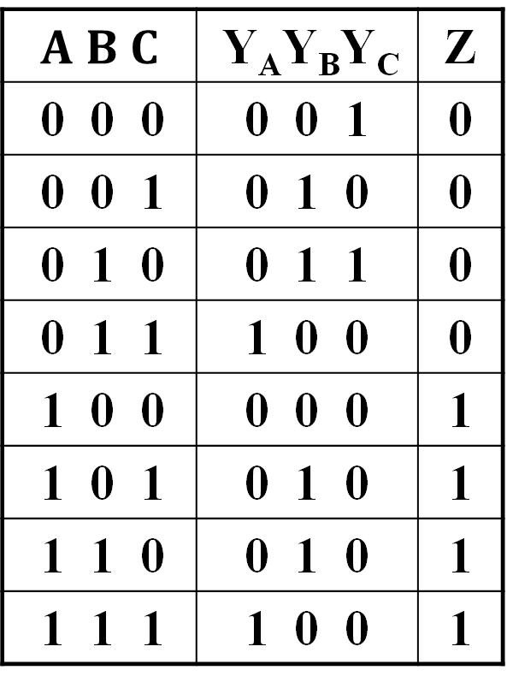
State Table
A(t+1) = $BC$
B(t+1) = $\overline{B}C+B\overline{C}$
C(t+1) = $\overline{A}\overline{C}$
Z = A
Let Y=X(t+1)
$A B C$ | Y_{A}Y_{B}Y_{C} | Z
0 0 0 | 0 0 1 | 0
0 0 1 | 0 1 0 | 0
0 1 0 | 0 1 1 | 0
0 1 1 | 1 0 0 | 0
1 0 0 | 0 0 0 | 1
1 0 1 | 0 1 0 | 1
1 1 0 | 0 1 0 | 1
1 1 1 | 1 0 0 | 1

Slide 41
State Diagram
Which states are used?
What is the function of
the circuit?
ABC
Reset
000
111
100
001
011
010
101
110
Notes:
Only states reachable from the reset state 000 are used: 000, 001, 010, 011, and 100.
The circuit produces a 1 on Z after four clock periods and every five clock periods thereafter:
000 -> 001 -> 010 -> 011 -> 100 -> 000 -> 001 -> 010 -> 011 -> 100 …
1 1
A mod 5 counter…

Slide 42
Unused States: The State Assignment Problem
The previous example has only 5 states, represented by 3-bit values. So, we have three unused state assignments in this case.
This is no real problem, except that at power up, the machine may start up in one of the unused states. Or, it could get into an unused state due to electrical noise (lightning, bad connections, etc).
One possibility is to add RESET logic to force the machine into state 000 on power up, or on detect of unused state. If entry to an unused state is considered fatal, then stop the FSM (force it into an ERROR state, where it stays) and transmit an error code.

Slide 43
Unused States: In the hardware Implementation of the FSM
A nasty problem is that of the machine appearing to freeze up if it gets into an unused state. This can happen if the unused states point to themselves or each other.
If all unused states point to used states, the machine is said to be "self starting" and, after power up, will function correctly. If the machine is self-starting, entering an unused state will cause a brief erratic operation, then the machine will resume correct operation.
So, if the application is fault-tolerant, and the machine is self-starting, we are OK to ignore the problem beyond verifying self start capability.
We can guarantee self start (assuming state 000 is a state we are using) by replacing the Xs in the implementation diagram above with 0s. This will force the machine into state 000 whenever an unused state is entered. The problem, of course, is more complex steering logic.
Notes:
erratic operation：异常操作
steering logic：控制逻辑

Slide 44
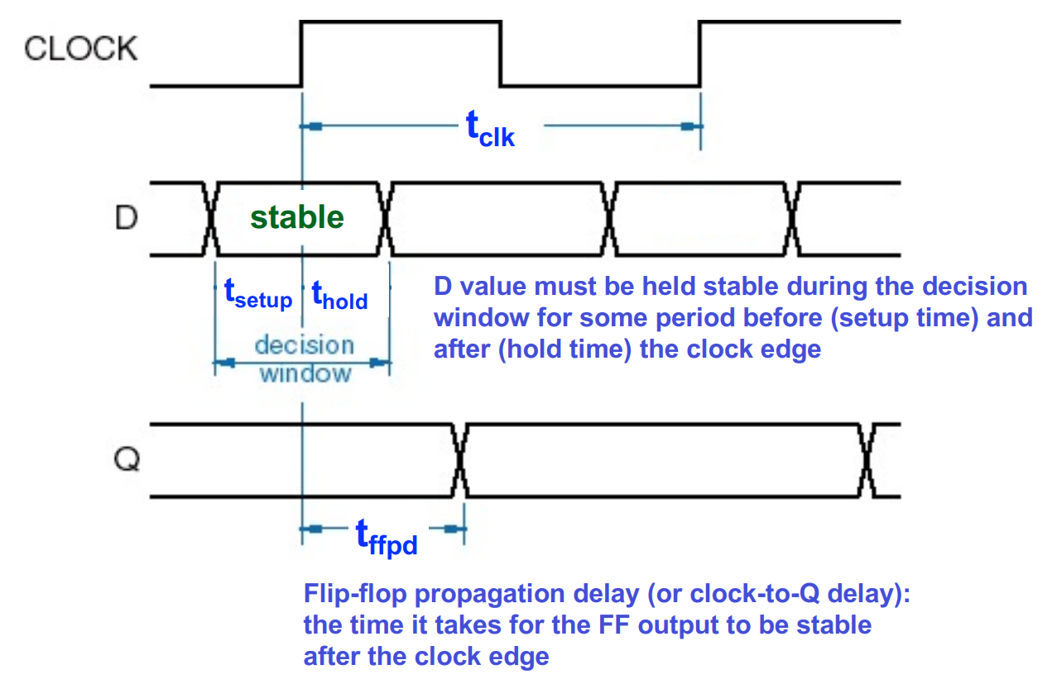
Flip-Flop Timing
E.g., D flip-flop
  tsetup - required time of stable input before CLK, input before CLK
  thold - required time of stable input after CLK, input after CLK
  tffpd - flip-flop propagation delay after CLK, aka Clk-to-Q time

Slide 45
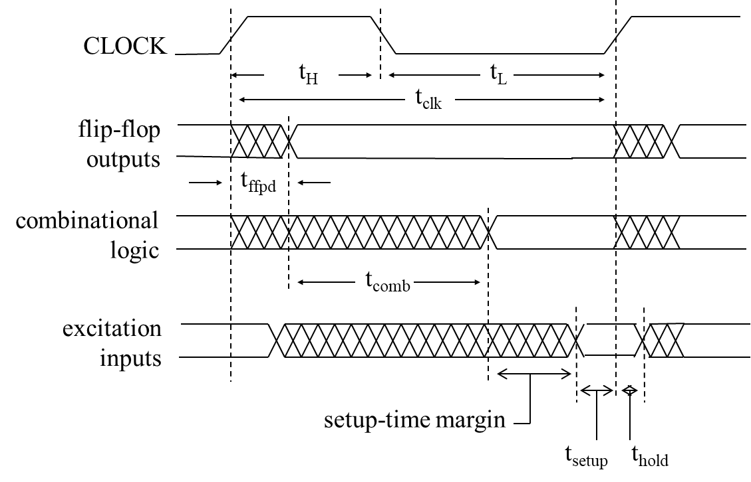
Timing Diagram of Sequential Circuits
tclk ≥ tffpd + tcomb + tsetup
thold ≤ tffpd + tcomb
Notes:
Excitation inputs == flip-flop inputs
e.g., t_{ffpd} = 0.3 ns, t_{comb} = 1.2 ns, t_{steup} = 0.2 ns
t_{clk} >= 1.7 ns -> feq <= 1 / 1.7 ns ~ 588 MHz

Slide 46
More Materials (Optional)
State Table & State Equation
Basic Flip-Flop Descriptors
Flip-Flop Behaviors

Slide 47
More Materials (Optional)
State Table & State Equation
Basic Flip-Flop Descriptors
Flip-Flop Behaviors

Slide 48
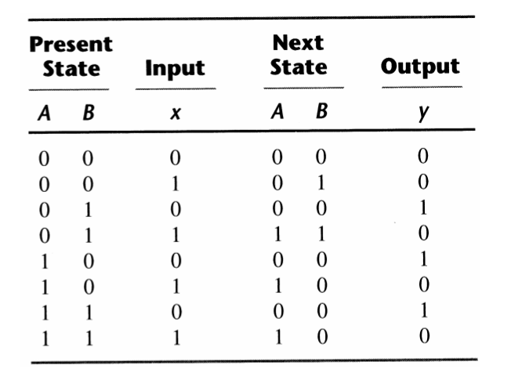
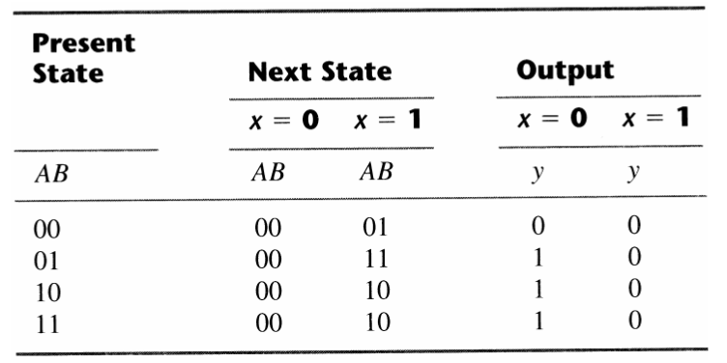
State Table: Two Alternative Forms

Slide 49
State Equation
The behavior of a clocked sequential circuit can be described algebraically by means of state equations.
A state equation (aka next-state equation) specifies the next state as a function of the present state and inputs.
Specifically, a state equation is an algebraic expression that specifies the condition for a flip-flop state transition. The left side of the equation with (t+1) denotes the next state of the flip-flop one clock edge later. The right side of the equation is Boolean expression that specifies the present state and input conditions that make the next state equal to 1.

Slide 50
More Materials (Optional)
State Table & State Equation
Basic Flip-Flop Descriptors
Flip-Flop Behaviors

Slide 51
Basic Flip-Flop Descriptors
Used in analysis
  Characteristic table - defines the next state of the flip-flop in terms of flip-flop inputs and current state
  Characteristic equation - defines the next state of the flip-flop as a Boolean function of the flip-flop inputs and the current state
Used in design
  Excitation table - defines the flip-flop input variable values as function of the current state and next state
  Excitation equation (aka input equation) - defines the combinational logic that drives the flip-flops

Slide 52
S-R Flip-Flop Descriptors
Characteristic Table
Characteristic Equation
Q(t+1) = S + R . Q(t), S.R = 0
Excitation Table
S
R
Q(t
+
1)
Operation
0
0
Q
(
t
)
No change
0
1
0
Reset
1
0
1
Set
1
1
?
Undefined
Q(t)
Q(t+
1)
S
R
Operation
0
0
0
X
No change
0
1
1
0
Set
1
0
0
1
Reset
1
1
X
0
No change

Slide 53
D Flip-Flop Descriptors
Characteristic Table
Characteristic Equation
Q(t+1) = D
Excitation Table
D
Q(t
+
1)
Operation
0
0
Reset
1
1
Set
Q(t
+1)
D
Operation
0
0
Reset
1
1
Set

Slide 54
J-K Flip-Flop Descriptors
Characteristic Table
Characteristic Equation
Q(t+1) = J Q_{(t)} + K Q_{(t)}
Excitation Table
J
K
Q(t
+
1)
Operation
0
0
Q
(
t
)
No change
0
1
0
Reset
1
0
1
Set
1
1
Q
(
t
)
Complement
Q(t)
Q(t
+
1)
J
K
Operation
0
0
0
X
No change
0
1
1
X
Set
1
0
X
1
Reset
1
1
X
0
No Change

Slide 55
T Flip-Flop Descriptors
Characteristic Table
Characteristic Equation
Q(t+1) = T ⊕ Q
Excitation Table
T
Q(t
+
1)
Operation
0
Q
(
t
)
No change
1
Q
(
t
)
Complement
Q(t
+
1)
T
Operation
Q
(
t
)
0
No change
Q
(
t
)
1
Complement

Slide 56
More Materials (Optional)
State Table & State Equation
Basic Flip-Flop Descriptors
Flip-Flop Behaviors

Slide 57
Flip-flop Behavior Example
Use the characteristic tables to find the output waveforms for the flip-flops shown:
Clock
D,T
D
QD
C
QT
T
C

Slide 58
Flip-Flop Behavior Example (continued)
Use the characteristic tables to find the output waveforms for the flip-flops shown:
Clock
S,J
R,K
S
QSR
?
C
R
J
QJK
C
K

