Slide 1
Sequential Logic Design
Lei Wu
Zhejiang University

Slide 2
Disclaimer
Many images and resources used in this lecture are collected from the Internet, and they are used only for the educational purpose. The copyright belong to the original owners, respectively.
Part of slides credit to
David Money Harris and Sarah L. Harris. Digital Design and Computer Architecture, 2nd Edition.
Morris R. Mano , Charles R. Kime and Tom Martin. Logic & Computer Design Fundamentals, Fifth Edition.
Prof. Yabo Dong @ ZJU
CSE 140: Components and Design Techniques for Digital Systems (Prof. C.K. Cheng @ UCSD)
CEG 360/560; EE 451/651: Digital System Design (Prof. Travis Doom @ Wright State University)

Slide 3
Overview
Introduction to sequential circuits
Basic sequential logic elements
Sequential logic design
Classic sequential logic elements

Slide 4
Classic Sequential Logic Elements
Registers
Basic introduction
Registers in the digital system
Shift Registers
Counters
Basic introduction
Ripple Counters
Synchronous Counters
Notes:
寄存器和计数器作为时序功能模块广泛应用于数字计算机系统的设计中。寄存器用于存储和处理数据信息，计数器主要用于对操作进行排序和控制。
计数器是指在时钟脉冲地激励下，能遍历预先规定好地状态序列地一种寄存器。计数器中按某种方式连接起来地逻辑门使得计数器能够生成规定顺序地二进制状态序列。尽管计数器也是一种特殊类型的寄存器，但一般而言，人们总是将它与寄存器区别对待。

Slide 5
Classic Sequential Logic Elements
Registers
Basic introduction
Registers in the digital system
Shift Registers
Counters
Basic introduction
Ripple Counters
Synchronous Counters

Slide 6
Registers
A collection of binary storage elements
A register is a sequential logic which can be defined by a state table
More often, think of a register as storing a vector of binary values
Frequently used to perform simple data storage and data movement and processing operations
Common sequential devices
They’re a good example of sequential analysis and design
They are also frequently used in building larger sequential circuits
Hold larger quantities of data than individual flip-flops
Registers are central to the design of modern processors
There are many kinds of registers to serve different purpose
Notes:
寄存器是用来暂存信息的逻辑部件，有各种类型的寄存器。

Slide 7
Registers vs. Flip-Flops
Flip-flops are limited because they can store only one bit
Two flip-flops are used for two-bit registers.
Most computers work with integers and single-precision floating-point numbers that are 32-bits long.
While a register is an extension of a flip-flop that can store multiple bits
Registers are commonly used as temporary storage in a processor
They are faster and more convenient than main memory.
More registers can help speed up complex calculations.

Slide 8
Example: 2-Bit Register
How many states are there?
How many input combinations? Output combinations?
What is the output function?
What is the next state function?
Mealy or Moore?
What are the quantities above for an n-bit register?
A1
In1
D
Q
Y1
C
A0
In0
D
Q
Y0
CP
C
Current
Next State
Output
State
A1(t+
1
) A0(t+
1
)
(=A1 A0)
For In1 In0 =
A1 A0
00 01 10 11
Y1 Y0
0 0
00 01 10 11
0 0
0 1
00 01 10 11
0 1
1 0
00 01 10 11
1 0
1 1
00 01 10 11
1 1
Notes:
States: 2² = 4
Input Combinations: 2² = 4
Output Combinations: 2² = 4
Y = A
A(t+1) = IN
Moore: Output has nothing to do with the input
States = 2^{n}
Input Combinations = 2^{n}
Output Combinations = 2^{n}

Slide 9
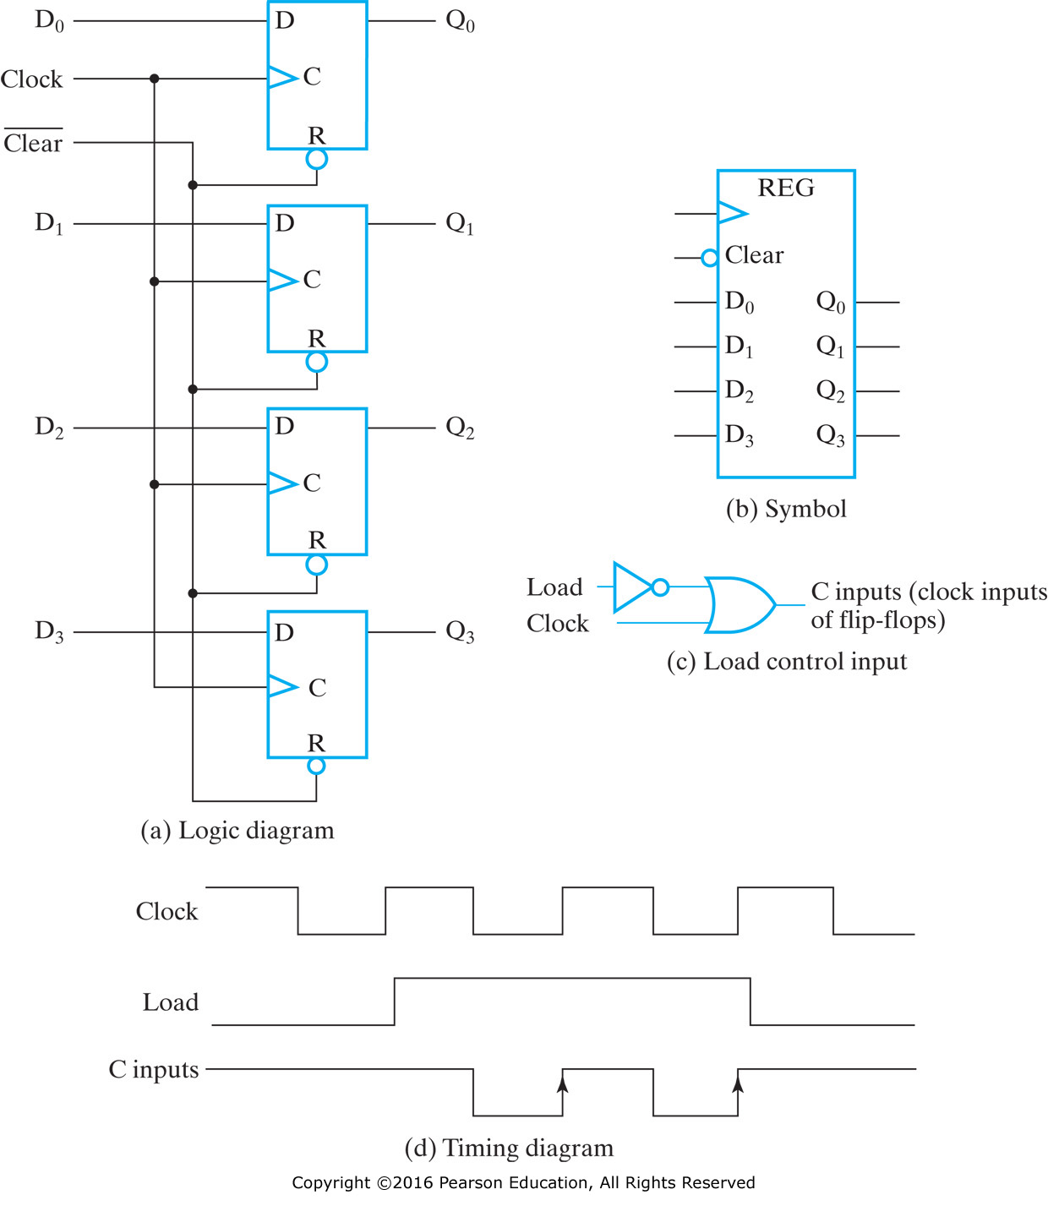
Example of 4-Bit Register: Clock Gating
Notes:
将新信息传送至寄存器称为寄存器的加载（loading）操作。
如果寄存器中所有位都是在公用时钟脉冲信号下同时加载的，则称这种加载为并行加载。
图c表示用加载控制信号Load和时钟信号组合实现控制时钟脉冲对寄存器影响：C_{input}=~（Load）+ CLK
在寄存器的CLK输入利用逻辑门控制时钟开关，所以称为门控时钟（clock gating）。

Slide 10
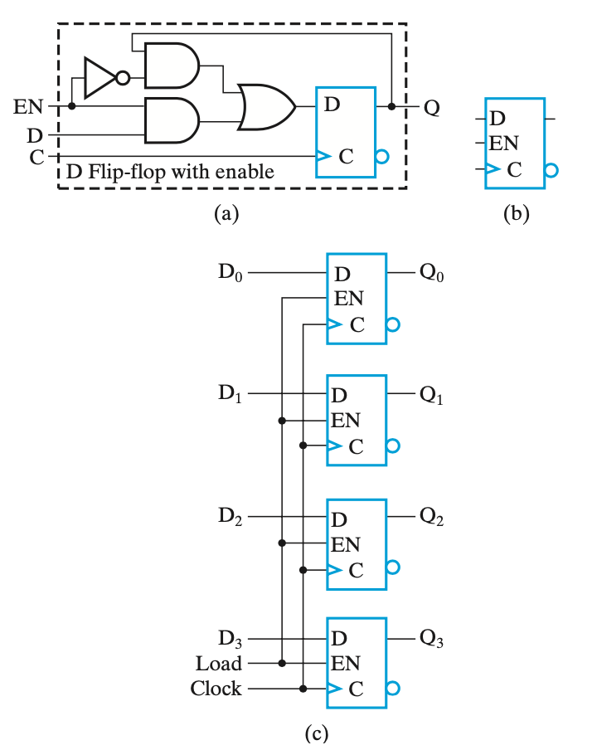
Flip-Flops With EN
Notes:
由于在时钟脉冲路径上插入额外的门，将会在带门控时钟和不带门控时钟的触发器的时钟和输入之间产生不同的传输延迟，导致时钟偏移（clock skew）。
因此对于真正的同步系统而言一般不建议使用门控时钟控制寄存器的工作，否则应控制时钟偏移尽量为0。
Load信号加载到触发器而非CLK。

Slide 11
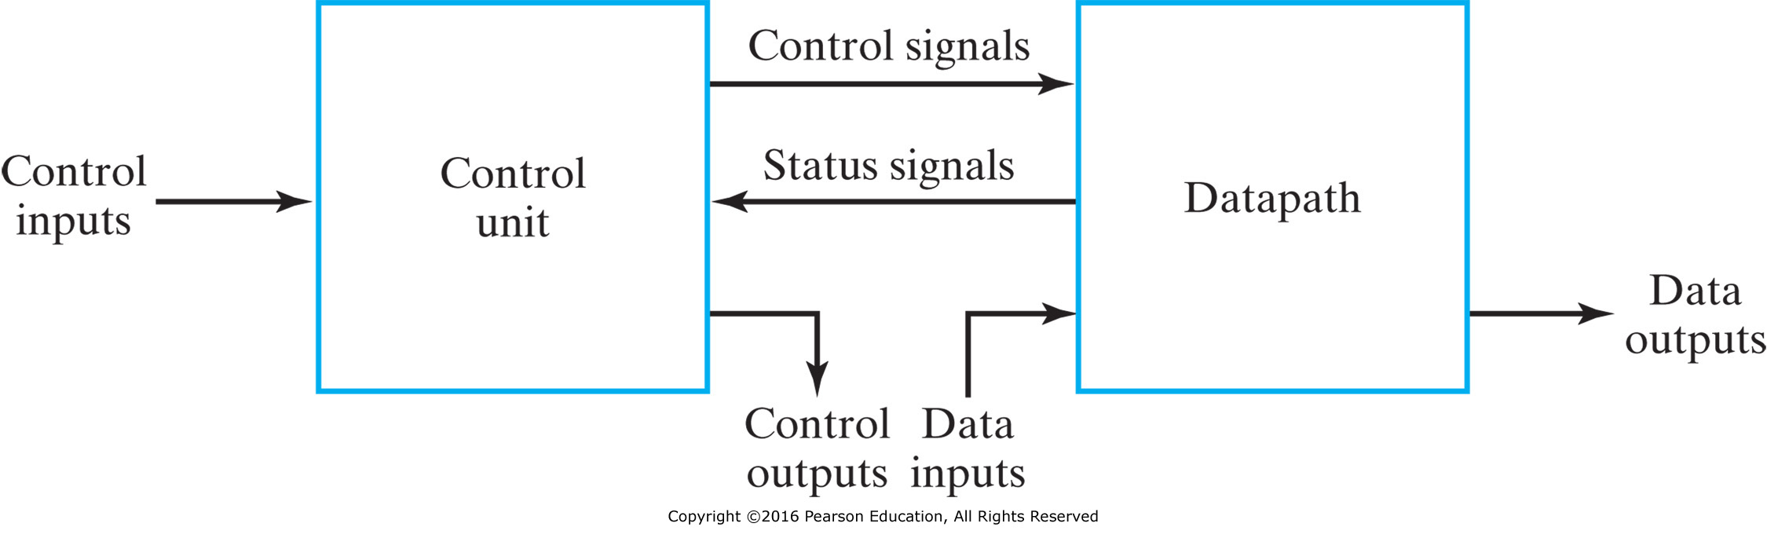
Registers in the Digital System
Two types of modules of a digital system
Datapath: performs data-processing operations
Control unit: determines the sequence of those operations
Datapaths are defined by their registers and the operations performed on binary data stored in the registers.
Examples of register operations are load, clear, shift, and count.
Notes:
数字系统可被划分为两种类型模块：
数据通路：完成数据处理操作
控制单元：决定操作的执行顺序
数据通路由一组寄存器以及对寄存器中所存储的二进制数的操作来定义，包括数据的load、clear、shift and count。
寄存器是数字系统的基本单元，对寄存器中存储的数据进行移动和处理定义为寄存器传输操作

Slide 12
Register Transfers
The registers are assumed to be basic components of the digital system
The movement of the data stored in registers and the processing performed on the data are referred to as register transfer operations, which are specified by the following three basic components:
The set of registers in the system
The operations that are performed on the data stored in the registers
The control that supervises the sequence of operations in the system
Notes:
寄存器是数字系统的基本单元，对寄存器中存储的数据进行移动和处理定义为寄存器传输操作
事实上，任何时序电路的触发器和其相关联的门电路都可以叫做寄存器。

Slide 13
Microoperation
A register has the capability to perform one or more elementary operations such as load, count, add, subtract, and shift
An elementary operation performed on data stored in registers is called a microoperation, e.g.,
Loading the contents of one register into another
Adding the contents of two registers
Incrementing the contents of a register
Four types of most widely used microoperations
Transfer, Arithmetic, Logic and Shift
Notes:
A microoperation is usually performed in parallel on a vector of bits during one clock cycle, while the result may:
Replace the previous binary data in the register
Be transferred to another register, leaving the previous data unchanged

Slide 14
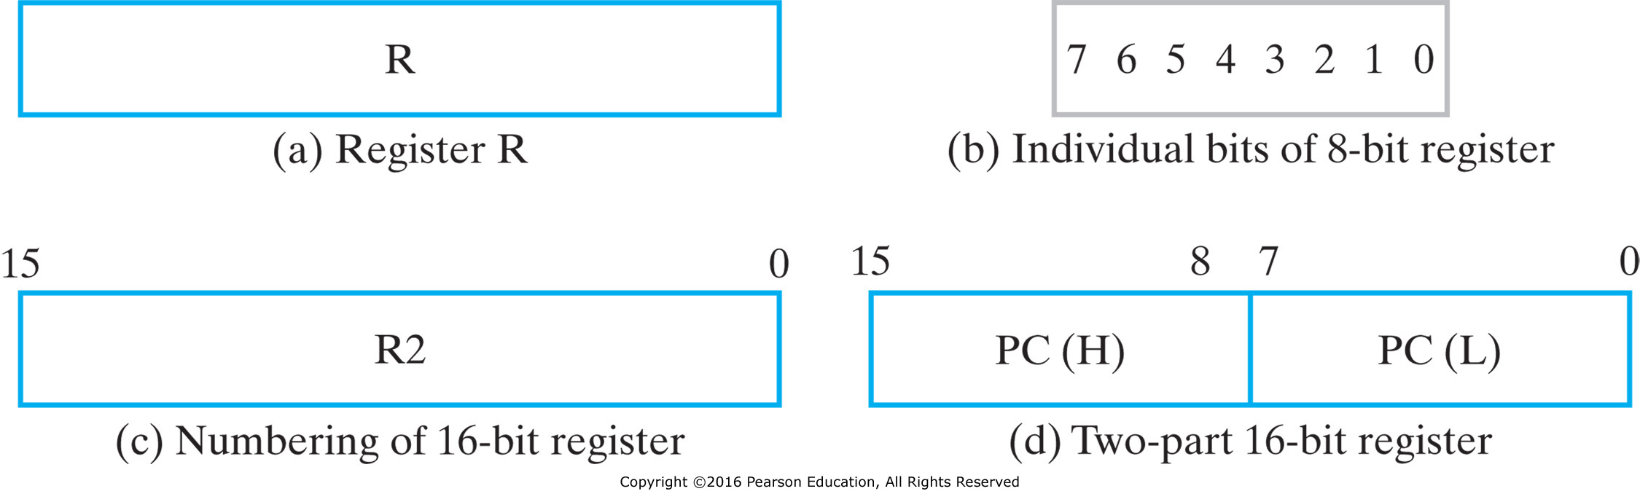

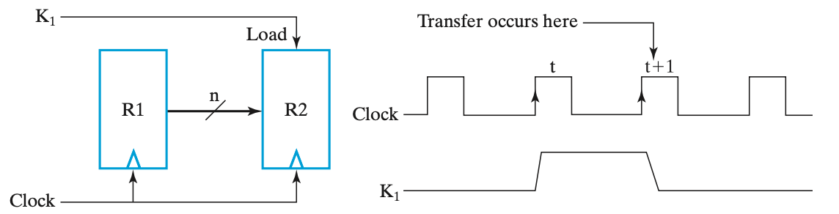
Register Representation
Notes:
R1和R2之间存在数据通路，且目的寄存器具有并行加载的能力。

Slide 15
Register Transfer Structures
Multiplexer-Based Transfers - Multiple inputs are selected by a multiplexer dedicated to the register, e.g.,
Shift registers
Counters
Bus-Based Transfers - Multiple inputs are selected by a shared multiplexer driving a bus that feeds inputs to multiple registers
Three-State Bus - Multiple inputs are selected by 3-state drivers with outputs connected to a bus that feeds multiple registers
Other Transfer Structures - Use multiple multiplexers, multiple buses, and combinations of all the above
Notes:
不同寄存器之间传输数据更为有效的方案时总线（bus），共享传输通路。
1. 专用多路复用器 vs. 单总线：总线减少了多路复用器，减少了门单元的数量（如三路硬件开销降低一半）
2. 多路复用器总线 vs. 三态总线：三态总线更容易构建具有多个数据源的总线，且数据连接数目减半，此外，三态总线信号可以双向传输，因此使用较多。

Slide 16
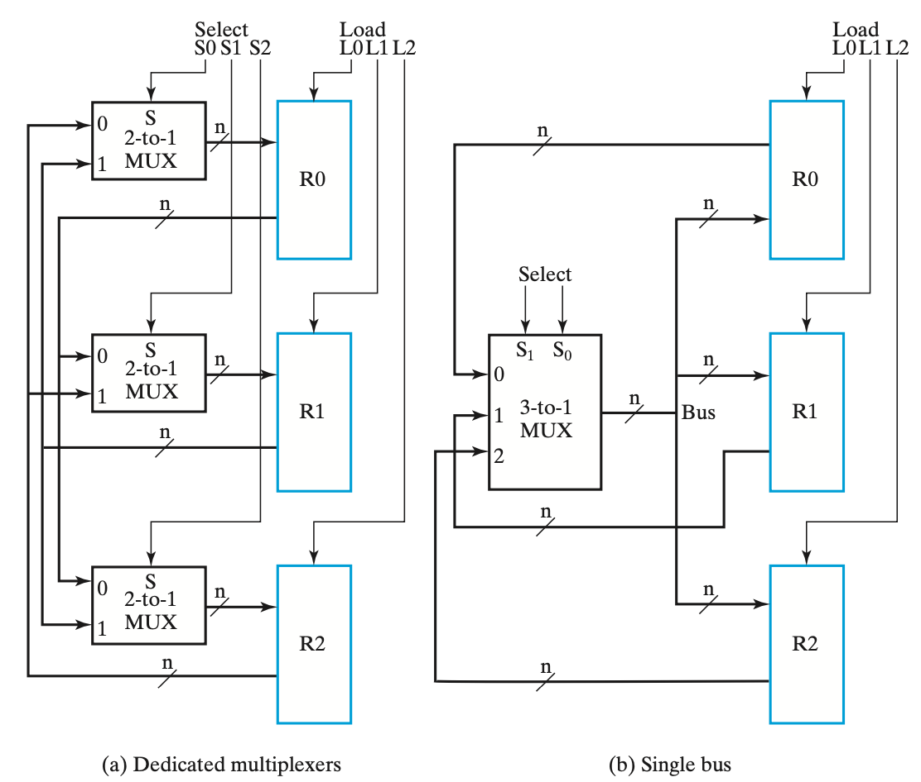
Dedicated Multiplexers vs. Single Bus
Notes:
不同寄存器之间传输数据更为有效的方案时总线（bus），共享传输通路。
1. 专用多路复用器 vs. 单总线：总线减少了多路复用器，减少了门单元的数量（如三路硬件开销降低一半）
2. 多路复用器总线 vs. 三态总线：三态总线更容易构建具有多个数据源的总线，且数据连接数目减半，此外，三态总线信号可以双向传输，因此使用较多。

Slide 17
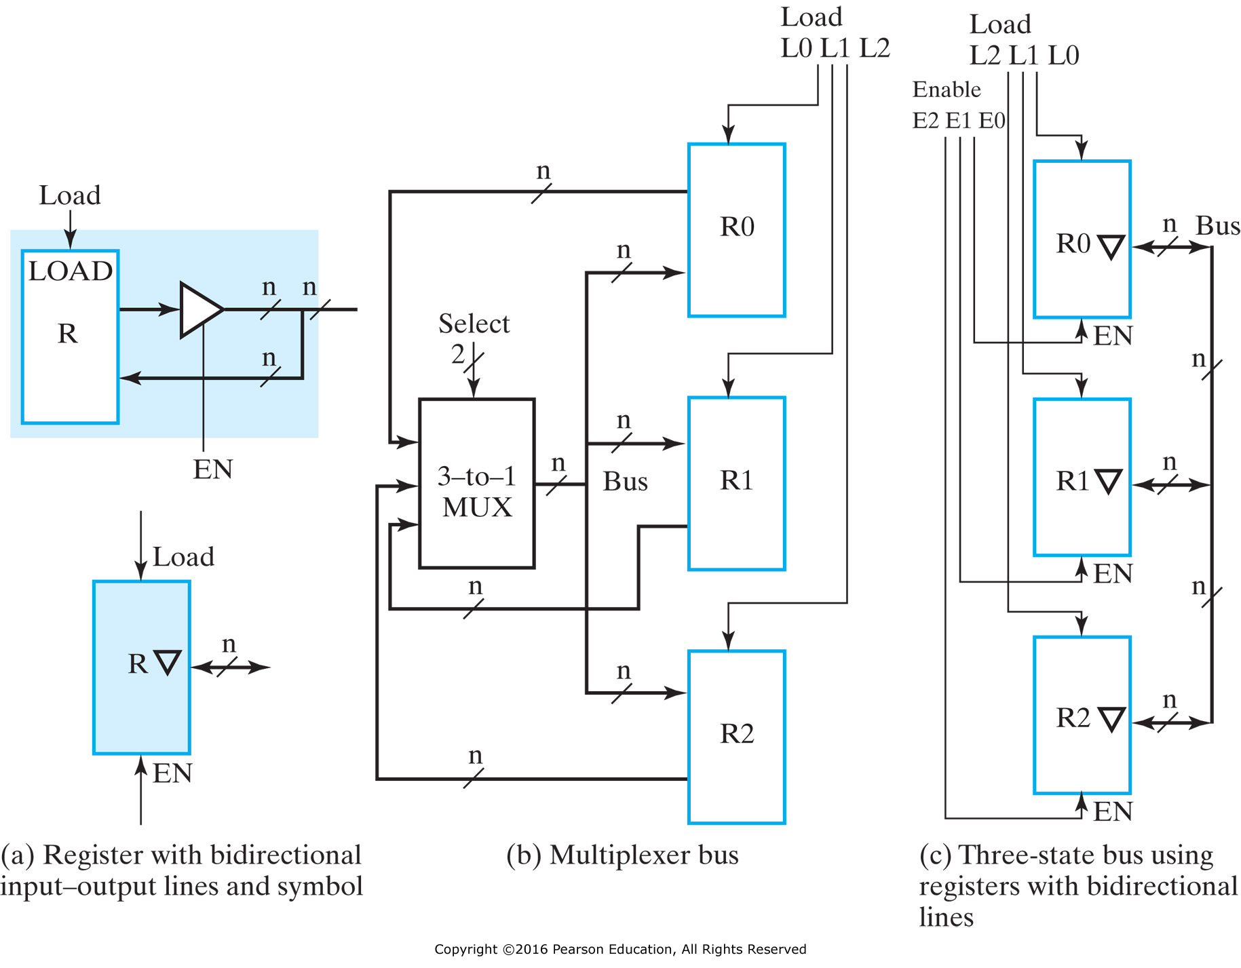
Multiplexer Bus vs. 3-State Bus
Notes:
不同寄存器之间传输数据更为有效的方案时总线（bus），共享传输通路。
1. 专用多路复用器 vs. 单总线：总线减少了多路复用器，减少了门单元的数量（如三路硬件开销降低一半）
2. 多路复用器总线 vs. 三态总线：三态总线更容易构建具有多个数据源的总线，且数据连接数目减半，此外，三态总线信号可以双向传输，因此使用较多。

Slide 18
Shift Registers
A register capable of shifting its stored bits laterally in one or both directions is called a shift register
Shift Registers move data laterally within the register toward its MSB or LSB position
In the simplest case, the shift register is simply a set of D flip-flops connected in a row like this:
Data input, In, is called a serial input or the shift right input
Data output, Out, is often called the serial output
The vector (A, B, C, Out) is called the parallel output if they can be accessed in parallel
Notes:
具有单向或双向移动存储数据的寄存器称作移位寄存器。
一个移位寄存器由一系列触发器构成，每个输出连接下一个输入，所有都是用相同的时钟脉冲输入来触发移位操作。
如果所有触发器的输出都是可访问的，那么串行移位操作进入的信息可以并行读出。

Slide 19
Shift Registers (cont’d)
The behavior of the serial shift register is given in the listing on the lower right
T0 is the register state just before the first clock pulse occurs
T1 is after the first pulse and before the second.
Initially unknown states are denoted by “?”
Complete the last three rows of the table
In
A
B
C
Out
D
Q
D
Q
D
Q
D
Q
Clock CP
CP
In
A
B
C
Out
T0
0
?
?
?
?
T1
1
0
?
?
?
T2
1
1
0
?
?
T3
0
1
1
0
?
T4
1
T5
1
T6
1
Notes:
Row T4: 10110
Row T5: 11011
Row T6: 11101

Slide 20
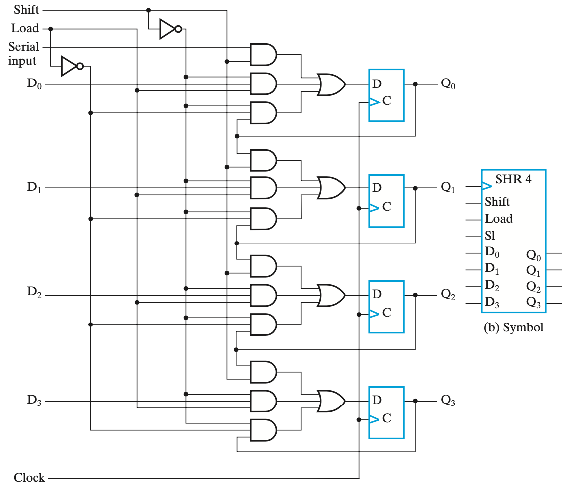
Shift Register with Parallel Load

Slide 21
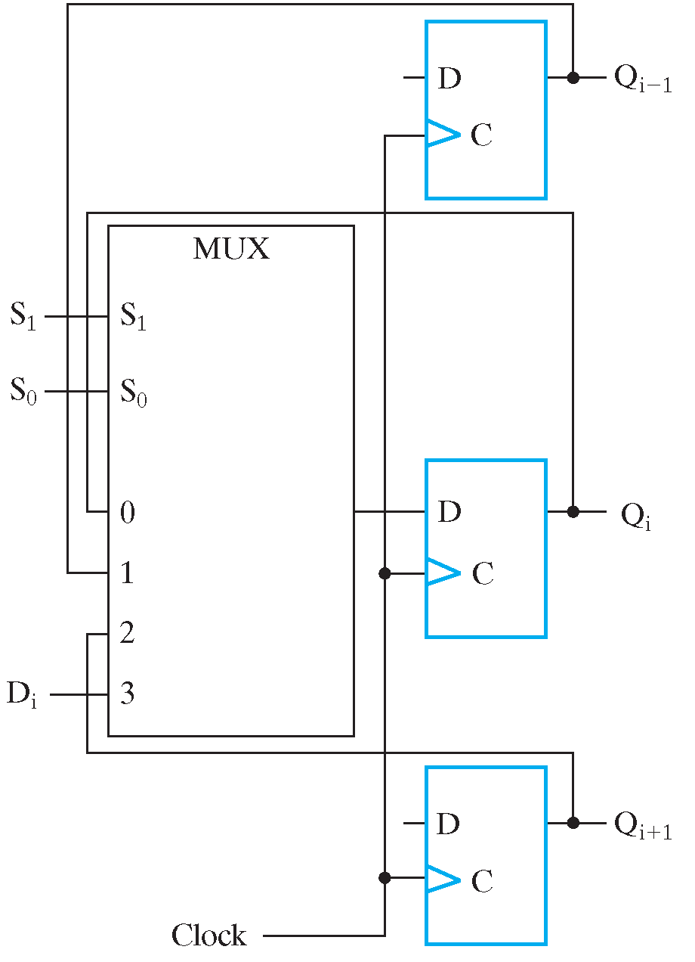
Shift Registers with Additional Functions
By placing a 4-input multiplexer in front of each D flip-flop in a shift register, we can implement a circuit with shifts right, shifts left, parallel load, hold.
Shift registers can also be designed to shift more than a single bit position right or left
Shift registers can be designed to shift a variable number of bit positions specified by a variable called a shift amount.

Slide 22
Classic Sequential Logic Elements
Registers
Basic introduction
Registers in the digital system
Shift Registers
Counters
Basic introduction
Ripple Counters
Synchronous Counters

Slide 23
Counters
Counters are sequential circuits which "count" through a specific state sequence. They can count up, count down, or count through other fixed sequences.
The state, or the flip-flop values themselves, serves as the “output.”
The output value increases by one on each clock cycle. After the largest value, the output “wraps around” back to 0.
Using two bits, we’d get something like this:
1
00
01
1
1
1
11
10
Notes:
计数器是一种对外部信号进行总数统计的时序逻辑元件，一般从0开始计数，达到最大计数值时输出一次计数完成（满值）信号，并重新开始计数，最大计数值为计数器的模。
从有限状态机的角度看，计数器就是一个状态链构成的环，在外部信号的驱动下，从当前状态转移到下一状态，满值后再回到初态，继续计数。

Slide 24
Counters (cont’d)
Counters can act as simple clocks to keep track of “time.”
You may need to record how many times something has happened.
How many bits have been sent or received?
How many steps have been performed in some computation?
All processors contain a program counter, or PC.
Programs consist of a list of instructions that are to be executed one after another (for the most part).
The PC keeps track of the instruction currently being executed.
The PC increments once on each clock cycle, and the next program instruction is then executed.

Slide 25
Counters (cont’d)
Two distinct types are in common usage:
Ripple Counters
Clock connected to the flip-flop clock input on the LSB bit flip-flop
For all other bits, a flip-flop output is connected to the clock input, thus circuit is not truly synchronous!
Output change is delayed more for each bit toward the MSB.
Resurgent because of low power consumption
Synchronous Counters
Clock is directly connected to the flip-flop clock inputs
Logic is used to implement the desired state sequencing
Notes:
Ripple counter：（异步）行波计数器，时钟连接低位（LSB），进位像波浪一样从低位向高位串行传送，本质上是一种异步时序逻辑电路；
串行变化延迟较长，如从1111变为0000，触发器状态反转过程串行从0-bit到3-bit，因此，外部时钟信号的宽度必须根据最长的延迟时间进行设计，行波计数器工作频率较慢。

Slide 26
Ripple Counters
When there is a positive edge on the clock input of A, A complements
The clock input for flip-flop B is the complemented output of flip-flop A
When flip A changes from 1 to 0, there is a positive edge on the clock input of B causing B to complement
D
A
Clock
C_{R}
D
B
C_{R}
Reset
CP
A
B
0
1
2
3
0
1
Notes:
A 0 -> 1: 01
A 1 -> 0, B 0 -> 1: 10
A 0 -> 1: 11
A 1 -> 0, B 1 -> 0: 00

Slide 27
Ripple Counters (cont’d)
The arrows show the cause-effect relation- ship from the prior slide =>
The corresponding sequence of states => (B,A) = (0,0), (1,0), (1,1), (0,0), (0, 1), …
Each additional bit, C, D, …behaves like bit B, changing half as frequently as the bit before it.
For 3 bits: (C,B,A) = (0,0,0), (0,0,1), (0,1,0), (0,1,1), (1,0,0), (1,0,1), (1,1,0), (1,1,1), (0,0,0), …
CP
A
B
0
1
2
3
0
1

Slide 28
Ripple Counters (cont’d)
These circuits are called ripple counters because each edge sensitive transition (positive in the example) causes a change in the next flip-flop’s state.
The changes “ripple” upward through the chain of flip-flops, i. e., each transition occurs after a clock-to-output delay from the stage before.
To see this effect in detailed look at the waveforms on the next slide.

Slide 29
Ripple Counters (cont’d)
Starting with C = B = A = 1, equivalent to (C,B,A) = 7 base 10, the next clock increments the count to (C,B,A) = 0 base 10. In fine timing detail:
The clock to output delay t_{PHL} causes an increasing delay from clock edge for each stage transition.
Thus, the count “ripples” from least to most significant bit.
For n bits, total worst case delay is n∙t_{PHL}
tPHL
CP
tPHL
A
tpHL
B
C

Slide 30
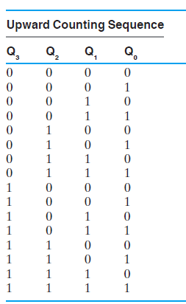
Synchronous Counters
To eliminate the "ripple" effects, use a common clock for each flip-flop and a combinational circuit to generate the next state.
For an up-counter, use an incrementer
Incre-menter
A3
S3
D3
Q3
A2
S2
D2
Q2
A1
S1
D1
Q1
A0
S0
D0
Q0
Clock
Notes:
也有向下的计数器，从15->0

Slide 31
Synchronous Counters (cont’d)
Internal details =>
Internal Logic
XOR complements each bit
AND chain causes complement of a bit if all bits toward LSB from it equal 1
Count Enable
Forces all outputs of AND chain to 0 to “hold” the state
Carry Out
Added as part of incrementer
Connect to Count Enable of additional 4-bit counters to form larger counters
Incrementer
Notes:
XOR取反，与D触发器连接，等价于T触发器
AND provides information to each stage about the state of the prior stages in the counter

Slide 32
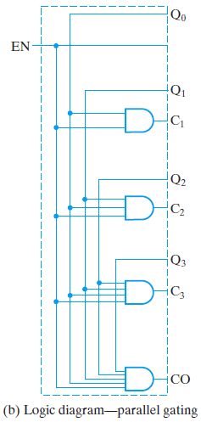
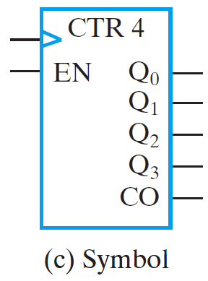
Synchronous Counters (cont’d)
Carry chain
Series of AND gates through which the carry “ripples”
Yields long path delays
Called serial gating
Replace AND carry chain with ANDs => in parallel
Reduces path delays
Called parallel gating
Like carry lookahead
Lookahead can be used on COs and ENs to prevent long paths in large counters
Symbol for synchronous counter

Slide 33
Other Counters
Divide-by-n (Modulo n) Counter
Count is remainder of division by n; n may not be a power of 2 or
Count is arbitrary sequence of n states specifically designed state-by-state
Includes modulo 10 which is the BCD counter
Notes:
Down Counter - counts downward instead of upward
Up-Down Counter - counts up or down depending on value a control input such as Up/Down
Parallel Load Counter - has parallel load of values available depending on control input such as Load

Slide 34
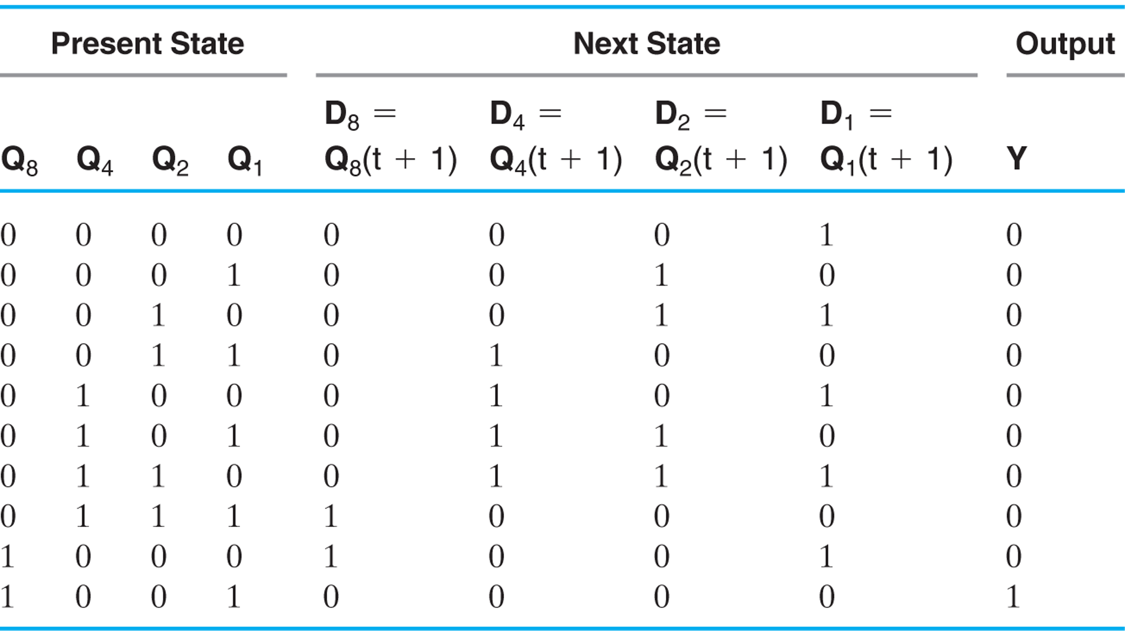
Synchronous BCD with D Flip-Flops
Use the sequential logic model to design a synchronous BCD counter with D flip-flops
Input combinations 1010 through 1111 are don’t cares
Notes:
Y = 0 0 0 0 0 0 0 0 0 1
i.e., 1001 -> 0000, Y = 1

Slide 35
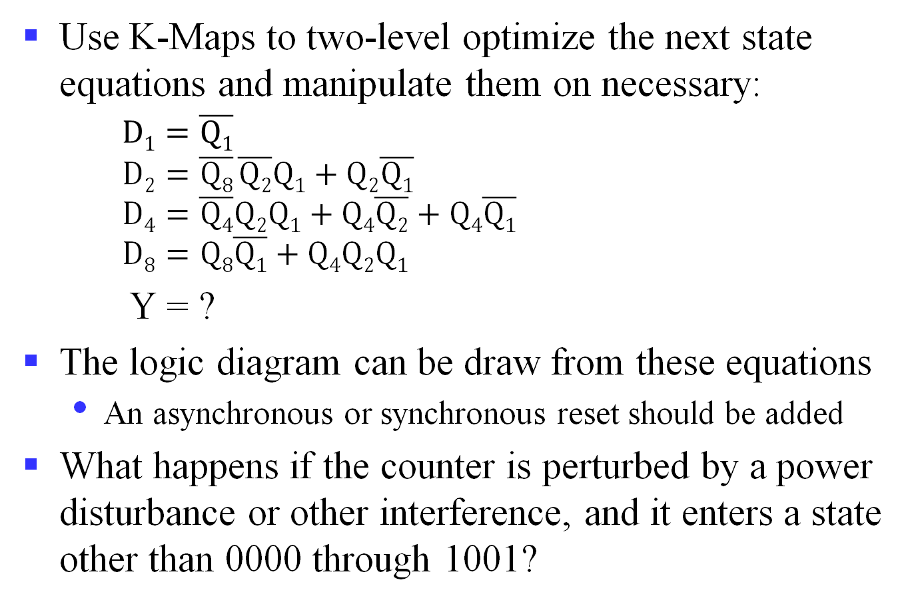
Synchronous BCD with D Flip-Flops (cont’d)
Use K-Maps to two-level optimize the next state equations and manipulate them on necessary: $D1=\overline{Q1}$ $D2=\overline{Q8} \overline{Q2}Q1+Q2\overline{Q1}$ $D4=\overline{Q4}Q2Q1+Q4\overline{Q2}+Q4\overline{Q1}$ $D8=Q8\overline{Q1}+Q4Q2Q1$
Y = ?
The logic diagram can be draw from these equations
An asynchronous or synchronous reset should be added
What happens if the counter is perturbed by a power disturbance or other interference, and it enters a state other than 0000 through 1001?
Notes:
$$y=Q8Q1$$

Slide 36
Synchronous BCD with D Flip-Flops (cont’d)
Find the actual values of the six next states for the don’t care combinations from the equations
Find the overall state diagram to assess behavior for the don’t care states (states in decimal)
0
Present State | Next State
Q₈ Q₄ Q₂ Q₁ | Q₈ Q₄ Q₂ Q₁
1 0 1 0 | 1 0 1 1
1 0 1 1 | 0 1 1 0
1 1 0 0 | 1 1 0 1
1 1 0 1 | 0 1 0 0
1 1 1 0 | 1 1 1 1
1 1 1 1 | 0 0 1 0
9
1
14
8
2
15
12
7
11
13
3
6
10
4
5

Slide 37
Synchronous BCD with D Flip-Flops (cont’d)
For the BCD counter design, if an invalid state is entered, return to a valid state occurs within two clock cycles
Is this adequate? If not:
Is a signal needed that indicates that an invalid state has been entered? What is the equation for such a signal?
Does the design need to be modified to return from an invalid state to a valid state in one clock cycle?
Does the design need to be modified to return from an invalid state to a specific state (such as 0)?
The action to be taken depends on:
The application of the circuit
Design group policy
Notes:
Error = Q8 Q4 + Q8 Q2

Slide 38
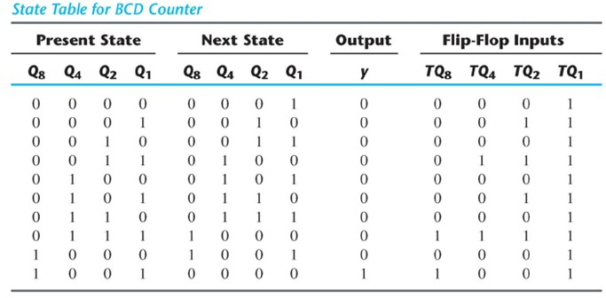
Synchronous BCD with T Flip-Flops
Use the sequential logic model to design a synchronous BCD counter with T flip-flops
Input combinations 1010 through 1111 are don’t cares
What about the equations?
Notes:
T_{Q1} = 1
T_{Q2} = $\overline{Q8} Q1$
T_{Q4} = Q₂Q₁
T_{Q8} = Q₈Q₁ + Q₄Q₂Q₁
y = Q₈Q₁
4 T flip-flops, 4 AND gates and 1 OR gate

