Slide 1
Computational Operations & Units
Lei Wu
Zhejiang University

Slide 2
Disclaimer
Many images and resources used in this lecture are collected from the Internet, and they are used only for the educational purpose. The copyright belong to the original owners, respectively.
Part of slides credit to
David Money Harris and Sarah L. Harris. Digital Design and Computer Architecture, 2nd Edition.
Morris R. Mano , Charles R. Kime and Tom Martin. Logic & Computer Design Fundamentals, Fifth Edition.
EECC 341, Prof. Muhammad Shaaban @ Rochester Institute of Technology

Slide 3
Overview
Basic computational units
Fixed number operations
Addition & Subtraction
Arithmetic logic unit (ALU)
Fixed number operations
Multiplication & Division

Slide 4
Overview
Basic computational units
Fixed number operations
Addition & Subtraction
Arithmetic logic unit (ALU)
Fixed number operations
Multiplication & Division

Slide 5
1-Bit Adders
Notes:
C_{out} = AB + (A^B)C_{in}

Slide 6
Multibit Carry Propagate Adders (CPA)
Types of CPA
Ripple-carry (slow)
Carry-lookahead (fast)
Prefix (faster)
Carry-lookahead and prefix adders faster for large adders but require more hardware
Symbol
Notes:
CRA: 行波进位加法器（串行）
CLA：先行进位加法器（并行）
Prefix：前缀加法器
几乎所有的算术运算都要用到ALU，ALU的核心是加法器，所以加法器的速度是提高运算速度的关键。
串行有依赖关系，并行消除依赖关系。

Slide 7
Ripple-Carry Adder (RCA)
Chain 1-bit adders together
Carry ripples through entire chain
Disadvantage: slow

Slide 8
Ripple-Carry Adder Delay
t_{ripple} = Nt_{FA}
t_{FA}: delay of a 1-bit full adder

Slide 9
Carry-Lookahead Adder (CLA)
E.g., a 4-bit adder
C₁ = A₀B₀ + (A₀ + B₀) C₀
C₂ = A₁B₁ + (A₁ + B₁) C₁
= A₁B₁ + (A₁ + B₁) A₀B₀ + (A₁ + B₁)(A₀ + B₀) C₀
C₃ = A₂B₂ + (A₂ + B₂) C₂
= A₂B₂ + (A₂ + B₂) A₁B₁ + (A₂ + B₂)(A₁ + B₁)A₀B₀ + (A₂ + B₂)(A₁ + B₁)(A₀ + B₀) C₀
C₄ = A₃B₃ + (A₃ + B₃) C₃
= A₃B₃ + (A₃ + B₃) A₂B₂ + (A₃ + B₃)(A₂ + B₂)A₁B₁ + (A₃ + B₃) (A₂ + B₂)(A₁ + B₁)A₀B₀ + (A₃ + B₃)(A₂ + B₂)(A₁ + B₁)(A₀ + B₀) C₀
Notes:
观察一下进位的计算，由两部分构成：
A_{i}B_{i}进位生成：A_{i}B_{i}均为1，不管有无低位的进位输入，本位一定向高位产生进位；
A_{i} + B_{i}进位传递：A_{i}B_{i}有一个为1，若有低位进位输入，则一定被传递到高位；

Slide 10
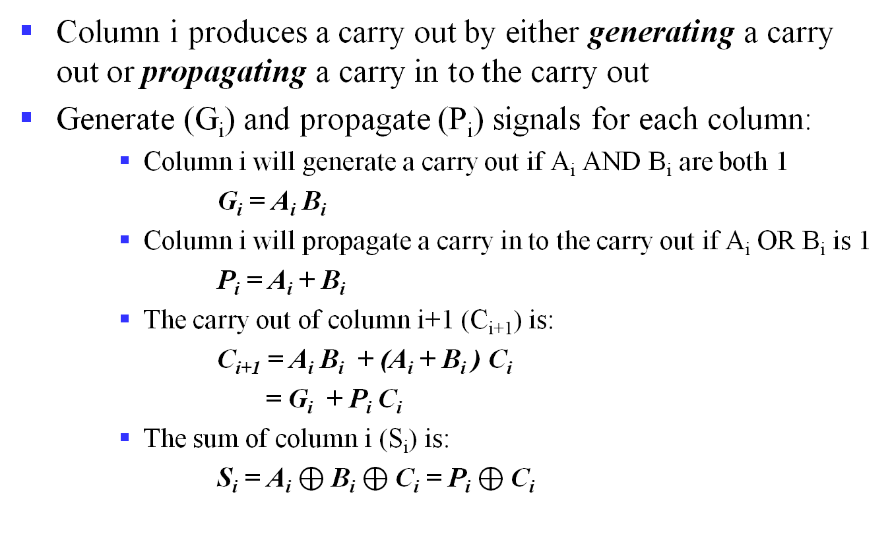
Carry-Lookahead Adder: Bit Level
Column i produces a carry out by either generating a carry out or propagating a carry in to the carry out
Generate (G_{i}) and propagate (P_{i}) signals for each column:
Column i will generate a carry out if A_{i} AND B_{i} are both 1
G_{i} = A_{i} B_{i}
Column i will propagate a carry in to the carry out if A_{i} OR B_{i} is 1
P_{i} = A_{i} + B_{i}
The carry out of column i+1 (C_{i+1}) is:
C_{i+1} = A_{i} B_{i} + (A_{i} + B_{i} ) C_{i}
= G_{i} + P_{i} C_{i}
The sum of column i (S_{i}) is:
S_{i} = A_{i} $⊕$B_{i} $⊕$C_{i} = P_{i} $⊕$C_{i}
Notes:
观察一下进位的计算，由两部分构成：
G_{i}进位生成函数
P_{i}进位传递函数
实现C_{i}逻辑表达式的电路称为先行进位部件，即CLU(Carry-Lookahead Unit)

Slide 11
Revisit the 4-Bit Adder
Compute carry out (C_{out}) for 4-bit blocks using generate and propagate signals
C₁ = G₀ + P₀C₀
C₂ = G₁ + P₁C₁
= G₁ + P₁ (G₀ + P₀C₀)
= G₁ + P₁G₀ + P₁ P₀C₀
C₃ = G₂ + P₂C₂
= G₂ + P₂ (G₁ + P₁G₀ + P₁P₀C₀)
= G₂ + P₂G₁ + P₂P₁G₀ + P₂P₁P₀C₀
C₄ = G₃ + P₃C₃
= G₃ + P₃ (G₂ + P₂G₁ + P₂P₁G₀ + P₂P₁P₀C₀)
= G₃ + P₃G₂ + P₃P₂G₁ + P₃P₂P₁G₀ + P₃P₂P₁P₀C₀

Slide 12
4-Bit CLA
Partial full adder

Slide 13
Carry-Lookahead Addition: Block/Group Level
The 4-bit CLA could be extended to more than four bits, however, in practice, due to limited gate fan-in, such extension is not feasible.
Instead, the concept is extended another level by considering group generate (G₃₋₀) and group propagate (P₃₋₀) functions:
G_{3:0} = G₃ + P₃(G₂ + P₂(G₁ + P₁G₀))
P_{3:0} = P₃P₂P₁P₀
Using these two equations:
C₄ = G₃ + P₃G₂ + P₃P₂G₁+ P₃P₂P₁G₀ + P₃P₂P₁P₀ C₀
= G_{3:0} + P_{3:0}C₀
Thus, it is possible to have four 4-bit adders use one of the same carry lookahead circuit to speed up 16-bit addition.
Notes:
更多位数的加法器可以通过将更多的CLU和CLA串接起来实现，比如4位一组（块），组内位4位先行进位，组间串行进位。
可以扩展到多位构成的块：如果一个块在不考虑进位输入的情况下也能产生进位输出，称其产生进位；如果一个块在有进位输入时能产生进位，称其传播进位。
有如下定义：
G_{i:j}：第i位到第j位进位生成函数，产生一个进位的条件是最高位列产生一个进位或者如果最高位列传递进位而且之前的列产生了进位，如此类推；
P_{i:j}：第i位到第j位进位传递函数，传递条件是块中所有列都能传播进位。

Slide 14
Carry-Lookahead Addition: Block/Group Level (cont’d)
Step 1: compute G_{i} and P_{i} for all columns
Step 2: compute G and P for k-bit blocks
Step 3: C_{in} propagates through each k-bit propagate/generate block
E.g., 4-bit blocks (G3:0 and P3:0) :
G3:0 = G3 + P3(G2 + P2(G1 + P1G0))
P3:0 = P3P2P1P0
Generally, for 4-bit blocks
Gi:j = Gi + Pi (Gi-1 + Pi-1 (Gi-2 + Pi-2Gj )
Pi:j = PiPi-1Pi-2Pj
Cj+1 = Gi:j + Pi:jCj
Notes:
更多位数的加法器可以通过将更多的CLU和CLA串接起来实现，比如4位一组（块），组内位4位先行进位，组间串行进位。
可以扩展到多位构成的块：如果一个块在不考虑进位输入的情况下也能产生进位输出，称其产生进位；如果一个块在有进位输入时能产生进位，称其传播进位。
有如下定义：
G_{i:j}：第j位到第i位进位生成函数，产生一个进位的条件是最高位列产生一个进位或者如果最高位列传递进位而且之前的列产生了进位，如此类推；
P_{i:j}：第j位到第i位进位传递函数，传递条件是块中所有列都能传播进位。

Slide 15
4-Bit CLA (ripple vs look ahead)
C0 – C1 – C2 – C3 – C4
Partial full adder
C0 –C4

Slide 16
Carry-Lookahead Addition: Block/Group Level (cont’d)
Step 1: compute G_{i} and P_{i} for all columns
Step 2: compute G and P for k-bit blocks
Step 3: C_{in} propagates through each k-bit propagate/generate block
Generally, for 4-bit blocks
Gi:j = Gi + Pi (Gi-1 + Pi-1 (Gi-2 + Pi-2Gj )
Pi:j = PiPi-1Pi-2Pj
Cj+1 = Gi:j + Pi:jCj
C₄ = G₃ + P₃G₂ + P₃P₂G₁ + P₃P₂P₁G₀ + P₃P₂P₁P₀C₀= G_{3:0}+ P_{3:0}C₀
C₈ = G₇ + P₇G₆ + P₇P₆G₅ + P₇P₆P₅G₄ + P₇P₆P₅P₄C₄= G_{7:4}+ P_{7:4}C₄
C₁₂ = G₁₁+P₁₁G₁₀+P₁₁P₁₀G₉+P₁₁P₁₀P₉G₈+ P₁₁P₁₀P₉P₈C₈= G_{11:8}+ P_{11:8}C₈
C₁₆ = G₁₅+P₁₅G₁₄+P₁₅P₁₄G₁₃+P₁₅P₁₄P₁₃G₁₂+P₁₅P₁₄P₁₃P₁₂C₁₂= G_{15:12}+ P_{15:12}C₁₂
Notes:
更多位数的加法器可以通过将更多的CLU和CLA串接起来实现，比如4位一组（块），组内位4位先行进位，组间串行进位。
可以扩展到多位构成的块：如果一个块在不考虑进位输入的情况下也能产生进位输出，称其产生进位；如果一个块在有进位输入时能产生进位，称其传播进位。
有如下定义：
G_{i:j}：第i位到第j位进位生成函数，产生一个进位的条件是最高位列产生一个进位或者如果最高位列传递进位而且之前的列产生了进位，如此类推；
P_{i:j}：第i位到第j位进位传递函数，传递条件是块中所有列都能传播进位。

Slide 17
4-Bit Adder vs. 16-Bit Adder
4-bit Adder
16-bit Adder
C₁ = G₀+ P₀C₀
C₂ = G₁+ P₁C₁
C₃ = G₂+ P₂C₂
C₄ = G₃+ P₃C₃
C₄ = G_{3:0}+ P_{3:0}C₀
C₈ = G_{7:4}+ P_{7:4}C₄
C₁₂ = G_{11:8}+ P_{11:8}C₈
C₁₆ = G_{15:12}+ P_{15:12}C₁₂
Exactly the same structure. So CLA could be used to generate Group Carry.
Notes:
可以扩展到多位构成的块：
G_{i:j}：第i位到第j位进位生成函数，生成条件是最高位列产生一个进位或者如果最高位列传递进位而且之前的列产生了进位，如此类推；
P_{i:j}：第i位到第j位进位传递函数，传递条件是块中所有列都能传播进位。

Slide 18
32-bit CLA with 4-bit Blocks

Slide 19
Carry-Lookahead Adder Delay
t_{CLA} = t_{pg} + t_{pg_block} +(N/k - 1) t_{AND_OR} + kt_{FA}
t_{pg}: delay to generate all P_{i}G_{i}
t_{pg_block}: delay of generate all P_{i:j}, G_{i:j}
t_{AND_OR}: delay from C_{in} to C_{out} of final AND/OR gate in k-bit CLA block

Slide 20
Delay: RCA vs. CLA
Gate levels of C_{i} and S_{i}
RCA (2 and 1) vs. CLA (3 and 4)
Different metric types
Only gate levels
All gates share the same cost
With specs
Delay of typical gate X # of gate levels
E.g.,
Carry propagation delay: 12 ns
Sum propagation delay: 15 ns
An N-bit carry-lookahead adder is generally much faster than a ripple-carry adder for N > 16

Slide 21
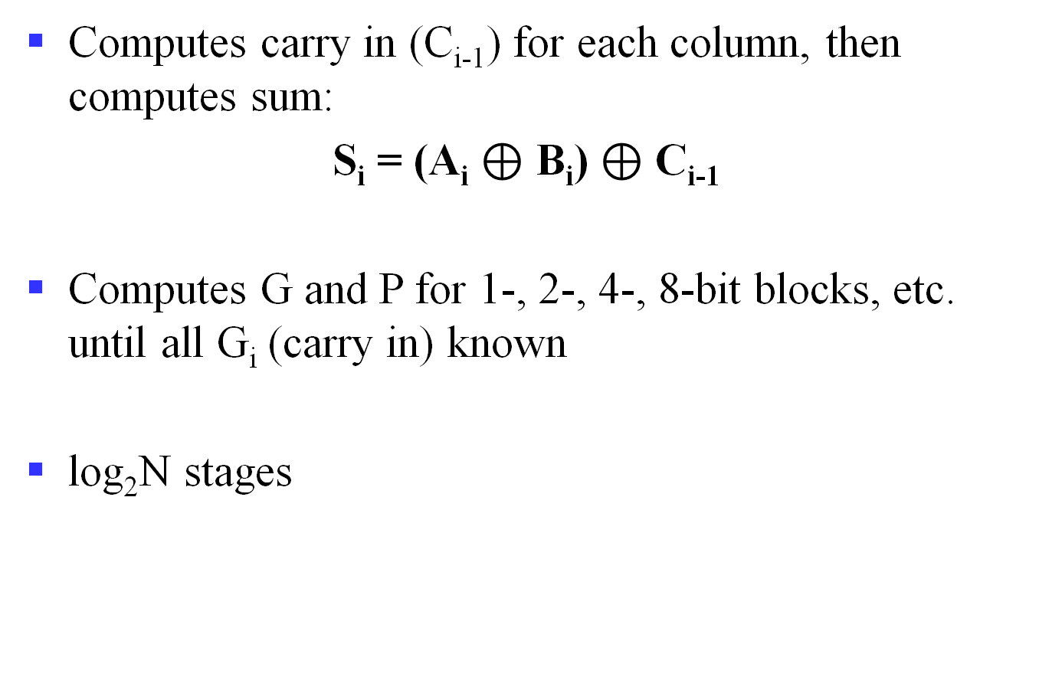
Prefix Adder
Computes carry in (C_{i-1}) for each column, then computes sum:
S_{i} = (A_{i} $⊕$ B_{i}) $⊕$ C_{i-1}
Computes G and P for 1-, 2-, 4-, 8-bit blocks, etc. until all G_{i} (carry in) known
log₂N stages
Notes:
为进一步提高运算速度，可以采用组内和组间都并行的两级先行进位方式。

Slide 22
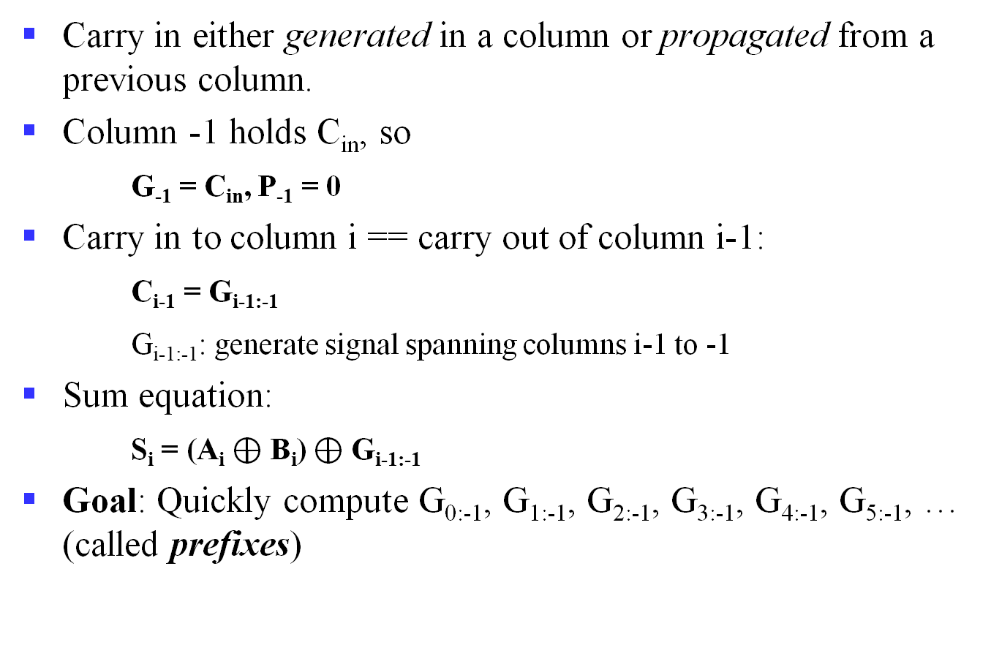
Prefix Adder (cont’d)
Carry in either generated in a column or propagated from a previous column.
Column -1 holds C_{in}, so
G₋₁ = C_{in}, P₋₁ = 0
Carry in to column i == carry out of column i-1:
C_{i-1} = G_{i-1:-1}
G_{i-1:-1}: generate signal spanning columns i-1 to -1
Sum equation:
S_{i} = (A_{i} $⊕$ B_{i}) $⊕$ G_{i-1:-1}
Goal: Quickly compute G_{0:-1}, G_{1:-1}, G_{2:-1}, G_{3:-1}, G_{4:-1}, G_{5:-1}, … (called prefixes)

Slide 23
Prefix Adder (cont’d)
Generate and propagate signals for a block spanning bits i:j:
G_{i:j} = G_{i:k} + P_{i:k} G_{k-1:j}
P_{i:j} = P_{i:k}P_{k-1:j}
In words:
Generate: block i:j will generate a carry if:
upper part (i:k) generates a carry or
upper part propagates a carry generated in lower part (k-1:j)
Propagate: block i:j will propagate a carry if both the upper and lower parts propagate the carry

Slide 24
Prefix Adder Schematic

Slide 25
Prefix Adder Delay
t_{PA} = t_{pg} + log₂N(t_{pg_prefix}) + t_{XOR}
t_{pg}: delay to produce P_{i}G_{i} (AND or OR gate)
t_{pg_prefix}: delay of black prefix cell (AND-OR gate)

Slide 26
Half Subtractor
Subtracting a single-bit binary value Y from anther X (i.e., X -Y ) produces a difference bit D and a borrow out bit B-out.
This operation is called half subtraction and the circuit to realize it is called a half subtractor.
Half Subtractor Truth Table
D = X’Y + XY’
= X ⊕ Y
B-out = X’Y
Inputs
Outputs
X
0
0
1
1
Y
0
1
0
1
D
0
1
1
0
B-out
0
1
0
0
X
Y
Difference D
X
Half
Subtractor
D
Y
B-OUT
B-out
Notes:
HS vs. HA

Slide 27
Full Subtractor
Subtracting two single-bit binary values, Y, B-in from a single-bit value X produces a difference bit D and a borrow out B-out bit. This is called full subtraction.
Difference D
X
XY
Bin
00 01 11 10
0
1
0
2
1
6
4
1
Full Subtractor Truth Table
1
1
3
7
1
5
Bin
Inputs
Outputs
X
0
0
0
0
1
1
1
1
Y
0
0
1
1
0
0
1
1
B-in
0
1
0
1
0
1
0
1
D
0
1
1
0
1
0
0
1
B-out
0
1
1
1
0
0
0
1
Y
D = X’Y’(Bin) + XY’(Bin)’ + XY’(Bin)’ + XY(Bin)
D = X ⊕ Y ⊕ (Bin)
Borrow Bout
X
XY
Bin
00 01 11 10
0
1
0
2
1
6
4
1
1
3
1
7
1
5
Bin
D(X,Y, Bin) = Σ (1,2,4,7)
Bout(X, Y, Bin) = Σ (1,2,3,7)
Y
Bout = X’Y + X’(Bin) + Y(Bin)
Notes:
FS vs. FA
全加器进位
全减器借位

Slide 28
Full Subtractor Circuit Using AND-OR
X
X’
X’Y’Bin
Y’
X
X’
B-in
X’
X’YBin’
Difference D
Y
Y
Y
Y’
B-in’
X
Y
Bin
B-in’
XY’Bin’
Bin
Bin’
X
Y
XYBin
B-in’
X
Y
X’
X’Y
Full
Subtractor
Y
Bout
Bin
X’
X’Bin
Bout
B-in
Y
D
B-in
YBin

Slide 29
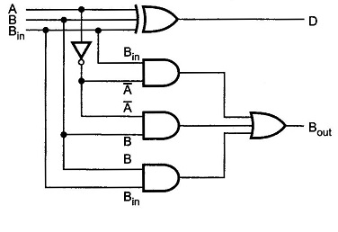
Circuit Using XOR

Slide 30
Implementation of N-bit Subtractors
An n-bit subtractor used to subtract an n-bit number Y from another n-bit number X (i.e., X-Y) can be built in one of two ways:
By using n full subtractors and connecting them in series, creating a borrow ripple subtractor:
Each borrow out B-out from a full subtractor at position j is connected to the borrow in B-in of the full subtractor at the higher position j+1.
By using an n-bit adder and n inverters:
Find 2’s complement of Y by:
Inverting all the bits of Y using the n inverters.
Adding 1 by setting the carry in of the least significant position to 1
The original subtraction (X - Y) now becomes an addition of X to two’s complement of Y using the n-bit adder.
Notes:
2’s complement实现加减法统一

Slide 31
4-bit Borrow Ripple Subtractor
Subtracts two 4-bit numbers:
Y = Y3 Y2 Y1 Y0 from
X = X3 X2 X1 X0
producing the difference D = D3 D2 D1 D0 , B_{out} = B4 from the most significant position j=3
Inputs
X3X2X1X0
Y3Y2Y1Y0
B4
4-bit
Subtractor
Bin
B0 =0
Bout
D3 D2 D1 D0
Difference Output D
Data inputs to be subtracted
X3
Y3
X2
Y2
X1
Y1
X0
Y0
B4
Full
Subtractor
B3
Full
Subtractor
B2
Full
Subtractor
B1
Full
Subtractor
B0 =0
Bout
Bin
Bout
Bin
Bout
Bin
Bout
Bin
D3
D2
D1
D0
Difference output D

Slide 32
4-bit Subtractor Using 4-bit Adder
Inputs to be subtracted
Y3 Y2 Y1 Y0
X3 X2 X1 X0
4-bit
Adder
C4
C-out
C-in
C0 = 1
S3 S2 S1 S0
D3 D2 D1 D0
Difference Output

Slide 33
Overview
Basic computational units
Fixed number operations
Addition & Subtraction
Arithmetic logic unit (ALU)
Fixed number operations
Multiplication & Division

Slide 34
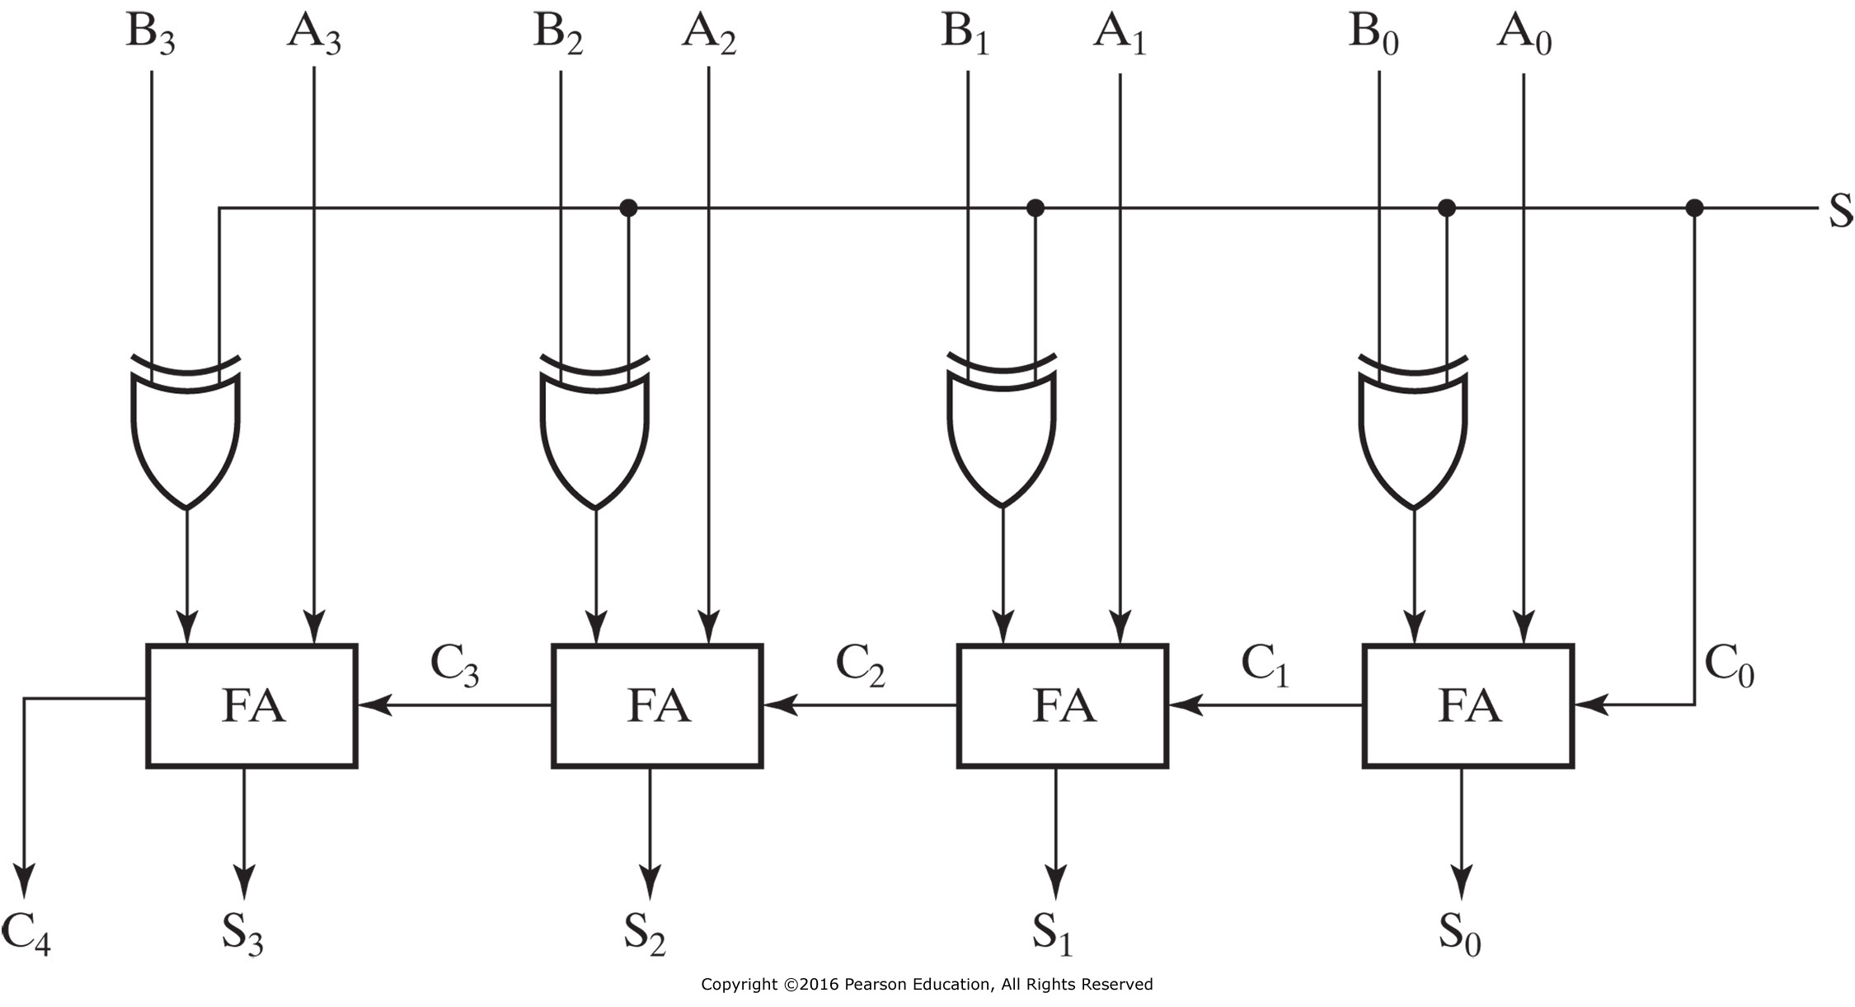
4-Bit Binary Adder-Subtractors
When S=0: Addition (A+B)
When S=1: Subtraction (A+2’s complement of B)
Can be used to add/subtract unsigned numbers and signed 2’s complement numbers

Slide 35
Addition/Subtraction
Both can be handled by using 2’s complement representation
Can achieve a unified implementation
Addition vs. subtraction
Unsigned vs. signed
Corner cases shall be considered
Some important flags

Slide 36
Carry & Overflow
Carry is important when…
Adding or subtracting unsigned integers
Indicates that the unsigned sum is out of range
Either < 0 or > maximum unsigned n-bit value
Overflow is important when…
Adding or subtracting signed integers
Indicates that the signed sum is out of range
Overflow occurs when?
Notes:
广义来讲，carry可被视为unsigned number的overflow
In unsigned magnitude addition
A carry out of the left-most bit is also an overflow
In unsigned magnitude subtraction
Overflow will occur in subtraction if we must borrow prior to the left-most bit

Slide 37
Signed Overflow
With two’s complement and a 4-bit adder, for example, the largest representable decimal number is +7, and the smallest is -8.
What if you try to compute 4 + 5, or (-4) + (-5)?
We cannot just include the carry out to produce a five-digit result, as for unsigned addition. If we did, (-4) + (-5) would result in +23!
Also, unlike the case with unsigned numbers, the carry out cannot be used to detect overflow, by itself
In the example on the left, the carry out is 0 but there is overflow.
Conversely, there are situations where the carry out is 1 but there is no overflow.
0 1 0 0 (+4)
+ 0 1 0 1 (+5)
0 1 0 0 1 (-7)
1 1 0 0 (-4)
+ 1 0 1 1 (-5)
1 0 1 1 1 (+7)

Slide 38
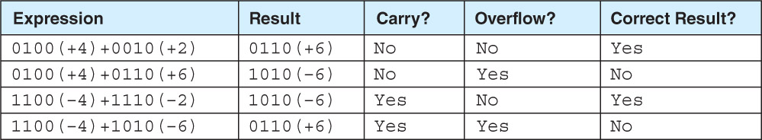
How to Detect Signed Overflow?
The impact of carry and overflow
The easiest way to detect signed overflow is to look at all the sign bits.
Examples of four signed additions
0 1 0 0 (+4)
+ 0 1 0 1 (+5)
0 1 0 0 1 (-7)
1 1 0 0 (-4)
+ 1 0 1 1 (-5)
1 0 1 1 1 (+7)
Notes:
1111 + 0001 = 0000 should set carry (15 + 1 = 0 is false) and clear overflow (-1 + 1 = 0 is true).
0111 + 0010 = 1001 should clear carry (7 + 2 = 9 is true) and set overflow (7 + 2 = -7 is false).
1001 + 1001 = 0010 should set both (9 + 9 = 2 and -7 + -7 = 2 are both false).

Slide 39
Detecting Signed Overflow
Overflow occurs only in the two situations:
Adding two positive numbers and the sum is negative
Adding two negative numbers and the sum is positive
Can happen because of the fixed number of sum bits
Overflow cannot occur if you add a positive number to a negative number. Do you see why?
In two’s complement addition/subtraction
If the two numbers have the same sign bit and the sum/difference has a different sign bit, then overflow
Or, if the carry out flags of the sign bit and the highest value bit are different

Slide 40
Important Flags
Zero flag (ZF)
ZF = 1 means the result is 0
Valid for both unsigned and signed operations
Sign flag (SF/NF)
The sign of the result, i.e., S_{n-1}
Valid for signed operations
Carry/borrow flag (CF)
If CF = 1
Carry for addition, i.e., C_{out}
Borrow for subtraction, i.e., ~C_{out}
Valid for unsigned operations
Overflow flag (OF)
Valid for signed operations
Notes:
零标志：ZF = 1 if and only if S = 0
符号标志：SF= S_{n-1}
进位/借位标志：CF = C_{out} ^ C_{in}，即C_{in}=0时，CF为进位C_{out}；反之，CF为进位C_{out}取反。
溢出标志：OF = C_{out} ^ C_{n-1}
C_{out}即C_{n}

Slide 41
Adders with Flags
ZF, SF, CF and OF
Symbol
SF
ZF
CF
OF
Notes:
零标志：ZF = 1 if and only if S = 0
符号标志：SF= S_{n-1}
进位/借位标志：CF = C_{out} ^ C_{in}，即C_{in}=0时，CF为进位C_{out}；反之，CF为进位C_{out}取反。
溢出标志：OF = C_{out} ^ C_{n-1}
C_{out}即C_{n}

