Slide 1
Instruction Set Architecture
Lei Wu
Zhejiang University

Slide 2
Disclaimer
Many images and resources used in this lecture are collected from the Internet, and they are used only for the educational purpose. The copyright belong to the original owners, respectively.
Part of slides credit to
David Money Harris and Sarah L. Harris. Digital Design and Computer Architecture, 2nd Edition.
ECE C61, Prof. Alok N. Choudhary @ Northwestern University
Computer Organization, Prof. Sukumar Ghosh @ University of Iowa
ECE 4100/6100, Prof. Hsien-Hsin Sean Lee @ Georgia Institute of Technology

Slide 3
Overview
Introduction to ISA
About ISA design

Slide 4
Overview
Introduction to ISA
About ISA design

Slide 5
Instruction Set Architecture (ISA)
Application
Compiler / Libraries of Macros and Procedures
Software
Operating System (OS)
Instruction Set Architecture (ISA)
Computer Organization (Micro Architecture)
Register Transfer Level (RTL)
Hardware
Digital Logic Circuit (DLC)
Device Technology
Notes:
Computer organization includes the high-level aspects of a design, such as the memory system, the bus structure, and the design of the internal CPU (where arithmetic, logic, branching and data transfers are implemented).
Computer hardware refers to the specifics of a machine, included the detailed logic design and the packaging technology of the machine.
Computer architects must design a computer to meet functional requirements as well as price, power, and performance goals. Often, they also have to determine what the functional requirements are, which can be a major task.
Desktop computers: focus on optimizing cost-performance as measured by a single user, with little regard for program size or power consumption,
Server computers – focus on availability, scalability, and throughput cost-performance,
Embedded computers – driven by price and often power issues, plus code size is important.

Slide 6
What is An Instruction?
Instruction = opcode + operands
Elements of an instruction
Operation code (Opcode)
Do this
Source Operand reference(s)
To this
Result Operand reference(s)
Put the answer here
Next Instruction Reference
When you are done, do this instruction next
Notes:
操作数和地址码

Slide 7
Where Are the Operands?
Main memory
CPU register
I/O device
In instruction itself
To specify which register, which memory location, or which I/O device, we’ll need some addressing scheme for each
Notes:
Stack also belongs to the memory

Slide 8
Instruction Formats
Instruction length
Whether short, long, or variable
Number of operands
3/2/1/0
Number of addressable registers
Memory organization
Whether byte- or word addressable
Addressing modes
Choose any or all: direct, indirect or indexed

Slide 9
Instruction Set
The complete collection of instructions that are understood by a CPU
The instruction set is ultimately represented in binary machine code also referred to as object code
Usually represented by assembly code to human programmer

Slide 10
Instruction Set Architecture (ISA)
The physical hardware that is controlled by the instructions is referred to as the Instruction Set Architecture (ISA)
One can think of an ISA as a hardware functionality of a given computer.
ISA refers to the actual programmer visible machine interface such as instruction set, registers, memory organization and exception (i.e., interrupt) handling.
Also called (computer) architecture
Implementation --> actual realization of ISA
ISA can have multiple implementations
ISA allows software to direct hardware
ISA defines machine language
Notes:
指令集体系结构是一台计算机的抽象模型（即计算机的“功能规范说明书“），可简称为指令系统：
1. 从硬件设计角度看，指令系统规定了一台计算机需要具备的基本功能，软件将使用这些功能对计算机的行为进行控制；
2. 从软件编程角度看，指令系统定义了系统程序员为了对计算机硬件进行编程而需要了解的所有内容。

Slide 11
Instruction Set Architecture (ISA)
Specification of a microprocessor design
The ISA defines the CPU, or a CPU family (e.g., x86)
Not only a collection of instructions,
Includes the CPU view of memory, registers number and roles, etc.
ISA ≠ CPU architecture (μ-architecture)
E.g., x86: Xeon ≠ Celeron, same ISA
Interface between user and machine’s functionality
The ISA is the contract between s/w and h/w
High level language code : C, C++, Java, Fortran,
compiler
Assembly language code: architecture specific statements
assembler
Machine language code: architecture specific bit patterns
software
instruction set
hardware
Notes:
指令系统位于软硬件之间的交界，是构成程序的基本元素，也是硬件设计的依据，衡量硬件的性能，反映硬件对软件的支持程度，其设计的好坏直接决定计算机的性能和成本，极其重要。
Serves as an interface between software and hardware.
Provides a mechanism by which the software tells the hardware what should be done.
The word “µarch” with ‘µ’ is a Greek letter pronounced as “mu” which scientifically represents the term “micro”. Thus, it combinedly formed micro + architecture. However, some keyboard doesn’t have ‘µ’ letter in it, so for sake of easiness, it is also called as “uarch”

Slide 12
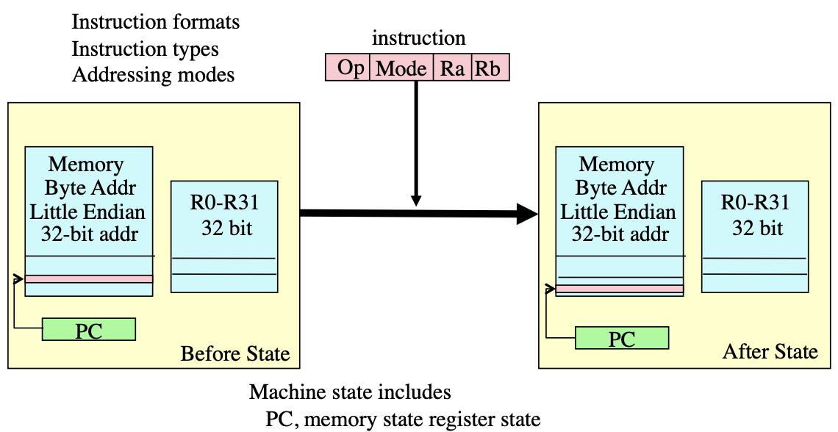
ISA Specifies How the Computer Changes State

Slide 13
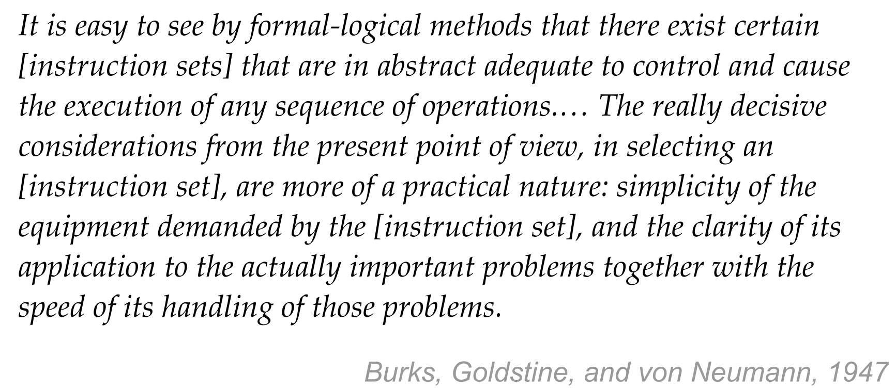
Different ISAs: More Like Regional Dialects

Slide 14
Some Thoughts of Instruction Formats
Short instruction length
Enough bits reserved for new opcodes
Distinct encoding and the illustration
Number of operands
Instruction alignment
Byte-/word- level alignment
Always keep regularity
Fixed instruction length
Fixed bits of opcodes
Fixed placement of operands
…

Slide 15
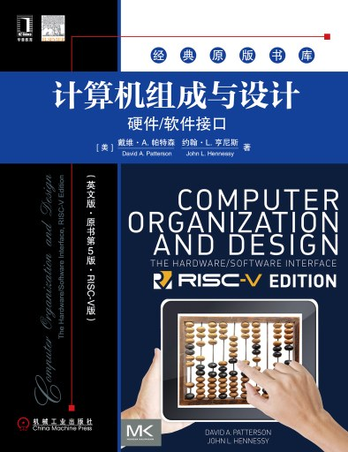
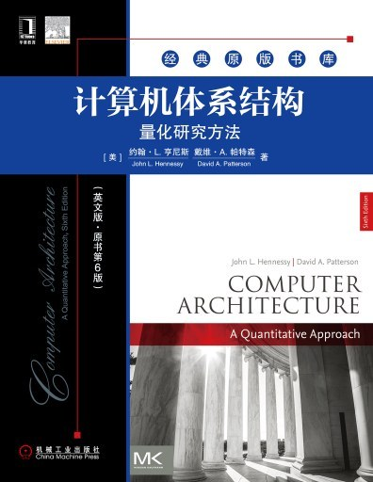
Design Principles
Underlying design principles, as articulated by Hennessy and Patterson:
Simplicity favors regularity
Make the common case fast
Smaller is faster
Good design demands good compromises

Slide 16
Design Principles
Simplicity favors regularity
E.g., instruction size, instruction formats, data formats
Eases implementation by simplifying hardware
Make the common case fast
Fewer bits to read, move, & write
Use/reuse the register file instead of memory
Smaller is faster
E.g., small constants are common, thus immediate fields can be small
Good design demands good compromises
Special formats for important exceptions
E.g., a jump far away (beyond a small constant)

Slide 17
Overview
Introduction to ISA
About ISA design
Issues in the design
Operands and addressing modes
Types of operations and encodings
Evolution and classification

Slide 18
About ISA Design
Issues in the design
Operands and addressing modes
Types of operations and encodings
Evolution and classification

Slide 19
Basic Design Issues
What data types are supported and what size
What operations (and how many) should be provided
LD/ST/INC/BRN sufficient to encode any computation, or just Sub and Branch!
But not useful because programs too long!
How (and how many) operands are specified
Most operations are dyadic (e.g., A <- B + C)
Some are monadic (e.g., A <- ~B)
Location of operands and result
Where other than memory?
How many explicit operands?
How are memory operands located?
Which can or cannot be in memory?
How are they addressed
How to encode these into consistent instruction formats
Instructions should be multiples of basic data/address widths
Encoding
Typical instruction set:
32-bit word
Basic operand addresses are 32 bits long
Basic operands, like integers, are 32 bits long
In general case, instruction could reference 3 operands (A := B + C)
Typical challenge:
Encode operations in a small number of bits
Notes:
Instruction set design issues include:
Where are operands stored?
registers, memory, stack, accumulator
How many explicit operands are there?
0, 1, 2, or 3
How is the operand location specified?
register, immediate, indirect, . . .
What type & size of operands are supported?
byte, int, float, double, string, vector. . .
What operations are supported?
add, sub, mul, move, compare . . .

Slide 20
About ISA Design
Issues in the design
Operands and addressing modes
Types of operations and encodings
Evolution and classification

Slide 21
Operands
One important design factor is the number of operands contained in each instruction
Has a significant impact on the word size and complexity of the CPU
E.g., lots of operands generally implies longer word size needed for an instruction
Consider how many operands we need for an ADD instruction
If we want to add the contents of two memory locations together, then we need to be able to handle at least two memory addresses
Where does the result of the add go? We need a third operand to specify the destination
What instruction should be executed next?
Usually the next instruction, but sometimes we might want to jump or branch somewhere else
Do we need a fourth operand to specify the next instruction to execute?
If all of these operands are memory addresses, we need a really long instruction!

Slide 22
Number of Operands
In practice, we won’t really see a four-address instruction.
Too much additional complexity in the CPU
Long instruction word
All operands won’t be used very frequently
Most instructions have one, two, or three operand addresses
The next instruction is obtained by incrementing the program counter, with the exception of branch instructions
Let’s describe a hypothetical set of instructions to carry out the computation for:
Y = (A-B) / (C + (D * E))

Slide 23
Three-Operand Instructions
If we had a three-operand instruction, we could specify two source operands and a destination to store the result.
Here is a possible sequence of instructions for our equation:
Y = (A-B) / (C + (D * E))
SUB R1, A, B ; Register R1 ← A - B
MUL R2, D, E ; Register R2 ← D * E
ADD R2, R2, C ; Register R2 ← R2 + C
DIV R1, R1, R2 ; Register R1 ← R1 / R2
The three-address format is fairly convenient because we have the flexibility to dictate where the result of computations should go. Note that after this calculation is done, we haven’t changed the contents of any of our original locations A, B, C, D, or E.

Slide 24
Two-Operand Instructions
How can we cut down the number of operands?
Might want to make the instruction shorter
Typical method is to assign a default destination operand to hold the results of the computation
Result always goes into this operand
Overwrites and old data in that location
Let’s say that the default destination is the first operand in the instruction
First operand might be a register, memory, etc.

Slide 25
Two-Operand Instructions
Here is a possible sequence of instructions for our equation (say the operands are registers):
Y = (A-B) / (C + (D * E))
SUB A, B ; Register A ← A - B
MUL D, E ; Register D ← D * E
ADD D, C ; Register D ← D + C
DIV A, D ; Register A ← A / D
Get same end result as before, but we changed the contents of registers A and D
If we had some later processing that wanted to use the original contents of those registers, we must make a copy of them before performing the computation
MOV R1, A ; Copy A to register R1
MOV R2, D ; Copy D to register R2
SUB R1, B ; Register R1 ← R1 - B
MUL R2, E ; Register R2 ← R2 * E
ADD R2, C ; Register R2 ← R2 + C
DIV R1, R2 ; Register R1 ← R1 / R2
Now the original registers for A-E remain the same as before, but at the cost of some extra instructions to save the results.

Slide 26
One-Operand Instructions
Can use the same idea to get rid of the second operand, leaving only one operand
The second operand is left implicit; e.g., could assume that the second operand will always be in a register such as the Accumulator:
Y = (A-B) / (C + (D * E))
LDA D ; Load ACC with D
MUL E ; Acc ← Acc * E
ADD C ; Acc ← Acc + C
STO R1 ; Store Acc to R1
LDA A ; Acc ← A
SUB B ; Acc ← A-B
DIV R1 ; Acc ← Acc / R1
Many early computers relied heavily on one-address based instructions, as it makes the CPU much simpler to design. As you can see, it does become somewhat more unwieldy to program.

Slide 27
Zero-Operand Instructions
In some cases, we can have zero-operand instructions
Uses the Stack
Section of memory where we can add and remove items in LIFO order
Last In, First Out
Envision a stack of trays in a cafeteria; the last tray placed on the stack is the first one someone takes out
The stack in the computer behaves the same way, but with data values
PUSH A ; Places A on top of stack
POP A ; Removes value on top of stack and puts result in A
ADD ; Pops top two values off stack, pushes result back on
Notes:
Java VM vs. DalVik VM

Slide 28
Stack-Based Instructions
Y = (A-B) / (C + (D * E))
Instruction Stack Contents (stack increase ->)
PUSH B ; B
PUSH A ; B, A
SUB ; (A-B)
PUSH E ; (A-B), E
PUSH D ; (A-B), E, D
MUL ; (A-B), (E*D)
PUSH C ; (A-B), (E*D), C
ADD ; (A-B), (E*D+C)
DIV ; (A-B) / (E*D+C)

Slide 29
How many operands are best?
More operands
More complex (powerful?) instructions
Fewer instructions per program
More registers
Inter-register operations are quicker
Fewer operands
Less complex (powerful?) instructions
More instructions per program
Faster fetch/execution of instructions

Slide 30
Design Tradeoff Decisions
Operation repertoire
How many ops?
What can they do?
How complex are they?
Data types
What types of data should ops perform on?
Registers
Number of registers, what ops on what registers?
Addressing
Mode by which an address is specified (more on this later)

Slide 31
Addressing
Addressing modes specify where an operand is located.
They can specify a constant, a register, or a memory location.
The actual location of an operand is its effective address.
Certain addressing modes allow us to determine the address of an operand dynamically.

Slide 32
Addressing Modes
Addressing refers to how an operand refers to the data we are interested in for a particular instruction
In the Fetch part of the instruction cycle, there are several common ways to handle addressing in the instruction
Immediate
Direct
Indirect
Register Direct/Indirect
Relative, Indexed and Based

Slide 33
Immediate Addressing
The operand directly contains the value we are interested in working with
E.g., ADD #5
Means add the number 5 to something
This uses immediate addressing for the value 5
The two’s complement representation for the number 5 is directly stored in the ADD instruction
Must know value at assembly time

Slide 34
Direct Addressing
The operand contains an address with the data
E.g., ADD 100
Means to add (Contents of Memory Location 100) to something
Downside: Need to fit entire address in the instruction, may limit address space
E.g., 32-bit word size and 32-bit addresses. Do we have a problem here?
Some solutions: specify offset only, use implied segment
Must know address at assembly time

Slide 35
Indirect Addressing
The operand contains an address, and that address contains the address of the data
E.g., Add [100]
Means “The data at memory location 100 is an address. Go to the address stored there and get that data and add it to the Accumulator”
Downside: Requires additional memory access
Upside: Can store a full address at memory location 100
First address must be fixed at assembly time, but second address can change during runtime! This is very useful for dynamically accessing different addresses in memory (e.g., traversing an array)
Indirect Addressing can be thought of as additional instruction subcycle

Slide 36
Register Direct/Indirect Addressing
Can do direct addressing with registers
E.g., ADD R5
Means to add (Contents of Register 5) to something
Upside: Not that many registers, don’t have previous problem of the direct addressing
Can also do indirect addressing with registers
E.g., Add [R3]
Means “The data in register 3 is an address. Go to that address in memory, get the data, and add it to the Accumulator”

Slide 37
Other Addressing Modes
Relative addressing uses the PC register as an offset, which is added to the address in the operand to determine the effective address of the data.
Indexed addressing uses a register (implicitly or explicitly) as an offset, which is added to the address in the operand to determine the effective address of the data.
Based addressing is similar except that a base register is used instead of an index register.
The difference between Indexed addressing and Based addressing is that an index register holds an offset relative to the address given in the instruction, a base register holds a base address where the address field represents a displacement from this base.

Slide 38
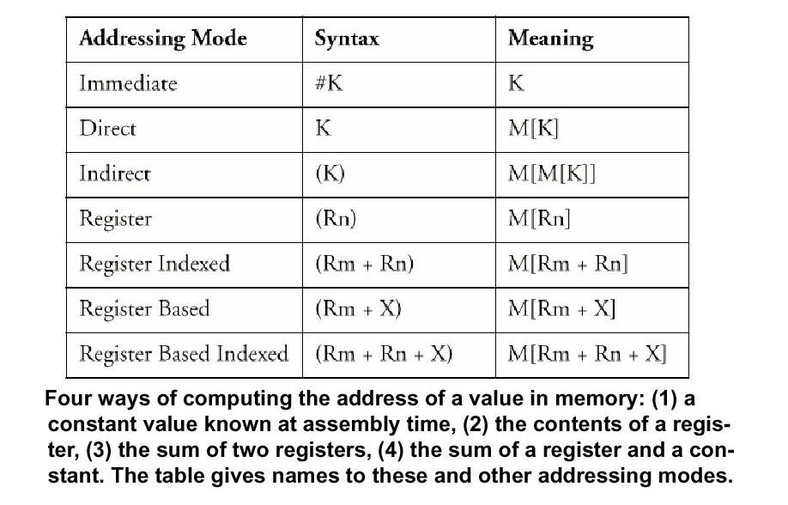
Summary - Addressing Modes

Slide 39
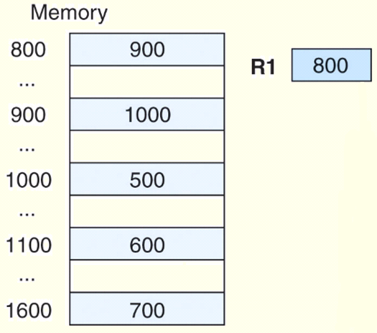
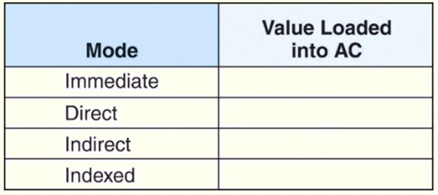
Addressing Example
What value is loaded into the accumulator for each addressing mode?
Load 800
Load 800
Load 800
Load R1[800]

Slide 40
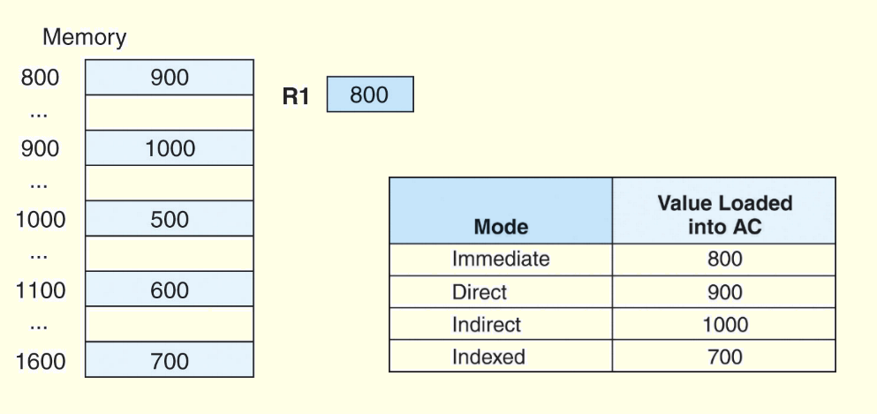
Addressing Example
These are the values loaded into the accumulator for each addressing mode.
Load 800
Load 800
Load 800
Load R1[800]
Load R1 Using Indirect Addressing?

Slide 41
About ISA Design
Issues in the design
Operands and addressing modes
Types of operations and encodings
Evolution and classification

Slide 42
Types of Operations
Arithmetic and Logic
Shift
Data Transfer
E.g., MOV/LOAD/STORE
String
Control
BRANCH/JMP/CALL/RET/…
System
HALT/INTERRUPT ON/INTERRUPT OFF/SWITCH…
Input/Output
…

Slide 43
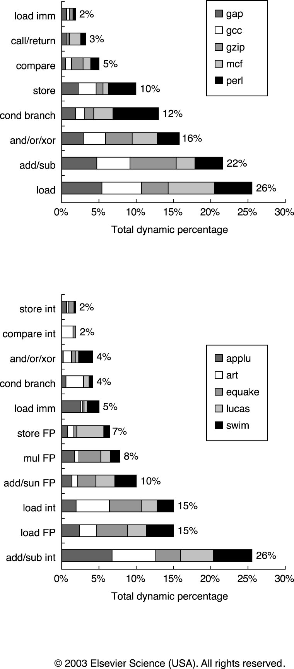
Typical Operations (little change since 1960)
Data Movement
Load (from memory)
Store (to memory)
memory-to-memory move
register-to-register move
input (from I/O device)
output (to I/O device)
push, pop (to/from stack)
Arithmetic
integer (binary + decimal) or FP
Add, Subtract, Multiply, Divide
Shift
shift left/right, rotate left/right
Logical
not, and, or, set, clear
Control (Jump/Branch)
unconditional, conditional
Subroutine Linkage
call, return
Interrupt
trap, return
Synchronization
test & set (atomic r-m-w)
String
search, translate
Graphics (MMX)
parallel subword ops (4 16bit add)

Slide 44
Types of Encodings
If code size is most important, use variable length instructions
If performance is most important, use fixed length instructions
Recent embedded machines (ARM, MIPS) added optional mode to execute subset of 16-bit wide instructions (Thumb, MIPS16); per procedure decide performance or density
Some architectures actually exploring on-the-fly decompression for more density.
Variable:
Fixed:
Hybrid:
…
…

Slide 45
About ISA Design
Issues in the design
Operands and addressing modes
Types of operations and encodings
Evolution and classification

Slide 46
Evolution of Instruction Sets
Single Accumulator (EDSAC 1950, Maurice Wilkes)
Accumulator + Index Registers
(Manchester Mark I, IBM 700 series 1953)
Separation of Programming Model
from Implementation
High-level Language Based
Concept of a Family
(B5000 1963)
(IBM 360 1964)
General Purpose Register Machines
Complex Instruction Sets
Load/Store Architecture
(Vax, Intel 432 1977-80)
(CDC 6600, Cray 1 1963-76)
CISC
RISC
Intel x86, Pentium
(MIPS,Sparc,HP-PA,IBM RS6000,PowerPC . . .1987)

Slide 47
CISC
Complex Instruction Set Computers
Close “semantic gap” between programming and execution
Smaller code size (memory was expensive!)
Simplify compilation
Another state machine (controlled by microcode) inside the machine
Example: x86, Intel 432, IBM 360, DEC VAX

Slide 48
CISC Example: x86
MOVSD ;; move a double word, 1-byte instruction
MOVSD // m32[DS:EDI] = m32[DS:ESI]
REP;; 1-byte prefix to repeat string operations
REP MOVSD // count set up in ECX
LOCK ADD ds:[esi+ecx*2+0x67452301], 0xEFCDAB89 // 13-byte
F0 3E 81 84 4E 01 23 45 67 89 AB CD EF
prefix
[--][--]+disp32
ESI+ECX*2

Slide 49
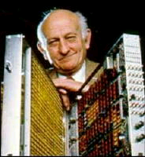
RISC
Observation made by IBM (John Cocke, Eckert-Mauchly Award’85, Turing Award’87,…)
Few of the available instructions are used
CISC : “n+1” phenomenon
Adding an instruction requiring an extra level of decoding logic can slow down the entire ISA
Reduced Instruction Set Computer
Originated at IBM in 1975, a telephone project
To achieve 12 MIPS (300 calls per sec, 20k inst per call)
Simple instructions
IBM 801 in 1978
More compiler effort to gain performance
Notes:
ACM 图灵奖（1987）
IEEE 计算机先驱奖 （1989）
美国国家技术奖章（1991）
美国国家科学奖章（1994）
IEEE 约翰·冯诺依曼奖（1994）

Slide 50
A Typical RISC
Smaller number of instructions
Fixed format instruction (e.g., 32 bits)
3-address, reg-to-reg arithmetic instructions
Single cycle operation for execution
Load-store architecture
Simple address modes
Base + displacement
No indirection
Simple branch conditions
Hardwired control (No microcode)
More compiler effort
Examples:
RISC I and RISC II at Berkeley
MIPS (Microprocessors without Interlocked Pipe Stage) at Stanford
IBM RISC Technology, Sun Sparc, HP PA-RISC, ARM

Slide 51
RISC Example: MIPS
R-format (Register-Register)
31
26
25
21
20
16
15
11
10
6
5
0
Op
Rs
Rt
Rd
Shamt
Funct
add $1, $2, $3
I-format (Register-Immediate)
31
26
25
21
20
16
15
0
immediate
addi $1, $2, -5
Op
Rs
Rt
I-format (Load/Store)
31
26
25
21
20
16
15
0
immediate
lw $1, 24($9)
Op
Base
Dest
I-format (Branch)
31
26
25
21
20
16
15
0
Op
Rs
Rt
immediate
beq L1, $4, $0
J-format (Jump / Call)
31
26
25
0
Op
target
j L2

Slide 52
CISC vs. RISC
CISC | RISC
Variable length instructions | Fixed-length instructions, single-cycle operation
Abundant instructions and addressing modes | Fewer instructions and addressing modes
Long, complex decoding | Simple decoding
Contain mem-to-mem operations | Load/store architecture
Use microcode | No microinstructions, directly decoded and executed by HW logic
Closer semantic gap (shift complexity to microcode) | Needs smart compilers, or intelligent hardware to reorder instructions
IBM 360, DEC VAX, x86, Moto 68030 | IBM 801, MIPS, RISC I, IBM POWER, Sun Sparc
Some definitions were from the paper by Colwell et al. in 1985

Slide 53
CISC vs. RISC (Reality)
CISC
RISC
 | IBM 370/168 | VAX 11/780 | Xerox Dorado | IBM 801 | Berkeley RISC1 | Stanford MIPS
Year introduced | 1973 | 1978 | 1978 | 1980 | 1981 | 1983
# instructions | 208 | 303 | 270 | 120 | 39 | 55
Microcode | 54KB | 61KB | 17KB | 0 | 0 | 0
Instruction size | 2 to 6 B | 2 to 57 B | 1 to 3 B | 4B | 4B | 4B
Execution model | Reg-reg Reg-mem Mem-mem | Reg-reg Reg-mem Mem-mem | Stack | Reg-reg | Reg-reg | Reg-reg

Slide 54
Observation and Controversy
“Instruction Set and Beyond: Computers, Complexity and Controversy” by Bob Colwell (Eckert-Mauchly Award, 2005) and gang from CMU, also see response from RISC camp: Patterson (Eckert-Mauchly Award, 2008) and Hennessy (Eckert-Mauchly Award, 2001)
CISC/RISC classification should *NOT* be a dichotomy!
Case in point: MicroVAX-32 by DEC, a single chip implementation
Subsetting VAX instructions (but still, 175 instructions!)
Emulate complex instructions
A RISC or a CISC? (Well, it has variable length instructions, not a ld/st machine, with a microcode control, have all VAX addressing mode)

Slide 55
Observation and Controversy
Effective processor design = CISC experiences + RISC tenets
RISC features are not incompatible or mutually exclusive
Large register file (w/ register windows)
RISC/CISC issues are best considered in light of their function-to-implementation level assignment

Slide 56
Modern X86 Machine Design
CISC outfit + RISC inside
E.g., Intel P6/Netburst/Core, AMD Athlon/Phenom/Opteron
Each x86 instruction is decoded into “micro-op” (μ op) or “RISC-op” on-the-fly
Internal microarchitecture resembles RISC design philosophy
Processor dynamically schedules “μ ops”
Compiler’s scheduling is still beneficial

Slide 57
Recent ISA Design Trend
Look at this instruction in MIPS (CISC or RISC?)
CABS.LE.PS $fcc0, $f8, $f10 ;; |y|≤|w| , |x| ≤ |w|?
Many complex instructions emerged for new apps
Viterbi instruction for wireless communication/DSP
Sum of absolute differences in SSE (PSAD) or other DSP: C = ∑|A-B| for MPEG (motion estimation)
In embedded domain, code size is critical
Reducing programming efforts
Optimizing performance via
Specialized hardware (accelerator-based)
Co-processor (controlled by main processor)
ISA plug-in (flexible)

Slide 58
Classification of ISAs
Accumulator (before 1960, e.g., 68HC11):
1-address add A acc ← acc + mem[A]
Stack (1960s to 1970s):
0-address add tos ← tos + next
Memory-Memory (1970s to 1980s):
2-address add A, B mem[A] ← mem[A] + mem[B]
3-address add A, B, C mem[A] ← mem[B] + mem[C]
Register-Memory (1970s to present, e.g., 80x86):
2-address add R1, A R1 ← R1 + mem[A]
load R1, A R1 ← mem[A]
Register-Register (Load/Store) (1960s to present, e.g., MIPS):
3-address add R1, R2, R3 R1 ← R2 + R3
load R1, R2 R1 ← mem[R2]
store R1, R2 mem[R1] ← R2

Slide 59
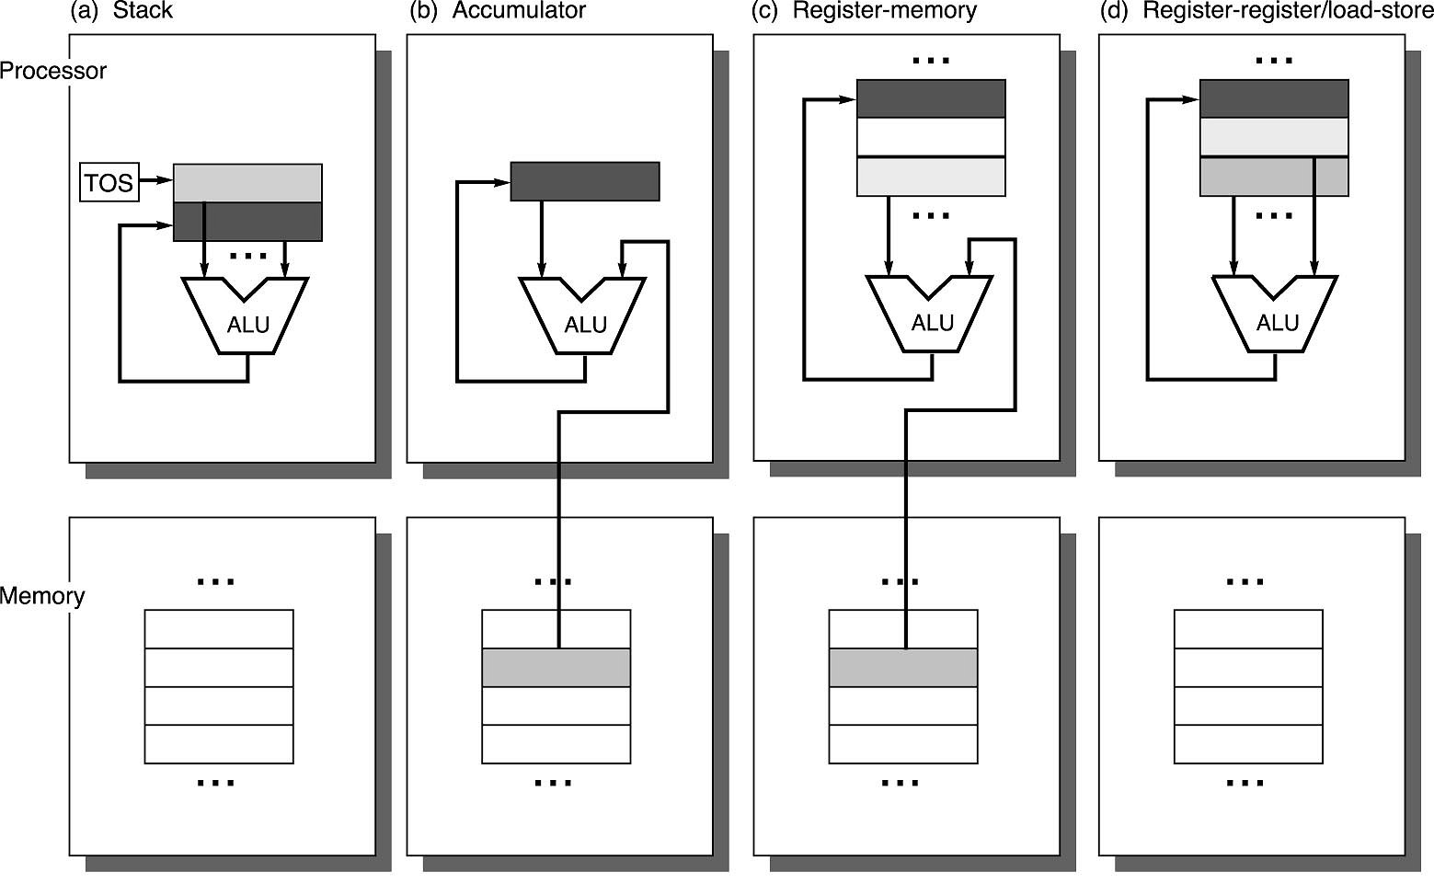
Operand Locations in Four ISA Classes
GPR

Slide 60
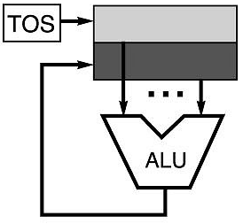
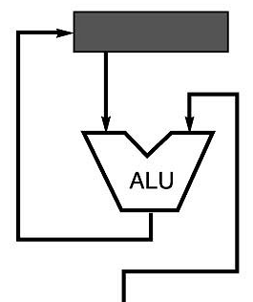
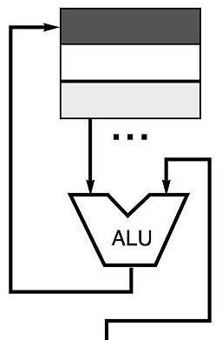
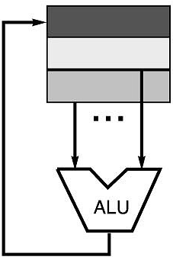
Code Sequence C = A + B for Four Instruction Sets
Stack | Accumulator | Register (register-memory) | Register (load-store)
Push A Push B Add Pop C | Load A Add B Store C | Load R1, A Add R1, B Store C, R1 | Load R1,A Load R2, B Add R3, R1, R2 Store C, R3
memory
memory
acc = acc + mem[C]
R1 = R1 + mem[C]
R3 = R1 + R2

Slide 61
More About General Purpose Registers
Why do almost all new architectures use GPRs?
Registers are much faster than memory (even cache)
Register values are available immediately
When memory isn’t ready, processor must wait (“stall”)
Registers are convenient for variable storage
Compiler assigns some variables just to registers
More compact code since small fields specify registers (compared to memory addresses)
Processor
Memory
Disk
Registers
Cache

Slide 62
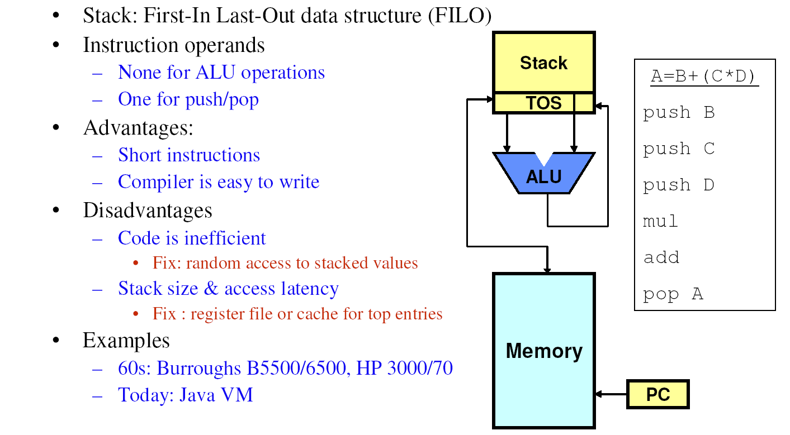
Stack Architectures

Slide 63
Stacks: Pros and Cons
Pros
Good code density (implicit top of stack)
Low hardware requirements
Easy to write a simpler compiler for stack architectures
Cons
Stack becomes the bottleneck
Little ability for parallelism or pipelining
Data is not always at the top of stack when need, so additional instructions like TOP and SWAP are needed
Difficult to write an optimizing compiler for stack architectures

Slide 64
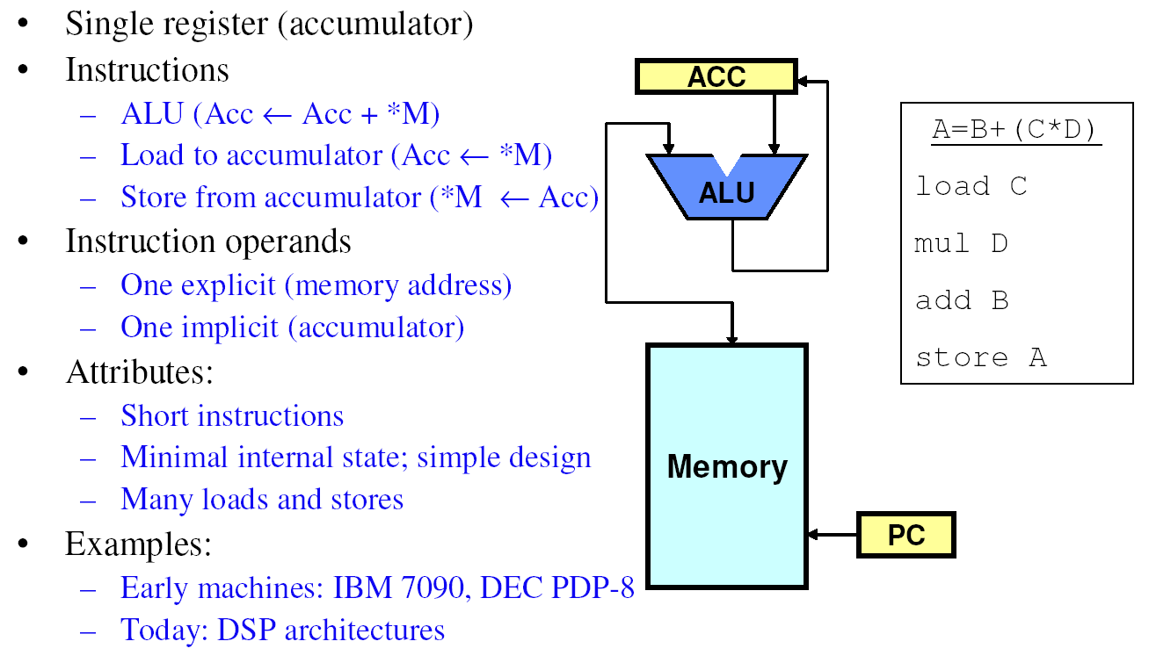
Accumulator Architectures

Slide 65
Accumulators: Pros and Cons
Pros
Very low hardware requirements
Easy to design and understand
Cons
Accumulator becomes the bottleneck
Little ability for parallelism or pipelining
High memory traffic

Slide 66
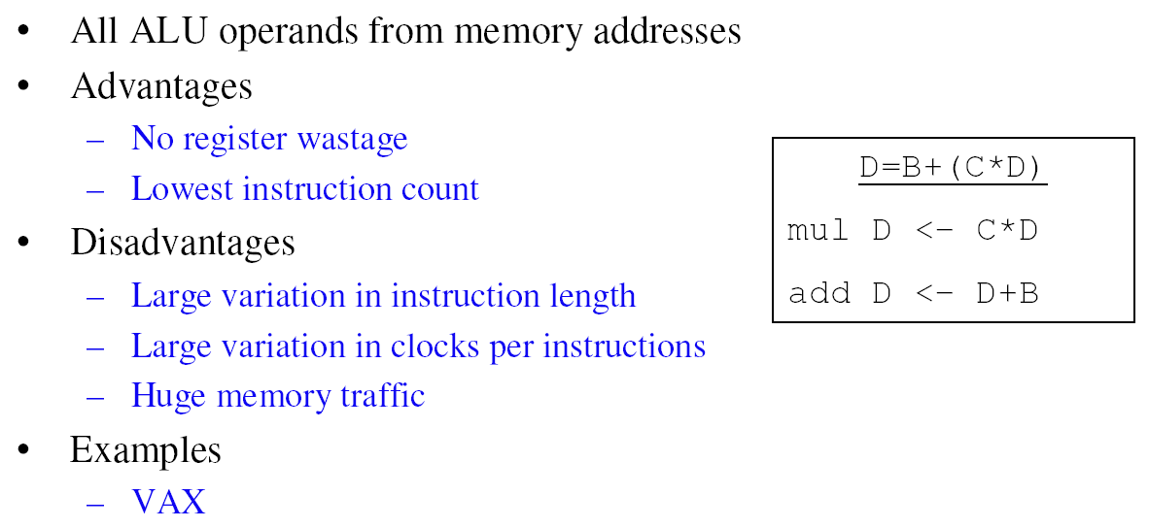
Memory-Memory Architectures

Slide 67
Memory-Memory: Pros and Cons
Pros
Requires fewer instructions (especially if 3 operands)
Easy to write compilers for (especially if 3 operands)
Cons
Very high memory traffic (especially if 3 operands)
Variable number of clocks per instruction
With two operands, more data movements are required

Slide 68
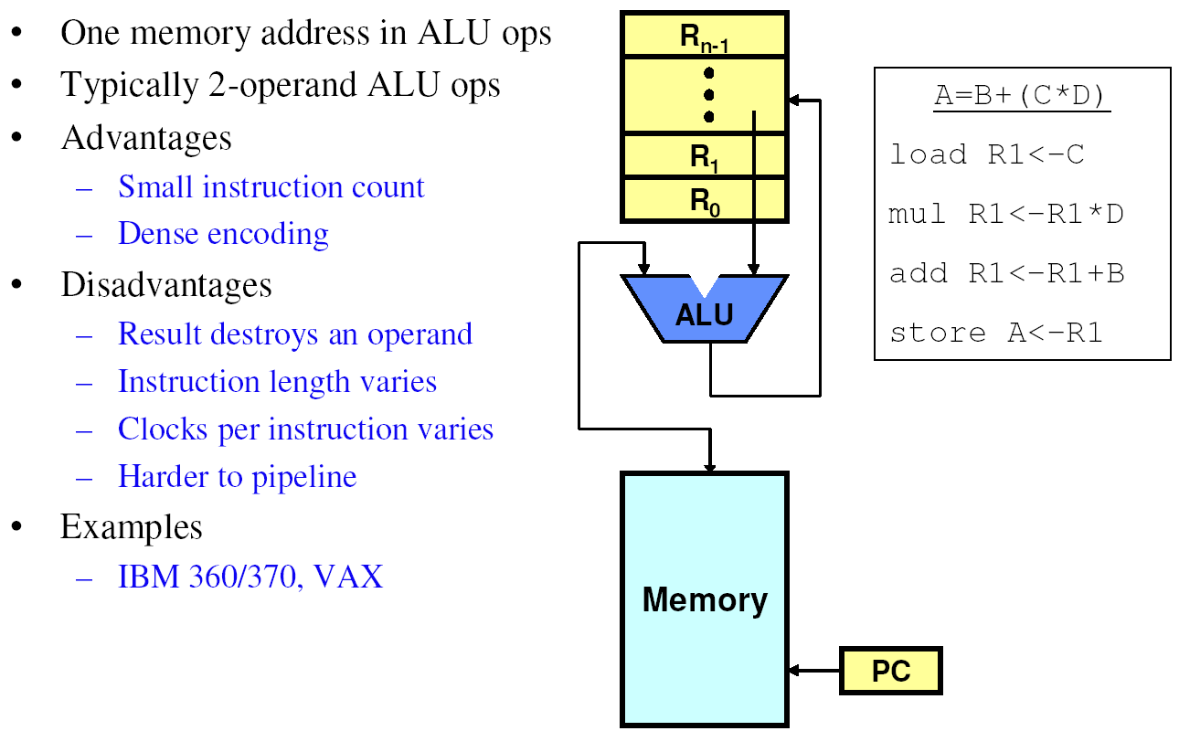
Register-Memory Architectures

Slide 69
Register-Memory: Pros and Cons
Pros
Some data can be accessed without loading first
Instruction format easy to encode
Good code density
Cons
Operands are not equivalent (poor orthogonal)
Variable number of clocks per instruction
May limit number of registers

Slide 70
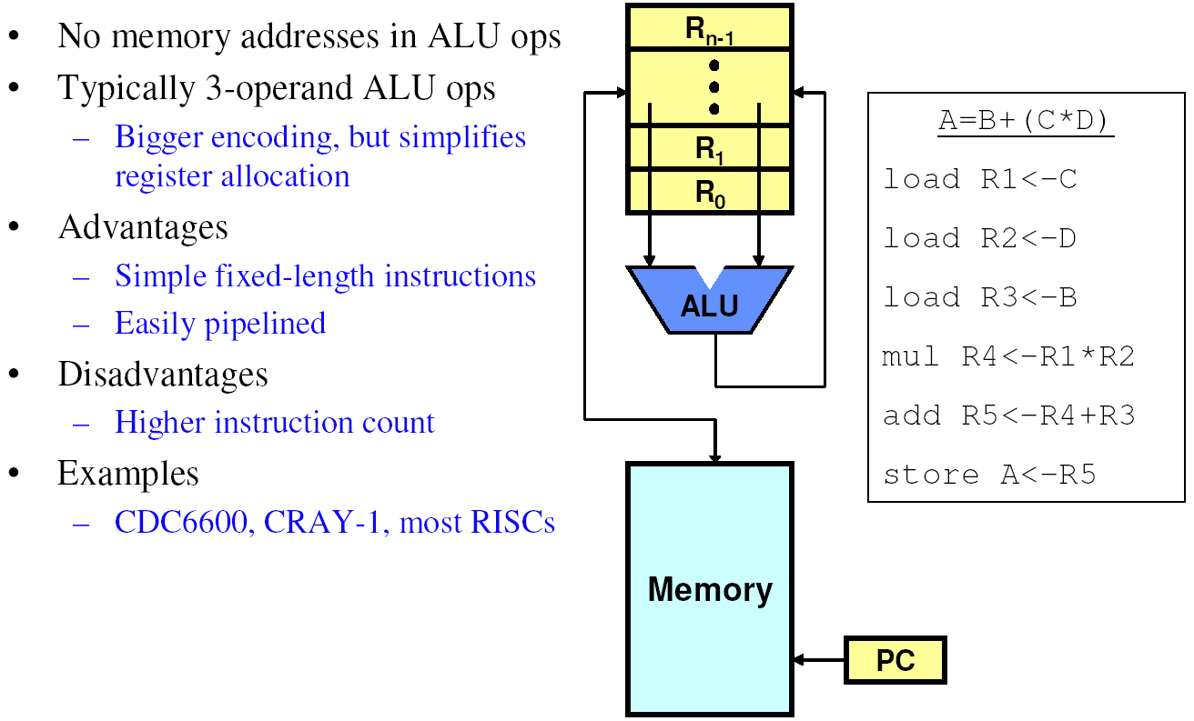
Load-Store Architectures

Slide 71
Load-Store: Pros and Cons
Pros
Simple, fixed length instruction encodings
Instructions take similar number of cycles
Relatively easy to pipeline and make superscalar
Cons
Higher instruction count
Not all instructions need three operands
Dependent on good compiler

Slide 72
Registers: Advantages and Disadvantages
Advantages
Faster than cache or main memory (no addressing mode or tags)
Deterministic (no misses)
Can replicate (multiple read ports)
Short identifier (typically 3 to 8 bits)
Reduce memory traffic
Disadvantages
Need to save and restore on procedure calls and context switch
Can’t take the address of a register (for pointers)
Fixed size (can’t store strings or structures efficiently)
Compiler must manage
Limited number
Every ISA designed after 1980 uses a load-store ISA (i.e., RISC, to simplify CPU design).

