Slide 1
Problem Statement
Intel Products Sentiment Analysis from Online Reviews

Slide 2
Unique Idea Brief (Solution)
The project's uniqueness lies in the combination of DistilBERT for accurate sentiment identification, Gemini for trend analysis of positive sentiment, and seamless integration with a web application for clear visualization. This multi-stage approach with LLMs allowed you to gain valuable insights into user sentiment for Intel processors over time.

Slide 3
Features Offered
Predict Sentiments for Reviews: Classify reviews as positive, negative, or neutral using sentiment analysis.
Positive-Negative Trend Over Years: Track sentiment trends in reviews from 2012 onwards using visual graphs.
Technical Specifications Insights: Extract and summarize key technical specifications from reviews.
Reviews Starting from 2012: Focus analysis on reviews written from 2012 to the present.
Features Offered: List features of products based on review analysis and specifications.

Slide 4
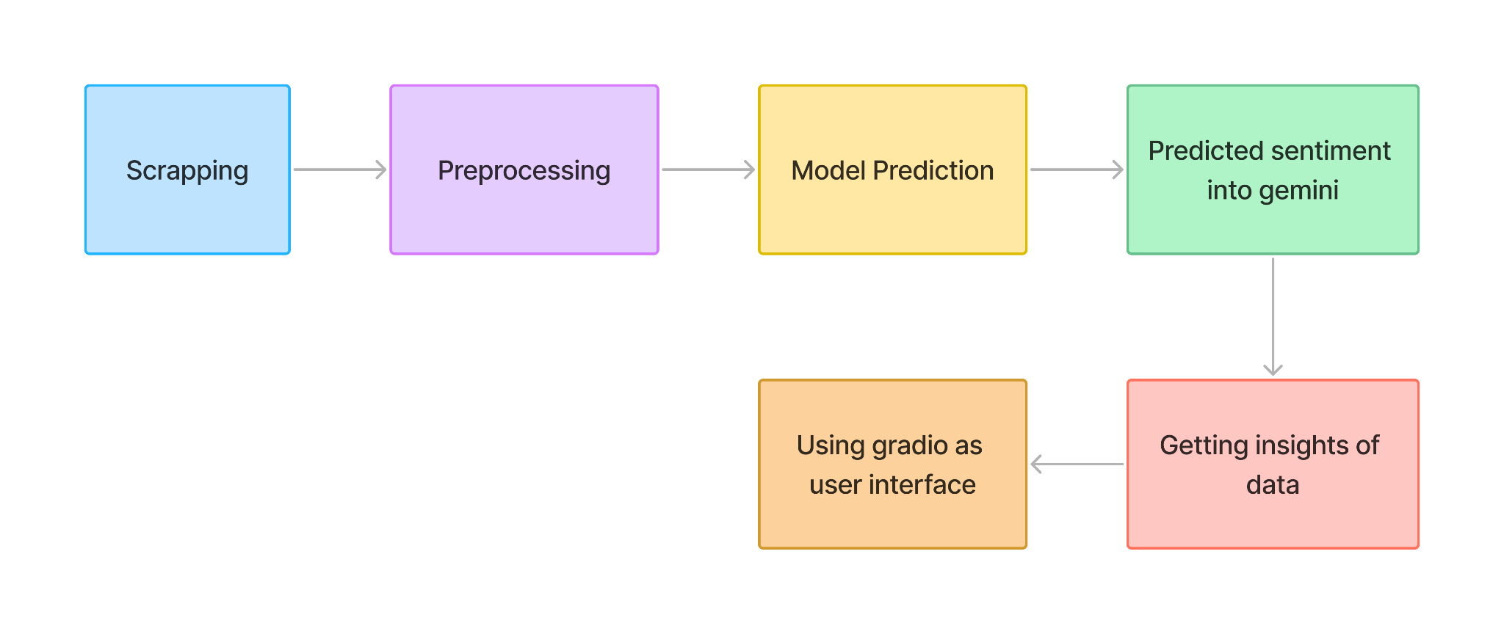
Process flow

Slide 5
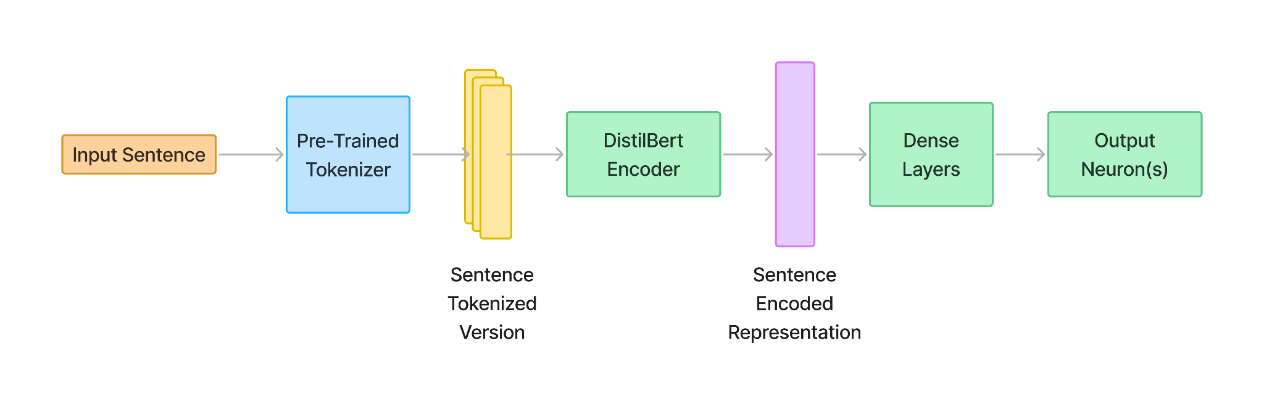
Architecture Diagram

Slide 6
Technologies Used
Data Scraping and PreProcessing
Selenium
Beautiful Soup
Pandas
Google Colab
Machine Learning
Transformer
PyTorch
Logistic Regression
DistilBert
Kaggle
Google colab
Data analysis and Visualisation
Power BI Desktop and Service
Microsoft Excel
Gradio
Google Colab

Slide 7
Team members and contribution:
Kumar Priyanshu:
He was in charge of the thorough data collecting using a variety of techniques, making use of sophisticated web scraping tools like Beautifulsoup and Selenium. He handled data files with efficiency and completed necessary cleaning and preparing work. This required making sure the data was accurate, dependable, and prepared for analysis by eliminating inconsistencies, fixing mistakes, and standardizing formats.
Avishikta Bhattacharjee
She has designed a multi-stage system: a logistic regression model set the baseline, while a fine-tuned DistilBERT model identified sentiment in tech reviews. Positive sentiment from DistilBERT was then analyzed by Gemini, another large language model, to uncover trends. Finally, the she has integrated Gemini with the Gardio web app, allowing visualization of these positive trends. This clever combination of models provided valuable insights into user sentiment.
Akangkha Sarkar
She was responsible for data visualization and analysis in this project. Leveraging tools such as Power BI and Excel, she has data to derive meaningful insights. Additionally, she has developed a Gradio-based web interface to effectively present the project findings. This interface not only enhances the accessibility of the results but also ensures a seamless and engaging user experience.

Slide 8
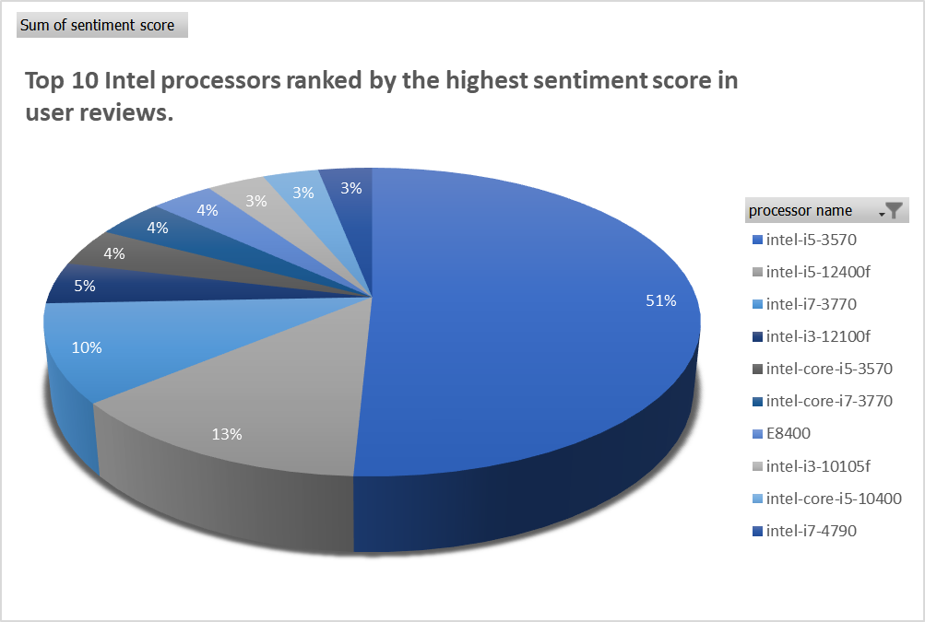
Conclusion

Slide 9
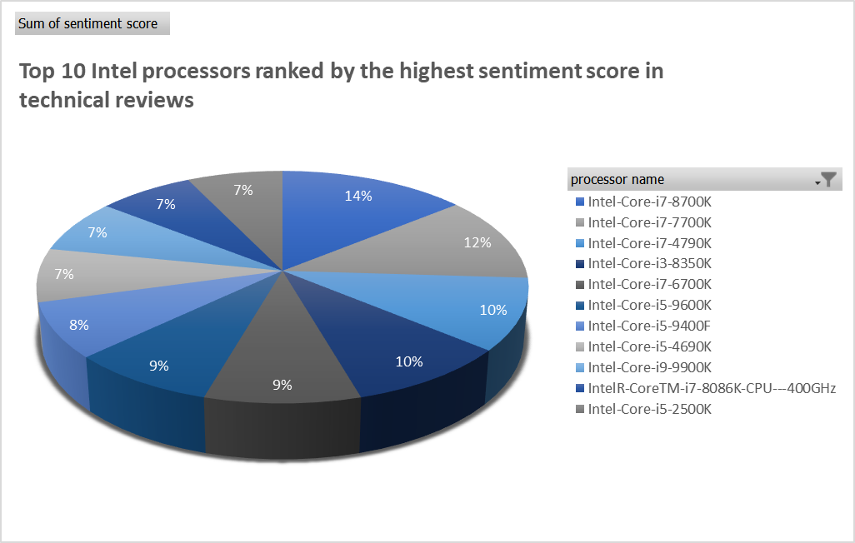
Conclusion

Slide 10
Conclusion
Our comprehensive sentiment analysis of user and technical reviews from 2019 to the present(2024) has provided valuable insights into the top 10 Intel processors. Leveraging web scraping tools such as Selenium and Beautiful Soup, we collected a substantial dataset comprising 1,173 user reviews and 4,437 technical reviews from various credible sources. Each review was assessed for user engagement and credibility, ensuring the reliability of our findings.
In this analysis, reviews were classified as either positive (+1) or negative (0). By aggregating these sentiment scores, we identified the Intel processors with the highest overall positive sentiment in both user and technical review categories. The results have been visually presented in a Power BI dashboard, enabling a clear and intuitive understanding of the data.
Additionally, we utilized Gradio to highlight the specific words and phrases that contributed to a review's positive or negative classification, providing further context and transparency. This nuanced approach allowed us to uncover the factors driving sentiment, offering deeper insights into user and technical reviewer perspectives.
The final rankings reflect the processors that have garnered the most favorable reception, based on their cumulative sentiment scores. These findings can guide consumers and professionals in making informed decisions about Intel processors, supported by a robust analysis of user and technical feedback over the past five years.

