Slide 1
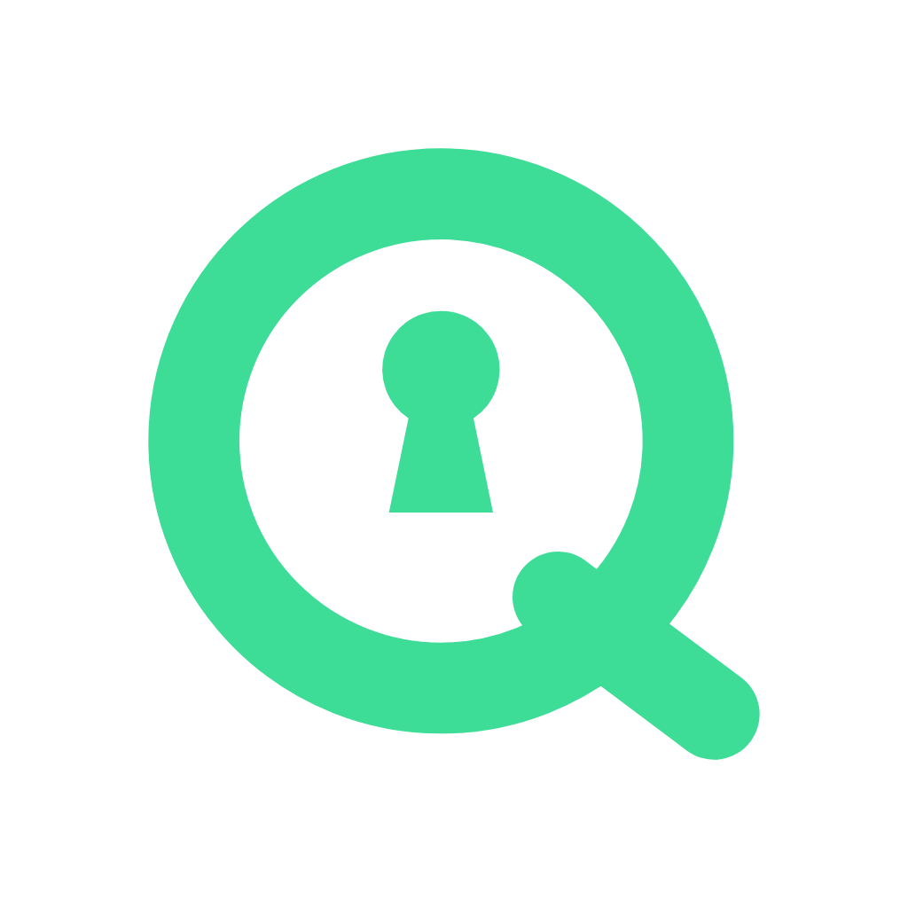
Qeep
Your Bitcoin dollars, kept safe for decades.
A post-quantum MUSD wallet that borrows and earns on Mezo, every big move approved by a key quantum computers can’t forge.
Mezo Buildathon · Wave 2 · Live on Mezo testnet · qeep-wallet.vercel.app
Notes:
Qeep is a self-custody MUSD wallet on Mezo. Everyday sends use a normal key; anything bigger, including borrowing and earning on Mezo, needs a post-quantum Vault Key.

Slide 2
Wallets sign with ECDSA. Quantum computers break it
THE PROBLEM
!
↓
$
Almost every wallet uses ECDSA
The threat keeps getting closer
MUSD is held for years
Shor’s algorithm breaks elliptic-curve keys outright on a large enough quantum computer.
Estimates of the hardware needed keep falling, and supervisors now name wallets as the exposed layer.
People borrow it against Bitcoin and keep it as savings: exactly what a future attacker targets.
Notes:
Almost every wallet signs with ECDSA, which a large quantum computer breaks. MUSD is long-held savings, so it is exactly the asset at risk. Qeep protects it today without waiting for Mezo or Ethereum to change signature schemes.

Slide 3
One account. Two keys
THE FIX
ECDSA · on your device
Post-quantum · WOTS
Daily key
Vault Key
Encrypted with your password on your phone. Sends MUSD instantly, up to a daily limit you choose.
24 words kept offline. Hash-based one-time signatures, verified on-chain. Approves big sends, Mezo loans, Stability Pool deposits and recovery.
Under the limit → Daily key. Above it, or on Mezo → Vault Key
Notes:
If the Daily key is stolen or broken, an attacker gets one day's limit at most. Everything else, including any action on Mezo, needs the Vault Key, which signs with Winternitz one-time signatures and rotates to a fresh key after every use.

Slide 4
Borrow and earn on Mezo, from inside Qeep
BUILT ON MEZO
Mezo contract | What Qeep does with it | Approved by
BorrowerOperations | Open a loan (BTC → MUSD), add BTC, borrow more, repay, close | Vault Key
StabilityPool | Deposit and withdraw MUSD, earn BTC from liquidations | Vault Key
TroveManager · PriceFeed | Live collateral ratio, liquidation price, interest, recovery mode | Read only
HintHelpers · SortedTroves | Sorted-list hints keep loan transactions cheap | Read only
MUSD | Hold, send under the daily limit, approve the pool | Daily or Vault Key
Every action runs from the user’s smart account (msg.sender = the Qeep account)
Notes:
This is the integration the judges asked for. The Vault Key path acts on Mezo itself: BorrowerOperations for loans, the Stability Pool for earning, TroveManager and PriceFeed for live health. No new contract was needed: vaultExecute already calls any contract as the account.

Slide 5
Live and verified on Mezo testnet
PROOF
1,800
148%
~230k
MUSD borrowed from a Qeep account against 0.04 BTC, approved by the Vault Key
collateral ratio, read live from Mezo’s TroveManager and PriceFeed
gas to verify a post-quantum signature on-chain and send MUSD
✓
Factory and account source verified on the Mezo explorer. One testnet run covers create, send, Vault send, Stability Pool, a full loan (open, borrow, repay, add BTC, close) and restore.
Factory 0xfd2f67cD354545712f9d8230170015d7e30d133A on explorer.test.mezo.org
Notes:
All figures are from real testnet transactions on November 9, 2026: the loan opened at a 148% collateral ratio using 777,166 gas, the Vault Key MUSD send used 228,878 gas, and the Stability Pool deposit 339,150. The testnet script in e2e/ reproduces them.

Slide 6
Checked on-chain, every time
HOW IT WORKS
Your device
Qeep relayer
QeepAccount
Mezo
Signs locally. Daily key for small sends, Vault Key for the rest.
Pays the BTC gas. Can’t move funds or change anything.
Verifies ECDSA or WOTS, enforces the limit, rotates keys.
MUSD, BorrowerOperations, Stability Pool.
If the Daily key is ever broken, an attacker gets one day’s limit at most. Everything else, including every Mezo action, stays behind the post-quantum Vault Key.
Notes:
The Vault Key signs with Winternitz one-time signatures over keccak256: 67 chains, w = 16. Security rests only on hash preimage resistance, so Shor's algorithm does not apply. Each key signs once; the account retires it before running the call, even if the call fails.

Slide 7
BUSINESS MODEL
Qeep pays the gas. Mezo actions pay Qeep
0.10%
Gas cost to Qeep, at Mezo mainnet prices
Action | Cost
Daily send | $0.015
Vault Key send | $0.025
Stability Pool deposit | $0.037
Open a Mezo loan | $0.084
Create a wallet (once) | $0.12
fee on MUSD borrowed or deposited to the Stability Pool, shown before signing. Holding, sending, repaying and withdrawing are free.
One 1,800 MUSD loan pays 1.80 MUSD: about 2.7 months of a heavy user’s gas.
Gas measured on testnet, priced at 1.46 gwei and BTC $74,000. Fee goes live with batched Vault actions at mainnet beta.
Notes:
Users never need BTC for fees. A heavy user (30 daily sends, 4 vault sends, 2 Mezo actions a month) costs about $0.67 a month. The fee and the Mezo action will run in one batched Vault Key action, so the fee is never taken if the action fails. On testnet, gas is fully sponsored and the fee is off.

Slide 8
What Qeep protects, and what it doesn’t
HONEST LIMITS
Protects
Doesn’t (yet)
Everything above the daily limit, including Mezo loans and deposits
Against a stolen phone, a broken Daily key or a rogue relayer
Against replay: one-time keys, nonces, chain and account bound
Mezo’s own consensus, which still uses ECDSA
The daily allowance, guarded only by the ECDSA Daily key
Plain WOTS today; WOTS+ or SLH-DSA and an audit before mainnet
Unaudited testnet software. Full model in docs/SECURITY.md
Notes:
Qeep protects the user's funds, not the chain. Being explicit about this builds trust with long-term holders and judges alike.

Slide 9
Live today. Mainnet next
ROADMAP
NOW
DEC 2026
Q1 2027
Q2 2027
Live on Mezo testnet
Mainnet beta
More of Mezo
Qeep SDK
Two keys, gasless relayer, Mezo borrow and Stability Pool, verified contracts.
Audit, WOTS+, batched Vault actions with the fee on, relayer limits.
Mezo Pools swaps, loan alerts, Telegram daily sends.
Any Mezo app adds a post-quantum approval step.
Notes:
Wave 2 delivered the Mezo integration the judges asked for. Mainnet beta turns on the business model with batched Vault actions, so the fee and the Mezo action are one post-quantum signature.

Slide 10
Try Qeep today
App
qeep-wallet.vercel.app
Demo video
[2-minute video link]
Code
github.com/Akanimoh12/Qeep-Wallet
Network
Mezo testnet · chain ID 31611
Team
Akanimoh · Founder and builder
Qeep · Your Bitcoin dollars, kept safe for decades.
Notes:
Thank you. The app runs on Mezo testnet with gas sponsored by Qeep, so anyone can try it without BTC for fees.

