Slide 1


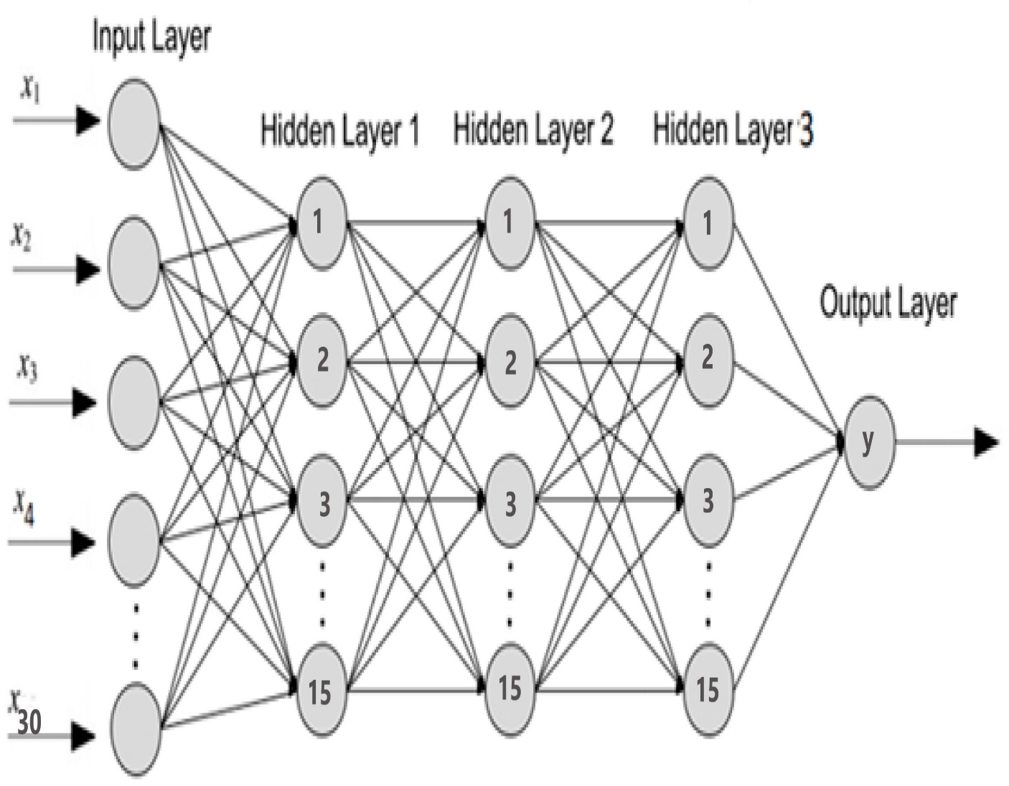
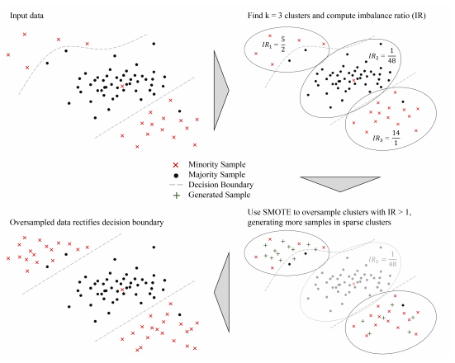
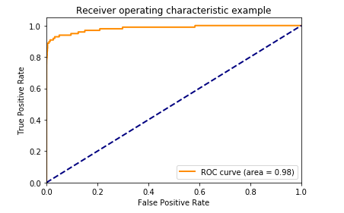

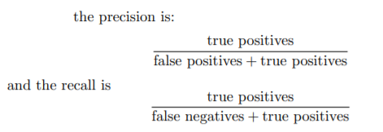
CREDIT CARD FRAUD DETECTION USING ANN WITH K-MEANS SMOTE
REPLACE THIS BOX WITH YOUR ORGANIZATION’S
HIGH RESOLUTION LOGO
DATASETS
The following table mentions the change in f1 score and accuracy score with ANN (with/o K-Means SMOTE) –
The datasets contain transactions made by credit cards in September 2013 by European cardholders. This dataset presents transactions that occurred in two days, where we have 492 frauds out of 284,807 transactions. The dataset is highly unbalanced, the positive class (frauds) account for 0.172% of all transactions.
It contains only numerical input variables which are the result of a PCA transformation. Unfortunately, due to confidentiality issues, we cannot provide the original features and more background information about the data. Features V1, V2, ... V28 are the principal components obtained with PCA, the only features which have not been transformed with PCA are 'Time' and 'Amount'. Feature 'Time' contains the seconds elapsed between each transaction and the first transaction in the dataset. The feature 'Amount' is the transaction Amount. Feature 'Class' is the response variable and it takes value 1 in case of fraud and 0 otherwise.
The two best models are highlighted in red in the above table.
First, we can observe that ANN with 5 neurons per hidden layer does not perform well in terms of f1 score; though ANN with K-Means resampling with the same parameters generates almost the best f1 score (77%).
Model | Parameters | F1-Score | Accuracy
Model1 | (30,5,1-NA) | 0.00 | 0.99
Model2 | (30,5,1-0.333) | 0.77 | 0.99
Model3 | (30,10,1-NA) | 0.00 | 0.99
Model4 | (30,10,1-0.333) | 0.79 | 0.99
Model5 | (30,5,5,1-NA) | 0.00 | 0.99
Model6 | (30,5,5,1-0.333) | 0.77 | 0.99
Model7 | (30,10,10,1-NA) | 0.76 | 0.99
Model8 | (30,10,10,1-0.333) | 0.77 | 0.99
Model9 | (30,15,15,1-NA) | 0.78 | 0.99
Model10 | (30,15,15,1-0.333) | 0.77 | 0.99
Model11 | (30,15,15,15,1-NA) | 0.79 | 0.99
Model12 | (30,15,15,15,1-0.333) | 0.76 | 0.99
Model13 | (30,15,15,15,1-0.538) | 0.78 | 0.99
Model14 | (30,15,15,15,1-0.176) | 0.77 | 0.99
METHODOLOGY
Preprocessing
First, we scaled the features ‘Time’ and ‘Amount’ because their standard deviation are higher than the other features, and then we split the dataset into training set (80%) and test set (20%).
Resampling Technique
K-Means Synthetic Minority Oversampling Technique (SMOTE) consists of three steps: clustering, filtering, and oversampling. Once the input space is clustered into K- groups using K-Means Algorithm, filtering allows to select clusters for oversampling, retaining those with a high proportion of minority class samples. It then distributes the number of synthetic samples to generate, assigning more samples to clusters where minority samples are sparsely distributed. Finally, in the oversampling step, SMOTE is applied in each selected cluster to achieve the target ratio of minority and majority instances. The algorithm is illustrated in figure 1 below.
Akankhya Mohapatra
Figure 2 –ANN structure
Table 2: Different models performance
Then, when ANN itself is well-tuned (Model 11 with parameters: batch_size = 32, epochs = 10, validation_split = 0.2, verbose = 2, shuffle = True), we reach the best f1 score(79%) and the KMS does not increase the prediction performance anymore. Finally, once we attain an acceptable structure for ANN, exploring different sampling strategy does not provide remarkable increase in f1-score (Model 12, 13 and 14).
Machine Learning I
Professor Laurent Charlin
Here, as a starting point, we initiated K-Means SMOTE algorithm with the following parameters:
Sampling strategy = 0.333 ((#minority instances / #majority instances)
K-neighbours = 5
random_state = 1234
Kmeans_estimator = MiniBatchKMeans (random_state = None)
cluster_balance_threshold = auto
This is the ROC curve for the best model (Model 4 and 11). Area under the ROC-curve make a trade off between the True positive rate and the false positive rate.
ABSTRACT
Figure 1: K-means SMOTE stages
Figure 3 –ROC Curve
Cyber criminal activities are witnessed in huge proportions now more than ever, especially in banking arena and Machine learning algorithms help to mitigate its effect by making detection early in the stage using behavioral patterns.
In this research, we propose an approach using Artificial Neural Networks (ANN) with K-Means SMOTE resampling technique on the credit card (CC) transaction data set from Kaggle. We evaluated the model performance according to f1-score metric by tuning hyperparameters for both the resampling technique and ANN. The goal of this project is to train a model which performs well in detecting fraudulent CC transactions
Key words: Fraudulent, Behavioral patterns, Machine learning, Artificial Neural networks, Cyber Criminality
Since the curve here is near the left upper corner, we can say that the prediction performance of the model is good.
Note that the resampling technique has been applied only on the training set. The purpose will be to evaluate, on the test set, changes in F1-score between the model trained with K-means SMOTE and the model trained without.
CONCLUSION
In this project, we targeted to evaluate the prediction performance of fraudulent Credit Card transactions with a feed forward neural network on a highly imbalanced dataset. To overcome the imbalance nature of the dataset, we have used the K-Means SMOTE resampling technique and compared performance according to the f1 score. We discovered that an ANN without resampling technique required a greater number of parameters (like hidden layers) to reach approximately the same performance as an ANN with K-Means SMOTE resampling technique and less parameters. The final model in the first case was an ANN with 3 hidden layers and 15 neurons per layer which provided an f1 score of 0.79. In the second case, the final model was an ANN with K-means SMOTE consisting of 1 hidden layer and 15 neurons yielded an f1-score of 0.79 as well.
ANN
We initiated with a fully connected feed-forward neural network with 1 hidden layer containing 5 neurons and an output layer with a single neuron. Gradually, we increased the depth and the width of the network in order to enhance the prediction performance. We also added regularization and tuning parameters (such as batch_size = 32, epochs = 10, validation_split = 0.2, verbose = 2, shuffle = True) on the final model. We used ‘relu’ activation function for hidden layers and ‘sigmoid’ activation function for the output layer.
Performance Metrics
Due to the imbalance nature of the dataset, the accuracy metric is not appropriate in this case. That is why we chose to focus on the f1-score which accounts for false positive rate and false negative rate
.
Since in real world, we don’t want a model to misclassify a fraudulent transaction, therefore with much more time, we could go further to minimize the False Negative rate by tuning the hyperparameters of the model and testing many other resampling techniques like Gaussian Mixture Model instead of K-Means for clustering step in the process of resampling.
Also, here since most of the features were masked due to confidentiality issues, finding an appropriate link between the target variables and features would have probably enabled us to increase the model performance.
Finally, it would be feasible to explore different classification algorithm to find out which ones suit the best this Machine Learning Problem.
where
RESULTS
REFERENCES
The following is the table specifying the minority and majority class instances before and after applying K-Means SMOTE –
Oversampling for Imbalanced Learning, Felix Last, Georgios Douzas, Fernando Bacao, 2017
Against the F-score, Adam Yedidia, December 8, 2016
Dataset URL: https://www.tinyurl.com/vgwe4f6
 | Number of instances
 | Class 0 | Class 1
Without KMS | 227451 | 394
With KMS (ratio=0.333) | 227451 | 75741
Table 1: Resampling outcome

