Slide 1

CSCI 1102 Computer Science 2
Meeting 2: Tuesday 2/2/2021
Getting Started with Java

Slide 2
Today
Compilation, Compile-time & run-time
The basic structure of a Java program
Static & Dynamic functions
Memory & Storage
A Simple Example

Slide 3
Compilation
Compiler
Object
Program
Source
Program
Libraries

Slide 4
Object Program
Native code – a sequence of simple instructions in the language of a particular physical machine (processor)
Byte code – a sequence of simple (byte-sized) instructions in the language of a virtual computer -- a software program that can be implemented on any physical processor.

Slide 5
Object Program
Native code – fast but not portable;
Byte code – portable but slow.

Slide 6
Virtual Machine
Typically uses a stack as its primary tool to interpret/execute the byte-code program
Virtual Machine
Byte Code

Slide 7
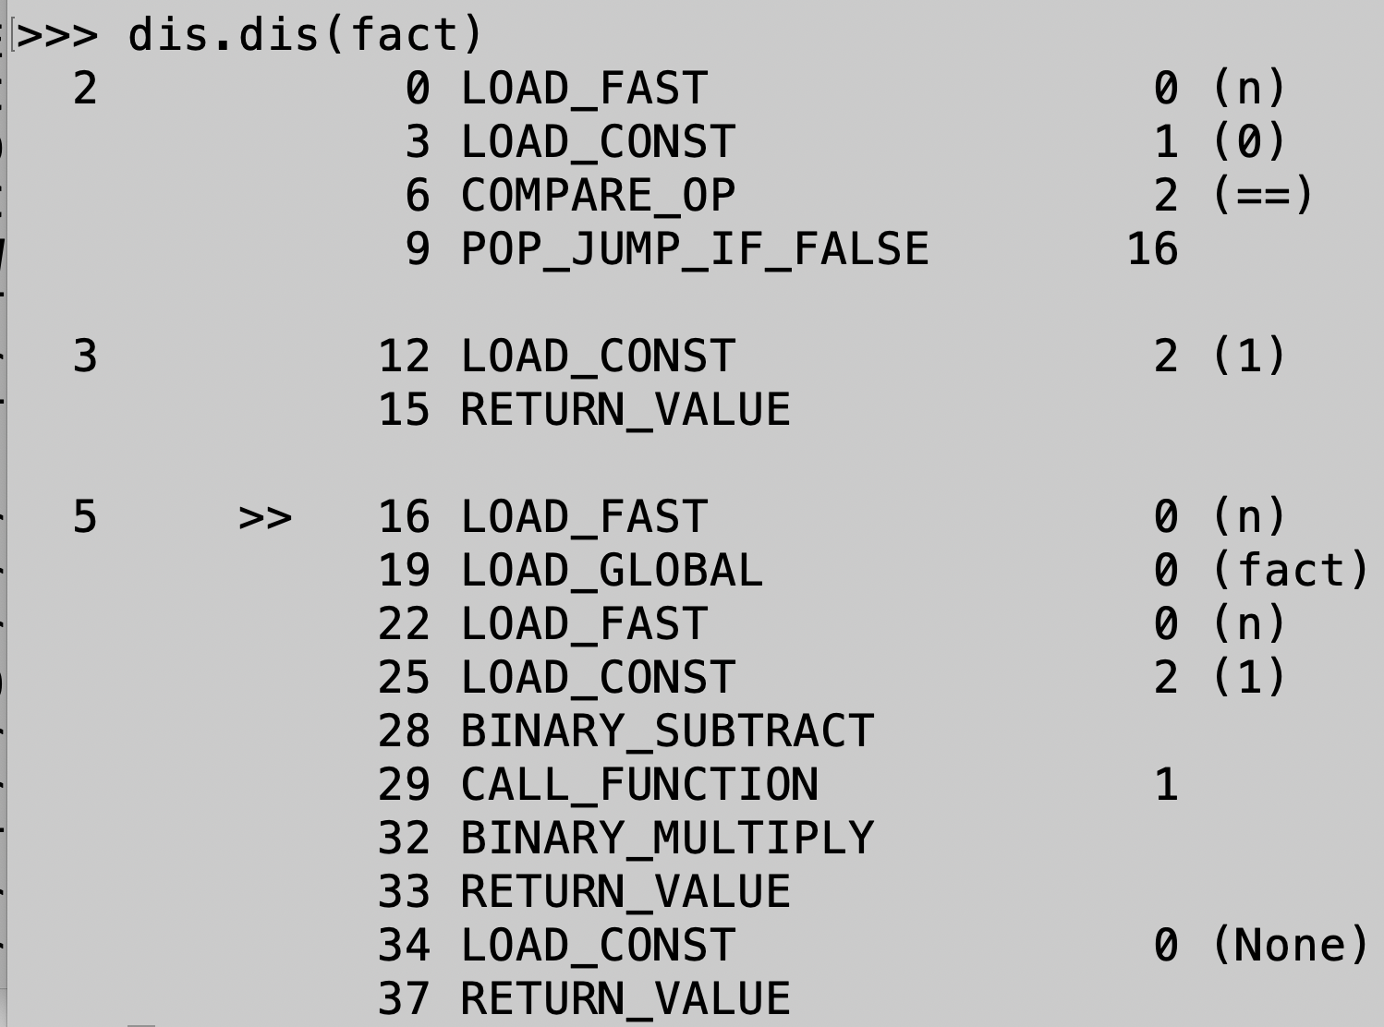
Dis-compiling byte-codes: Python
def fact(n):
if n == 0:
return 1
else:
return n * fact(n - 1)

Slide 8
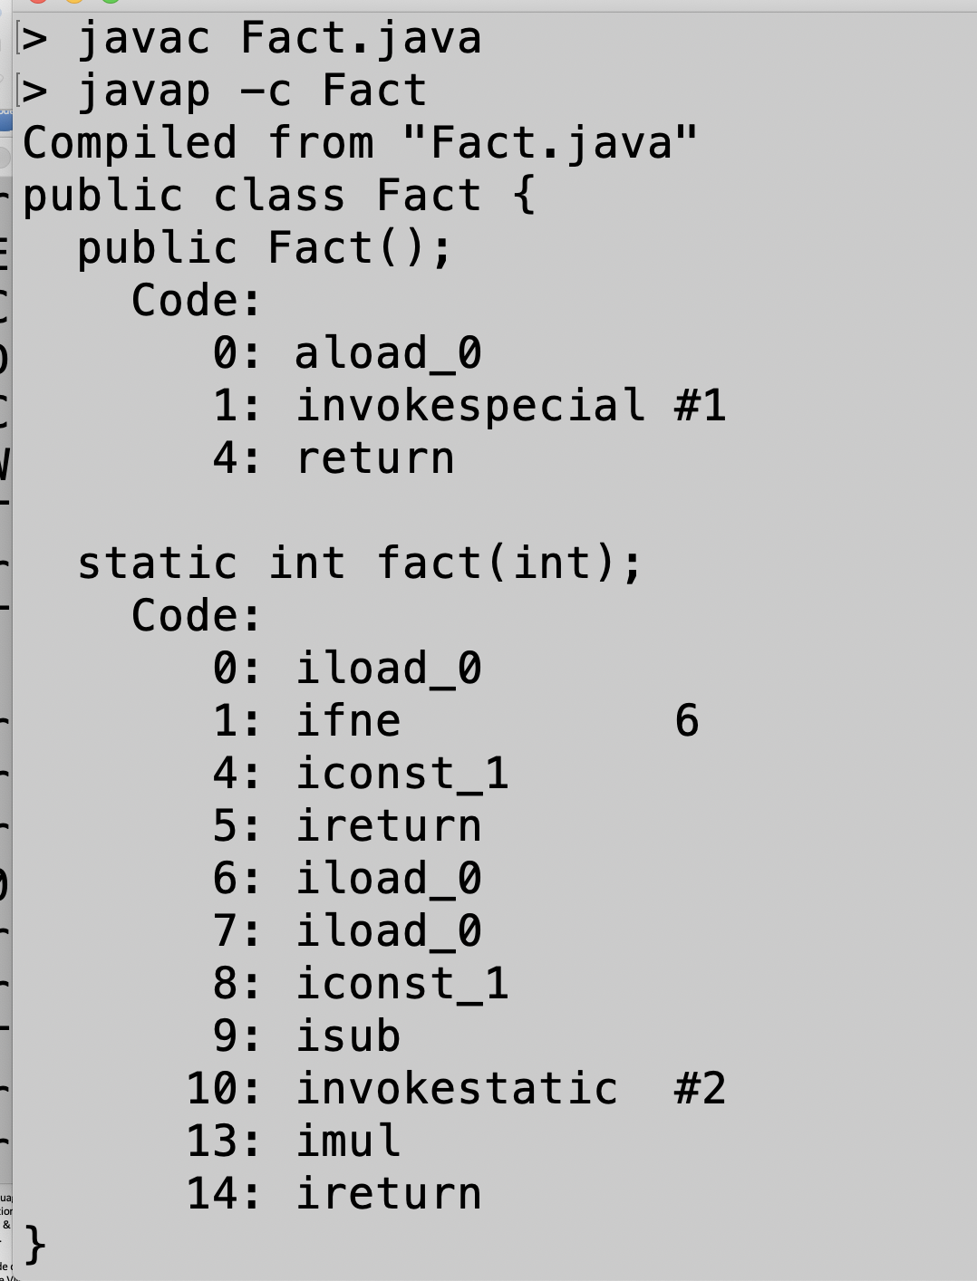
Dis-compiling byte-codes: Java
public class Fact {
static int fact(int n) {
if (n == 0)
return 1;
else
return n * fact(n - 1);
}
}

Slide 9
Compiler + Virtual Machine
A compiler and VM are sometimes combined into one program, often called an interpreter or REPL. Python uses this model.
Virtual Machine
Compiler
Byte Code
Source
Program
Libraries

Slide 10
Compiler
Byte Code
Source
Program
In some language implementations, the compiler & VM are separate.
The byte-code can be run on the VM any time after compilation.
Libraries
Tuesday
Compile-time
Friday
Run-time
Virtual Machine
Byte Code

Slide 11
Advantages of the Phase Separation
The compiler can find and report many (but not all) errors before the program is running;
The compiler can sort out the type information at compile time so this work isn’t required at run-time, this leads to more performant code.
NB: compile-time information about a program is often said to be static

Slide 12
Python is dynamically-typed – the types of operands must be determined as the program is running
No type information
def fact(n):
if n == 0:
return 1
else:
return n * fact(n - 1)
What kind of multiply?

Slide 13
In order for BINARY_MULTIPLY to choose between integer multiply and floating point multiply, the operands (i.e., numbers) must be accompanied by type information at run-time. This is costly.

Slide 14
Java and Ocaml are statically typed – type information is known at compile time.
public class Fact {
static int fact(int n) {
if (n == 0)
return 1;
else
return n * fact(n - 1);
}
}
Inferred to be an integer multiply on Tuesday.
No need for run-time type information

Slide 15
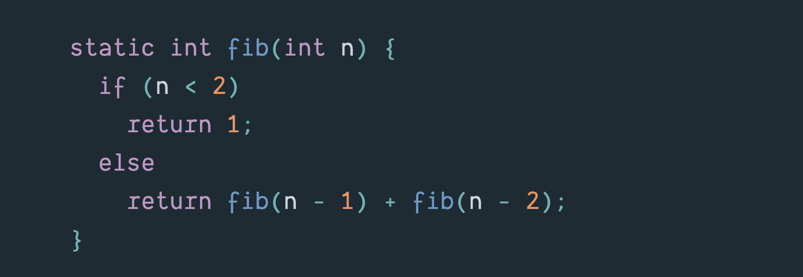
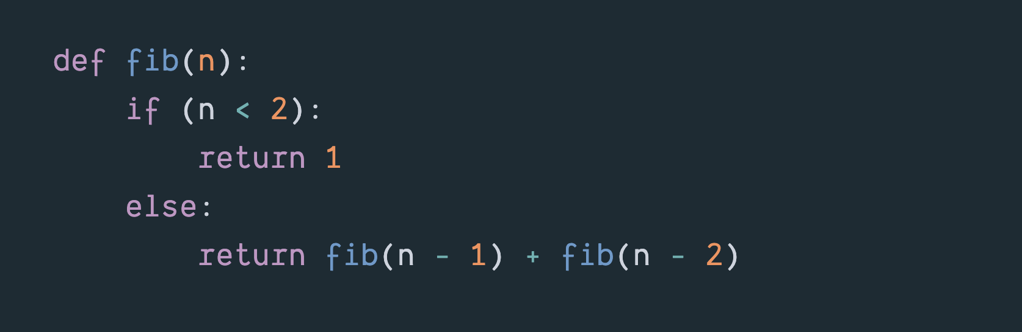
Two wildly inefficient Fibonacci functions.

Slide 16
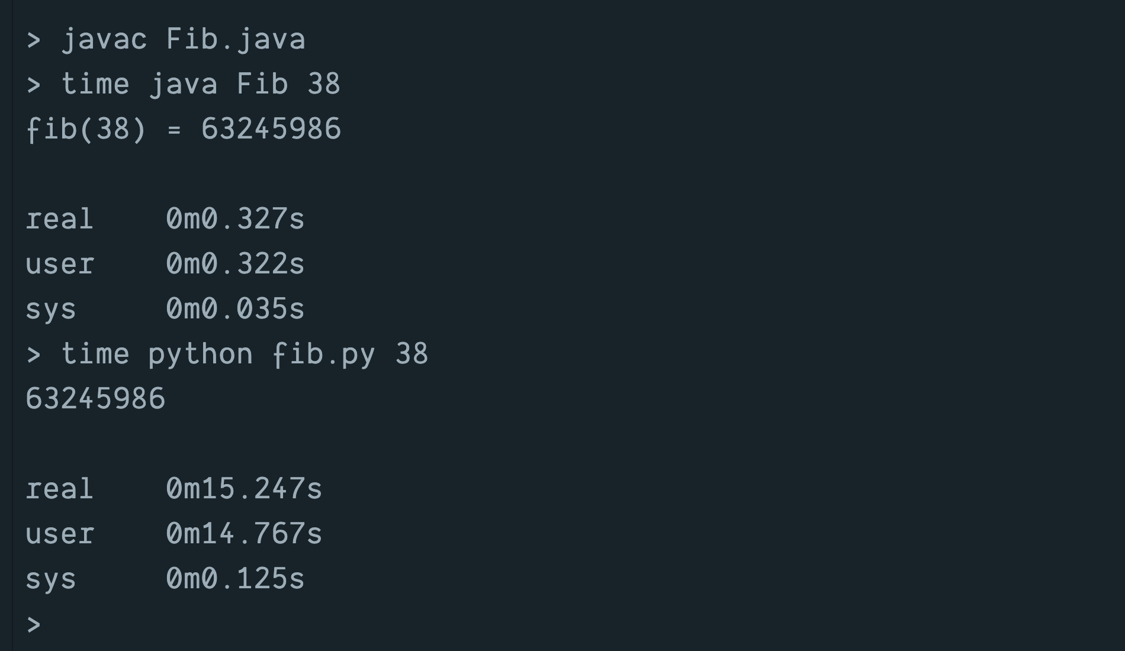
Run-times on VMs for fib(38)
The Python time includes time for translation.

Slide 17
 | REPL | Byte-Code Compiler | Native-Code Compiler
Python | YES |  | NO
Java | NO | YES | NO
OCaml | YES | YES | YES

Slide 18
2. The basic structure of a Java program
What Java programs look like.
How they work.

Slide 19
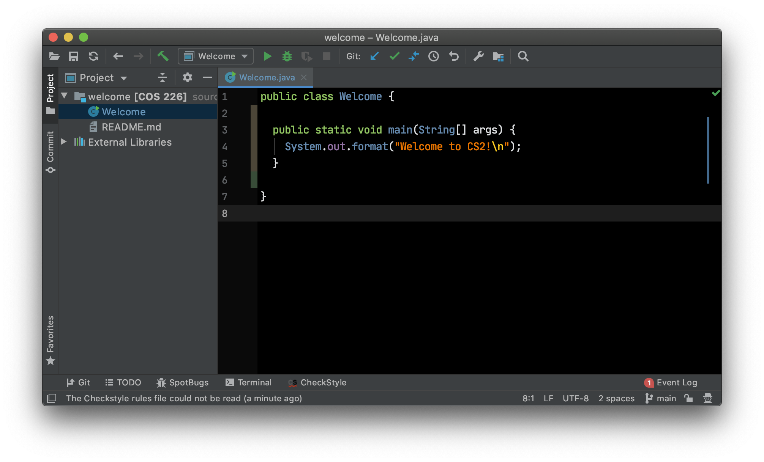

Slide 20
The keyword symbol public is a visibility attribute. The class Welcome and function main are visible anywhere. Another common visibility attribute for a declaration is private – the name is visible only within the class.

Slide 21
Class names begin with a capital letter. A file can have at most one public class. The name must match the file name.

Slide 22
If you compile a Java source file containing a public class and want to execute the code in it, it must have a public and static function called main.

Slide 23
The symbol void is a type, in this position it is the return type of function main. Function main doesn’t return a value.

Slide 24
The symbol args is a formal parameter of the function main. The programmer declares that it will hold a value of type array of Strings. These are the command line arguments.

Slide 25
The body of the function, enclosed in braces {}, simply calls the format function contained in the System.out class.

Slide 26
Example: Who is taking CS2?

Slide 27
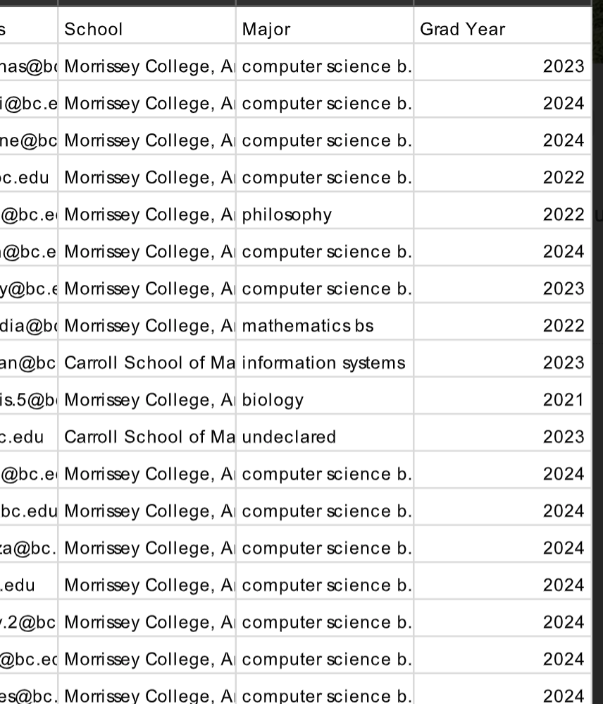
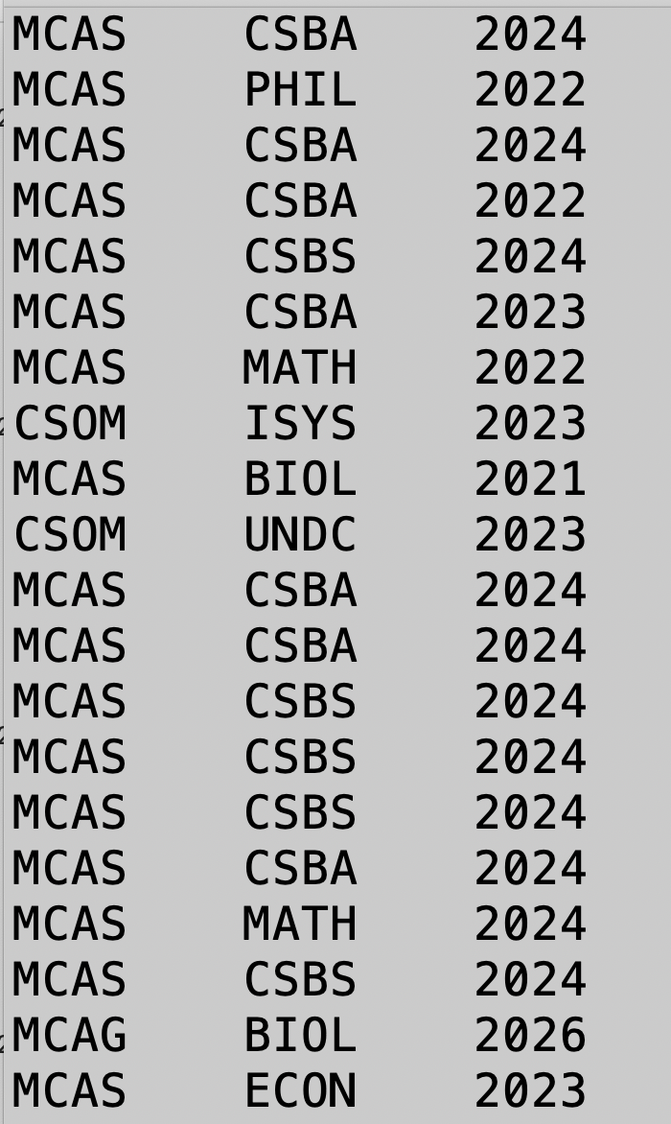

Slide 28
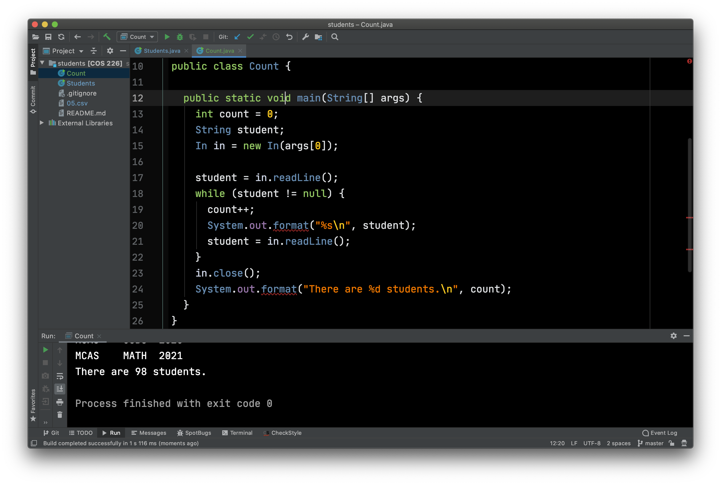
Count Enrolled Students

