Slide 1


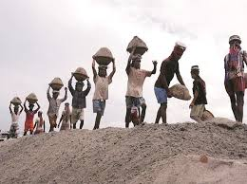
NATIONAL RURAL EMPLOYEMENT GURANTEE ACT (NREGA)
DATA – INSIGHTS FOR OPTIMIZING SCHEME
-BY AKANKSHA KUMARI

Slide 2

WHAT IS NREGA ABOUT?
In 2009, it was renamed as Mahatma Gandhi National Rural Employment Guarantee Act (MGNREGA). It guarantees 100 days of wage employment annually to rural households. (MGNREGA) was notified on September 7, 2005.
The primary goal is enhancement of livelihood security to the households in rural areas of the State in a financial year to every household volunteer to do unskilled manual work.
Under the scheme, minimum wages of Rs. 374/- per man-day notified by the Ministry of Rural Development, Govt of India w.e.f. 1st April, 2024 are being paid equal to men and women workers .

Slide 3


objective
The project aims to use Power BI to analyze the effectiveness of MGNREGA in providing rural employment, identify regional disparities in its implementation, and examine the correlation between budget utilization and employment generation. By examining the key factors the project objective is to identify inefficiencies and roadblocks of the scheme.
Evaluating financial efficiency, and providing insights for targeted regional interventions it will help stakeholders make data-driven decisions to improve the program's effectiveness.

Slide 4
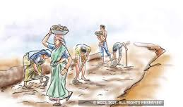

PROBLEM STATEMENT
How effective is NREGA in providing employment opportunities to rural households?
Are there regional disparities in the implementation and outcomes of the scheme?
What is the utilization of the allocated budget, and how does it correlate with
employment generation?
What are the key factors contributing to the completion of NREGA works, and are there
any roadblocks to its success?
Can data-driven insights guide policymakers and administrators in optimizing the
scheme's impact?
2024.22.06
Indian gov . scheme
4

Slide 5

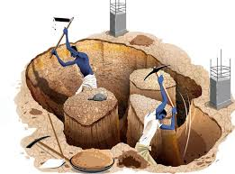


Data set overview
Source:- Official government site
Mode:- CSV
Columns
state_name
district_name
Total Individuals Worked
Differently abled persons worked
Number of GPs with NIL expenditure
Total No of GPs
Total No of Works Takenup
Number of Ongoing Works
Number of Completed Works
% of NRM Expenditure(Public + Individual)
% of Category B Works
% of Expenditure on Agriculture & Agriculture Allied Works
Total Exp(Rs. in Lakhs)
Wages(Rs. In Lakhs)
Material and skilled Wages(Rs. In Lakhs)
Total Adm Expenditure (Rs. in Lakhs.)
Total No. of Job Cards issued
Total No. of Workers
Total No. of Active Job Cards
No. of Active Workers
SC workers against active workers
ST workers against active workers
Approved Labour Budget
Persondays of Central Liability so far
SC persondays
ST persondays
Women Persondays
Average days of employment provided per Household
Average Wage rate per day per person(Rs.)
Total No of HHs completed 100 Days of Wage Employment
Total Households Worked

Slide 6
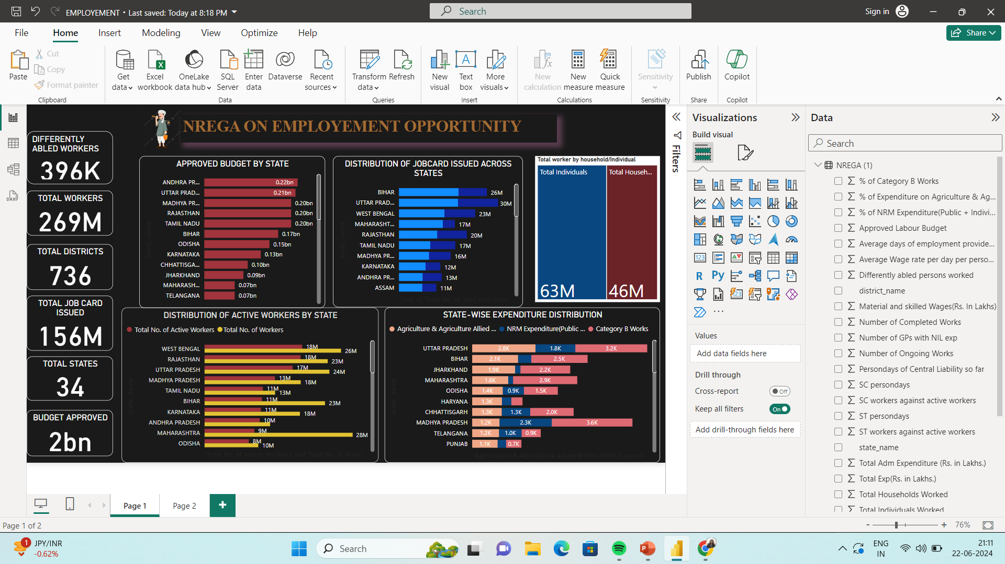

Slide 7
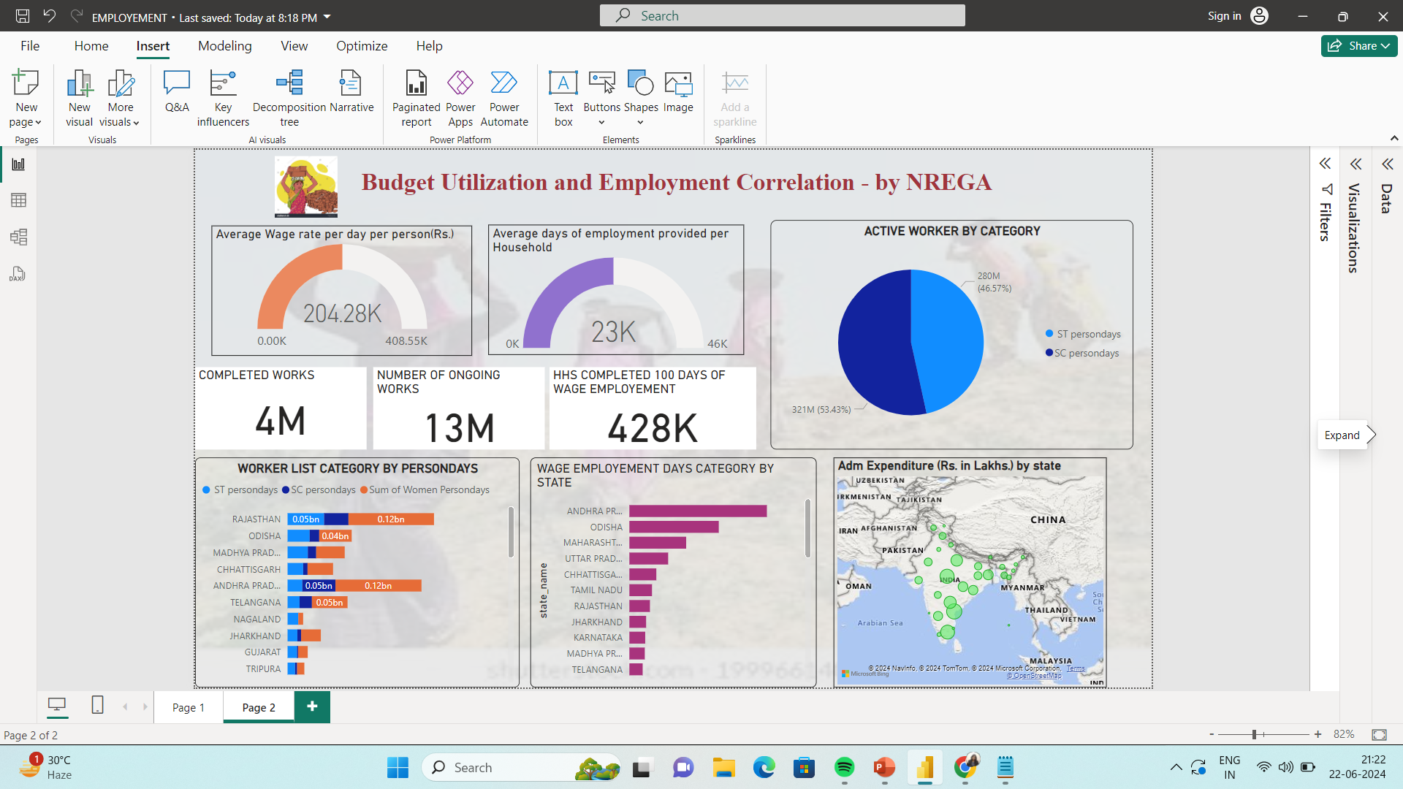

Slide 8


KEY INSIGHTS
1. Distribution of Job Cards and Workers:
- Total Job Cards Issued: 156 million across 34 states and 736 districts.
- Highest Number of Active Workers: Uttar Pradesh (28 million), Bihar (23 million), and West Bengal (26 million).
- Highest Number of Job Cards Issued: Uttar Pradesh (30 million), Bihar (26 million), and West Bengal (23 million).
2. Budget Allocation and Expenditure:
- Total Approved Budget: $2 billion.
- Top Budget Recipients: Andhra Pradesh ($0.22 billion), Uttar Pradesh ($0.21 billion), and Madhya Pradesh ($0.20 billion).
- State-wise Expenditure: Uttar Pradesh, Bihar, and Maharashtra lead in expenditure on agriculture and allied works.
3. Employment Categories and Wages:
- Active Worker Categories: 53.43% are general category workers, and 46.57% belong to SC/ST categories.
- Wage Rates: The average wage rate per day per person is approximately 408.55 INR.
- Average Employment Days: Households received an average of 46 days of employment.
4. Project Progress:
- Ongoing Works: 13 million.
- Completed Works: 4 million.
- Employment for Differently-Abled Workers: 396,000 workers involved.
​

Slide 9
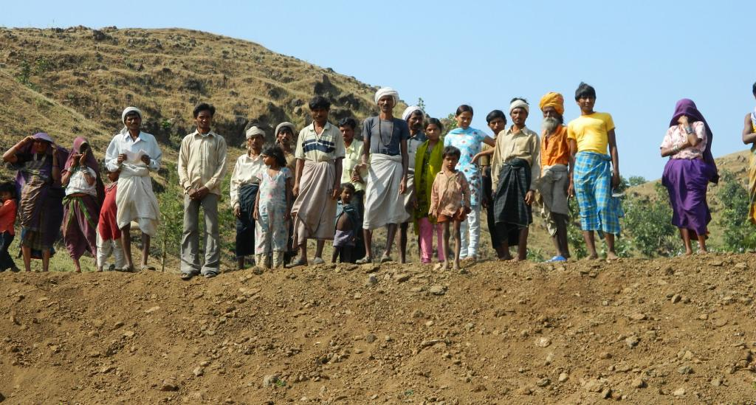
INSIGHTS IMPACTING OPTIMIZATION OF SCHEME
MANAGES IMPACTS ON CONDITIONAL ANSWERS.
PROVIDES DEEP HIGHLIGHTS OF RESOURCES.
KEEP EVALUATION OF METRICES.
EASIER VISUALIZATION.
HELPS IN PROVIDING FEEDBACKS .

Slide 10


RECOMMENDATION
INCREASE EMPLOYEMENT DAYS.
PRACTICE FAIR DISTRIBUTION OF WORK , FUNDS AND WAGES .
TRAINING OF OFFICIALS FOR MANAGEMENT.
FOCUS ON VULNERABLE POPULATIONS .
SUPPORT FOR UNDERPERFORMING REGIONS.

Slide 11





Thank you
-by AKANKSHA

