Slide 1
PES University, Bengaluru
Final Semester Assessment (FSA) – B.Tech. (CSE) – IV Sem
Session: August – December, 2019
UE17CS302 – INTRODUCTION TO OPERATING SYSTEMS
Verification of Producer-Consumer synchronization in GPU Programs
TEAM:
SL No | Name | SRN | Roll No
1 | Akanksha Tonne | PES1201700275 | 19
2 | Rachana Sudhindra Dani | PES1201700950 | 29
3 | Rishika Malla | PES1201700162 | 10
4 | Radhika Sadanand | PES1201701702 | 54
5 | G.Rachana Rao | PES1201700960 | 30

Slide 2
OBJECTIVE
To define what it means for a warp specialized program to be correct and to measure the correctness of programs. The paper presents the algorithms to verify the correctness. The authors of the paper also present the Weft and algorithm to verify the correctness of the warp specialized code.

Slide 3
Keywords that need explanations
Data Parallel GPU Programming model
Operational Semantics
Barrier Synchronization
Thread Blocks

Slide 4
NAMED BARRIERS
Available in PTX on NVIDIA GPUs.
They are used to perform Synchronization.
Arrive that is Non-blocking and Sync that is blocking.

Slide 5
WARP-SPECIALIZED KERNELS.
Warp is a group of 32 threads.
Three properties.

Slide 6
Compute Unified Device Architecture(CUDA)
Data programming model.
Kernels commonly execute using a streaming paradigm That is loading data -n-chip,perform computation on the data and write back off-chip.
Barrier is used for synchronizing.

Slide 7
WEFT
Verifier that is capable of efficiently checking the correctness.

Slide 8
Warp-Specialization and Named Barriers

Slide 9
Warps
Each CTA is decomposed into warps where a warp is 32 contiguous threads in the same CTA.
System Manager performs scheduling at warp-granularity:
Each warp has its own program counter
All threads in a warp execute in lock-step

Slide 10
Warp Specialization
Individual warps are assigned different computations
Differentiates warps into
  Compute
    CudaDMA specializes warps in compute
    act as consumers
  DMA
    optimize the loading of data in shared memory
    act as producers
Warp specilizations kernels communicate through shared memory.
Communication in warp-specialized kernels is asymmetric
  one or more warps acting as producers,
  one or more other warps acting as consumers

Slide 11
Named Barriers
GPU supports named barriers through instructions :
  Sync
    causes the threads in a warp arriving at the barrier to block until the barrier completes
  Arrive
    allows a warp to register arrival at a barrier and immediately continue executing without blocking
Producer-Consumer synchronization can be maintained by the above instructions.

Slide 12
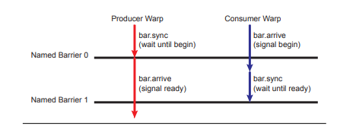
2 named barriers are used to coordinate movement of data from a producer warp to a consumer warp through a buffer in shared memory.
The producer warp first waits for a signal from the consumer warp that the buffer is empty.
The consumer warp signals the buffer is ready by performing a nonblocking arrive operation.
At some point the consumer warp blocks on the named barrier 1 waiting for the buffer to be full. The producer warp signals when the buffer is full using arrive operation on the named barrier 1.
Named barriers support synchronization between arbitrary subsets of warps within a CTA which includes allowing synchronization between a single pair of warps as in this example.

Slide 13
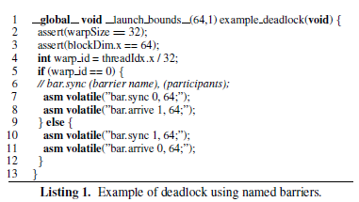
The 2 threads - warp with id 0 and warp with id 1 are running parallel
The both warps are calling on sync which is a blocking operation.
Warp with id 0 at named barrier 0 is waiting for the warp with warp id 1 to register itself at named barrier 0 by calling arrive.
Warp with id 1 at named barrier 1 is waiting for the warp with warp id 0 to register itself at named barrier 1 by calling arrive.
Hence, one thread waits for other in a cyclical fashion resulting in a deadlock.

Slide 14
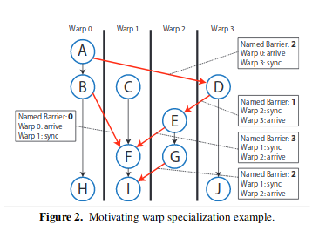
Properties of the warp specialized kernels:
Reuse of named barrier
  To avoid conflicting arrivals at named barriers from participants of different generations, a happens-before relationship is established.
When all barriers successfully execute and are reused correctly, it is called well synchronization kernel.
Synchronization pattern is completely static
The named barriers constraints parallelism in the kernel so that it is both deterministic and known at compile-time.

Slide 15
Operational Semantics
Checking for
deadlock-freedom
proper named barrier recycling
shared memory data race freedom
Assumption is that all CTA’s execute the same program.

Slide 16
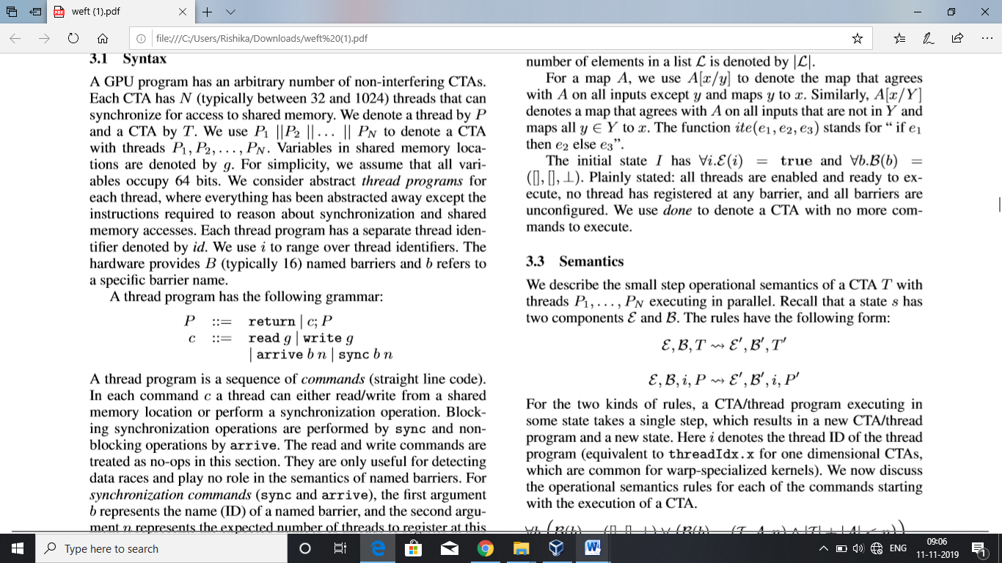
SYNTAX
CTA – 32 to 1024 threads
Thread – P
CTA-T
CTA with threads P₁, P₂, P₃…….P_{N} - P₁||P₂||P₃….. ||P_{N}
Shared memory variables –g
Thread identifier- id
Named barriers – B (typically 16)
Specific barrier name – b
Command – c
Program point -ἠ
We use i to range over thread identifiers
A thread has the following grammar

Slide 17
Blocking synchronization operation -sync
Non-blocking operation – arrive
Program point ἠ and command c_{ἠ} correspond if η is the program point just after c_{ἠ}.
The ﬁrst program point of thread i is denoted by η^{i}_{I} and the last by η^{i}_{F}.

Slide 18
State
state ‘s’ of CTA consists of the following
Enabled map ἐ - It maps thread identifiers to Booleans indicating whether a thread is enabled or not.
Barrier map B –It maps the barrier names to a triple consisting of a list I of threads that have synced at the barrier, a list A of threads that have arrived at the barrier, and the thread count
The thread count of unconﬁgured barriers is denoted by ⊥
An empty list of thread identiﬁers is denoted by []
“::” adds a thread to a list
A[x/y] to denote the map that agrees with A on all inputs except y and maps y to x
, A[x/Y ] denotes a map that agrees with A on all inputs that are not in Y and maps all y ∈ Y to x
The function ite(e1,e2,e3) stands for “ if e1 then e2 else e3”
The initial state I has ∀i.E(i) = true and ∀b.B(b) =([] ,[],⊥)

Slide 19
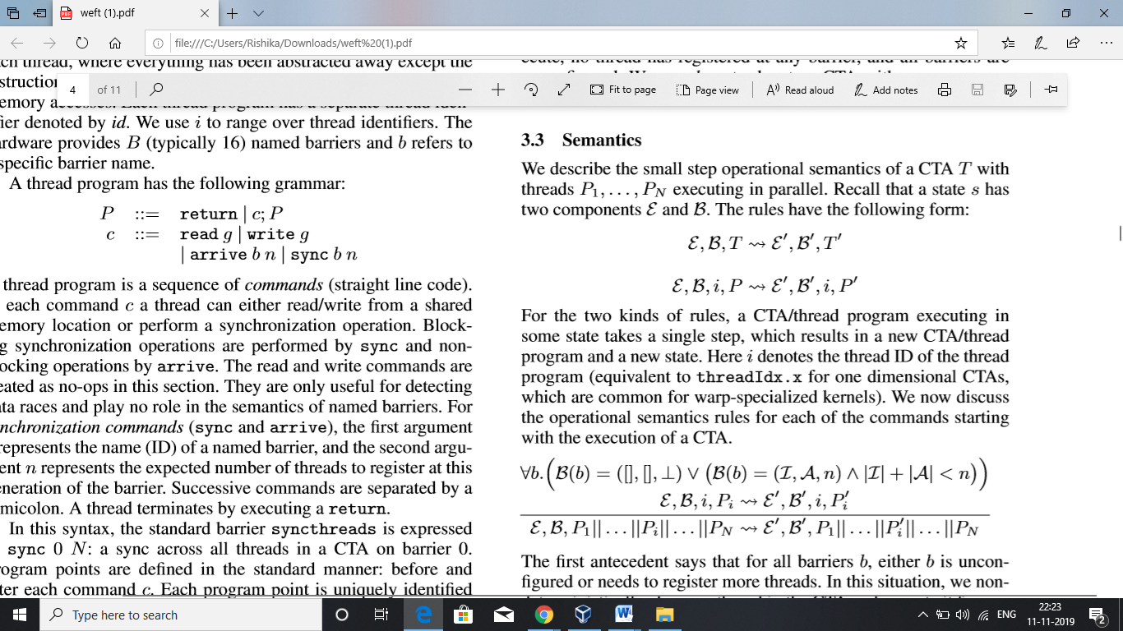
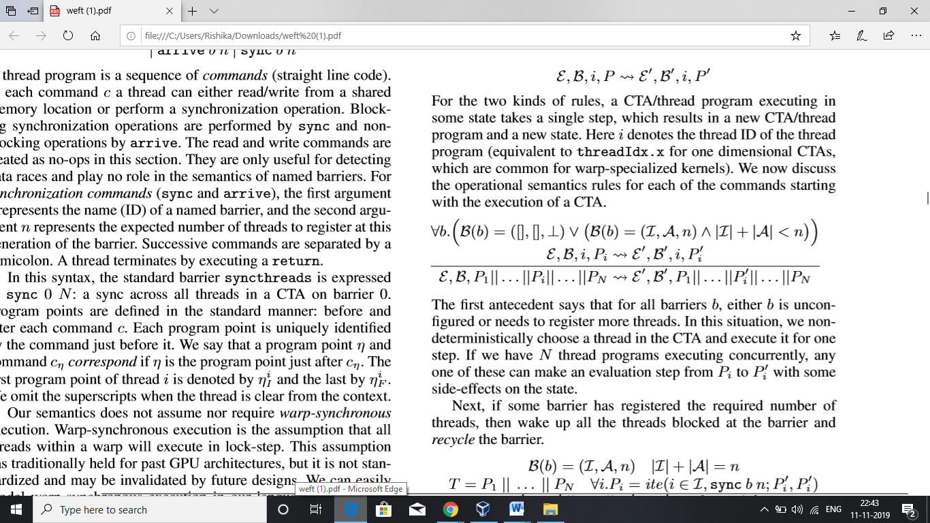
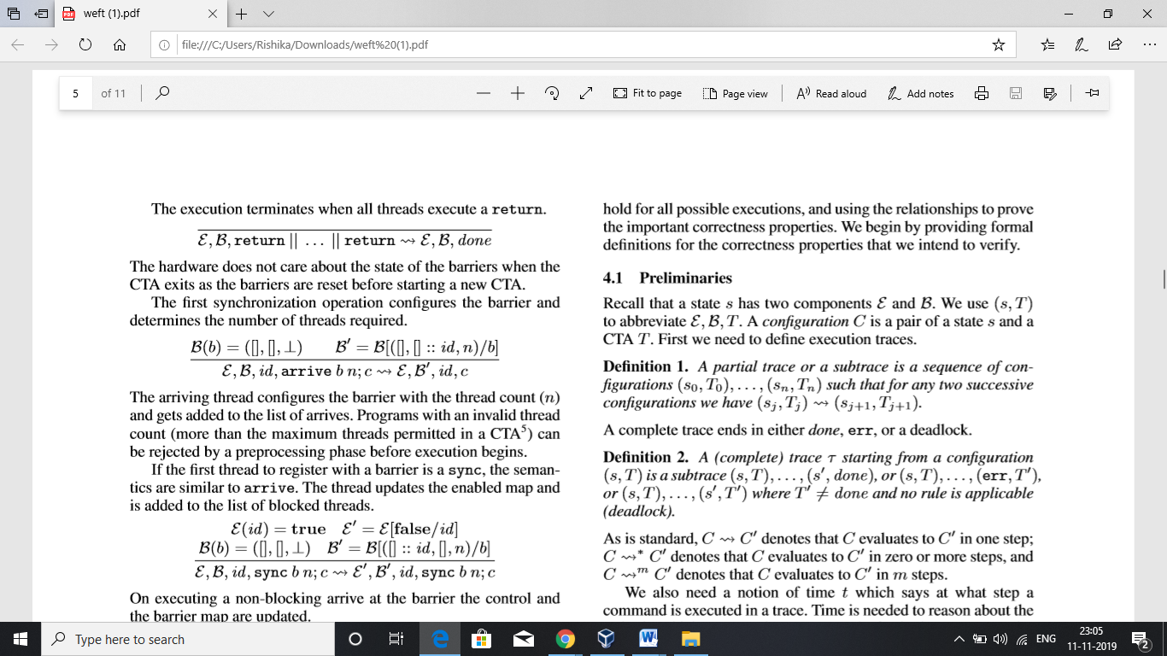
Semantics
We consider a CTA T with threads P₁, P₂, P₃…….P_{N} executing in parallel
For all barriers b, either b is unconfigured or needs to register more threads. We non-deterministically choose a thread in CTA and execute it for one step. If we have N thread programs executing concurrently, anyone can make step from P^{i} to P_{i}’
Execution terminates when all threads execute a return

Slide 20
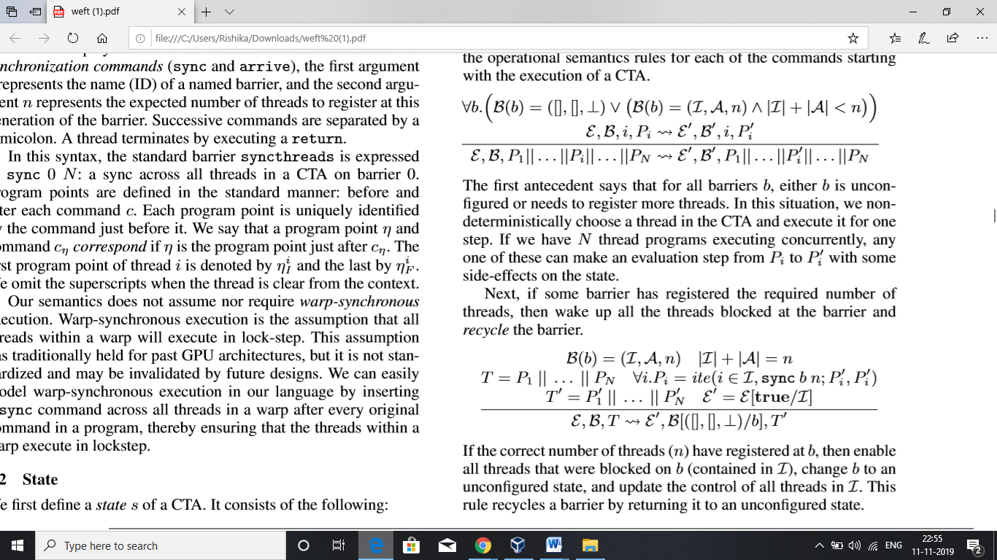

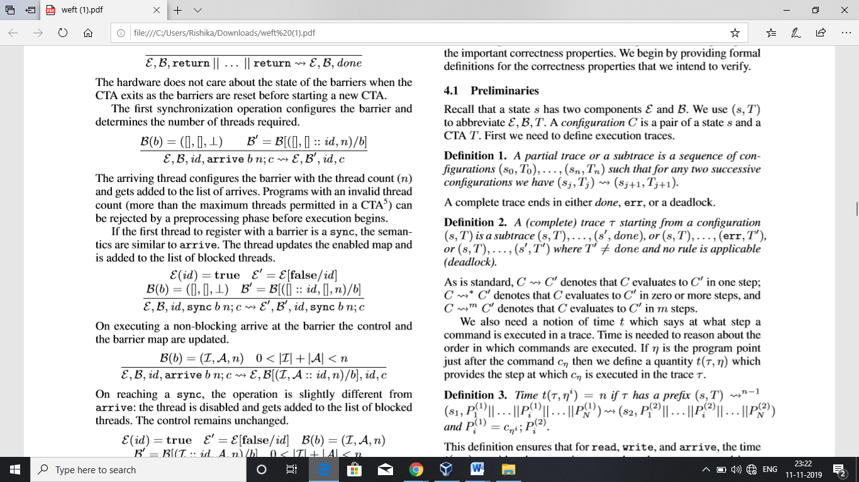
If some barrier has registered required number of threads, then wake up all threads registered at barrier. If n threads registered at b, enable all threads blocked on b, change b to an unconfigured state, update the control of all threads in I.
The arriving thread conﬁgures the barrier with the thread
count (n) and gets added to the list of arrives
If the first thread to register with a barrier is sync, the thread updates the enabled map and is added to list of blocked threads.

Slide 21
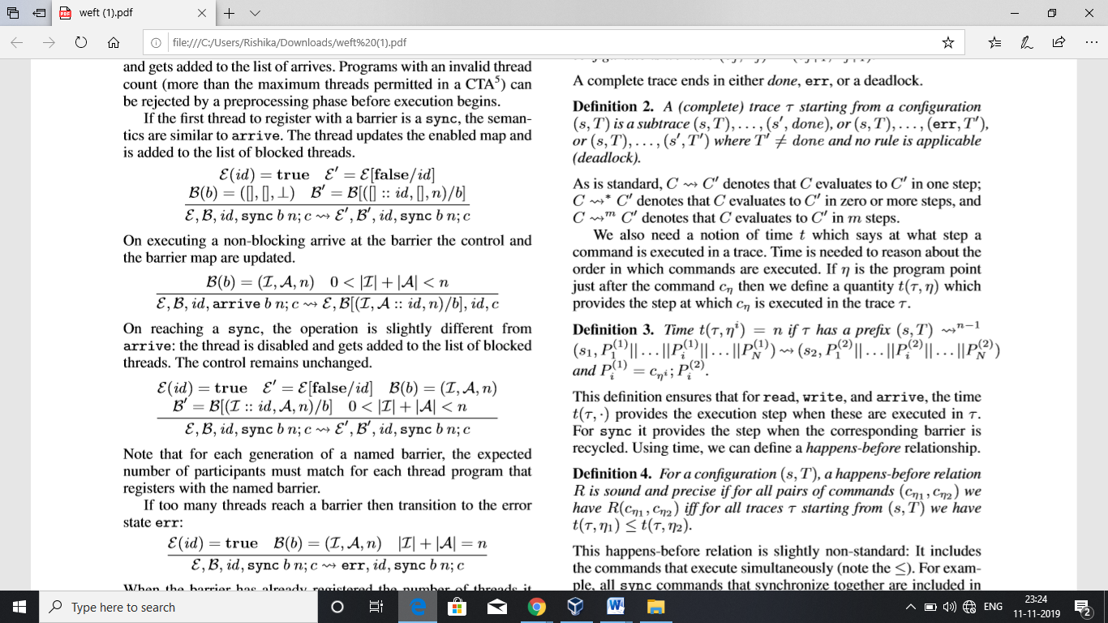
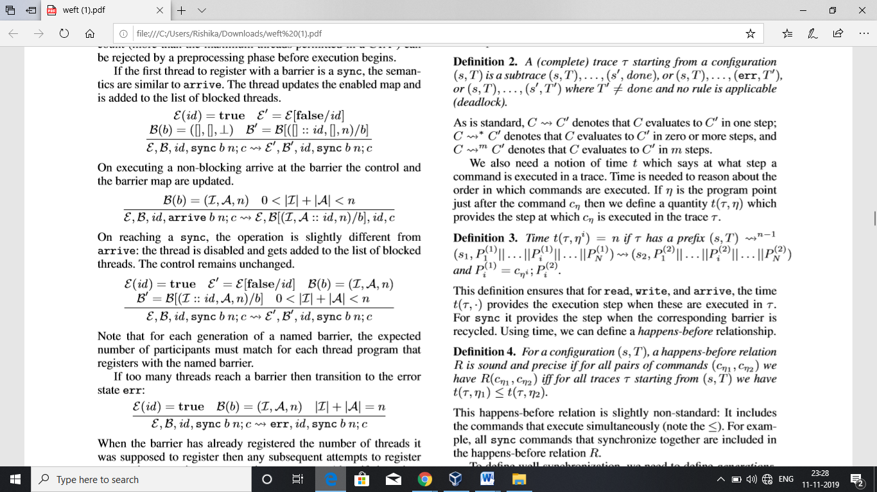
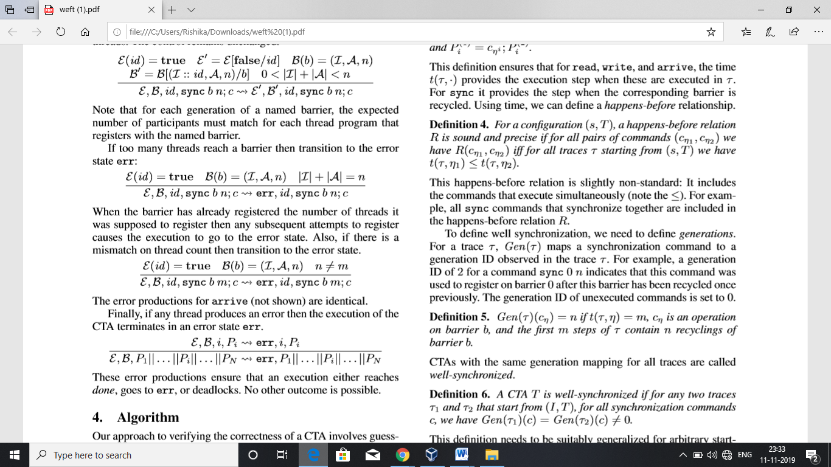
When a non-blocking arrive is executed at barrier, the control and the barrier map are updated.
On reaching sync, the thread is disabled and gets added to the list of block threads.
If too many threads reach a barrier then transition to state err

Slide 22
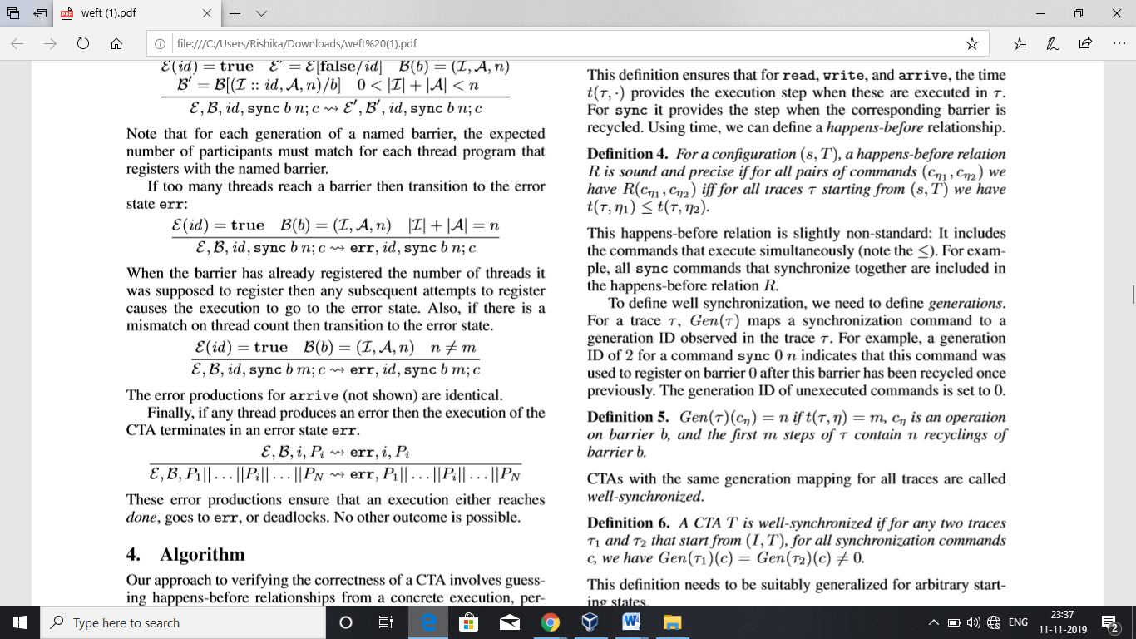

The transition to the error state occurs when there is a mismatch on thread count (similar for arrive)
If any thread produces an error then the execution terminates in an error state.
These error productions ensure that execution either reaches done, goes to err, or deadlocks.

Slide 23
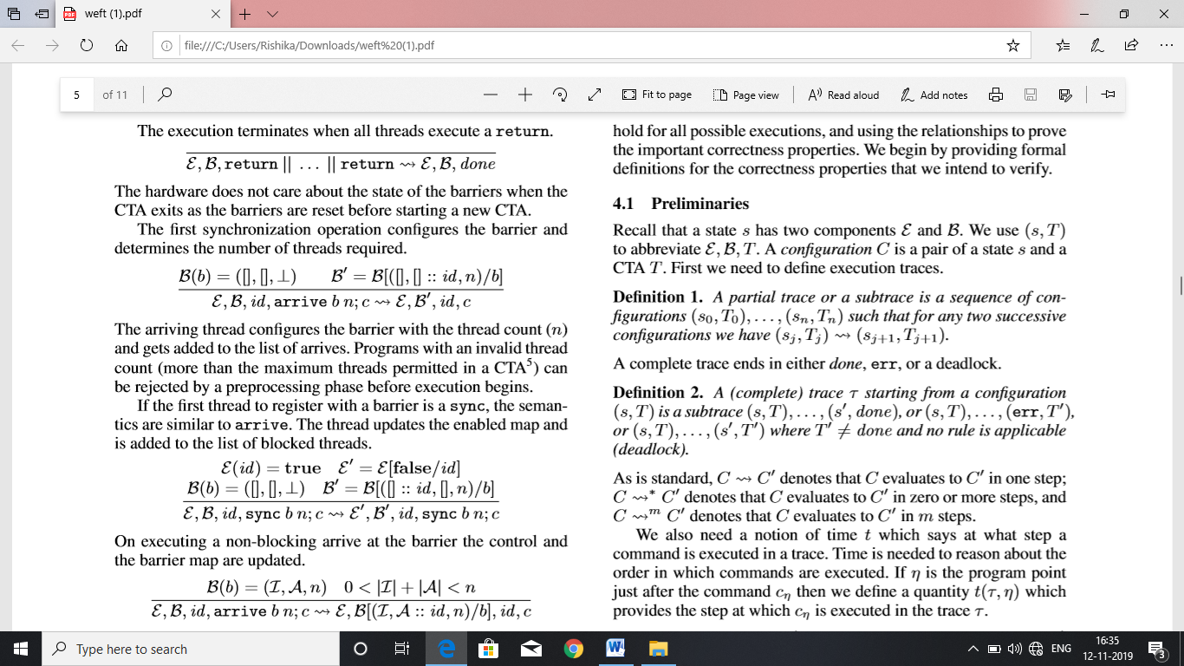

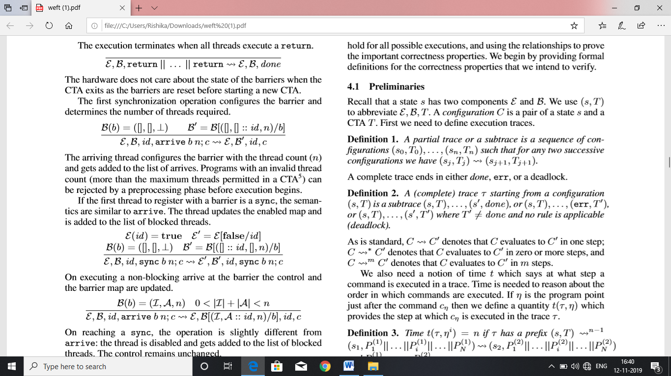
Algorithm
Verifying the correctness of CTA involves guessing happens-before-relationships and using them to prove correctness of properties
We use (s, T) to abbreviate .A configuration C is a pair of a state s and a CTA T.
A complete trace ends in either done, err, or a deadlock

Slide 24
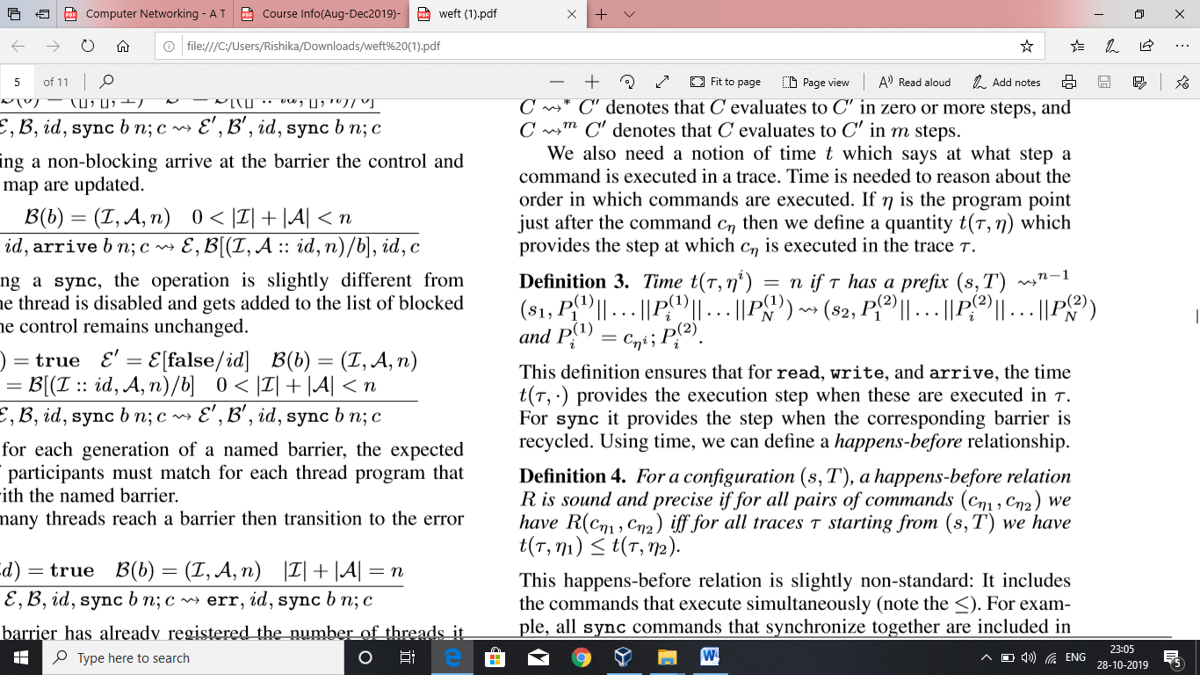
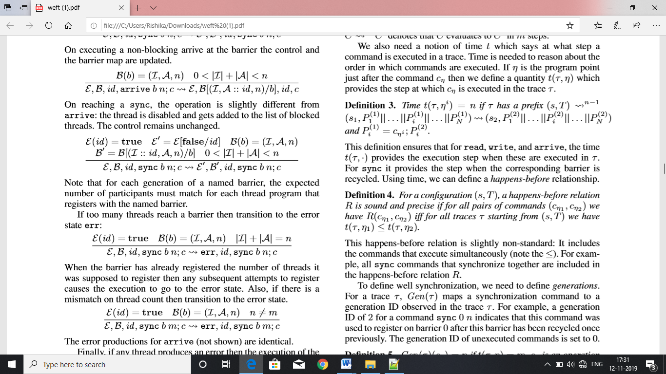
C->C’ – C evaluates to C’ in one step
C->*C’ – C evaluates to C’ in zero or more steps
C->^{m}C’- C evaluates to C’ in m steps
If η is the program point just after the command cη then we deﬁne a quantity t(τ,η) which provides the step at which cη is executed in the trace τ.
Time t(T,.) provides the execution step when read , write and arrive are executed in T. Sync , the step is when the corresponding barrier recycled

Slide 25
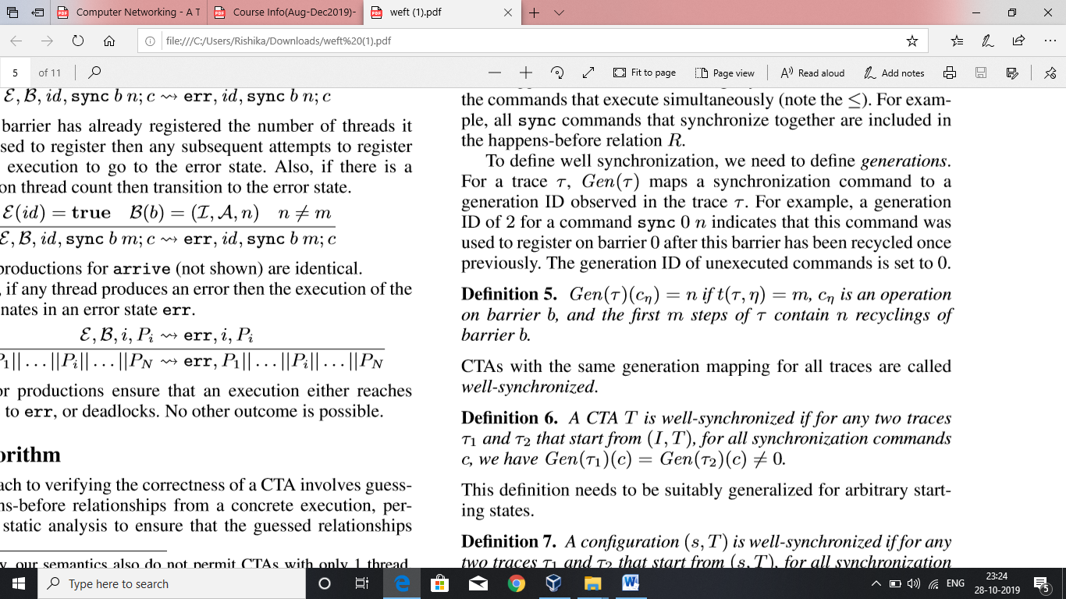

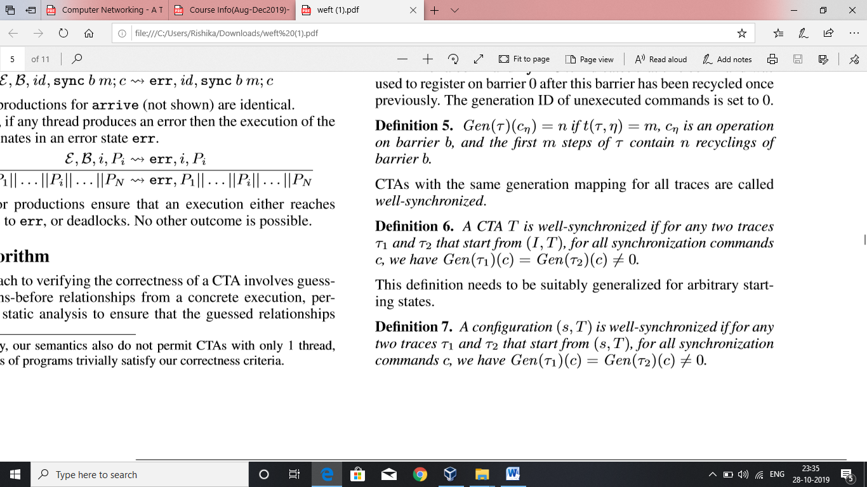
Gen(T) maps a synchronization command to a generation ID
The gen ID of unexecuted commands is set to 0
If the generation mapping for all traces in the CTA are same , then it is said to be well-synchronized

Slide 26
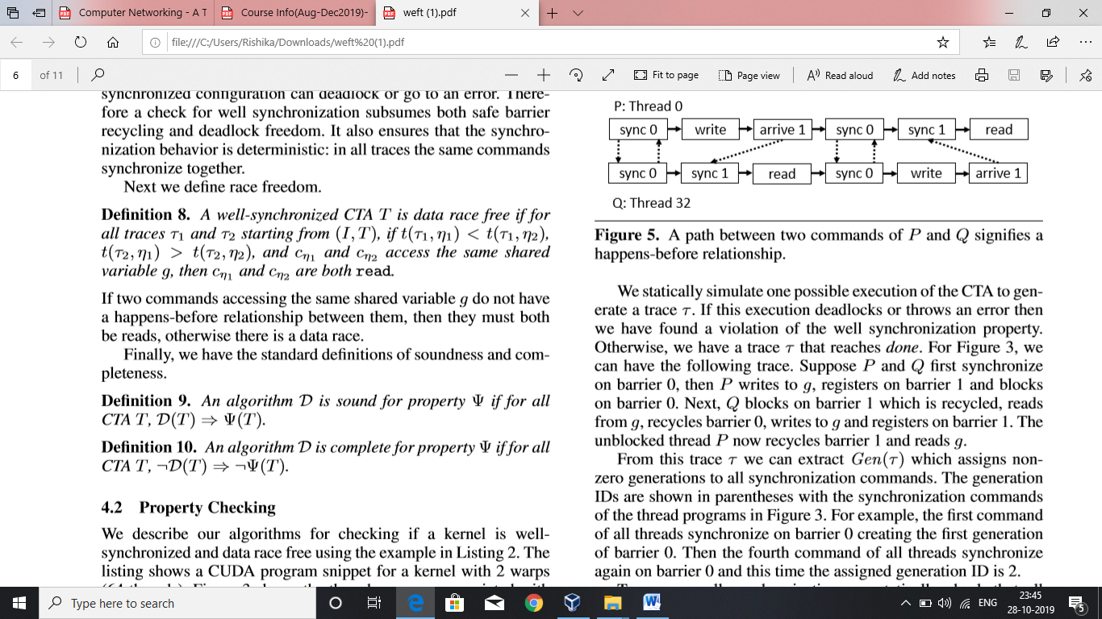
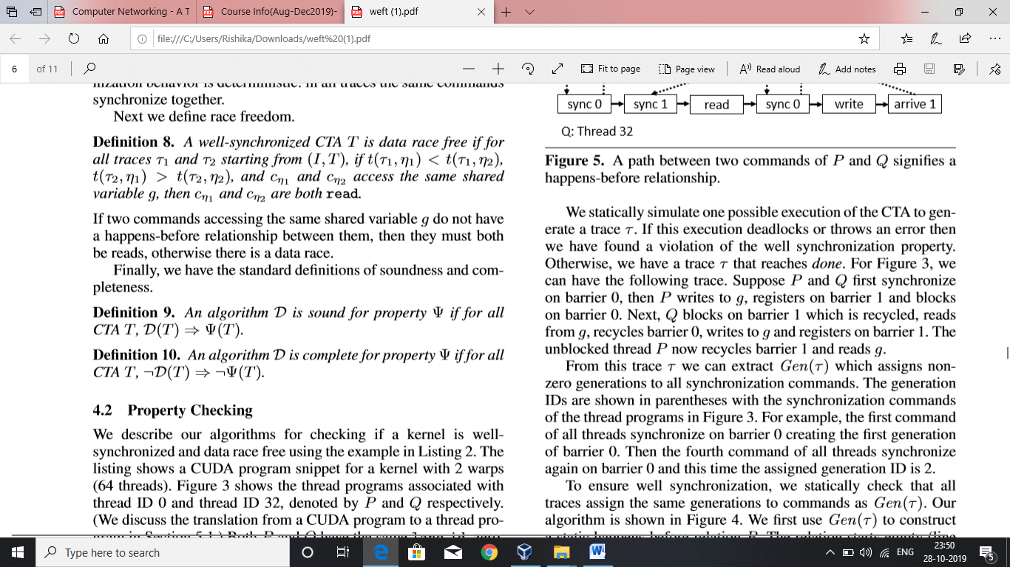
The non-zero check takes care
  No trace can deadlock
  No trace can go to error
  Considers safe barrier recycling
  Considers deadlock freedom
  Ensures that same commands in trace synchronize together
If Two commands access the same shared variable g and they do not have a happens before relationship between them , then both should be reads .If there is any write , they get into dataraces.

Slide 27
Warp-Specialization and Named Barriers

Slide 28
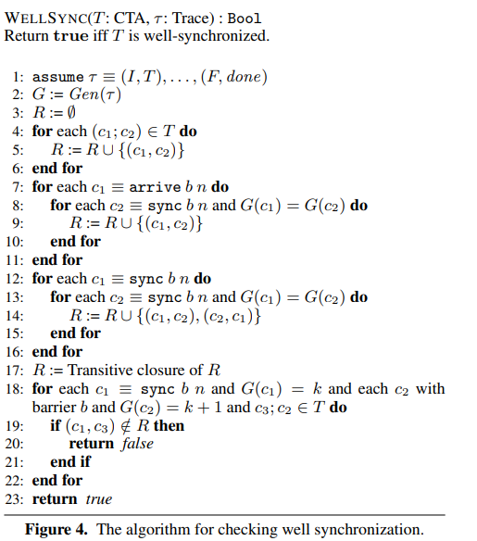
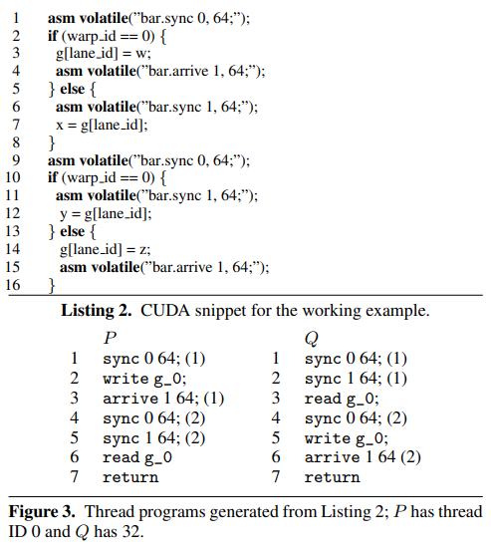
4.2Property checking

Slide 29
5.1 Emulation of GPU programs in WEFT
Input to the WEFT PTX – assembly language code used in CUDA environment
Emulates each thread in the warp till one of the stopping situations occur
1.No more instructions to emulate
2.Deadlock
3.Not being able to acquire inputs for certain instruction.

Slide 30
5.2 Optimized WEFT Veriﬁcation Algorithm
1. Synchronization check
2. Barrier Dependence Graph
3. Detection of Data Races

Slide 31
Synchronization Check:
Omit all read and write commands
Omit Memory accesses as they do not affect synchronization
Use Algorithm to verify.

Slide 32
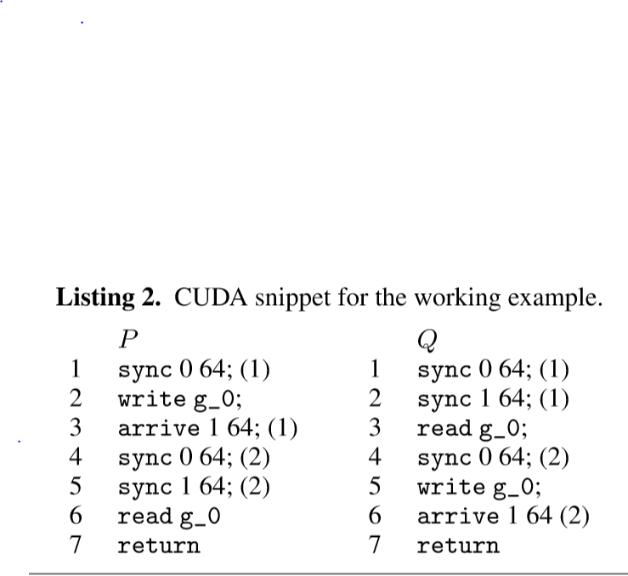
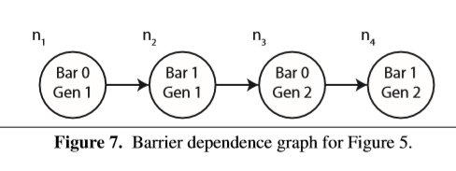
Barrier Dependence Graph
Acyclic directed graph indicates well synchronization

Slide 33
Optimised Algorithm:
Data Race Detection
WEFT ﬁrst computes the earliest/latest happens-after/before points reachable in every thread program from each node in the barrier dependence graph.
Happens-before points
2. Earliest Happens-after points

Slide 34
Experiments:
WEFT was evaluated on 13 warp-specialized kernels that use the CudaDMA library and 13 warp-specialized kernels that were emitted by the Singe compiler.
CudaDMA : 65-1561 lines of CUDA Singe compiler: 1684-13245 lines of CUDA
All experiments were run on an Intel Xeon X5680 Sandy Bridge processor clocked at 3.33 GHz with 48 GB of memory divided across two NUMA domains.
All experiments using WEFT were run with four threads (two per NUMA domain).
.

Slide 35
WEFT
Performance
1. Statistics on each of the kernels including the number of dynamic barriers
2. Total shared memory addresses that are used
3. Total commands in the formal language across all threads
4. The number of thread programs, and the total race tests that were performed.
Performance is measured by the time required to verify each kernel and the total memory required to perform the veriﬁcation.
WEFT reports whether the kernel is well-synchronized and race-free.
In the future, the authors anticipate WEFT will be especially valuable in giving feedback for debugging warp specialized kernels that either deadlock or crash due to a violation of the well-synchronized property during development.
WEFT is able to verify most kernels in a few minutes or less making it practical for use by real developers

Slide 36
Conclusion:
As GPU usage continues to expand
More task parallelism and larger working sets, warp specialization will become increasingly important for handling challenging kernels that do not ﬁt the standard data-parallel paradigm
Difficult to identify Bugs. Hence, WEFT tool can come handy.
WEFT runs on large, complex, warp-specialized kernels requiring upto billions of checks for race conditions and completes in a few minutes.

Slide 37
THANK YOU! ☺

