Slide 1

DEPARTMENT OF COMPUTER SCIENCE Project Presentation (KCS 851) KrishiKom
Guide Name: Prof.Rahul Kumar
1.Shivam Sharma(2000290120150) CS 8C
2.Shivam Nautiyal(2000290120149) CS 8C

Slide 2
Problem Statement-
The agricultural sector in India struggles with inadequate market infrastructure, limited access to real-time information, and unsustainable farming practices, leading to low productivity and financial instability for farmers. There is a critical need for a comprehensive, technology-driven solution to empower farmers with accurate weather updates, expert crop advice, efficient irrigation techniques, and access to financial and market resources. The "KRISHIKOM" mobile application aims to address these challenges by providing a user-friendly platform that enhances communication, supports sustainable agriculture, and improves farmers' economic well-being.

Slide 3
Objectives-
Real-Time Weather Monitoring: Providing accurate and timely weather forecasts to help farmers plan their activities.
Professional Crop Advice: Offering expert guidance on crop management to improve yield and quality.
AR-Based Irrigation Guidance: Utilizing augmented reality to assist farmers with efficient irrigation techniques.
Sustainable Farming Practices: Educating farmers on methods to maintain and improve soil health and crop productivity sustainably.
Community Building: Creating a platform for farmers to share experiences, collaborate, and support each other.
Shared Farming Equipment: Facilitating the sharing of farming tools and machinery to reduce costs and improve efficiency.
Financial Inclusion: Providing access to financial services and resources to support farmers' economic stability.
Global Market Trends Analysis: Offering insights into market trends to help farmers make informed decisions about selling their produce.

Slide 4




Technology Used
Server : Node.js
Application : React Native Expo
Database : Firebase
Technology: Android

Slide 5
Literature Survey
I. TITLE: A Modern Farming Techniques using Android Application (2011)
AUTHORS: Santosh G. Kirkhill and Sudarshan G. huge
DESCRIPTION: Santosh G. Kirkhill and Sudarshan G. Guge use their research to explore the potential of Android apps to revolutionize agricultural practices. They recognize the limitations of traditional farming methods and propose to develop a comprehensive Android application specifically designed to address these shortcomings. The app will act as a central hub for farmers, offering a variety of features to optimize farm management and decision-making. Imagine a mobile app that uses built-in sensors to collect real-time data on important factors like soil moisture and temperature. This valuable information allows farmers to make informed choices about irrigation practices, potentially saving water and improving crop health. The app also includes an extensive database of crop information, giving farmers easy access to planting guides, pest control measures and disease identification tools using image recognition technology. By providing these resources accessible from a smartphone, farmers can gain the valuable knowledge they need to optimize crop growth and minimize losses. But the benefits go beyond data collection and access to information. The proposed Android application is a platform to promote a sense of community among farmers. By incorporating features that allow users to connect with agricultural experts or fellow farmers, the app can foster knowledge sharing and problem-solving on a larger scale. Farmers can share best practices, seek advice on specific issues and stay up to date on the latest developments in the agricultural sector. This collaborative approach has the potential to empower individual farmers and contribute to the overall growth and efficiency of the agricultural industry. Essentially, Kirkhill and Gouge's research suggests Android applications that go beyond simply providing information. The project aims to create a vibrant ecosystem that provides farmers with real-time data, fosters knowledge sharing and ultimately paves the way for a more sustainable and productive agricultural future.

Slide 6
II. TITLE: Applications of Smartphone-Based Sensors in Agriculture
AUTHORS: Suporn Pongnumkul, Pimwadee Chaovalit, and Navaporn Surasvadi (2018)
DESCRIPTION: This study explores the exciting world of using smartphone sensors to transform agriculture. Explore how a variety of embedded sensors, including GPS and cameras, can be used in innovative applications. These applications have the potential to revolutionize the way farmers collect data, manage crops, and ultimately improve yields. Imagine a scenario where your smartphone becomes a powerful agricultural tool. GPS can track locations and map fields, and cameras combined with image recognition software can detect crop diseases for early intervention. This research pushes the boundaries by exploring the potential of other sensors, such as microphones and accelerometers, for tasks such as monitoring irrigation systems or analyzing animal behavior. Research shows that by combining these different features, a smartphone app can give farmers the ability to collect real-time data on a variety of important aspects of their land. This valuable data can be used to optimize resource use, improve decision-making, and ultimately improve agricultural productivity. In essence, this research paves the way for a new era of smart agriculture that empowers farmers to make informed choices and achieve greater success in agriculture.
III. TITLE: Smart Agriculture Applications Using Deep Learning Technologies: A Survey (2020)
AUTHORS: Maha Altalak et al.
DESCRIPTION: This study, led by Maha Altalak and researchers (etc. stands for “and others”), takes a comprehensive look at the exciting field of smart agriculture based on deep learning technologies. Deep learning, a type of machine learning, is excellent for tasks related to image recognition and pattern analysis. This study explores how deep learning can be used to develop innovative applications that will transform agricultural practices. The research goes beyond this basic application. Harness the potential of deep learning for tasks such as soil analysis, weed detection, and even precision irrigation. Deep learning can analyze massive agricultural data sets to reveal complex patterns and relationships, providing a more data-driven and optimized approach to agriculture. This study was conducted by Altalak et al. Highlights the significant potential of deep learning technologies to revolutionize agriculture. By leveraging the analytical capabilities of deep learning, researchers are paving the way for a future of “smart agriculture” where technology allows farmers to make informed decisions, optimize resource use, and ultimately achieve greater agricultural success.

Slide 7
IV. TITLE: Machine learning applications for precision agriculture: A comprehensive review (2016)
AUTHORS: Sharma, A., Jain, A., Gupta, P., & Chowdary, V.
DESCRIPTION: This research focuses on applying machine learning (ML) to achieve “precision agriculture.” Machine learning algorithms can analyze massive data sets collected from a variety of sources, including agricultural equipment sensors, satellite images, and weather data. By identifying patterns and trends in this data, ML can provide farmers with useful information to optimize resource allocation, predict yields, and identify potential problems early. Imagine a system that analyzes data about soil conditions, weather conditions, and historical crop yield data. The system can use machine learning to generate recommendations for fertilization, watering schedules, and even optimal planting times. This data-driven approach can lead to more targeted resource use, minimized waste, and maximized crop health. This study explores the potential of ML in various agricultural fields, including disease and pest prediction, weed detection, and livestock health monitoring. This research envisions a future that uses the power of machine learning to help farmers make informed decisions through technology, leading to a more sustainable and productive agricultural industry

Slide 8
Diagrams
Diagram to show the process involved in the project.
ER Diagram
USE CASE Diagram
DFD
Process Flow Diagram

Slide 9
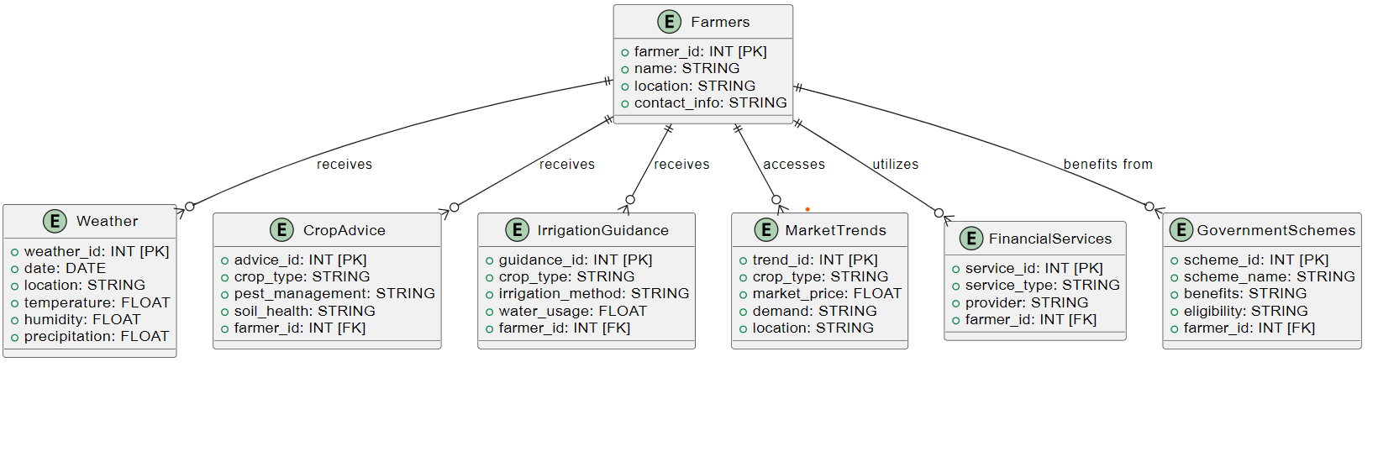
ER Diagram

Slide 10
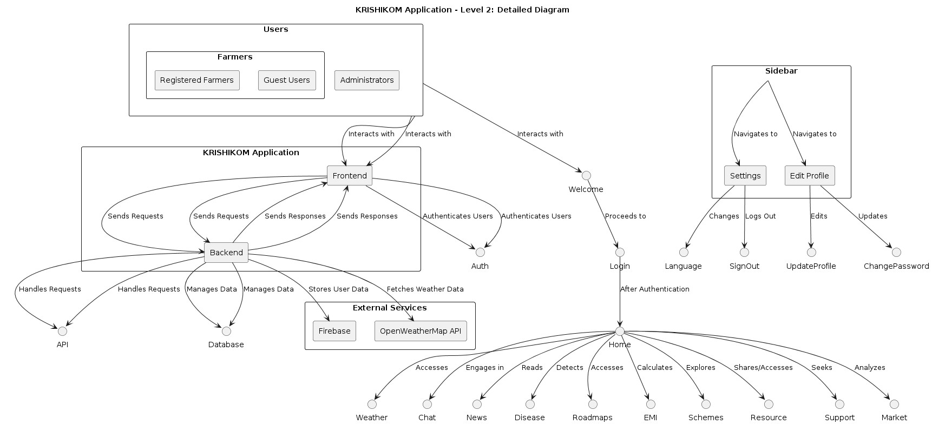
DFD-

Slide 11
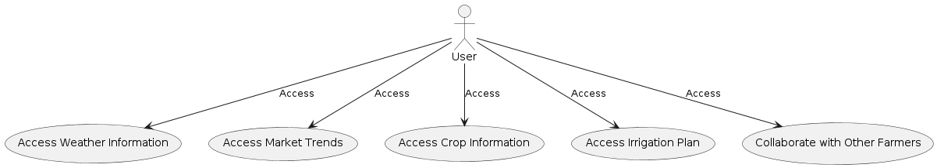
Use Case Diagram

Slide 12
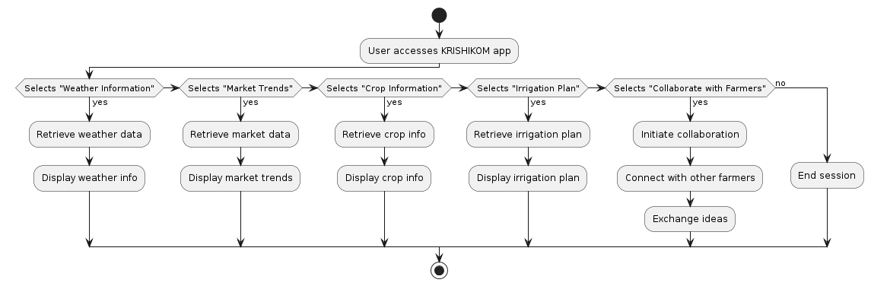
Process Flow Diagram

Slide 13
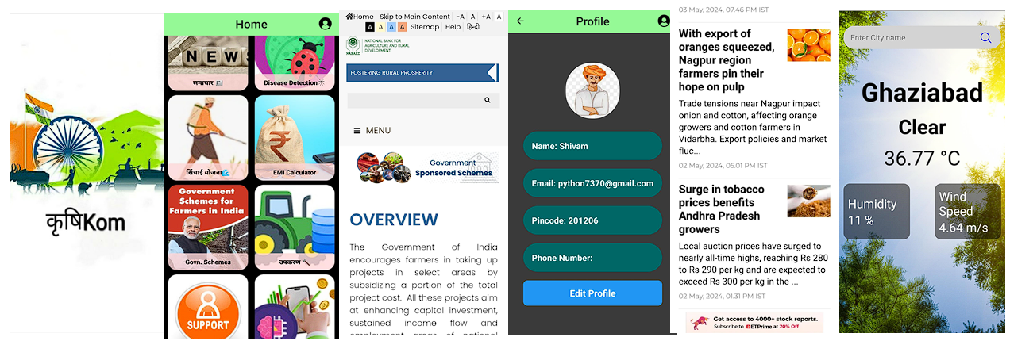
Project Status
Project completion status-90%
Working project-Yes
https://github.com/shivamshi/KrishiKom

Slide 14
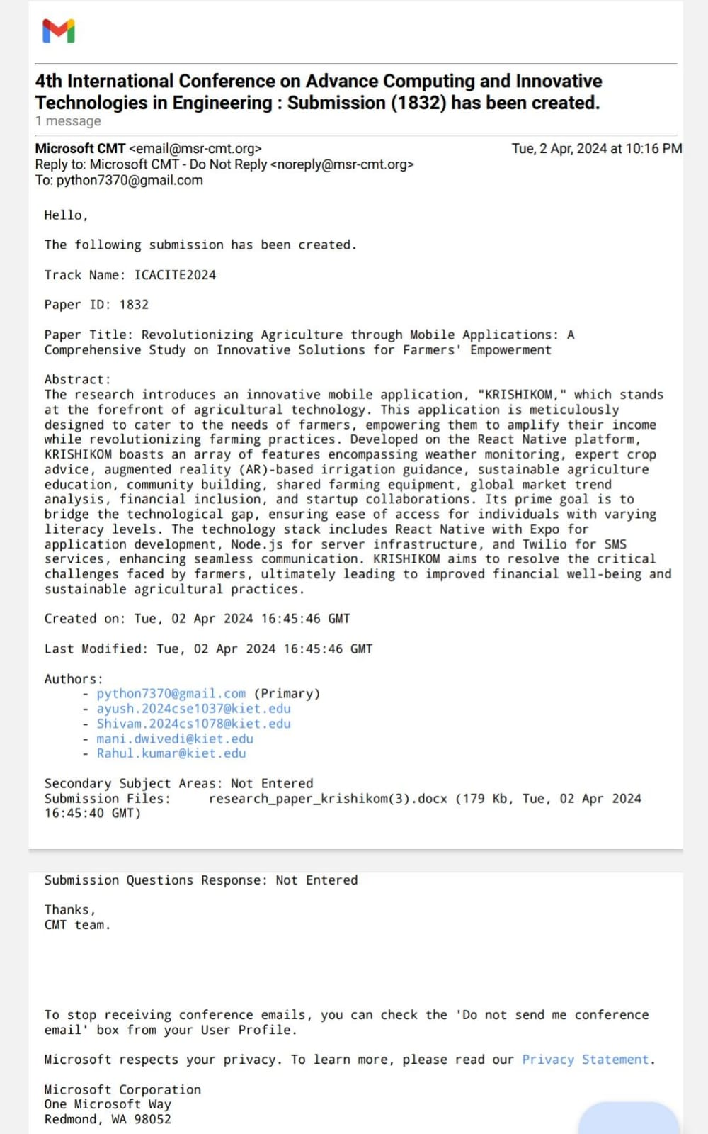
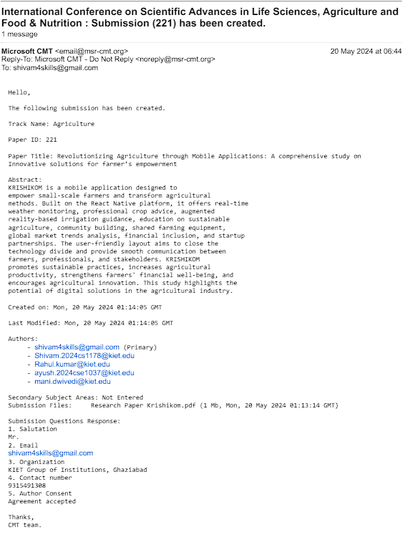
Research Paper Status

Slide 15
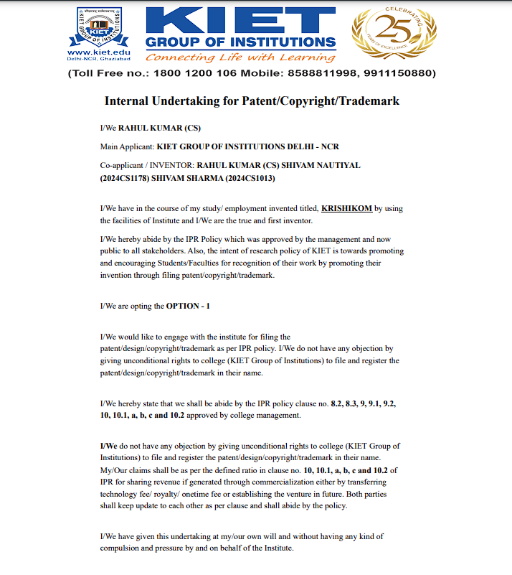
Patent Status

Slide 16
All documents Proofs (Github and Drive)
Hyperlink of the testing report: https://docs.google.com/document/d/1DPPvbHxA1xhi1QeRtycB1gSJnRzp-8TZ/edit?usp=sharing&ouid=112247029902819060464&rtpof=true&sd=true
Hyperlink of the Synopsis: https://docs.google.com/document/d/1g9He8tjMTX_nb-nRkn1rjpc0Da8rk_s5/edit?usp=sharing&ouid=112247029902819060464&rtpof=true&sd=true
Hyperlink of the SRS: https://docs.google.com/document/d/1g9He8tjMTX_nb-nRkn1rjpc0Da8rk_s5/edit?usp=sharing&ouid=112247029902819060464&rtpof=true&sd=true
Hyperlink of Report: https://docs.google.com/document/d/1DPPvbHxA1xhi1QeRtycB1gSJnRzp-8TZ/edit?usp=sharing&ouid=112247029902819060464&rtpof=true&sd=true
Hyperlink of Research Paper: https://drive.google.com/file/d/1YF9ZMhuAZ2eqnKJhC_FTreh6nv-GgG2w/view?usp=sharing

Slide 17
References-
[1] | P. B. P. S. &. G. K. B. Adhiguru, "Strengthening pluralistic agricultural information delivery systems in India.," in Agricultural Economics Research Review, 2009.
[2] | A. &. J. R. Gulati, "Transforming indian agriculture," in Indian agriculture towards, 2030, 9-37., 2022.
[3] | A. R. Q. B. K. G. M. &. A. S. Chhachhar, "Impact of information and communication technologies in agriculture development.," in Journal of Basic and Applied scientific research, 4(1), 281-288., 2014.
[4] | A. N. K. U. R. &. G. K. A. V. E. R. Y. Seth, "Digital technologies transforming Indian agricultureThe Global Innovation Index, 105-111.," in The Global Innovation Index, 105-111, 2017.
[5] | K. K. S. G.-D. P. P. R. L. P. S. T. .. &. B. B. Sriprateep, "Automated Classification of Agricultural Species through Parallel Artificial Multiple Intelligence System," in Ensemble Deep Learning. Mathematics, 12(2), 351., 2024.
[6] | A. &. S. R. Vincent, "Agricultural Extension and Advisory Systems in Tamil Nadu," in National Institute of Agricultural Extension Management (MANAGE)(An organisation of Ministry of Agriculture and Farmers’ Welfare, Govt. of India) , 2020.
[7] | K. J. R. &. K. P. Nazhat, "Potential of M-Commerce of Agricultural Inputs in Kolar, Karnataka, India.," in Research Journal of Recent Sciences ________________________________________________E-ISSN, 2277, 2502, 2016.
[8] | N. Jamaluddin, "Adoption of E-commerce practices among the indian farmers, a survey of Trichy District in the state of Tamilnadu, India," in Procedia economics and finance, 2013.
[9] | J. &. T. P. E. Hellström, "The innovative use of mobile applications in East Africa," in Swedish international development cooperation agency (Sida), 2010.
[10] | M. &. Z. Y. Ferroni, "Achievements and challenges in agricultural extension in India.," in Global Journal of Emerging Market Economies, 2012.
[11] | C. G. M. J. P. &. K. A. Gupta, "Information and communication technology in agribusiness: A study of mobile applications in perspective of India.," in Journal of Applied and Natural Science, 2021.

