Slide 1


I Project Presentation (KCS 753) I “Grievance Redressal System”
KIET Group of Institutions, Ghaziabad
(An ISO – 9001: 2008 Certified & ‘A+’ Grade accredited Institution by NAAC)
Guide Name: Prof. Pallavi Sharma
Project Members :
1.Vishal Yadav(2000290120194)
2.Yuvraj Narayan Mishra(2000290120200)
3.Shruti Gautam(2000290120155)

Slide 2
Problem Statement
In the context of India's progress towards cleanliness and digitalization, there's a need for a convenient grievance communication system regarding issues like cleanliness, drainage, and unauthorized construction. Current methods are hindered by long queues and limited service hours, leading to neglected problems and citizen disengagement. An online platform is required to facilitate easy reporting of issues, promoting citizen involvement and efficient problem-solving by authorities.

Slide 3
Objectives
To create a user-friendly online interface for citizens to communicate with administrative body and, reduce the distance and time barrier between citizens and administration.
To create a online platform where people can share ideas, invoke discussions, issue complaints, create suggestion/petitions for improvement of city administration.
To encourage the citizens to actively participate in city administration to bring transparency and flexibility in system.
NEED FOR GRIEVANCE REDRESSAL SYSTEM:
Limited hour service availability in the current system.
Lack of involvement of people in exhibiting their responsibilities towards society.
Consider a scenario where a society is facing overflowing drains and garbage bins or if there are uncovered potholes and other related issues that need immediate response. Then these problems can be directly addressed through this website with the help of geo-tagging facility so that authorities can efficiently locate and solve these issues with just a click.

Slide 4
Technology Used
PHP
JAVASCRIPT
HTML
CSS
BOOTSTRAP
DATABASE - MYSQL

Slide 5
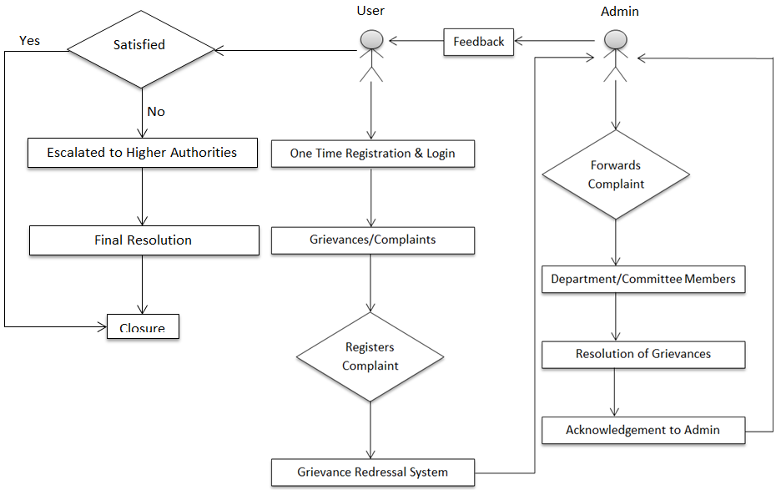
Workflow Diagram

Slide 6
Project Scope
Secure Communication: Users can submit grievances and interact with authorities through a secure messaging system, ensuring confidentiality of sensitive information with end-to-end encryption.
Transparent Tracking: Users can track the status of their grievances transparently, with access to a public ledger or dashboard displaying the progress of complaints from submission to resolution, fostering accountability and trust.
Feedback Mechanism: Users are provided with avenues to provide feedback on the grievance redressal process, enabling continuous improvement and refinement of the system to better serve the needs of stakeholders.
User Authentication and Authorization: Robust authentication and authorization mechanisms are implemented to ensure that only authorized individuals can access and interact with the grievance redressal system, maintaining data security and privacy.
Offline Access: While real-time communication is prioritized, features for offline submission of grievances or accessing previously submitted complaints may be considered for future iterations to accommodate users with limited connectivity.

Slide 7
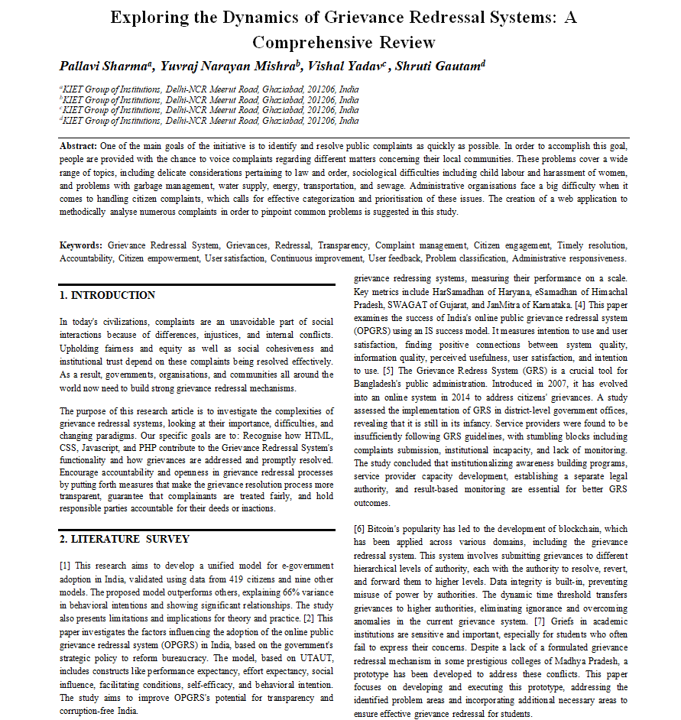
Research Paper Status : 100% Completed

Slide 8
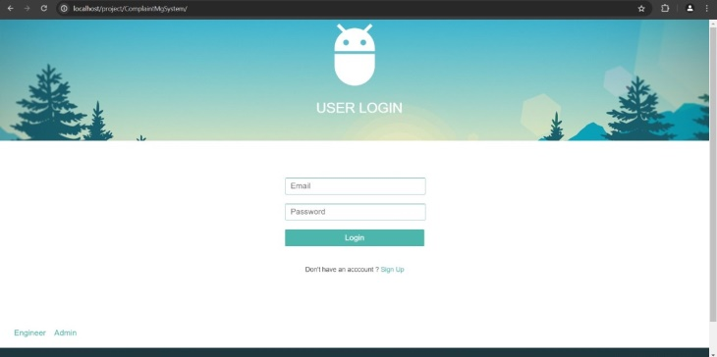
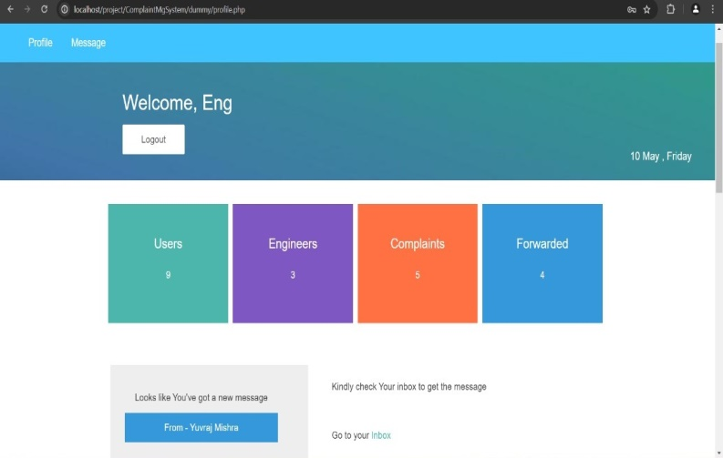
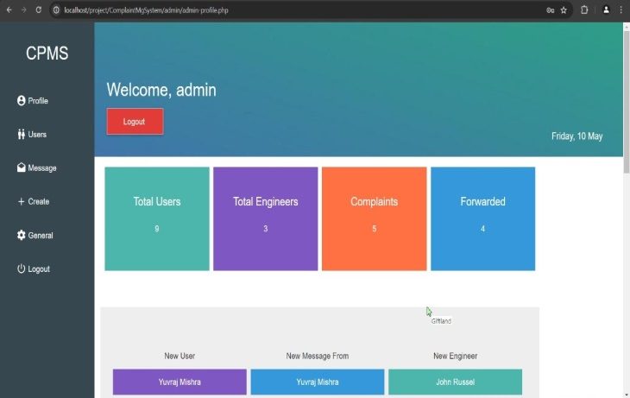
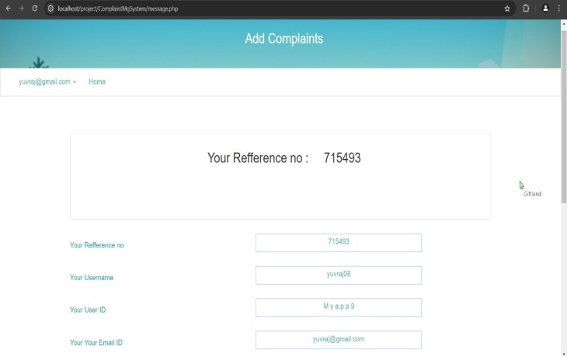
Project Status : 100% Completed

Slide 9
Future Work
Mobile Application Development: Developing dedicated mobile applications for online grievance redressal systems can improve accessibility and user experience, allowing individuals to submit and track grievances conveniently from their smartphones.
Blockchain Technology: Utilizing blockchain technology for secure and transparent record-keeping of grievance-related data could enhance trust and transparency in the grievance redressal process.
Offline Functionality:Develop a robust offline complaint registering system, allowing users to register complaints even in low or no internet connevtivity scenarios, ensuring uninterrupted communication.

Slide 10
References
[1] Rana, Nripendra P., et al. "Adoption of online public grievance redressal system in India: Toward developing a unified view." Computers in Human Behavior 59 (2016): 265-282.
[2] Rana, Nripendra, Michael Williams, and Yogesh Dwivedi. "Examining factors affecting adoption of online public grievance redressal system: A case of India." (2013).
[3] Rana, Nripendra P., Yogesh K. Dwivedi, and Michael D. Williams. "Examining the factors affecting intention to use of, and user satisfaction with online public grievance redressal system (OPGRS) in India." Grand Successes and Failures in IT. Public and Private Sectors: IFIP WG 8.6 International Working Conference on Transfer and Diffusion of IT, TDIT 2013, Bangalore, India, June 27-29, 2013. Proceedings. Springer Berlin Heidelberg, 2013.
[4] Chowdhury, Md Shahidul Islam. "Strengthening Grievance Redress System: A Case of Narsingdi District Administration." angladesh ournal of ublic dministration 31.1 (2023): 23-46.
[5] Shettigar, Rakshitha, et al. "Blockchain-Based Grievance Management System." Evolution in Computational Intelligence: Frontiers in Intelligent Computing: Theory and Applications (FICTA 2020), Volume 1. Springer Singapore, 2021.
[6] Chander, Subhash, and Ashwani Kush. "Assessing grievances redressing mechanism in India." International Journal of Computer Applications 52.5 (2012).
[7] Prajapat, Shaligram, Vaibhav Sabharwal, and Varun Wadhwani. "A prototype for grievance redressal system." Proceedings of International Conference on Recent Advancement on Computer and Communication: ICRAC 2017. Springer Singapore, 2018.
[8] Shahi, Abhinav. "Grievance Redressal in India during Pandemic and the Way Forward." ASCI Journal of Management 51.1 (2022).

