Slide 1

Speed Force
Oscar & Akanksha

Slide 2
Purpose
Speed Force can detect a crash using your smartphone sensors and inform your designated emergency contact person that a possible crash has occurred. While similar tools exist, to our knowledge the nearby contacts feature is not included.
Speed Force will send a prompt to nearby users informing them of a possible accident nearby and ask them if they are willing to assist, in addition to the emergency contact.
This tool is meant to be used in a community setting to support each other and ensure immediate emergency response. Maybe Speed Force can save a life at a busy intersection with local businesses, or while driving to get groceries for loved ones.

Slide 3
We are not the first to have this idea:
Papers WreckWatch: Automatic Traffic Accident Detection & Notification with Smartphones Jules White, Chris Thompson, Hamilton Turner, Brian Dougherty, and Douglas C. Schmidt
Car Accident Detection and Notification System Using Smartphone Hamid M. Ali, Zainab S. Alwan Apps http://www.sosmartapp.com/ https://www.noonlight.com/ https://www.carlock.co/

Slide 4
Why are we different?
We use the nearby connection features both in Android and iOS as a key social aspect. We want the community to be engaged. When an accident occurs not only are the user and user’s emergency contact person (ECP) contacted but nearby users will be alerted of a possible accident or unsafe conditions.
Sometimes as a bystander you feel helpless, but with this app you can contribute by allowing the ECP to contact your phone if the hurt user’s phone happens to be damaged. Noticed a car or someone fleeing the scene? take a picture and possibly solve a hit and run!

Slide 5
Detection Phase
Detection start at 24Kph =14.9 Mph - This assumes you/phone are in motion and not Usain Bolt who’s world record is 23.35 mph
Acceleration values greater than or equal to 4G - minimizes false positives from dropped phones
Both values must be met. *other sensors used but limited for project*
Values derived from research papers and are for a person in a car at constant velocity, but research discusses potential application for people outside of car ie pedestrians or cars traveling at slower speeds ie city intersections with constant starting/stopping.

Slide 6
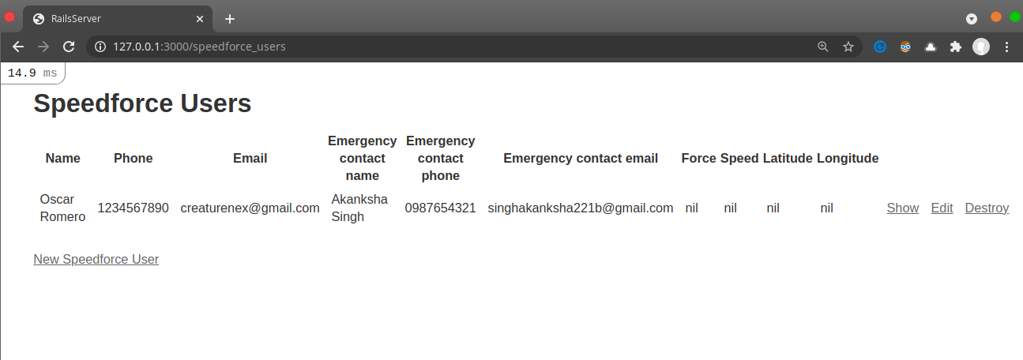
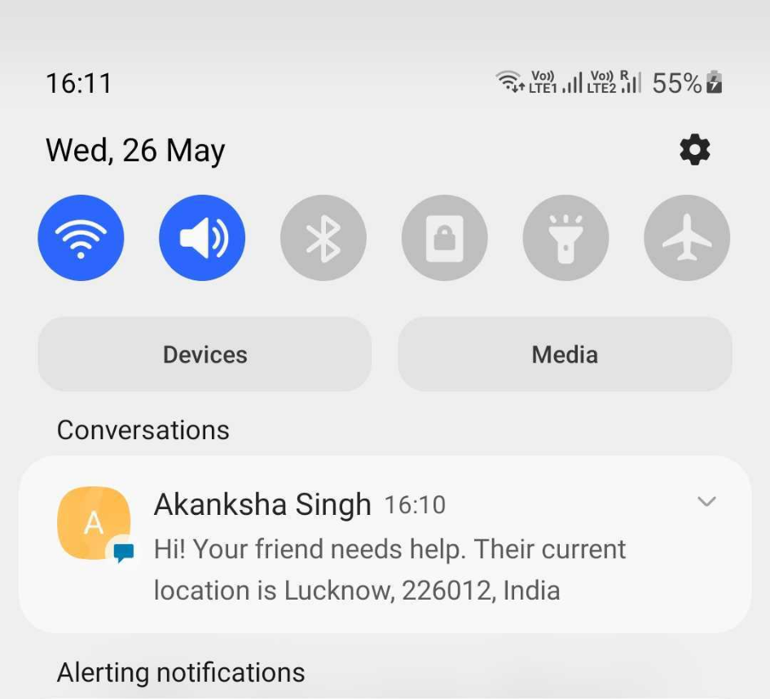
Collection and Transmission Phase
Send relevant data to server to be incorporated into database
Name
Phone
Email
ECP Name
ECP phone
ECP email
Speed
Force
Latitude
Longitude
Access relevant from database to alert
User
Emergency Contact
Nearby Users

Slide 7
Termination Phase
Everything OK
User or Emergency Contact confirm everything ok and app returns to listening mode.
Everything NOT OK
User or Emergency Contact reach Emergency Personnel for Help.
If no solution is made after X time. We are sorry no further data to assist.
For Nearby User
If no accident noticed, returns to listening mode
If accident noticed
Willing to be point of contact for Emergency Contact
Notice suspicious behavior? Take photo!
Return to listening mode

Slide 8
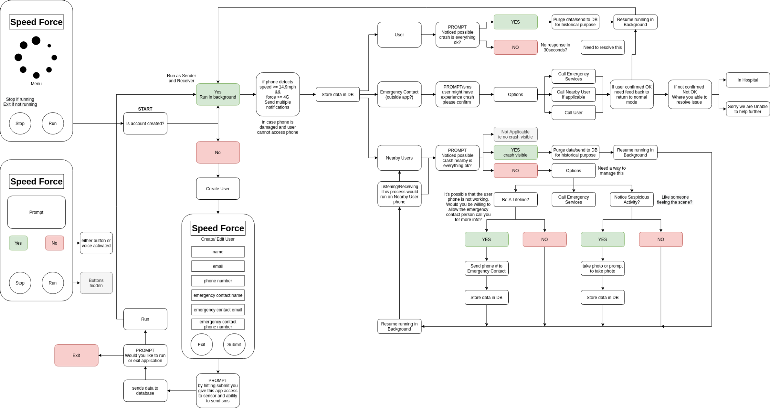
Design Diagram

Slide 9
What was accomplished?
Design Diagram to focus design choices
Designed a user interface demo using Flutter and Android
Incorporated multiple plugin for the relevant sensors
geolocator 7.0.3 - GPS
sensors 2.0.1 - Accelerometer & Gyroscope
flutter nearby connections 1.0.11
flutter sms 2.3.1
Constructed a Ruby on Rails Server with a database to capture user data
Had to learn Rails :)
Presentation Material

Slide 10
What was not accomplished and why?
Not able to interface the mobile UI/UX with the backend server. - Neither of us has had this experience before.
Not able to incorporate New Relic dashboard. - First we did not have a completed project to test against - What metrics are important? Ie connection speed, transmission speed or dropped connections etc
Not sure of the best way to model nearby user for database purpose - new NearbyUser model or use User model and add more parameters
The idea and scope of this project is large. But we choose Hack for Good because we believe strongly in using technology to help instead of hinder. We are a two person team created last minute who both have limited experience with this type of project. We learn a lot quickly but time still ran out :)

Slide 11
Future Improvements?
Build a robust algorithm so this can also be used for pedestrians.
Build better social tools, along the lines of Waze
Build a Web Application to visualize data. Did someone say New Relic Agent?
Incorporate Twitter somehow ie post accidents to Department of Transportation showing dangerous intersection hopefully build traction for municipal improvement.
Biggest issue is how to entice users and pay for servers.

Slide 12
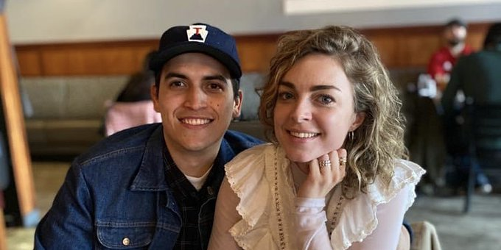

For Danny and Lovisa
And The Relicans

