Slide 1
Streaming Service User Analysis
Key Insights and Findings
Prepared by Akanksha

Slide 2
Key Analysis Area- 1.) Subscription & Revenue Analysis 2.) User Engagement Metrics 3.) Demographic & Behavioural Insights 4.) Retention & Loyalty 5.) Payment Preferences & Regional Trends

Slide 3
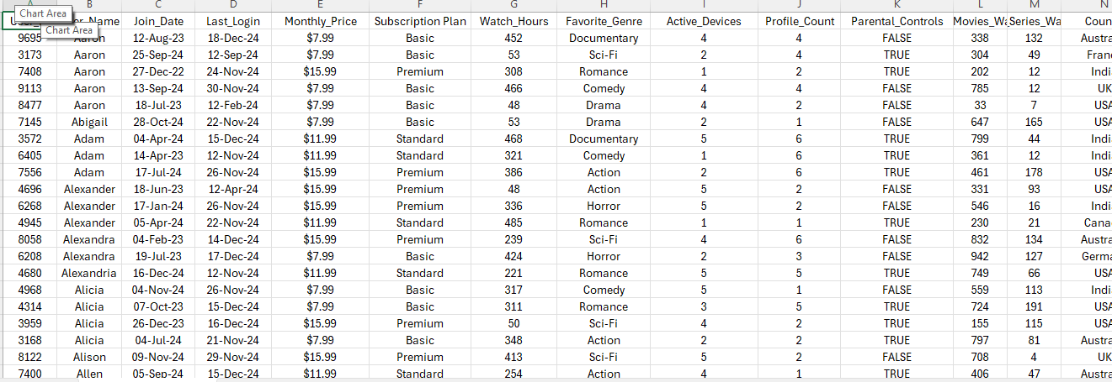
Data Cleaning & Standardization

Slide 4
1.) Changed the join & login date format. 2.) Converted the subscription price in dollars. 3.) Added a new category “Subscription Plan” on the basis of subscription price where $7.99 is “Basic”, $11.099 is “Standard” and $15.99 is “Premium”.

Slide 5
Subscription & Revenue Analysis: ○ Monthly revenue based on different subscription plans. ○ Distribution of users across different price tiers.

Slide 6
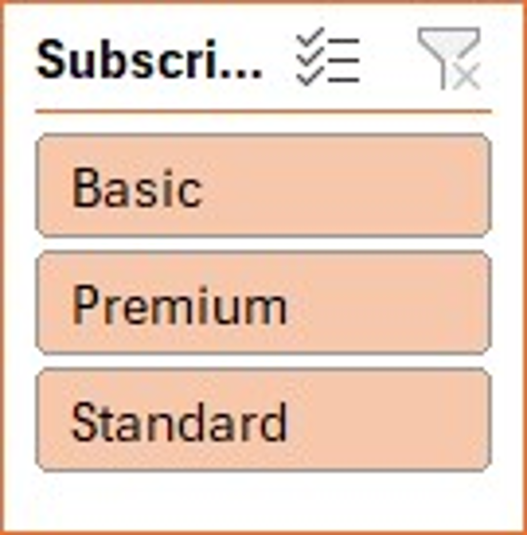
Monthly Revenue Analysis By Subscription Plan-

Slide 7
Distribution of users across different price tiers.

Slide 8
KEY ANALYSIS- Monthly revenue by Basic subscription- 1.) Basic = $2580.77 2.) Standard = $4136.55 3.) Premium = $5308.68 Total monthly revenue- $12026 The most subscribed plan was Premium while the least subscribed plan was the Basic plan. All the users are fairly distributed across the subscription plan.

Slide 9
User Engagement Metrics: ○ Average watch hours per user. ○ Total movies vs. series watched per user. ○ Impact of recommended content on engagement.

Slide 10
Average watch hour per user- Here the user id are grouped is a group of 500 as the analysis of data for 1000 users with different user id is not feasible.

Slide 11
Total movies and series watched per user- Here the user id are grouped is a group of 500 as the analysis of data for 1000 users with different user id is not feasible.

Slide 12
Impact of recommended content on engagement

Slide 13
KEY ANALYSIS-
Avg. Watch Hours per User: 254.52hours
Total Movies Watched: 515897
Total Series Watched: 99746
The calculated correlation is -0.026, which is very close to zero, suggesting almost no direct impact of recommended content on engagement.

Slide 14
Demographic & Behavioural Insights:
○ Preferred genres by age group.
○ Device usage trends.
○ Peak watch time trends (Morning, Evening, Late Night).

Slide 15
Preferred genres by age group.

Slide 16
Device usage trends

Slide 17
Peak watch time trends (Morning, Evening, Late Night).

Slide 18
KEY ANALYSIS-
Preferred genres by age groups
-Age Group 18 – 25 is more preferring “Documentary”.
-Age Group 25 - 34 is more preferring “Horror”.
-Age Group 34 - 44 is more preferring “Horror”.
-Age Group 45 - 54 is more preferring “Romance”.
-Age Group 55 + is more preferring “Comedy”.
-Age Group 45 - 54 is watching most number of “Genres”.
-Device usage trends
-Age Group 18 – 25 is more preferring “Tablet”.
-Age Group 25 - 34 is more preferring “Tablet”.
-Age Group 34 - 44 is more preferring “Tablet”.
-Age Group 45 - 54 is more preferring “Smart TV”.
-Age Group 55 + is more preferring “Smart TV”.
-Among all the Age Group “Tablet” are more Preferable device for watching contents.

Slide 19
Peak watch time trends (Morning, Afternoon, Evening, Late night)
-Total watch hour in morning period of time is “62017 Hours”.
-Total watch hour in Afternoon period of time is “65381 Hours”.
-Total watch hour in Evening period of time is “66661 Hours”.
-Total watch hour in Late night period of time is “60457 Hours”.
-Total watch hour in Afternoon period of time is 65381 Hours
-Among all the watching time of period “Evening” has most watching hours than other “66661 Hours”.

Slide 20
Retention & Loyalty:
○ Membership status (Active vs. Inactive).
○ Loyalty points distribution.
○ Frequency of logins and content downloads.

Slide 21
Membership status (Active vs. Inactive)

Slide 22
Loyalty points distribution

Slide 23
Frequency of logins and content downloads

Slide 24
KEY ANALYSIS-
Among all of the users there are no inactive users and total “1000 users” are active .
The highest loyalty points were distributed to users between the user IDs“4003-4502”.
The most frequent logins occurred in the month of November 2024 with the highest content download count of 262

Slide 25
Payment Preferences & Regional Trends
○ Preferred payment methods by region.
○ Subscription trends by country.
○ Language preferences and their correlation with engagement.

Slide 26
Preferred payment methods by region

Slide 27
Subscription trends by country

Slide 28
Language preferences and their correlation with engagement

Slide 29
KEY ANALYSIS-
Payment preferences varied by region:
Credit Card: USA
PayPal: UK
Debit Card: India
Cryptocurrency: France

Slide 30
Most common price tiers were- $11.99, $15.99, $7.99
Highest revenue was generated from $11.99 tier
Language preference affects watch time:
The highest number of content was watched by the French speakers with 273 hours average.
Spanish users were also highly engaged with an average of 265 watch hours.

Slide 31
THANK YOU

