Slide 1
Price Prediction of used car
Using different ML algorithmns
Using Machine Learning Algorithm
By:- Akanksha Sinha

Slide 2
Contents
02
01
04
03
Data Collection
01
Problem Statement
Different ML Algorithms
EDA
05
Conclusion

Slide 3
Problem Statement
In this I going to predict the price of the used car and price of car depends upon many features like Location, Year, Kms driven, Owner type, Fuel type and Power.

Slide 4
Purpose of project
As now a day we know many people are buying second hand car instead of buying new one, but main question is how will us know actual price of car based on their features so in order to solve this problem I build project which will give us estimated price of car at which car should be sold.

Slide 5
Dataset Description
Name
Location
Year
Tell about brand and model name of car
Tell about place where car sold
Tell about in which year car being sold
Km Driven
Fuel Type
Transmission
Tell about total km driven by car
Give which type of fuel is used
Tell about weither car is manual or automatic

Slide 6
Dataset Description
Owner Type
Mileage
Engine
Tell about either its second or third hand
Give information about mileage
Tell about engine of car
Power
Seats
Price
Give information about power
Number of seats in car
Its our target variable

Slide 7
Machine Learning Model
Data Collection
Data Cleaning
EDA
Features Selection
Model Building

Slide 8
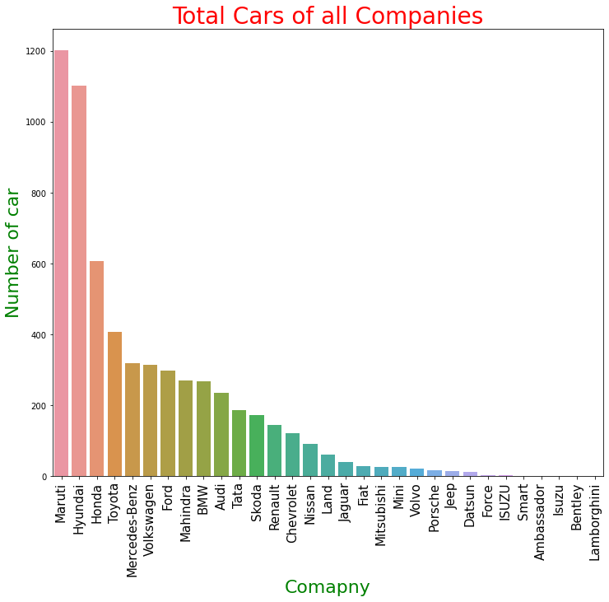
Total Number of Cars of different Companies

Slide 9
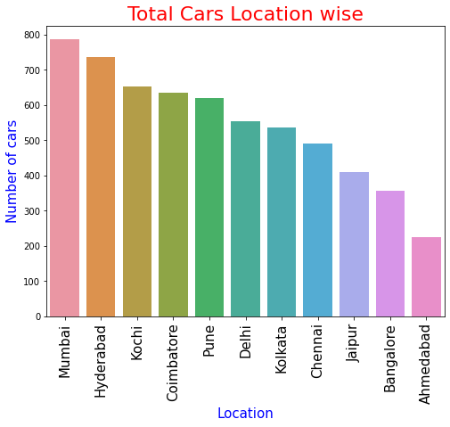
Total Cars Location wise

Slide 10
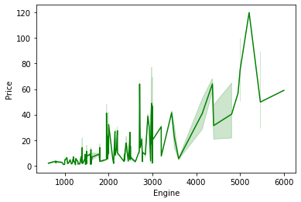
Engine v/s Price

Slide 11
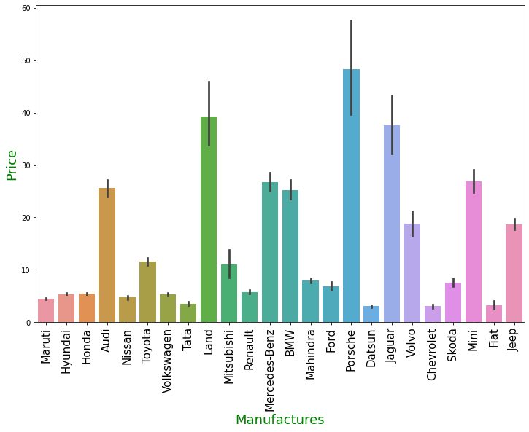
Price range of different manufactures

Slide 12
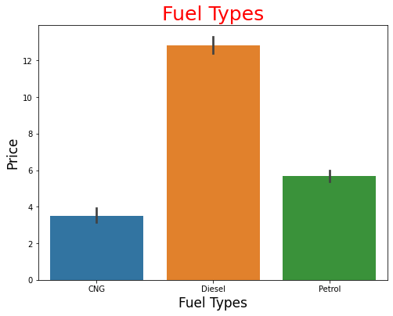
Fuel Type

Slide 13
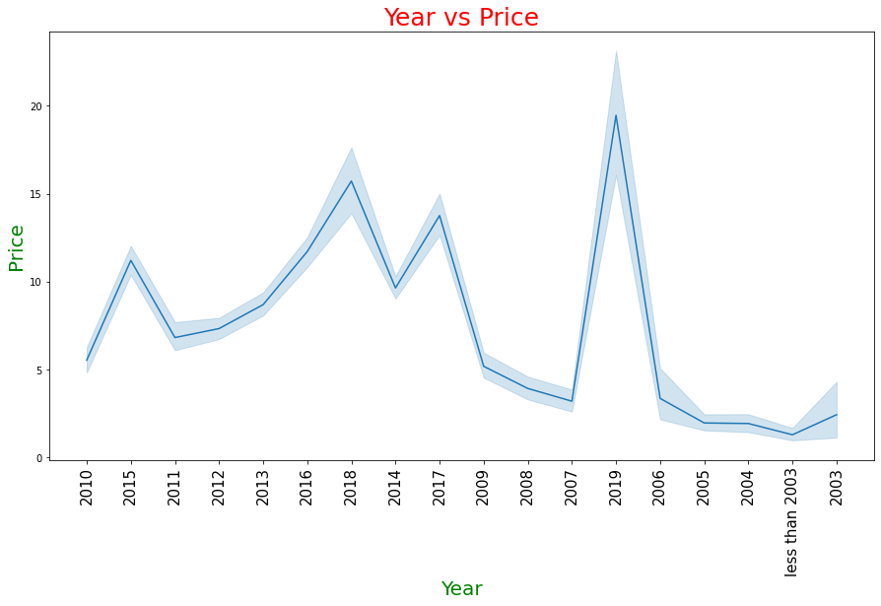
Year vs Price

Slide 14
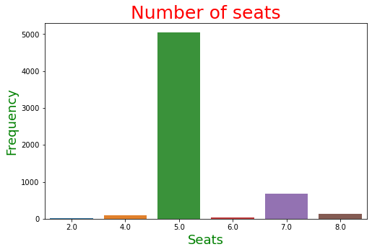
Number of Seats

Slide 15
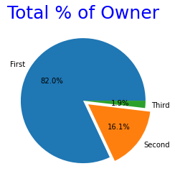
Owner type

Slide 16
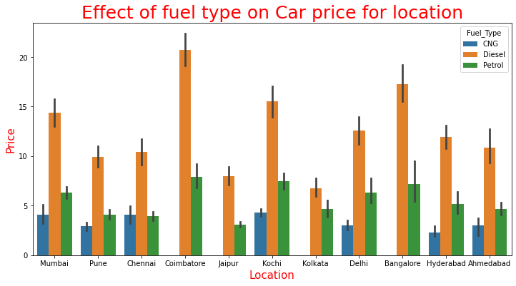
Effect of Fuel type on Price

Slide 17
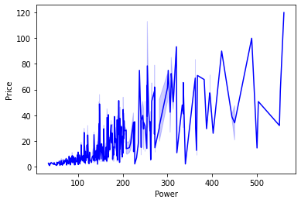
Power v/s Price

Slide 18
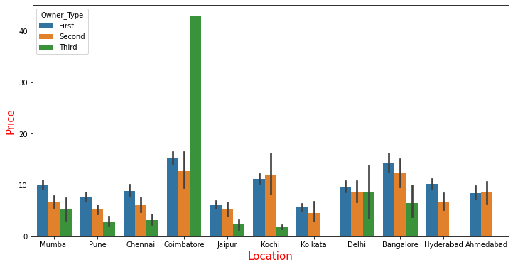
Owner relation with Price

Slide 19
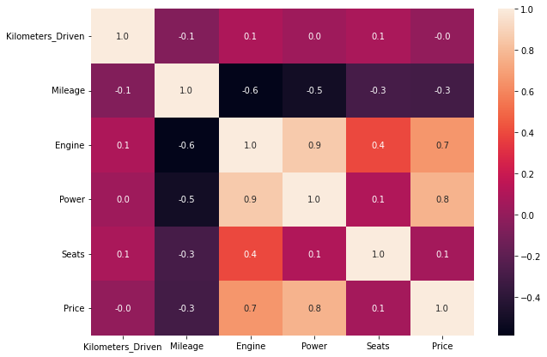
Heat Map

Slide 20
Algorithmns
Linear Regression
Decision
Tree
Random Forest
Giving 68% Accuracy
Giving 74% Accuracy
Giving 91% Accuracy

Slide 21
Conclusion
As I predicted accuracy with three algorithm but I choose Random forest to predict the price of used car. As I am getting highest accuracy with it. So it will help customer who want to sell or buyer there car to evaluate there car price efficiently with good accuracy.

Slide 22

THANK YOU

