Slide 1


RAJARAMBAPU INSTITUTE OF TECHNOLOGY RAJARAMNAGAR
1

Slide 2
INDUSTRIAL TRAINING PRESENTATION
Presented By:
Yashraj Jagdish Mali
[2283028]
Topic:
Simple Calculator App
2

Slide 3
INTRODUCTION
Swara Software Solutions is a renowned IT company specializing in innovative software solutions, app development, and technology consulting.
Known for its commitment to excellence and customer satisfaction, Swara Software Solutions has been at the forefront of delivering high-quality tech solutions to adverse clientele.
The company's collaborative work culture, coupled with its focus on continuous learning and development, made it an ideal setting for my internship.
3

Slide 4
OBJECTIVE
To Develop a basic calculator app for Android to perform standard arithmetic operations such as addition, subtraction, multiplication, and division.
To Create an intuitive and user-friendly interface with clear buttons and display by ensuring accurate calculations and stable performance.
To Gain practical experience with Android app development and improve problem-solving skills.
Utilize Android Studio for app development and optimize the app for smooth performance and responsiveness.
4

Slide 5
REQUIREMENTS
Software Requirements
Android Studio:
IDE: Android Studio (latest stable version recommended).
SDK Tools: Ensuring to have the Android SDK and necessary build tools installed.
Programming Languages:
Java/Kotlin: Contains the Kotlin and Java source code files, including Junit test code.
Necessary language support in Android Studio.
5

Slide 6
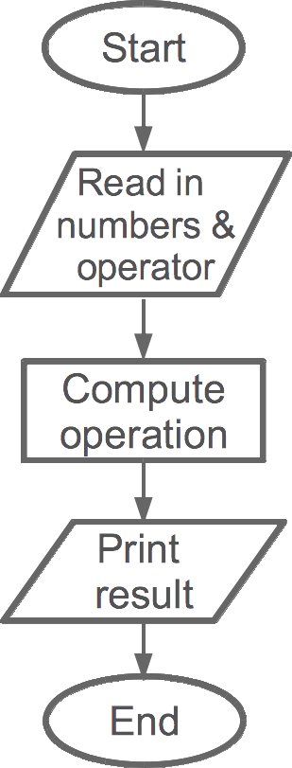
DATA FLOW DIG
6

Slide 7
User Input:
Action: The user selects an arithmetic operation (+, -, *, /) by pressing the corresponding button on the calculator app.
Data Flow: This action generates an input signal that is sent to the Operation Selection process.
Operation Selection Process:
Function: The app records the selected operation (e.g., +) and stores it in the Operator Store.
Data Flow: The selected operation is also sent to the Calculation Engine process for use in computation.
Calculation Engine:
Function: Retrieves the numeric values from the Input Buffer and the selected operation from the Operator Store. It then performs the arithmetic operation.
Data Flow: The Calculation Engine computes the result based on the operation and numeric values.
7

Slide 8
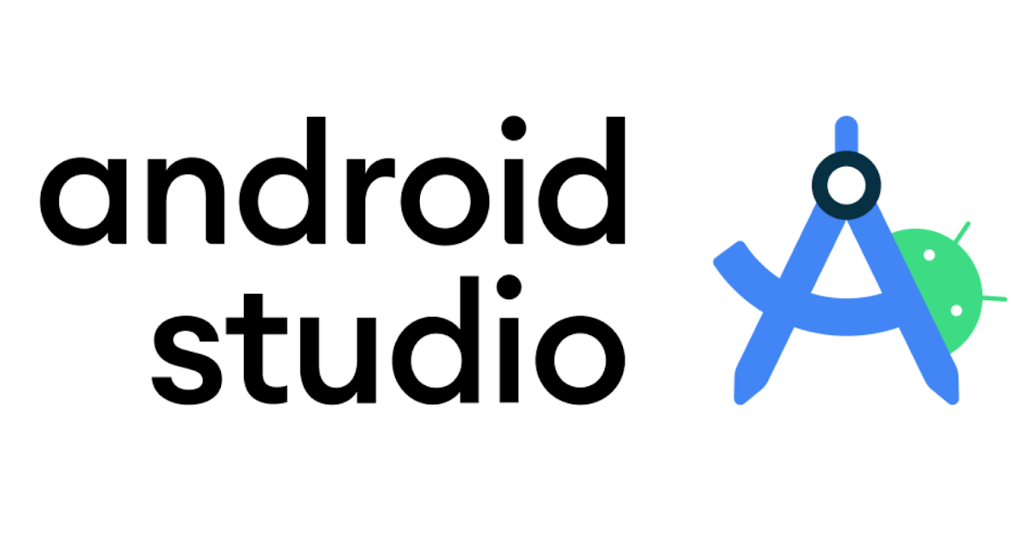
SOFTWARE USED
Android Studio is the official IDE for Android app development, built on JetBrains' IntelliJ IDEA.
It provides tools and features designed to help developers build Android applications efficiently.
User Interface (UI) Designer:
Layout Editor: Drag-and-drop UI elements to design the app’s calculator interface easily.
Code Editor:
Code Completion: Auto-complete code and provide syntax suggestions to speed up development.
User Interface (UI) Designer:
Layout Editor: Drag-and-drop UI elements to design the app’s calculator interface easily.
Code Editor:
Code Completion: Auto-complete code and provide syntax suggestions to speed up development.
8

Slide 9
IMPLEMENTATION
Sr no. | Component
1 | Application Interface
2 | Addition Operation
3 | Subtraction Operation
4 | Multiplication Operation
5 | Division Operation
9

Slide 10
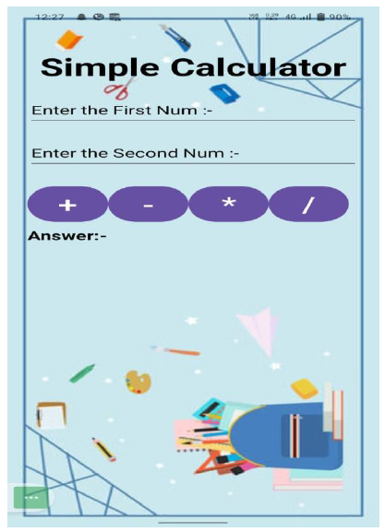
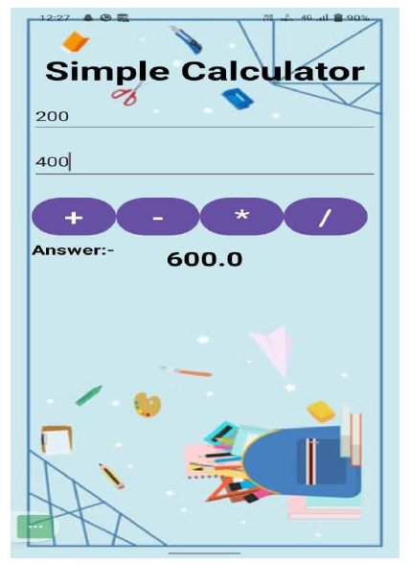
Application Interface
Addition Operation
10

Slide 11
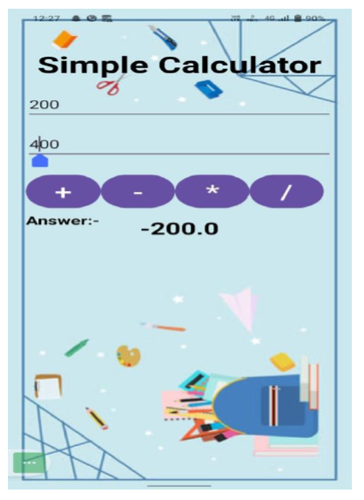
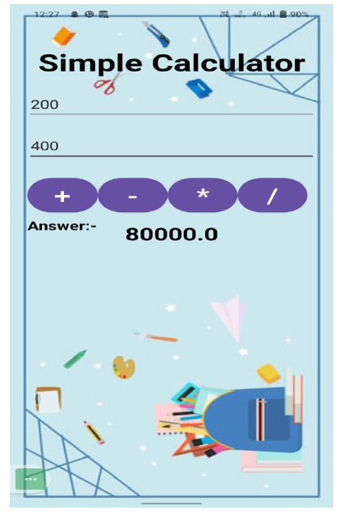
Subtraction Operation
Multiplication Operation
11

Slide 12
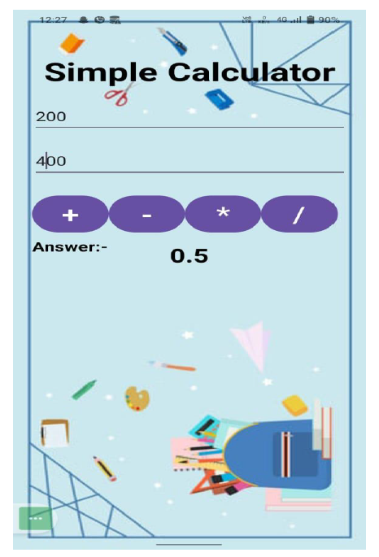
Division Operation
12

Slide 13
CONCLUSION
In conclusion, the development of a basic calculator app for Android aims to provide a simple yet effective tool for performing standard arithmetic operations such as addition, subtraction, multiplication, and division. The project focuses on creating an intuitive and user-friendly interface, ensuring that buttons are clear and the display is easy to read while maintaining accurate calculations and stable performance. By utilizing Android Studio, developers will gain practical experience in Android app development, enhance their problem-solving skills, and optimize the app for smooth performance and responsiveness. The project leverages Java/Kotlin for coding and ensures all necessary SDK tools are in place for a successful build and deployment process.
13

Slide 14
FUTURE SCOPE
Advanced Functionalities:
Add scientific operations and features like square roots and exponentiation.
User Interface Improvements:
Implement customizable themes and enhance accessibility features.
Integration and Expansion:
Introduce cloud synchronization and support for multiple languages.
Performance Enhancements:
Optimize algorithms and improve battery and resource management.
14

Slide 15
Thanks!
15

