Slide 1


BVRIT HYDERABAD College of Engineering for Women
Real-Time Facial Expression Detection
59
Team No:
Names with roll numbers:
Akanksha B Vennu -20WH1A05A9
U.Tejasree-20WH1A05A2
P.Sahithya-20WH1A05A1
Medhanvesh 2023 ChatGPThon

Slide 2
Abstract:
Facial expressions are the changes occurring on the human face indicating a person's internal emotional states, intents or societal communications. Depending on the expressions on the face, human face is the most principal mode of conveying and deducing affective states of human ones. In real time, facial expression detection has become a prominent research area as it plays an important role in Human Computer Interaction. The applications of the facial expression detection are computer vision, biometric security, social interaction, emotional intelligence and social intelligence . It applied in several areas such as safety, health and in human machine interfaces.
Medhanvesh 2023 ChatGPThon

Slide 3
DESIGN AND TECHNOLOGIES
Capturing the image
Face Landmark Detection and Alignment
Feature Extraction and Representation
Expression Classification Model
Output : Detected facial Expression
Techstack:cv2,deepface,numpy libraries of python.
Medhanvesh 2023 ChatGPThon

Slide 4
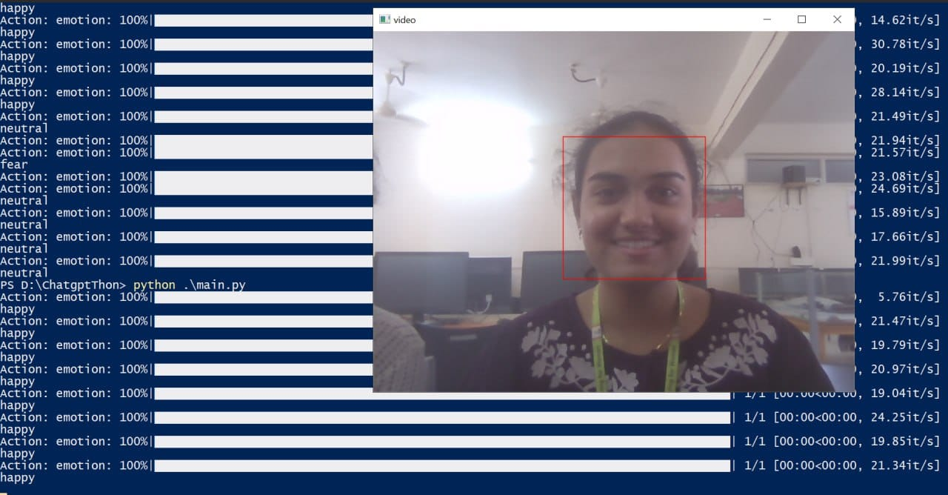
Output:
Medhanvesh 2023
ChatGPThon

