Slide 1


GSOC 16 Mid Evaluation Report

Slide 2

First Aide(PCSA Web App)
Organisation: Systers, Anita Borg Institute
Mentor: Prajakta Naik
Student: Akanksha Bodhankar

Slide 3
Abstract
PCSA (Peace Corps Safety App) is a web application developed to help the volunteers if they become victims of sexual harassment.It also ensures safety by sending messages to fellow volunteers when in trouble. Usually, the victims are uncomfortable to report the crime or unwilling to get support. This app ensures that the victim can be sure of getting all the help he/she needs. The sexually assaulted volunteer can get information of Peace Corps reporting and safety procedures and also contact Peace Corps for help.

Slide 4
Technologies Used
HTML5, CSS3, Javascript, Jquery – Front end
PHP – Backend
MySQL – Database
Platform
XAMPP
Third party API used for messaging and calling
Twilio

Slide 5
Project Docs and Code
The code is being pushed time to time on Github. Find the code here:
https://github.com/AkankshaBodhankar/GSOC16Work
The project mockup and other documents can be found here:
https://github.com/AkankshaBodhankar/GSOC16Work/project-docs

Slide 6

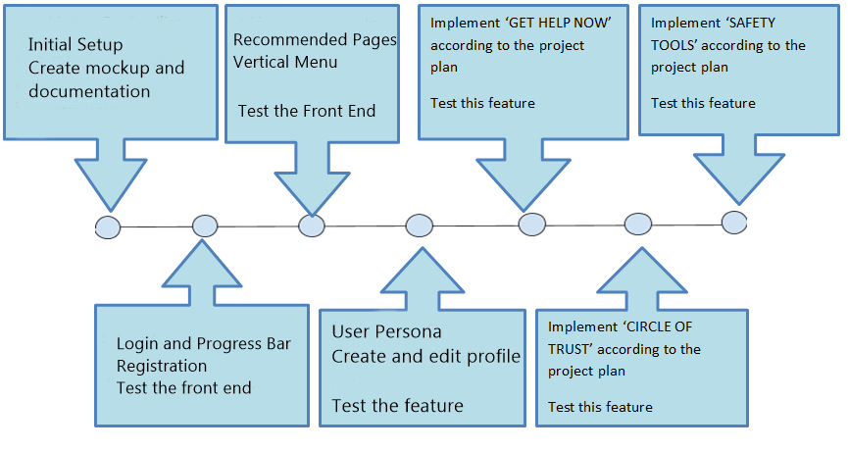
Project Milestones
Done
To be Done

Slide 7

Completed Work
1. Splash Screen
A splash screen opens up when the application is opened and then redirects to the login page

Slide 8

2. User Registration and Login
Registration is done using email id, name, password and country of the user. Validations also have been added
Login form uses email id and password for authentication
Once the registration is successful user is redirected to the login page
The user can logout using the option present in the menu od the application
Database table ‘user’ is being used for storing the data

Slide 9
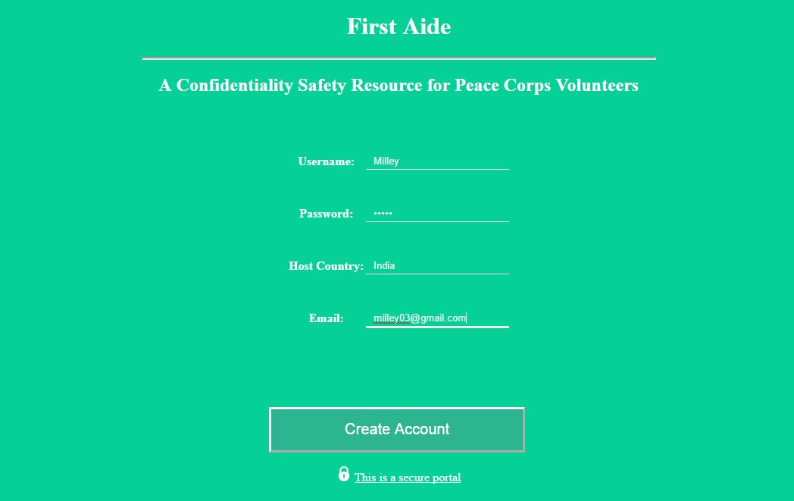
Registration Page

Slide 10
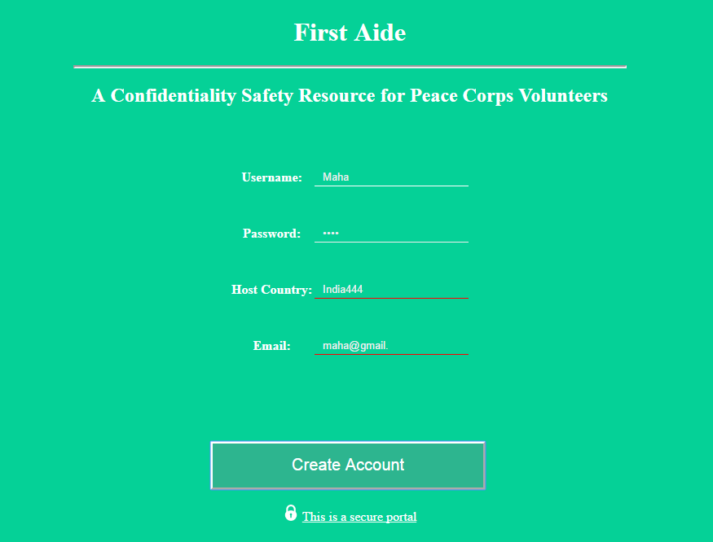
Red mark shown on wrong input

Slide 11
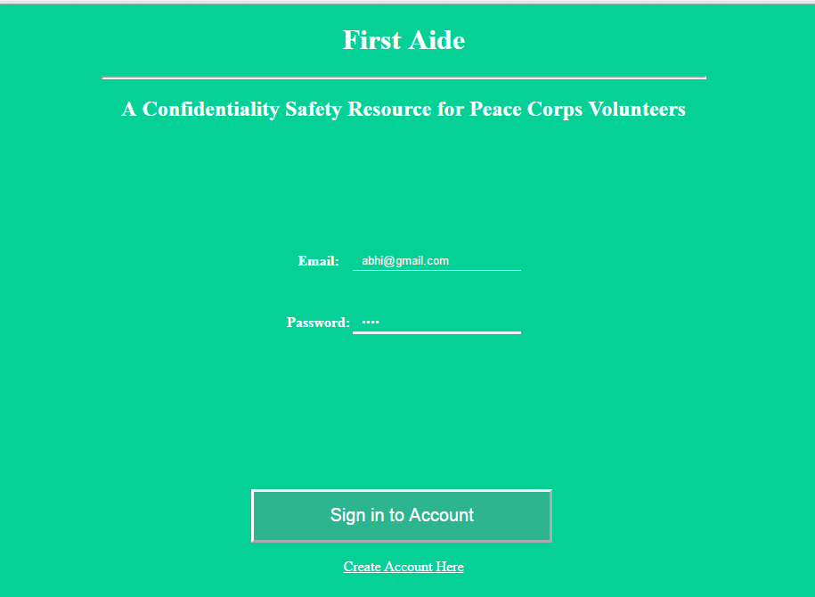
Login Page

Slide 12


3. Progress Bar
A progress bar is shown when the user logins and then redirected to the main application.

Slide 13
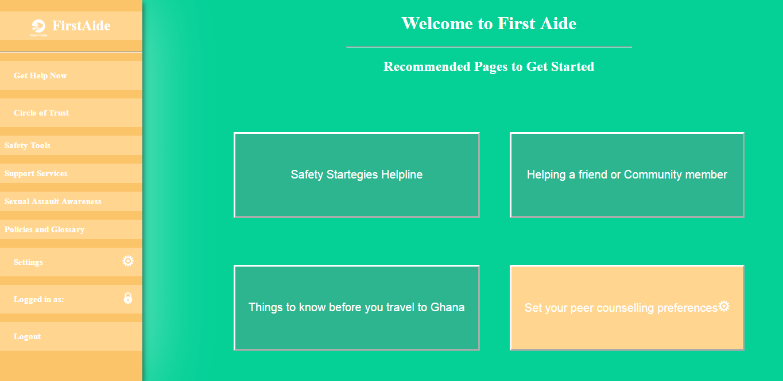
4. Welcome Page - Recommended pages to get started
The user is redirected to this page after successful login. This is the home page of the application.

Slide 14
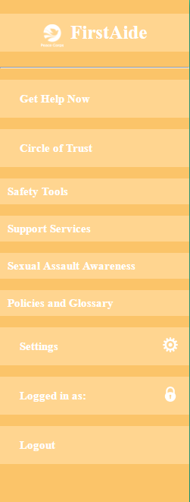
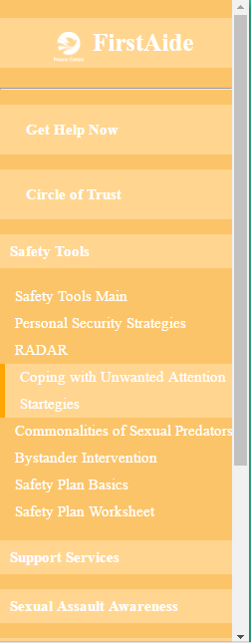
5. Menu for Navigation
The menu contains all the pages of the app placed in proper order. This makes navigation to pages easier. Placed on the left of every page.

Slide 15
6. Get Help Now
The user can contact helplines using this feature. Two services are provided for contacting, sending a message or making a call.
The helpline numbers vary according to the location chosen
There are three locations : Syria, Uganda and Tunisia. When a particular location is set then, phone numbers of that area will be loaded.
Sending message and making Call:
For message (SMS), body of message is taken as input from user and SMS is sent to the selected helpline number. Whereas, in Call the phone call can be connected on one button click
These functionalities are enabled using Third Party API ‘Twilio’ . It has been chosen because their service is reliable and has easy to use API’s. It is also inexpensive.
Read more about Twilio here: https://www.twilio.com/

Slide 16
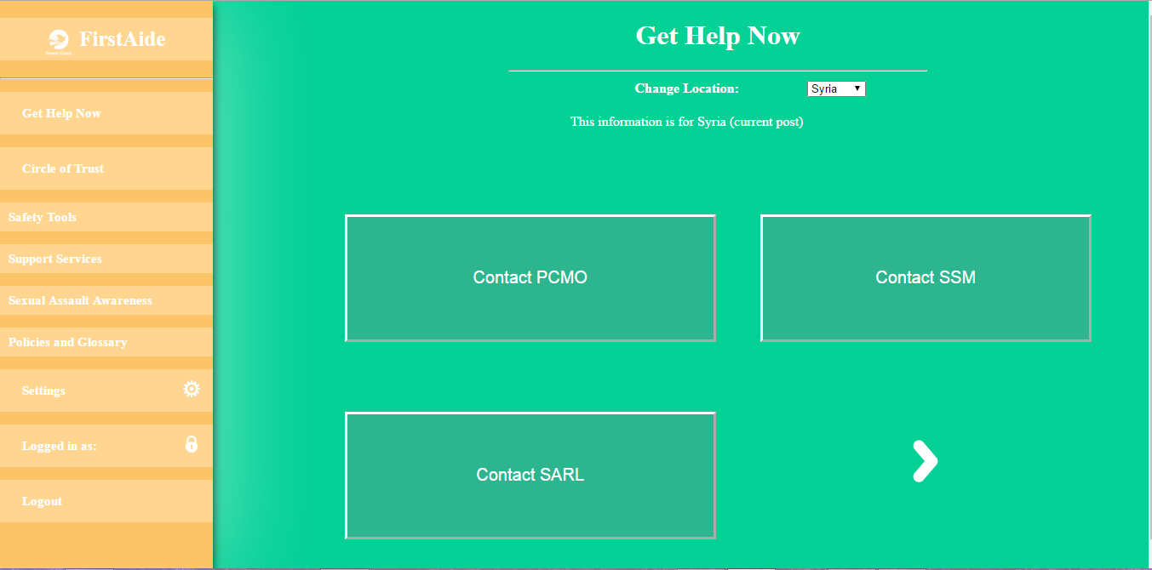
Get Help Now – Page 1
Change location
from here

Slide 17
The sub-features in Get Help Now
The sub-features are the choices of helplines to contact. They are represented as buttons which provide a contact service on click. User can get in touch with any of the following
Contact PCMO
Contact SSM
Contact SARL
PC Saves Anonymous Helpline
Office of Victim Advocacy
Office of Inspector General
Office of Civil Rights and Diversity

Slide 18
Get Help Now – Page 1

Slide 19
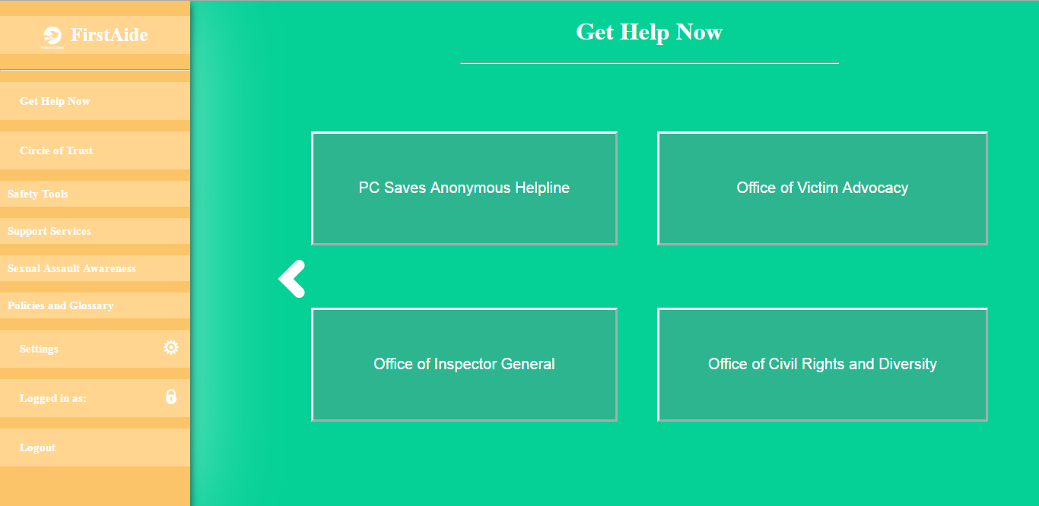
Get Help Now – Page 2

Slide 20
Sub-features in Get Help Now
Contact PCMO, Contact SSM and Contact SARL
When any of these features are selected ( via buttons) then, a pop up is opened and an option for Voice Call or Send Message is provided in it. The user may select an option and use that service to contact PCMO or SSM or SARL
When ‘Send Message’ selected
If the user selects this option, the app is redirected to another page. It consists of an input box to type the body of message and a Submit button to send the message.
When ‘Voice Call’ selected
If the user selects this option, the app is redirected to another page. It consists of a Submit button to start a call
Note: The phone numbers of helplines are loaded automatically through backend. User need not provide them

Slide 21
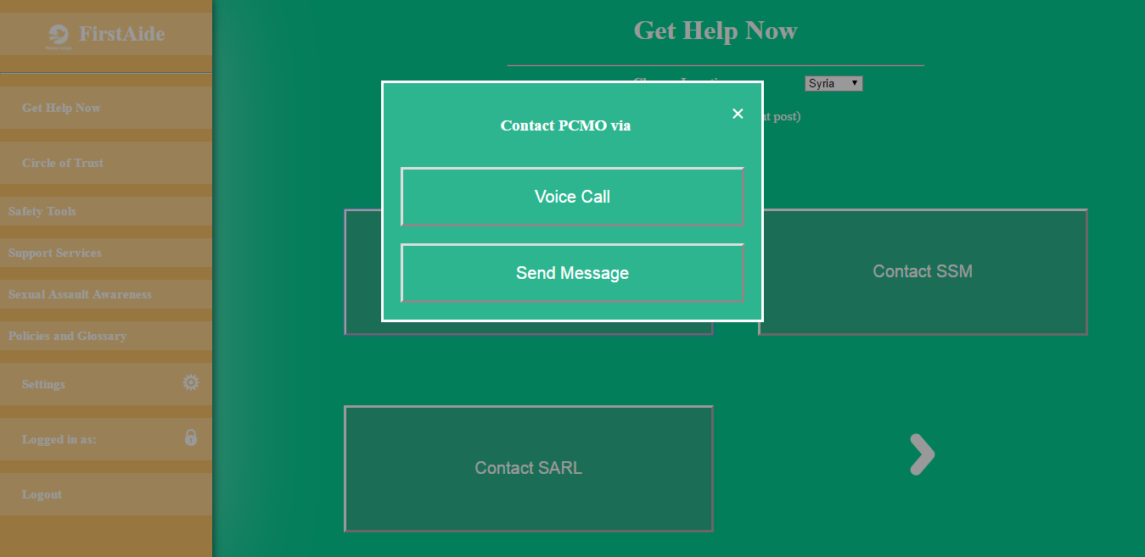
Contact PCMO /Contact SSM /Contact SARL clicked
Respective pop up opens. Select any one service to contact

Slide 22
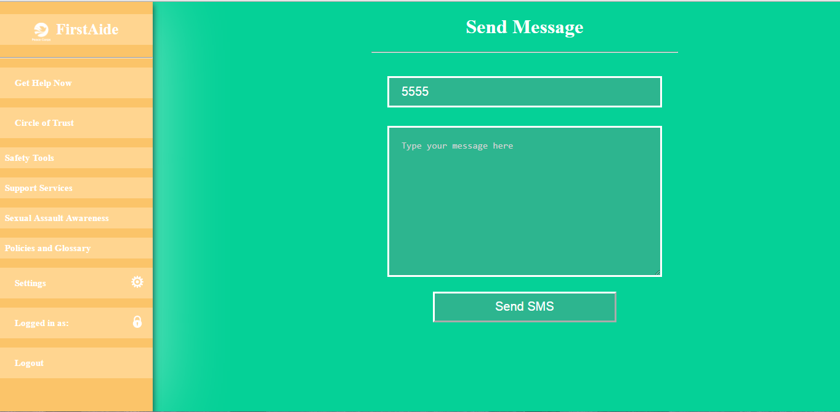
‘Send Message’ Selected

Slide 23
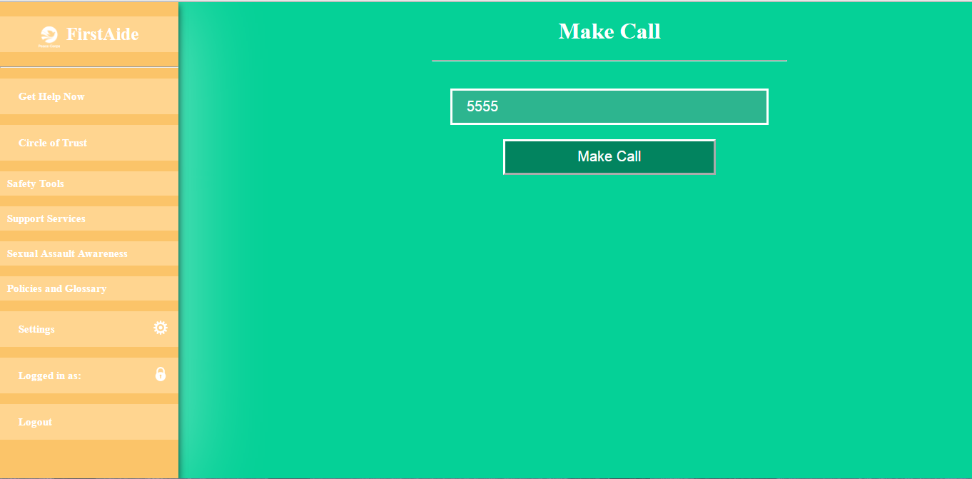
‘Voice Call’ Selected

Slide 24
Sub-features in Get Help Now
PC Saves Anonymous Helpline, Office of Victim Advocacy,
Office of Inspector General, Office of Civil Rights and Diversity
When any of these features are selected ( via buttons) then, a new page is loaded with the information regarding the helpline. As in the first three sub-features (Contact PCMO etc.) a pop up is opened using ‘Contact Now’ button. An option for Voice Call or Send Message is provided in it. The user may select an option and use that service to contact
When ‘Send Message’ selected
If the user selects this option, the app is redirected to another page. It consists of an input box to type the body of message and a Submit button to send the message.
When ‘Voice Call’ selected
If the user selects this option, the app is redirected to another page. It consists of a Submit button to start a call
Note: The phone numbers of helplines are loaded automatically through backend. User need not provide them

Slide 25
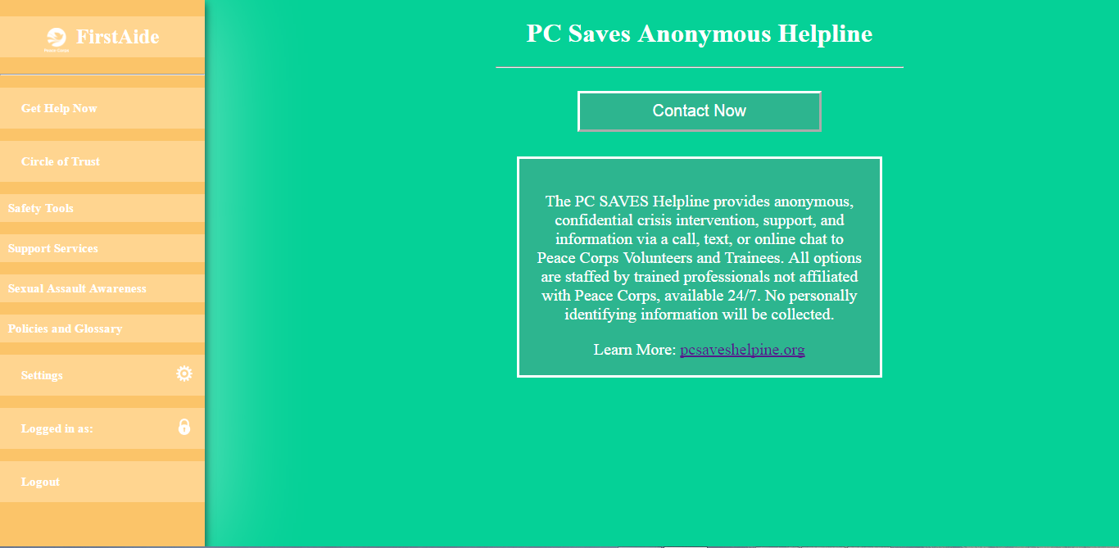
PC Saves Anonymous Helpline (Other three sub-features also similar)

Slide 26
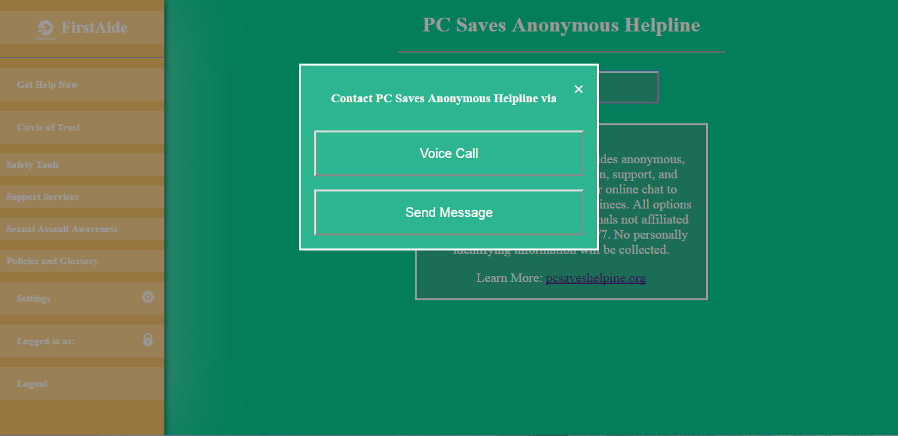
‘Contact Now’ button clicked (Other three sub-features also similar)

Slide 27
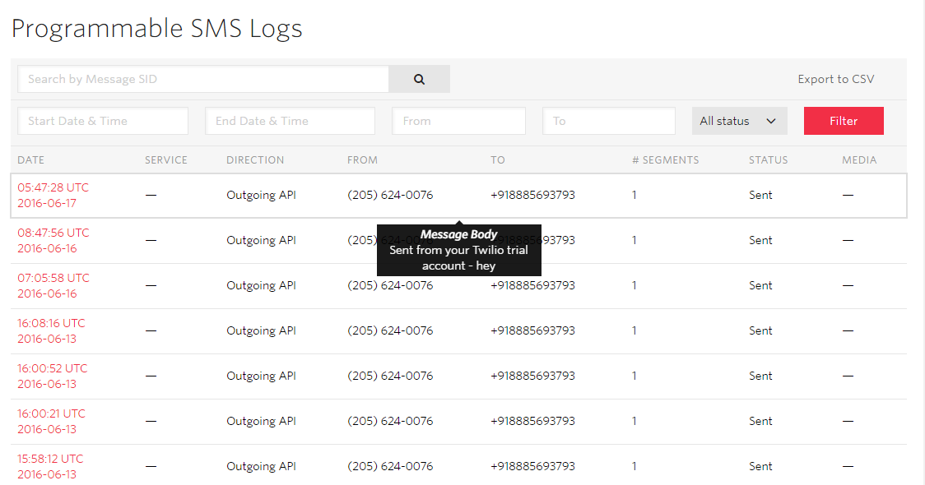
Message Testing Results(using twilio)
These are the logs of SMS sent when the functionality was tested

Slide 28
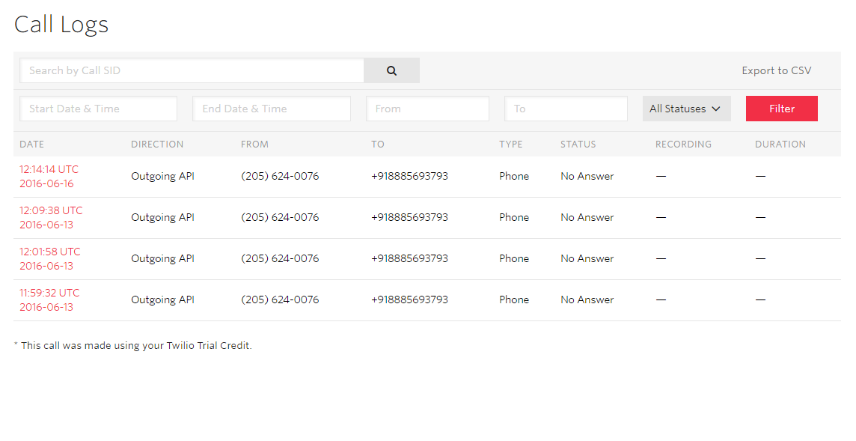
Call Testing Results (using twilio)
These are the logs of calls made when the functionality was tested

Slide 29
Thank You

