Slide 1

NAME: AKANKSHA KUMARI ROLL: akanksha_2312res61 ID: IITP000334 PROJECT TITLE: EMPLOYEE ATTENDANCE TRACKER

Slide 2

INTRODUCTION
This project analyzes employee attendance records to identify trends, calculate overall attendance, and summarize each employee’s presence. By automating the process using Python, the system reduces manual work, ensures accuracy, and provides clear insights into workforce discipline and productivity.
Automates tracking of attendance
Reduces manual effort & errors
Provides insights into employee discipline & productivity

Slide 3
OBJECTIVES
Clean & preprocess data
Calculate attendance %
Summarize presence/absence
Visualize trends with graphs
Export CSV/Excel reports

Slide 4
CODE FUNCTIONS
Load & clean attendance data
Calculate attendance percentage
Detect frequent absentees
Generate visual charts
Save final summary as report

Slide 5
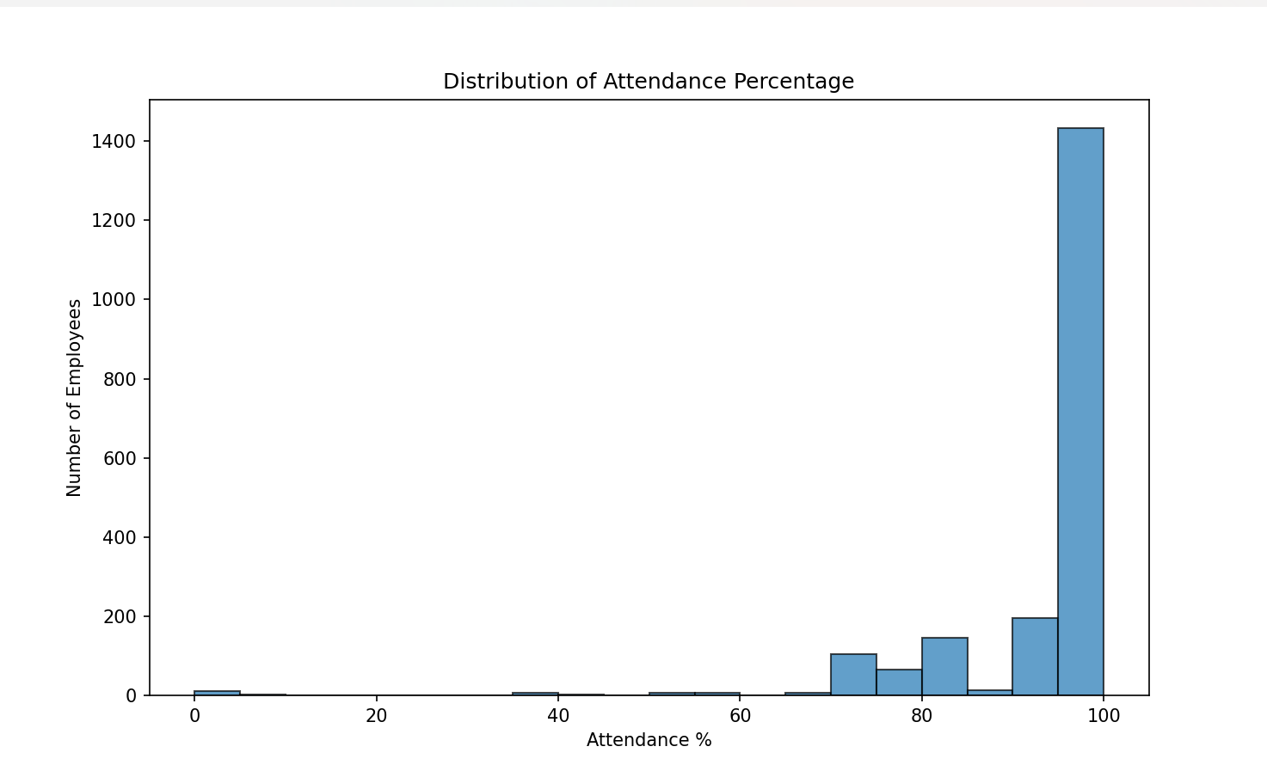
VISUALIZATIONS

Slide 6
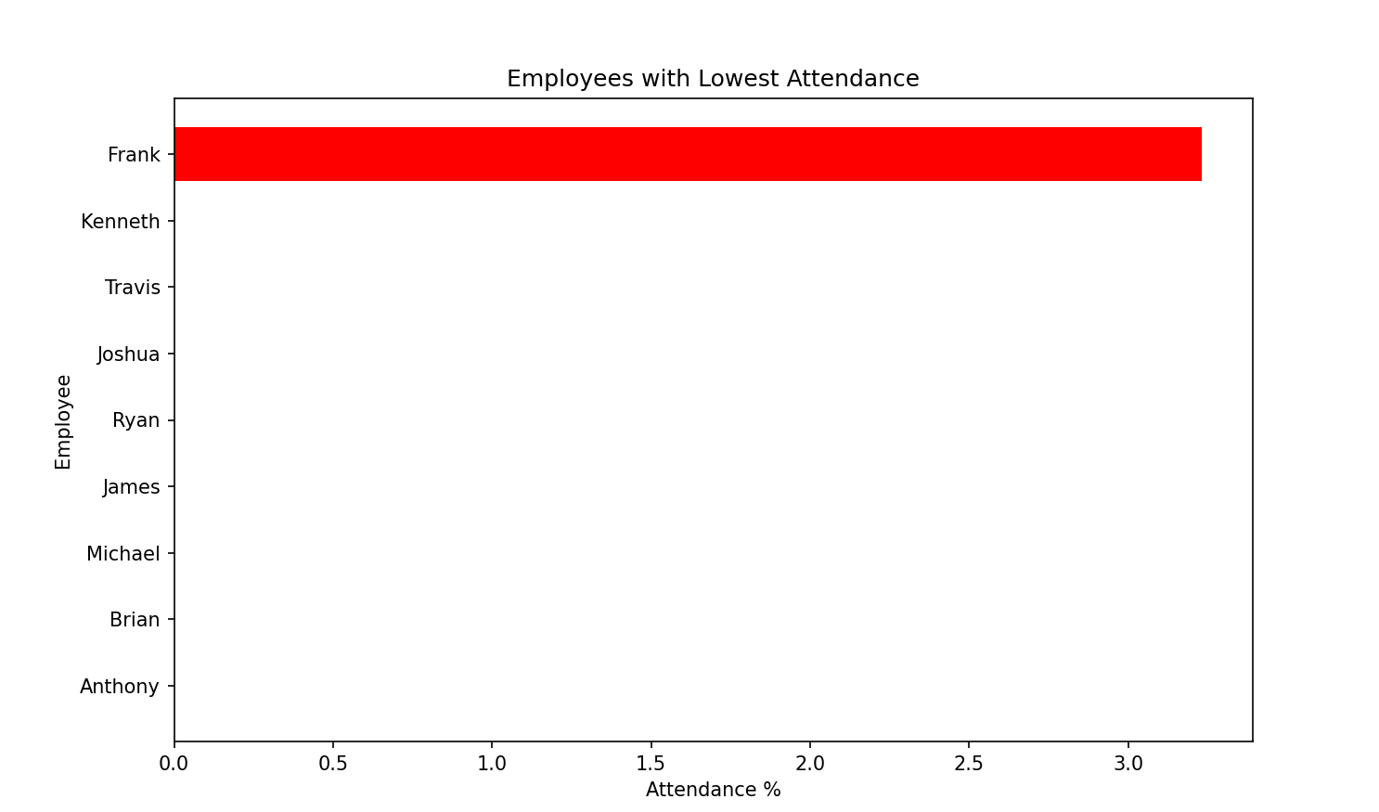
Lowest attendance graph

Slide 7
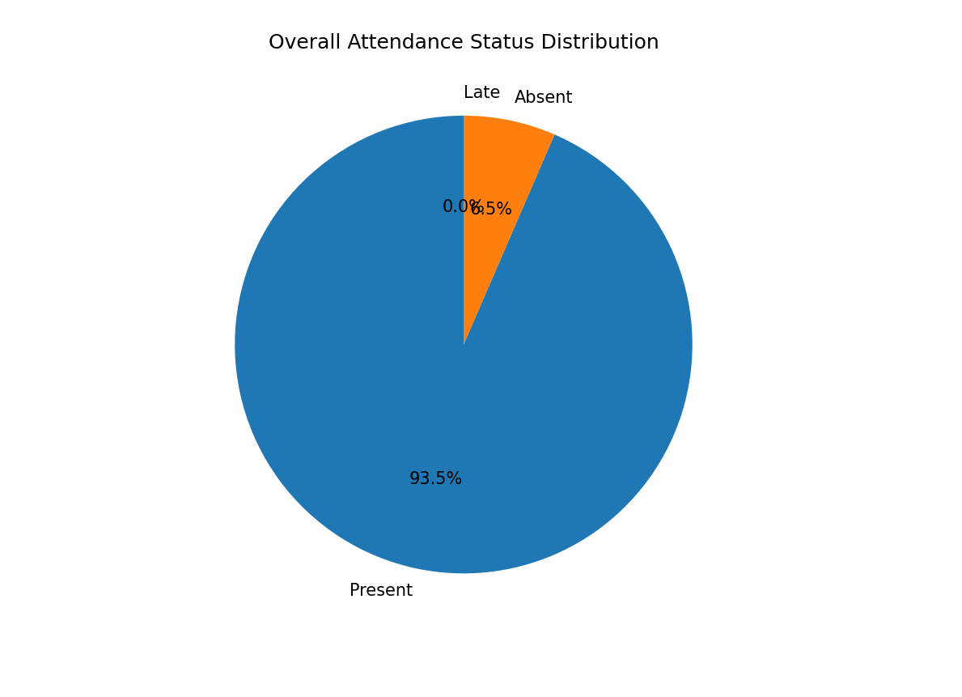
PIE CHART

Slide 8
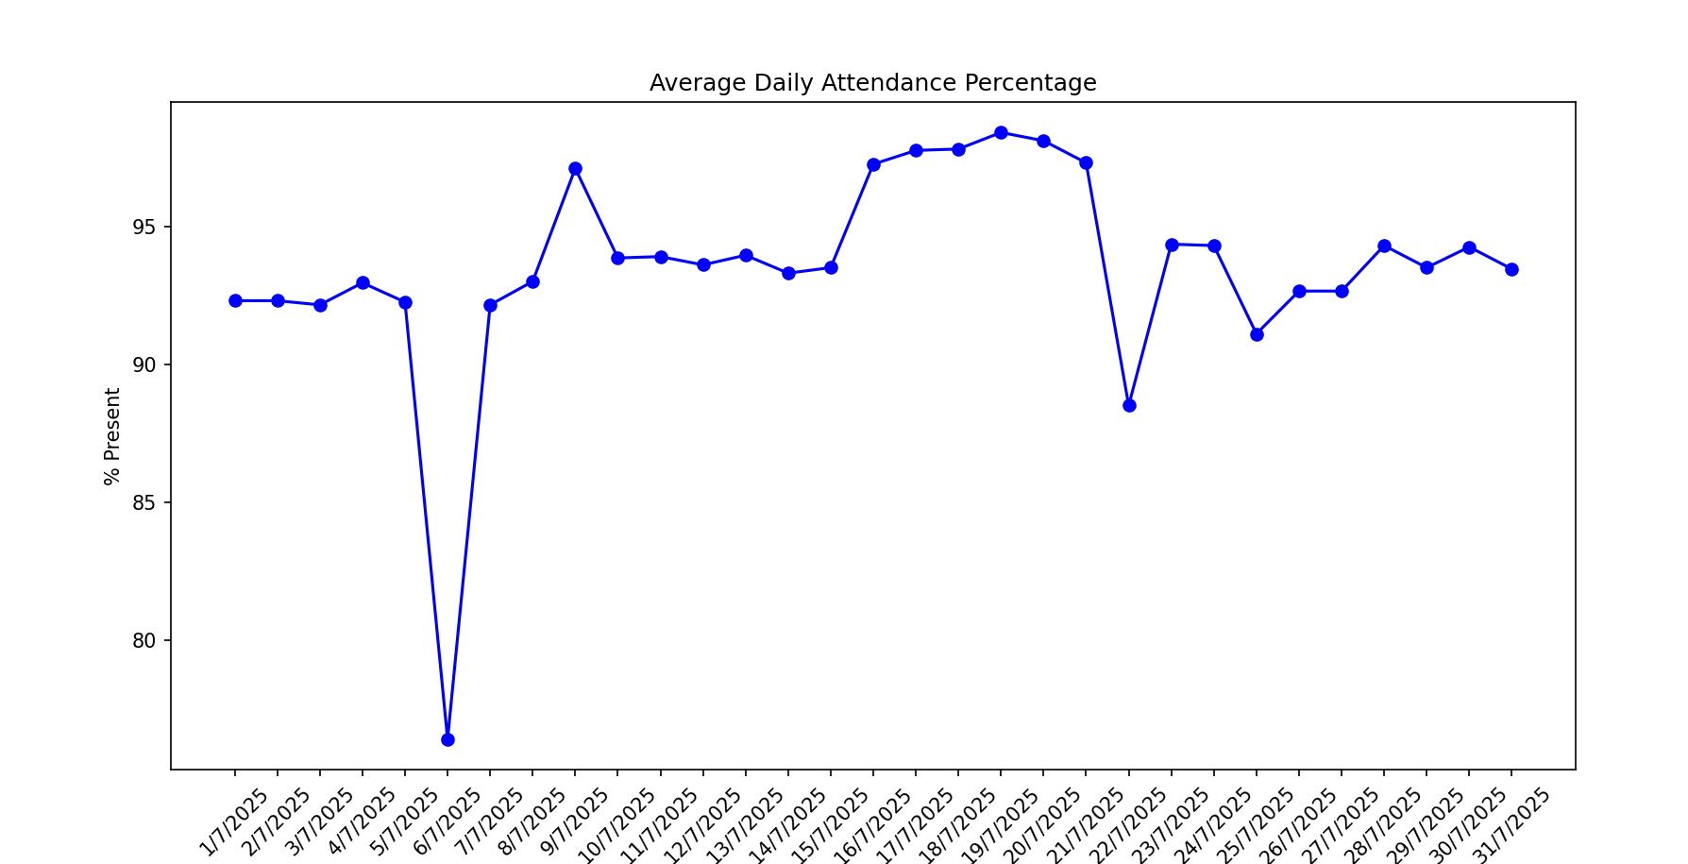
LINE CHART

Slide 9
DATASET OVERVIEW
THE DATASET CONTAINS 2001 ROWS AND 37 COLUMNS.
IT CONTAINS THE INFORMATION OF 2000 EMPLOYEES WITH THEIR EMPLOYEE ID, FIRST AND LAST NAME, EMAIL, GENDER , WORK STATUS, AND THEIR ATTENDENTANCE OF THE MONTH JULY 2025.
SOURCE IS SELF CREATED AND NAMES AND EMAIL ID HELP FROM KAGGLE, THIS DATASET IS CREATED BY MYSELF TO MATCH THE PROJECT QUALITY A GLIMPSE IS GIVEN HOWEVER THE WHOLE DATASET IS ALSO ATTACHED ALONG WITH THE SUMMARY OUTPUT OBTAINED FROM CODE ON MY GITHUB REPOSITORY , A GLIMPSE OF SUMMZARY IS ALSO SHOWN HERE

Slide 10
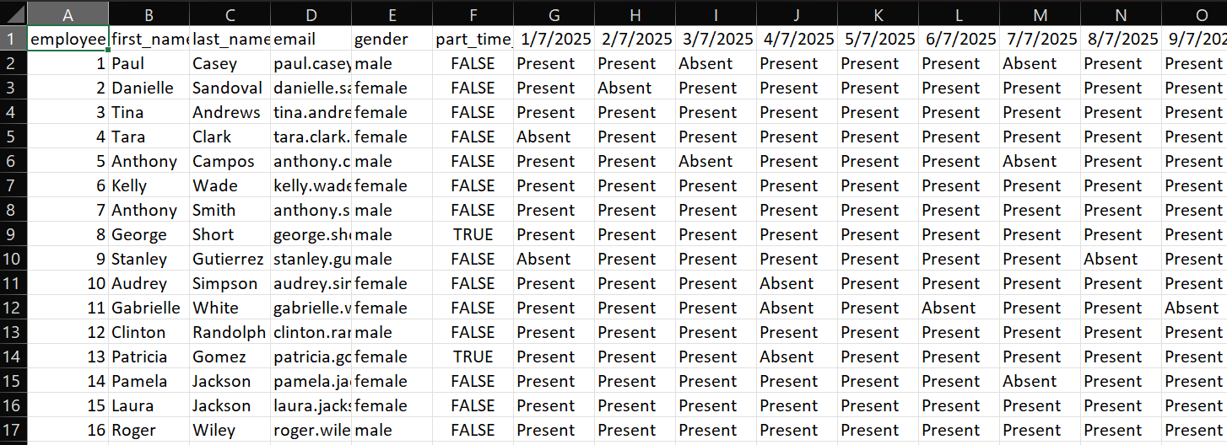
DATASET OVERVIEW
z

Slide 11
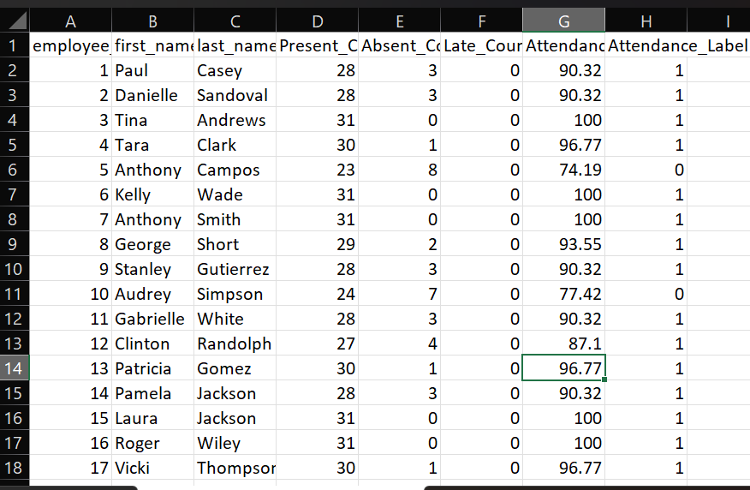
SUMMMARY OVERVIEW

Slide 12
CONCLUSION FUTURE SCOPE
Accurate & automated summaries
Clear visual insights
Easy reporting for HR/management
Saves time, reduces errors
Can be extended with advanced analytics
INTEGRATION WITH LIVE HR SYSTEM
ADDING PREDICTIVE ANALYSIS
AUTOMATING EMAILS ALERT FOR HR
And many more……
By: AKANKSHA KUMARI akanksha_2312RES61

